Slide 1
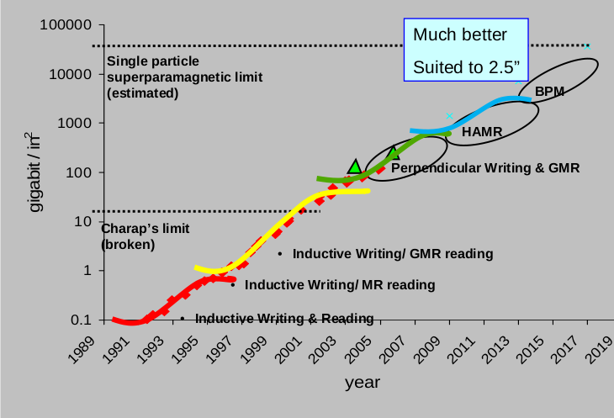
Hard Drive Storage vs Time (Different Technologies) – Kryder’s Law
http://blog.dshr.org/2014/05/talk-at-seagate.html
Figure 1

Slide 2
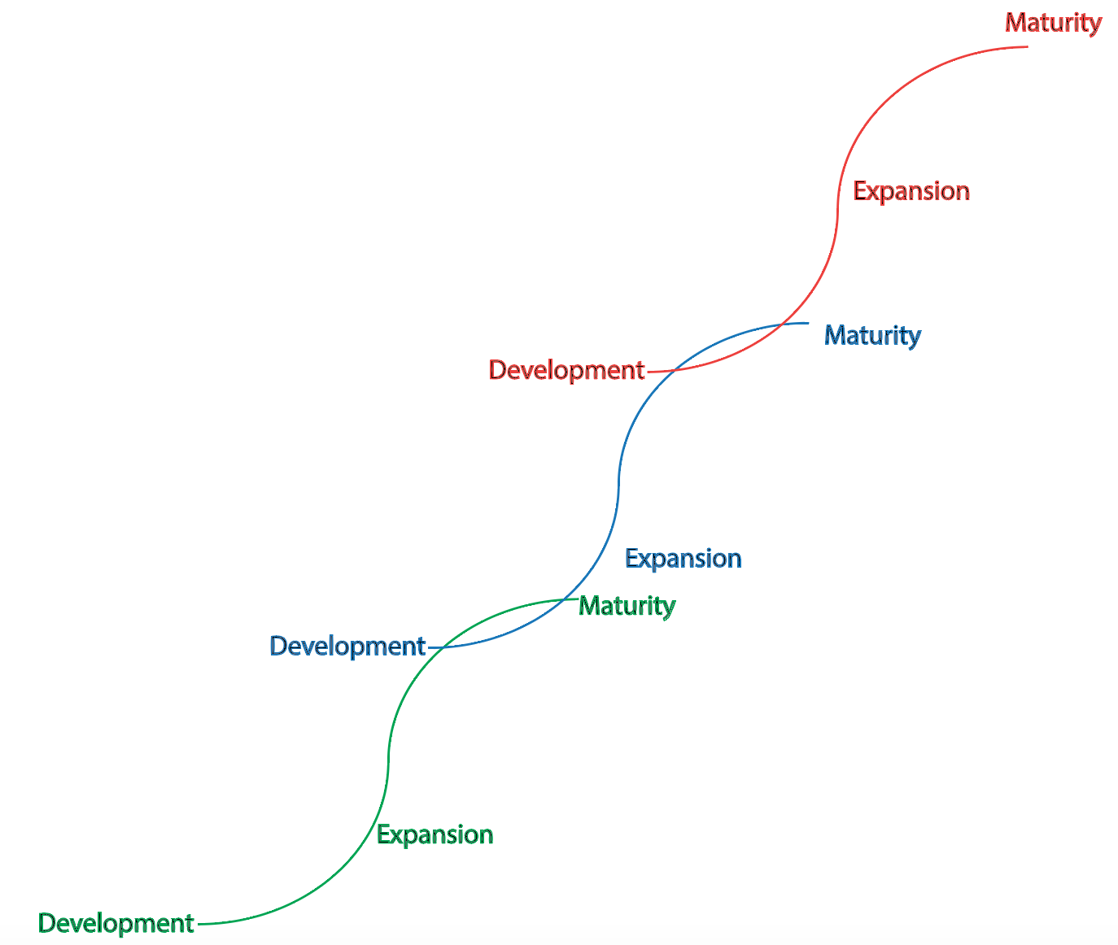
Figure 1

Slide 3
Alignment algorithms
Figure 2

Slide 4
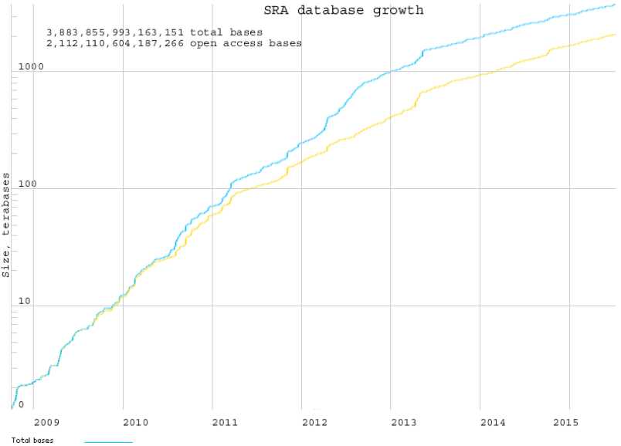
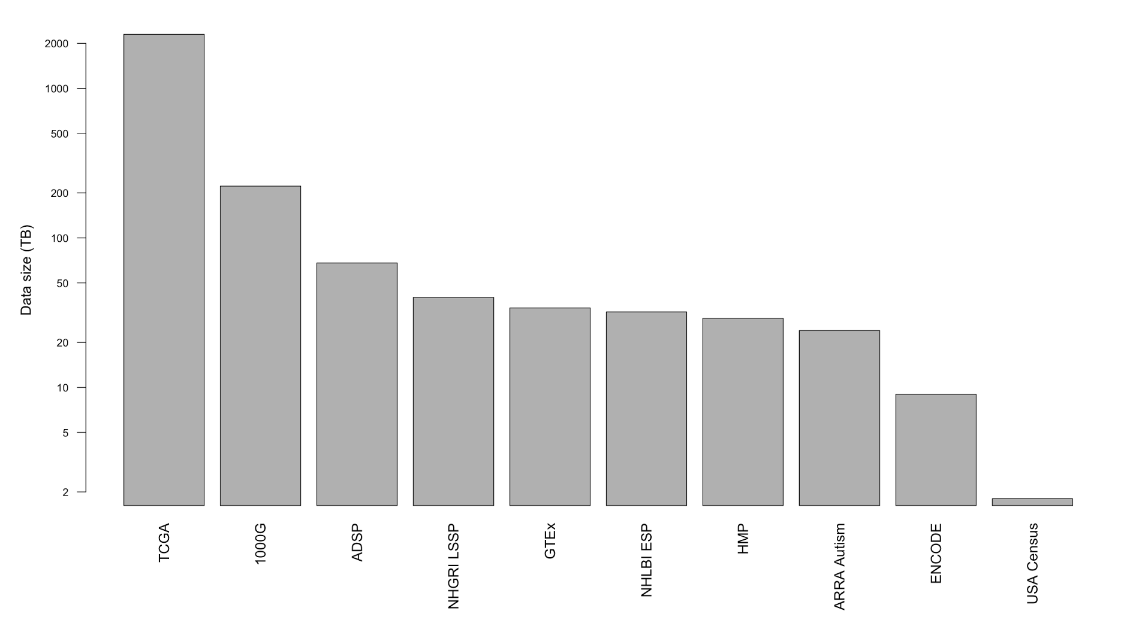
Box

Slide 6
“Genome Sequencing” vs “Microarray” Funding Dollars by Fiscal Year
Box
NIH Reporter
NIH Reporter

Slide 7
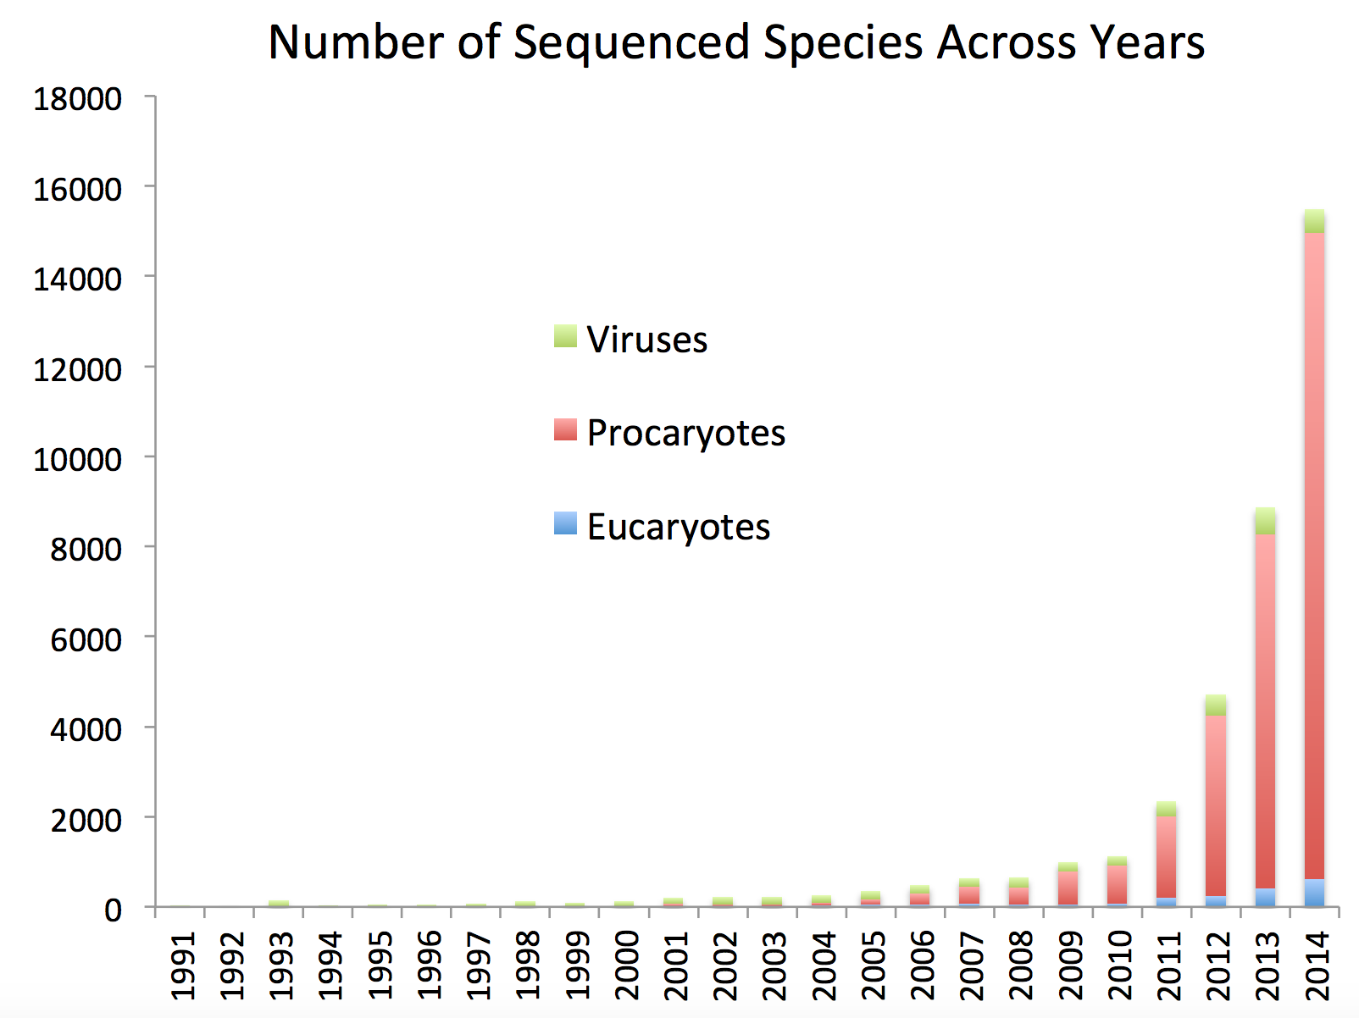

Slide 8
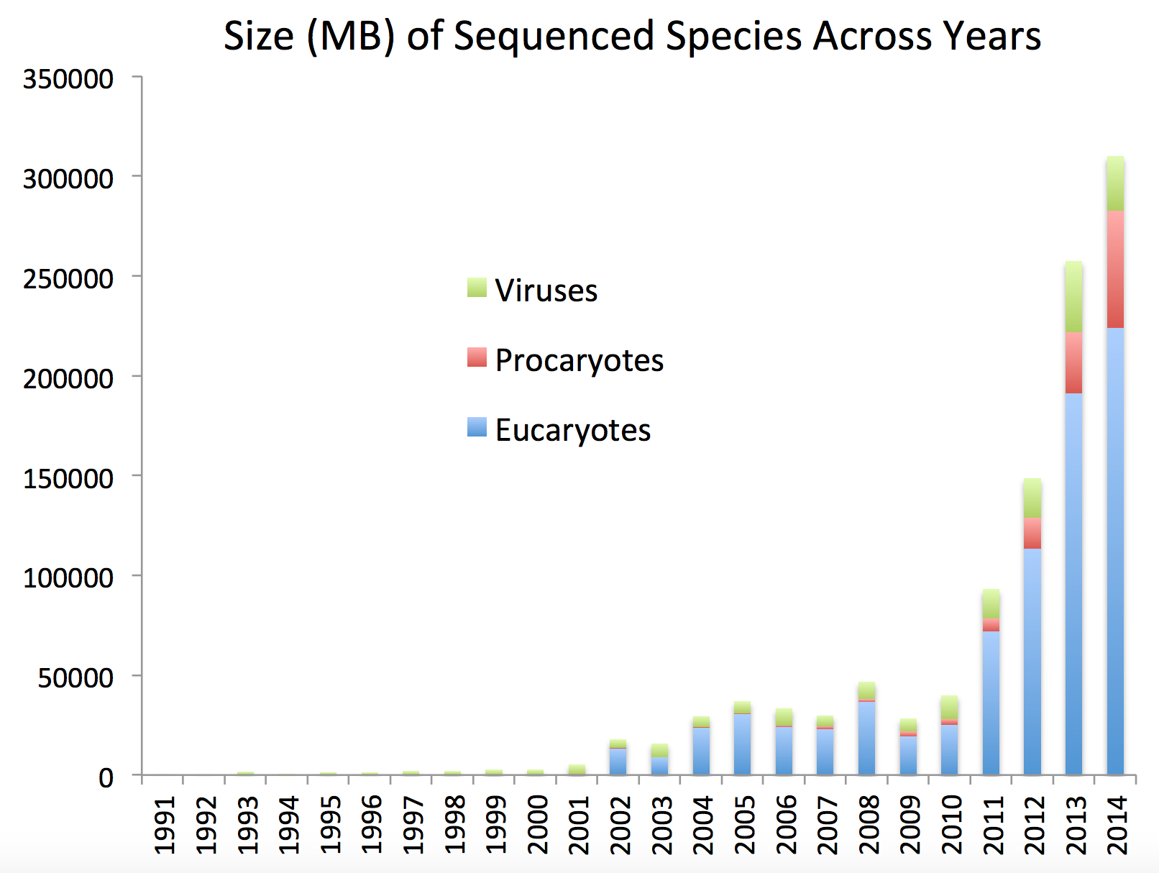

Slide 9
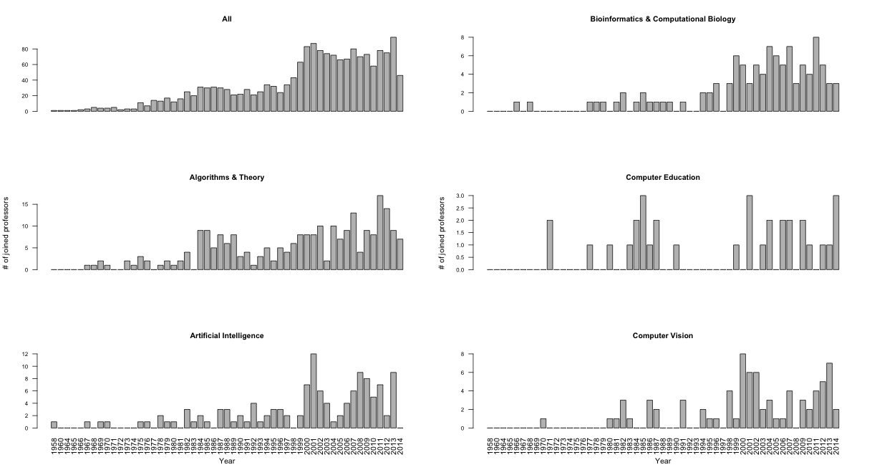
Number of joined computer science professors in 55 top US schools
Figure 4

Slide 10
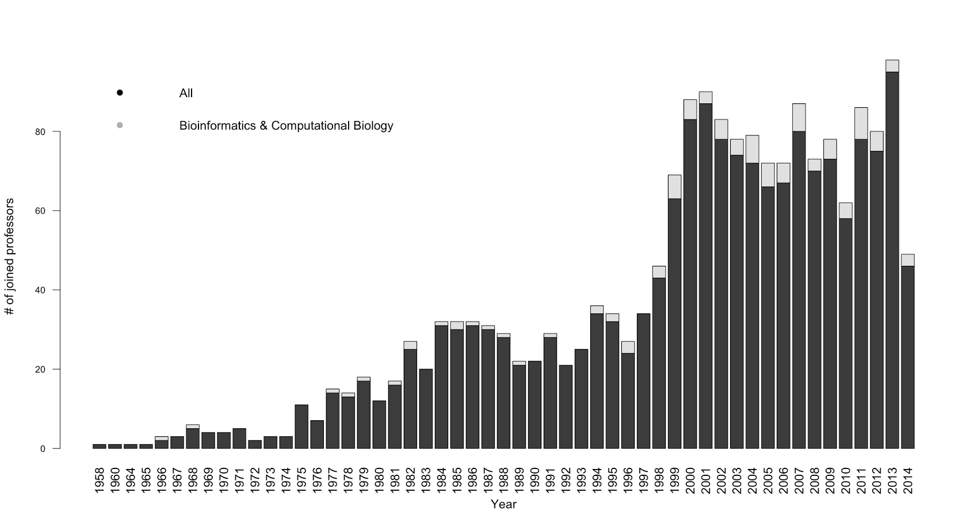
Figure 4

