Slide 1
Possible Brain cancers

Slide 2
Main Brain cancers
PBCA: Pediatric Brain Cancer , 251+ WGS, quiet genome, 2nd most popular after leukemia, 2500 cases per year
PEME: Pediatric Medulloblastoma, 0+ WGS,
GBM: Glioblastoma multiforme, 41+ WGS, mostly adults, relative quiet genome, very aggressive, poor reactions to treatment
LGG: Brain Lower Grade Glioma, 19+ WGS from ICGC+TCGA, but possibly 42 more need access application. Children and young adult, grow slowly, but can not be surgically resected
PCPG: Pheochromocytoma and Paraganglioma, 0 WGS

Slide 3
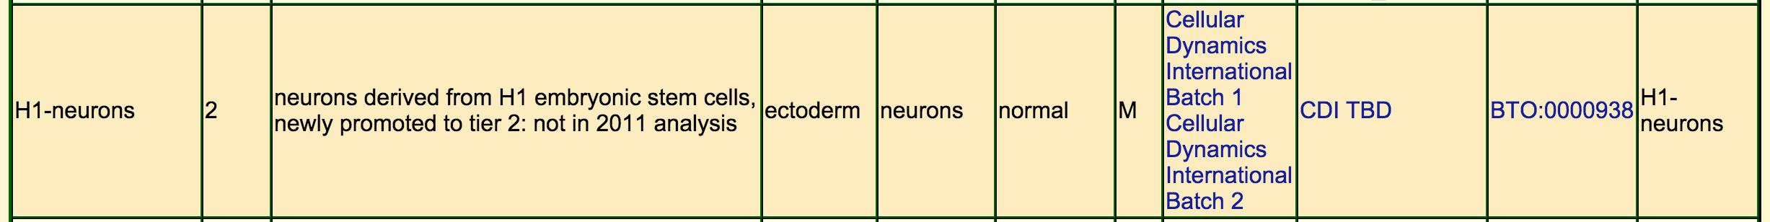
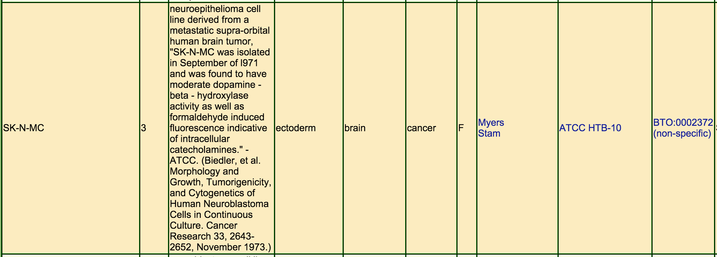
Tier 2 cell lines:
Tier 3 cell lines:
LGG

Slide 4
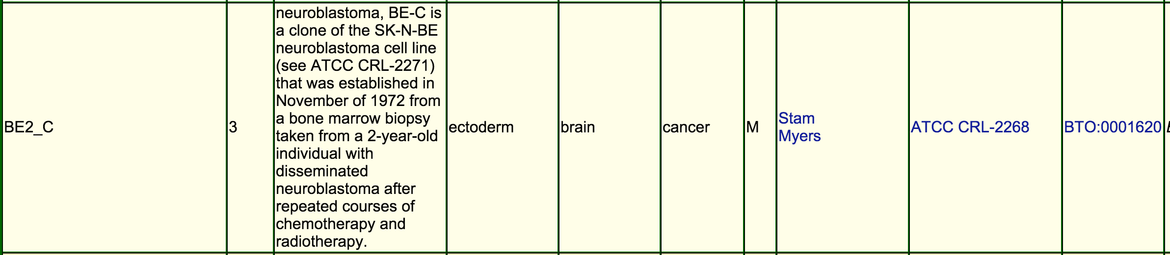
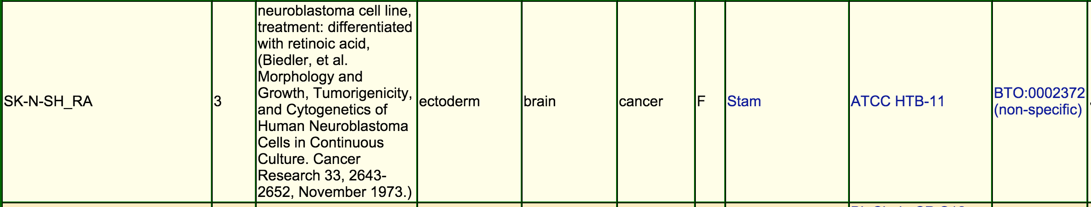
Tier 3 cell lines:
PCPG
GBM

