Slide 1
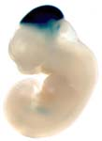
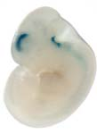
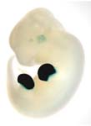
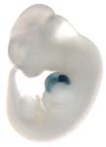
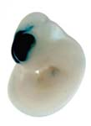
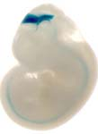
Experimentally calibrating a genome-wide set of tissue-specific in vivo enhancer predictions
A MOUSE DEVELOPMENT ENHANCER ENCYCLOPEDIA

Slide 2
Goals
Histone marks can predict tissue-specific enhancer activity
No single mark shows perfect correlation between tissue-specific peaks and tissue-specific in vivo enhancer activity
Best single mark so far: H3K27ac (anecdotally 50-80% specificity in best data sets)
Aim: Provide ChIP-seq derived enhancer predictions with empirically determined likelihood scores of being positive in a transgenic experiment

Slide 3
Mouse Developmental Tissue Update
Stage | e10.5 | e11.5 | e12.5 | e13.5 | e14.5 | e15.5 | e16.5 | P0
forebrain | TBD | YEAR 2 | YEAR 4 | YEAR 3 | YEAR 1 | YEAR 3 | YEAR 2 | YEAR 1
midbrain | TBD | YEAR 2 | YEAR 4 | YEAR 3 | YEAR 1 | YEAR 3 | YEAR 2 | YEAR 1
hindbrain | TBD | YEAR 2 | YEAR 4 | YEAR 3 | YEAR 1 | YEAR 3 | YEAR 2 | YEAR 1
neural tube | TBD | YEAR 2 | YEAR 4 | YEAR 3 | YEAR 1 | YEAR 3
limb | TBD | YEAR 2 | YEAR 4 | YEAR 3 | YEAR 1 | YEAR 3
cranioface | TBD | YEAR 2 | YEAR 4 | YEAR 3 | YEAR 1 | YEAR 3
heart | TBD | YEAR 2 | YEAR 4 | YEAR 3 | YEAR 1 | YEAR 3 | YEAR 2 | YEAR 1
liver | TBD | YEAR 2 | YEAR 4 | YEAR 3 | YEAR 1 | YEAR 3 | YEAR 2 | YEAR 1
intestine |  |  |  |  | YEAR 1 | YEAR 3 | YEAR 2 | YEAR 1
kidney |  |  |  |  | YEAR 1 | YEAR 3 | YEAR 2 | YEAR 1
lung |  |  |  |  | YEAR 1 | YEAR 3 | YEAR 2 | YEAR 1
stomach |  |  |  |  | YEAR 1 | YEAR 3 | YEAR 2 | YEAR 1
58 Tissues (Completed)
>16 Tissues (Pending)

Slide 4
Ultimate Deliverable: In Vivo Enhancer Predictions
100s of mouse tissue data sets:
multiple histone marks, methylation etc.
multiple tissues
multiple time-points
Goal:
forebrain_e15.5_0.75
limb_e11.5_0.80
heart_e12.5_0.25
forebrain_e17.5_0.50
limb_e14.5_0.60
Genome-wide track with benchmarked in vivo activity predictions including:
predicted tissue of activity
predicted developmental stage of activity
confidence, i.e. likelihood of being a positive enhancer based on benchmarking from same datasets - or as similar as possible
limb_e14.5_0.60

Slide 5
Training sets
Various histone marks across multiple tissues from mouse e11.5
>2,000 transgenic experimental mouse results - each testing a different region of the mouse genome for enhancer activity. For positive enhancers, provides information about tissue-specific expression
Initial focus: Heart and Forebrain Enhancers

Slide 6
H3K27ac-based predictions
ChIP-seq data sets:
E11.5 heart: 16,580 peaks after filtering
E11.5 forebrain: 6,629 peaks after filtering
Intersection with previously tested transgenic
Peaks reduced to 1000bp core region
Demand that at least 500bp of peak core region were included in transgenic construct
Intersection results:
Heart:
285 tested elements
200 (70%) are enhancers
105 (37%) are heart enhancers
Forebrain:
311 tested elements
248 (80%) are enhancers
145 (47%) are forebrain enhancers

Slide 7
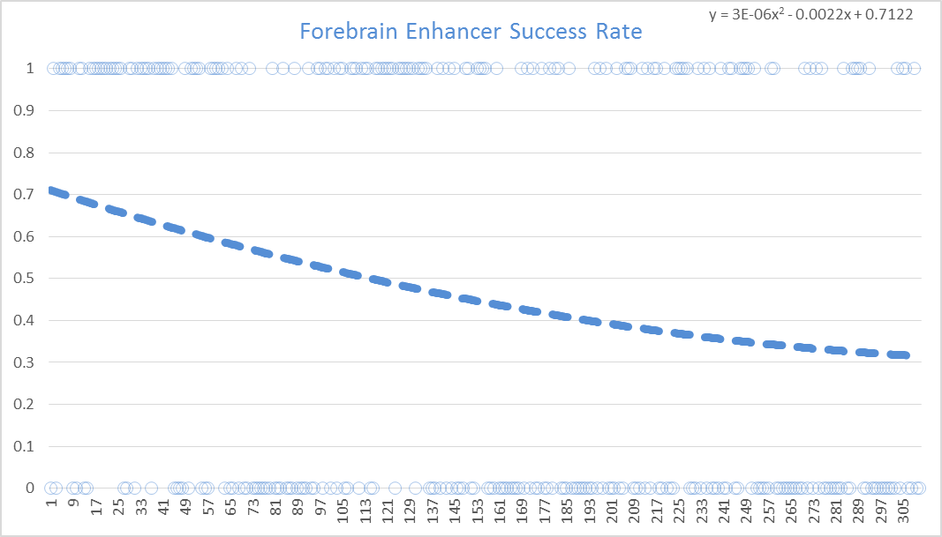
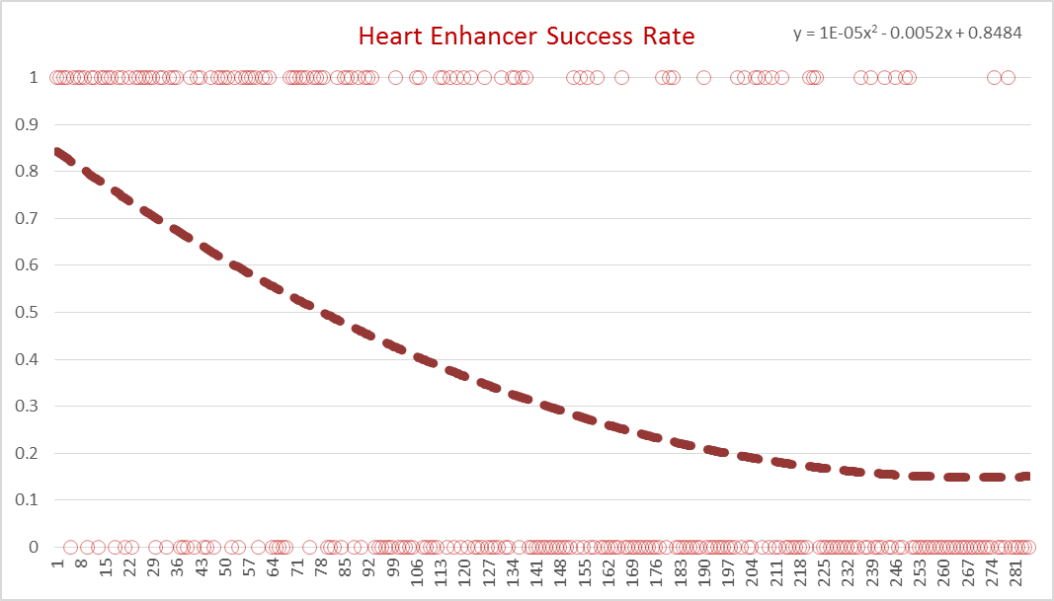
For assigning likelihoods based on ChIP-seq scores, fit a 2nd order polynomial trendline over all tested elements…
1
1
forebrain enhancer activity
by peak rank
heart enhancer activity
by peak rank
In vivo validation rate
0
0
best forebrain H3K27ac peaks worst
best heart H3K27ac peaks worst
Observation: Heart Enhancer Success Rates Decay Faster Than Forebrain

Slide 8
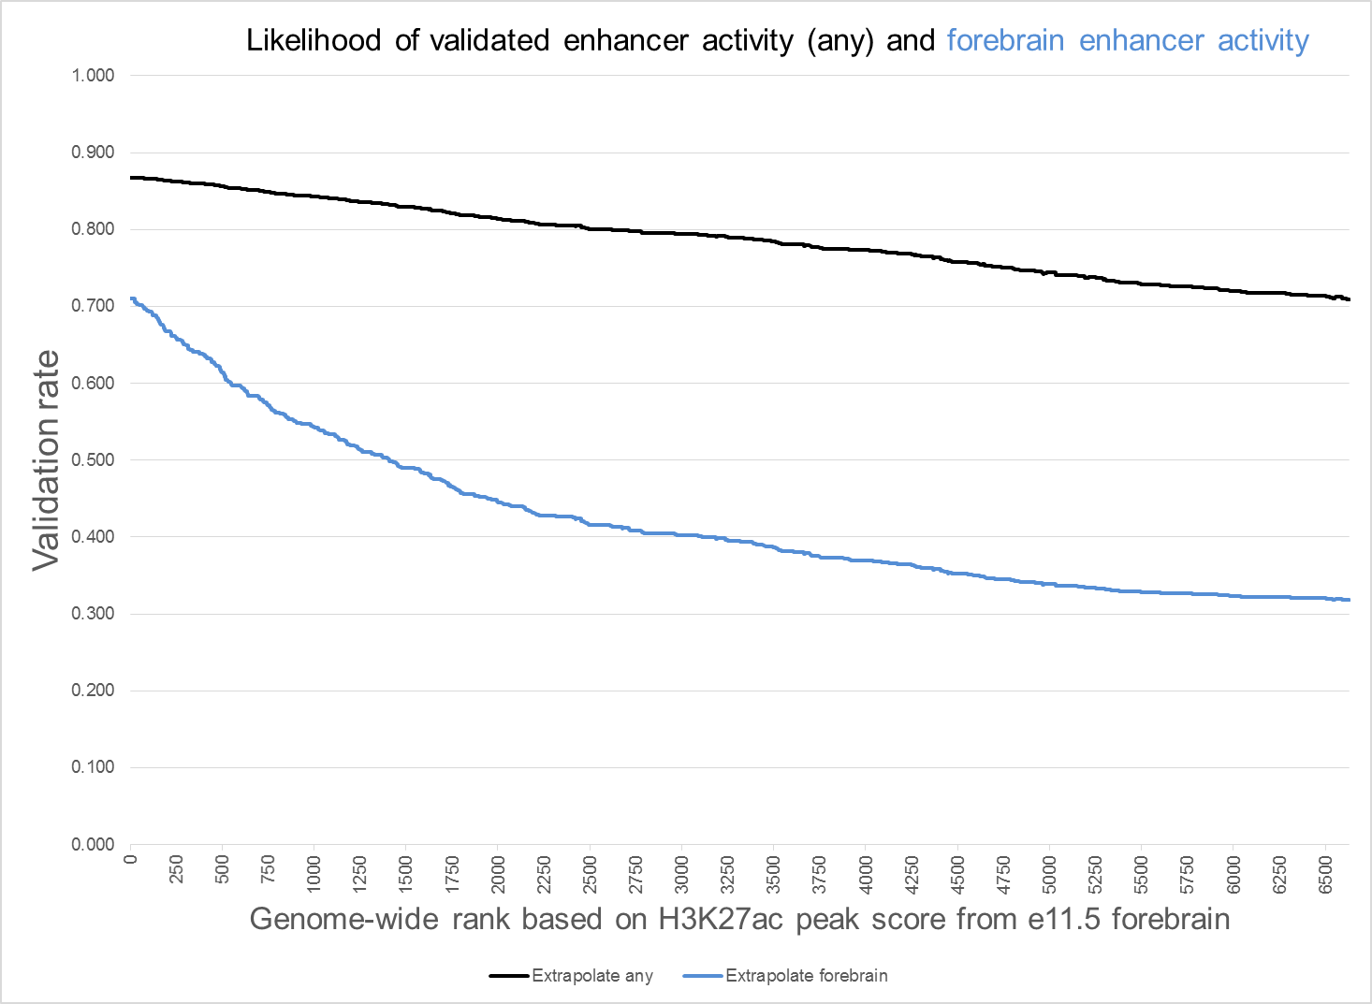
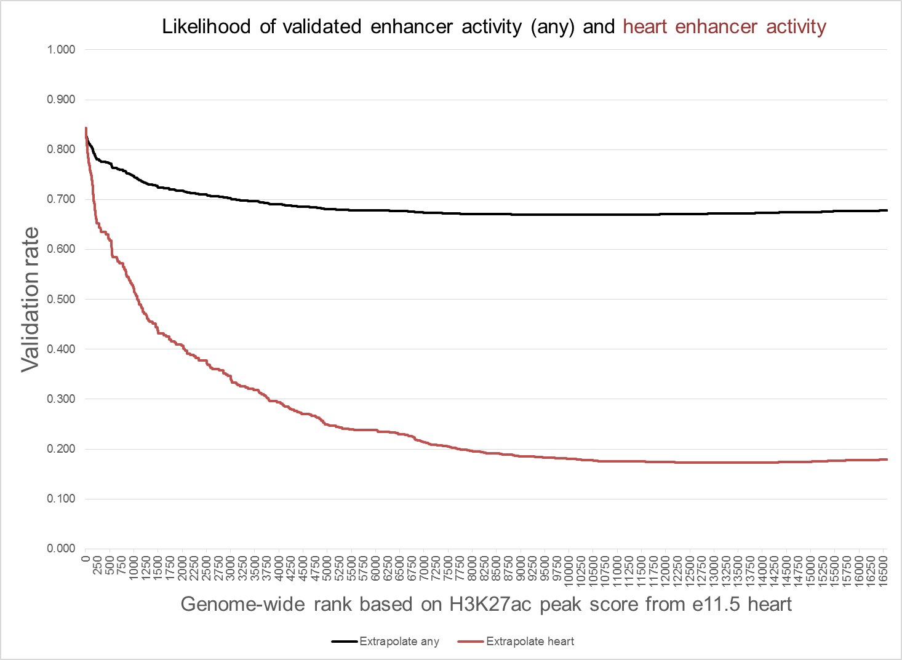
…and extrapolate to genome-wide ChIP-seq data sets
E11.5 forebrain H3K27ac ChIP-seq peaks
E11.5 heart H3K27ac ChIP-seq peaks

Slide 9
This provides in principle what we were trying to accomplish
Goal:
forebrain_e15.5_0.75
limb_e11.5_0.80
heart_e12.5_0.25
forebrain_e17.5_0.50
limb_e14.5_0.60
predicted tissue of activity
predicted developmental stage of activity
likelihood of being any kind of enhancer (based on heart data)
likelihood of being a heart enhancer
heart_e11.5_0.70_0.35
E11.5 heart H3K27ac ChIP-seq peaks
Provides predictions of in vivo activity for genome-wide set of 16k peaks (heart) or 6k peaks (brain)
Major Caveat:
Biases in previously tested elements

Slide 10
Proposal for transgenic testing
Ideally would test all of the following:
sample predictions across the spectrum of likelihood predictions to compare predicted with real outcomes
large numbers of data points for different confidence levels
test multiple tissues (or at least both forebrain and heart) since there may be differences (clearly suggested by retrospective comparisons)
Limitation:
We want to test at most 150 distinct elements in this round.
PROPOSAL:
For forebrain and heart, test each:
~20 high-confidence predictions
~20 medium-confidence predictions
~20 modest-confidence prediction
2 x 3 x 20 = 120 elements total

Slide 11
How to pick them?
(showing just heart, same for forebrain)
Pick 20 consecutive elements with similar likelihood, e.g.:
rank 501-520
rank 2,001-2020
rank 10,001-10,020

Slide 12
How to pick them? Results.
Pick 20 consecutive elements with similar likelihood, e.g.:
rank 501-520
rank 2,001-2020
rank 10,001-10,020
Tissue-Correct | Top 20 Predicted | Top 20 Observed | Mid 20 Predicted | Mid 20 Observed | Bottom 20 Predicted | Botom 20 Observed
Forebrain(6K) | 61% | 66% (12/18) | 45% | 33% (7/21) | 34% | TBD
Heart (16K) | 62% | 33% (6/18) | 41% | 15% (2/13) | 18% | NA
Positive Anywhere | Top 20 Predicted | Top 20 Observed | Mid 20 Predicted | Mid 20 Observed | Bottom 20 Predicted | Botom 20 Observed
Forebrain | 86% | 50% (9/18) | 81% | 71% (15/21) | 74% | TBD
Heart | 77% | 56% (10/18) | 72% | 31% (4/13) | 67% | NA

Slide 13
How to get to the ENCYCLOPEDIA?
Find a suitable method (H3K27ac rank order default). Needs to be a rank order to enable #2. (Next Month)
Determine acceptable accuracy/sensitivity (Ongoing).
Calibrate series of tissues/time-points using transgenics. Confirm cutoffs are acceptable. (before end of year?)
Release enhancer catalog (late 2016)
Possible Challenges:
- Each tissue has different histone enhancer rules. Case in point, no AWG method did better in both forebrain/heart.
- Catalog is smaller than hoped (stringent accuracy cutoff)
OTHER/DISCUSSION?

