Slide 2
BWA

Slide 3
Why Burrows-Wheeler?
BWT very compact:
  Approximately ½ byte per base
  As large as the original text, plus a few “extras”
  Can fit onto a standard computer with 2GB of memory
Linear-time search algorithm
  proportional to length of query for exact matches

Slide 4
Burrows-Wheeler Transform (BWT)
BWT
$acaacg
aacg$ac
acaacg$
acg$aca
caacg$a
cg$acaa
g$acaac
acaacg$
gc$aaac
Burrows-Wheeler Matrix (BWM)

Slide 5
Burrows-Wheeler Matrix
$acaacg
aacg$ac
acaacg$
acg$aca
caacg$a
cg$acaa
g$acaac

Slide 6
Burrows-Wheeler Matrix
3
1
4
2
5
6
$acaacg
aacg$ac
acaacg$
acg$aca
caacg$a
cg$acaa
g$acaac
See the suffix array?

Slide 7
Key observation
¹$acaacg¹
²aacg$ac¹
¹acaacg$¹
³acg$aca²
¹caacg$a¹
²cg$acaa³
¹g$acaac²
a¹c¹a²a³c²g¹$¹
“last first (LF) mapping”
The i-th occurrence of character X in the last column corresponds to
the same text character as the i-th occurrence of X in the first column.

Slide 8
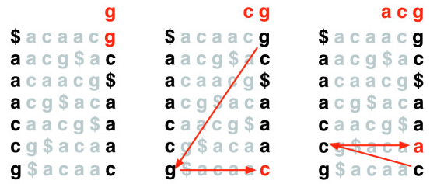
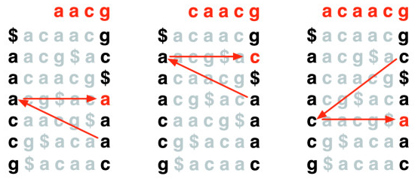
Recover text
4
5
6
5
6
6
3
4
5
6
3
4
2
5
6
3
1
4
2
5
6

Slide 9
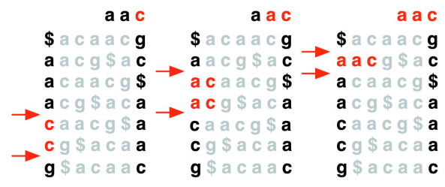
Exact match
3
1
4
2
5
6

Slide 10
Exact match (another example)
BWT(agcagcagact) = tgcc$ggaaaac
Search for pattern: gca
gca
gca
gca
gca
$agcagcagact
act$agcagcag
agact$agcagc
agcagact$agc
agcagcagact$
cagact$agcag
cagcagact$ag
ct$agcagcaga
gact$agcagca
gcagact$agca
gcagcagact$a
t$agcagcagac
$agcagcagact
act$agcagcag
agact$agcagc
agcagact$agc
agcagcagact$
cagact$agcag
cagcagact$ag
ct$agcagcaga
gact$agcagca
gcagact$agca
gcagcagact$a
t$agcagcagac
$agcagcagact
act$agcagcag
agact$agcagc
agcagact$agc
agcagcagact$
cagact$agcag
cagcagact$ag
ct$agcagcaga
gact$agcagca
gcagact$agca
gcagcagact$a
t$agcagcagac
$agcagcagact
act$agcagcag
agact$agcagc
agcagact$agc
agcagcagact$
cagact$agcag
cagcagact$ag
ct$agcagcaga
gact$agcagca
gcagact$agca
gcagcagact$a
t$agcagcagac
Test with your own seq and pattern at: http://www.allisons.org/ll/AlgDS/Strings/BWT/

Slide 11
Auxiliary data structures
Key for efficient pattern matching: how to find the corresponding chars in the first column efficiently, in terms of both time and space.
 | a | c | g | T
rank | 1 | 5 | 8 | 11
BWT
1
2
3
4
5
6
7
8
9
10
11
SA
$agcagcagact
act$agcagcag
agact$agcagc
agcagact$agc
agcagcagact$
cagact$agcag
cagcagact$ag
ct$agcagcaga
gact$agcagca
gcagact$agca
gcagcagact$a
t$agcagcagac
t
g
c
c
$
g
g
a
a
a
a
c
a | c | g | t
0 | 0 | 1 | 1
0 | 1 | 1 | 1
0 | 2 | 1 | 1
0 | 2 | 1 | 1
0 | 2 | 2 | 1
0 | 2 | 3 | 1
1 | 2 | 3 | 1
2 | 2 | 3 | 1
3 | 2 | 3 | 1
4 | 2 | 3 | 1
4 | 3 | 3 | 1
9
7
4
1
6
3
10
8
5
2
11
FM indices

Slide 12
Auxiliary data structures
Key for efficient pattern matching: how to find the corresponding chars in the first column efficiently, in terms of both time and space.
 | a | c | g | t
rank | 1 | 5 | 8 | 11
BWT
gca
1
2
3
4
5
6
7
8
9
10
11
SA
$agcagcagact
act$agcagcag
agact$agcagc
agcagact$agc
agcagcagact$
cagact$agcag
cagcagact$ag
ct$agcagcaga
gact$agcagca
gcagact$agca
gcagcagact$a
t$agcagcagac
t
g
c
c
$
g
g
a
a
a
a
c
a | c | g | t
0 | 0 | 1 | 1
0 | 1 | 1 | 1
0 | 2 | 1 | 1
0 | 2 | 1 | 1
0 | 2 | 2 | 1
0 | 2 | 3 | 1
1 | 2 | 3 | 1
2 | 2 | 3 | 1
3 | 2 | 3 | 1
4 | 2 | 3 | 1
4 | 3 | 3 | 1
9
7
4
1
6
3
10
8
5
2
11
FM indices
Next block:
From 1 + 0 = 1
to 1 + (4-1) = 4

Slide 13
Auxiliary data structures
Key for efficient pattern matching: how to find the corresponding chars in the first column efficiently, in terms of both time and space.
 | a | c | g | T
rank | 1 | 5 | 8 | 11
BWT
gca
1
2
3
4
5
6
7
8
9
10
11
SA
$agcagcagact
act$agcagcag
agact$agcagc
agcagact$agc
agcagcagact$
cagact$agcag
cagcagact$ag
ct$agcagcaga
gact$agcagca
gcagact$agca
gcagcagact$a
t$agcagcagac
t
g
c
c
$
g
g
a
a
a
a
c
a | c | g | t
0 | 0 | 1 | 1
0 | 1 | 1 | 1
0 | 2 | 1 | 1
0 | 2 | 1 | 1
0 | 2 | 2 | 1
0 | 2 | 3 | 1
1 | 2 | 3 | 1
2 | 2 | 3 | 1
3 | 2 | 3 | 1
4 | 2 | 3 | 1
4 | 3 | 3 | 1
9
7
4
1
6
3
10
8
5
2
11
FM indices
Next block:
From 5 + 0 = 5
to 5 + (2-1) = 6

Slide 14
Auxiliary data structures
Key for efficient pattern matching: how to find the corresponding chars in the first column efficiently, in terms of both time and space.
 | a | c | g | T
rank | 1 | 5 | 8 | 11
BWT
gca
1
2
3
4
5
6
7
8
9
10
11
SA
$agcagcagact
act$agcagcag
agact$agcagc
agcagact$agc
agcagcagact$
cagact$agcag
cagcagact$ag
ct$agcagcaga
gact$agcagca
gcagact$agca
gcagcagact$a
t$agcagcagac
t
g
c
c
$
g
g
a
a
a
a
c
a | c | g | t
0 | 0 | 1 | 1
0 | 1 | 1 | 1
0 | 2 | 1 | 1
0 | 2 | 1 | 1
0 | 2 | 2 | 1
0 | 2 | 3 | 1
1 | 2 | 3 | 1
2 | 2 | 3 | 1
3 | 2 | 3 | 1
4 | 2 | 3 | 1
4 | 3 | 3 | 1
9
7
4
1
6
3
10
8
5
2
11
FM indices
Next block:
From 8 + 1 = 9
to 8 + (3-1) = 10

Slide 15
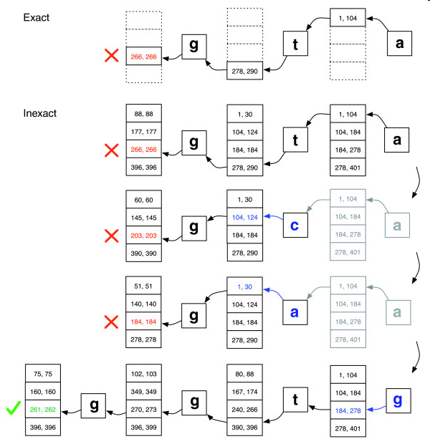
Inexact match

Slide 16
Main advantage of BWT against suffix array
BWT needs less memory than suffix array
For human genome m = 3 * 10⁹ :
  Suffix array: mlog₂(m) bits = 4m bytes = 12GB
  BWT: m/4 bytes plus extras = 1 - 2 GB
    m/4 bytes to store BWT (2 bits per char)
    Suffix array and occurrence counts array take 5 m log₂ m bits = 20 n bytes
    In practice, SA and OCC only partially stored, most elements are computed on demand (takes time!)
    Tradeoff between time and space

Slide 17
Comparison
Spaced seeds
Requires ~50Gb of memory.
Runs 30-fold slower.
Is much simpler to program.
MAQ
Burrows-Wheeler
Requires <2Gb of memory.
Runs 30-fold faster.
Is much more complicated to program.
Bowtie

Slide 18
MAQ

Slide 19
It builds multiple hash tables to index the reads and scans the reference sequence against the hash tables to find the hits. By default, six hash tables are used, ensuring that a sequence with two mismatches or fewer will be hit. The six hash tables correspond to six noncontiguous seed templates
After the read indexing with the two templates, the reference will be scanned base by base on both forward and reverse strands.

Slide 20
Consecutive seed
Consecutive seed 9bp with no mismatches:
Reference sequence
ACTCCCATCGTCATCGTACTAGGGATCGTAACA
CCACTGTCCTCCTACATAGGAACGA
SNP ‘heavy’ read
TCATCGTAC
TCCTCCTAC
Cannot find seed match due to A->C SNP and G->C SNP
Even allowing for 2 mismatches in the seed - no seeds match.
No hits!

Slide 21
Spaced seeds
To increase sensitivity we can used spaced-seeds:
11111111111
Consecutive seed template with length 9bp
ACTATCATCGTACACAT
Reference
TCATCGTAC
Query
11001100110011001
Spaced-seed template with weight 9bp
ACTATCATCGTACACAT
Reference
ACTCTCACCGTACACAT
Query
Notes:
All positions with a 1 indicate a perfect match. Those with a 0 indicate a mismatch. Weight in a spaced seed is simply the number of positions which require a match

Slide 22
Spaced seeds
Spaced seed with weight 9bp and no mismatches:
Reference sequence
ACTCCCATTGTCATCGTACTTGGGATCGTAACA
CCACTGTAATCGTACATGGGAACGA
SNP ‘heavy’ read
CCATTGTCATCGTACAT
CCXXTGXXATXXTAXXT
Despite SNPs – seed matched with 0 mismatches
Can now extend with Smith-Waterman or other local alignment

Slide 23
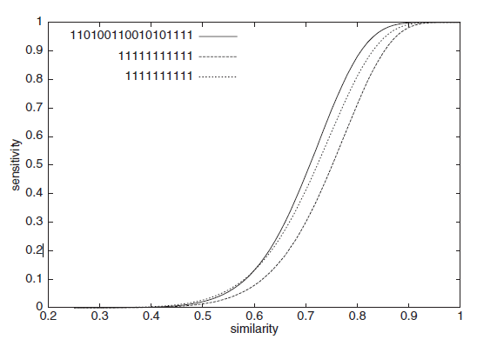
Spaced seeds
Spaced seeds:
A seed template ‘111010010100110111’ is 55% more sensitive than BLAST’s default template ‘11111111111’ for two sequences of 70% similarity
Typically seeds of length ~30bp and allow up to 2 mismatches in short read datasets
Ma, B. et al. PatternHunter. Bioinformatics Vol 18, No 3, 2002

Slide 24
BLAST

Slide 25
BLAST
Speed is achieved by:
  Pre-indexing the database before the search
  Parallel processing
Uses a hash table that contains neighborhood words rather than just random words.

Slide 26
Neighborhood words
The program declares a hit if the word taken from the query sequence has a score >= T when a scoring matrix is used.
This allows the word size (W (this is similar to ktup value)) to be kept high (for speed) without sacrificing sensitivity.
If T is increased by the user the number of background hits is reduced and the program will run faster

Slide 27
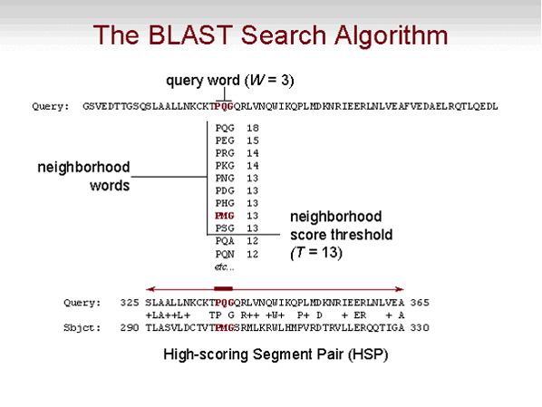

Slide 28
Comparison Matrices
In general, the BLOSUM series is thought to be superior to the PAM series for detecting evolutionarily distant sequences to the because they are derived from areas of conserved sequences.
It is important to vary the parameters when performing a sequence comparison. Similarity scores for truly related sequences are usually not sensitive to changes in scoring matrix and gap penalty.
Thus, if your “hits list” holds up after changing these parameters you can be more sure that you are detecting similar sequences.

Slide 29
High Scoring Pairs

Slide 30
BLAST
Matching words are extended into ungapped local alignments between query sequence and the database sequence.
Extensions are scored until the alignment score drops below a threshold.
The maximal-scoring segment pairs (MSPs) are combined where possible into local alignments.

Slide 31
Statistical Significance of Sequence Comparisons
Assess the statistical significance of a particular global alignment by generating many random sequence pairs of the appropriate length and composition, and calculating the optimal alignment score for each.

Slide 32
BLAST step 1
Filtering
Some sequences contain low complexity regions
Give rise to many random hits
Remember dotplots
Filter out by replacing with Xs

Slide 33
BLAST step 2
Compiling word list
Word length L=3 (protein) or L=11 (nucleotides)
Choose score threshold T (usually 11)
Find all words of length L in query sequence
  One for each position
Compare to all possible length L words (8000/~4.2M)
For each position in query, remove words below T
Limited to appr. 50 words per position

Slide 34
The word list
APLSADQASLVKSTWAQVRNSEVEILAAVFTAYPDIQARF…
APL
PLS
LSA
SAD
ADQ
DQA…
Word list, position 1 APL: APC,APS,APT,APE…
Remove words w with score(APL,w)<T

Slide 35
BLAST step 3
Scan database
Store words for each position in efficient search tree
Scan each sequence in database
Remember exact word hits
If query length is 100, scan for appr. 50·100 hits

Slide 36
Scanning
APL →
APA →
LPL →
IIAPLIGNESNAPAVQTLVGQLPLSHKARG…
Perfect match between word and database is a hit

Slide 37
BLAST step 4
Extend hits (BLAST2)
HSP: High-scoring Segment Pair
Find two hits on same diagonal with distance ≤A
Connect them (ungapped alignment)
Extend using gaps, matches and mismatches
Extension continues while score increases
Stop when score drops X below highest score
Original BLAST
Extend all single word hits (higher T needed)

Slide 38
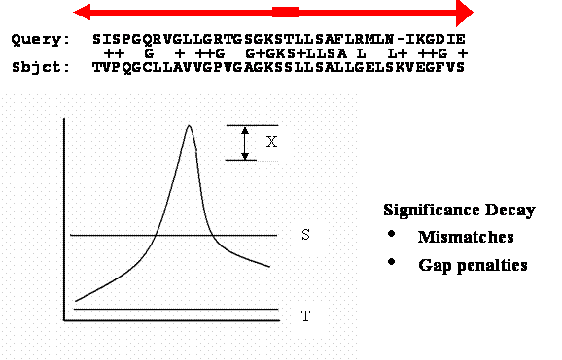
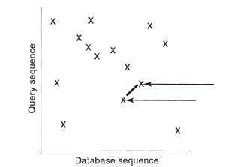
BLAST extension
Find diagonal hits
Extend alignment

Slide 39
BLAST step 5
Calculate E-scores
Compile list of HSPs scoring more than S
Let x be the score of a HSP
The probability of seeing this score by chance
P(score≥x)
The expectation of seeing this score in the database
E≈1-e^{-P(score≥x)D}
Rather complicated calculations
The Karlin-Altschul equation (written in many ways)

Slide 40
BLAST step 6
Report the results
List the hits (sorted by E-value)
Graphical representation
Show Smith-Waterman alignment of the HSPs

Slide 41
Using BLAST
Settings
Query sequence
  Sub-sequence
Database ← important
Conserved Domain search: Additional info
What organisms to search
Scoring matrix
Normally leave the rest as defaults
  But you can change, well, anything

Slide 42
Understanding BLAST
Output
Database searched and query used
Number of hits
Color-coded diagram
  Magnitude of score
  Relation between hits (if any)
Hits sorted by E-value
Alignments
Additional info by clicking a link

Slide 43
BLAST summary
Heuristic local alignment
Finds word matches
Extends locally
Might miss optimal solutions
Fast
Lower E-value → better result
Many hits between query and sequence possible
Remember: Use a proper scoring matrix!

Slide 44
FASTA

Slide 45
The FASTA program is the uses Hash tables.
These tables speed the process of word search.
Query Sequence = TCTCTC
123456 (position number)
Database Sequence = TTCTCTC
1234567 (position number)
You choose to use word size = 4 for your
table (total number of words in your table is
4⁴ = 256)
?
Sequence (total
of 256)
Position w/in query
Position w/in DB
Offset (Q minus DB)
TCTC 1,3 2,4 -1 or -3 or 1
CTCT 2 3 -1
TTCT 1

Slide 46
FASTA Steps
1
Different offset values
2
Identical offset
values in a
contiguous sequence
Diagonals are extended
Local regions of
identity are found
Rescore the local regions
using PAM or Blos. matrix
4
3
Eliminate short diagonals
below a cutoff score
Create a gapped alignment in
a narrow segment and then
perform S-W alignment

Slide 47
The steps in FASTA
Find word hits
Score the hits and trim results
Join regions of similarity
Find the best alignment

Slide 48
FASTA step 1
Word hits
Choose word size ktup (2 for protein, 4 or 6 for DNA)
Create two word lists: Query and database
Find all words that occur in both
Connect nearby hits directly (i.e. no gaps)

Slide 49
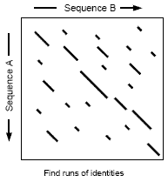
Word hits
Find all hits
Connect hits on same diagonal

Slide 50
FASTA step 2
Score and trim
Only keep the best 10 segments from step 1
Re-evaluate all hits using PAM250
For each hit: Note the best score

Slide 51
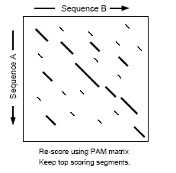
Score and trim
Keep 10 best hits
Recalculate scores

Slide 52
FASTA step 3
Join regions
All regions scoring over a threshold are kept
Crudely join regions
Add linear gap penalty for joining to diagonals
Keep the best scoring rough alignments
Removes unlikely similar regions

Slide 53
BLAST vs. FASTA
Differences between the two
BLAST searches the neighbourhood
FASTA looks for exact matches
BLAST returns all the best hits in a sequence
FASTA returns one hit per sequence
BLAST is faster than FASTA
FASTA produces better final alignment

Slide 54
