Slide 1
- Constructing critical expressional landscapes
- across different Cancer types, - evaluate their association with clonality/mutations and
- their effect in immune response
Leonidas Salichos, P-Var 9/10/2015

Slide 2
Aims / Timeline
Aim I : Evaluate the convergence into one or more critical expressional profiles using clinical and sequence data (#Baskiotis)
Aim II : Identify and score genetic mutations based on their respective changes in expressional landscapes and associate these expressional landscapes with clonal populations. (#Funseq #Dovrolis )
Aim III : Evaluate the effect of tumor heterogeneity and variation in expressional profiles before and after drug treatment (#Rubin #JAX #PDX)

Slide 3
Specific Aim 1
Background
Clinical data, such as the number of days from cancer diagnosis until the patient’s death, may indicate the severity of each expressional profile and the disease.
As critical profiles, I consider these profiles that are responsible for a very short lifespan.

Slide 4
Specific Aim 1
Background
Clinical data, such as the number of days from cancer diagnosis until the patient’s death, may indicate the severity of each expressional profile and the disease.
As critical profiles, I consider these profiles that are responsible for a very short lifespan.
    Identify transcripts across cancer types that are associated with tumor aggression based on clinical data from TCGA.

Slide 5
Specific Aim 1
Background
Clinical data, such as the number of days from cancer diagnosis until the patient’s death, may indicate the severity of each expressional profile and the disease.
As critical profiles, I consider these profiles that are responsible for a very short lifespan.
    Identify transcripts across cancer types that are associated with tumor aggression based on clinical data from TCGA.
    Construct expressional profiles with a reduced dimensionality and high predictability of aggressiveness.

Slide 6
Specific Aim 1
Background
Clinical data, such as the number of days from cancer diagnosis until the patient’s death, may indicate the severity of each expressional profile and the disease.
As critical profiles, I consider these profiles that are responsible for a very short lifespan.
    Identify transcripts across cancer types that are associated with tumor aggression based on clinical data from TCGA.
    Construct expressional profiles with a reduced dimensionality and high predictability of aggressiveness.
    Explore critical expressional profiles, i.e. whether the most aggressive profiles tend to converge by applying regression analysis and machine learning techniques. (#deterministic #stochastic)

Slide 7
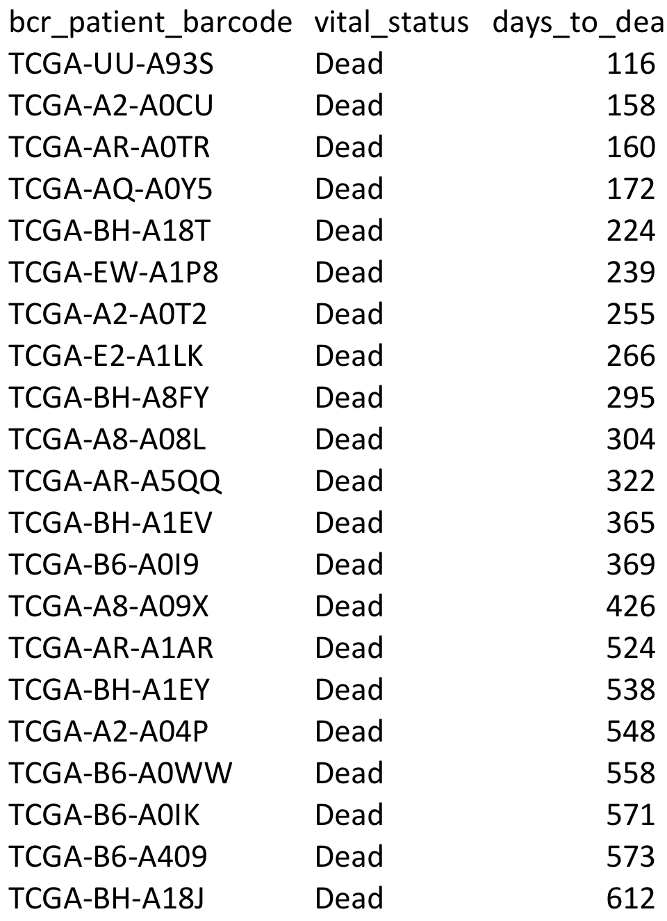
PCR using aggressive genes associated with DaysToDeath criterion
GENEID | TCGA-E9-A1RD | TCGA-E9-A1RC | TCGA-AC-A8OP | TCGA-…
1 | 118.2891 | 19.0335 | 196.1144 | …
10 | 2.5728 | 2.0974 | 2.0707 | …
100 | 93.1369 | 205.5405 | 79.2036 | …
1000 | 58.1463 | 3.8451 | 45.555 | …
10000 | 402.3927 | 1286.7255 | 557.0137 | …
100009676 | 82.1689 | 95.5624 | 95.5775 | …
10001 | 347.8485 | 283.8416 | 261.4237 | …
10003 | 5.9175 | 360.0454 | 20.1892 | …
100033416 | 41.6363 | 35.1132 | 34.3889 | …
100033820 | 137.0219 | 22.1935 | 34.1507 | …
100037417 | 94.9637 | 181.0924 | 380.1877 | …
10004 | 19.8109 | 70.6109 | 32.6133 | …
100048912 | 9.5195 | 1.3982 | 35.7193 | …
100049587 | 40.3936 | 20.624 | 11.9064 | …
10005 | 321.6826 | 200.5173 | 289.528 | …
10006 | 1357.0695 | 1146.902 | 1302.9875 | …
10007 | 1200.4888 | 671.1527 | 890.3936 | …
10008 | 161.06 | 632.0021 | 37.79 | …
10009 | 1335.3058 | 767.2813 | 1120.757 | …
100093630 | 863.7036 | 382.0676 | 2683.6049 | …
1001 | 86.4475 | 2.4469 | 431.2197 | …
10010 | 811.7322 | 1230.097 | 1067.9546 | …
100101267 | 765.6783 | 785.1088 | 781.1651 | …
100101467 | 625.2396 | 373.0385 | 206.385 | …
100101490 | 14.0426 | 11.2453 | 13.242 | …

Slide 8
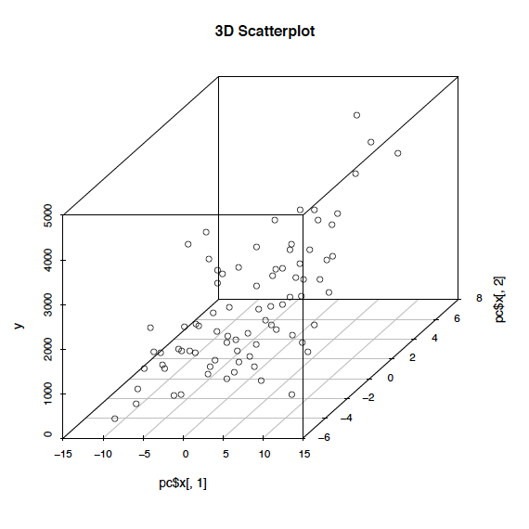
Preliminary Results for Breast Cancer:
High predictability/ Converging profiles
A
B
Days to death
Dpi-Dpmin
Each dot is a person
(treat it with respect)
Predicted Days to death
Dpi-Dpmean
Figure 1. Using the expression values of 72 transcripts associated with tumor aggressiveness in breast cancer disease to create expressional profiles for 77 patients, in A) By performing Principal Component Regression we show the high predictability of days to death for each expressional profile, B) we show the high correlation between “Dpi-Dpmin” -which we define as the geometric distance in R⁷² space between each patient i and the most aggressive profile (based on minimum days to death) Vs “Dpi-Dpmean” -which we define as the geometric distance in R⁷² space between each patient i and the mean geometrical profile (based on average expression values), which combined with C) A 3d scatterplot for the first 2 principal components plotted against tumor aggressiveness, strongly indicate the most aggressive patient profile as a critical profile of convergence
C

Slide 9
Cancer Types currently analyzed
(Cor > 0.3 || Pval < 0.001)
Cancer Type | Nr of Patients | with Aggr. Crit | Nr of Correlated genes
Breast invasive carcinoma [BRCA] | 1098 | 105 | 209
Colon adenocarcinoma [COAD] | 461 | 61 | 396
Glioblastoma multiforme [GBM] | 528 | 368 | 93
Kidney renal clear cell carcinoma [KIRC] | 536 | 162 | 5
Lung adenocarcinoma [LUAD] | 521 | 124 | 48
Lung squamous cell carcinoma [LUSC] | 504 | 158 | 10
Pancreatic adenocarcinoma [PAAD] | 185 | 67 | 762
Stomach adenocarcinoma [STAD] | 443 | 87 | 225

Slide 10
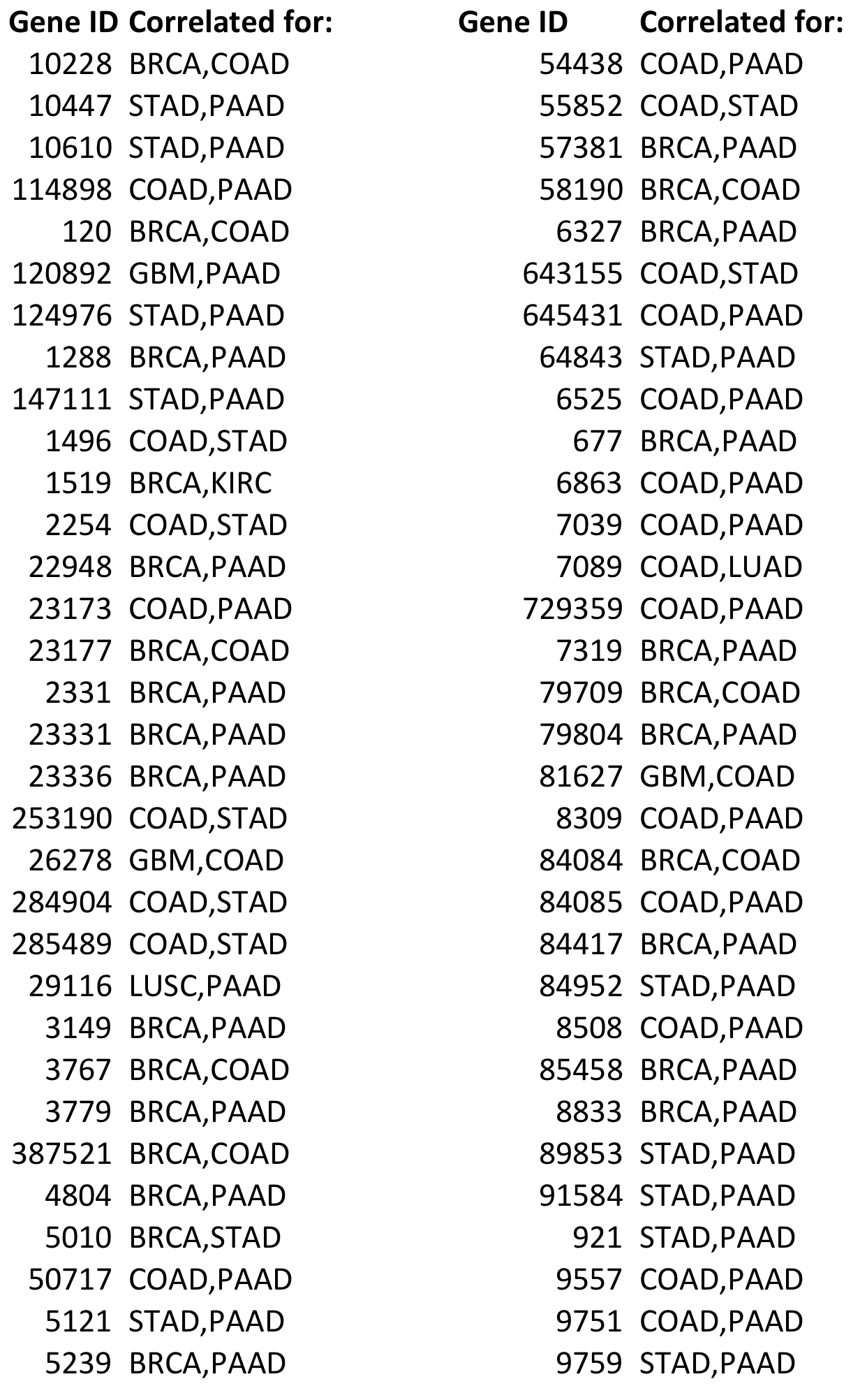
Aggressive Genes for two Cancers
(Cor > 0.3|| Pval < 0.001)

Slide 11
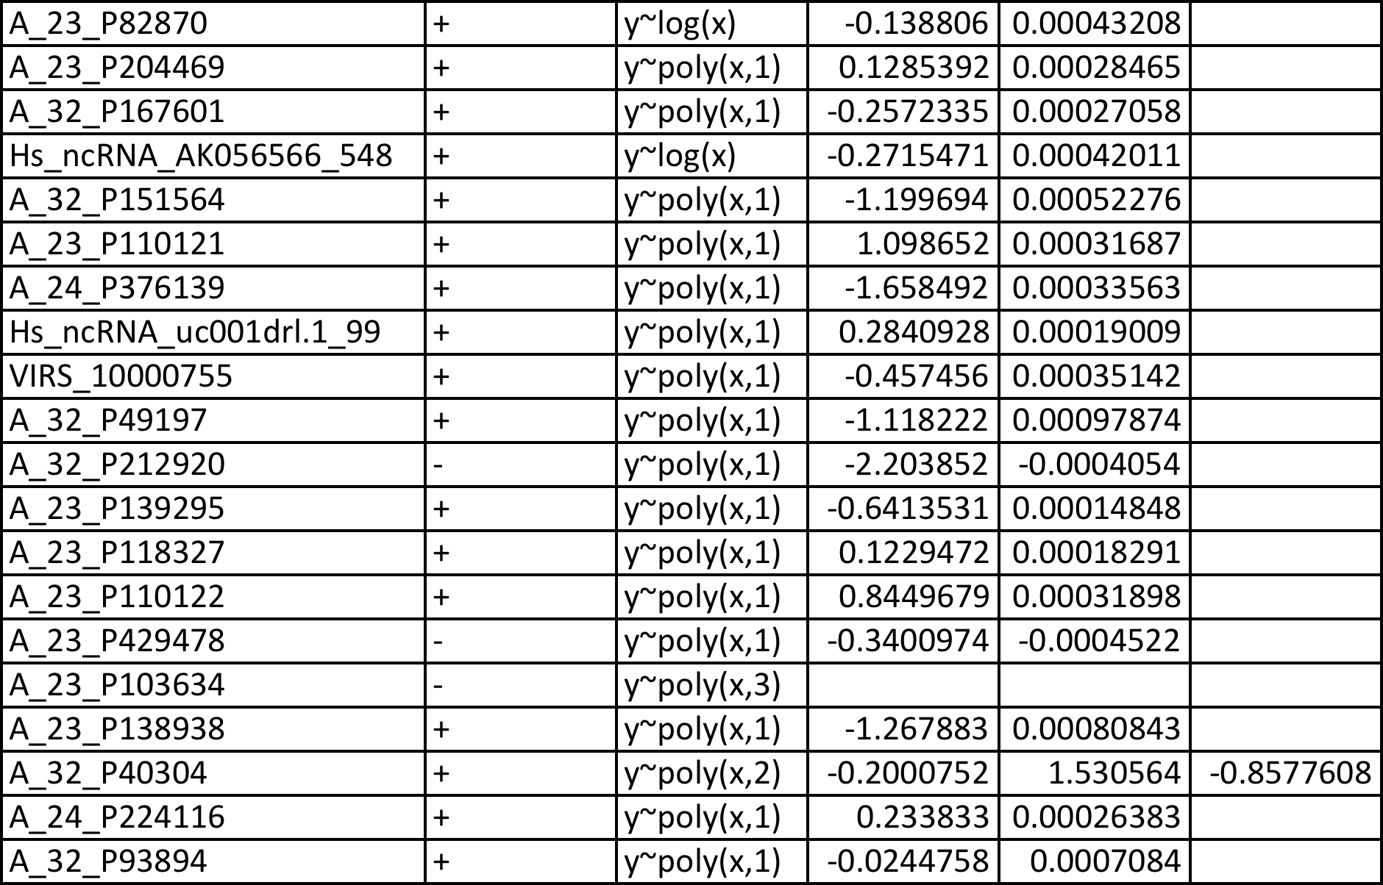
Individual Gene function
Estimate critical profiles by setting Y (nr of days to death) ~ 0

Slide 12
Future Days
Complete Aim I
  Construct critical profiles for all cancer types
  Evaluate landscape and convergence
  Identify converging profiles without D2D criterion (#stochastic #Baskiotis)
Going to Aim II
  Construct regulatory networks for correlated genes using Funseq database
  Identify clonality, mutations and
  cascade effect in these networks (#Dovrolis)

Slide 13

That’s it for now, thank you

