Slide 1
RNA RoVeR and other stories…
Designing
in
anking
ariants
N
A
http://guardianlv.com/2013/06/nasas-mars-curiosity-rover-can-be-yours/
RNA image adapted from Erin Duffy
Michael Rutenberg-Schoenberg
Gerstein Lab
Group meeting
9 Sept 2015

Slide 2
Outline
RNA RoVeR
Prioritizing genetic variants in noncoding RNA using functional annotation
RNA turnover
Completed: Improved chemistry for RNA labeling enables study of miRNA turnover
Plans: Predicting RNA turnover/gene expression using RNA-protein interactions

Slide 3
Protein coding
Modulate noncoding function
Disease
Noncoding function
Splicing defect
Noncoding,
no obvious function
Degradation
Nothing!
Image adapted from Erin Duffy

Slide 4
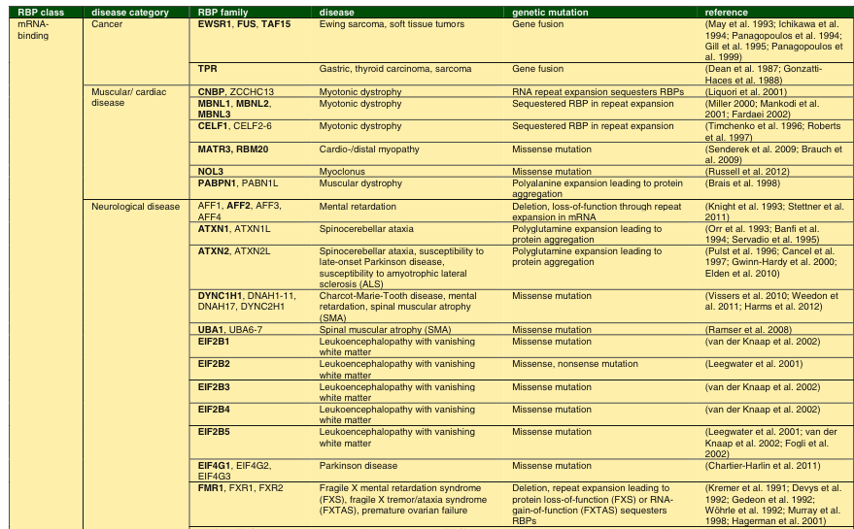
RNA binding and disease
Gene Yeo 2014 http://www.springer.com/gp/book/9781493912209

Slide 5
Approach
Annotation: Analyze functionally related regions together to increase power
Population genetics: Search for genomic regions that are depleted for common genetic variants/enriched for rare variants.

Slide 6
Established work: Prioritizing genetic variants in noncoding DNA
Proportion of Rare SNPs with derived allele frequency < 0.005.
Khurana et al. Science 2013

Slide 7
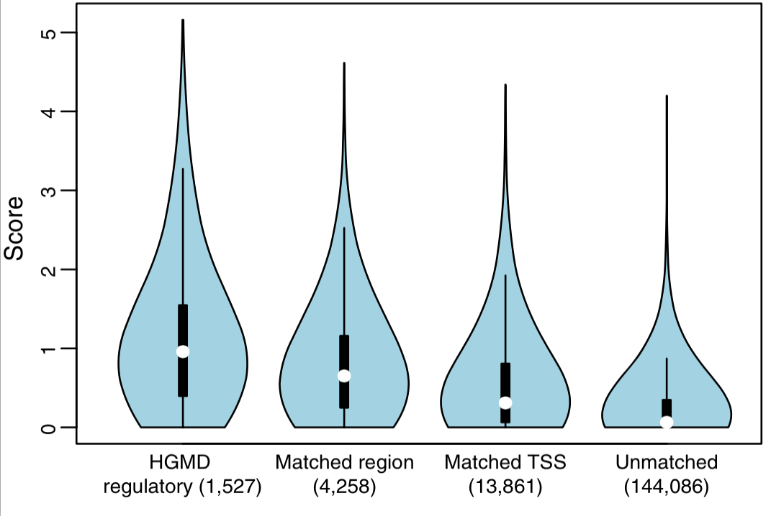
FunSeq2
FunSeq2 distinguishes annotated disease-causing variants from those in similar genomic regions
Fu et al. Genome Biology 2014

Slide 8
What are useful annotations for RNA?
Protein binding sites
CLIP-Seq data
Models/SELEX-based experiments to determine sequence preferences
Secondary structure
Computational prediction +/- supporting experimental data
RNA base modifications
Regulatory elements
Splicing sites, transcription termination sites, etc.
Evolutionary conservation

Slide 9
CLIP-Seq data
StarBase2
Li et al. NAR 2014
doRiNA
Blin et al. NAR 2014
CLIPdb
Yang et al. BMC Genomics 2015
Zhi John Lu
63 distinct RNA binding proteins represented

Slide 10
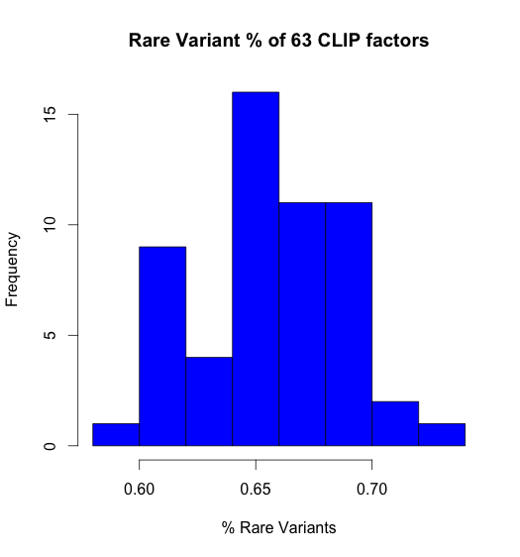
CLIP-Seq footprints are enriched for rare variants

Slide 11
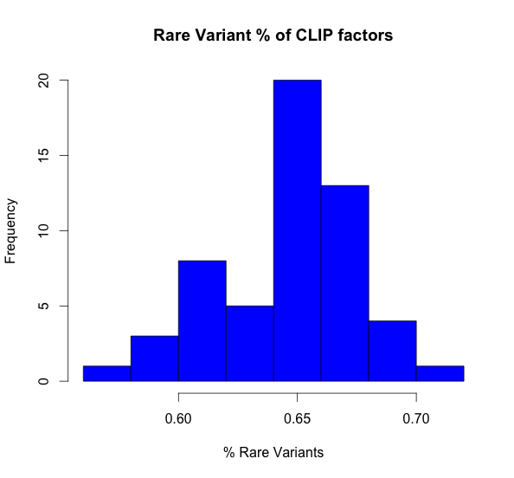
CLIP-Seq footprints are enriched for rare variants
CDS sequences omitted

Slide 12
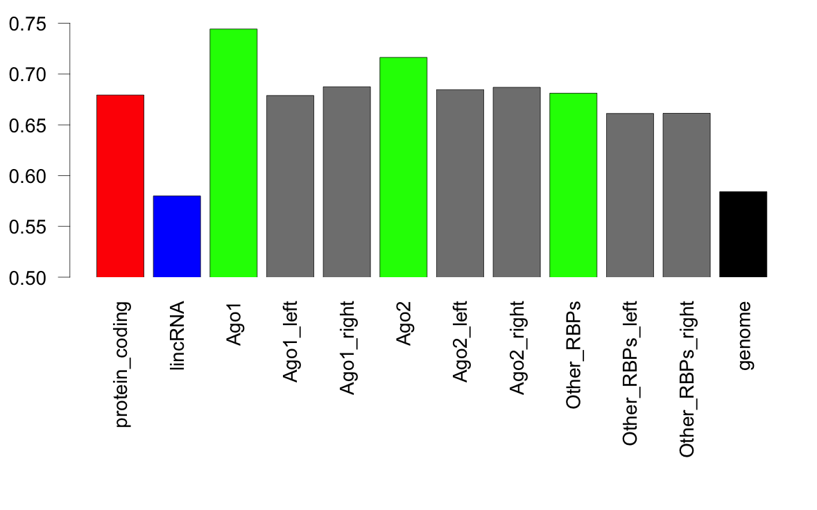
Comparison to adjacent regions
12
Left Matching Region
CLIP-Seq Footprint
Right Matching Region

Slide 13
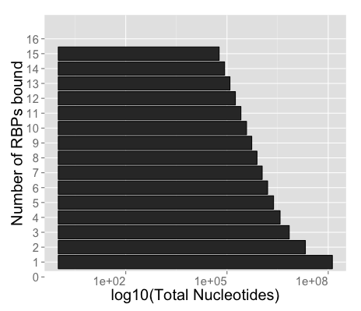
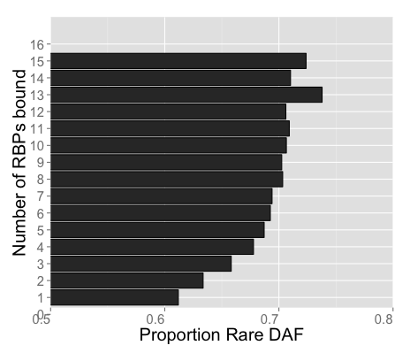
Highly Occupied Regions
RNA regions bound by many RBPs are more sensitive to mutation
Analogous to enhancers

Slide 14
RNAcompete
SELEX-based method of determining sequence preferences of RNA-binding proteins
Designed library of sequences, assayed by array
155 of every 7mer, 33 of each 8mer, 8 of each 9mer
Ray et al. Nat Biotech 2009

Slide 15
RNAcompete
Advantages:
explores more sequence space than CLIP
not reliant on (inefficient) UV crosslinking
Disadvantage: Less physiological than CLIP
Ray et al. Nat Biotech 2009

Slide 16
RNAcompete
>80 Human proteins available
18 with matched CLIP-Seq experiments
Comparisons in progress…

Slide 17
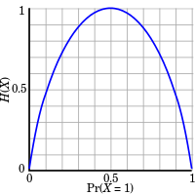
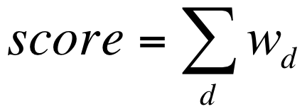
Scoring Scheme
Funseq score: 1 – Shannon Information
Shannon information
1
0
P(X)
Intuition: Quantify information from observation of variant overlapping feature of interest
Fu et al. Genome Biology 2014
https://en.wikipedia.org/wiki/Entropy_(information_theory)

Slide 18
Scoring Scheme
Funseq score: 1 – Shannon Information
Shannon information
1
0
P(X)
Is p_{d} an accurate representation of the probability of observing a variant overlapping a feature?
Other corrections?
Derived allele frequencies
Length
Fu et al. Genome Biology 2014
https://en.wikipedia.org/wiki/Entropy_(information_theory)

Slide 19
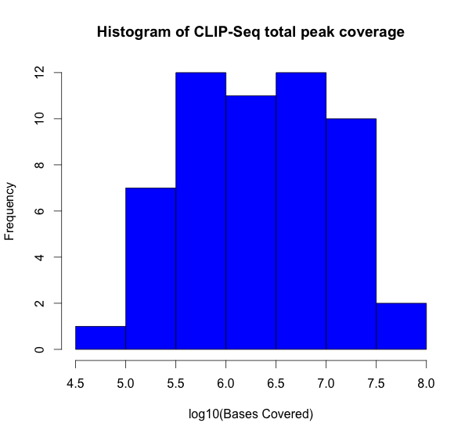
Problem: Are metrics like GERP and rare DAF stable for short annotations?

Slide 20
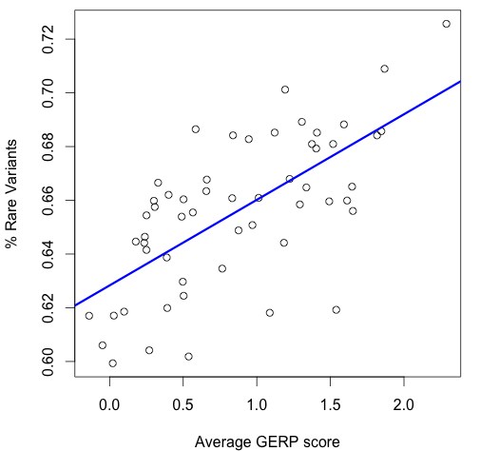
GERP vs. rare DAF %
4 proteins with very low total RNA coverage omitted
R = 0.66

Slide 21
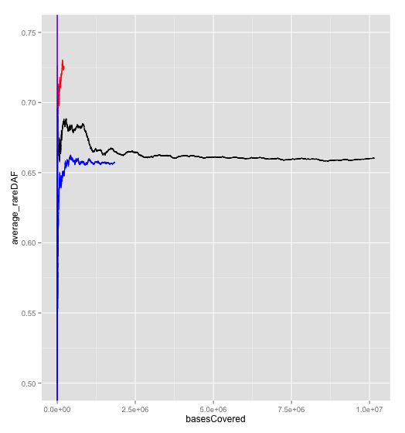
Stability of rare DAF %
PTPB1
NOP58
CPSF1

Slide 22
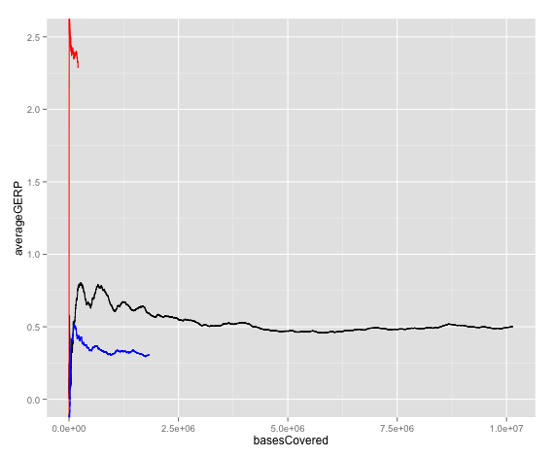
Stability of GERP Score
PTPB1
NOP58
CPSF1

Slide 23
Goals: 1. Add relevant RNA features!
Protein binding sites
CLIP-Seq data
Models/SELEX-based experiments to determine sequence preferences
Secondary structure
Computational prediction +/- supporting experimental data
RNA base modifications
Regulatory elements
Splicing sites, transcription termination sites, etc.
Evolutionary conservation
Gene Expression (GTEx?)

Slide 24
Goals: 2. Assess scoring schemes for RNA variant prioritization
Same comparison should work form FunSeq2, also maybe use ClinVar
Start with basic FunSeq2 scheme!

Slide 25
Goals: 2. Assess scoring schemes for RNA variant prioritization
Compare stability of different metrics between TF and RNA features
Same comparison should work form FunSeq2, also maybe use ClinVar
Start with basic FunSeq2 scheme!

Slide 26
Outline
RNA RoVeR
Prioritizing genetic variants in noncoding RNA using functional annotation
RNA turnover
Completed: Improved chemistry for RNA labeling enables study of miRNA turnover
Plans: Predicting RNA turnover/gene expression using RNA-protein interactions

Slide 27
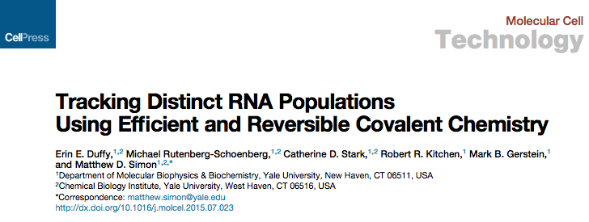
coming soon to the papers page….

Slide 28
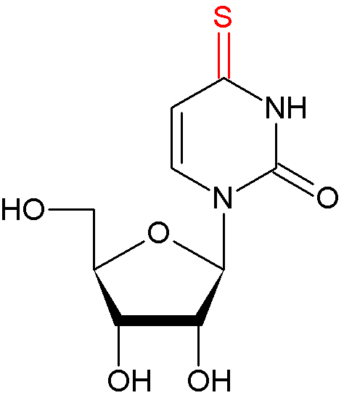
Using s⁴U to label and track RNA
4-thiouridine (s⁴U)
http://modomics.genesilico.pl/modifications/s4U/
Duffy et al 2015 under review

Slide 29
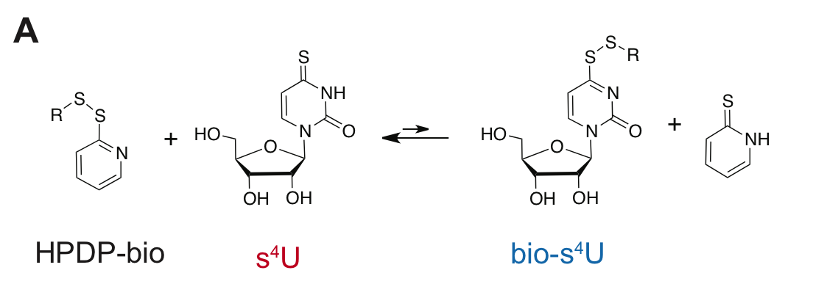
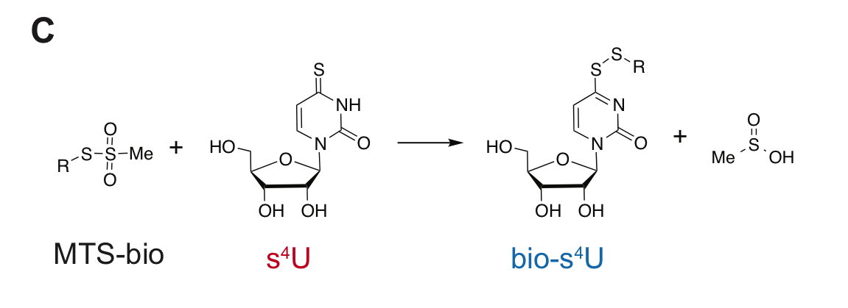
Zoom in on chemistry
Duffy et al 2015 under review

Slide 30
MTS enables more efficient s⁴U labeling than HPDP
HPDP
MTS
Mass spectrometry assay of single nucleoside reactions
Red = unlabeled Blue = labeled
Erin E. Duffy, Michael Rutenberg-Schoenberg, Catherine D. Stark, and Matthew D. Simon 2015 under revision

Slide 31
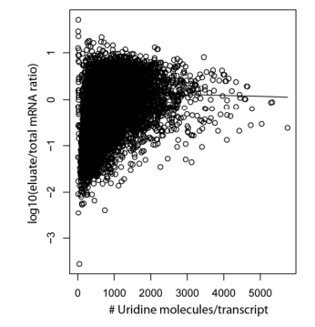
Length bias in HPDP-biotin enriched metabolic labeling experiments
Poor s⁴U labeling or low biochemical enrichment?
Schwanhausser et al. Nature 2010

Slide 32
MTS-biotin enriches RNA much better than HPDP

Slide 33
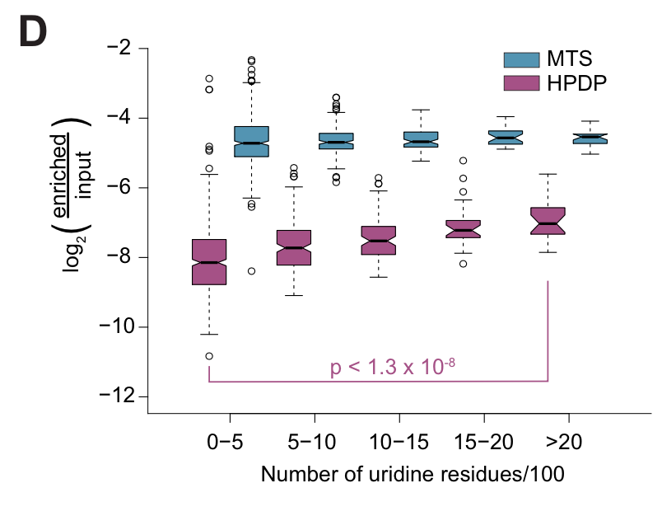
MTS-biotin alleviates length bias seen with HPDP
Duffy et al 2015 under review

Slide 34
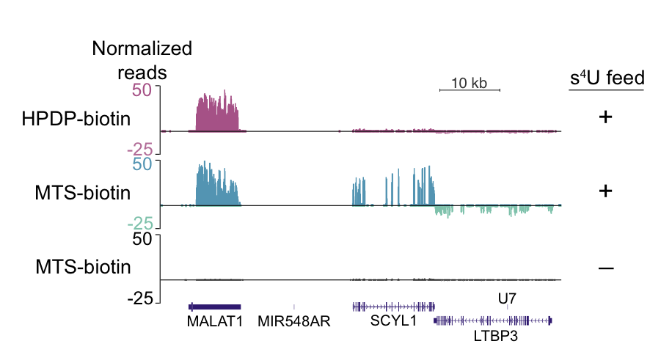
MTS enriches short transcripts missed by HPDP
Duffy et al 2015 under review

Slide 35
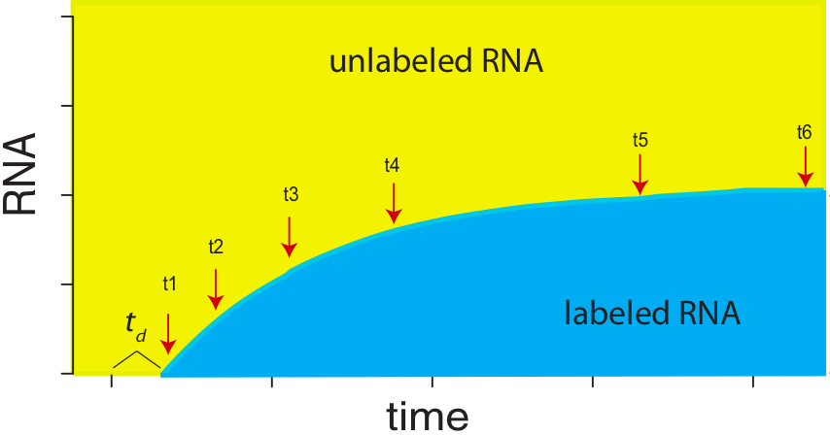
Assaying miRNA dynamics
First time done in a cell system that is producing mature miRNAs

Slide 36
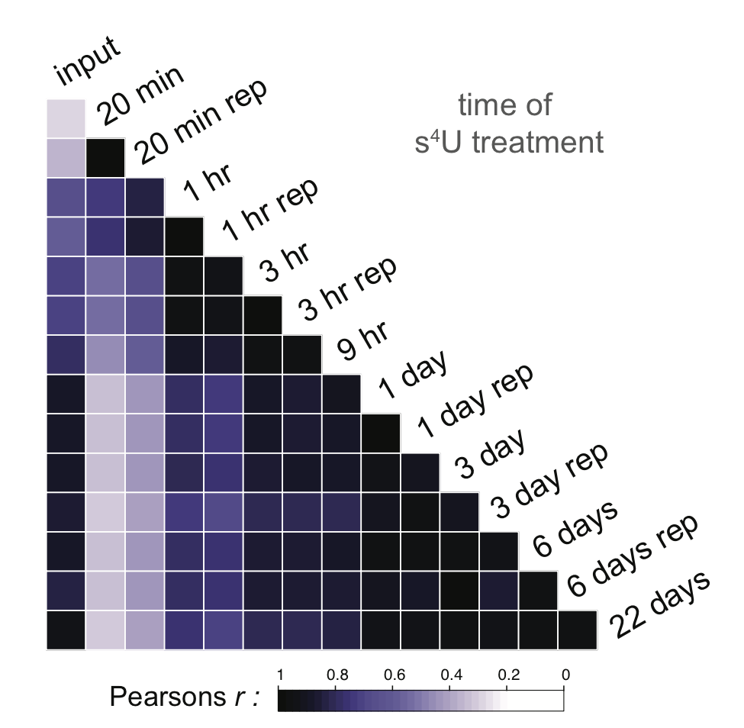
miRNA expression over time
Pearson Correlation of miRNA counts

Slide 37
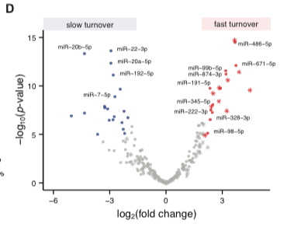
edgeR differential expression of miRNAs: 20 min vs. 6d
miRNA*’s tend to degrade quickly, relative to other miRNAs

Slide 38
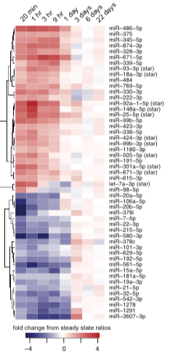
Time series of differentially expressed miRNAs
Long and short-lived miRNAs approach steady state steadily over time
Notes:
Need to permute in order to determine significance

Slide 39
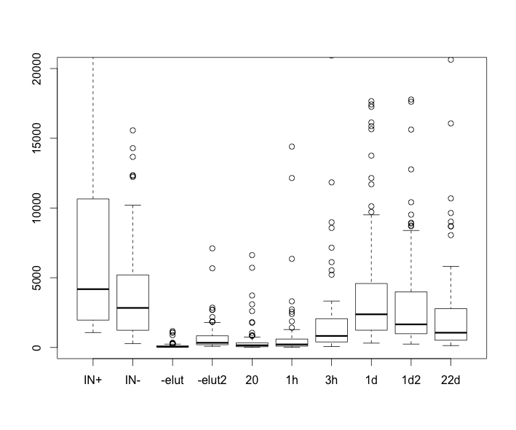
Challenges in previous work
Absolute quantifications with spike-ins not as consistent as relative quantifications
Expected
downward trend in late time points
Normalized read counts
Time
Neymotin et al. RNA 2015

Slide 40
Plan
Optimize absolute RNA quantification in s4U
Perform s4U-Seq experiments to determine RNA half lives
Model RNA degradation and overall RNA levels, incorporating CLIP-Seq and ChIP-Seq data
Inspired by Chao Cheng’s work

Slide 41
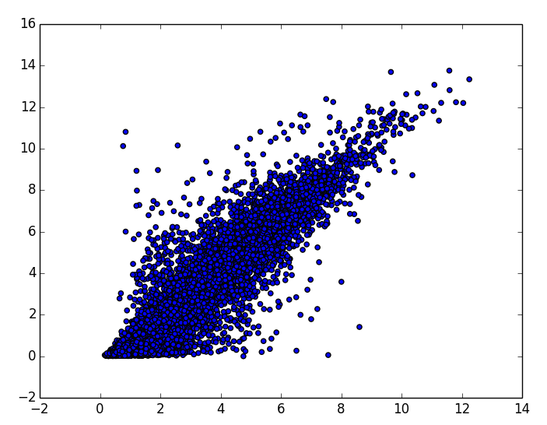
Modeling progress
Sample processed features look correct, but performance slightly lower than reported in Gerstein et al Nature 2014
Random Forest model
K562 ENCODE data
Trained on random coding OR noncoding genes
Predicted FPKM
R = 0.6
Expect R>0.8
Observed FPKM

Slide 42
Modeling goals
Are these RNAs
degraded quickly
Are these long lived RNAs?
Predicted FPKM
R = 0.6
Expect R>0.8
Random Forest model
K562 ENCODE data
Observed FPKM
Can we improve prediction with RBPs?
Or by incorporating degradation rates explicitly?

Slide 43
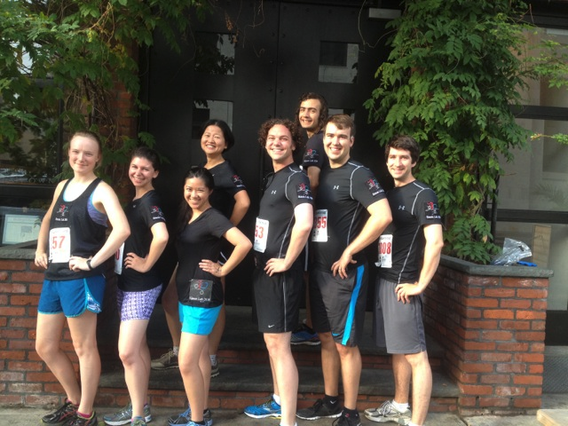
Acknowledgements
Jing Zhang
Rob Kitchen
Anurag Sethi
Joel Rozowsky
P2-Tech
P2-Var
Jayanth Krishnan
Donghoon Lee
Mengting Gu
Mark Gerstein
Erin Duffy
Catherine Stark
Alec Sexton
Jeremy Schofield
Tyler Smith
Will Culligan
Peter Wang
Matthew Simon
Who has the lab picture
from a few months ago?
Notes:
----- Meeting Notes (9/9/15 14:02) -----
Classification+Regression?

