Slide 1
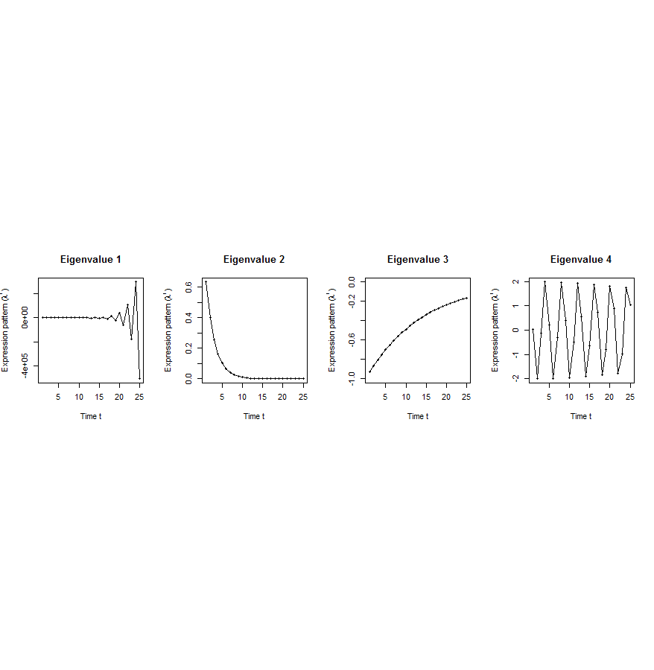
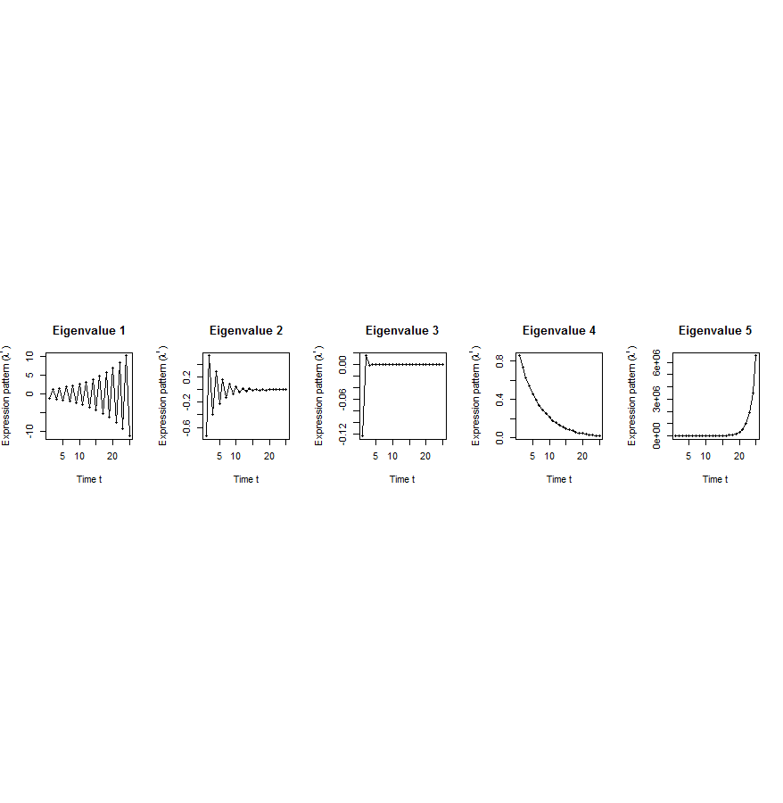
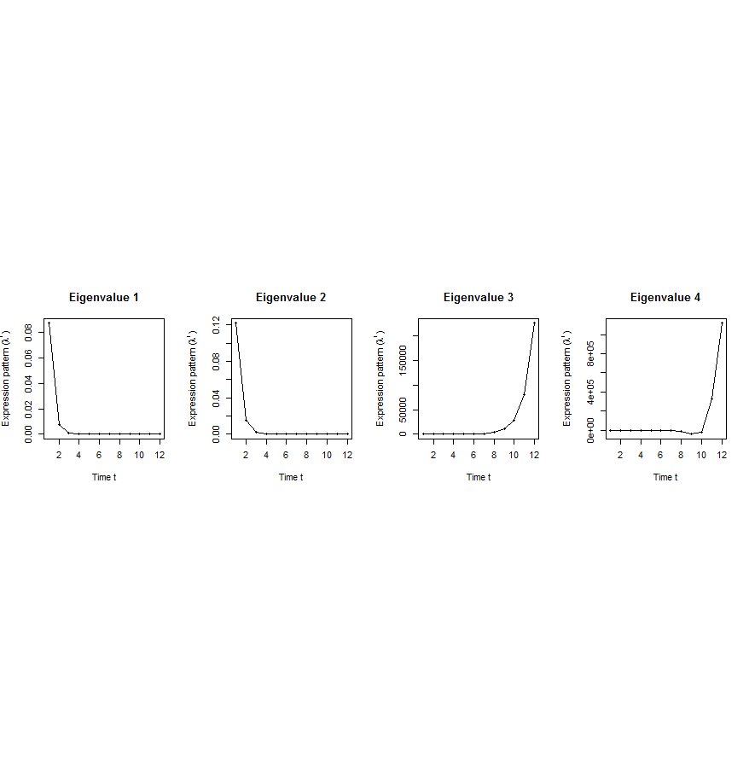
A. Gene state-space model
C. Meta-gene state-space model
B. Dimensionality Reduction
X_{t+1}=AX_{t}+BU_{t}
Genes of X
Meta-genes of X
time
E. Gene’s internal (INT) and external (EXT) driven expression dynamics composed of PDPs
D. Internal/External Principal Dynamic Patterns (PDPs)
time
[λ_{p}¹, λ_{p}², …, λ_{p}^{T}] [σ_{q}¹, σ_{q}², …, σ_{q}^{T}]
x^{INT}=c₁ +c₂
+c₃ +c₄
Genes of U
Meta-genes of U
time
time
…
x^{EXT}=d₁ +d₂
+d₃ +d₄
/
Internal regulation among genes/meta-genes Group X by A/Ã
/
External regulation from genes/meta-genes in Group U
to genes/meta-genes in Group X by B/
/
Genes/Meta-genes in Group X
/
Genes/Meta-genes in Group U

Slide 2
No enough time samples
X_{t+1}
A
X_{t}
B
U_{t}
u_{t}[k]
B[i,k]
x_{t+1}[i]
A[i,j]
x_{t}[j]
A[i,j], B[i,k]: temporal causal influence
Dataset | Group X | Group U | Developmental stages | # of unknown parameters in A and B | # of available time samples
worm (C. elegans) | N₁=3147 worm-fly orthologs (incl. ortholog TFs) | N₂=509 worm-specific transcription factors | T=25 time points: 0, 0.5, 1, …, 12 hours | 3147*3147+3147*509=11.5M | 3147*25+509*25=91400
fly (D. mel.) |  | N₂=442 fly-specific transcription factors | T=12 time points: 0, 2, 4, 6, 8,…, 20, 22 hours | 3147*3147+3147*442=11.3M | 3147*25+442*25=89725

Slide 3
Effective state space model for meta-genes
Not enough data to estimate state space model for genes
Dimensionality reduction from genes to meta-genes (e.g., singular value decomposition)
Effective state space model for meta-genes

Slide 4
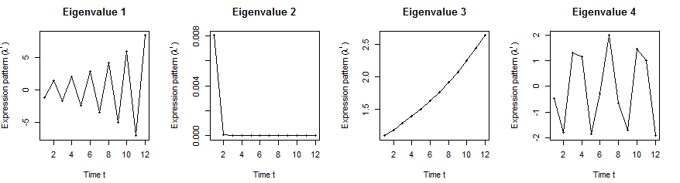
Orthologs have similar internal but different external dynamic patterns during embryonic development
Worm’s effective state space model
iPDPs: time exponentials of Ã eigenvalues in worm
ePDPs: time exponentials of eigenvalues in worm
1st iPDP
2nd iPDP
3rd iPDP
4th iPDP
1st ePDP
2nd ePDP
3rd ePDP
4th ePDP
Expression
Expression
Similar iPDP canonical trajectories
Different ePDP canonical trajectories
1st iPDP
2nd iPDP
3rd iPDP
4th iPDP
1st ePDP
2nd ePDP
3rd ePDP
4th ePDP
Expression
Expression
iPDPs: time exponentials of Ã eigenvalues in fly
ePDPs: time exponentials of eigenvalues in fly
Fly’s effective state space model

Slide 5
Orthologs have correlated iPDP coefficients
1st iPDP
2nd iPDP
r=+0.33
r=+0.66
Coefficients of orthologs on fly iPDPs
3rd iPDP
4th iPDP
r=+0.67
r=+0.73
Coefficients of orthologs on worm iPDPs

Slide 6
Evolutionarily conserved and younger genes exhibit the opposite internal and external PDP coefficients
p<0.001
p<2.2e⁻¹⁶
Coefficients of ribosomal related genes (absolute)
Ribosomal genes have significantly larger coefficients for the internal than external PDPs, but signaling genes exhibit the opposite trend
p<7e-4
p<6e-4
iPDPs ePDPs
Coefficients of signaling genes (absolute)
* p-values from KS-test
iPDPs ePDPs
iPDPs ePDPs
Notes:
Ribosomal related genes: coefficients over conserved (iPDP) and specific (ePDP) meta-patterns

