Slide 1
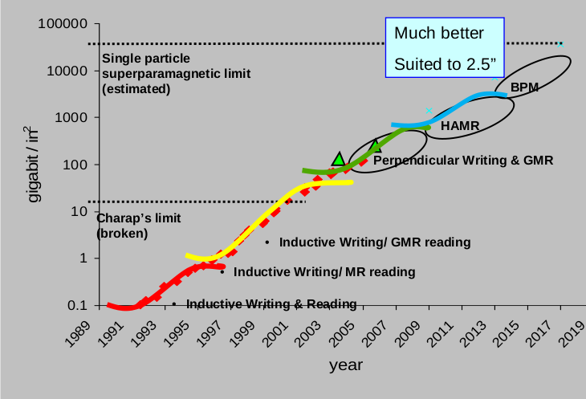
Hard Drive Storage vs Time (Different Technologies) – Kryder’s Law
http://blog.dshr.org/2014/05/talk-at-seagate.html
Figure 1

Slide 2
Alignment algorithms
Figure 2

Slide 3
Figure 3 Graphs

Slide 4
Figure 3 Graphs

Slide 5
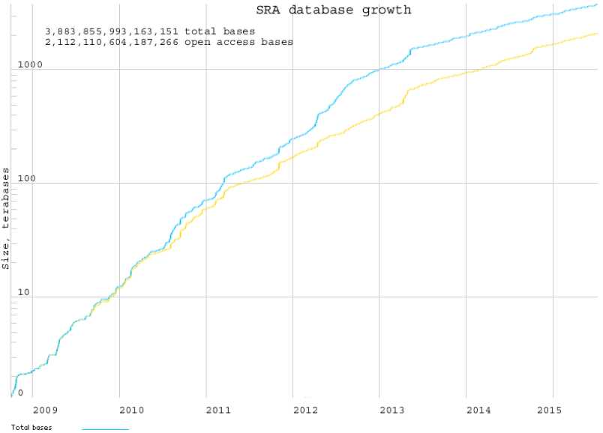
Figure 3 Graphs

Slide 6
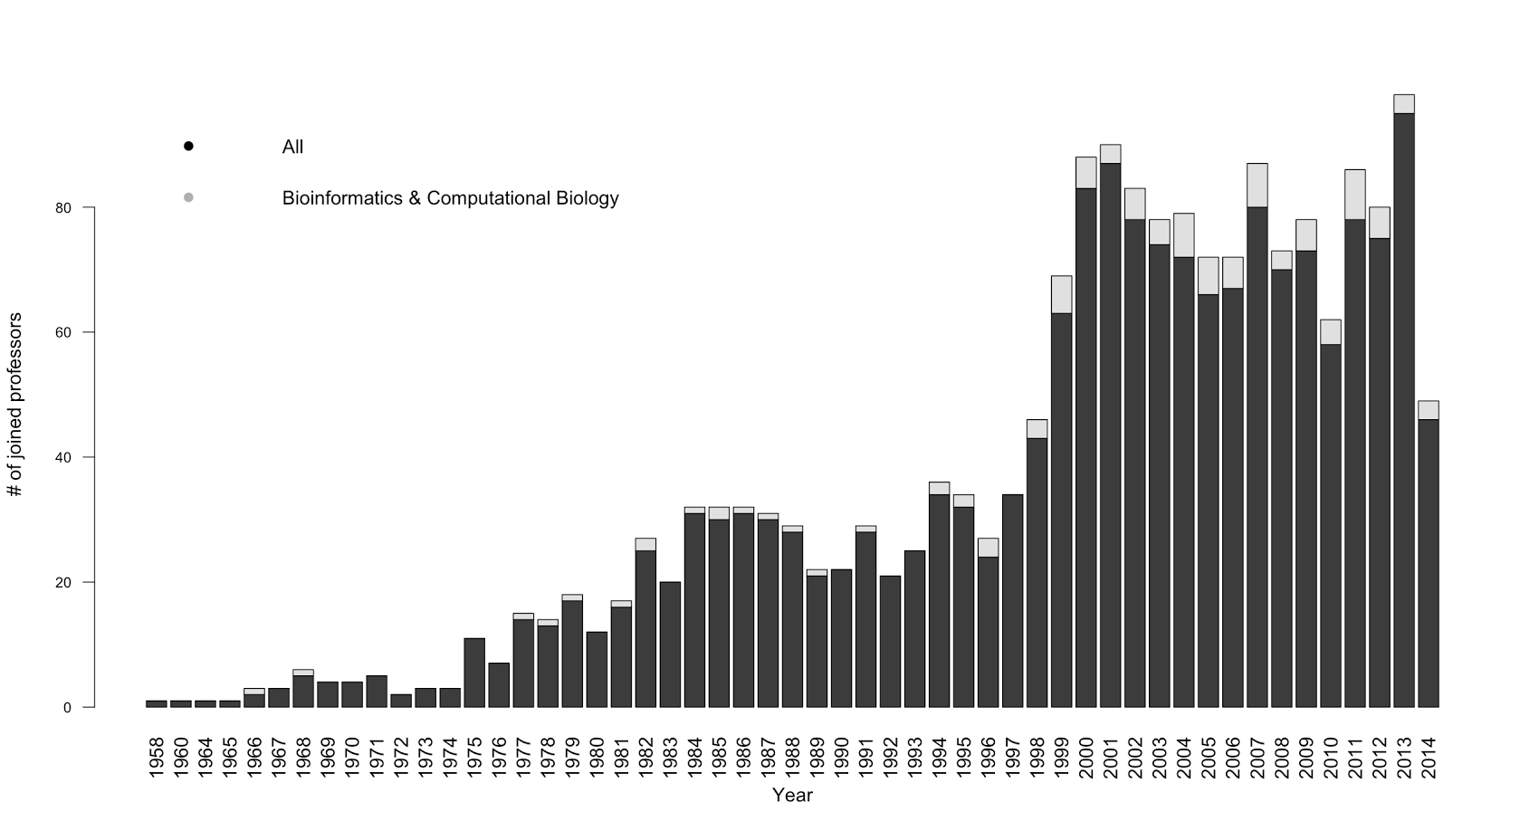
Number of joined computer science professors in 55 top US schools
Figure 4

