Slide 1
PrivaSeq Figure Pack
May 12, 2015

Slide 2

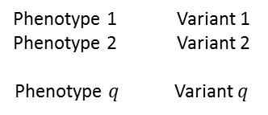

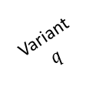
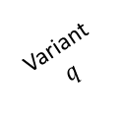
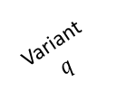
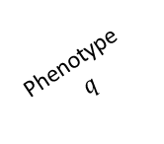
Fig 1a: Linking Attack Scenario
Online Databases
Data Acquisition
Phenotype Dataset
(Public)
Genotype Dataset
(Stolen/Hacked/Queried)
Phenotype
ID
Phenotype 1
Phenotype-Genotype
Correlation Dataset
Genotype
ID
Variant
$$q$$
HIV Status
Phenotype 2
Phenotype
$$q$$
Variant 1
Variant 2
PID-1
HIV+
…
Phenotype 1 Variant 1
Phenotype 2 Variant 2
Phenotype $q$ Variant $q$
GID-1
…
PID-2
HIV-
…
…
GID-2
…
…
…
…
…
…
PID-$n$
HIV-
…
GID-m
…
Genotype
Prediction
Phenotype
ID
Predicted Variant
Genotypes
HIV
Status
Variant 2
Variant
$$q$$
Variant 1
…
PID-1
HIV+
…
Genotype Comparison and Matching
PID-2
HIV-
…
…
…
…
PID-$n$
HIV-
Genotype
ID
Phenotype
ID
HIV
Status
Predicted/Matched Genotypes
Variant 1
Variant
$$q$$
Variant 2
GID-1
PID-8
HIV+
…
GID-2
PID-3
HIV-
…
GID-3
PID-1
HIV-
…
GID-4
PID-1
HIV+
…
GID-5
…
…
…
…
Notes:
Caption: Illustration of Linking attack. (a) Phenotype dataset contains q different phenotype measurements and the HIV Status for n individuals. Genotype dataset contains the variant genotypes for m individuals. Phenotype-Genotype correlation datasets contains q phenotypes, variants, and their correlations. The attacker predicts the variant genotypes and build the predicted genotypes matrix. The attacker then links the phenotype dataset to the genotype dataset by matching the predicted genotypes to the genotype dataset. The linking reveals the HIV status for the subjects in the genotypes dataset. The phenotype, genotype IDs and HIV Status are colored to illustrate how the linking combines the entries in the two datasets. Some of the genotype IDs are not linked to any phenotype. These are indicated with pattern filled rows.

Slide 3
Fig 1a: Linking Attack Scenario
Online Databases
Data Acquisition
Phenotype Dataset
(Public)
Genotype Dataset
(Stolen/Hacked/Queried)
Phenotype
ID
Phenotype 1
Phenotype-Genotype
Correlation Dataset
Genotype
ID
Variant
$$q$$
HIV Status
Phenotype 2
Phenotype
$$q$$
Variant 1
Variant 2
PID-1
HIV+
0.1
-2.7
…
90.3
Phenotype 1 Variant 1
Phenotype 2 Variant 2
Phenotype $q$ Variant $q$
GID-1
0
1
…
1
PID-2
HIV-
0.5
8.6
…
63.5
…
GID-2
2
1
…
0
…
…
…
…
…
…
…
…
…
…
…
PID-$n$
HIV-
-0.2
5.4
…
50.3
GID-m
1
2
…
1
Genotype
Prediction
Phenotype
ID
HIV
Status
Predicted Variant
Genotypes
Variant 2
Variant
$$q$$
Variant 1
…
PID-1
HIV+
1
0
…
2
Genotype Comparison and Matching
PID-2
HIV-
2
2
…
1
…
…
…
…
…
…
PID-$n$
HIV-
0
1
1
Genotype
ID
Phenotype
ID
HIV
Status
Predicted/Matched Genotypes
Variant 1
Variant
$$q$$
Variant 2
GID-1
PID-8
HIV+
0/0
1/1
…
1/1
GID-2
PID-3
HIV-
2/2
1/1
…
0/0
GID-3
PID-1
HIV-
1/0
1/0
…
0/2
GID-4
PID-1
HIV+
2/2
0/0
…
1/1
GID-5
0/1
1/1
…
2/1
…
…
…
…
…
…
…
Notes:
Caption: Illustration of Linking attack. (a) Phenotype dataset contains q different phenotype measurements and the HIV Status for n individuals. Genotype dataset contains the variant genotypes for m individuals. Phenotype-Genotype correlation datasets contains q phenotypes, variants, and their correlations. The attacker predicts the variant genotypes and build the predicted genotypes matrix. The attacker then links the phenotype dataset to the genotype dataset by matching the predicted genotypes to the genotype dataset. The linking reveals the HIV status for the subjects in the genotypes dataset. The phenotype, genotype IDs and HIV Status are colored to illustrate how the linking combines the entries in the two datasets. Some of the genotype IDs are not linked to any phenotype. These are indicated with pattern filled rows.

Slide 4
Fig 1a: Linking Attack Scenario
Online Databases
Data Acquisition
Phenotype Dataset
(Public)
Genotype Dataset
(Stolen/Hacked/Queried)
Phenotype
ID
HIV
Status
Phenotype 2
Phenotype-Genotype
Correlation Dataset
Genotype
ID
Variant
$$q$$
Phenotype 1
Phenotype
$$q$$
Variant 1
Variant 2
PID-1
HIV+
…
Phenotype 1 Variant 1
Phenotype 2 Variant 2
Phenotype $q$ Variant $q$
GID-1
…
PID-2
HIV-
…
…
GID-2
…
…
…
…
…
…
PID-$n$
HIV-
…
GID-m
…
Genotype
Prediction
Phenotype
ID
HIV
Status
Predicted Variant
Genotypes
Variant 2
Variant
$$q$$
Variant 1
…
PID-1
HIV+
…
Genotype Comparison and Matching
PID-2
HIV-
…
…
…
…
PID-$n$
HIV-
Genotype
ID
Phenotype
ID
HIV
Status
GID-1
PID-8
HIV+
GID-2
PID-3
HIV-
GID-3
PID-1
HIV-
GID-4
PID-1
HIV+
GID-5
…
…
…
Notes:
Caption: Illustration of Linking attack. (a) Phenotype dataset contains q different phenotype measurements and the HIV Status for n individuals. Genotype dataset contains the variant genotypes for m individuals. Phenotype-Genotype correlation datasets contains q phenotypes, variants, and their correlations. The attacker predicts the variant genotypes and build the predicted genotypes matrix. The attacker then links the phenotype dataset to the genotype dataset by matching the predicted genotypes to the genotype dataset. The linking reveals the HIV status for the subjects in the genotypes dataset. The phenotype, genotype IDs and HIV Status are colored to illustrate how the linking combines the entries in the two datasets. Some of the genotype IDs are not linked to any phenotype. These are indicated with pattern filled rows.

Slide 5

















Fig 1b: Datasets
Genotype Matrix
$$v$$
$$n_{v}$$
$$j$$
$$\sim V_{k}$$
$$q$$
$$k$$
$$v_{k,j}$$
$$E_{k}$$
$ρ(E_{k},V_{k})$
eQTL Dataset
$$e$$
$p(E_{k},V_{k})$
0
1
2
$$V_{k}$$
$$q$$
$$k$$
$$e_{k,j}$$
$${\sim E}_{k}$$
$$n_{e}$$
Expression Matrix
Notes:
Caption: (b) Illustration of the expression and genotype datasets. Variant genotype dataset contains the genotypes for q eQTL variants for n_v individuals. J^th entry for k^th eQTL is denoted by v_k,j. Similarly, the expression dataset contains the expression levels for q genes. The k^th expression level for j^th individual is denoted by e_k,j. The variant genotypes for k^th variant is distributed over samples with distribution specified by the random variable V_k. Likewise, the expression levels for k^th gene is distributed per random variable E_k. These random variables are correlated with each other with correlation coefficient, denoted by \rho(E_k, V_k) (bottom).

Slide 6


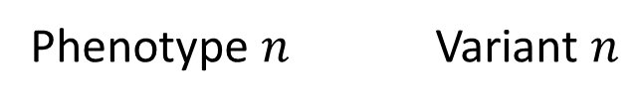

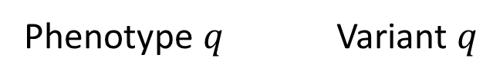


Fig 2a
$$ρ_{1}$$
Phenotype 1 Variant 1
Vulnerable Individual
$$ρ_{2}$$
Non-vulnerable Individual
Phenotype 2 Variant 2
Decreasing Phenotype-Genotype
Correlation and Predictability
…
$$ρ_{k}$$
Increasing Number of Potentially
Characterizable Individuals
Phenotype $n$ Variant $n$
…
Increasing Fraction of
Individuals with Mispredicted
Genotypes
$$ρ_{q}$$
Phenotype $q$ Variant $q$
$${|ρ}_{1}\left|>{|ρ}_{2}\right|>…>{|ρ}_{q}|$$
Notes:
Caption: Quantification of ICI and correct genotype predictability (a) Adversary’s genotype prediction strategy. The phenotype-genotype correlations \rho_1, \rho_2,… are sorted with respect to decreasing absolute correlation, as shown on each line. For a selected set of n variants, the genotypes are predicted using the phenotypes. As n increases (traversing down the list) the number of potentially characterizable individuals (represented with red) increase. The fraction of characterizable individuals, however, decrease. The green and red individuals on the right represent the vulnerable and non-vulnerable individuals, respectively.

Slide 7
Fig 2a
$$ρ_{1}$$
Vulnerable Individual
Phenotype 1 Variant 1
$$ρ_{2}$$
Non-vulnerable Individual
Phenotype 2 Variant 2
…
Increasing Fraction of Individuals with Mispredicted Genotypes
Decreasing Phenotype-Genotype
Correlation and Predictability
$$ρ_{k}$$
Increasing Number of Potentially
Characterizeable Individuals
Phenotype $n$ Variant $n$
…
$$ρ_{q}$$
Phenotype $q$ Variant $q$
$${|ρ}_{1}\left|>{|ρ}_{2}\right|>…>{|ρ}_{q}|$$
Notes:
Caption: Quantification of ICI and correct genotype predictability (a) Adversary’s genotype prediction strategy. The phenotype-genotype correlations \rho_1, \rho_2,… are sorted with respect to decreasing absolute correlation, as shown on each line. For a selected set of n variants, the genotypes are predicted using the phenotypes. As n increases (traversing down the list) the number of potentially characterizable individuals (represented with red) increase. The fraction of characterizable individuals, however, decrease. The green and red individuals on the right represent the vulnerable and non-vulnerable individuals, respectively.

Slide 8
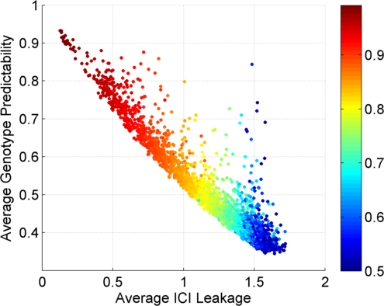
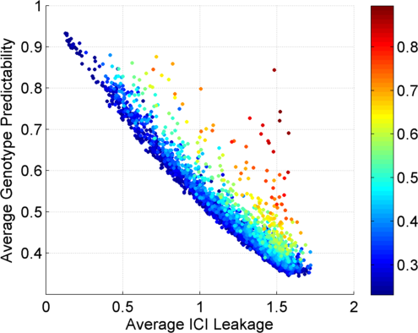
Fig 2b
Colors by Major Allele Frequency
Colors by Absolute Correlation
Major Allele Frequency
Absolute Correlation
Notes:
Caption: (b) Plots show, for each, eQTL the information leakage (x-axis) versus correct genotype predictability (y-axis). For each eQTL, the estimated ICI leakage and genotype predictability are plotted. Each eQTL’s point is colored with respect to the major allele frequency (left) and with respect to absolute correlation of the eQTL (right).

Slide 9
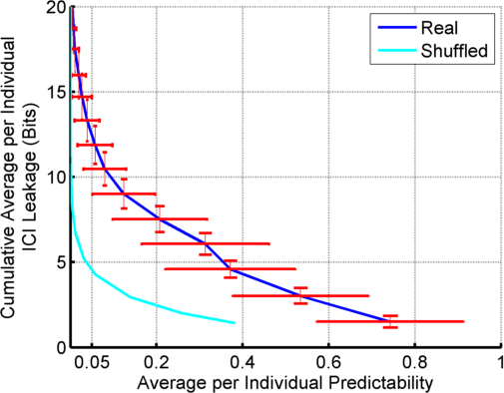
Fig 2c: Predictability vs Information leakage: Multiple eQTLs
10
9
8
7
6
5
4
3
2
1
Notes:
Caption: (c) Average predictability versus cumulative average individual characterizing information leakage. For the top 20 eQTLs, the plot shows the distribution of average predictability and average ICI leakage for the top eQTLs. The number of eQTLs that are used for computing the values at each point are shown next the the point. Only 10 of them are numbered in the figure. The error bars show the standard deviations among the sample set. The cyan plot shows the same plot for shuffled gene-variant pairs. The error bars are left out for simplification. Notice the significant difference in the leakage between shuffled and real data.

Slide 10
Fig 3: 3 Steps of Linking Attack
Step 1
Step 2
Step 3
Gender, Population, Age
G-P
Correlation
Dataset
Prediction
Methodology
Auxiliary Information
Phenotype and Genotype Selection
Genotype Prediction
Linking
Absolute Value of Correlation
Maximum a Posteriori Genotype
Minimum Distance between Predicted and Individual Genotypes
Notes:
Caption: The figure illustrates the steps of the linking attack. The first step consists of selecting the phenotypes and genotype to be used in linking. The absolute value of correlation can be used as one of the selection criteria. The second step comprises the genotype prediction using the selected set of phenotypes. Maximum a posteriori genotype prediction can be used for prediction. Third step in characterization is the linking step, where the predicted genotypes are matched to the genotype dataset. The matching can be performed by comparing the distance between the predicted genotypes and individual genotypes in the dataset.

Slide 11
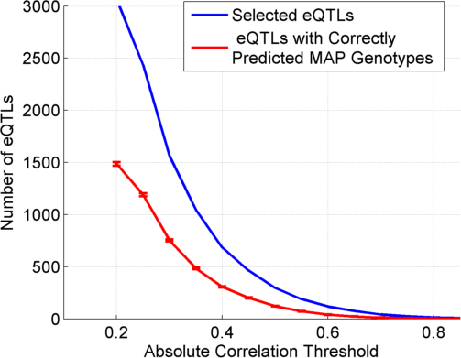
Figure 4a: MAP Genotype Prediction Accuracy
Notes:
Caption: MAP genotype prediction accuracy and vulnerable fraction. (a) The number of eQTLs selected (blue) and the number of correctly predicted eQTL genotypes (red). At each absolute correlation threshold, the number of eQTLs passing the threshold are shown and the number of correctly predicted genotypes using MAP prediction are shown. The error bars show the distribution of accuracy over all the samples.

Slide 12
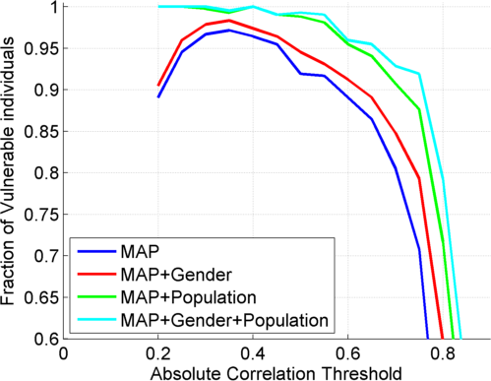
Fig 4b: Fraction of Vulnerable Individuals
Notes:
Caption: The fraction of vulnerable individuals with MAP genotype prediction. X-axis shows the absolute correlation threshold used to select eQTLs. Y-axis shows the fraction of vulnerable individuals. At correlation threshold of 0.35, the fraction is maximized, as indicated by the dashed yellow line. The red, green, and cyan lines show the fraction of vulnerable individuals when gender, population, and gender and population information, respectively, are available as auxiliary information.

Slide 13
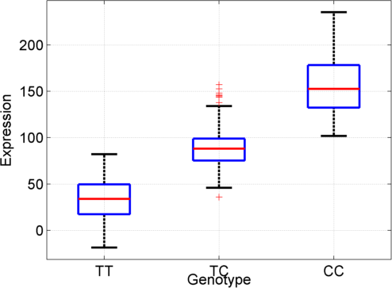
Fig 5a: Extremity based genotype prediction
Negative Extremity
Positive Extremity
Frequency
Lower expression:
Negative Extremity
Most likely TT
Higher expression:
Positive Extremity
Most likely CC
Expression
Notes:
Caption: Extremity based genotype prediction and extremity based linking attack (a) Figure illustrates the extremity based genotype prediction. The joint distribution of expression levels and genotypes is shown on left. Given the relation between expression and genotypes, the lower expression levels (Labelled with “Negative Extremity” shown in red ellipse on left) are assigned the genotype “TT” and higher expression levels (Labelled with “Positive Extremity” shown in green ellipse on left) are assigned the genotype “CC”. The extremity value 0 is indicated with the dashed grey line which is the midpoint between the highest and lowest expression levels. The heterozygous genotype (TC) is shaded with grey to indicate that it is not used in the genotype prediction.

Slide 14
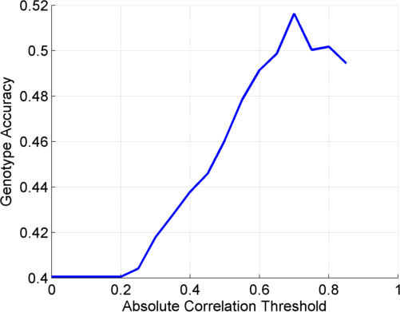
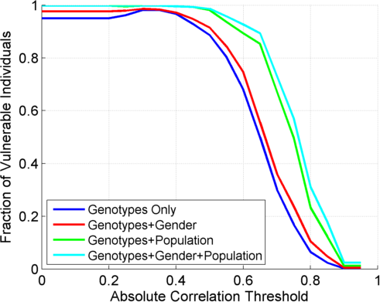
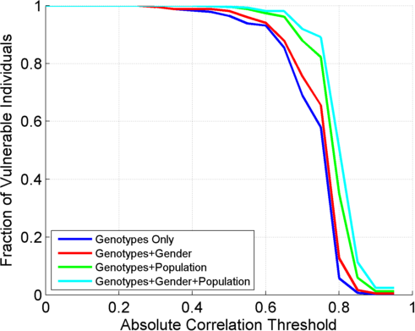
Fig 5bcd
(5b)
(5c)
(5d)
Notes:
Caption: (b) The extremity based genotype prediction accuracy versus the absolute correlation threshold used to select the eQTLs. (c) The fraction of vulnerable individuals versus the correlation threshold in blue. The red, green, and cyan plots show the vulnerable fraction when gender, population, and gender + population are available, respectively, as auxiliary information. (d) The genotype accuracy when homozygous only matching is used. (e) The vulnerable individual fraction with homozygous only matching.
Change gradient to correlation
Make the label more obvious
Can we add auxiliary information to the genotype accuracy?

Slide 15
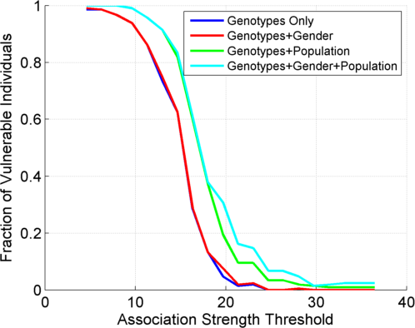
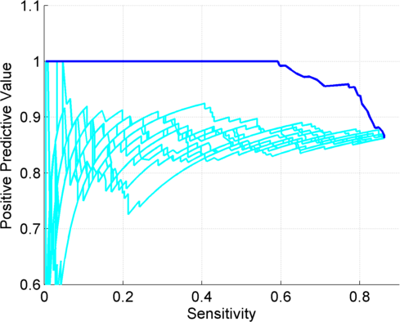
Fig 6: Linking Accuracy on Testing Dataset
(6a)
(6b)
Notes:
Caption: The accuracy of linking on the testing dataset. (a) The fraction of vulnerable individuals on the testing dataset. (b) The sensitivity versus positive predictive value (PPV) of linking with changing d_{1,2} threshold. The plot is generated with eQTLs with higher than 11.3 association (indicated with yellow dashed lines) strength. Blue line shows the ranking with d_{1,2} and cyan lines shows PPV and sensitivity with random ranking for comparison. The grey lines indicate 95% PPV, at which approximately 80% sensitivity is achieved.

Slide 16
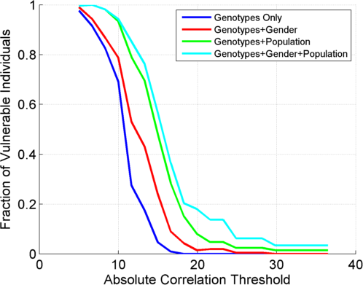
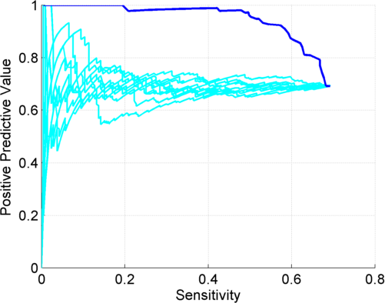
Fig 7: Simulated 100k testing dataset accuracy
(7a)
(7b)
Notes:
Caption: The vulnerable individual fraction statistics for simulated genotypes dataset. (7a) The fraction of vulnerable individuals. (7b) The sensitivity versus positive predictive value. The plot is for the eQTL selection at association strength 9.9, as indicated by the yellow dashed line in (a), where the vulnerable fraction is around 70%. The dashed grey line show the 95% PPV level, where the sensitivity is around 52%. The cyan plots show the sensitivity-PPV plot for 10 randomized rankings of the data for comparison.

Slide 17
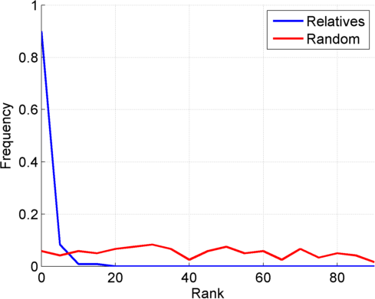
Fig 8: Distribution of ranks for relatives in linking
Notes:
Caption: The distribution of linking ranks (in genotype comparison) of close relatives on 30 trios from HAPMAP project. The blue plot shows the distribution of ranks assigned to close relatives (child-mother or child-father relations) excluding the self ranks of the individual being linked. Red plot shows, as a control, the same distribution for randomly selected individuals for each individual being linked. The ranks for close relatives are much smaller, indicating that they are scored much higher than random individuals.

Slide 18
Supplementary Figures

Slide 19
Table S1ab: Per population and per tissue stratification
(a)
eQTLs Trained On
# linked/# total | TSI | CEU | FIN | GBR | YRI
TSI | - | 92/92 | 92/92 | 92/92 | 81/92
CEU | 77/78 | - | 78/78 | 77/78 | 50/78
FIN | 89/89 | 88/89 | - | 89/89 | 74/89
GBR | 85/85 | 84/85 | 84/85 | - | 61/85
YRI | 67/77 | 36/77 | 66/77 | 68/77 | -
eQTLs Tested On
(b)
eQTLs Trained On
# linked/# total | Whole Blood | Lung | Stomach | Muscle-Skeletal | Thyroid | Adipose
Whole GEUVADIS | 370/421 | 366/421 | 344/421 | 319/421 | 350/421 | 356/421
Notes:
Caption: Linking accuracy of extremity based linking attack using the eQTLs are identified in different populations and different tissues. (a) The table shows the linking accuracies (for populations shown in the rows) when the eQTLs that are identified using data (indicated in each column) from different populations. (b) The linking accuracy of individuals in GEUVADIS project when eQTLs identified from different tissues are used in linking.

Slide 20
Table S2
Method (# of input data per eQTL) |  | Top 1000 eQTLs
Extremity Attack (1 data point) |  | 174/174
Schadt et al (All training data) |  | 173/174
Schadt et al (20 data points) |  | 136/174
Schadt et al (30 data points) |  | 171/174
Schadt et al (40 data points) |  | 173/174
Schadt et al (50 data points) |  | 169/174

Slide 21
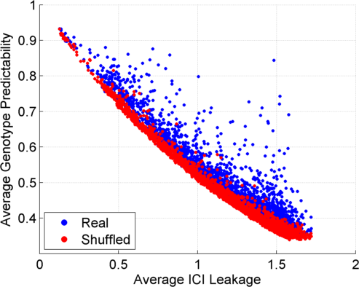
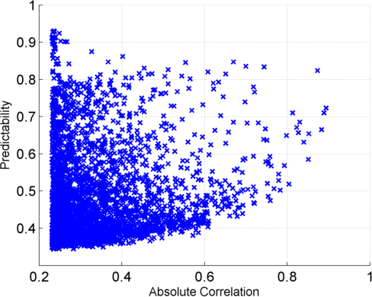
Fig S1ab: eQTL properties
(a)
(b)
Notes:
Caption: The figure shows different properties of the eQTLs. The average ICI leakage versus the genotype predictability is shown for real (red) and shuffled (blue) eQTL dataset is shown in bottom left. Finally, the absolute correlation versus predictability is shown in bottom right.

Slide 22


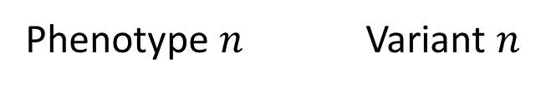

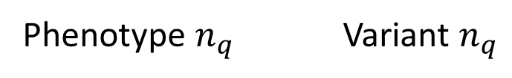



Fig S2a: Computation of Cumulative ICI and Predictabilities
Phenotype
Measurements for Individual j
Sort P-G correlations in decreasing order
Select the top variants to predict
Predict the Genotypes for
Individual j
$$ρ_{1}$$
Phenotype 1 Variant 1
Joint Predictability of Genotypes:
$$ρ_{2}$$
$$π\left(V_{1},V_{1},…,V_{n} | Phenotypes\right)$$
Phenotype 2 Variant 2
Decreasing Phenotype-Genotype
Correlation and Predictability
…
Individual Characterizing Information:
$$ρ_{k}$$
$$\text{ICI}\left(V_{1},V_{1},…,V_{n}\right)$$
Phenotype $n$ Variant $n$
…
$$ρ_{q}$$
Phenotype $n_{q}$ Variant $n_{q}$
Notes:
Caption: Figure shows the attacker’s presumed strategy for linking attack. The phenotype and variant pairs are sorted with respect to decreasing absolute correlations values. For the top n pairs, joint predictability and ICI are computed.

Slide 23
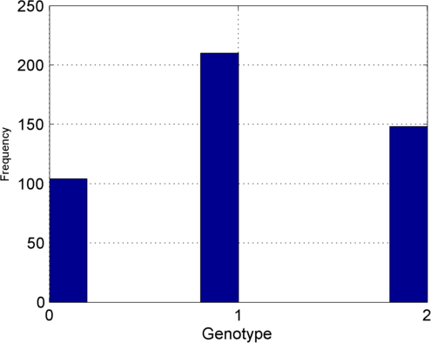
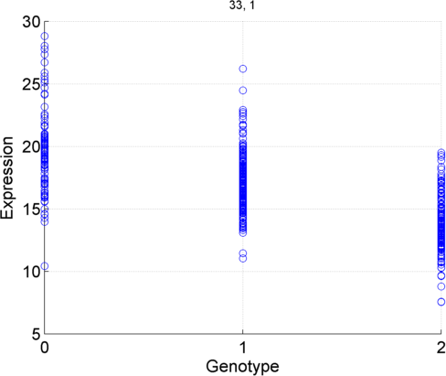
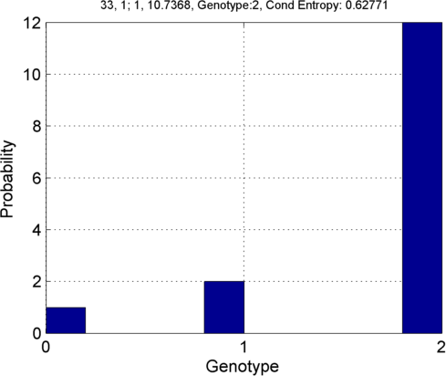




Fig S2b: Illustration of a priori, a posteriori distributions
Posterior:
  Prior: $p\left(V_{k} \right)$
  Joint: $p\left(V_{k}, E_{k}\right)$
  $$p\left(V_{k} | E_{k}=10\right)$$
$${v′}_{k,j}^{}=2$$
Notes:
Caption: Illustration of prior, joint, and posterior distribution of genotypes and expression levels. Leftmost figure shows the distribution of genotypes over the sample set, which is labelled as the prior distribution. Middle figure shows the joint distribution of genotypes and expression levels. Notice that there is a significant negative correlation between genotype values and the expression levels. Rightmost figure shows the posterior distribution of genotypes given that the gene expression level is 10. The posterior distribution has a maximum at genotype 2, which is indicated by a star.

Slide 24
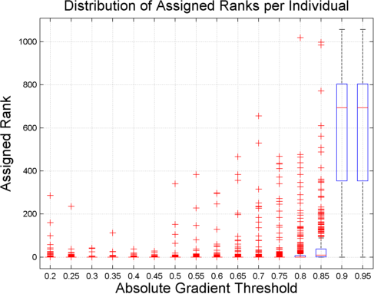
Fig S3
Notes:
Caption: The distribution of self ranks of the individuals in the linking step. At each gradient threshold, the box plots show, for each individual, their ranks in the genotype comparison in the 3rd step of linking attack with MAP genotype prediction. Notice that at around 0.35 correlation threshold, the assigned ranks are minimized, i.e., most of the individual are linked correctly.

Slide 25
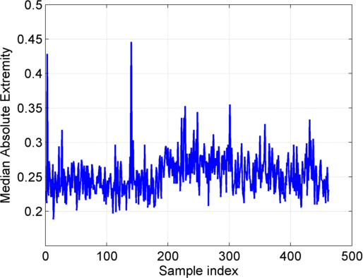
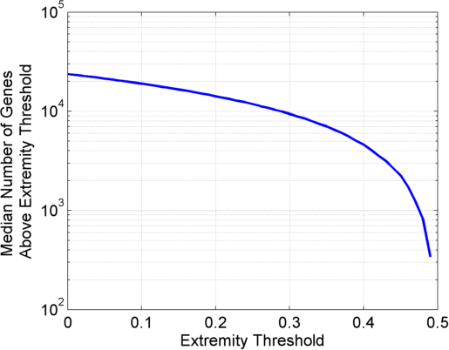
Fig S4ab
(a)
(b)
Notes:
Caption: The median absolute gene expression extremity statistics over 462 individuals in GEUVADIS dataset. (a) For each individual, the extremity is computed over all the genes (23,662 genes) reported in the expression dataset. The median of the absolute value of the extremity is plotted. X-axis shows the sample index and y-axis shows the extremity. The absolute median extremity fluctuates around 0.25, which is exactly the mid point between minimum and maximum values of absolute extremity. (b) For each individual, we count the number of genes above the extremity threshold. The plot shows the extremity threshold versus the median number of genes (over 462 individuals) above the extremity threshold. Around half of the genes (indicated by dashed yellow lines) have higher than almost 0.3 extremity on average over the individuals. Also, around median number of 1000 genes over the samples have higher than 0.45 extremity (indicated by dashed red lines).

Slide 26

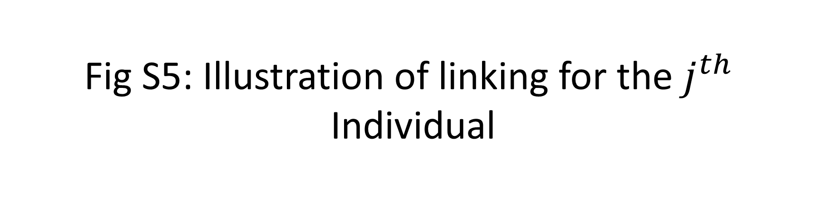







Fig S5: Illustration of linking for the $j^{th}$
Individual
Phenotype Dataset
Genotype
Prediction
Predicted Genotypes
j
$${\tilde{v}}_{∙,j}$$
Genotype
Distance
Computation
Sort
Distances
$$d_{j,\left(1\right)}$$
$$d_{j,\left(2\right)}$$
$$d_{2,1}$$
a
$$v_{∙,a}$$
$$d\left({\tilde{v}}_{∙,j}, v_{∙,a}\right)$$
b
$$v_{∙,b}$$
$$d\left({\tilde{v}}_{∙,j}, v_{∙,b}\right)$$
Genotype Dataset
Genotype
Distances
Sorted
Distances
Notes:
Caption: Illustration of linking for $j^{th}$ individual. The attacker first predicts the genotypes (${\tilde{v}}_{∙,j}$) which are then used to compute the distance to all the individuals in the genotype dataset. The computed distances are then sorted in decreasing. The top matching individual (in the example, individual a) is assigned as the linked individual. The first distance gap, $d_{2,1}$, is computed as the difference between the second ($d_{j,\left(2\right)}$) and the first ($d_{j,\left(1\right)}$) distances in the sorted list.

Slide 27
Fig S6ab: Linking Attacks vs “Genome in a Mixture” Attacks
(a)
Linking Attacks
(Schadt et al, Extremity attack)
(b)
“Detection of a Genome in a Mixture”
Attacks (Homer et al, Im et al)
“Predicting”
Phenotypes
Sensitive Phenotypes
Genotype
Dataset
QTL Study
Statistics
---------------------
Population Genotyping
Study
Statistics
Genotype
Prediction
Predicted
Genotypes
Sensitive Phenotypes
IDs
Genotypes
Statistical
Testing
Reference
Population
Allele
Frequencies
Genotype
Linking
Study
Membership
Status (0/1)
Genotype
Dataset
IDs
Predicted
Genotypes
Genotypes
Sensitive Phenotypes
Notes:
Caption: Schematic comparison of Linking attacks (Left) and detection of a genome in a mixture attacks (Right). Each box in the figure represents a dataset in the form of a matrix. Multiple boxes next to each other correspond to concatenation of matrices. Linking attacks aim at linking genotype and phenotype datasets. The phenotype datasets contain both “predicting” phenotypes and other phenotypes, some of which can be sensitive. The attacker first predict genotypes for each of the predicting phenotype. The predicted genotypes are then compared with the genotypes in the genotype dataset. After the linking, all the datasets are concatenated where the identifiers can be matched to the sensitive phenotypes. Different colors indicate how the linking merges different information. The detection of a genome in a mixture attacks start with a genotype dataset. The attacker gets access to the statistics of a GWAS or genotyping dataset (for example, correlation coefficients or allele frequencies). Then the attacker generates a statistic and tests it against that of a reference population. The testing result can be converted into the study membership indicator (attended/not attended) which shows whether the tested individual was in the study cohort or not.

Slide 28
Fig S7: Extremity Based Linking Attack
1
Genes
PID
ABCB1
RAB
HIST3
M6PR
RNF5
DNAJC3
HIV
Status
Positive Extreme Expression
Negative Extreme Expression
Phenotype Dataset
Non-Extreme Expression
…
…
…
…
…
…
…
…
PID-a
PID-b
PID-c
…
…
…
…
…
…
…
…
eQTL Dataset
Genotype
Prediction
ABCB1
rs7274244
RAB
rs6052708
HIST3
rs8122783
M6PR
rs12479581
RNF5
rs6053462
DNAJC3
rs6077023
2
SNPs
3
Genotype Dataset + Linkings
PID
rs7274244
rs6052708
rs8122783
rs12479581
rs6053462
rs6077023
HIV
Status
Name
rs7274244
rs6052708
rs8122783
rs12479581
rs6053462
rs6077023
Genotype Predictions
…
…
…
…
…
…
…
…
…
…
…
…
…
…
…
PID-a
Bob
PID-b
Alice
PID-c
John
…
…
…
…
…
…
…
…
…
…
…
…
…
…
…
PID-k
…
…
…
…
…
…
…
…
Correct Genotype Prediction (Positive Extreme Phenotype)
Correct Genotype Prediction (Negative Extreme Phenotype)
Incorrect Genotype Prediction
Notes:
Caption: A representative example of extremity based linking. The phenotype dataset (Consisting of gene expression levels for 6 genes) are shown above. Each phenotype measurement is represented by green (negative extreme), red (positive extreme), or grey (non-extreme) dots. Based on the extremity of phenotypes, the attacker performs prediction of genotypes, which are shown below. He/she uses the eQTL dataset (with genes and SNPs). Green and red dots correspond to correct genotype predictions corresponding, respectively, to negative and to positive extreme. The grey crosses correspond to the incorrect or unavailable genotype predictions. The attacker finally performs linking of the individuals to the genotype dataset. The attacker links the predicted genotypes to the genotype datasets, where 3 individuals (Bob, Alice, and John) are highlighted. The attacker can link Bob and John by matching them to their genotypes. The correct prediction of rs7274244 (in yellow dashed rectangle) enables the attacker to distinguish between correct entries and reveal both of their disease status as positive. For Alice, the predicted genotypes are equally matching at two entries; PID-b and PID-k (with negative and positive disease status) thus the attacker cannot exactly reveal Alice’s disease status.

Slide 29

Fig S8: Generalized Risk Assessment Procedure
ICI
QTL Discovery
$$π$$
QTL Identification
Significant
Quantitative
Trait Loci
Leakage vs Predictability Quantification
Risk Assessment
Joint Genotyping
And Phenotyping
Section 2.2
Phenotype
Dataset
External
QTL Databases
Genotype
Dataset
Application of
3-step
Linking Attacks
Risk Assessment
Sections 2.3 and 2.4
Linking
Accuracy
QTL Selection
Notes:
Caption: Illustration of risk assessment procedure for joint genotyping/phenotyping data generation. There are two paths of risk assessment to be performed. The first path evaluates the risks associated with release of the QTL datasets. The genotype and phenotype data (on the left) is first used for quantitative trait loci identification (QTL identification box). This generates the significant QTLs. These are then utilized, in addition to the list of external QTL databases, in quantification of leakage versus predictability (ICI versus $π$ plots), as presented in Section 2.2. These results are then relayed to the risk assessment procedures. The second risk assessment procedure evaluates the release of genotype and phenotype datasets. For this, the datasets are input to application of the 3-step linking attacks with different QTL and linking methodologies (Presented in Sections 2.3, and 2.4, and other linking attacks in the literature) for evaluation of characterization risks. The results are then relayed to risk assessment procedures.

Slide 30
































Fig S9: Modeling of Joint Genotype-Expression Distribution
$$E_{k}$$
$p(E_{k},V_{k})$
$$E_{k}$$
$p(E_{k},V_{k})$
(a)
(b)
$$μ_{3}$$
$σ_{3}$
$$μ_{2}$$
$σ_{2}$
$$μ_{1}$$
$σ_{1}$
0
1
2
$$V_{k}$$
0
1
2
$$V_{k}$$
(c)
$$E_{k}$$
$p(E_{k},V_{k})$
(d)
$$E_{k}$$
$p(E_{k},V_{k})$
$$μ_{3}$$
$σ$
$$e_{4}$$
$$μ_{2}$$
$σ$
$$e_{3}$$
$$μ_{1}$$
$σ$
$$e_{2}$$
$$e_{1}$$
0
1
2
$$V_{k}$$
$$V_{k}$$
0
1
2
(e)
$$E_{k}$$
$p(E_{k},V_{k})$
$$e_{mid}$$
0
1
2
$$V_{k}$$
Notes:
Caption: Examples of models of genotype-expression joint distribution with varying numbers of parameters for a positively correlated eQTL. (a) shows the true distribution where grey boxes represent the expression distributions with different genotypes. Red line show the gradient of correlation between genotype and expression. First simplification of the model is shown in (b). The expression distribution can be modeled with Gaussians with different means and variances with total of 6 parameters. The variances can be assumed same for different genotypes (c), where 4 parameters are required. (d) illustrates a representation of the distribution with 4 parameters on expression levels for each genotype. The conditional distribution of expression is uniform (cross shaded rectangles) over the ranges ($e_{1}$, $e_{2}$), ($e_{2}$, $e_{3}$), and ($e_{3}$, $e_{4}$) given genotypes 0, 1, and 2, respectively. The transparent grey rectangles shows the original distributions. (e) is a simplification of (d) where no conditional probability of expression is assigned given genotype is 1. In this model, only 1 parameter ($e_{mid}$) is necessary. The conditional probability of expression given genotypes 0 and 2 are uniform for expression levels below $e_{mid}$ and above $e_{mid}$, respectively (shown with cross shaded rectangles). The original distribution is included with grey rectangles for comparison. Extremity based prediction is an instantiation of the model in (e).

