Slide 1
K-mer Analysis on Developmental and Housekeeping Enhancer Peaks
Yunsi Yang
Mentor: Anurag Sethi

Slide 2
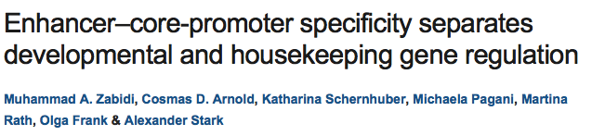
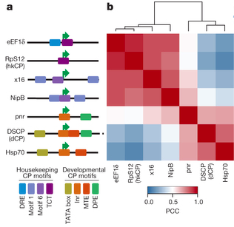
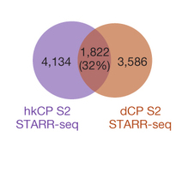
Goal: To test if different core promoters exhibit specificity to certain enhancers
Result: Show that thousands of enhancers in Drosophila melanogaster S2 exhibit specificity to one of two core promoters and confirm the existence of these two classes (housekeeping and developmental) for five additional core promoters.
a, Different core promoters and their motif content
b, Bi-clustered heat map show the separation between housekeeping and regulated core promoters.
hkCP: RpS12, eEF1δ, NipB, x16
dCP: DSCP, eve, evelong, pnr, Hsp70
STARR-seq set-up use RpS12(hkCP)
and DSCP(dCP)
MA Zabidi et al. Nature 000, 1-4 (2014) doi:10.1038/nature13994
Notes:
hkCP: RpS12, eEF1δ, NipB, x16
dCP: DSCP, eve, evelong, pnr, Hsp70

Slide 3
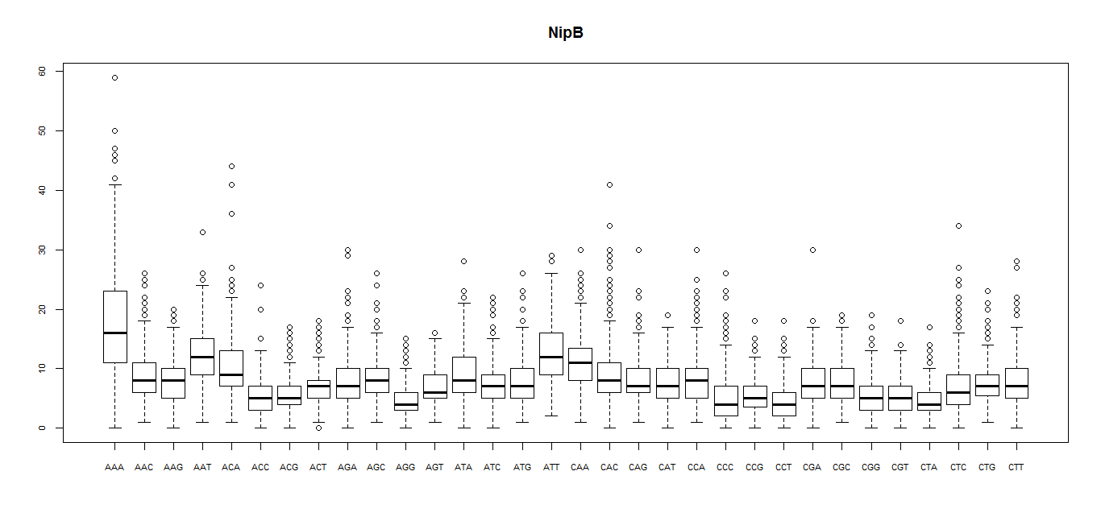
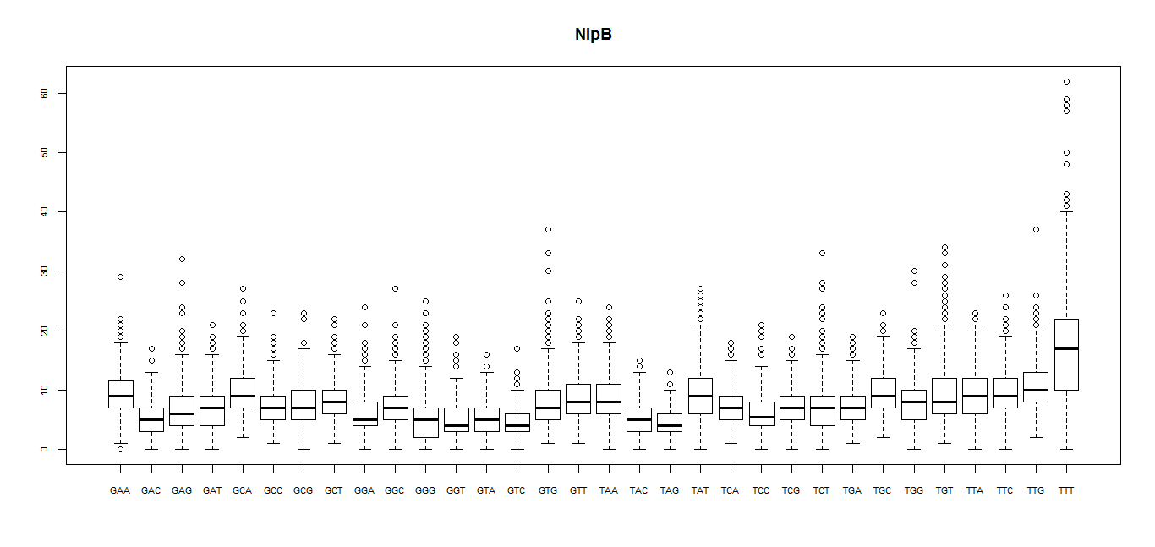
Goal: Find an alternative way to detect promoter specificity of enhancers
Basic idea is to find significantly different k-mers.
Step 1: For each enhancer peak, count all k-mer to get k-mer frequency

Slide 4
Step 2: For each pair of promoters, run ANOVA test on each k-mer to detect if there is significant difference in means of frequency.
NipB v.s. pnr
3mer:
"AGG" "ATA" "GGT" "TAT”
4mer:
"AGGT" "CAGG" "GATA" "GCCA" "GGAC" "GGTG" "TATG”
5mer:
"AGATA" "ATATG" "TGATA”
6mer:
"AGAAGG" "AGCGAA" "AGTCTC" "ATGTGT" "GAGTCT" "GCCAGT" "TATATG" "TCATAA” "TCCTGG" "TGCACC" "TTATGA”
7mer:
"AGTCTCA" "CACTGTG" "CCAGAAC" "CCCGTAC" "CCGCAAC" "GAGTCTC" "GCAGATC” "GGCGATC" "GTGAGTC" "GTTTCAG" "TATGTGT" "TCATAAA" "TTCATAA”
8mer:
"AAAATTCC" "AAGACTCC" "ACTTTTAG" "ATCTCGGA" "CAACCGCT" "CATTTCTG” "CCACTGTG" "CCCATATG" "CGAATGAG" "CGAGTCTC" "CGTTGTTG" "CTAATTGG”…

Slide 5
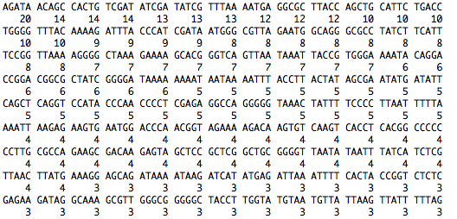

Slide 6
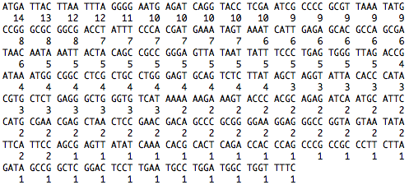
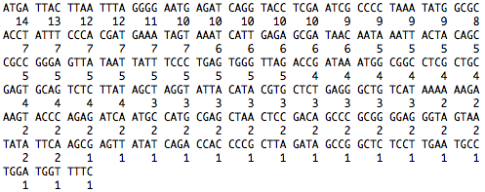
Step 3: Narrow down significant k-mer

Slide 7
dCP v.s. hkCP

Slide 8
Result
3mer: ATG AGA TTA
4mer: ATGA TTAC TTAA TTTA GGGG AATG AGAT CAGG TACC TCGA
5mer: AGATA CACTG TCGAT ATCGA TATCG TTTAA AATGA GGCGC TTACC AGCTG CATTC TGACC TGGGG TTTAC
6mer: TATCGA ATCGAT CAGCTG ACAGCT CTATCG TCGATA GTGACC AGATAA CGATAG TTTAAA ATTTAA GGTCAC
7mer: TATCGAT GGTCACA ATCGATA ACAGCTG ACTATCG TGTGACC CTATCGA GTGTGAC TCGATAG TTATCGA ATATCGA ATCGATT GTTATCG GTCACAC TCACACT

Slide 9
Further Research
1. Be more confident on these significant k-mer
2. Compare the results with known motif
3. Build machine learning model to classify enhancer peaks

