Slide 1
Pan-cancer network analysis identifies combinations of rare somatic mutations across pathways and protein complexes
Leiserson, Mark DM, et al.
Nature genetics 47.2 (2015): 106-114.

Slide 2
Motivation
^{TP53}

Slide 3
Importance of network directionality
Reduces ‘star subnetworks’ and decreasing false positive rates
+ finding subtle subnetworks with rare mutations of high biological relevance

Slide 4
Motivation

Slide 5
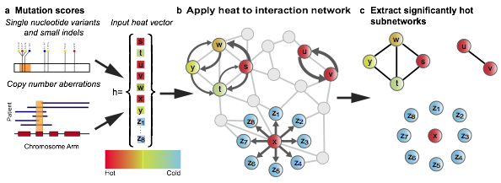
Overview of Algorithm
identify sub-networks according to mutation frequency & local network topology
Partition depends on both the individual genes scores (mutation freq, MutSigCV score) and the local topology of protein interactions

Slide 6
Overview of Algorithm & Nature of Output
Capturing genes with a wide range of heat scores (frequently mutated, known cancer-related genes and rarely mutated genes) – ‘delving’ into long tail of rarely mutated genes

Slide 7
Removal of hyper-mutated and lowly-expressed samples

Slide 10
Significant co-occurrence (or mutual exclusivity) between pairs of sub-networks

Slide 11
Well-known pathways identified: TP53, PI3K, NOTCH and RTK signaling
Recently-identified pathways found: SWI/SNF chromatin-remodeling complex38 and the BAP1 complex
Co-Occurrence
Identified several novel sub-networks with potential roles in cancer: cohesin and condensin complexes54, MHC class I proteins and the telomerase complex

Slide 12
Web Server – example visualization for SWI/SNF

