Slide 1
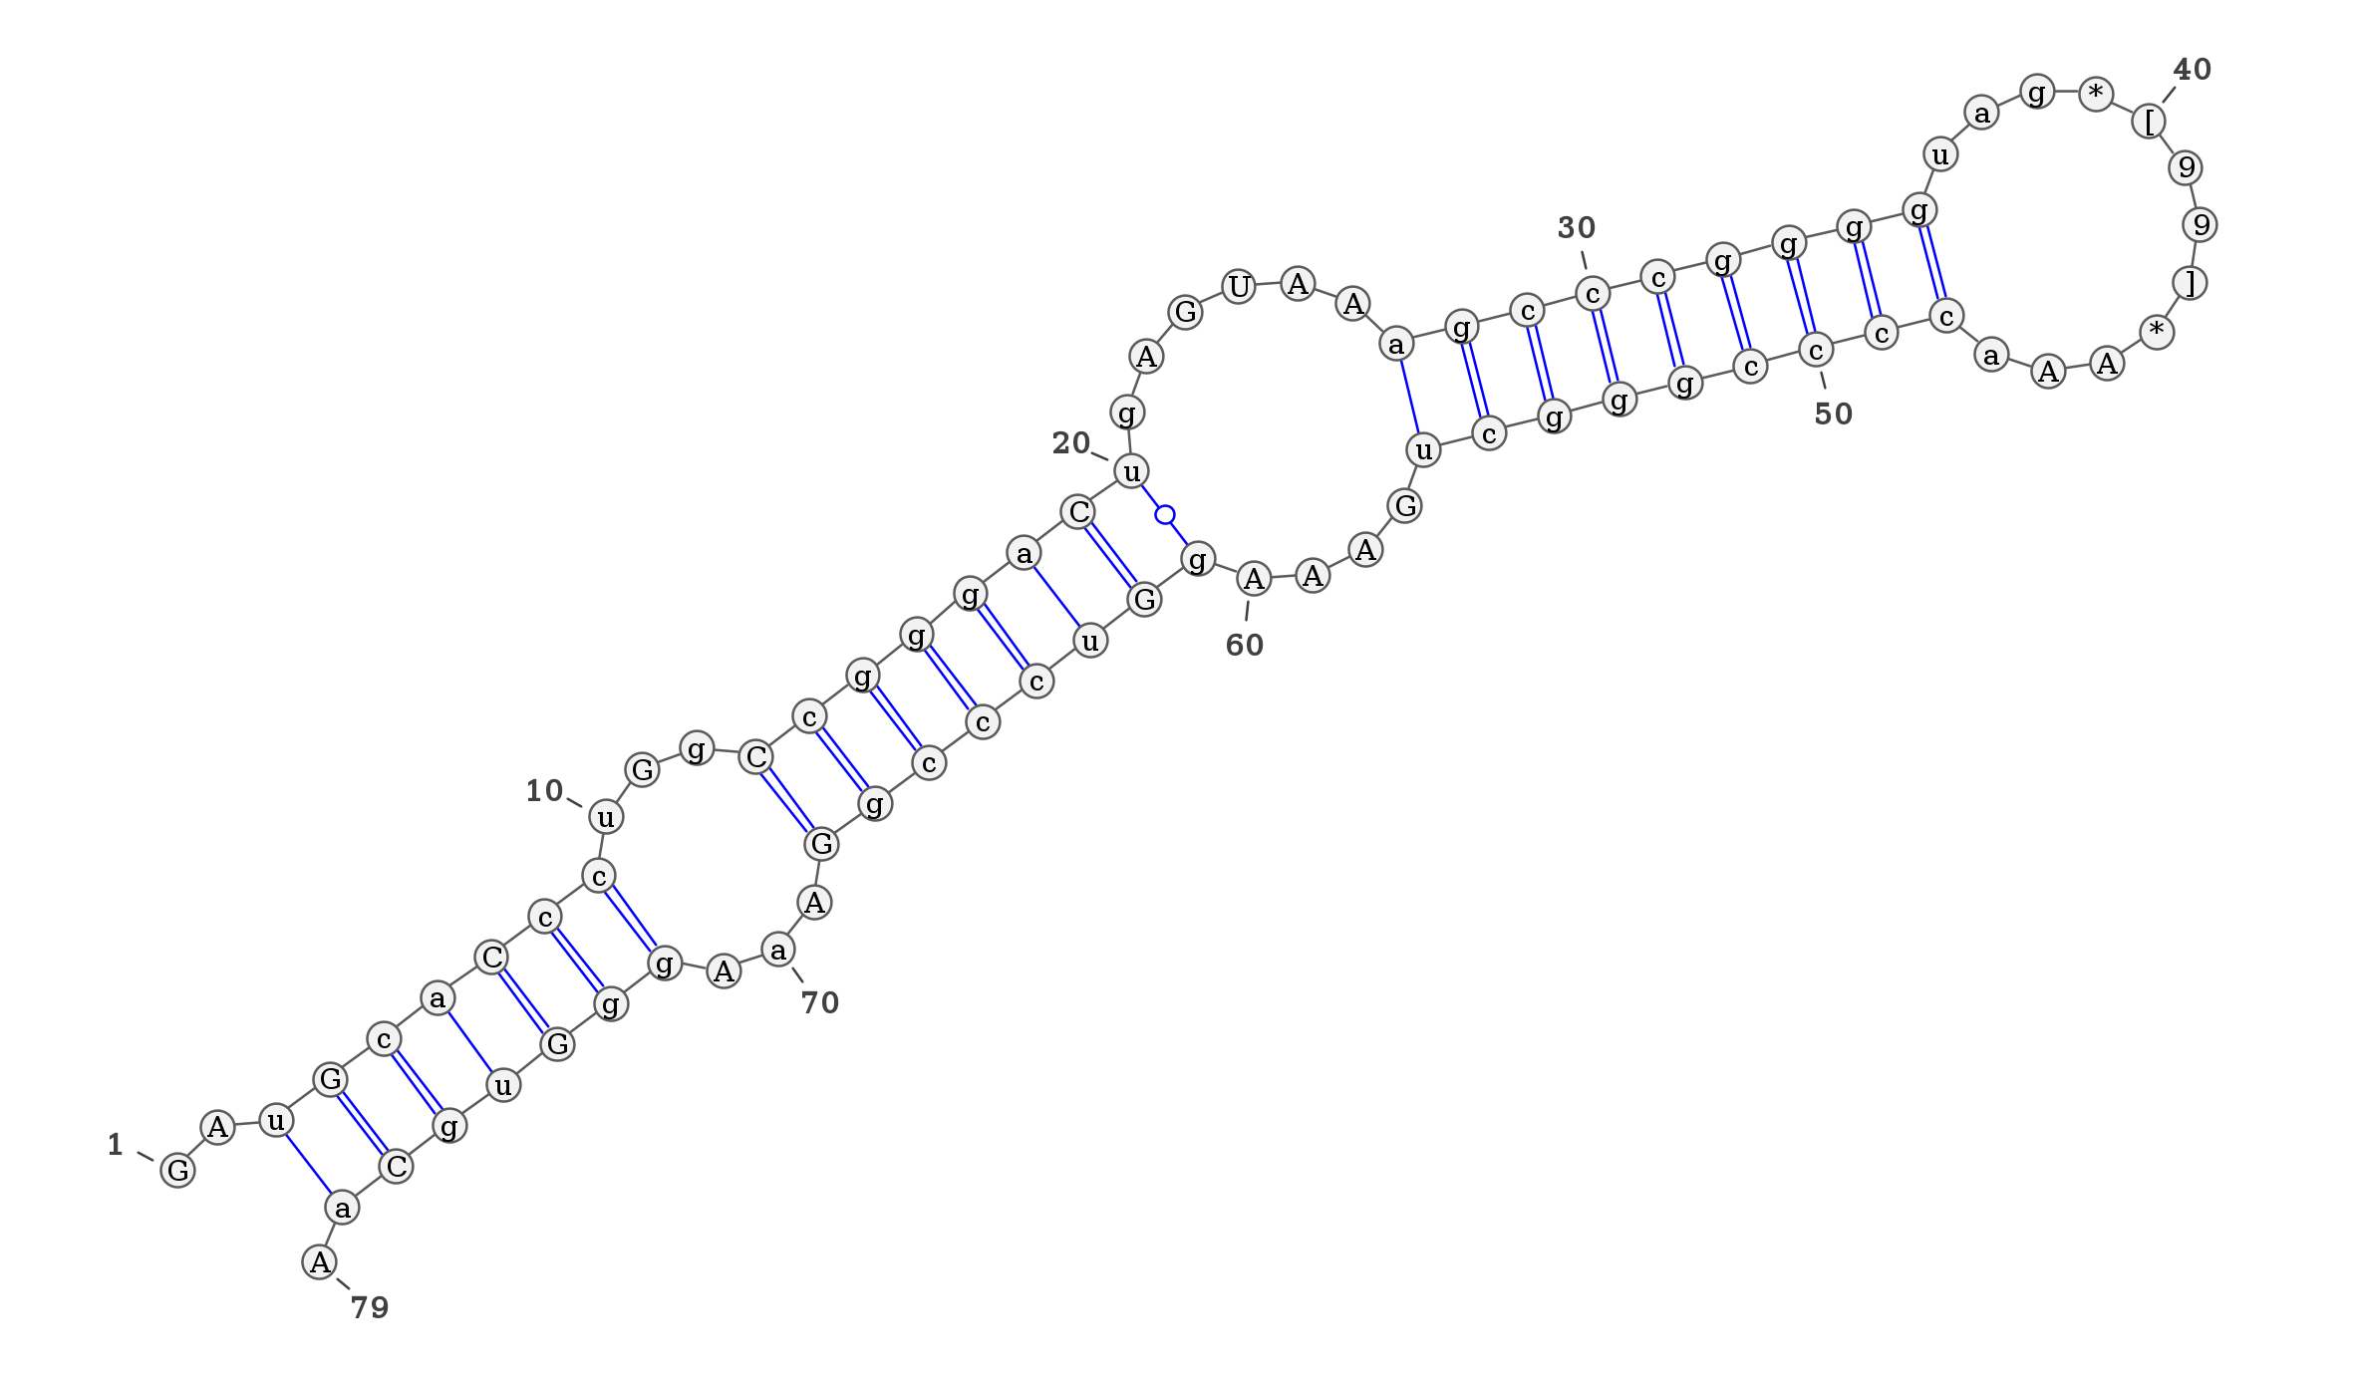

Probing Sequence-specific effects
RNA-Seq and RNA Synthesis
Alton Etheridge, Nikita A. Sakhanenko, David J. Galas
Pacific Northwest Research Institute
Seattle, WA
April 2014

Slide 2
Focus on small RNAs
Our focus is on small RNAs because
  This is a major area of interest for us and the NIH exRNA consortium
  There are significant issues with small RNA-seq
Longer RNA present a different set of problems

Slide 3
Sources of bias in RNA-seq Experiments
Sample Acquisition and Handling
RNA isolation and purification
Seq. Library preparation
Our focus is here
Sequence data acquisition
Data analysis

Slide 4
The RNA-seq Bias problem
Recent studies have identified RNA-seq library construction biases as a significant problem.
Up to 100-fold differences in miRNA read levels between different protocols have been reported
Systematically study the library construction bias issue
Goals
  Characterize the biases in detail
  Understand the source of biases, and
  Try to find a correction method
This is an important issue for the reference profiles

Slide 5
References: Bias in RNA-seq Libraries
Hafner M, Renwick N, Brown M, Mihailovic A, Holoch D, Lin C, Pena JT, Nusbaum JD, Morozov P, Ludwig J et al. 2011. RNA-ligase-dependent biases in miRNA representation in deep-sequenced small RNA cDNA libraries. RNA 17: 1697-1712.
Huang X, Yuan T, Tschannen M, Sun Z, Jacob H, Du M, Liang M, Dittmar RL, Liu Y, Liang M et al. 2013. Characterization of human plasma-derived exosomal RNAs by deep sequencing. BMC genomics 14: 319.
Jayaprakash AD, Jabado O, Brown BD, Sachidanandam R. 2011. Identification and remediation of biases in the activity of RNA ligases in small-RNA deep sequencing. Nucleic acids research 39: e141.
Leshkowitz D, Horn-Saban S, Parmet Y, Feldmesser E. 2013. Differences in microRNA detection levels are technology and sequence dependent. RNA 19: 527-538.
Raabe CA, Tang TH, Brosius J, Rozhdestvensky TS. 2014. Biases in small RNA deep sequencing data. Nucleic acids research 42: 1414-1426.
Sorefan K, Pais H, Hall AE, Kozomara A, Griffiths-Jones S, Moulton V, Dalmay T. 2012. Reducing ligation bias of small RNAs in libraries for next generation sequencing. Silence 3: 4.
Zhang Z, Lee JE, Riemondy K, Anderson EM, Yi R. 2013. High-efficiency RNA cloning enables accurate quantification of miRNA expression by deep sequencing. Genome biology 14: R109.
Zhuang F, Fuchs RT, Sun Z, Zheng Y, Robb GB. 2012. Structural bias in T4 RNA ligase-mediated 3'-adapter ligation. Nucleic acids research 40: e54.

Slide 6
Original hypotheses
The ligation step seems to be the critical one for small RNA bias (based on several studies including Tuschl’s)
If the sequence specificity is based on the ligation bias, the end sequences of the RNA should be most important in determining bias.
Characterizing the bias for specific end sequences might provide a correction factor for each protocol
We need a systematic study of sequence specificity to determine if this is possible
Now we know that using the ends is insufficient and won’t work as a correction method as we expected

Slide 7
Systematic Approach to Bias
Ribo-oligonucleotide Libraries with degenerate bases
A range of synthetic RNA populations with fixed and degenerate bases have been made and sequenced. These include:
  Synthetic 23 mers with random bases on each end and a fixed core sequence (with several different cores)
  Synthetic RNAs with internal degenerate bases
We examined several RNA-seq library protocols
  Included Illumina True-seq, NEB, BioO and a home-brewed protocol
In the course of this work we discovered:
  How to assess the synthesis bias and
  How to separate out the sequence-specific library bias
  Some information and hypotheses about the nature of sequence-specific library bias

Slide 8
Scheme for Small RNA Library Bias Assessment
Synthesize random-end RNA oligo library
4-mer 15-bases 4-mer
NNNN Core NNNN
Ligate on Adapters
Lib. protocols
5’ NNNN Core NNNN 3’
RT, amplify and Sequence
Reads
Analyze data and assess bias for each oligonucleotide

Slide 9
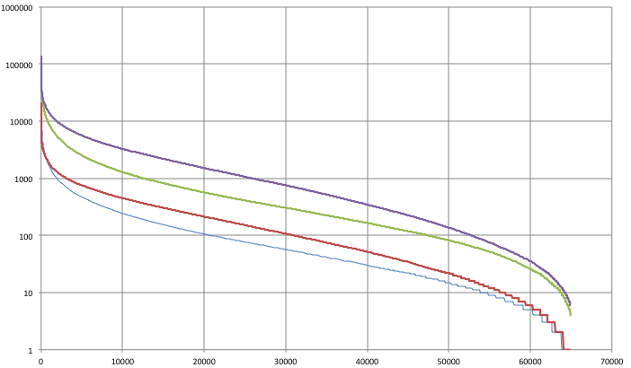
Wide range of read numbers over the ~65,000 Oligonucleotides
L1 core, Protocols: TS 15, TS 8, NEB 15, NEB 8 (all fixed end, different PCR cycle numbers)
What part of this is sequence bias?
Number of Reads
NEB 15
> 4 orders
of magnitude
NEB 8
TS 8
TS 15
TS = Illumina True seq protocol
NEB = New England Biolab protocol
Number = number of PCR cycles
Oligo Number ordered by Number of Reads

Slide 10
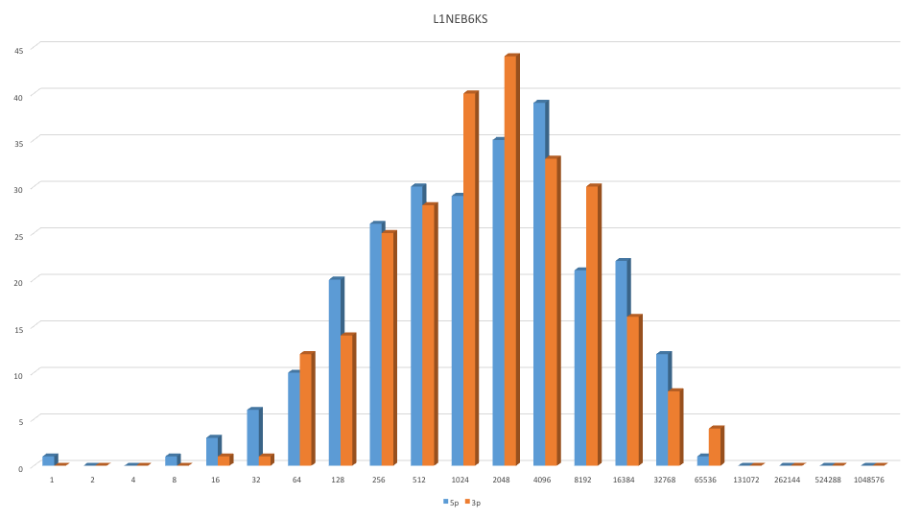
Distribution of read numbers for each end (TS protocol)
(approximately log normal)
Number of oligos with read numbers in interval
5’ 3’

Slide 11
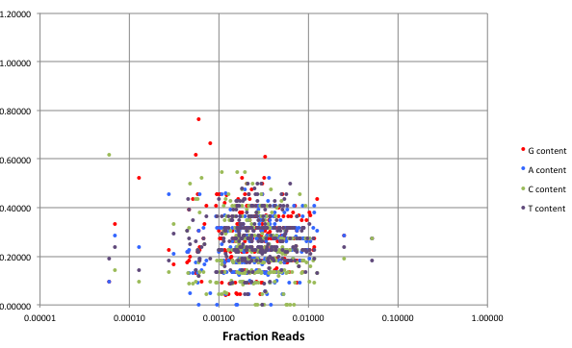
Fixed sequences have no synthesis bias (288 synthetic miRNAs)
Base content of miRNAs (fractions) vs fraction of reads
25%

Slide 12
Distribution of reads for 288 equimolar miRs (red)
is also roughly log normal (blue)
H protocol

Slide 13
Examples of the RNA populations synthesized
Some Libraries with Degenerate Bases
Base content observed in the degenerate bases
Library | Sequence
L1 | NNNNAUGGCUGACGUACGUNNNN
L2 | NNNNUUCGUGCGAUCUAGGNNNN
L5 | UUGNAUGNCUGNCGUNCGUNACG
L6 | UUGAAUGGCNNNNNUACGUGACG
L7 | NNNNGCUAGCGUUCAGGUCNNNN
L8 | NNNNCAACCAUCGAGCUAANNNN
Library | % A | % C | % G | % T
L1 | 26 | 15 | 34 | 25
L2 | 27 | 15 | 33 | 25
L5 | 20 | 15 | 42 | 23
L6 | 22 | 16 | 39 | 23
L7 | 23 | 18 | 37 | 22
L8 | 23 | 17 | 41 | 19
Avg. | 23.5 | 16.0 | 37.7 | 22.8

Slide 14
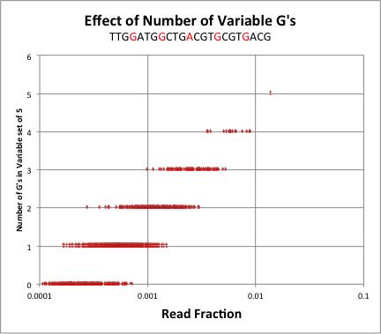
: H
H protocol: 4N adaptors
TTGNATGNCTGNCGTNCGTNACG
(L5)
Read fraction median as a function of number of G’s, n:
f(n) ≅ 0.0003 e ^{0.757 n}

Slide 15
Synthesis bias
In principle variations could be due to any combination of Synthesis and Sequencing bias
Can we distinguish synthesis bias in our experimental libraries?
    If context were not important in synthesis bias, and sequence-specific bias is mostly context, the fractional composition profile of random reads can be predicted from insertion bias
    These hypotheses can be directly tested
    For n degen. bases there are n+1 quantities predicted by a single parameter, so a total of 4(n+1) measured quantities and 4 parameters
    In addition there are 4 other measured quantities the base content of the degenerate bases

Slide 16
: H
AE protocol: 4N adaptors
(L5)
Read fraction median as a function of number of G’s, n:
f(n) ≅ 0.0003 e ^{0.757 n}

Slide 17
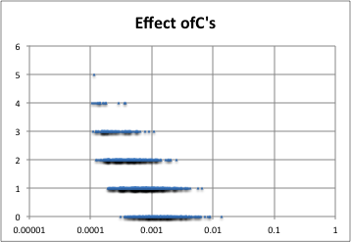
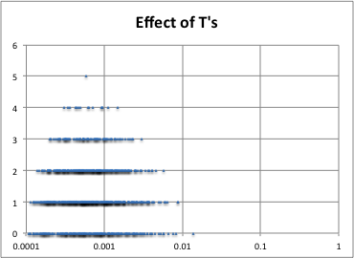
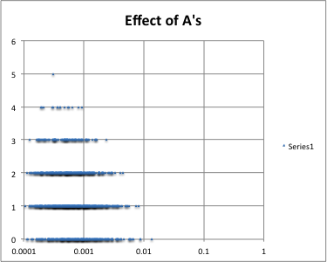
Internal “RANDOM” bases
TTGNATGNCTGNCGTNCGTNACG
C has the opposite effect of G, but
A & T have almost no effect

Slide 18
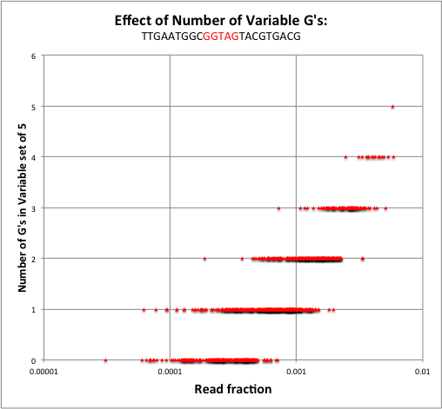
AE protocol: 4N adaptors
(L6)
Read fraction median as a function of number of G’s, n:
f(n) ≅ 0.00027 e ^{0.65 n}

Slide 19
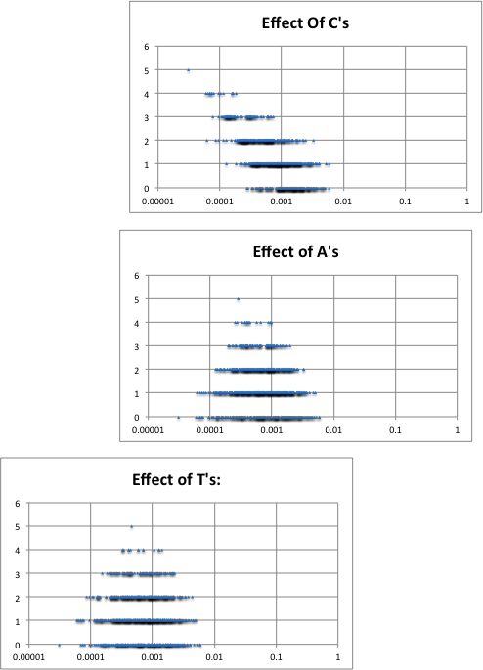
Clustered internal “RANDOM” bases
TTGAATGGCNNNNNTACGTGACG
C has the opposite effect of G, but
A & T have almost no effect

Slide 20
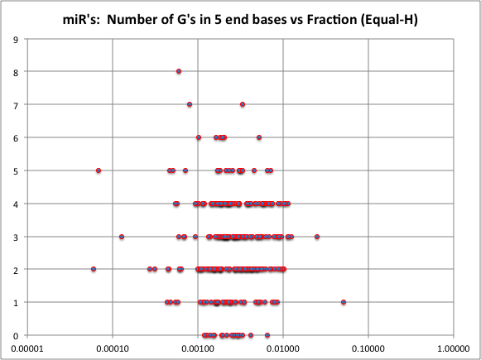
For fixed sequence synthetic oligos (288)

Slide 21
Logic of Sorting out Synthesis Bias
What is the base composition profile of the sequence reads? These are measured quantities
Can we explain the observed profile with a single parameter?
YES (assume position independence ➔ tight fit to model)
Thus, conclude there is no overall context effect in synthesis. What is this parameter? It is equal to the overall base composition of the observed reads (tight fit)
Additional evidence:
No composition bias is seen for fixed sequence synthetic miR’s
There are different parameters for different syntheses – difference are greater than SD measured
If there is no selection of reads from the synthetic population based on composition then
base composition of reads equals base composition of input population. This implies that the base composition is equal to the synthetic base insertion frequency – our parameter
We then infer that: the composition of the synthetic RNA population from the read measurements
Conclude: Sequence specificity is caused by the order of bases among the specific composition groups of oligos

Slide 22
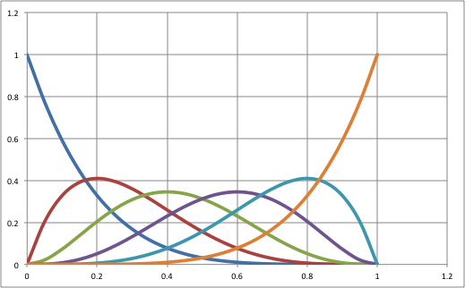
Probability of G composition in Synthesis
5 degenerate bases 6 measured quantities
equal
n=0
n=5
Fraction of Sequences Expected ( 5 bases)
n=2
n=3
n=1
n=4
p (Probability of G insertion)

Slide 23
Measured quantities
For L5 there are 6 quantities measured for G (or any other base) composition.
If we assume the independent insertion frequency model there is then one parameter to fit these 6 quantities
All these equations must be satisfied simultaneously
This is a highly constrained system [f(G=n) is the fraction of all oligos with n G’s in the degenerate bases]
f(G=0)=(1-p)⁵
f(G=1)=5p(1-p)⁴
f(G=2)=10p²(1-p)³
f(G=3)=10p³(1-p)²
f(G=4)=5p⁴(1-p)
f(G=5)=p⁵
In addition, the measured quantity, which is the fractional base content of the degenerate bases, f(G) should be equal to p

Slide 24
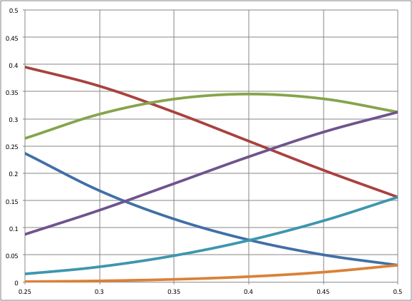
L5: Comparison with Data: G
TTGNATGNCTGNCGTNCGTNACG
n=1
n=2
n=3
n=0
Probability of G Composition in 5 bases
n=4
n=5
p (Probability of G insertion)
Data is explained by an insertion rate of G’s of ~ 0.42,
and f(G), the fraction of degenerate bases that are G, = ~0.42

Slide 25
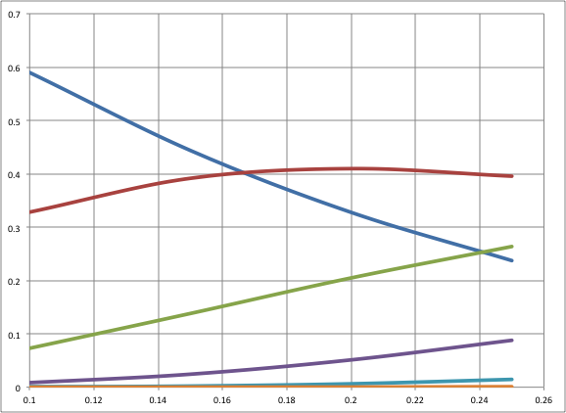
L5: Comparison with Data: C
n=0
n=1
Probability of G Composition in 5 bases
n=2
n=3
n=4
n=5
p (Probability of C insertion)
Data is explained by an insertion rate of C’s of 0.15, and f(G)=0.15

Slide 26
Comparison with Data: T
n=0
n=1
Probability of G Composition in 5 bases
n=2
n=3
n=4
n=5
p (Probability of T insertion)
Data is explained by an insertion rate of C’s of 0.236

Slide 27
L6: Comparison with Data: G
TTGAATGGCGGTAGTACGTGACG
n=1
n=2
n=3
n=0
Probability of G Composition in 5 bases
n=4
n=5
p (Probability of G insertion)
Data is explained by an insertion rate of G’s of ~ 0.40 (0.39 to 0.43),
and f(G)=0.4

Slide 28
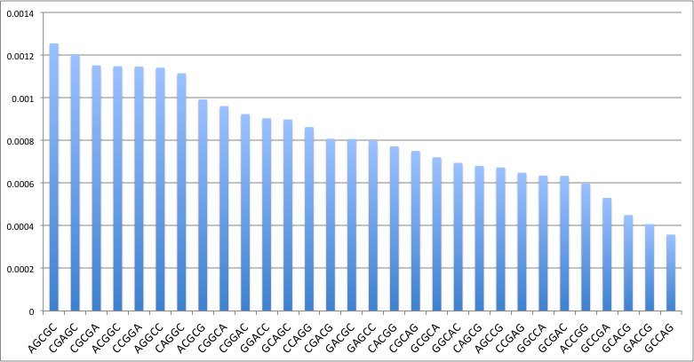
Fractions of Reads for Identical Composition 2210: L5-H
[Composition code: 2210 = 2G’s, 2C’s, 1 A and no T’s]

Slide 29
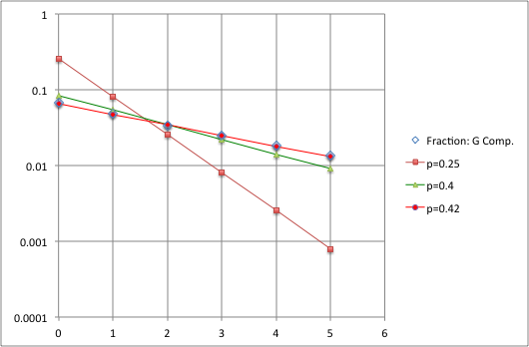
L5-H: Fraction of reads for oligos with specific number of G’s
divided by the number such oligos
(independent of position)
f(G=n)=B(5,n)p^{n}(1-p)^{5-n}
B(5,n) = binomial coefficient
G Composition measured

Slide 30
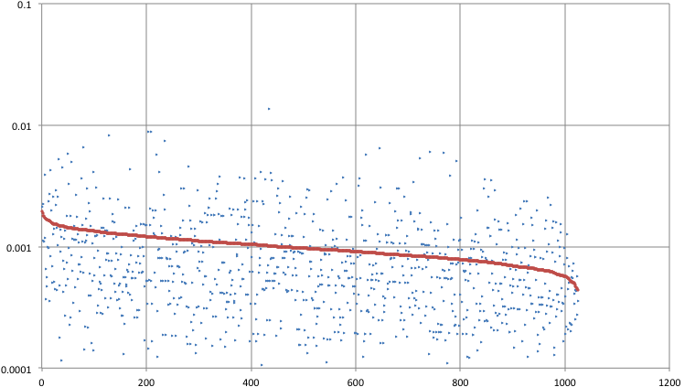
Read Fractions of L5 oligos corrected for composition synthesis
Ordered by corrected fractions (red), uncorrected in blue

Slide 31
Conclusion: Synthesis bias
The fraction of reads of all oligos with specific numbers of bases fits a single parameter model
A single insertion probability, largely independent of position, explains all fractions
Either:
  The specific insertion of each of the bases in synthesis is responsible, or
  the sequence-specific bias is affected by bases numbers in a fashion independent of position in the oligo (degenerate bases) – unlikely!

Slide 32
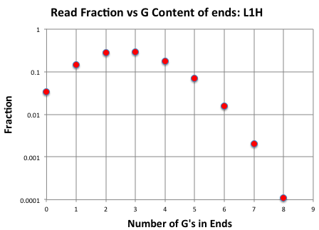

Data from L1-H Library: 8 degenerate bases
(sum of read fractions vs G content: 9measured quantities)
NNNN-------L1---------NNNN

Slide 33
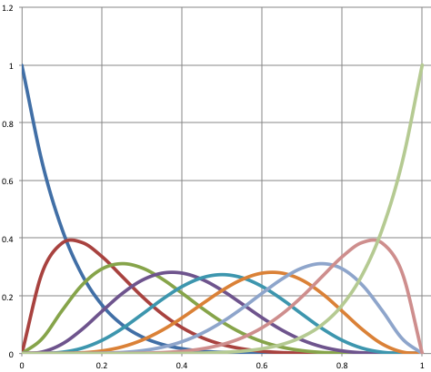
Probability of G composition in Synthesis
equal
n=0
n=8
Fraction of Sequences Expected ( 8 bases)
n=1
n=2
n=5
n=6
n=7
n=3
n=4
p (Probability of G insertion)

Slide 34
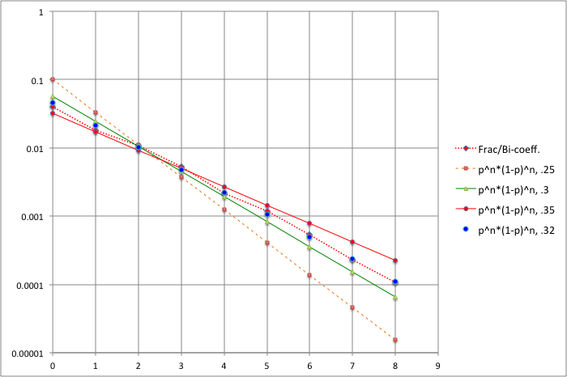
Multiple Fractions G content data: 3’ 8N—L1 (H protocol)
Single parameter fit G data (blue dots), independent insertion model
Data
G insertion,
p = 0.32
(best fit)
Equal probabilities
Number of G’s

Slide 35
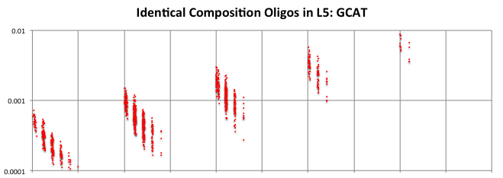
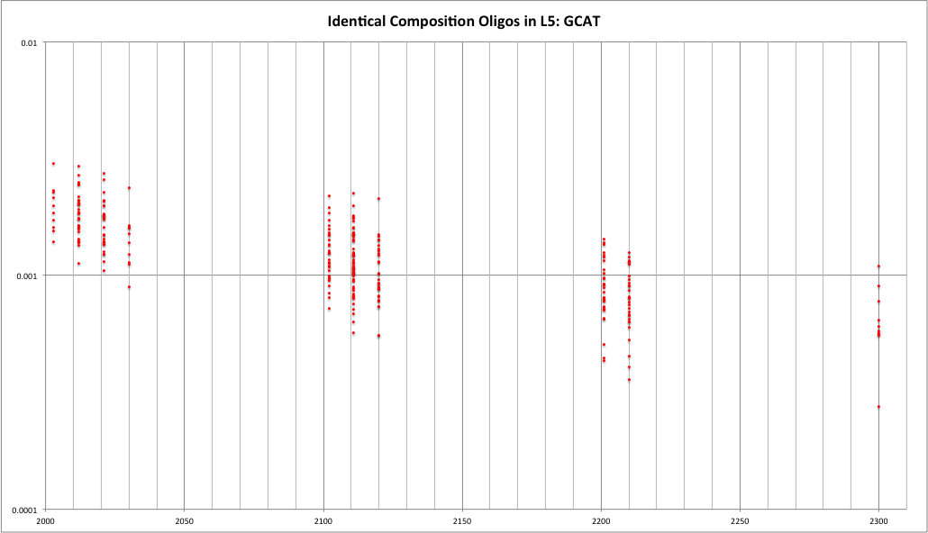
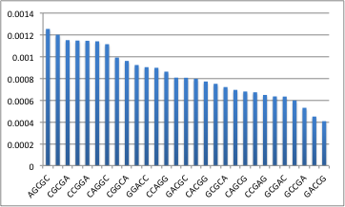
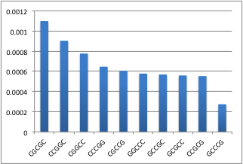
3 G’s
2 G’s
1 G
4 G’s
0 G’s
2 G’s
2 G’s, 3 C’s
2210: 3-fold range

Slide 36
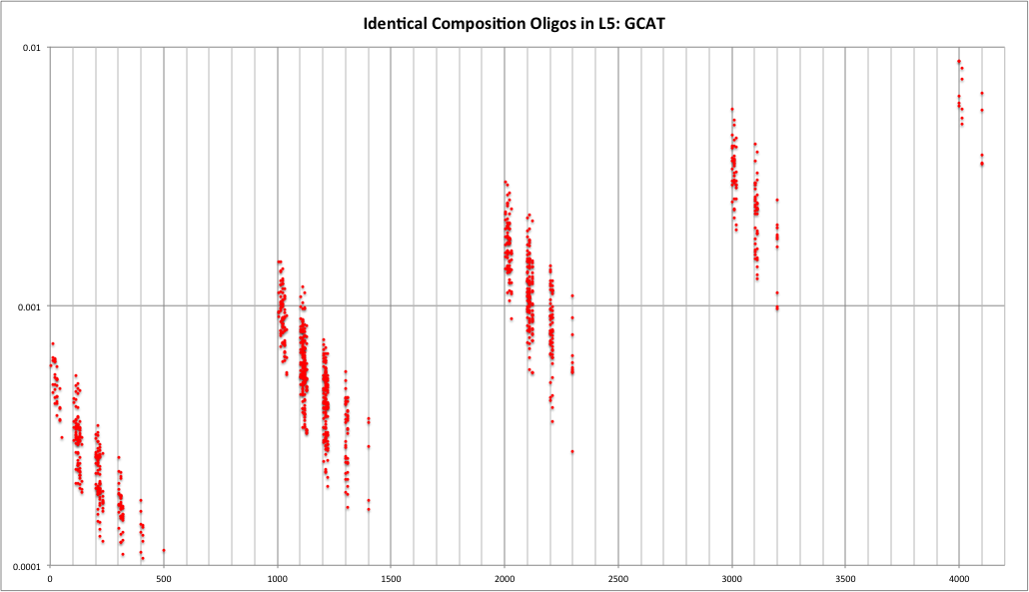
0 G’s 1 G 2 G 3 G
C
0 1 2 3 4
C
0 1 2 3 4
C
0 1 2 3 4
C
0 1 2 3 4

Slide 37
Summary
We can quantitatively characterize large synthetic RNA-populations to a high degree
  single base synthesis insertion frequencies account for the levels of composition seen in RNA-seq.
Large synthetic RNA populations are powerful tools for dissecting sequence-specific bias. In short,
  Sequence-specific variation levels are protocol-specific
  Sequence-specific effects are order-specific
  They range from <10 fold to >100 fold
New computational approaches probing sequence features that are the sources of bias detect some patterns.
A work in progress!

