Slide 1
Presented by: Baikang Pei
JClub, Gerstein Lab
08/12/2015

Slide 2
Why Bother to Present It
Everyone knows multiple hypothesis testing, and may implement some multiple testing
But
What are the state-of-the-art multiple hypothesis testing approaches?
Any Intuition behind multiple hypothesis testing methods?
There are some confusion about multiple testing, at least for me…

Slide 3
Some Confusions (I have)
After calling a set of significant results with multiple testing, can I “zoom-in” to a subset of the results?
Is it legitimate to reduce number of multiple tests to get more power, i.e., to reject more hypotheses?
Following the above question, it looks like whether a hypothesis is rejected or not depends on the number of tests. For example, a hypothesis may be not rejected originally, but becomes rejected after reducing number of tests. How to take that?

Slide 4
Outline
Background
Hypothesis testing
Type I and Type II error
Multiple testing
Error rate vs. false discover rate (FDR)
Assumptions of multiple tests
Three classes of multiple tests
FWER control
FDR control
FDP estimate and confidence interval

Slide 5
Hypothesis Testing
Objective:
Test a hypothesis of a population
Idea:
Roughly speaking, it is proof by contradiction. Assume a hypothesis is true about the population, then get a sample from the population, check whether the sample data exhibits something ridiculous (i.e., significant). If so, reject the hypothesis.
Steps:
Formulate null and alternative hypothesis;
Identify a sample statistic that can be assessed under null;
Compute p-value of the sample statistic;
Decide whether p-value is significant enough by comparing it to a critical value (α). Rejects null if p-value is less than α.

Slide 6
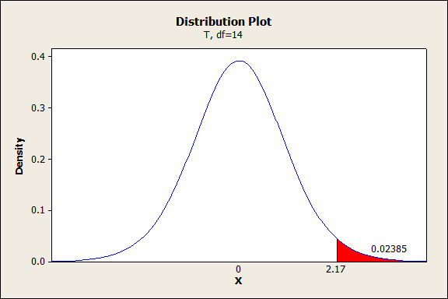
An Example of Hypothesis Testing: one sample t-test
Example: given a set of numbers and test the mean. One sample t-test
Steps:
H₀: μ = 100; H_{a}: μ > 100
T = ... = 2.17
P-value = 0.02385 (the probability that a sample statistic is at least as significant as the observed sample)
P-value = 0.02385 < 0.05. Significant
Something important to note:
1. There are assumptions associated with hypothesis testing
2. Conventionally, people want to control type I error, but care less about Type II error.

Slide 7
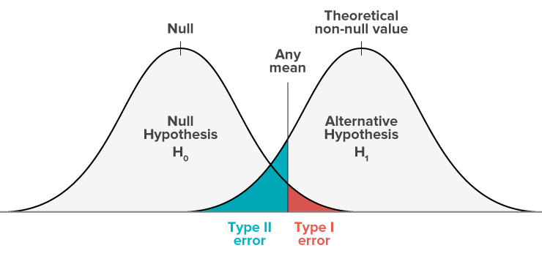
Type I & Type II Error
There is a trade-off between type I and type II error
Conventionally, people want to control type I error, but care less of Type II error.

Slide 8
What is Multiple Testing and Why it matters
Multiple testing: to test a set of hypotheses at the same time
Problem with Naïve approach, which to test each hypothesis individually Flood of Type I error.
Needed: to control, or at least to quantify the type I error that arise when multiple hypothesis tests are performed simultaneously

Slide 9
Error Rate vs. False Discovery Rate (FDR)
To generalize the control of type I error rate in multiple testing:
Approach 1: PWER. Probability of at least one false positive called.
i..e, control Pr(V>0)
Approach 2: FDR. Within positive call set, what portion is false positive
i.e., control E(V/R)
Approach 3: FDP estimate and confidence
i.e., estimate V/R

Slide 10
Outline
Background
Hypothesis testing
Type I and Type II error
Multiple testing
Error rate vs. false discover rate (FDR)
Assumptions of multiple tests
Three classes of multiple test
FWER control
FDR control
FDP estimate and confidence interval

Slide 11
Assumption of Multiple Testing
To carry out multiple hypothesis testing, there are assumptions on the dependence structure of p-values from all the tests.
Three choices on assumptions
No Assumption
- that means methods need to work for the “worst case”
scenario, which are quite conservative
PDS Assumption: positive dependence through stochastic ordering
- methods based on PDS are quite robust to genomics problems
Permutation
- Data permutation to adapt to p-values dependencies
- Null invariant assumption: no change of joint distribution of the
p-values corresponding to true hypotheses

Slide 12
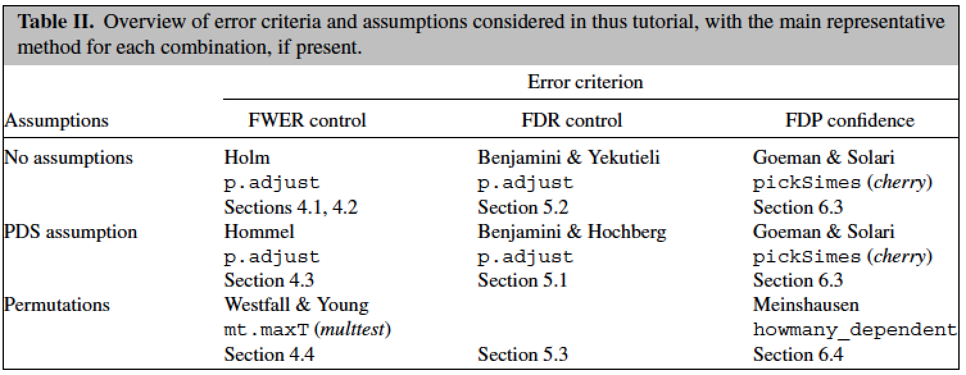
Assumption of Multiple Testing

Slide 13
Outline
Background
Hypothesis testing
Type I and Type II error
Multiple testing
Error rate vs. false discover rate (FDR)
Assumptions of multiple tests
Three classes of multiple test
FWER control
FDR control
FDP estimate and confidence interval

Slide 14
Recurring Notation
m: all hypotheses with p-values p₁, p₂, …, p_{m}
Ranked p-values p₍₁₎, p₍₂₎, …, p_{(m)}
m₀: number of true hypotheses, i.e., hypothesis should not be rejected)
R: total rejects
V: false rejects, i.e., hypothesis from m₀ but gets rejected. False positive

Slide 15
FWER: Bonferroni
How it works:
Set critical value to α/m, where α is the critical value for a single
test, and m is total number of tests
Underlying rationale
Conservative b/c equal sign only holds as events are disjoint
Conservative if many false hypotheses exist

Slide 16
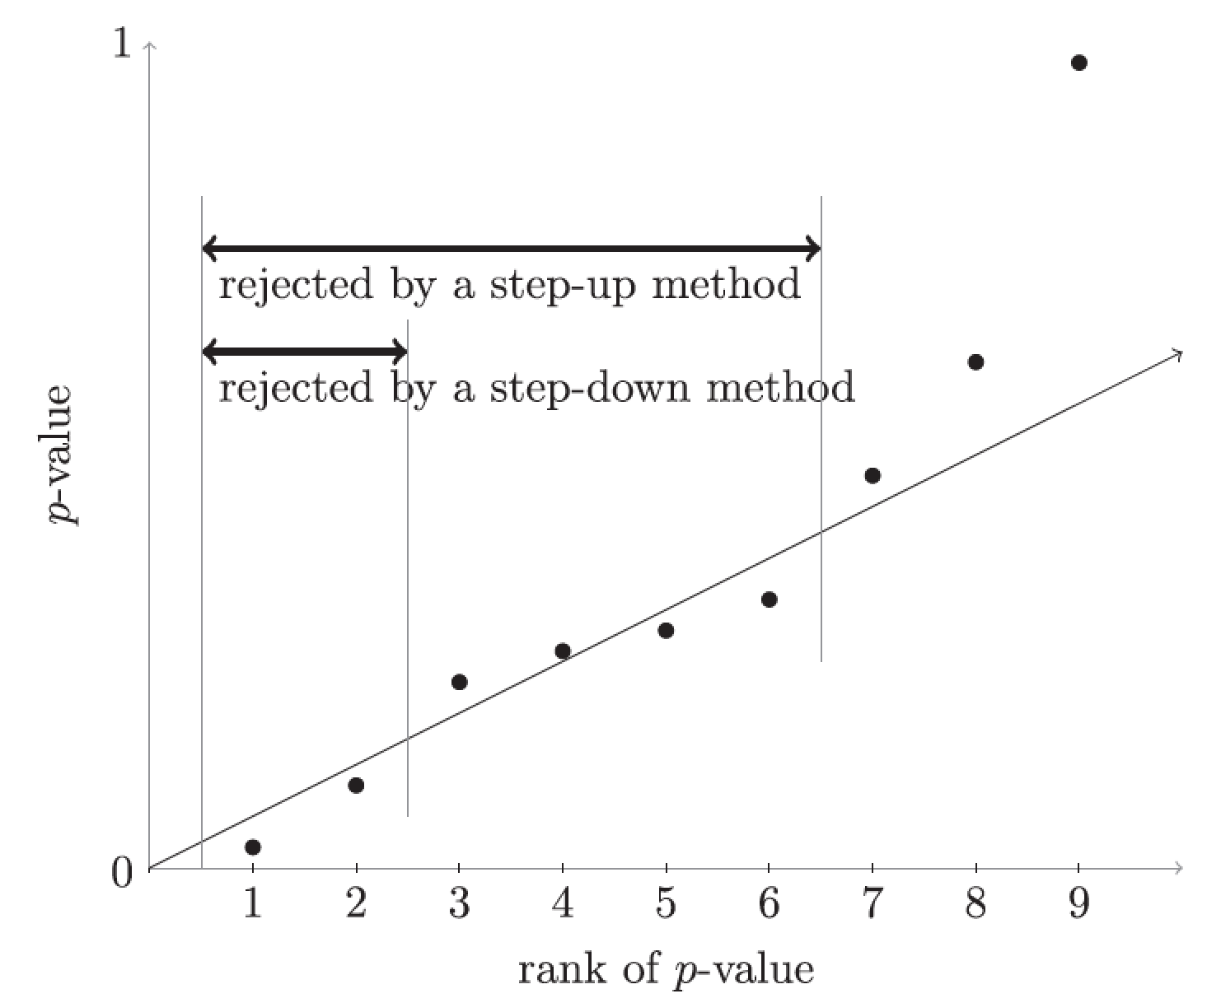
FWER: Holm and Hochberg
Holm: similar as Bonferroni, makes no assumption.
- Improves over Bonferroni to
reach α, instead of m₀/m*α.
- Always use Holm instead of Bonferroni, but may have no difference in practice.
Hochberg
Holm
Hochberg: needs PDS assumption.
- Step up approach.
- More powerful than Holm.
R implementation: p.adjust
Critical values: α/m, α/(m-1), α/(m-2), etc.

Slide 17
FWER: Permutation Approach – Westfall & Young’s maxT method
 | Perm 1 | … | Perm k
g₁ | p₁₁ |  | p_{1k}
g₂ | p₂₁ |  | p_{2k}
g₃ | p₃₁ |  | p_{3k}
g₄ | p₄₁ |  | p_{4k}
g₅ | p₅₁ |  | p_{5k}
…
g_{n} | p_{n1} |  | p_{nk}
 | Perm 1 | … | Perm k
g₁ | p₁₁ |  | p_{1k}
g₂ | p₂₁ |  | p_{2k}
g₃ | p₃₁ |  | p_{3k}
g₄ | p₄₁ |  | p_{4k}
g₅ | p₅₁ |  | p_{5k}
…
g_{n} | p_{n1} |  | p_{nk}
Set α-percentile of k lowest p-values as critical value, reject original hypothesis
Repeats. Step down approach
1000 permutation is usually sufficient at α = 0.05.
Typically more powerful than Holm and Hochberg.
Permutation-based testing is always recommended whenever permutation is feasible.
R package multtest implements the maxT procedure.

Slide 18
FWER Comments
Quite conservative indeed, but…
Results are individually reliable, means every subset is very likely to be true results.
Whenever feasible, use more powerful methods like permutation.
However, if can be followed by experimental validation, researchers tend to tolerate some error in results to reduce type II error.

Slide 19
Outline
Background
Hypothesis testing
Type I and Type II error
Multiple testing
Error rate vs. false discover rate (FDR)
Assumptions of multiple tests
Three classes of multiple test
FWER control
FDR control
FDP estimate and confidence interval

Slide 20
FDR: Benjamini & Yekutieli (BY)
No assumption on p-values structure needed.
How it works:
Set critical value to iα/m for corresponding p-value, p_{(i)}
Step-up approach
Critical values:

Slide 21
FDR: Benjamini & Hochberg (BH)
Assumption: PDS
How it works:
Set critical value to iα/m for corresponding p-value, p_{(i)}
Step-up approach
Always more powerful than Hochberg method.
Critical values: α/m, 2α/m, 3α/m, etc.

Slide 22
FDR Comments
FDR control is usually much less conservative than FWER control
FDR control is more suitable for exploratory genomics experiments than FWER control
However…
FDR methods only control the expected value of false discovery proportion, which may vary and be large in the result set
No subsetting property

Slide 23
Outline
Background
Hypothesis testing
Type I and Type II error
Multiple testing
Error rate vs. false discover rate (FDR)
Assumptions of multiple tests
Three classes of multiple test
FWER control
FDR control
FDP estimate and confidence interval

Slide 24
FDR Control vs. FDP Estimate
FDR = E(V/R), which is an average false discovery of all the rejection sets (all R’s).
FDP = V/R, which is the false discovery of a given rejection set R
Whereas FDR control methods identify a rejection set with bounded FRD, the FDP estimate methods reverse the procedure and allow the user to pick any set of hypothesis and compute its false discovery.

Slide 25
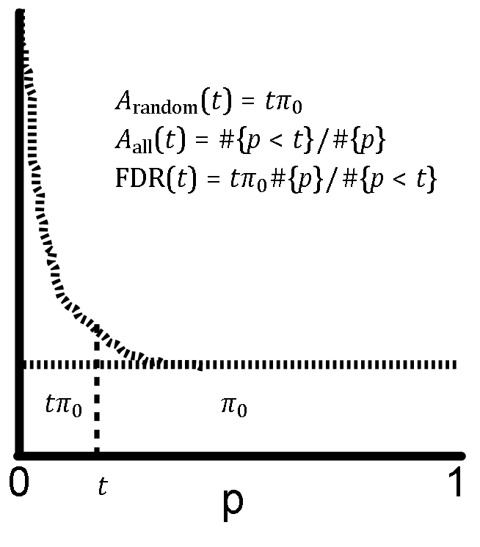
Storey’s q-value
Point estimate of FDP for the collection of the top k hypotheses with best p-values.
To estimate number of true null hypothesis:
Estimate of FDP
True
Positives
Proportion of true null
False
Positives
Critical value

Slide 26
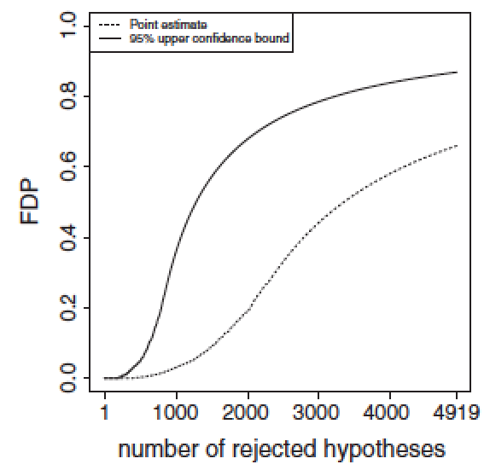
FDP Confidence
Storey’s approach gives a point estimate of FDP, but without variation, a point estimate is of limited value
Goeman and Solari’s approach to compute a FDP confidence interval for any user picked set of hypothesis R: [0, Q(R)_{CI}], where
Pr( Q(R) ≤ Q(R)_{CI} ) ≥ 1 – α
Point estimate by setting α = 0.5
Approach: combine closed testing procedure and the critical values for p_{(i)} from Simes/Hommel inequality
Implementation: R package cherry

Slide 27
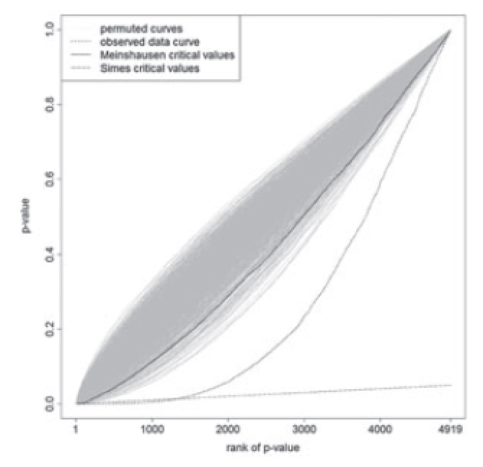
FDP Confidence by Permutation
Similar as Goeman and Solari’s approach, except the critical values for p(i) are from permutation results.
Goeman and Solari’s approach to compute a FDP confidence interval for any user picked set of hypothesis R: [0, Q(R)_{CI}], where
Pr( Q(R) ≤ Q(R)_{CI} ) ≥ 1 – α
Point estimate by setting α = 0.5
Approach: combine closed testing procedure and the Simes/Hommel inequality
Implementation: R package cherry

Slide 28
Reducing the Number of Tests
Remove irrelevant hypotheses
Remove uninteresting tests (for example, unannotated regions)
Remove low power test (for example, tests with few data)
Tests aggregation
For example, aggregate at gene level

Slide 29
Conclusion
There are three different classes of methods for multiple testing correction
FWER control
FDR control
FDP estimate & confidence
Within each class, there are variants of method for different assumptions on p-values structure
FDR methods are usually more powerful than FWER methods
FWER results have the subsetting property, while FDR/FDP results don’t
If followed by experimental validation of whole call set, FDR/FDP methods are perferred
Reduce number of hypothesis by selection and aggregation

Slide 30
Revisit My Confusions
After calling a set of significant results with multiple testing, can I “zoom-in” to a subset of the results?
A: Depends on methods used to call
Is it legitimate to reduce number of multiple tests to get more power, i.e., reject more hypotheses?
A: Theoretically, ok to remove irrelevant/less interesting/low power tests.
Following the above question, it looks like whether a hypothesis is rejected or not depends on the number of tests. For example, a hypothesis may be not rejected originally, but becomes rejected after reducing number of tests. How to take that?
A: Multiple testing is about the whole call set, but not individual gene. So having a gene in or not in doesn’t say much about the gene itself? Mmm… still somehow confused.

Slide 31
Questions?

