Slide 1
Constructing a Mouse Cellular Small RNA Atlas
James Diao | Joel Rozowsky | Gerstein Lab
Summer 2015

Slide 2
Part 1: Background

Slide 3
Small RNAs
These are: highly conserved, non-protein coding RNAs (<200 nt)
Include: miRNAs, siRNAs, piRNAs, tRNAs
Function: regulation of gene expression, cell-cell signaling
Extracellular/Circulating RNA
Clinical applications: biomarkers, diagnostic tools
Main point of interest: deconvolution problem Many sources: heterogeneous samples
Notes:
[ ]
Convolution is when the RNA expressions from different sources get blended together, and it’s hard to recognize patterns. Deconvolution is separating them.

Slide 4
DeconRNASeq
R package: deconvolves heterogeneous RNA-Seq data
Based on a linear model: X = AS, or $x_{jk}=\sum_{i=1}^{N}{a_{ki}s_{ij}}$
X – observed expressions (samples v. RNAs)
A – proportions (samples v. tissues)
S – tissue signatures (tissues v. RNAs)
RNA Expression
Tissues
RNA Expression
Samples
X A S
Samples
Tissues
Ting Gong and Joseph D. Szustakowski. Bioinformatics. Vol. 29, No. 8, 2013. Pages 1083–1085 <http://bioinformatics.oxfordjournals.org/content/29/8/1083.full.pdf>
Notes:
One way of solving the deconvolution problem is with DeconRNASeq, an R package developed by Gong and Szustakowski. It uses non-negative matrix factorization based on this linear model: X=AS. DeconRNASeq takes two inputs: X, the RNA-Seq data, and S, the tissue signature matrix, and with that, it outputs A, the matrix of deconvolved tissue proportions. [ ] x3
So again, X is the input of sequence reads A is the output of tissue proportions S allows you to get A from X.

Slide 5
The Signature Matrix
Project Objective
The signature matrix is like an experimentally determined “constant”
This allows you to solve for the tissue proportions.
S exists for common tissues in humans, but not for mice.
Calculate experimental S for major tissues in mice and quantify its predictive power:
Identify driving small RNAs
Clean S; remove noise
Use DeconRNASeq to identify samples
Notes:
Having S for mice is important because it makes a lot of the model organisms research analyzable. This also allows for study of certain biological areas of interest that are sparse in human data, like the role of small RNAs in development.

Slide 6
Part 2: Collecting Data
Part 1: Background

Slide 7
RNA-Seq Data from the SRA
To calculate S, you need data from representative tissues
This is found on the SRA – sequence read archive
Notes:
Each one of them had RNA sequenced from a specific tissue, like (as shown) the ovaries, or leukocytes.

Slide 8
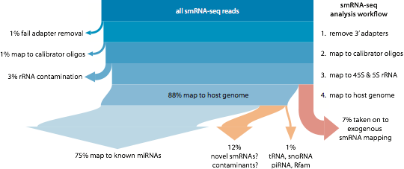
Processing with the ExceRpt Pipeline
Removes adapters; matches to mmu C57B6/L genome
Picture by Dr. Robert Kitchen
Notes:
The pipeline takes the raw data and outputs a list of RNAs present.
This involves removing adapters, rRNA, exogenous RNA, and mapping the rest to the mouse genome.
Since miRNAs constitute the vast majority of reads; 75% to <1% tRNAs and piRNAs, my analysis will mostly be on the miRNAs, but I include a brief look at the others at the end.

Slide 9
Inclusion and Exclusion of Sample Data
All Data
C57BL/6 Strain
Read Count/ Quality
Tissue Representation
(<8 samples)
Perturbed v. Wild-type
604
287
317
134
Perturbed
183
44
56
139
83
Wild-type
Notes:
Out of 604 original data samples: [ ]
1. 317 were from B6 mice. I had to use samples from a single strain because the pipeline needs to be able to map RNA reads to a single genome.
2. Of the 317, 183 were of sufficient read count/quality. [ ]
3. Of these, 139 were from well-represented tissues. [ ]
4. These remaining 139 were partitioned into 83 wild-type mice, and 56 perturbed mice, which were mutated, knockouts, heterozygous, or otherwise experimentally manipulated.

Slide 10
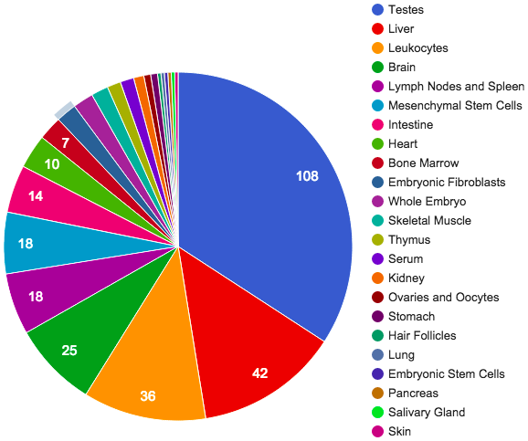
Tissue Proportions in SRA Samples
All C57BL/6 Samples
High-Quality, Wild-Type C57BL/6 Samples
Notes:
The pie chart on the left captures the broad diversity of tissue samples that I started with. After taking only high-quality, wild-type samples, and trying to group them as best I could, it looked like the chart on the right.
I ended up taking the 6 biggest categories: Brain, Blood-Associated Organs, Leukocytes, Liver, Heart, and Testes, and the roughly 20% of samples that didn't fall into these groups were excluded.
Testes may be overrepresented because research on piRNA is often on its ability to inhibit transposons from interfering in germ cell formation.

Slide 11
Part 3: Getting the Signature Matrix
Part 1: Background Part 2: Collecting Data

Slide 12
Result:
miRNAs
Samples
Average the miRNAs in the samples for each tissue to get the expression “signature” for that tissue.
Tissues
miRNAs
Notes:
The table you see is the output from the ExceRpt pipeline. The top left corner, at least. There are actually 87 rows and 1,800 columns. This will later be used as the input, X, for deconvolution.
To calculate the signature, you essentially split this matrix by tissue and average the expressions for each miRNA in that tissue.
Once you do that, you get the following result:
[ ]
6 columns for 6 tissues, and 1,800 rows, for that many miRNAs.
This is the signature matrix. We're hoping that the signatures are very different between tissues. While the columns are visibly different, we're not actually guaranteed that these differences are significant, or even representative of the individual samples.

Slide 13
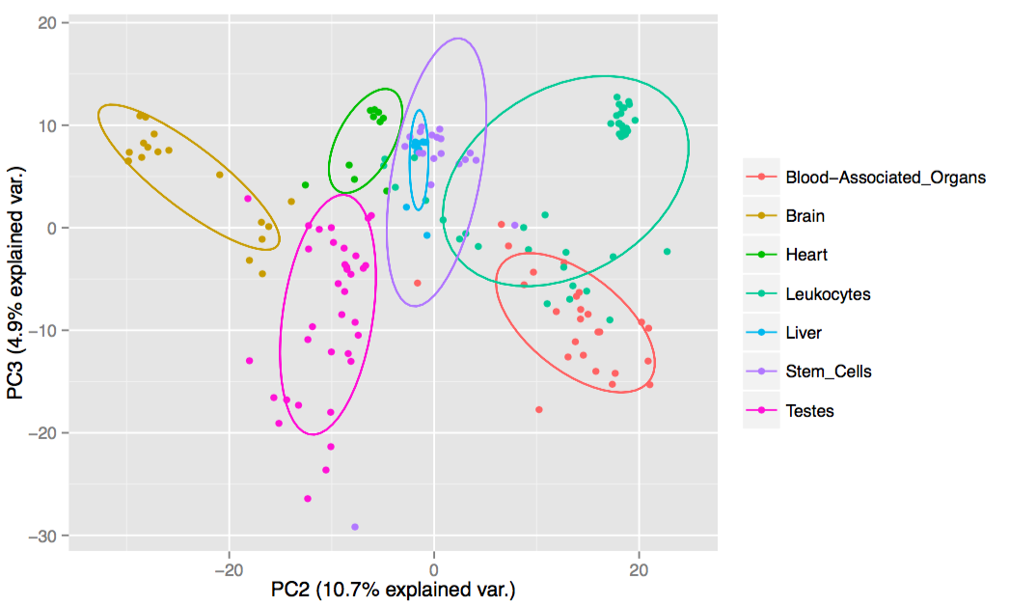
Principle Component Analysis
Notes:
The Principle Component Analysis, however, seems to suggest that the tissue signatures ARE distinct.
In PCA, each point is a sample read, and its location captures information about expression levels across all 1,800 miRNAs in that sample.
I plotted them against the 2nd and 3rd PCs, since PC1 tended to have everything stretched way thin.
It's clear that the different groups tend to be within the same general areas. Brain is in the top left, Testes are to the bottom, and so on.
We also see significant overlap, and liver didn't separate out at all, but it's important to keep in mind that this is just taking a slice of the full picture, which actually has 1,800 dimensions. It's likely that looking down other PCs would help it separate things out even better.

Slide 14
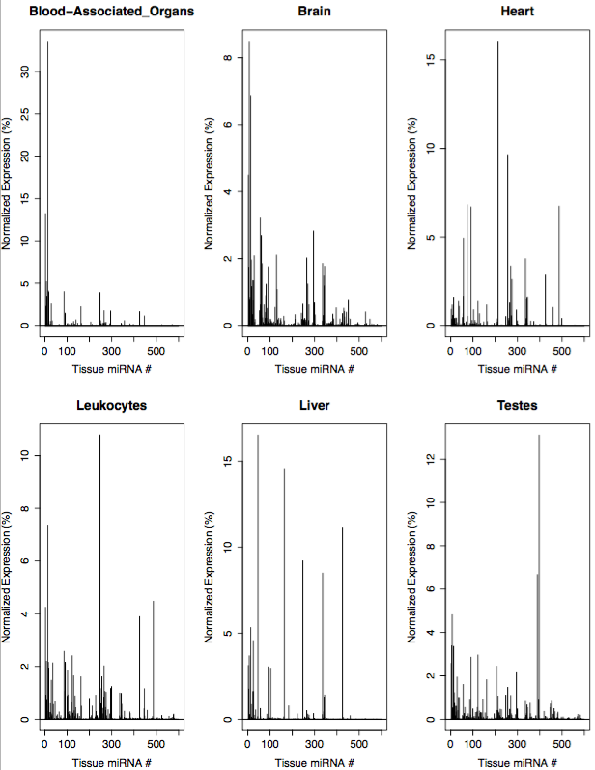
miRNA Signature Matrix Plot by Tissue
Notes:
This is visual view of S, where it’s been partitioned by tissue and plotted.
The x-axes have all the different miRNAs, and the y-axes shows how highly expressed they are.
In other words, each plot is its own column of the matrix.
We can already see some possible patterns.
The highly distinctive spikes are likely the most important parts of the matrix, containing the most information.
The very low ones are more likely to be noise.
How do we separate the two?

Slide 15
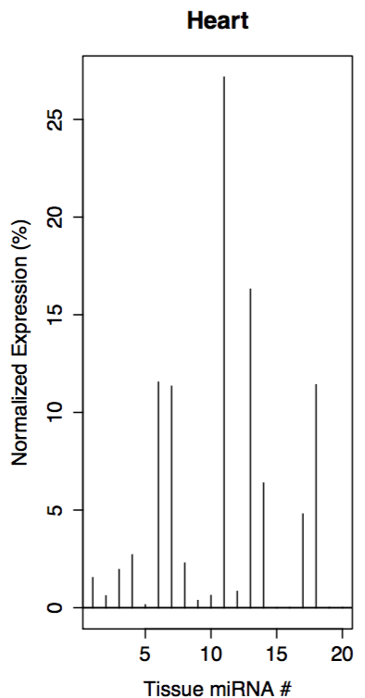
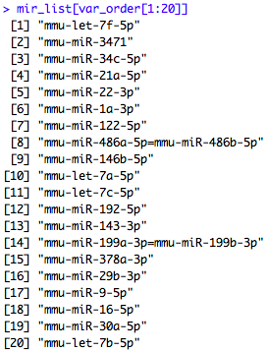
Top-20-Variance-Reduced S
Notes:
One way to clean up the signature is by variance. I took the 20 miRNAs with the highest variance; these are the ones most likely to capture the differences between tissues. Notice that the signature matrix still contains some useless information, i.e. the little stubs.

Slide 16
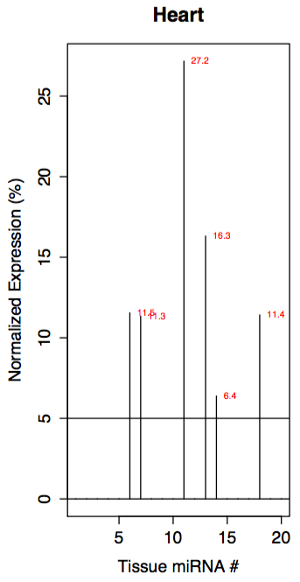
Top-20-Variance/5%-Proportion-Reduced S
Notes:
To get rid of the stubs, we draw a line at 5%, and round everything below it down to zero.
The 5% cutoff is not actually arbitrary. It’s the highest cutoff point that preserves all 20 miRNAs.
The choice of 20 miRNAs is also not arbitrary, but I’ll explain that later.

Slide 17
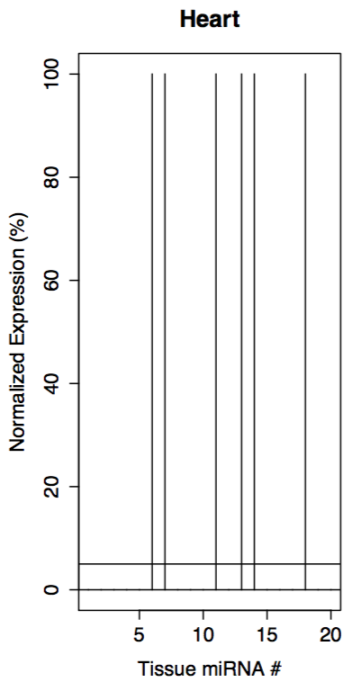
Binary Reduced S
Notes:
Another consideration is whether you can simplify it even further, by just looking at whether expression is over the 5% threshold. Here, all non-0 values are replaced with 1’s.

Slide 18
miRNA Signature Matrix: Full v. Reduced
Notes:
We can do a comparison. The top table is the first bit of the old signature matrix, and the bottom table is the first bit of the new reduced matrix.
[ ]
As you can see, only the miRNAs judged to be important are left in the matrix. Since there aren't very many of them, the S matrix is now actually mostly 0’s. We can condense it by omitting the not-very-important miRNAs – the rows with only 0’s.

Slide 19
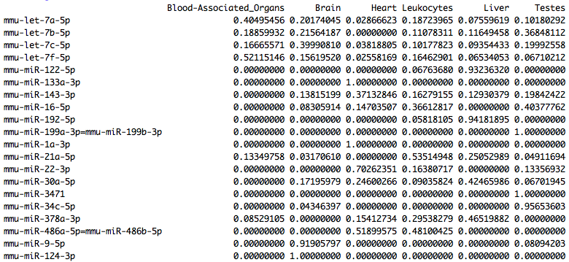
Condensed S matrix
Notes:
Here, we’re only looking at the 20 relevant miRNAs. We're actually going to change up our analysis. Before, we were looking at what miRNAs are present in each tissue. Now, we'll examine what tissues each miRNA tends to come from.
To reflect this, I set the cutoff to 1% instead of 5%, and also normalized it by miRNA instead of by tissue.
[ ]
There are miRNAs that are (at least in my given data set) unique to a certain tissue, which I've marked in red. There are also miRNAs that are highly distinct, and almost always found in 1 tissue (>90%). I've marked these in blue.
[ ]
Lastly, there are miRNAs that are mostly found in 1 tissue (>50%) but may also be found in others.

Slide 20
Condensed S: miRNA Table
 | miRNA | Tissue | Expression
Unique: *Expression > 99% | mmu-miR-1a-3p | Heart | 100%
 | mmu-miR-133a-3p | Heart | 100%
 | mmu-miR-124-3p | Brain | 100%
 | mmu-miR-3471 | Testes | 100%
 | mmu-miR-199a/b-3p | Testes | 100%
Distinctive: *Expression > 90% | mmu-miR-34c-5p | Testes | 96%
 | mmu-miR-192-5p | Liver | 94%
 | mmu-miR-122-5p | Liver | 93%
 | mmu-miR-9-5p | Brain | 92%
Majority: *Expression > 50% | mmu-miR-22-3p | Heart | 70%
 | mmu-miR-21a-5p | Leukocytes | 54%
 | mmu-let-7f-5p | Blood-Associated Organs | 52%
 | mmu-miR-486a/b-5p | Heart, (Leukocytes) | 52% (48%)
Other: *Expression >25% | mmu-miR-378a-3p | Liver, Leukocytes | 42%, 30%
 | mmu-miR-30a-5p | Liver | 42%
 | mmu-let-7a-5p | Blood-Associated Organs | 40%
 | mmu-let-7c-5p | Brain | 40%
 | mmu-miR-16-5p | Testes, Leukocytes | 40%, 37%
 | mmu-let-7b-5p | Testes | 37%
 | mmu-miR-143-3p | Heart | 37%
Notes:
Here’s a slightly easier-to-interpret, tabulated version.
If you see the miRNA in the first or second row --say you see mmu-miR-1a-3p-- you can be pretty confident that the sample is heart tissue.
But just as a caveat, the converse is not true; not all heart tissue will necessarily have this miRNA.
For the rest, each miRNA gives you confidence that your sample really is a certain type.
Once you look at the expression levels for all of these RNAs in a sample, you should be able to take a guess at what tissue the sample comes from.

Slide 21
Part 4: Dependent Tissue Identification
Part 1: Background Part 2: Collecting Data Part 3: Getting the Signature Matrix
Notes:
So that's what we're going to do now.
We're going to input the sample data as a parameter in DeconRNASeq, and see if it it can identify those samples with our S matrix.
I call this dependent, because we're testing our signature matrix against the samples used to make it.

Slide 22
Tissue Identification Model
The output of DeconRNASeq is the A matrix: shown below
This assigns each sample a tissue breakdown based on how its miRNAs match the signature matrix S.
If one tissue accounts for at least 50% more than any other tissue, it is considered the dominant tissue.
Tissues
Samples
Notes:
DeconRNASeq was meant to give a breakdown for heterogeneous samples, but maybe we can test it on the homogeneous samples we have. After plugging in our original samples and our signature matrix into DeconRNASeq, we get the following matrix of tissue proportions, called the A matrix.
If DeconRNASeq was perfectly precise, we'd see a lot more zeros. It would be able to take a heart sample and say: 100% of this is coming from the heart. Or maybe 90%+, but you get the idea.
Since it's not that precise, I just took the highest number, but only when it was at least 50% higher than the next highest. Otherwise, if the top 2 were close, I say it was unable to confidently identify the sample. [ ]
In this case, the first two are identified as testes, and the next four are identified as brain.

Slide 23
miRNA Identification Accuracy
 | Predictions | Accuracy | Total Correct
Full S | 92% | 95% | 87%
Top 20 miRNAs S | 95% | 91% | 87%
Binary S | 81% | 88% | 71%
Notes:
So here we can see the three different ways we fiddled with the S matrix earlier, and how good of a predictive model they turned out to be.
The first column shows how many predictions were made, and the second column shows how accurate those predictions were. Multiplying these two gives the percentage of the total that was correctly identified.
It turns out that removing all but 20 of the 1,800 miRNAs doesn't reduce your total accuracy. It's actually able to make more predictions, which is good, but is a little less accurate with them, which is bad, and these cancel out.
The binary signature matrix, where everything was a 1 or 0 depending on whether that miRNA accounted for more than 5% of total expression, was less able to make confident predictions, and also had lower accuracy. But these numbers are actually pretty good when you remember that it's making these guesses based on just 15 bytes of data.

Slide 24
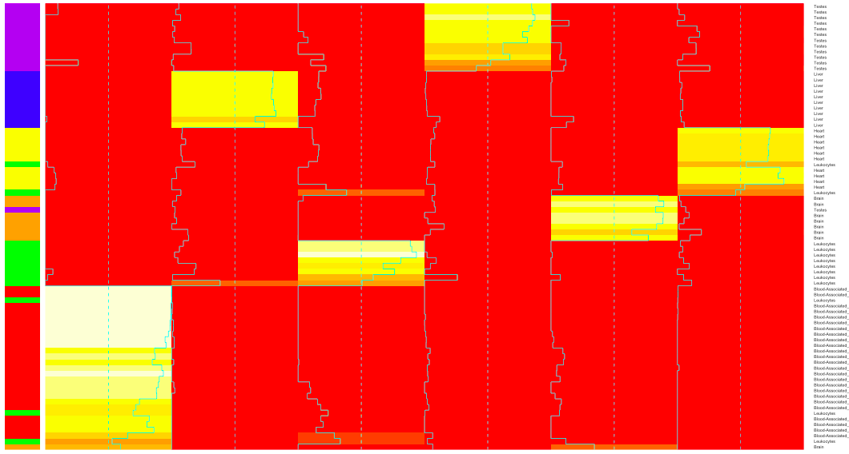
A Matrix: Tissue Proportions
Blood-Associated Leukocytes Brain Heart Liver Testes
Samples
Blood-Associated Liver Leukocytes Testes Brain Heart
Organs
Notes:
Here's the A matrix again, just colorful and organized.
On the left, vertical axis is samples, color-coded by tissue. So the purple ones are testes, the blue ones are liver, and so on.
They light up whenever they match the signature of a certain tissue. White is 100% match, red <30%, yellow is in the middle.
The heat map then groups the things that light up in similar ways; each block represents a different guess group.
You would hope that the blocks tend to match the actual samples, that the colors on the left would also block together, and they do.
There are a number of mistakes, mostly from leukocytes --the green bars-- being confused with other tissues, but it's easy to see that the overall accuracy is very high.

Slide 25
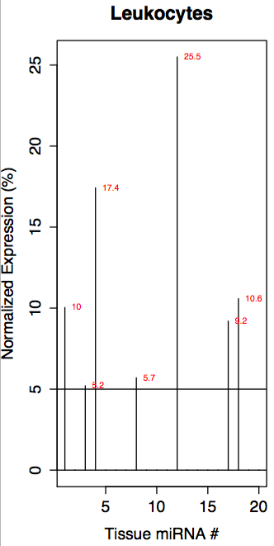
ID Accuracy by Tissue
Category | Correct (%)
Blood-Associated Organs | 100
Liver | 100
Heart | 100
Brain | 88
Testes | 87
Leukocytes | 64
All | 91
Notes:
This table shows how accurate we were able to guess each type of tissue.
The only one that doesn't do so well is leukocytes, which we noticed earlier. It's kind of hard to show in a powerpoint, but I looked at the individual read data, and there was a lot more variation between samples. [ ]
What I saw was that these peaks in the signature are not never present in combination. Instead, some will have THIS peak, others will have THESE peaks, and so on. If your sample only has 1 peak, and it happens to also match the signature for another tissue, you may get a misclassification.
Looking at this breakdown on the left also gives us an idea of what we want in a model. We want a high average accuracy, but also a high lowest tissue accuracy. This gives us two kinds of numbers to maximize when deciding how to reduce S. It becomes an optimization problem, which I’m going to show visually.

Slide 26
How many miRNAs should be considered?
Notes:
The x-axis is the number of high-variance miRNAs to include. The y-axis gives the overall accuracy in red, and the lowest tissue accuracy in blue.
The plot shows that overall accuracy peaks at around 14 miRNAs, but that the leukocytes still do really badly until around 20. So, this is why I ended up going with 20.
The sharp jumps in the plot also seem to suggest that we can identify certain miRNAs that don't matter at all, like 7-11, and others that matter a lot, like #35.
However, adding #35 to our initial 20 didn't have any effect, and removing some of the flat areas did.
This implies that the effects of miRNA information are often synergistic instead of independent, and the increases are not solely attributable to the last one that prompted the increase. It's a team effort.

Slide 27
Proportion of miRNA Expression Read Count
55%
Notes:
We should also consider how many miRNAs reads we need to identify the tissue - not just by how many types.
It's kind of expected that high variance miRNAs would be the ones with the highest read counts because:
First of all, there are a LOT of miRNAs --basically the last 1,200-- which are minimally expressed.
Second, variance is calculated by differences in expression between tissues, and the bigger the biggest one, the bigger the difference.
You see this in the tendency to decrease on the right-hand plot, but also the downward concavity on the left-hand cumulative proportion plot.
[ ]
Specifically, the top 20 variance miRNAs make up almost 55% of the total reads.

Slide 28
Part 5: Independent Tissue Identification (Perturbed)
Part 1: Background Part 2: Collecting Data Part 3: Getting the Signature Matrix
Part 4: Dependent Tissue Identification (Wild-type)
Notes:
So we went on a little tangent to explore the data set, but back to tissue identification.
Earlier, we identified wild-type samples that we used to make our signature matrix.
Now, I want to try identifying samples that were not used to make the matrix. These are the perturbed samples we excluded earlier.

Slide 29
Testing against Independent Experimental Samples
Independent testing is the best way to confirm that the data samples used are representative.
Of the 139 processed samples, 83 were wild-type/control. The other 56 were mutated/KO/experimental/perturbed.
Bias: not from “normal” body tissues
Notes:
The worry is that there's some risk that the wild-type samples are not truly representative, and that the model will perform worse when presented with new samples.
One way to get around this issue is test against independent samples that were not used to create the model. Ideally, I would get new samples from the SRA, but the pipeline is being updated and Grace is being finnicky, so I decided to instead run the 56 samples from the experimental groups that I had excluded earlier.
Since these are not "normal" samples, we expect these predictions to be worse.

Slide 30
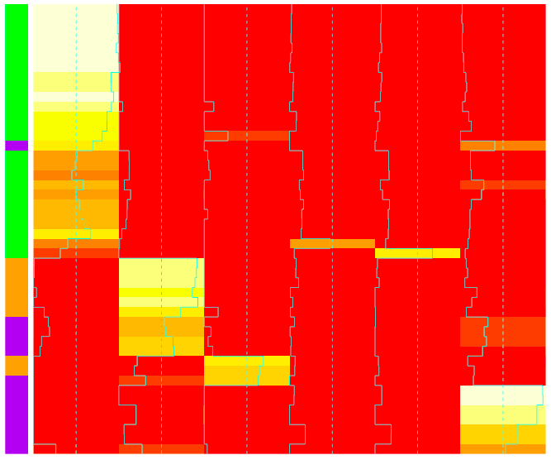
Matrix A: Tissue Identifications of Perturbed Samples
Category | Correct (%)
Brain | 78%
Leukocytes | 96%
Testes | 54%
All | 81%
Prediction | 86%
Testes Brain Leukocytes
Leukocytes Brain Blood-Associated Heart Liver Testes
Organs
Notes:
We use our perturbed samples and our S matrix as parameters for DeconRNASeq, and we get the following output.
This time, leukocytes do surprisingly well. The biggest mixups are highlighted in grey. Some testicular tissue (in purple) is mistakenly clustered with brain tissue, and some brain tissue (in orange) is mistaken for blood-associated.
[ ]
I've tabulated the numbers. 86% of the samples were able to be identified, and 81% of those guesses were right. 81% x 86% gives a 70% overall accuracy. Again, we see that leukocytes do great, brain does okay, and testes do rather poorly.

Slide 31
ID Accuracy of S-matrices with Different Inputs
Notes:
A natural question is whether using the perturbed data to make the signature matrix would improve its accuracy.
The grey bars show the accuracy when DeconRNASeq uses S calculated from just wild-type data, which is what I did earlier.
The yellow bars show the accuracy when S is calculated from all sample data, wild-type AND perturbed.
The two S matrices are used to identify three sets of data, on the x-axis: the wild-type samples (on the left), the perturbed samples (in the middle), and the combined samples (ton the right).
The accuracy difference between bars 1-2 and bars 3-4 shows that the experimental data is clearly different in some way – neither matrix is able to identify them as reliably as they are able to identify wild-type data.
However, the data does show that including the perturbed data to update our tissue signatures does NOT have any significant effect on our ability to make predictions, good or bad. So the perturbed data can't be THAT different.
This plot also gives us a tentative lower and upper bound for the actual accuracy of our original model.
[ ]
Since wild-type, dependent data is a best case scenario and perturbed, independent data is a worst case scenario, our accuracy should generally be between the two, or from 70-87%.

Slide 32
Part 6: Repeat with tRNA & piRNA
Part 1: Background Part 2: Collecting Data Part 3: Getting the Signature Matrix
Part 4: Dependent Tissue Identification (Control)
Part 5: Independent Tissue Identification (Experimental)
Notes:
That concludes the crux of my project, but I'll just quickly run through the results I got with with tRNA and piRNA

Slide 33
Identification Accuracy (tRNAs and piRNAs)
tRNAs
 | Predictions Made | Predictions Correct | Total Correct
Full S | 96% | 80% | 77%
Top 100 tRNAs S | 96% | 82% | 78%
piRNAs
 | Predictions Made | Predictions Correct | Total Correct
Full S | 87% | 82% | 71%
Top 100 piRNAs S | 88% | 77% | 68%
Notes:
Here, we see the accuracy for the full and reduced signature matrices, for tRNAs and piRNAs.
The most obvious point is that there aren’t many driving tRNAs or piRNAs, since we needed at least 100 of the highest-variance ones to make reasonable predictions, as opposed to 20 from before. In the end, it seems okay, but this model is definitely not as robust as the one from miRNA, and the accuracy numbers are a bit lower too.

Slide 34
Follow-up
Apply the atlas to independent normal samples (Problems with Grace; can’t use ExceRpt)
Signatures for more tissues, especially significant tissues studied to model human systems.
Sub-signatures in tissues
Notes:
There are lots of ways to continue developing this small RNA atlas.
1. First, as I said earlier, It would be ideal to test the atlas on independent, wild-type samples, which is the only category I haven't tested yet. This will give us a point estimate of the accuracy, which should be between 70 and 87%. This would involve getting more samples from the SRA- namely, the ones that have been uploaded in the past two months after I did my initial data collection. But first, I need Grace to cooperate.
2. We can also try to calculate signatures for more tissues, like lungs and kidneys, which have greater clinical importance. This would also require more samples, which, again, is a waiting game.
3. In the meantime, I can try to split the general tissue categories into more specific groups, and see if accuracy can be improved that way.

Slide 35
Addition to the ExceRpt Pipeline
Picture by Robert Kitchen
Map to tissue signatures
Notes:
Rob and Joel also tell me that the S matrix I've talked so much about can be appended as a next step in the ExceRpt pipeline.
[ ]
This way, the next time someone sequences small RNAs from B6 mice, they'll get an output saying 80% of this sample is from the heart, 15% is from the liver, and 5% from other sources.

Slide 36
Summary:
In this project, I’ve calculated and refined the tissue signature matrix for small RNAs in B6 mice, and quantified its ability to identify tissue samples.
I’m hoping this can be useful as a tool for researchers to better study small RNA in mouse systems.
These same methods might also be applicable to other deconvolution problems.

Slide 37
Acknowledgements
Joel Rozowsky: Mentor
Rob Kitchen: Direction/Pipeline/Debugging
Mark Gerstein: PI
Jason Liu: Recommending this lab to me; moral support

