Slide 1
YALE-CyTOF2 Single-Cell Analysis Using Inductively Coupled Plasma Mass Spectrometry (ICP-MS) Technology
Figures were obtained from DVS Sciences

Slide 2
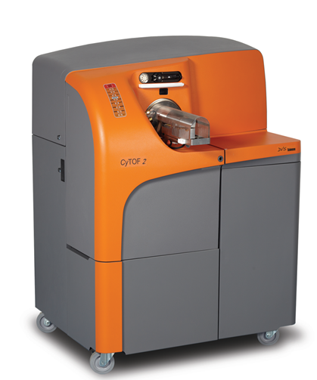
Cytometry Time-of-Flight Mass Spectrometry (CyTOF-MS)
The CyTOF2 mass cytometer analyzes individual cells labeled with stable heavy metal isotopes using Time-of-Flight Inductively Coupled Plasma mass spectrometry (TOF ICPMS) technology.
With over 120 detection channels, the CyTOF2 has the ability to simultaneously resolve multiple elemental probes per cell at high acquisition rates without the need for compensation, thereby maximizing the per-cell information obtained from a single sample.
These attributes provide researchers with an unparalleled ability to generate high resolution phenotypic and functional profiles of cells from normal and diseased states.

Slide 3
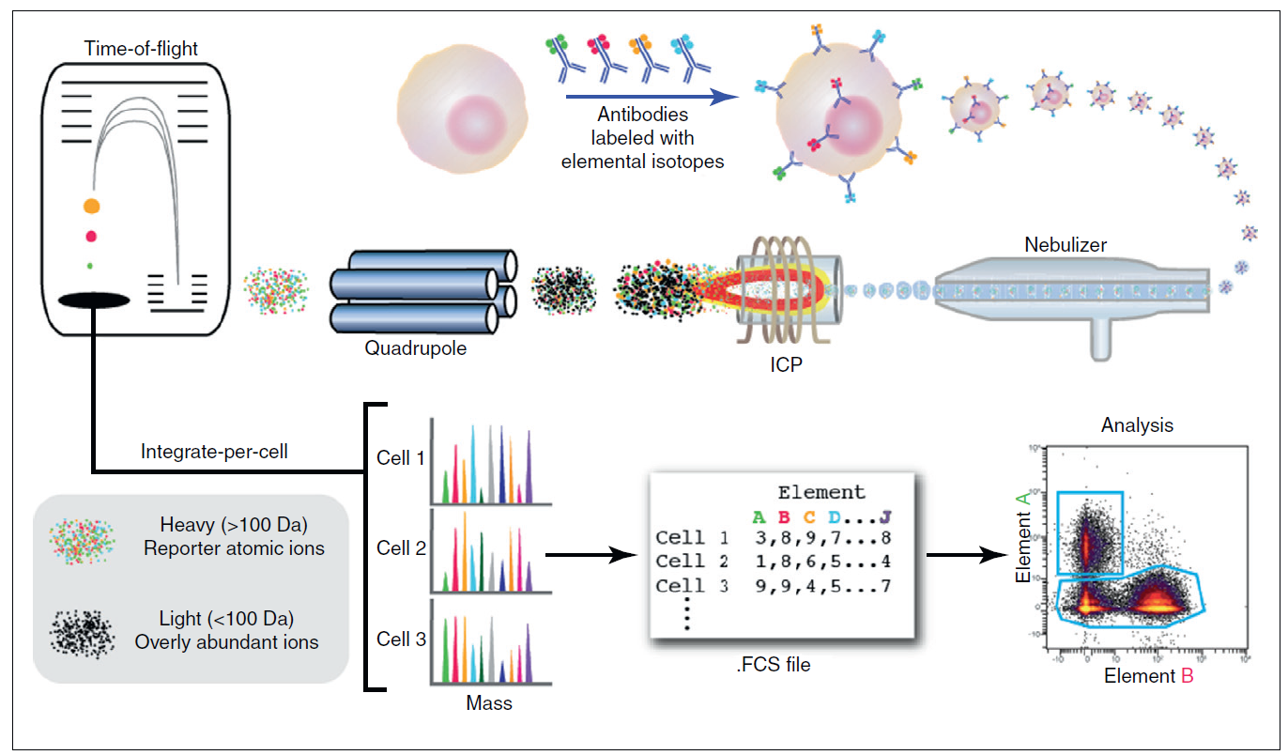
Workflow: ICP-MS-based analysis of cellular markers

Slide 4
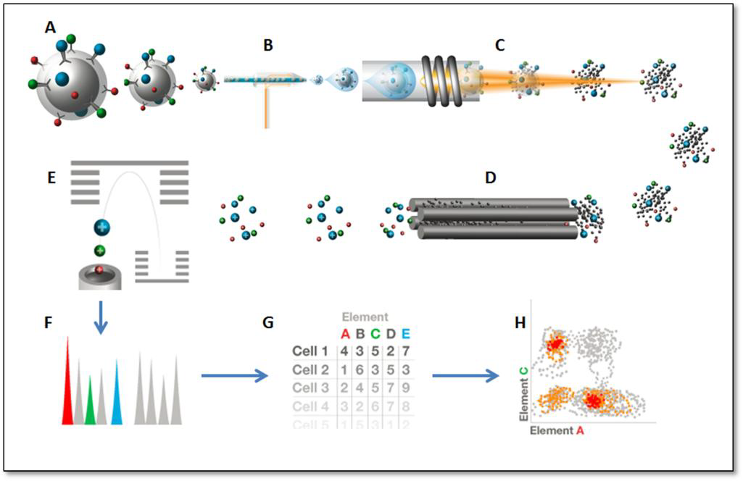
Principles of CyTOF Sample introduction (A), ionization (B&C), mass analysis (D&E), and data acquisition (F-H)
A liquid sample containing cells labeled with heavy metal isotope conjugated probes (A) is introduced into the nebulizer (B) where it is aerosolized. The aerosol droplets are directed into the ICP torch (C) where the cells are vaporized, atomized and ionized. Low mass ions are removed in the RF Quadrupole Ion Guide (D), resulting in a cloud of ions enriched for the probe isotopes. The ion cloud then enters the Time-of-Flight (TOF) chamber (E) where the probes are separated on the basis of their mass to charge ratio as they accelerate towards the detector. The time-resolved detector thus measures a mass spectrum (F) that represents the identity and quantity of each isotopic probe on a per-cell basis. Data is generated in .fcs format (G) and analyzed in Cytobank software programs (H).
After cells stained with metal conjugated probes in a single cell suspension are introduced into the CyTOF2. The cells undergo a multi-step process within the instrument, resulting in generation of a file that records the identity and amount of each probe on each cell

Slide 5
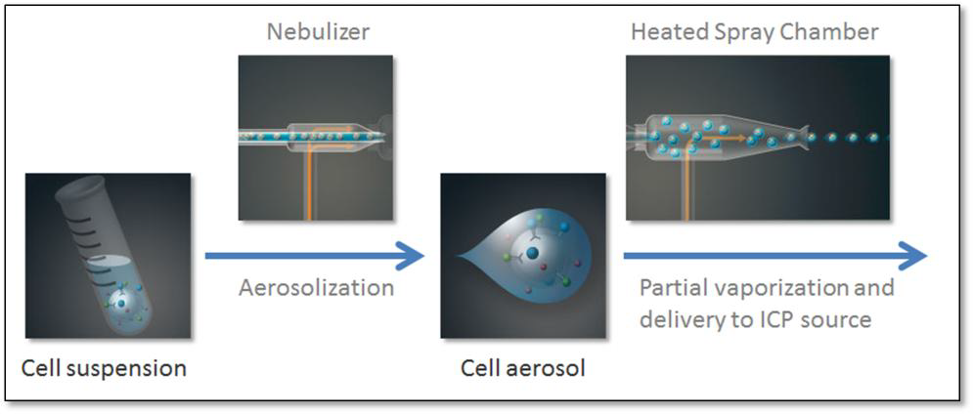
Sample Introduction
The sample introduction system de-solvates the liquid sample suspension and introduces cells one at a time into the ICP source for ionization. The liquid sample is introduced into a nebulizer where it is aerosolized into a heated spray chamber. Within the spray chamber, the high temperature partially vaporizes the aerosol, and gas flows direct the aerosolized cells to the ICP source.

Slide 6
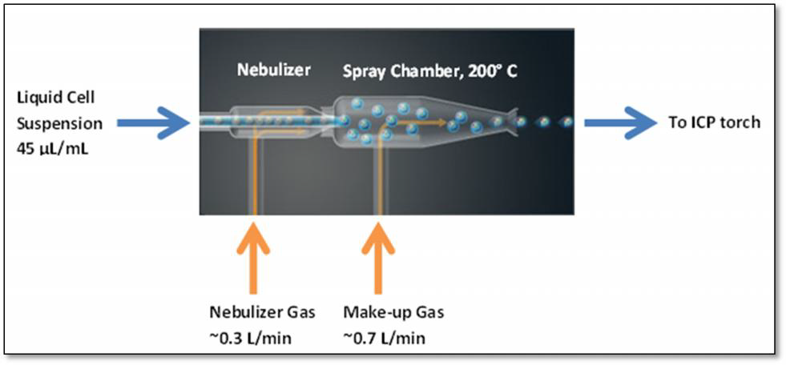
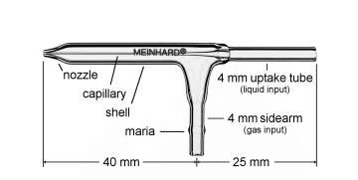
CyTOF-Nebulizer
For liquid sample analysis, it is critical to remove as much water as possible from the sample so that it can be efficiently ionized in the plasma. Liquid cell suspension is aerosolized by nebulizer gas as it exits the nebulizer. Make-up gas carries the aerosol through the heated spray chamber where it is partially de-solvated and delivered to the ICP torch.

Slide 7
Ionization The mixture of single cell aerosol droplets and argon that exits the spray chamber is transmitted to the ICP source where it is vaporized, atomized and ionized in the plasma for subsequent mass analysis
The plasma is created within the plasma torch by induction using a radio-frequency-generated electromagnetic field. The torch consists of the torch body – a fused assembly of two concentric quartz tubes – and a quartz sample injector tube that is inserted inside the torch body. When assembled, the torch consists of three concentric chambers. The outermost chamber (between the torch body tubes) contains argon ‘plasma’ gas flowing at 17 L/min that is ignited to form the plasma. The central chamber (between the inner torch body tube and the sample injector) contains argon ‘auxiliary’ gas flowing at ~1 L/min that is used to change the position of the base of the plasma relative to the sample injector. The innermost chamber inside the sample injector transmits the argon stream and sample aerosol from the spray chamber directly into the center of the plasma. The torch assembly is mounted inside an induction load coil that is supplied with radio-frequency generated current that creates an electromagnetic field.

Slide 8
Formation of the ICP discharge and ionization of the sample
Plasma is formed by collision induced ionization of argon gas within an intense electromagnetic field. First, argon plasma gas flows tangentially from the outer chamber of the torch body. RF power supplied to the load coil produces an oscillating current (40 MHz), creating a strong electromagnetic field precisely at the point the plasma gas exits the outer chamber. A high voltage spark strips away free electrons from the exiting argon atoms. These free electrons accelerate dramatically in the electromagnetic field and collide with sufficient energy to ionize the argon gas into plasma. Temperatures within the plasma typically range from 5,000 to 10,000K. When the aerosolized sample is introduced through the injector into the base of the plasma, the water droplets are rapidly vaporized. The de-solvated individual cells are then broken down into a cloud of ground-state atoms. Subsequent electron collisions result in ionization of the cell. Thus, the argon ionic beam that exits the plasma contains bursts of ionic clouds corresponding to individual cells that were introduced into the torch in aerosol form

Slide 9
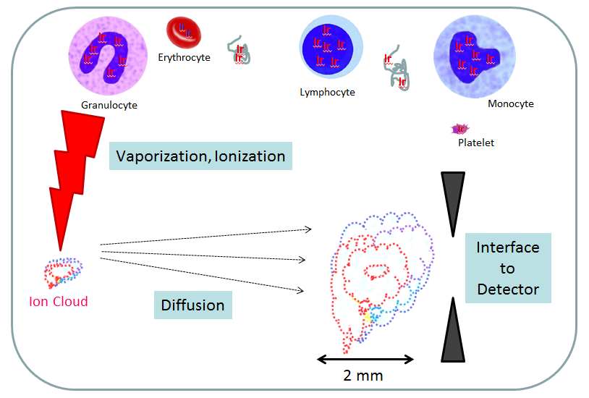
Cell to Ion Cloud

Slide 10
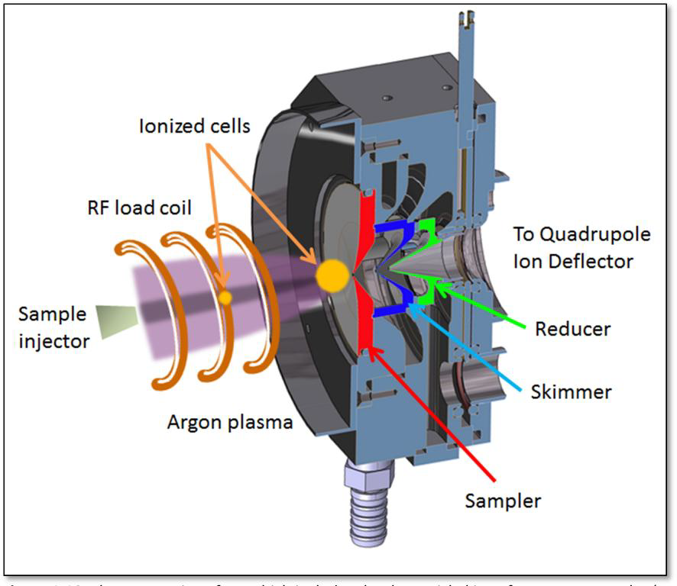
Mass Analysis
The ion beam leaving the torch enters the low pressure ion optical chamber. High mass ions leaving the Quadropole Ion Guide are directed to the Time-of-Flight chamber where they are separated on the basis of mass to charge ratio and directed to the detector.

Slide 11
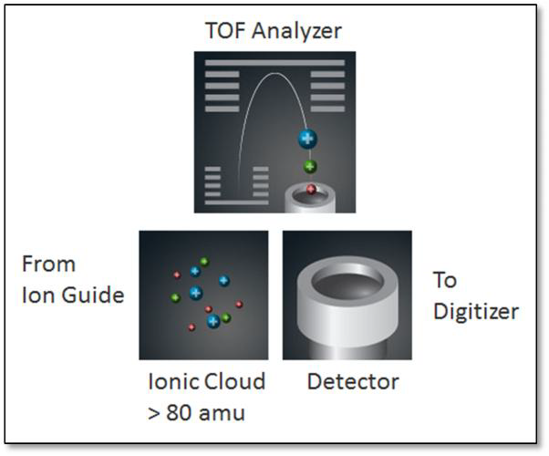
Mass Analysis
The Quadrupole Ion Guide removes unwanted low molecular weight argon and endogenous cellular ions from the beam that emerges from the quadrupole Ion Deflector, transmitting clouds that contain isotopic probe ions (>80 amu) to the TOF analyzer.
Ions pushed into TOF chamber at 13 μsec intervals. Separation of ions in the TOF chamber. Ionic clouds are subjected to an electrostatic force that orthogonally accelerates the incoming ions toward the detector. As a result, the ions separate based on their mass/charge ratio, with lighter elements reaching the detector first.

Slide 12
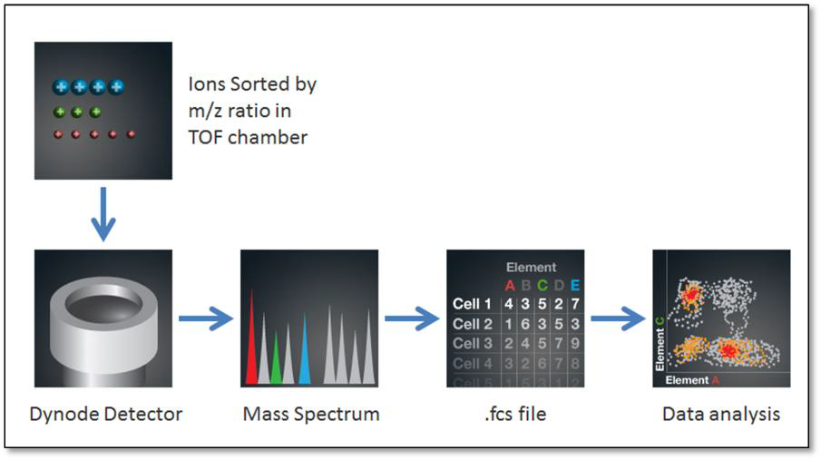
Data Acquisition
After the ions separated in the TOF chamber are detected using a discrete dynode electron multiplier. When an ion strikes the first dynode of the detector, several secondary electrons are liberated. These electrons strike the next dynode where they generate more electrons. This process is repeated at each dynode, resulting in an electron pulse that is captured by the anode of the detector. The output analog signal is amplified and converted to digital values at 1 ns sampling intervals. Instruments are set to collect data from at least 120 mass channels (each corresponding to 1 amu), typically starting at mass 88.

Slide 13
