Slide 1
BrainSpan ChIP-seq results
By Xuming Xu

Slide 2
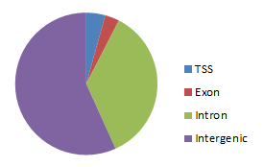
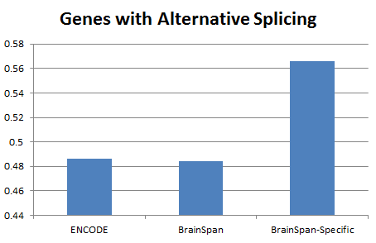
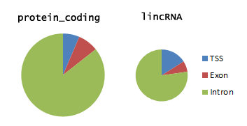
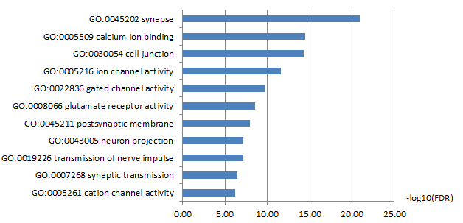
Genes with brain-specific H3K27ac peaks have more alternative splicing
Brain-specific H3K27ac peaks
Brain-specific H3K27ac peaks are enriched in intergenic and Intron
Genes with brain-specific H3K27ac peaks are enriched for synapse function

