Slide 1
Journal Club
08/05/2015

Slide 2
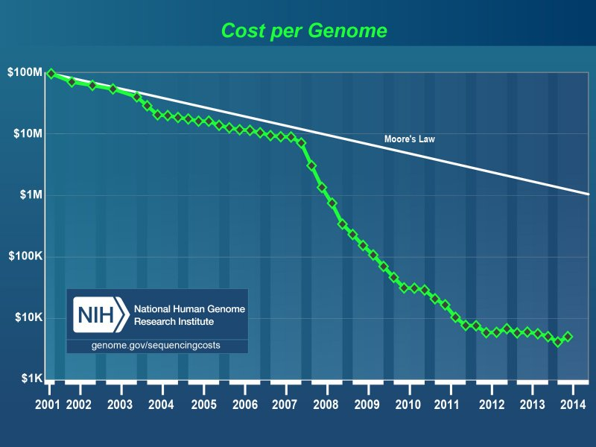
Problem we are facing:
Notes:
The growth rate of genomic data in the past few years outpace the rate predicted by Moore’s law
NGS data obtained by the 1000 Genomes Project in the first 6 months exceeded the sequence data in NCBI Genbank database accumulated in the last 21 years

Slide 3
Problems we are facing:
Genomes
Genomic data: reads, quality scores and metadata
Storage
Retrieval
Transmission
Notes:
Before NGS techniques were introduced, compression algorithms were intended for relatively short sequences with an upper bound of tens of Megabases, and compression of raw sequencing data were typically not required.
More scalable compression algorithms have been introduced to handle much longer genomic sequences as well as large raw sequencing data.
Provide a comprehensive review of the existing compression methods specialized for genomic data

Slide 4
Outline
Traditional Genomic Sequence Compression
Advances in Genomic Sequence Compression
Reference-based compression
Reference-free compression
Experimental Results
Next-Generation Sequencing Data Compression
Challenges and Future Prospects
Notes:
Provide a comprehensive review of the existing compression methods specialized for genomic data

Slide 5
General-purpose compression:
Substitutional / Directory based
Statistical based
Gzip (http://www.gzip.org)
Bzip2 (http://www.bzip.org)
Other
Specialized compression algorithms
Take advantage of repetitive subsequences inherent in genomic sequences to achieve higher compression ratio.
Reference-based VS reference-free
Notes:
Frequently used for efficient text storage and transferring
Depending on whether reference genomic sequences were used to facilitate compression
Compression is achieved by replacing each repetitive subsequence in the target genomic sequence by the corresponding encoded subsequence in the codebook.
highly repetitive subsequences are identified and stored in a codebook or dictionary

Slide 6
General-purpose compression:
Substitutional / Directory based
Statistical based
Gzip (http://www.gzip.org)
Bzip2 (http://www.bzip.org)
Other
Specialized compression algorithms
Take advantage of repetitive subsequences inherent in genomic sequences to achieve higher compression ratio.
Reference-based VS reference-free
Notes:
highly repetitive subsequences are identified and stored in a codebook or dictionary
The performances of different algorithms differ mainly based on how many repetitive subsequences can be identified and how efficiently they can be encoded.

Slide 7
Run-length Encoding
Consider a sequence:
111122233333311112222
It can be encoded as (1, 4), (2,3), (3,6), (1,4), (2,4)
How much compression?
In the worst case encoding is more heavy than original file: 2*integer rather than 1* integer if original data is integer vector/array.
Notes:
Compression is achieved by replacing each repetitive subsequence in the target genomic sequence by the corresponding encoded subsequence in the codebook.
The savings are dependent on the data.

Slide 8
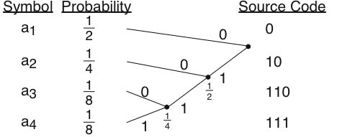
Huffman Coding
Prefix code
Lossless data compression
Common symbols are generally represented using fewer bits than less common symbols
Encode in linear time to the input weights if weights are sorted
Expected length: 1.75
Entropy: 1.75
Notes:
there is no code word in the system that is a 2prefix (initial segment) of any other code word in the system
Shannon shows that this is optimal for coding in binary bits

Slide 9
Sliding window Lempel-Ziv (LZ77)
Encodes a string by finding the longest match anywhere within a window of past symbols
Represents the string by a pointer to location of the match within the window and the length of the match
Ex: Let W=4 (window size)
ABBABBABBBAABABA:
A,B,B,ABBABB,BA,A,BA,BA
(0,A),(0,B),(1,1,1),(1,3,6),(1,4,2),(1,1,1),(1,3,2),(1,2,2)
Notes:
Ziv and Lempel wrote the paper in 1977
Recursion

Slide 10
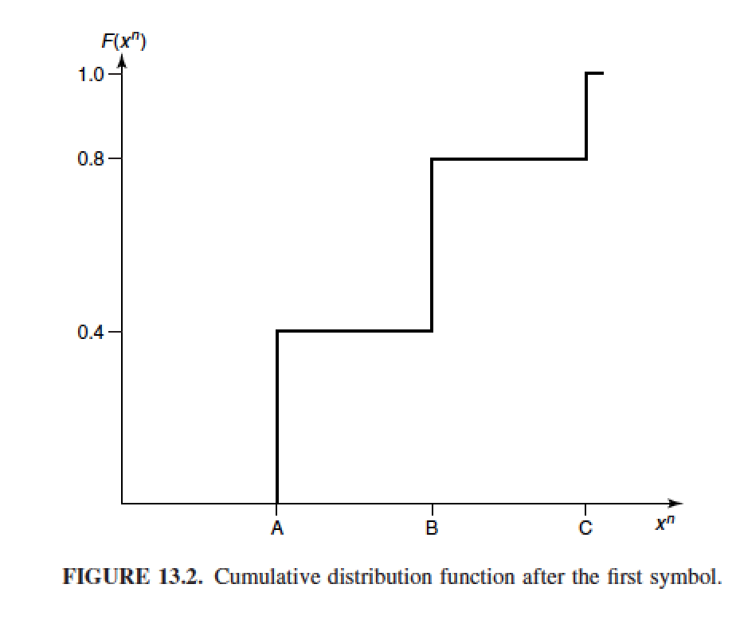
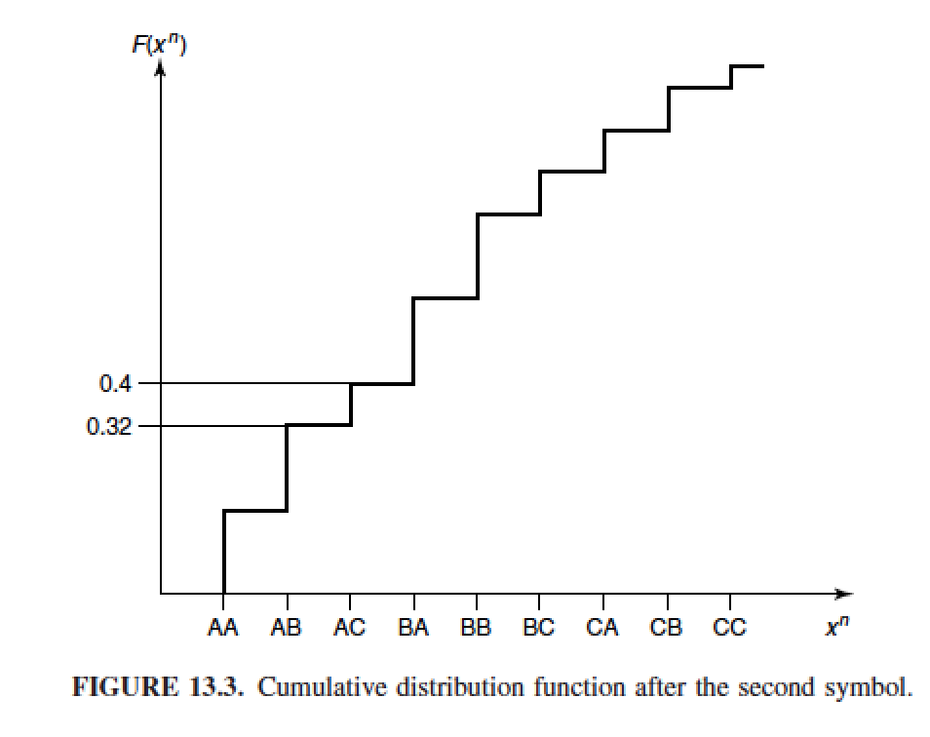
Arithmetic coding
Encodes the entire message into a single number
Code length: bits
Cumulative distribution function
Ex: Random variable X with a ternary alphabet {A,B,C}, with probabilities 0.4, 0.4, 0.2

Slide 11
To encode ACAA:
After the first symbol A is [0, 0.4)
After the second symbol C is [0.32, 0.4)
After the third symbol A, it is [0.32, 0.352)
After the fourth symbol A, it is [0.32,0.3328)
Since the probability of the sequence is 0.4*0.2*0.4*0.4 = 0.0128
The length of the code should be log(1/0.0128)+2=9 bits
Encode the midpoint of the interval sequence, 0.3264, which is 0.010100111

Slide 12
BioCompress, BioCompress-2:
Lempel-Ziv (LZ) style substitutional algorithm to compress the exact repeats and palindromes.
BioCompress-2 also utilizes an order context-based arithmetic encoding scheme to store the non-repetitive regions.
GenCompress and DNACompress
Identify approximate repeats and palindromes so that a larger fraction of the target sequences can be captured.
Textual data compression in computational biology: a synopsis. Bioinformatics 2009;25:1575–86.
Notes:
GenCompress and DNACompress: a higher compression ratio is achived

Slide 13
Outline
Traditional Genomic Sequence Compression
Advances in Genomic Sequence Compression
Reference-based compression
Reference-free compression
Experimental Results
Next-Generation Sequencing Data Compression
Challenges and Future Prospects
Notes:
Provide a comprehensive review of the existing compression methods specialized for genomic data

Slide 14
Reference-based Compression
Align the target genome to the reference
Identify and encode the mismatches
Mismatch: position, type (insertion, deletion or substitution), value
Notes:
When a large portion of a newly assembled genomic sequence, i.e. the target, has been captured by a similar, previously documented sequence, i.e. the reference, the target can be fully identified given the reference as well as the differences between the target and the reference.
Various coders like Huffman coding to encode the mismatches and achieved a best 345-fold compression rate when applied to Human mitochondrial genome sequences

Slide 15
DNAzip:
rely on the human population variation database
(SNP or indel)
Encoded James Watson Genome: 4MB
Compression ratio: 750-fold
De novo compression program: GRS
Obtains variant information directly via a modified UNIX diff program.
Notes:
All variants of a newly obtained sequence can be identified by comparing the sequence against the database.
Because the number of variants in the human population is substantially smaller than the size of human genome, DNAzip was able to encode the James Watson genome using merely 4MB

Slide 16
GReEn
Proposed a probabilistic copy model that calculates target base probabilities based on the reference.
Given base probabilities as input, an arithmetic coder was then used to encode the target.
GReEn was shown to be more effective compared with GRS when the target and the reference have less similarity.
Notes:
Follow the motivation
of denovo compression of GRS

Slide 17
Reference-free Compression
BIND
Encodes each target sequence using two binary strings
First string: A or T assigned with bit 0
G or C assigned with bit 1
Second string: T or C is assigned with bit 0
A or G assigned with bit 1
Two strings were subsequently stored by recording the length of alternating blocks of 1’s and 0’S using unary coding scheme
Notes:
Nonetheless, reference-free methods are required such as in de novo sequencing and metagenomic sequencing, where target genomes share weaker similarities with known ones and variation information is not readily available.

Slide 18
Reference-free Compression
DELIMINATE:
The positions of the two most dominated types of the bases are delta encoded and eliminated from the sequence.
Remaining bases are represented with binary code.
DELIMINATE—a fast and efficient method for loss-less compression of genomic sequences
Notes:
BIND and DELIMINATE were shown to achieve higher compression efficiency than the general-purpose compression algorithms such as gzip, bzip2 and lzma when applied to prokaryotic genomes in FNA (FASTA Nucleic Acid) format, prokaryotic gene sequences in
FFN (FASTA nucleotide coding regions) format, human chromosomes and NGS genomic datasets.
It could be interesting to know how they perform the delta compression on the genomic data sets. You can check out their paper here. They also compared some other compression methods with their methods in this paper

Slide 19
Outline
Traditional Genomic Sequence Compression
Advances in Genomic Sequence Compression
Reference-based compression
Reference-free compression
Experimental Results
Next-Generation Sequencing Data Compression
Challenges and Future Prospects
Notes:
Provide a comprehensive review of the existing compression methods specialized for genomic data

Slide 20
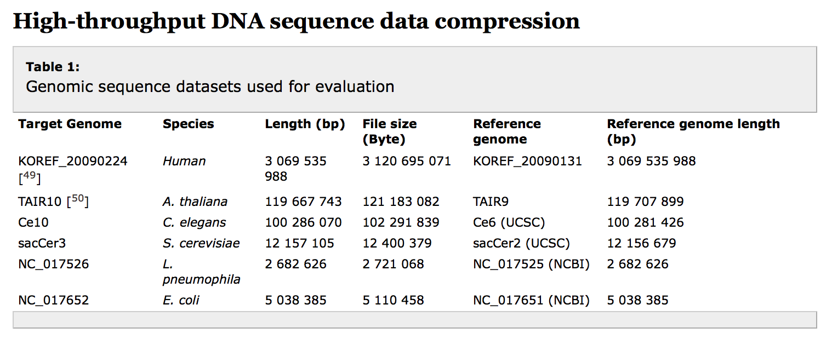
Testing Data
Notes:
In the experiment, a set of genomes that have different species origin, length and repeat content are selected.

Slide 21
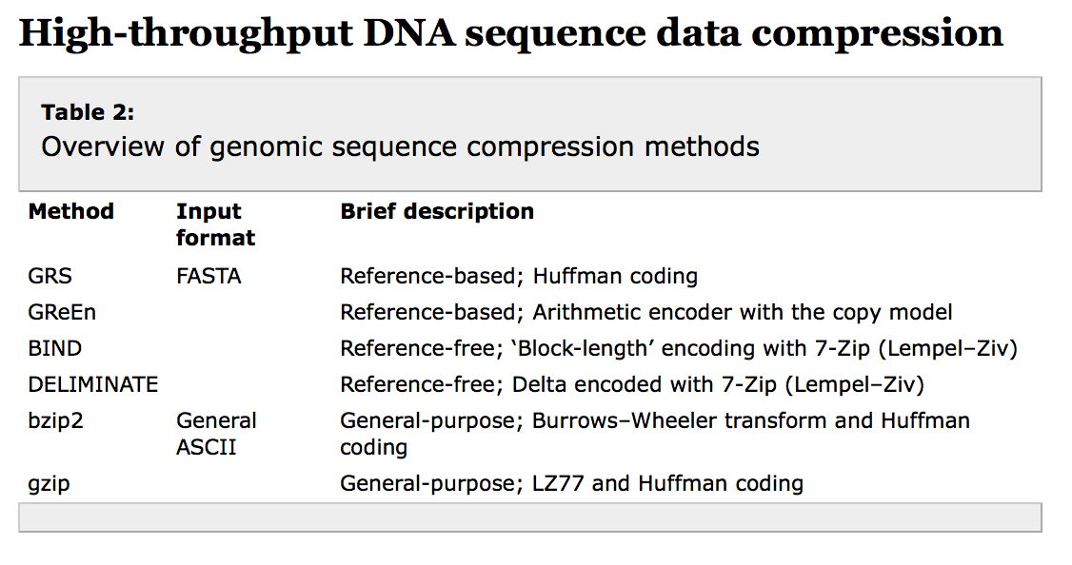

Slide 22
Experiment
Testing platform:
All methods are tested on a cluster running 64-bit Red Hat 4.4.4–13 with 32-core 3.1GHz Intel(R) Xeon(R) CPU E31220
Experiment results
Compression ratio
Memory usage
Compression time
Decompression time

Slide 23
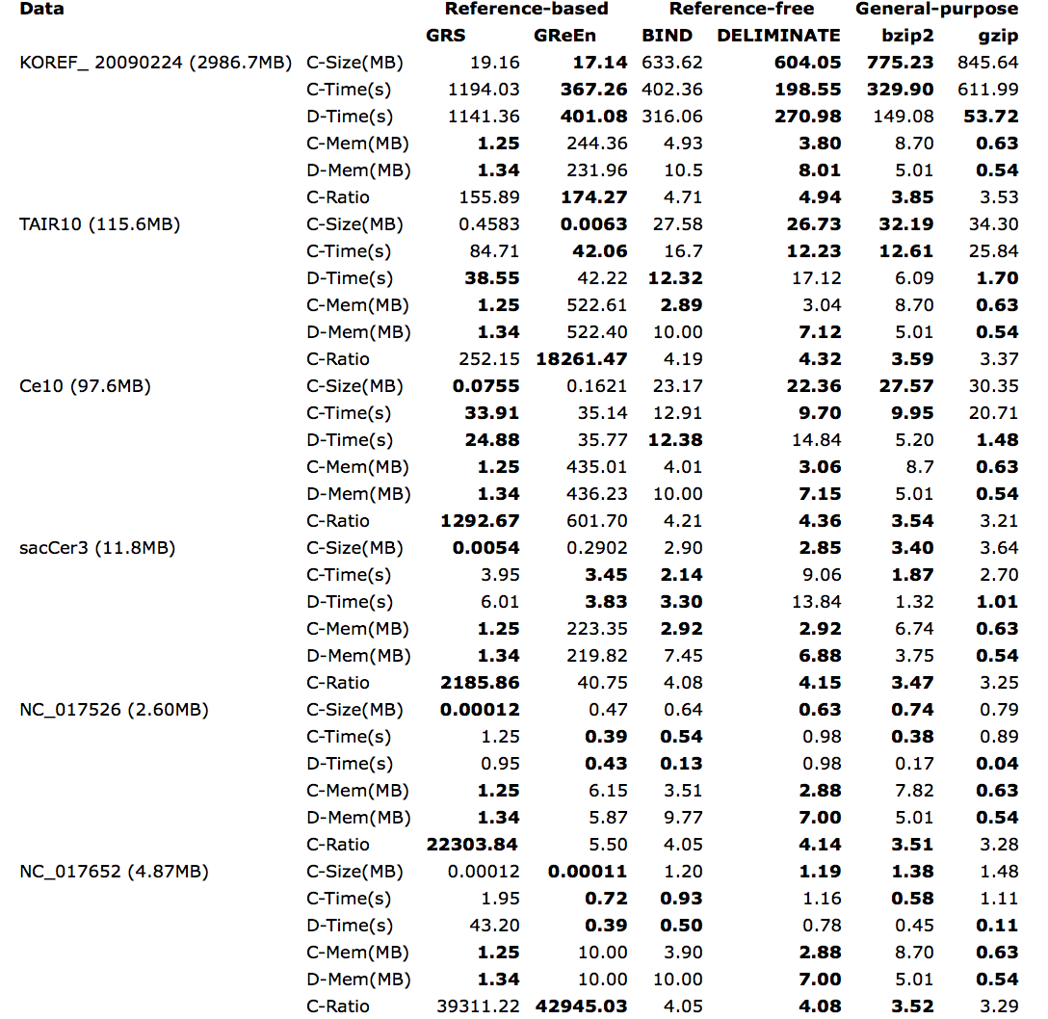
Notes:
C-Size: file size after compression; C-Time and D-Time denote compression time and decompression time in seconds, respectively; C-Mem and D-Mem denote the average memory used in compression and decompression, respectively; C-Ratio: compression ratio, i.e. the ratio of file sizes pre- and post- compression. Best-performed values within the same category are bolded.
For datasets involving more than one chromosome (e.g. human, Arabidopsis thaliana, Caenorhabditis elegans and Saccharomyces cerevisiae), each chromosome was individually compressed.
The run-times of compression and decompression reported in Table 3 are the summation over all chromosomes whereas the sizes of memory were the average values

Slide 24
Notes:
It can be seen that both reference-based and reference-free methods outperform the general-purpose methods in terms of compression ratio. Whereas on these datasets, the reference- free methods generally achieved a 15–40% better compression ratio over general-purpose compression programs, the availability of homologous reference has made a striking difference, where the reference-based programs achieved a 40-fold to over a 10 000-fold better compression ratio.
Gzip uses the least memory among the methods tested, whereas GReEn tends to consume more memory than other methods
----- Meeting Notes (8/2/15 20:49) -----
Reference-free: 15%-40% better compression ratio
Reference-based: 40 fold to over 10,000 fold better compression ratio

Slide 25
Notes:
The reference-based methods could take much longer time for compression and decompression for genomes with large size (when reaching a scale of 100MB in the current
experiment) because the compress/decompress process takes longer query time for bases/substrings for longer reference.
Thus, when an appropriate reference is available and the compression gain on the target sequences can compensate the extract space requirement for the reference genome (such as in the case of multiple targets), reference-based methods should be favorable. As more genomic sequences have been uniquely documented in public databases,
we expect a good use of reference-based methods in cases that require the transferring of large target sequences
over the Internet. On the other hand, reference-free methods are self-contained and have a better balance between time efficiency and compression ratio compared with reference-based methods. Also, as shown in the current experiment, the total time used for compression and decompression is comparable between reference-free and general- purpose methods, making the former a more favorable choice.

Slide 26
Outline
Traditional Genomic Sequence Compression
Advances in Genomic Sequence Compression
Reference-based compression
Reference-free compression
Experimental Results
Next-Generation Sequencing Data Compression
Challenges and Future Prospects
Notes:
Provide a comprehensive review of the existing compression methods specialized for genomic data

Slide 27
NGS Data Compression
Compression of reads
Reference-based VS Reference-free
Compression of Quality Score
Loss-less VS Lossy Compression
Metadata: Read name, Platform, Project ID, etc
Strategies used for general-purpose compression
Notes:
For datasets involving more than one chromosome (e.g. human, Arabidopsis thaliana, Caenorhabditis elegans and Saccharomyces cerevisiae), each chromosome was individually compressed.

Slide 28
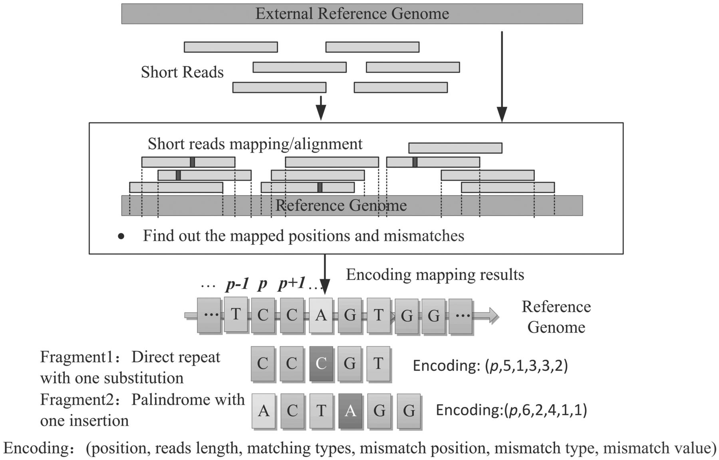
Reference-based read compression
Read mapping
Encoding of the mapping results
Notes:
First, reads are aligned to an appropriately selected reference genome, de novo assembled or chosen from the database, using one of the NGS aligners such as Bowtie, BWA and Novoalign.
Then, the mapping results are encoded via methods such as arithmetic coding and Huffman coding

Slide 29
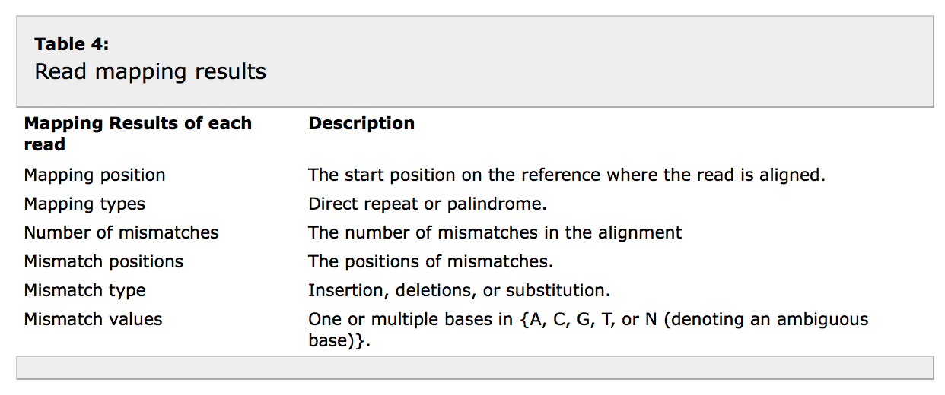

Slide 30
Reference-based read compression
Notes:
First, reads are aligned to an appropriately selected reference genome, de novo assembled or chosen from the database, using one of the NGS aligners such as Bowtie, BWA and Novoalign.
Then, the mapping results are encoded via methods such as arithmetic coding and Huffman coding

Slide 31
Reference-Free Read Compression
Statistical encoding methods such as Huffman coding and arithmetic coding or LZ77 are used.
DSRC:
The input is divided into blocks of 32 records.
Every 512 blocks is grouped into a superblock.
Each superblock is indexed and compressed via LZ77
Quip:
Arithmetic coding based on high order Markov Chain
Notes:
De novo sequencing and meta genomic sequencing, where there is no clear choice of a reference
DSRC: enable fast access to individual record

Slide 32
General purpose compression schemes to losslessly preserve the quality score information
Lossy Compression:
Achieve more aggressive compression.
Ex: SlimGene employs randomized rounding strategy.
Reduce the alphabet size of the quality scores
No significant loss of accuracy in downstream analysis
CRAM-L
Preserve quality score for non-matching bases with full precision, and bin quality scores for positions flanking deletions
Notes:
Quality scores are important and they are required to be distributed along with reads
A quality score is denoted by an ASCII character, which can be converted to the probablity of the corresponding base been correctly determined during sequencing.
The alphabet size is large, ex: 40 compared to 4 genome basepair
A series of algorithms have been introduced to cluster quality scores with similar values to achieve more aggressive compression

Slide 33
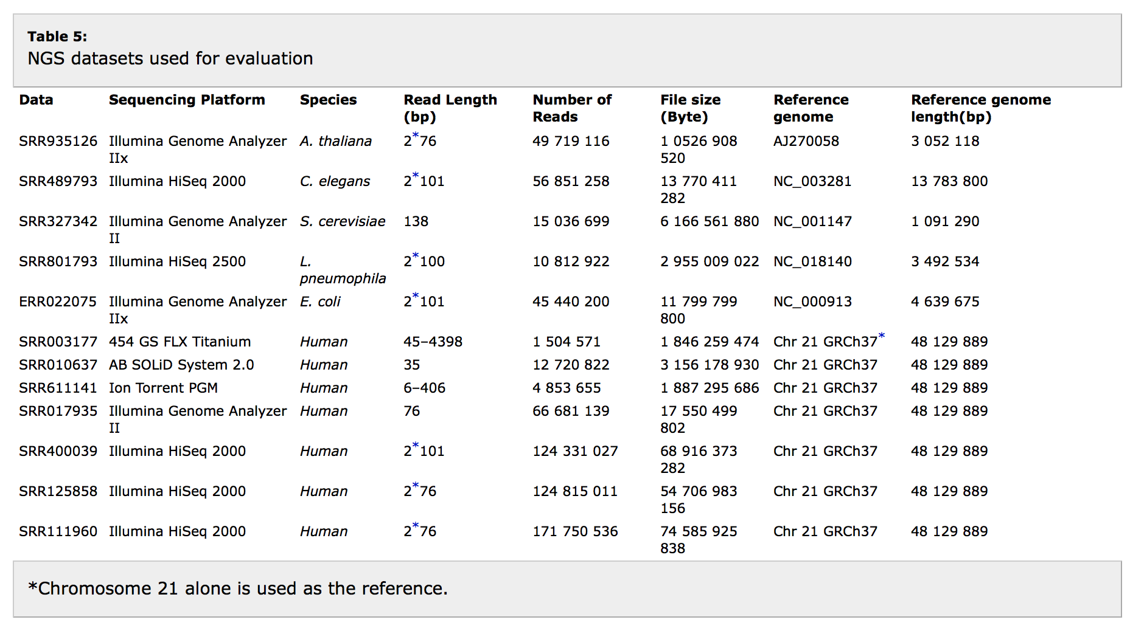

Slide 34
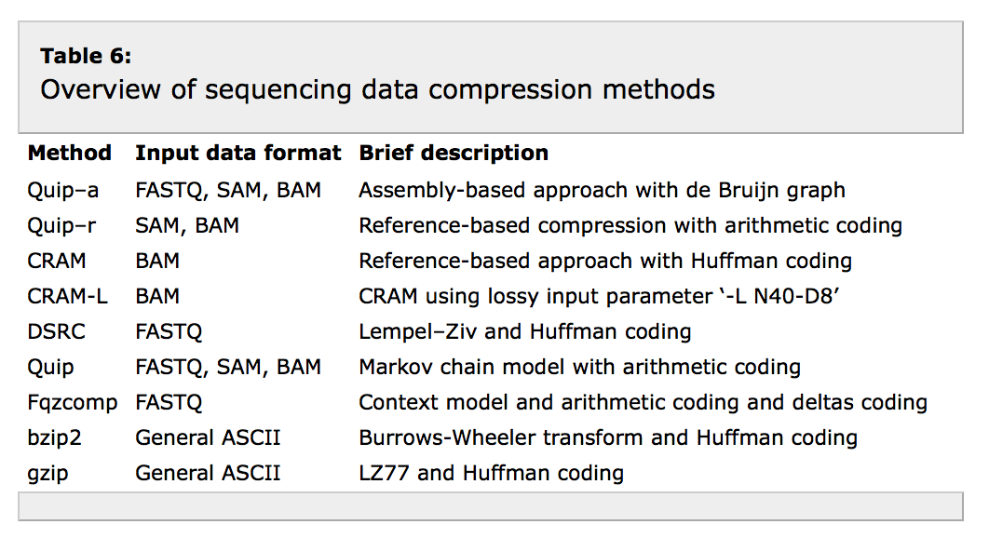

Slide 35
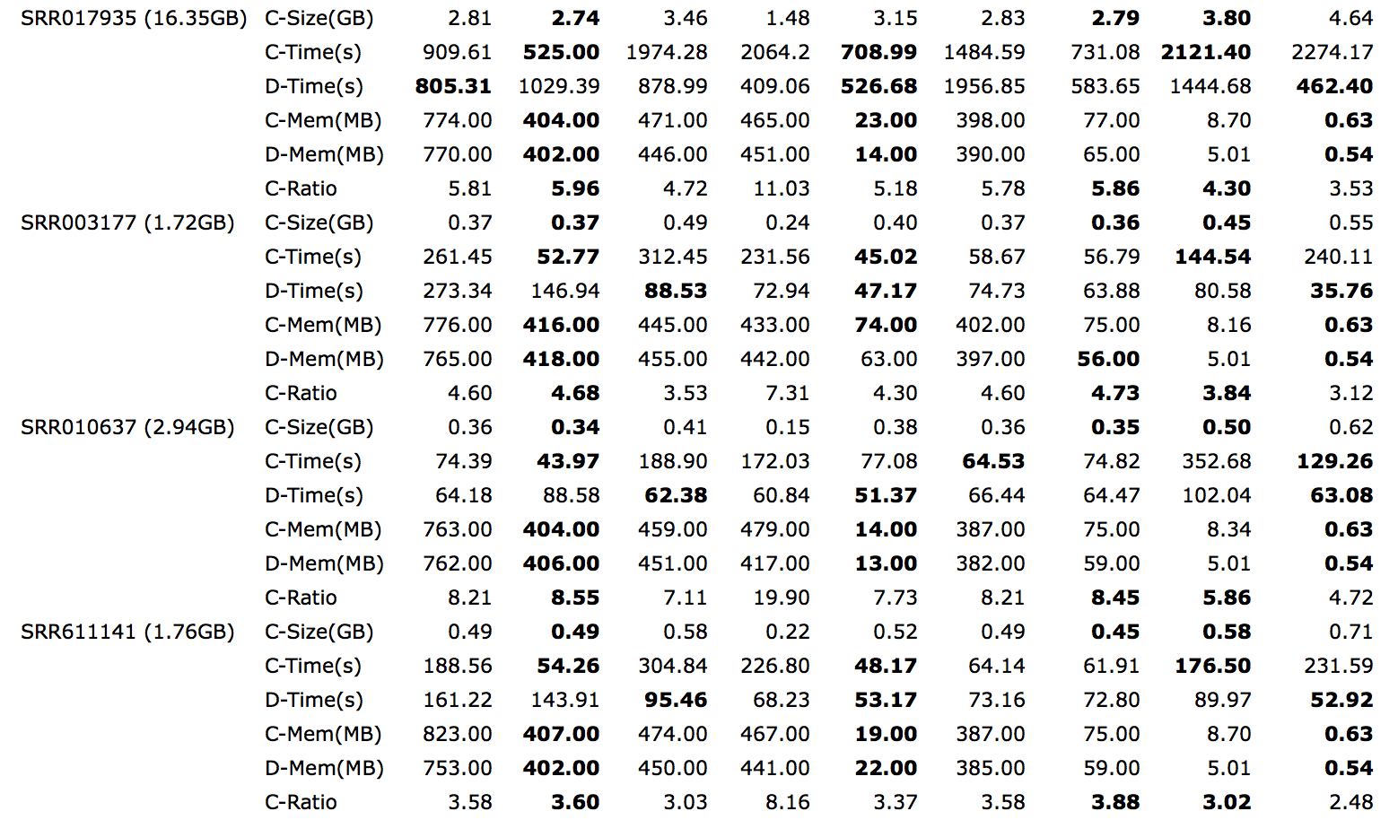
Notes:
Note that the time spent on read mapping is not included in the time of compression
it is not surprising to observe that CRAM-L obtained the best compression ratio due to its lossy nature.
Both reference-based and reference-free methods outperform the general-purpose methods in terms of compression ratio

Slide 36
Challenges and Future Prospects
Compressive Genomics
Algorithms directly work with compressed data
Alignment algorithms BLAST and BLAT on compressed non-redundant large genomic datasets
Query, extract,retrieval and random access on compressed datasets directly
Expected in read mapping applications
Routine analysis on compressed sequence data remains to be a challenge
Notes:
Compressive version of alignment algorithms BLAST and BLAT to operate on compressed non-redundant large genomic datasets and achieved a similar accuracy with substantial reduction in run time

Slide 37
Challenges and Future Prospects
High performance DNA sequence compression
Parallel compression methods are to be developed
Combination of encryption and compression
Redundancy elimination of DNA sequence database
NCBI, EBI and DDBJ
Notes:
1000 genome project

Slide 38
Thanks!

