Slide 2
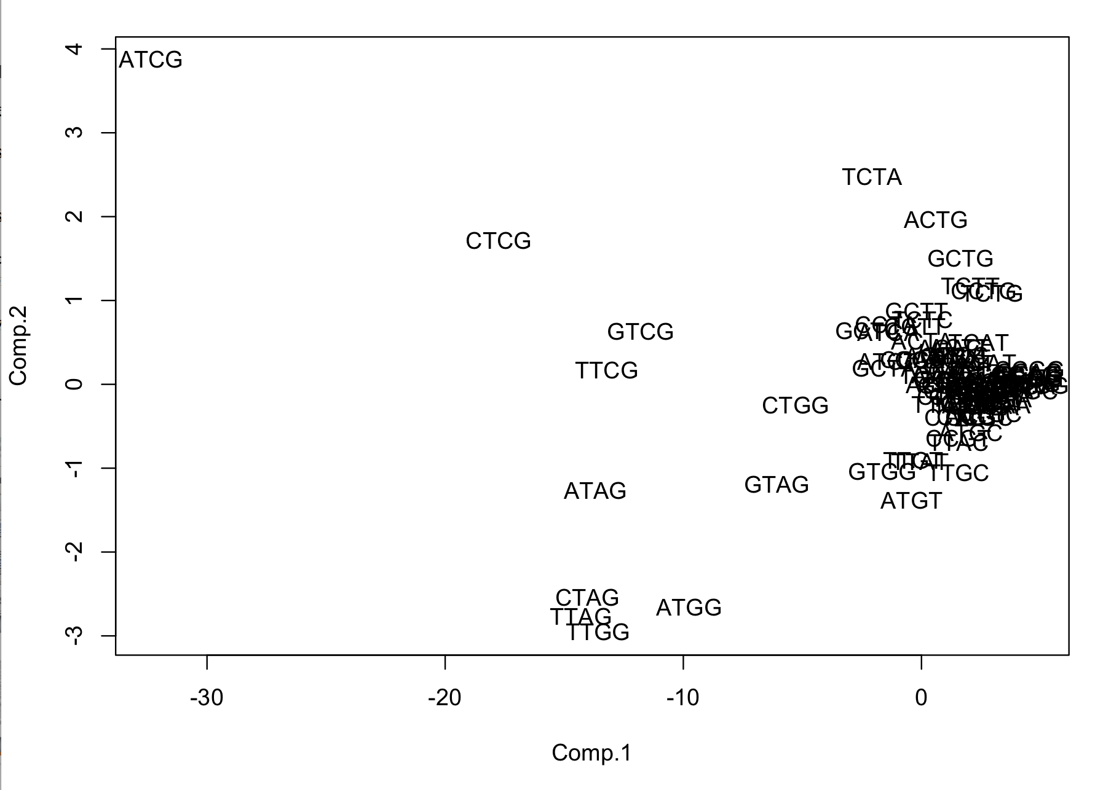
C>T in CpG (methylation, endogenous)
T>A in TpG)
T>G in TpG

Slide 3
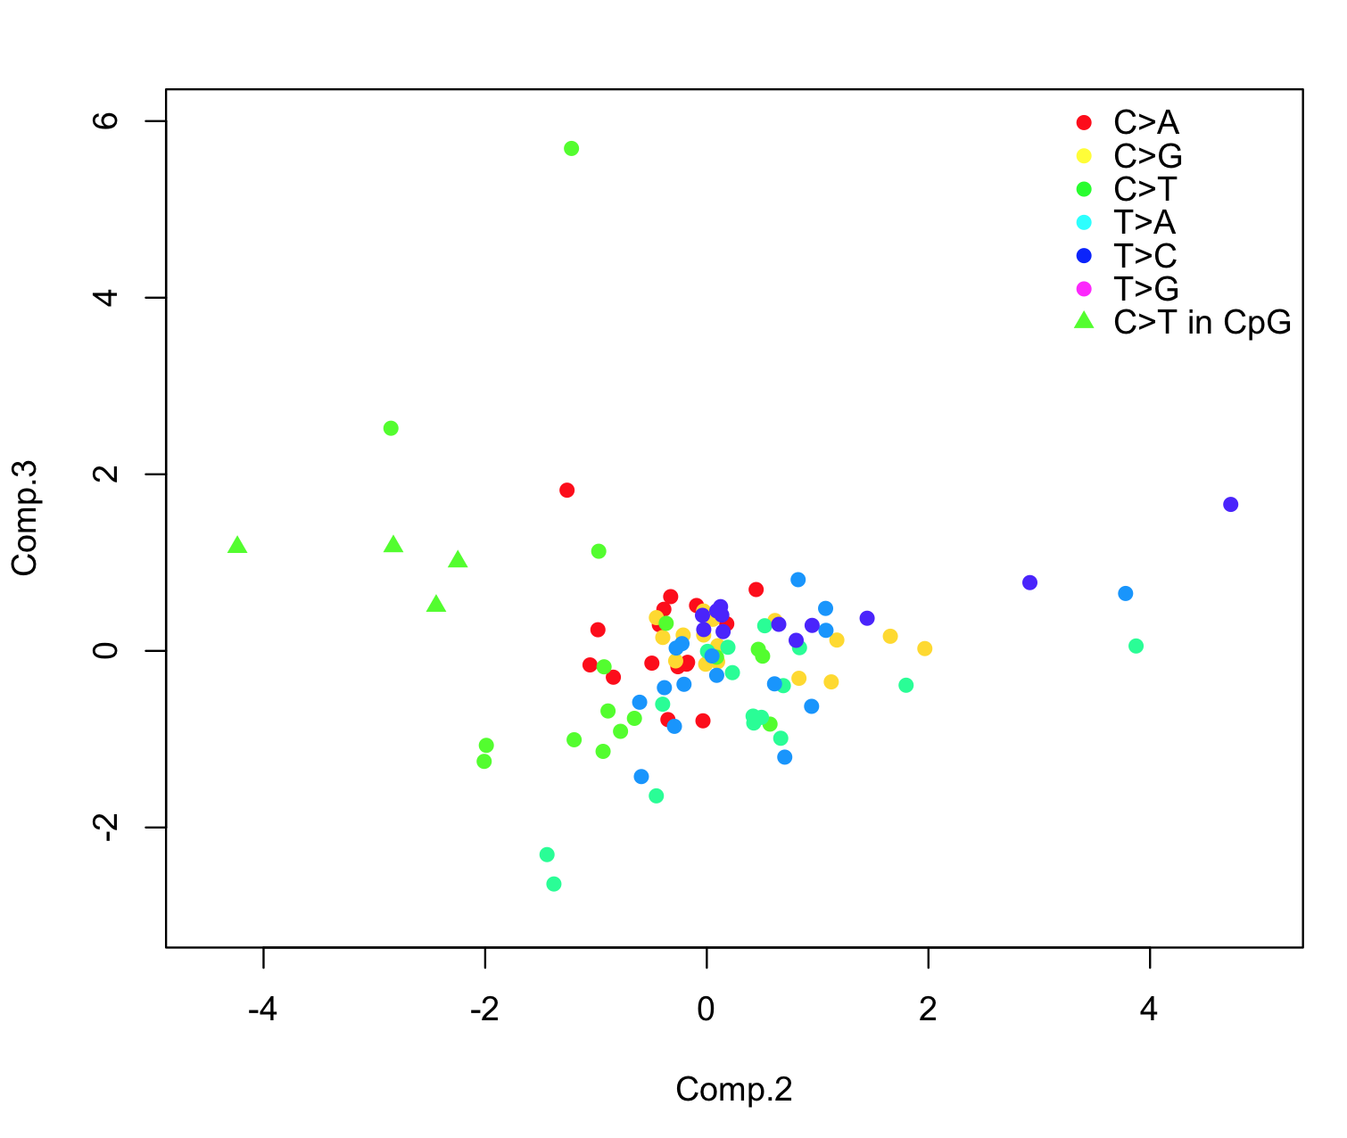

Slide 7
Novel Smoking Signature?

Slide 8
Not Significant

Slide 9
P<0.05 in All Cases (T1 vs T3)

Slide 10
Not Significant in Meth Cluster 2

Slide 11
C>T in CG

Slide 12
Fraction ~ Total Mut.
p < 0.025

Slide 13
Chromatin Environment
3,252 mutations fall in HEK293K (embryonic kidney) DHS peaks
Epigenetics effects mutation landscape
  SETD2, KDM6A, PBRM1, SMARCB1, DNMT3A(meth), ARID1A, ARID2, MLL2, MLL3, MLL4

Slide 14
Chromatin Modifier Mutation Effects Mutation Landscape

Slide 15
p > 0.1

