Slide 1
1000 Genomes Phase3 SV Analyses
(Mainly Focus on Analyses Contributed by Gerstein Lab)
Yan Zhang, Ph.D.
Gerstein Lab, Yale University
The 1000 Genomes Project SV Group & Analysis Group
7/28/2015

Slide 2
Outline
Background
Functional Impact of Various SVs
Personal Diploid Genome and Effects on SVs
SV Formation Mechanism Annotation
Loss-of-function Annotation
Notes:
Mention 3 papers

Slide 3
Outline
Background
Functional Impact of Various SVs
Personal Diploid Genome and Effects on SVs
SV Formation Mechanism Annotation
Loss-of-function Annotation
Notes:
Mention 3 papers

Slide 4
Human Genetic Variations
Single nucleotide variants (SNVs)
Short insertions and deletions (Indels)
Structural variations (SVs)
– Sequence variations of at least 50bp in size
[1] Weischenfeldt J, et al. Nat Rev Genet, 2013.
Notes:
Human genome – 3 billion DNA base pairs
--
[1] Weischenfeldt J, et al. Phenotypic impact of genomic structural variation: insights from and for human disease. Nat Rev Genet, 2013.

Slide 5
Structural Variations (SVs)
SVs make up the majority of varying nucleotides among humans.
More base pairs are altered as a result of SVs, than of single-nucleotide variations.
  A personal genome differs from the reference genome by 0.5-1% for SVs, and by 0.1% for SNVs.
[1] Weischenfeldt J, et al. Nat Rev Genet, 2013.
[2] Pang AW, et al. Genome Biol, 2010.
Notes:
[1] Weischenfeldt J, et al. Phenotypic impact of genomic structural variation: insights from and for human disease. Nat Rev Genet, 2013.
[2] Pang AW, et al. Towards a comprehensive structural variation map of an individual human genome. Genome Biol, 2010.

Slide 6
Objective of 1000GP SV Analysis
Discover and genotype major classes of SVs
Enable integration of these SVs into phased reference panel for population and genetic studies
[3] 1000GP SV main paper. Submitted to Nature.

Slide 7
Summary Statistics of 1000GP SV Phase3
68,818 SVs
2,504 unrelated individuals
26 populations
37,250 SVs with resolved breakpoints
[3] 1000GP SV main paper. Submitted to Nature.

Slide 8
Distribution of Different SVs in Normal Human Populations
Total ~70K SVs from over 2,500 normal individuals (the 1000 Genomes Project)
Notes:
The above pie-chart is in terms of the number of sites.
On the other hand, in terms of size,
Each individual has ~18.4 Mbp of SV per diploid genome (62% contributed by mCNVs, 31% contributed by biallelic deletions).

Slide 9
Distribution of Different SVs Stratified by Allele Frequency
Number of SVs
Allele frequency bins
(0, 0.001] (0.001, 0.01] (0.01, 1]
Rare SVs Common SVs
Notes:
Distribution of Different SVs in Normal Populations
Stratified by AF
Results (not typing): Rare SVs are More Abundant than Common SVs
Esp. DEL, DUP
(ALU insertion not so… Maybe related to natural selection. ALU insertion might be more benign than DEL.)

Slide 10
Outline
Background
Functional Impact of Various SVs
Personal Diploid Genome and Effects on SVs
SV Formation Mechanism Annotation
Loss-of-function Annotation
Notes:
Mention 3 papers

Slide 11
Outline
Background
Functional Impact of Various SVs
Personal Diploid Genome and Effects on SVs
SV Formation Mechanism Annotation
Loss-of-function Annotation
Notes:
Mention 3 papers

Slide 12
Enrichment Overlap Analysis
Measure overlap between SVs and genomic elements
Test statistical significance of the overlap
Notes:
Commonly asked question - How much overlap?

Slide 13
Measure of Overlap between SVs and Genomic Elements
SV intervals
DEL1
DEL2
Genomic element
intervals
CDS1
CDS2
CDS3
Partial overlap statistic:
Count the number of genomic elements that have at least 1 bp overlap with SVs.
Notes:
Partial overlap statistic:
The count of genomic elements (e.g. CDS) that have at least 1bp overlap with SV intervals (e.g. deletions).
Concise toy example

Slide 14
Permutation Tests
Permutation scheme
  Randomly shuffle SV locations while maintaining the local structure
    Same number of SVs, same length distribution
    Shuffled SVs still locate on the same chromosome
    Hg19 gap removed
  Log2 fold change and empirical p-values
Datasets
  8 types of SVs from the 1000 Genomes Project
  20 types of genomic elements from GENCODE, ENCODE, and other literature
Notes:
GENCODE (Encyclopedia of genes and genes variants)
ENCODE (ENCyclopedia Of DNA Elements)

Slide 16
Zoom in
Rarest
Most common

Slide 17
Conclusion
Important biologically functional genomic elements are depleted with DELs.
CDS regions under strong purifying selection are most depleted.
This conclusion applies to other SV types; but less significant than DELs.
We observed similar trend for SNVs binned by allele frequency.

Slide 18
Outline
Background
Functional Impact of Various SVs
Personal Diploid Genome and Effects on SVs
SV Formation Mechanism Annotation
Loss-of-function Annotation
Notes:
Mention 3 papers

Slide 19
Outline
Background
Functional Impact of Various SVs
Personal Diploid Genome and Effects on SVs
SV Formation Mechanism Annotation
Loss-of-function Annotation
Notes:
Mention 3 papers

Slide 20
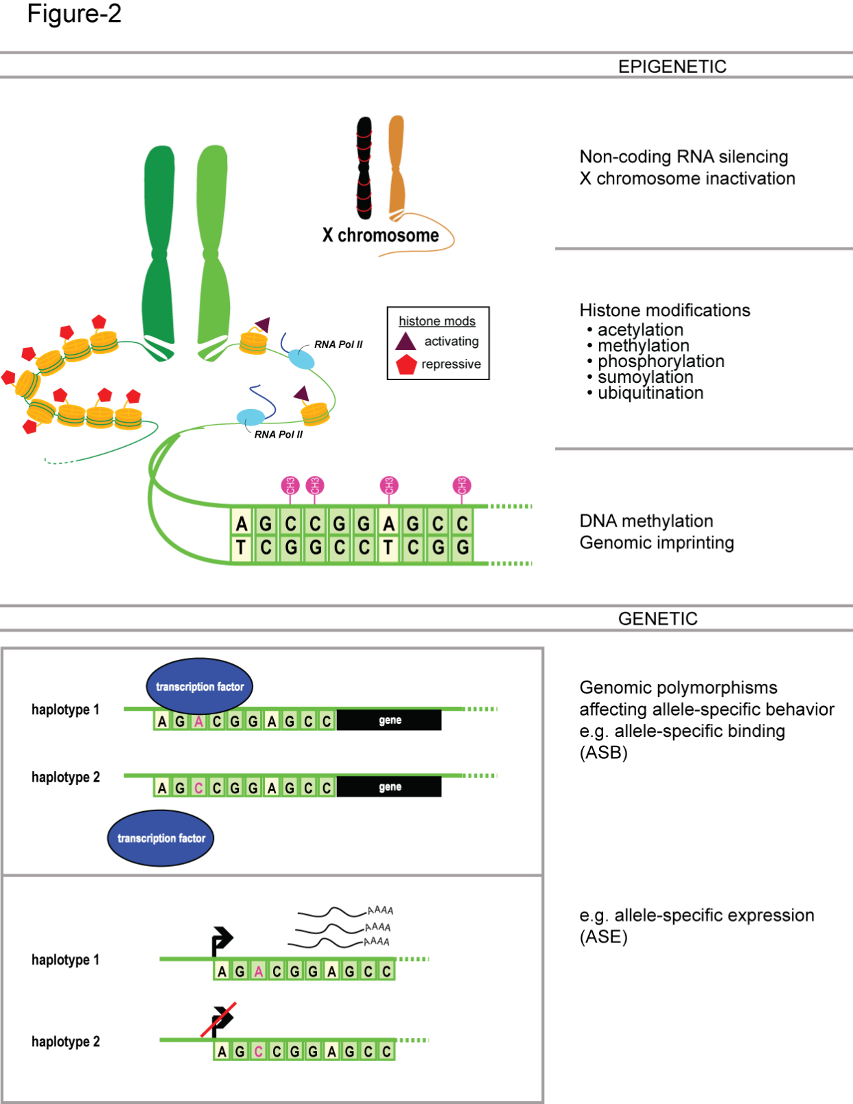
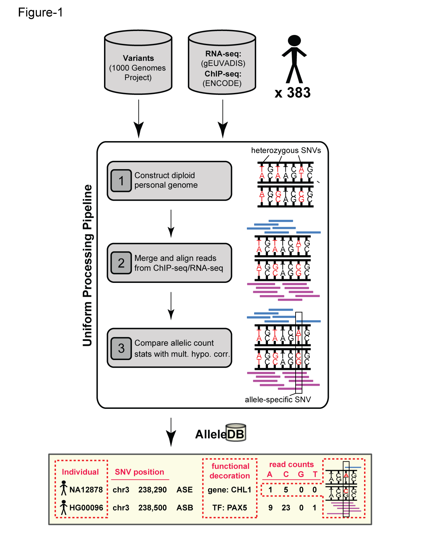

Personal Diploid Genome and Effects on SVs
M
Reference
genome
SV
P
gene
Paternal variation
SNVs: 2,480,064
Indels: 389,657
SVs: 892
SV
Paternal
gene
Maternal
gene
Maternal variation
SNVs: 2,468,771
Indels: 388,114
SVs: 847
NA12878
Jieming Chen, in collaboration with Oliver Stegle

Slide 21
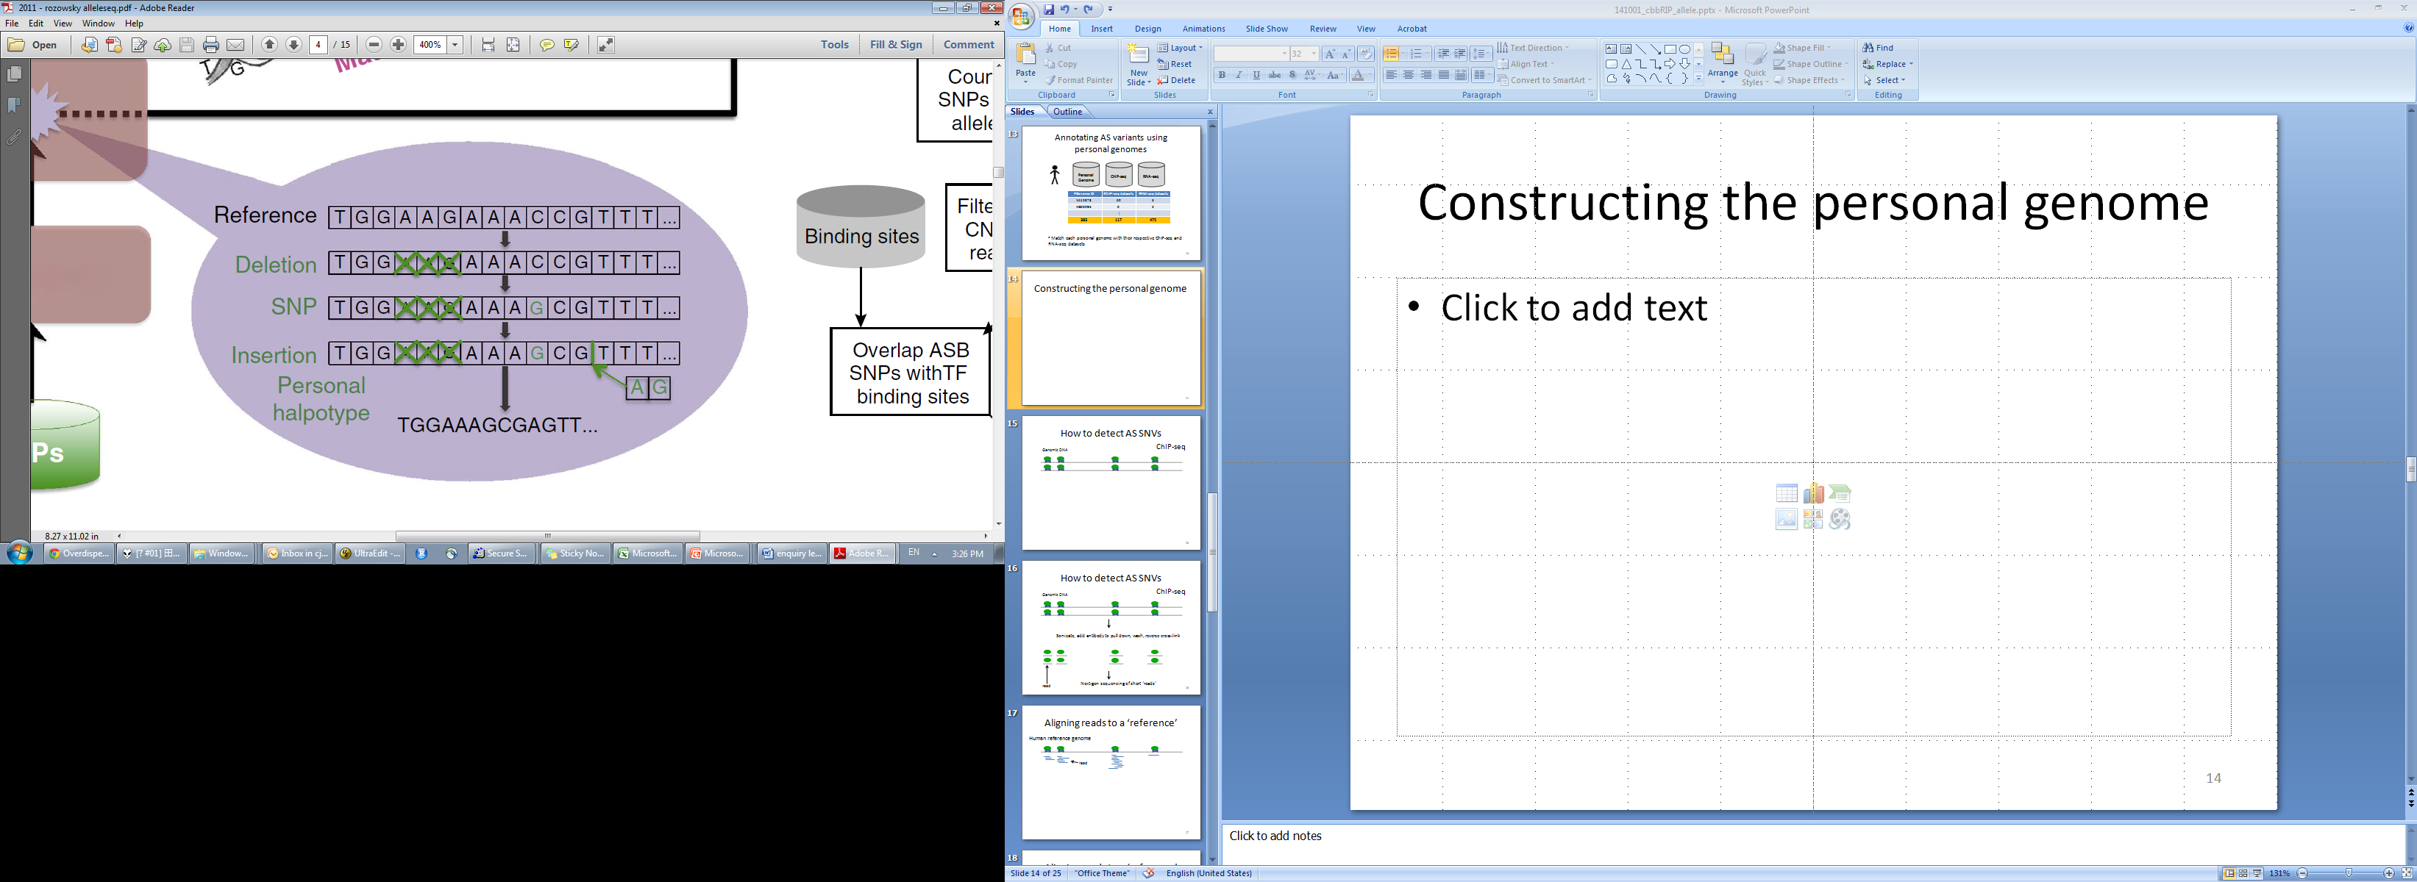
Personal Genome Construction
AlleleDB uses AlleleSeq pipeline that constructs a personal genome for allele-specific analyses
M
P
Personal Genome
ChIP-seq
RNA-seq
NA12878
[4] Rozowsky J, et al. Mol Syst Biol, 2011.
http://alleleseq.gersteinlab.org/
Jieming Chen, in collaboration with Oliver Stegle

Slide 22
Outline
Background
Functional Impact of Various SVs
Personal Diploid Genome and Effects on SVs
SV Formation Mechanism Annotation
Loss-of-function Annotation
Notes:
Mention 3 papers

Slide 23
Outline
Background
Functional Impact of Various SVs
Personal Diploid Genome and Effects on SVs
SV Formation Mechanism Annotation
Loss-of-function Annotation
Notes:
Mention 3 papers

Slide 24
BreakSeq Annotation
Formation Mechanisms
Ancestral States
Remarks: There are 79 STEI_NAH events, i.e. 79 events were changed from NAHR to STEI based on our new criteria in the enhanced BreakSeq. Extended annotations from BreakSeq such as NAHR_EXT, STEI_NAH, etc are grouped into their corresponding mechanisms in the above.
Hugo Lam

Slide 25
Formation Mechanism Comparison
a
b
1KG
Phase 3
Conrad et al.
2010
c
d
Mills et al.
2011
1KG Phase 3 using
Conrad et al. 2010
criteria
Remarks: For comparison purpose, extended annotations from BreakSeq such as NAHR_EXT, STEI_NAH, etc are not included in the above mechanisms.
Hugo Lam

Slide 26
Repeat-mediated NAHR Events
Hugo Lam

Slide 27
Outline
Background
Functional Impact of Various SVs
Personal Diploid Genome and Effects on SVs
SV Formation Mechanism Annotation
Loss-of-function Annotation
Notes:
Mention 3 papers

Slide 28
Outline
Background
Functional Impact of Various SVs
Personal Diploid Genome and Effects on SVs
SV Formation Mechanism Annotation
Loss-of-function Annotation
Notes:
Mention 3 papers

Slide 29
Impact of Genetic Variability: Loss-of-function
Gene
Polymorphic
Pseudogene
- Truncating nonsense SNPs
- Splice-disrupting SNPs
- Frameshift-causing indels
- Disrupting structural variants
Previous LoFs are considered as having high probability of being deleterious
Surprisingly, ~ 100 LoF variants per genome, 20 genes are completely inactivated
Among ~100 LoFs, we estimate 2 recessive, close to 0 dominant disease nonsense variants per healthy genome.
Yao Fu, Suganthi Balasubramanian

Slide 30
ALoFT workflow
Annotate variant with Mismapping,
Functional, Conservation and etc.
Predict disease-causing potentials
Yao Fu, Suganthi Balasubramanian
Notes:
-- YZ (comment below) --
NMD prediction - Prediction of nonsense-mediated mRNA decay (NMD)
Information of benign, dominant and recessive are from HGMD-DM
Prediction model based on random forests
Wiki:
In genetics, a nonsense mutation is a point mutation in a sequence of DNA that results in a premature stop codon, or a nonsense codon in the transcribed mRNA, and in a truncated, incomplete, and usually nonfunctional protein product.
Wiki:
Nonsense-mediated mRNA decay (NMD) is a surveillance pathway that exists in all eukaryotes. Its main function is to reduce errors in gene expression by eliminating mRNA transcripts that contain premature stop codons. If these aberrant mRNA transcripts were translated, the result would be deleterious gain-of-function or dominant-negative activity of the resulting proteins.
Biostars:
Neutral Evolution (drift): dN/dS ratio = 1 implies there has been equal numbers of synonymous (dna substitutions that do not affect the protein sequence) and non-synonymous changes (dna substitutions that do affect the protein sequence) during the time between ancestral to the modern versions of the protein.
Positive Selection (adaptive evolution): dN/dS ratio > 1 implies there has been more non-synonymous changes than synonymous changes. There has been evolutionary pressure to escape from the ancestral state - i.e. positive selection pressure. This can occur for example in paralogues that are required to serve a novel function, or in proteins of parasites that need to escape host immune recognition (e.g. changes to avoid MHC-1 binding to evade T-cell attack).
Negative Selection (conservation): dN/dS ratio < 1 implies there has been more synonymous changes than non-synonymous changes. There has been evolutionary pressure to conserve the ancestral state - i.e. negative selection pressure. This can occur for example in orthologues that are required to maintain (conserve) some function encoded in the protein sequence, since changes from this state would lead to disruption of function.

Slide 31
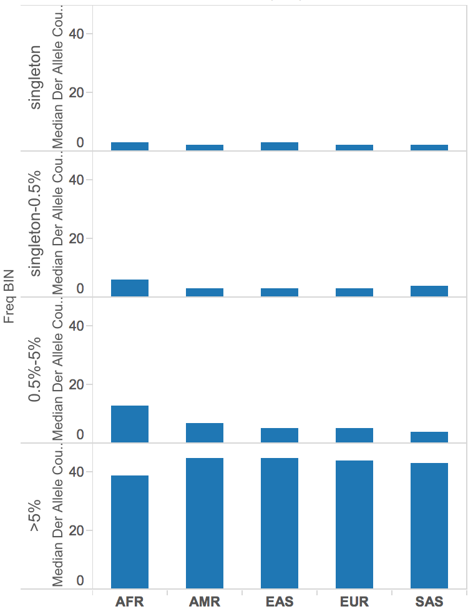
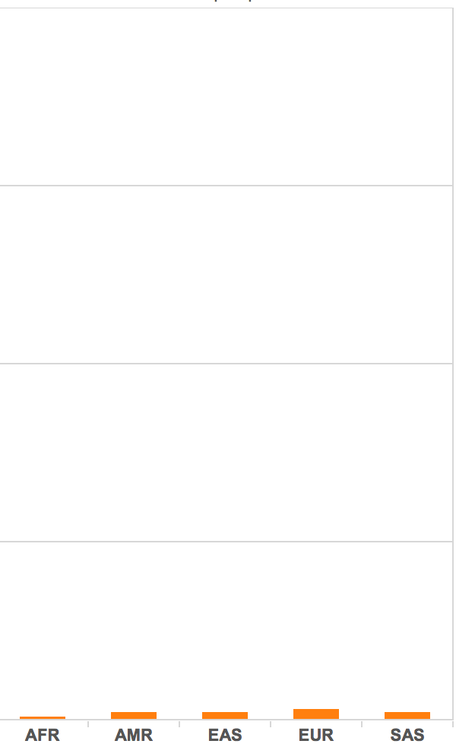
Stop-gain (median derived allele counts)
Accessible
Masked
Yao Fu, Suganthi Balasubramanian
Notes:
Aloft count for phase 3
-- YZ (comment below) --
Note: I add a red rectangular in the plot.
AFR has the largest diversity, they have the largest count of variants (sum of the bars in the red rectangular) compared to other populations.
The percentage of rare variants is largest in AFR. AFR does not have as many common variants (e.g. >5%) compared to other populations.

Slide 32
Acknowledgements
Gerstein Lab @ Yale
Mark Gerstein
Alexej Abyzov (Mayo Clinic)
Jieming Chen
Hugo Lam (Bina)
Yao Fu
Jing Zhang
Jasmine X. Mu
Suganthi Balasubramanian
Baikang Pei
And other members
The 1000 Genomes Project
1000GP SV Group
1000GP Analysis Group
Notes:
Proteomics - cancer cell line specific pseudogene translation
Pseudogene localization, material exchange between chromosomes
ENCODE - Encyclopedia of DNA Elements
GENCODE - Encyclopædia of genes and gene variants

