Slide 1



Variant Interpretation in Personal Genomes using Protein Sequences, Networks and Allele-specific Analyses
Jieming Chen
Program in Computational Biology & Bioinformatics, Integrated Graduate Program in Physical and Engineering Biology
Yale University
Advisors: Profs. Mark Gerstein & Lynne Regan
Thesis Committee: Profs. Don Engelman, Anita Wang, Sherman Weissman
Dissertation Seminar

Slide 2
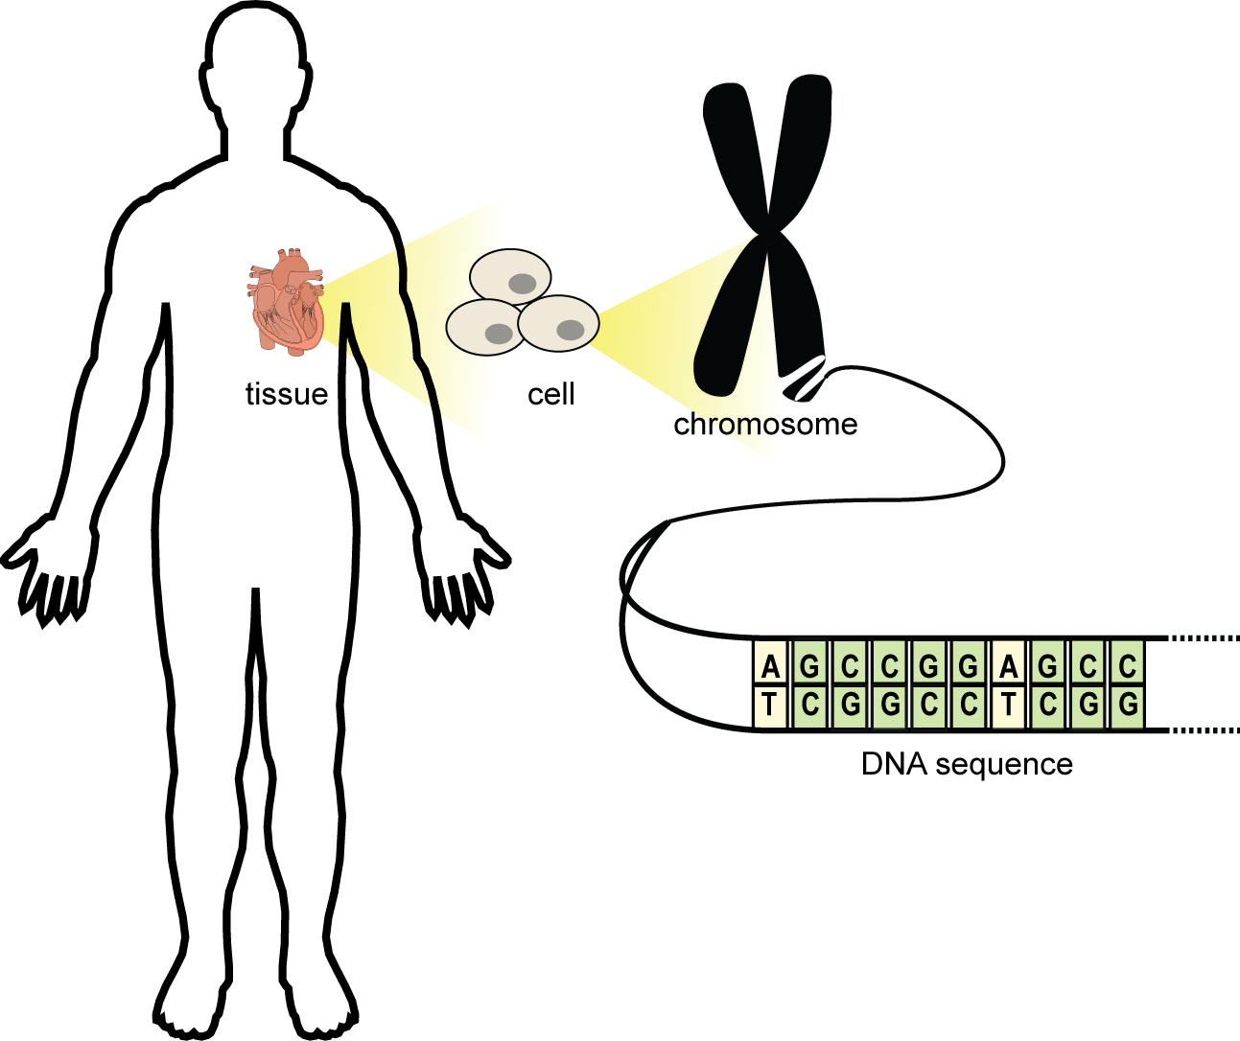
We are made of DNA
Nucleotide/“letter”
We need to do DNA sequencing to know the
3 billion letters on the human genome!!!

Slide 3
Each person’s DNA is slightly different
Many types of variation
SNV: 1 base pair; single nucleotide variants
Indel: short insertion and deletion
SV: larger structural variants (duplications, inversions etc.)
So we need a catalog of all SNVs in humans
Notes:
To do that we need to sequence a lot of individuals
; NA12878

Slide 4



Each person’s DNA is slightly different
Many types of variation
SNV: 1 base pair; single nucleotide variants
Indel: short insertion and deletion
SV: larger structural variants (duplications, inversions etc.)
So we need a catalog of all SNVs in humans
A
C
G
G
C
T
A
A
C
C
Single nucleotide variant (SNV)
A
C
T
G
C
C
A
G
C
C
A
C
G
G
G
C
A
G
C
C
Notes:
To do that we need to sequence a lot of individuals
; NA12878

Slide 5
Human variant catalog requires many genomes
Challenges since the Human Genome Project:
1) sequencing cost
2) sequencing technology

Slide 6
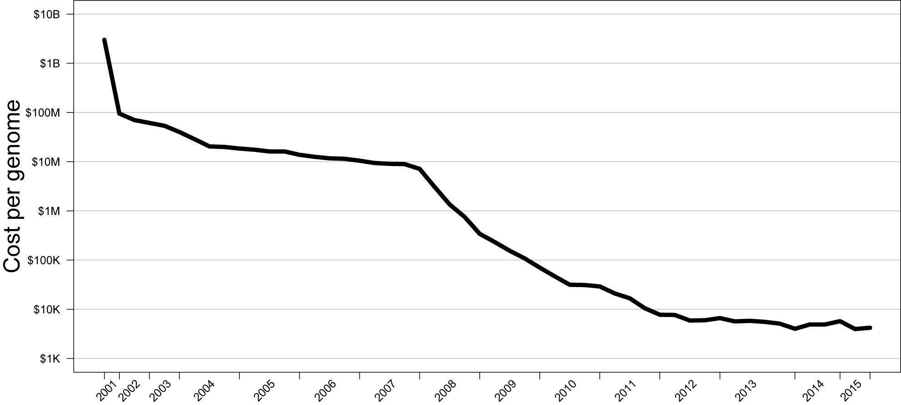
Cost of sequencing decreasing very rapidly
Human Genome Project
($3b)
Towards the $1K goal →
Year
Data from: www.genome.gov/sequencingcosts
Notes:
At the very heart of this

Slide 7
Technology of sequencing helping the cost
Human Genome Project
($3b)
Sanger sequencing
(low throughput)
Next Generation Sequencing (NGS)
(high throughput)
Towards the $1K goal →
Year
Data from: www.genome.gov/sequencingcosts
Notes:
At the very heart of this

Slide 8
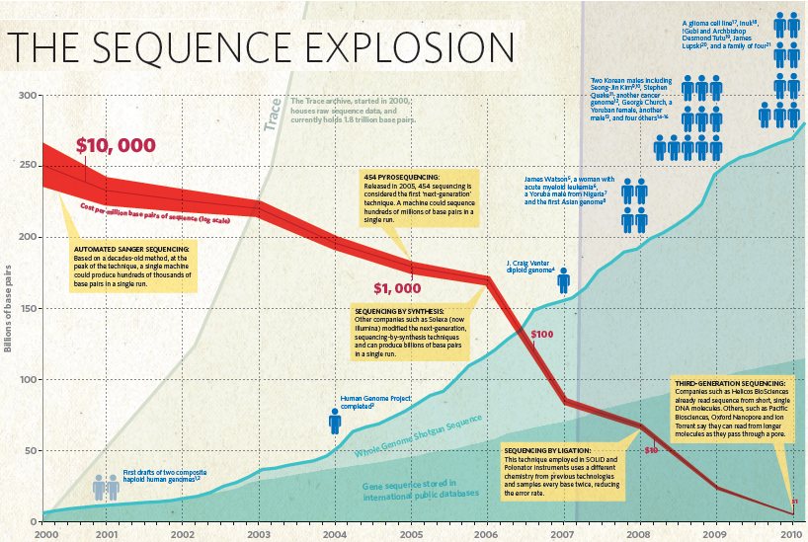


The Rise of the Personal Genome
George Church & the Personal Genome Project
9
James Watson’s genome
(first by next-gen sequencing)
11
4
Billions of base pairs
Craig Venter’s genome
(by Sanger sequencing)
1
Two composite human haploid genome drafts
Human Genome Project completed
Adapted from: Nature 2010

Slide 9
Number of DNA sequences exploding out of control in recent years
Exome Aggregation
Consortium
60,706
9
11
Exome Sequencing
Project
4
6515
1
1000 Genomes
Project Phase 1
1092
2007
2008
2009
2010
2011
2012
2015

Slide 10
Current genomic landscape
Rapidly reducing cost
Better technology
Resulting in,
many personal genomes/exomes
huge catalog of variants
Notes:
Why

Slide 11
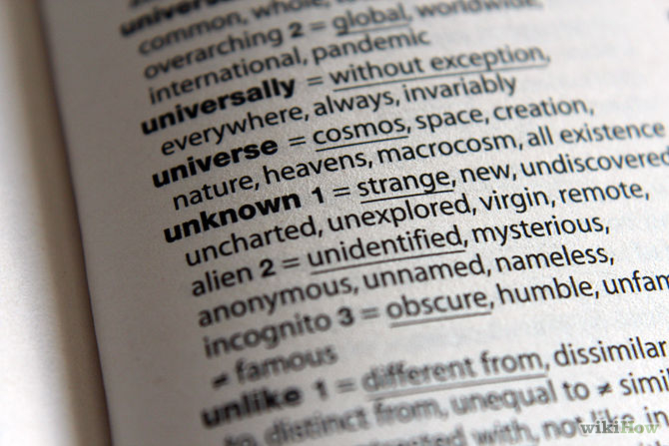
A challenge: Variant annotation
We know where the variants are in the genome, but we have no idea what they do!
Interpretation of the variants
But what do they affect?
Do they cause diseases or traits?
We know the ‘letters’ but not their ‘meaning’…
????????
????????
????????
Notes:
There are different kinds of variation in the genome – focus on a single nucleotide

Slide 12
Variant Annotation Approach 1:
Using the human reference genome
Overlapping of variants onto known parts of the genome
Based on the human reference genome
Single nucleotide variant (SNV)
Reference genome
protein-coding gene
Regulatory element

Slide 13

Variant Annotation Approach 1:
Using the human reference genome
Overlapping of variants onto known parts of the genome
Based on the human reference genome
protein-coding gene
Regulatory element

Slide 14


Variant Annotation Approach 2:
Using the personal genome
Every individual’s genome is different!
Annotate based on a personal genome
Notes:
Transition fromreference to personal genome whats the big deal? Need to elaborate

Slide 15
Outline
Approach 1: Using the human reference genome
Project 1: Annotating coding variants in protein-protein interactions using networks and protein repeat domains
-- a network perspective
-- a molecular perspective
-- a protein domain perspective
Approach 2: Using personal genomes
Project 2: AlleleDB, a resource for allele-specific variants using 1000-Genomes individuals
-- what is allele-specific behavior
-- how to detect genome-wide allele-specific variants
-- creating the AlleleDB resource

Slide 16
Annotating variants in protein-protein interactions using networks and protein repeat domains

Slide 17
Based on the following selected work
Khurana E.*, Fu Y*., Chen J. and Gerstein M., PLoS Comp Biol (2013)
Chen J., Sawyer N. and Regan L. Prot Sci (2013)
Sawyer N.*, Chen J.* and Regan L. J Mol Biol (2013)
Chen J., Gerstein M.# and Regan L.# (manuscript in preparation)
* These authors contributed equally
# These senior authors co-directed

Slide 18
A network perspective
Annotating variants in protein-protein interactions using networks and protein repeat domains

Slide 19

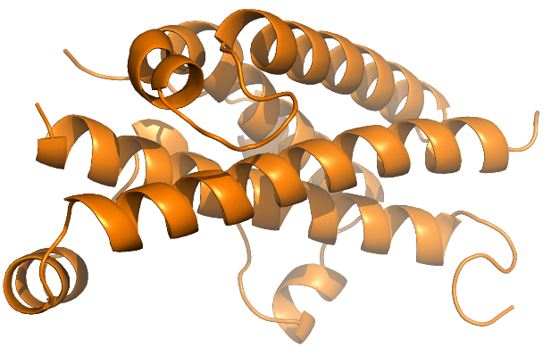
Proteins are encoded by DNA
DNA
sequence
protein-coding
gene
Regulatory element
RNA
Amino acid sequence
Met...Gln-Cys-Asp-Tyr-*
Credit: PDB 1AXI (human growth hormone)
Protein
3D structure

Slide 20
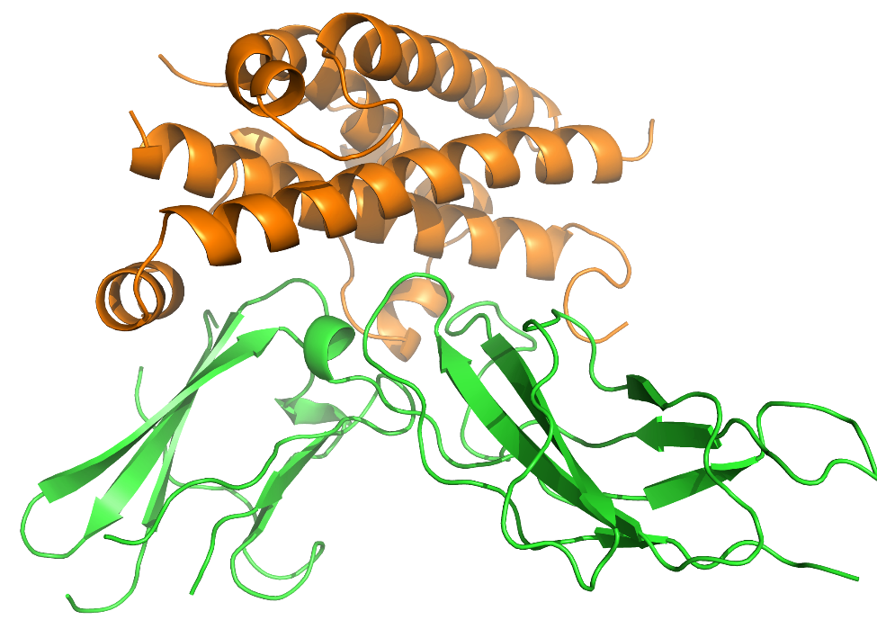
Proteins do not work in isolation: build a protein network
Human growth hormone
Protein network
Node = protein
Edge = interaction
Human growth hormone receptor
Credit: PDB 1AXI
(human growth hormone)

Slide 21
Proteins do not work in isolation: build a protein network
Human growth hormone
Protein network
Node = protein
Edge = interaction
Human growth hormone receptor
Credit: PDB 1AXI
(human growth hormone)

Slide 22
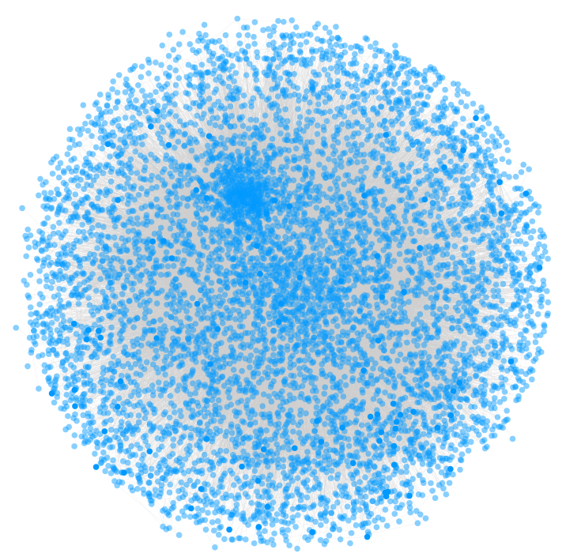
No single network is able to capture all the interactions in the body
‘Multinet’: a mega-network combining
regulatory, physical protein-protein
interaction, signaling, metabolic, genetic
and phosphorylation networks
Nodes (blue): ~15,000 protein-coding genes
Edges (grey): ~110,000 interactions
Khurana*, Fu*, Chen and Gerstein. PLoS Comp Biol. (2013)

Slide 23
Network interpretation of protein-coding genes
Connectivity in Multinet
Four gene categories:
-- LoF-tol: Loss-of-Function tolerant
-- Neutral
-- Disease
-- Essential
Genes with higher impact tend to be more highly connected.
Genes of increasing impact
Khurana*, Fu*, Chen and Gerstein. PLoS Comp Biol. (2013)

Slide 24
Network interpretation of protein-coding genes
Four gene categories:
-- LoF-tol: Loss-of-Function tolerant
-- Neutral
-- Disease
-- Essential
Genes with higher impact tend to be more highly connected.
Essential
LoF-tol
Khurana*, Fu*, Chen and Gerstein. PLoS Comp Biol. (2013)

Slide 25
SNV annotation in the context of a protein network
Protein network
Based on where the SNV lie in the network, we can say something about the effect of the mutation.
We can broadly infer that:
-- highly connected proteins/genes are more impactful (essential or disease genes)
-- if the SNV is in a highly connected gene/protein, it could possibly be deleterious.

Slide 26
Can we more specifically annotate the effects of a SNV in protein-protein interaction?
Human growth hormone
A naïve network SNV mapping assumes: every mutation that falls onto a node has an equal effect on the protein
-- SNV at the interface VS
Protein interface
Human growth hormone receptor
Credit: PDB 1AXI
(human growth hormone)

Slide 27
Can we more specifically annotate the effects of a SNV in protein-protein interaction?
Human growth hormone
A naïve network SNV mapping assumes: every mutation that falls onto a node has an equal effect on the protein
-- SNV at the interface VS
Does every mutation at the interface even have a direct impact on the interaction?
-- What are the molecular properties
of a protein interface?
Protein interface
Human growth hormone receptor
Credit: PDB 1AXI
(human growth hormone)

Slide 28
A molecular perspective
Annotating variants in protein-protein interactions using networks and protein repeat domains

Slide 29
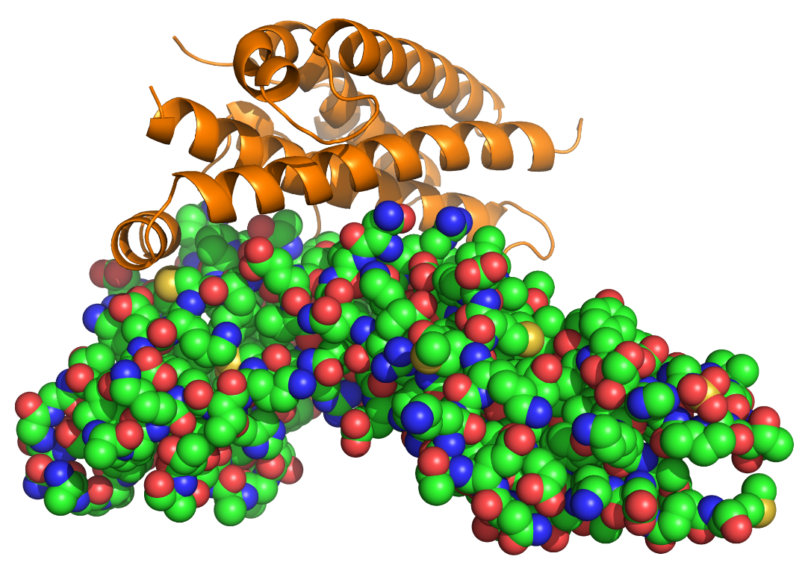
Molecular perspective of the protein interface
nitrogen
oxygen
carbon
sulphur
Credit: PDB 1AXI
(human growth hormone)

Slide 30
Molecular perspective of the protein interface
nitrogen
oxygen
carbon
sulphur
Focus on the physico-chemical:
-- how large is the interface?
Credit: PDB 1AXI
(human growth hormone)

Slide 31
Molecular perspective of the protein interface
nitrogen
oxygen
carbon
sulphur
Focus on the physico-chemical:
-- how large is the interface?
-- what is the amino acid composition?
-- what is the chemical composition?
-- what is the binding energy landscape?
How are these physico-chemical properties related to an interaction or binding?
Credit: PDB 1AXI
(human growth hormone)

Slide 32
Dataset difference then and now
General properties of protein-protein interfaces explored by Chothia and Janin, Nature (1975) and later by Nooren and Thornton, J Mol Biol (2003), based on 19 dimer structures.
Suggest that proteins interfaces with strong interaction/binding affinities are generally
Large
Hydrophobic
Now, we have 113 dimer structures from PDB, via semi-manual curation.

Slide 33
Some questions we revisited
1) Is there a relationship between binding affinity (K_{d}) and
interface surface area (large?)
interface chemical composition (hydrophobic?)
2) What does the binding energy landscape at the interface look like?
∆G = - RT ln K_{d}

Slide 34
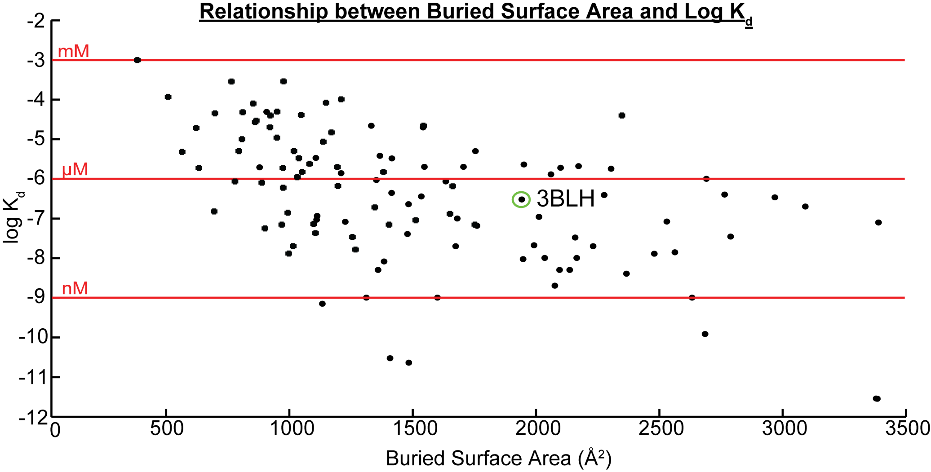

As interface area increases, binding affinity increases
Area
1AXI
C = -0.53
P = 3e-9
Decreasing strength of interaction
Chen, Sawyer and Regan. Prot. Sci. (2013)

Slide 35
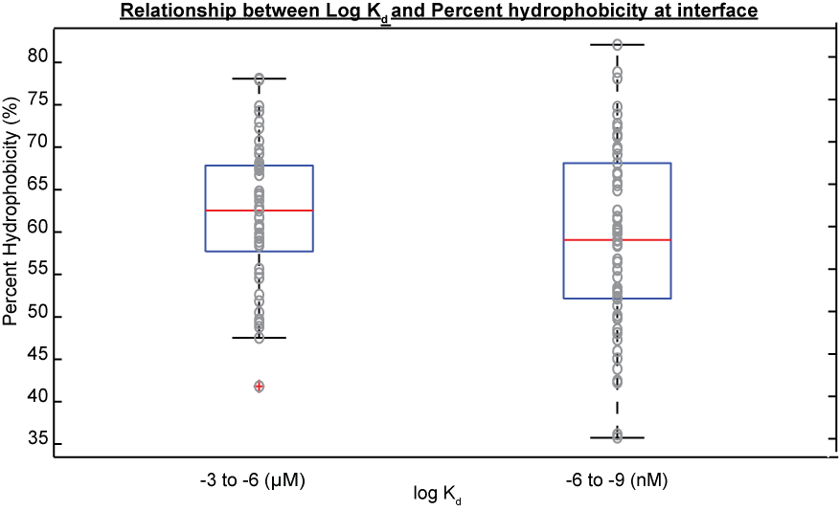
% hydrophobicity is important but not determinant
Chen, Sawyer and Regan. Prot. Sci. (2013)

Slide 36
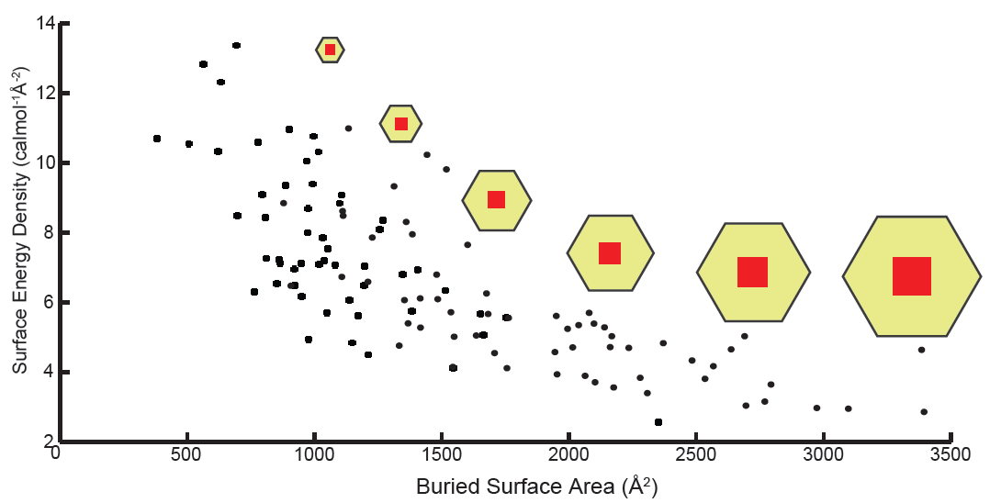
Two regimes:
≤ 2000 Å, energy density decreases
> 2000 Å, energy density plateaus
∆G = - RT ln K_{d}
Chen, Sawyer and Regan. Prot. Sci. (2013)
Notes:
non-uniform increase in energy distribution as interface area increases

Slide 37
Interface density should not be evenly distributed
Chen, Sawyer and Regan. Prot. Sci. (2013)
Notes:
non-uniform increase in energy distribution as interface area increases
Interface density should not be evenly distributed for this to occur

Slide 38
A subset of residues at the interface is important:
In support of the ‘hot spot’ theory
A non-commensurate increase in the size of the ‘hot spots’ at the interface
Chen, Sawyer and Regan. Prot. Sci. (2013)
Notes:
non-uniform increase in energy distribution as interface area increases

Slide 39
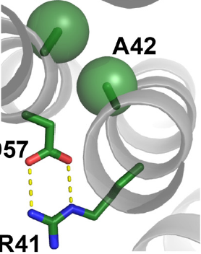
Summary: Annotating variants involved in protein-protein interactions
Protein network
→ Not all proteins will have high impact on protein-protein interactions
Molecules at interface
→ Not all amino acids will have high impact on protein-protein interactions

Slide 40
Summary: Annotating variants involved in protein-protein interactions
Protein network
→ Not all proteins will have high impact on protein-protein interactions
?
Molecules at interface
→ Not all amino acids will have high impact on protein-protein interactions
Can we focus on high impact protein regions and identify residues that are important in protein-protein interaction?

Slide 41
A protein domain perspective
Annotating variants in protein-protein interactions using networks and protein repeat domains

Slide 42
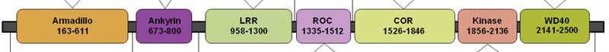
Using protein domains that mediate protein-protein interactions
Protein domain: a functional module within a protein
FOCUS: domains that mediate protein-protein interactions (PPI)
→ e.g. protein repeat domains
PPI domains
Kinase
LRRK2
GTPase
Credit: Rubio et. al. Human Mutation (2012)
Notes:
Protein kinase: multiple binding partners
Involved in Parkinson’s disease
Chr12: 40,689,229-40,763,086 (73,857 bp)
51 exons (including 5’ and 3’ UTRs)
14,227 bp (gene only)

Slide 43
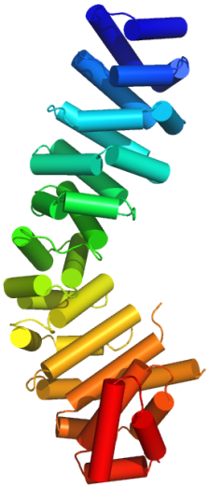
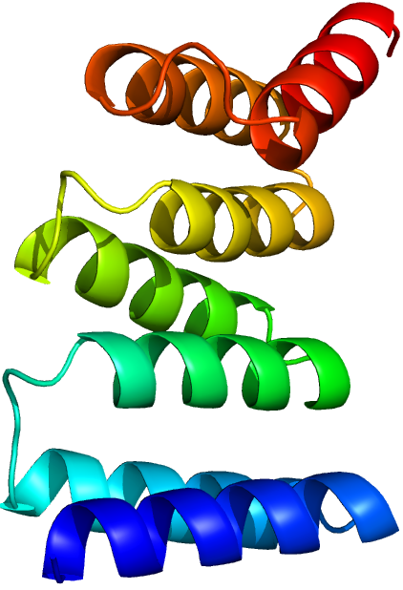
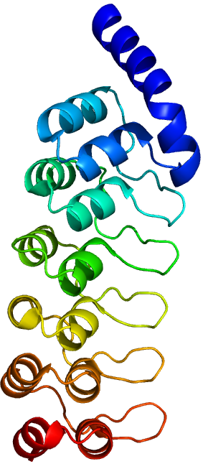
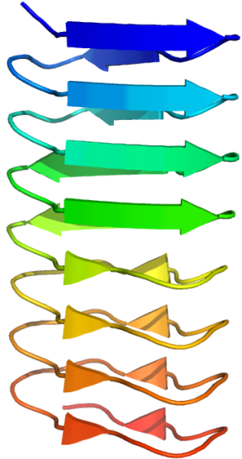
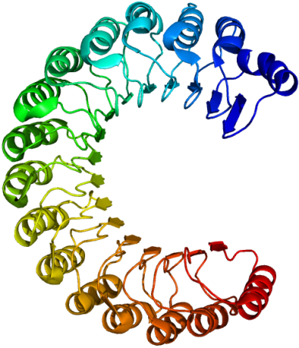
Repeat domains
Each family of repeat domains mediate a diversity of protein-protein interactions
They are modular
Repeat domains are largely classified by their structural folds
Leucine-rich repeat (LRR)
Beta-solenoid
Armadillo (ARM)
Tetratricopeptide repeat (TPR)
Ankyrin (ANK)

Slide 44
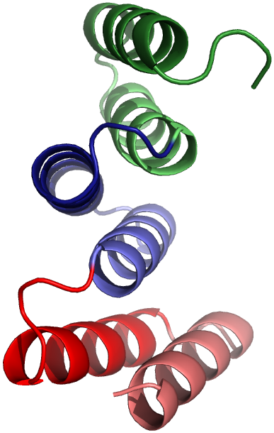
Tetratricopeptide repeat (TPR)
A repeat domain is defined by the number of repeat motifs
e.g. Tetratricopeptide repeat (TPR)
B1
B1
Each repeat, or TPR motif, is
- 34 amino acids
A1
A1
Sawyer*, Chen* & Regan. J Mol Biol (2013)

Slide 45
Tetratricopeptide repeat (TPR)
A repeat domain is defined by the number of repeat motifs
e.g. Tetratricopeptide repeat (TPR)
B3
A3
DOMAIN
A2
B1
MOTIF/
REPEAT
B1
B1
A1
A1
A1
Sawyer*, Chen* & Regan. J Mol Biol (2013)

Slide 46



To identify residues important in PPI:
Conservation in inter-species multiple sequence alignment
‘Conservation’
We look for amino acid conservation over long evolutionary time, via similar regions in genomes of different species
Notes:
Baseline within human pop: 99.9% of the elements should be conserved

Slide 47
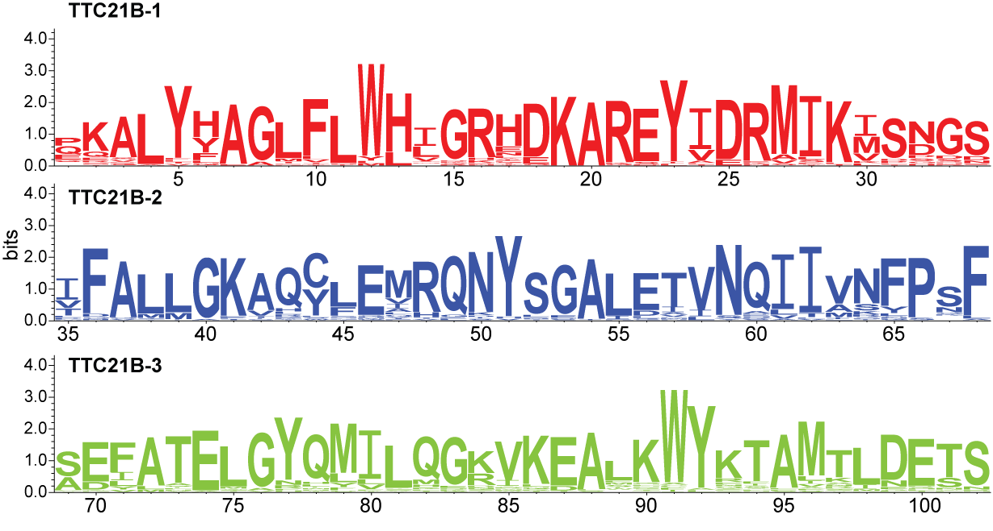
Using species homology, all positions are important!
Showing 3 out of 16 TPRs of TTC21B in 250 species
Chen, Gerstein and Regan (manuscript in preparation)
Notes:
SNVs are also sparsely distributed throughout the entire TPR domain

Slide 48
To identify important residues:
Conservation in intra-species multiple sequence alignment
Similarity across species
Similarity within a single human genome

Slide 49
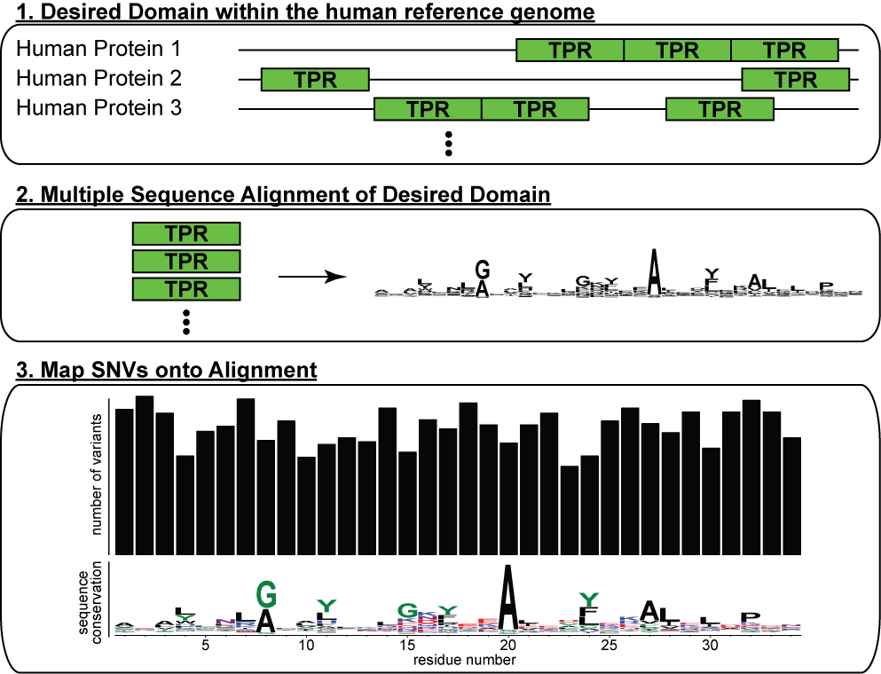
Strategy
Chen, Gerstein and Regan (manuscript in preparation)

Slide 50
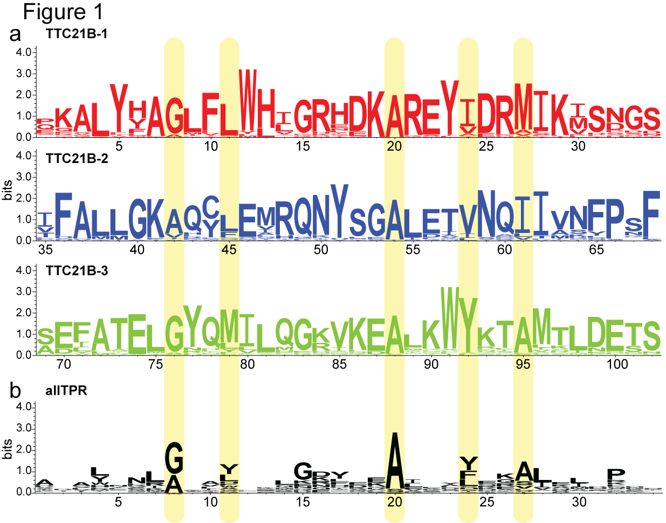
Identify important residues in protein interaction domains
250 sequences
671 sequences
Chen, Gerstein and Regan (manuscript in preparation)

Slide 51
SNV mapping using data from ExAC (Exome Aggregation Consortium)
 | ExAC
Number of individuals | 60,706
Total number of autosomal SNVs | 7,202,445
Total number of autosomal SNVs in TPRs (excl. singletons) | 3,342

Slide 52
Evolutionary constraints and the nature of a SNV/mutation
Effect of the SNV on residues
→ synonymous (S): mutation that causes no change in amino acid
e.g. GCA and GCC both give alanine.
→ non-synonymous (NS): mutation that causes a change in amino acid
e.g. GCA gives alanine while GAA gives glutamic acid
Evolutionary constraint on a NS mutation is higher
(assume evolutionary constraint on a S mutation is neutral)

Slide 53
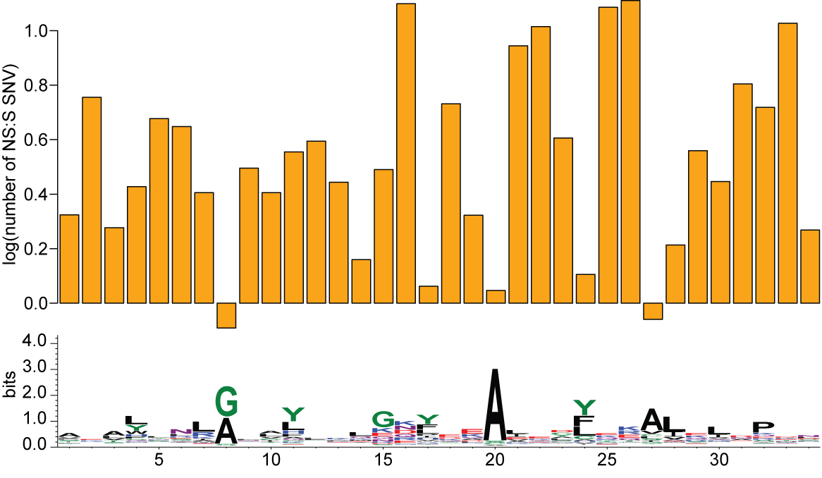
Conserved positions show signs of high selective constraints (low NS:S ratio)

Slide 54
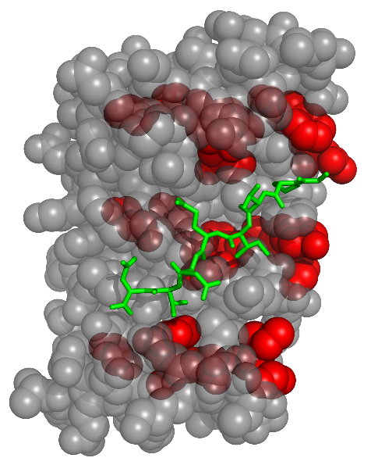
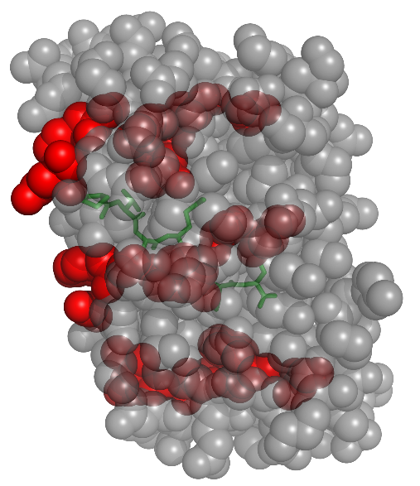
Conserved sites are at the core in TPR domains
concave
convex
Credit: PDB 1ELW

Slide 55
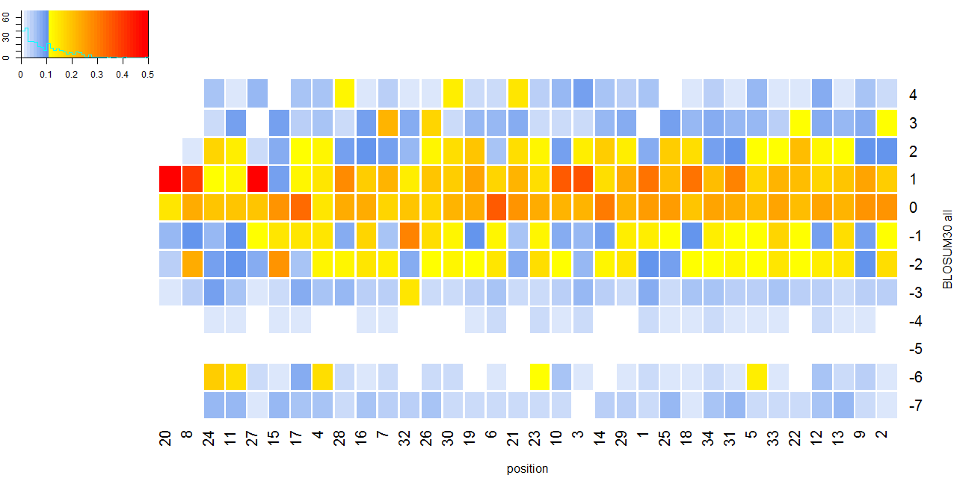
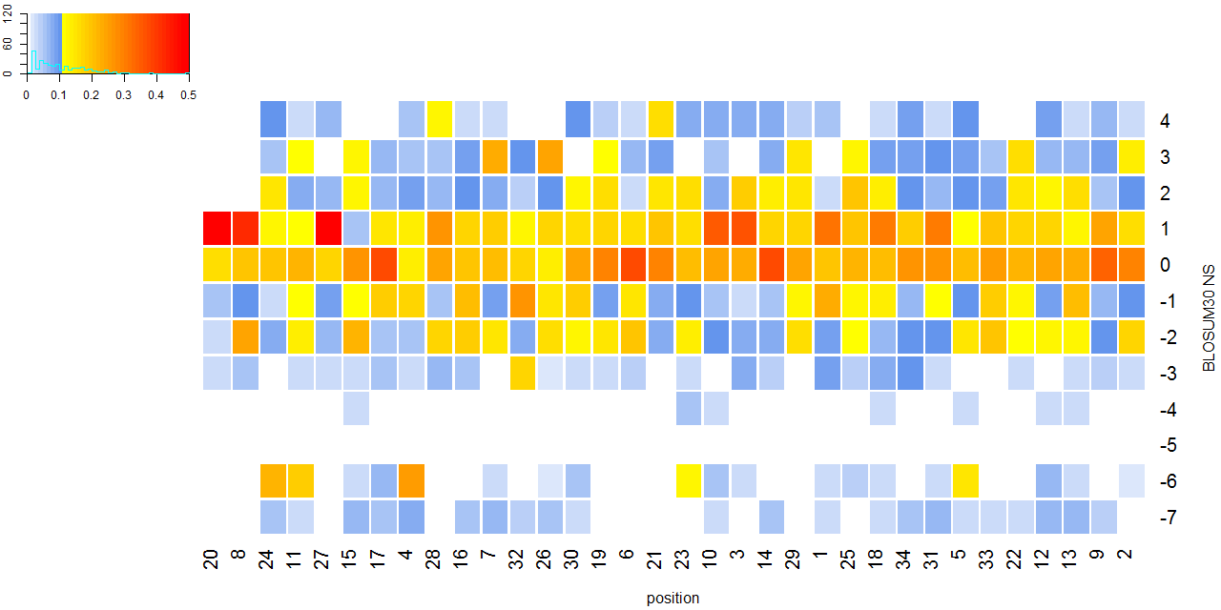
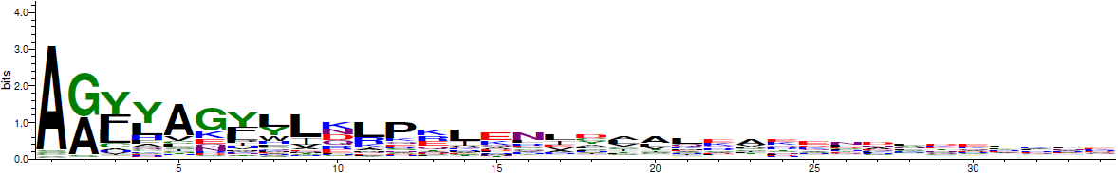
Using BLOSUM30 scores to determine severity of mutation that fall on conserved sites
Notes:
Between BLOSUM 30, BLOSUM 62
What if we take away S?
NS changes concentrate around neutral or <neutral/deleterious changes in general in both matrices
Pos20 in BLOSUM 62 concentrates on neutral aa changes, while BLOSUM 30 has positive aa changes → why?
But it seems that physicochemical changes do not show as much information as conservation
What are these changes? Heatmaps….

Slide 56
Summary: Annotating variants involved in protein-protein interactions
Networks provide variant annotation in a broad, high-level fashion

Slide 57
Summary: Annotating variants involved in protein-protein interactions
Networks provide variant annotation in a broad, high-level fashion
Molecular perspective of the protein interface shows that not all residues at the interface are as important in binding.

Slide 58
Summary: Annotating variants involved in protein-protein interactions
Networks provide variant annotation in a broad, high-level fashion
Molecular perspective of the protein interface shows that not all residues at the interface are as important in binding.
Using domains involved in protein-protein interactions, we can identify residues that are more important at the interface.
→ SNVs on these residues are likely to be more impactful

Slide 59
Summary: Annotating variants involved in protein-protein interactions
Networks provide variant annotation in a broad fashion
Molecular perspective of the protein interface shows that not all residues at the interface are as important in binding.
Using domains involved in protein-protein interactions, we can identify residues that are more important at the interface.
→ SNVs on these residues are likely to be more impactful

Slide 60
AlleleDB: A resource for allele-specific variants and elements

Slide 61
Based on the following selected work
1000 Genomes Project Consortium, Nature (2012)
Khurana E, … , Chen J. et al. Science (2013)
Sudmant P, …, Chen J. et al. Nature (2015) (in press)
Chen J., Rozowsky J. et al. (manuscript under review)

Slide 62
Allele-specific variant annotation expands to whole genome
Non-coding
(98%)
Protein-coding (2%)

Slide 63
What is allele-specific behavior
AlleleDB: A resource for allele-specific variants and elements

Slide 64
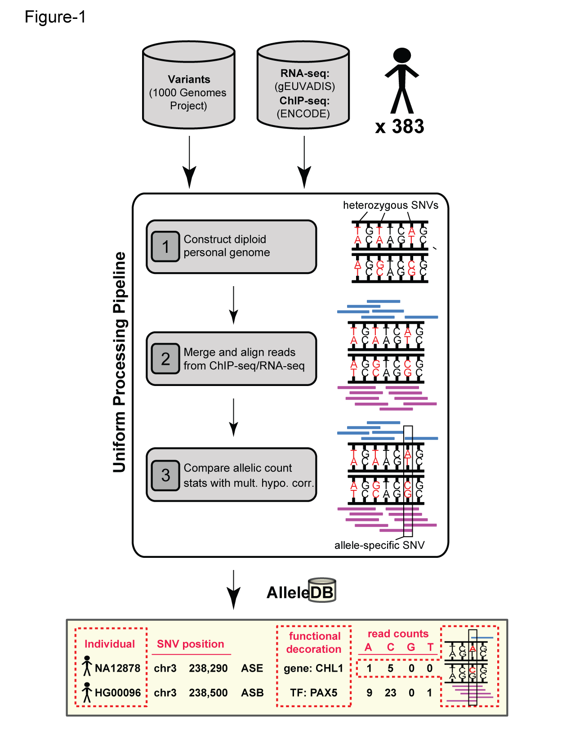
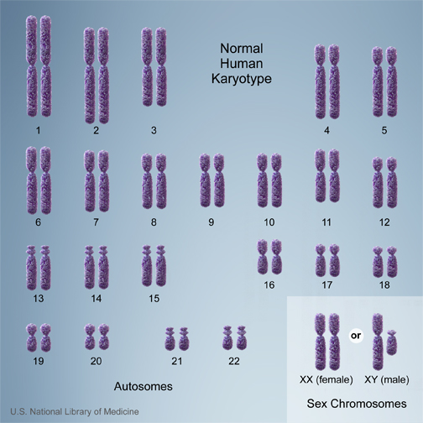
The human genome is diploid
Haploid
Reference
Genome
Allele 1
P
M
Allele 2
Credit: http://ghr.nlm.nih.gov/handbook/illustrations/normalkaryotype

Slide 65
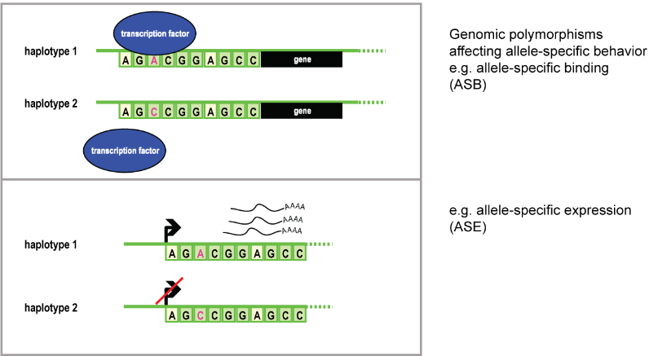
What is allele-specific binding and expression?
P
*
M
*
P
*
M
*

Slide 66
Allele-specific (AS) behavior is important
Allele-specific behavior
-- gene expression
-- transcription factor binding
-- histone modification, protein translation etc.
Some diseases implicated by allele-specific effects:
-- Prader-Willi/Angelman Syndrome
-- Various cancers e.g. colorectal cancer (Valle et al. Nat Genet 2008)
healthy
diseased
M
P
Notes:
Cis = TFBS, promoters, 3’, 5’, QTLs
Trans = TFs

Slide 67
How to detect allele-specific variants
AlleleDB: A resource for allele-specific variants and elements

Slide 68


Finding allele-specific variants starts with a functional assay – e.g. ChIP-seq
Transcription-factor (TF); DNA-binding
Sonicate (using sound energy to break DNA up)
Crosslink with formaldehyde
Add TF-specific antibody
Immunoprecipitate and purify the complex
Reverse crosslink
DNA reads

Slide 69
How to detect AS variants (typical)
Start with reads:
-- RNA-seq reads for allele-specific expression (ASE)
-- ChIP-seq reads for allele-specific binding (ASB)
Alignment of functional assay reads onto human reference genome
Find heterozygous variants in regions with differential read counts between reference and alternate alleles using a statistical test, e.g. binomial test.
read
Human reference genome
read

Slide 70
How to detect AS variants (typical)
Start with reads:
-- RNA-seq reads for allele-specific expression (ASE)
-- ChIP-seq reads for allele-specific binding (ASB)
Alignment of functional assay reads onto human reference genome
Find heterozygous variants in regions with differential read counts between reference and alternate alleles using a statistical test, e.g. binomial test.
read
Human reference genome
read

Slide 71
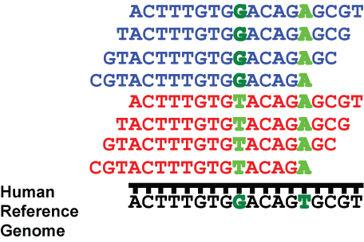
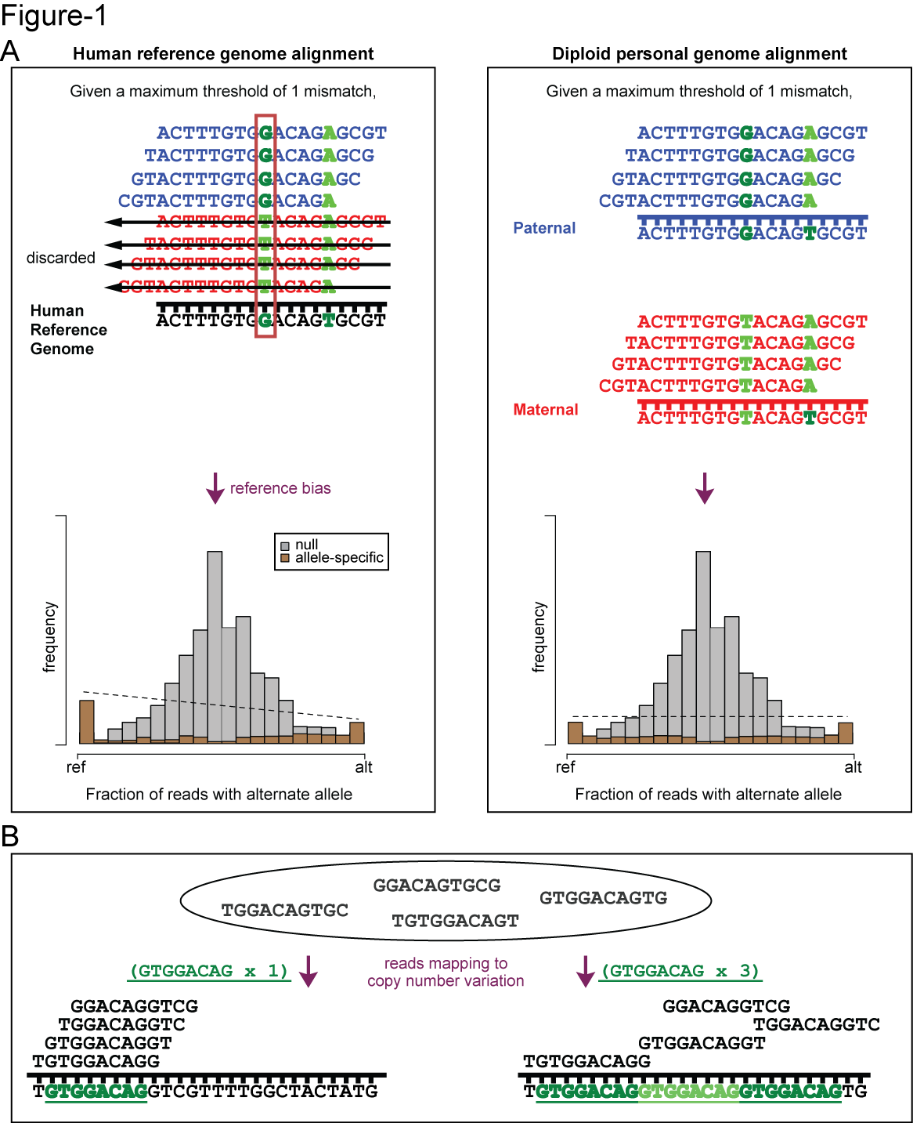
Statistical test to determine if a variant is allele-specific
Test for significance deviating from hypothesis there should be an equal number of reads on both alleles (proportion = 0.5)
H₀: allelic ratio = 0.5
H₁: allelic ratio ≠ 0.5
This does not determine
causality.
G/T
# reads
4
G (ref)
0
T
allelic ratio
= ref/total = 4/4 = 1

Slide 72
Creating the AlleleDB resource
AlleleDB: A resource for allele-specific variants and elements

Slide 73
Two issues
Reference bias
-- from the use of the human reference genome
-- we use personal genomes
Overdispersion in ChIP-seq and RNA-seq data
-- binomial test does not account
-- we use a beta-binomial test, which can account for overdispersion

Slide 74
Two issues
Human reference genome
-- introduces reference bias
-- we use personal genomes
Binomial test
-- this statistical test does not account for possible overdispersion of ChIP-seq and RNA-seq data
-- we use a beta-binomial test, which can accommodate overdispersion

Slide 75
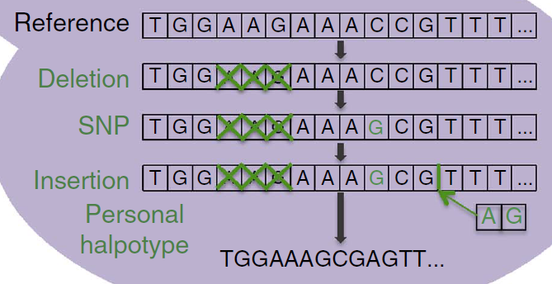

We construct a personal genome and match each individual with ChIP-seq and RNA-seq sets for AS analyses
M
P
ChIP-seq
RNA-seq
Personal Genome
NA12878
Rozowsky et al. Mol. Syst. Biol. (2011)
http://alleleseq.gersteinlab.org/

Slide 76
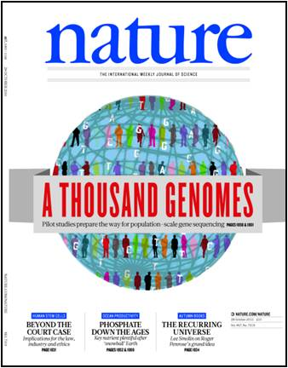


Using publicly available DNA-seq, RNA-seq and ChIP-seq datasets
8 different studies: 1000 Genomes Project, gEUVADIS, Encode + 5 more
Have to uniformly re-process all of the datasets!
1000 Genomes Project Consortium, Nature (2012)
Khurana E, … , Chen J. et al. Science (2013)

Slide 77
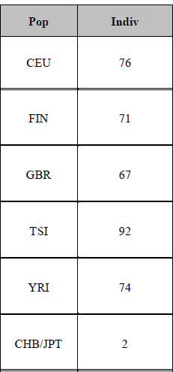
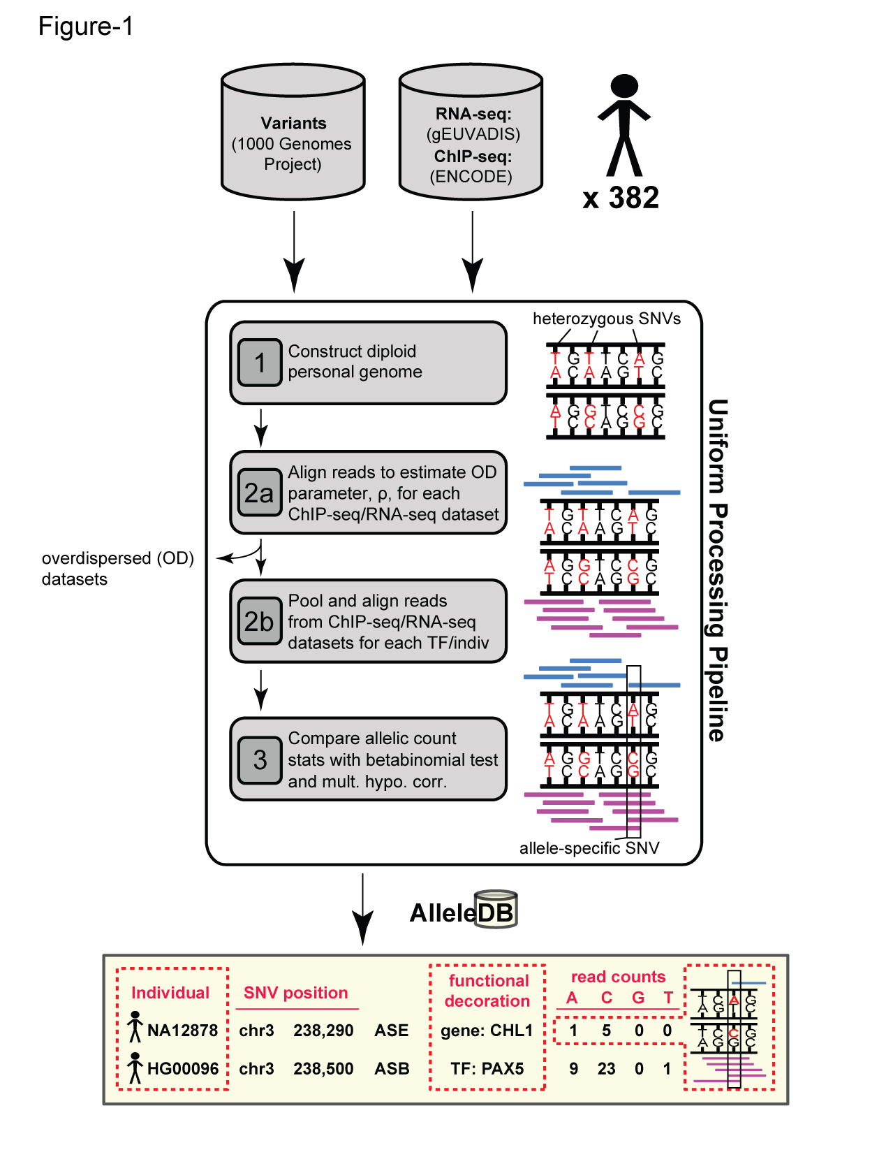
AlleleDB: Build 382 personal genomes then detect AS variants
# studies = 8
# RNA-seq = 993
# ChIP-seq = 287
Chen J., Rozowsky J. et al. (manuscript under review)

Slide 78
Two issues
Human reference genome
-- introduces reference bias
-- we use personal genomes
Binomial test
-- does not account for possible overdispersion of ChIP-seq and RNA-seq data
-- we use a beta-binomial test, which can accommodate overdispersion

Slide 79
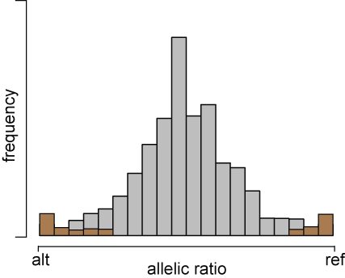
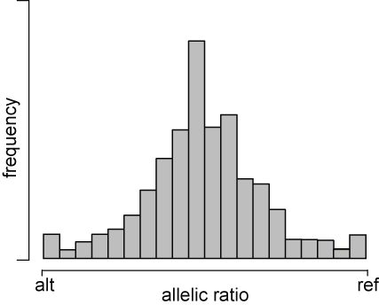
Allelic ratio distributions
Allelic ratio = ref/total
To detect allele-specific imbalance, use statistical test
-- deviation from allelic ratio of 0.5 (balance)

Slide 80
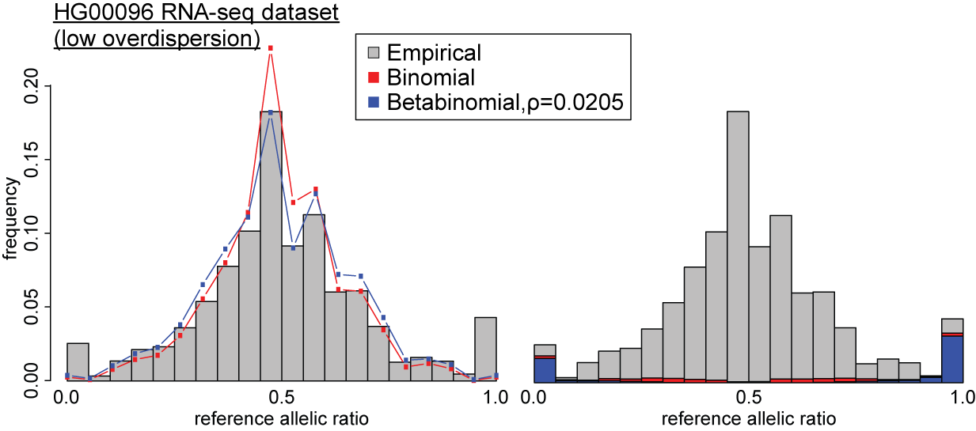
Accounting for overdispersion:
Binomial VS Beta-binomial
Chen J., Rozowsky J. et al. (manuscript under review)

Slide 81
Accounting for overdispersion:
Binomial VS Beta-binomial
Chen J., Rozowsky J. et al. (manuscript under review)

Slide 82
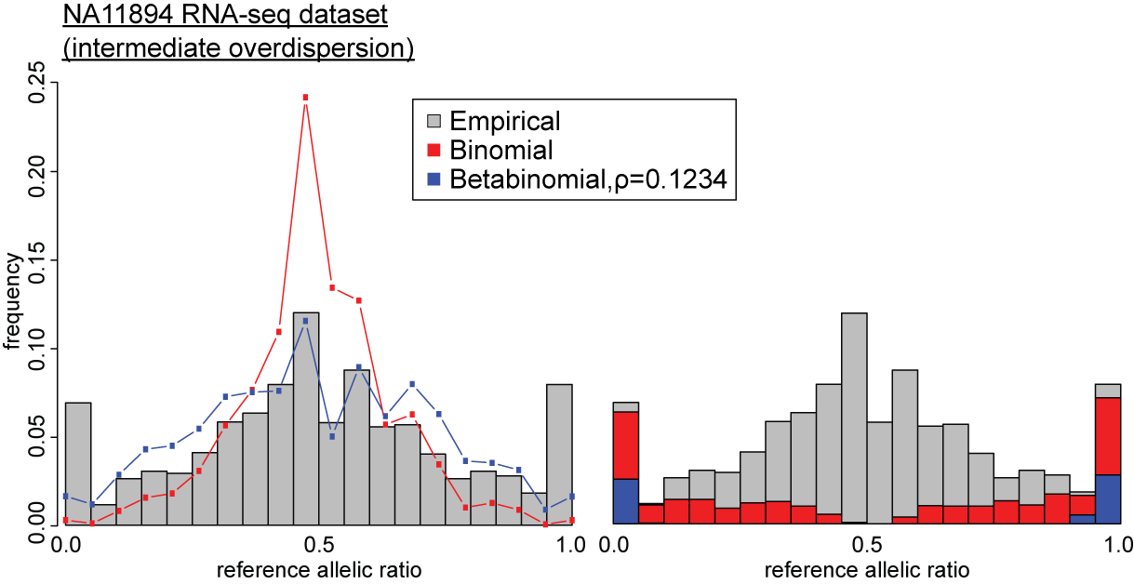
Accounting for overdispersion:
Binomial VS Beta-binomial
Chen J., Rozowsky J. et al. (manuscript under review)

Slide 83
Accounting for overdispersion:
Binomial VS Beta-binomial
Chen J., Rozowsky J. et al. (manuscript under review)

Slide 84
A 2-step serial overdispersion calculation
Chen J., Rozowsky J. et al. (manuscript under review)

Slide 85
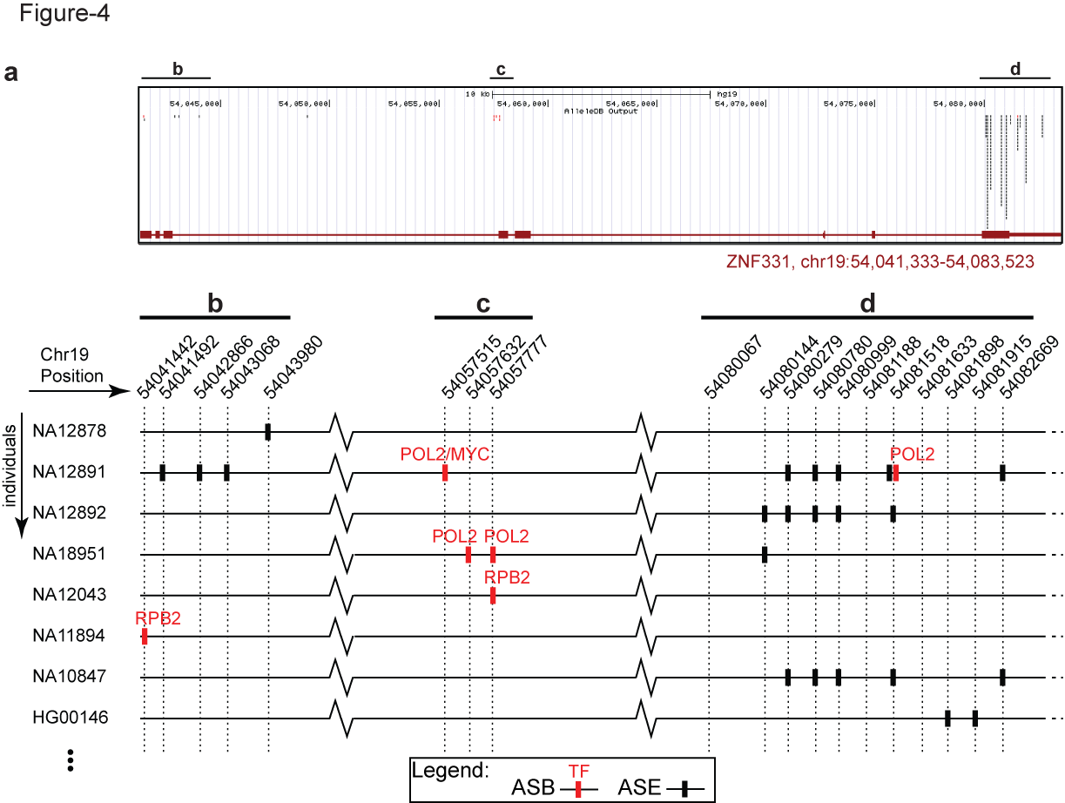
AlleleDB: repository and visualization for allele-specific binding and expression variants
Interfaces with UCSC genome browser
Chen J., Rozowsky J. et al. (manuscript under review)

Slide 86
Using personal genomes to further annotate allele-specific genomic regions
Does a particular genomic element have a higher tendency to be allele-specific?
-- Fisher’s exact test, for the enrichment of allele-specific variants in the element (with respect to non-allele-specific variants)
allele-specific
non-allele-specific
Human reference
genome

Slide 87
AlleleDB resource also provides pre-computed allele-specific annotation of genomic elements
Allele-specific annotation for
-- 20K protein-coding genes
-- 952 non-coding genomic categories (e.g. transcription factor binding peaks and motifs, DNaseI hypersensitivity sites)
E.g. Potential impact of SNPs on binding at transcription factor (TF) motifs
-- 7,985 candidate SNPs located at TF motifs across
14 individuals
Chen J., Rozowsky J. et al. (manuscript under review)

Slide 88
Summary
AlleleDB
-- resource for exploring allele-specific variants, genomic elements and genes
-- interfaces with UCSC browser
-- based on construction of personal genomes
Annotation for the personal genome does not have to be the endpoint;
we can use the personal genomes in an informative way
Genome Annotation
Personal genomes
Notes:
View personal genome Not as an endpoint but as an informative way to feedback into the genome annotation process

Slide 89
Acknowledgements
My advisors: Lynne and Mark
My committee members: Don, Sherman and Anita
Special thanks to Mary and Janet
My support group: Gerald (Goh), Cheow Thia (Chan), Gili (Zilberman), Lauren Ann (Metskas), Nick (Sawyer), Lisa (Sobel), Namita (Gupta), Stephen (Gaffney)
My mentors: Joel, Suganthi, Ekta, Arif
PEB program, and to Doro
CBB program, and all CBBers
Gerstein Lab, all past and present members, especially: Alexej, Cristina, Darryl, Declan, Jane, Jasmine, Rob, Timur and Yao
Regan Lab, all past and present members, especially: Betsy, Ashley (AKA Chatty Bay members), Robie and Robert
My squash buddies, especially: Stephen and Miles
All my roommates, past and present: Matt, Craig, Alex, Kelly, Mark, Manavi, Rebecca, Victor
All my friends in the audience

Slide 90
Acknowledgements
My family: my parents, my aunt, my brother Jiejing, my godsister Nadia and my best buddy Russell
My partner: Siying

Slide 91
Appendices

Slide 92
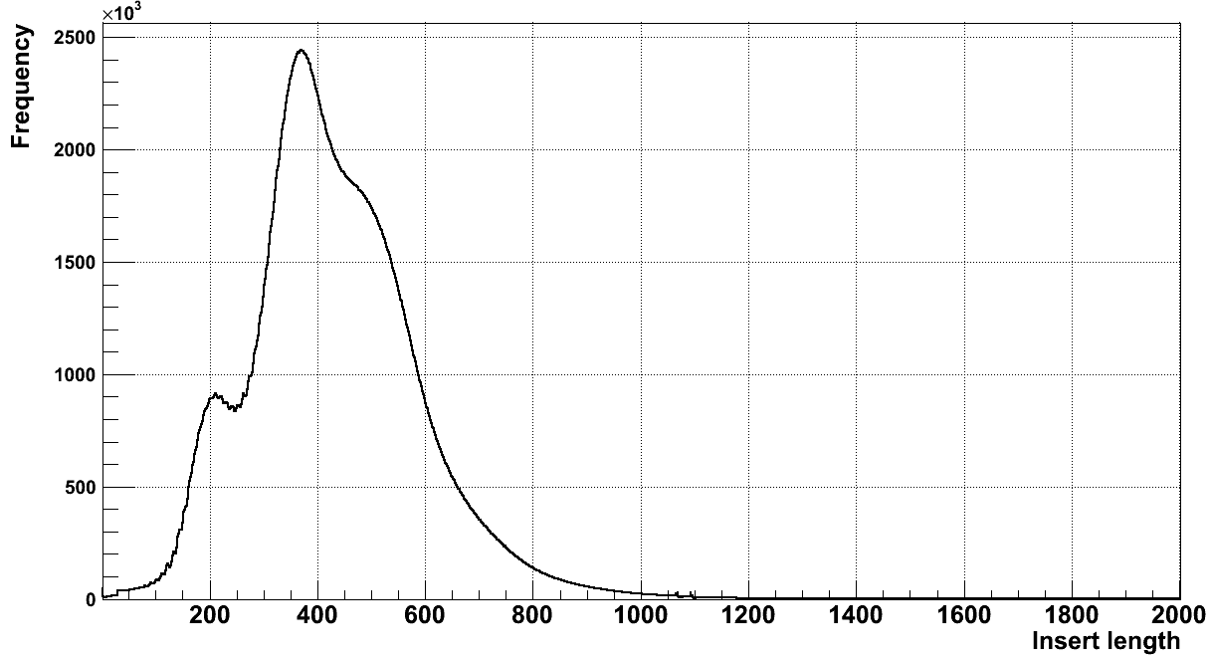
Insert length for PCRfree (PCR+) technology
Insert size = ~400bp
Read length = 250bp
For >50% of pairs of reads significantly overlap
Credit: Alexej Abyzov

Slide 93
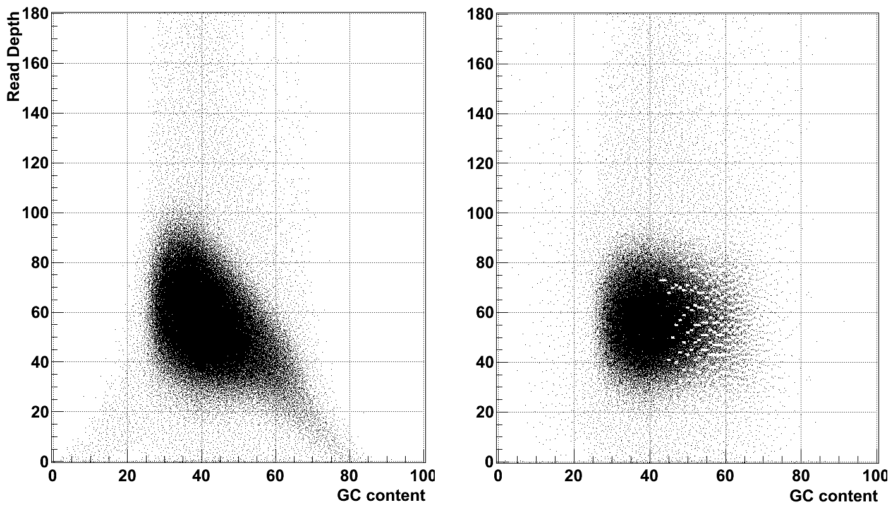
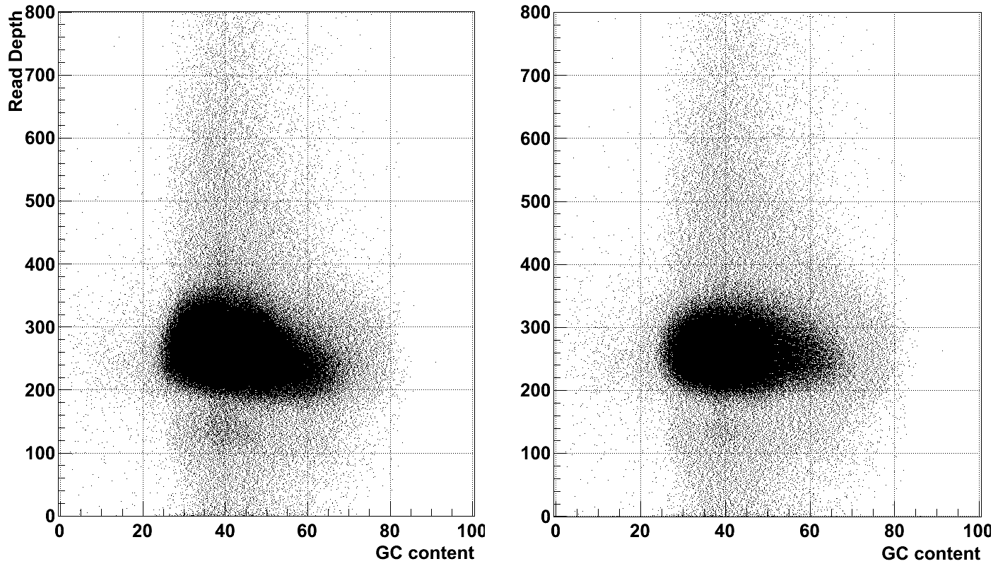
GC bias
PCR+
PCR-
Credit: Alexej Abyzov

Slide 94
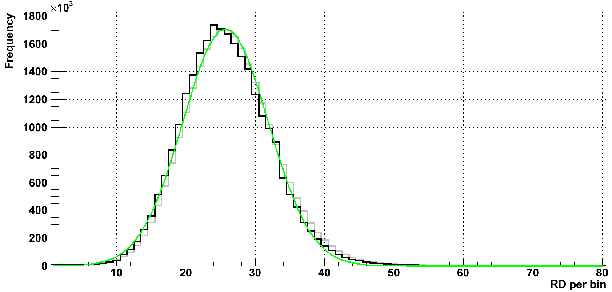
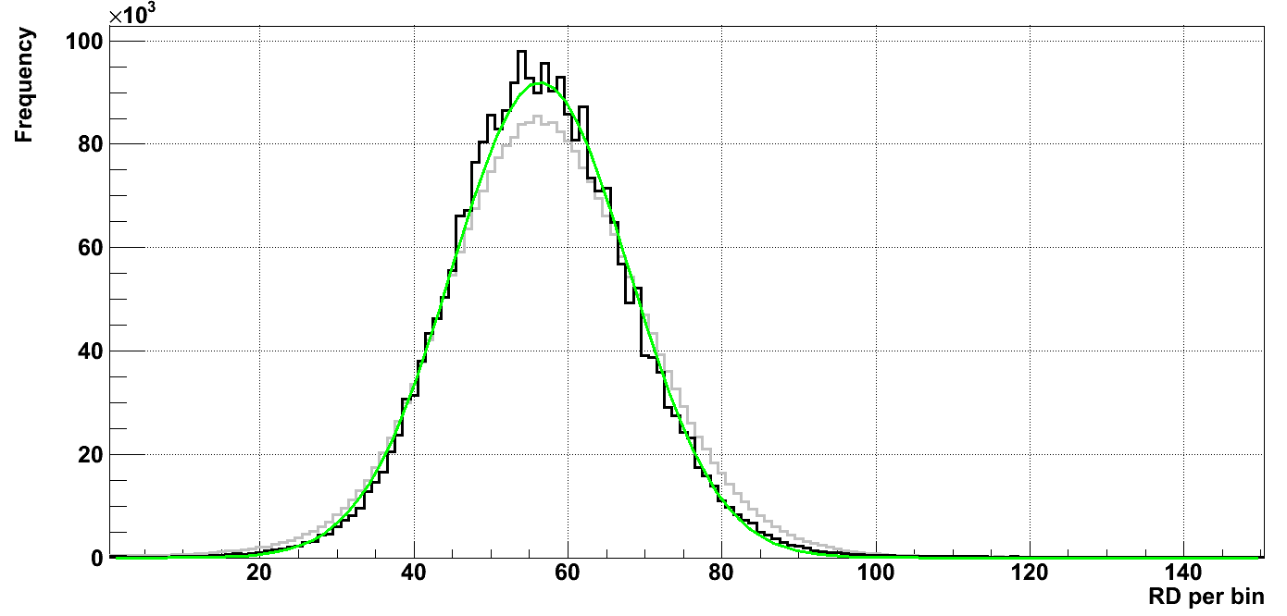
Coverage uniformity
PCR+
Raw RD
Corrected RD
Gaussian 25.7+-6.17 (12%)
Expectation 25.7 +- 5.07
PCR-
Raw RD
Corrected RD
Gaussian 56.4 +-11.5 (15%)
Expectation 56.4 +- 7.51
Credit: Alexej Abyzov

Slide 95
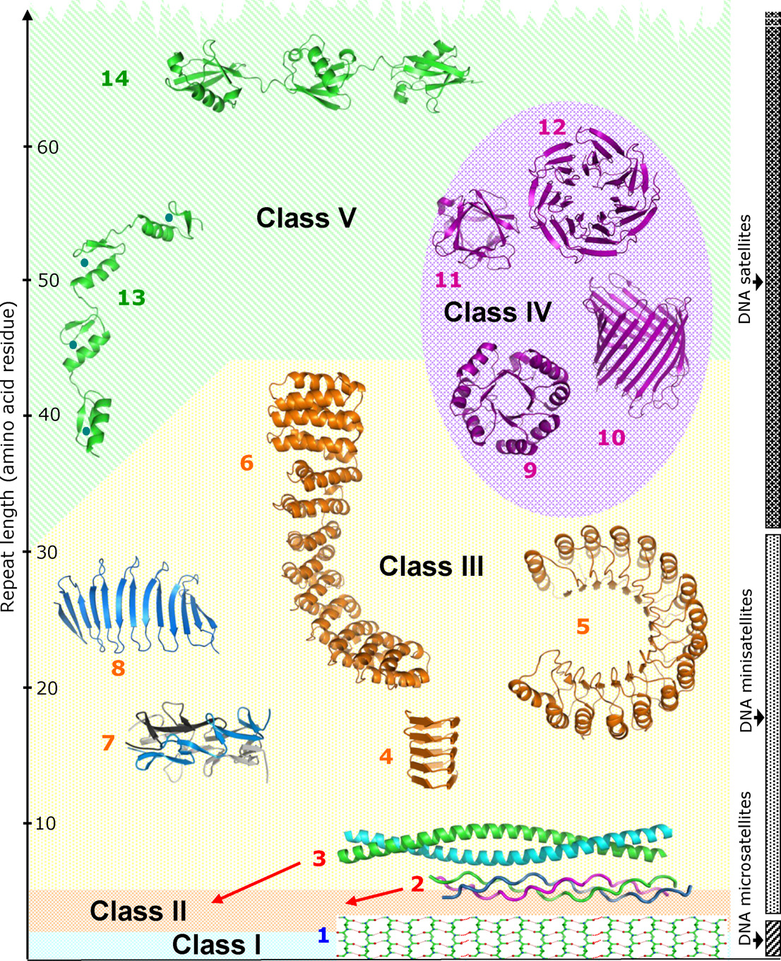
Credit: Kajava 2013 Journal of Struct Biol
V: repeats can fold indptly
e.g. Zn finger domain (13), polyubiquitin (14)
titin
IV: “closed” structures
e.g. TIM barrels (9), WD40/beta propeller (12),
beta barrels (10)
III: elongated structures
solenoid: e.g. TPR, ankyrins
Non-solenoid: e.g. beta structures
II; fibrous : e.g. collagen
I; homopolymers : e.g. polyQ tract HTT gene

Slide 96
Kajava 2013 Journal of Struct Biol
IV: “closed” structures
e.g. TIM barrels (9), WD40/beta propeller (12),
beta barrels (10)
III: elongated structures
solenoid: e.g. TPR, ankyrins
Non-solenoid: e.g. beta structures

Slide 97
Binomial → Betabinomial
k~beta(a,b)
Binomial
X ~ (n,k)
Betabinomial
X ~ (n,a,b)
Assumes each X is an independent event
Accounts of “overdispersion” (broader distribution)
n = total number
k = number of ref reads
(fixed number)
X can be dependent on each other
Accounts of “overdispersion” (broader distribution)
n = total number
k is sampled from a betabinomial distribution with parameters (a,b)

Slide 98
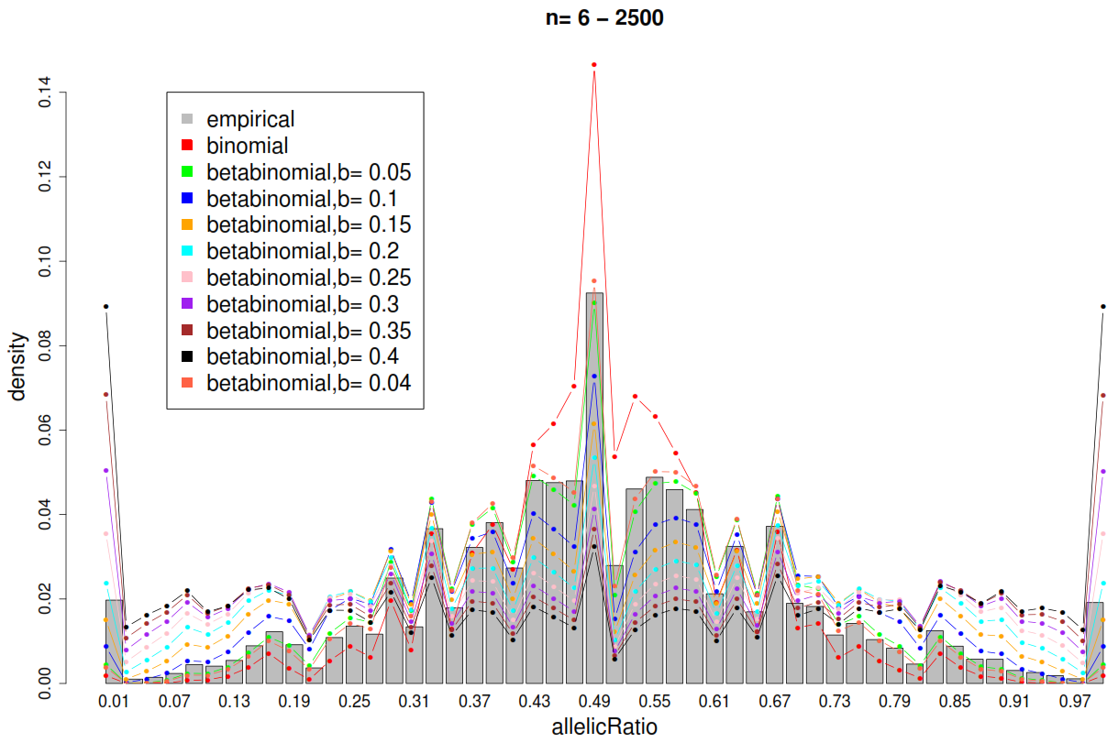
Fix a, scan for b, using Least Sum Squared Errors

Slide 99
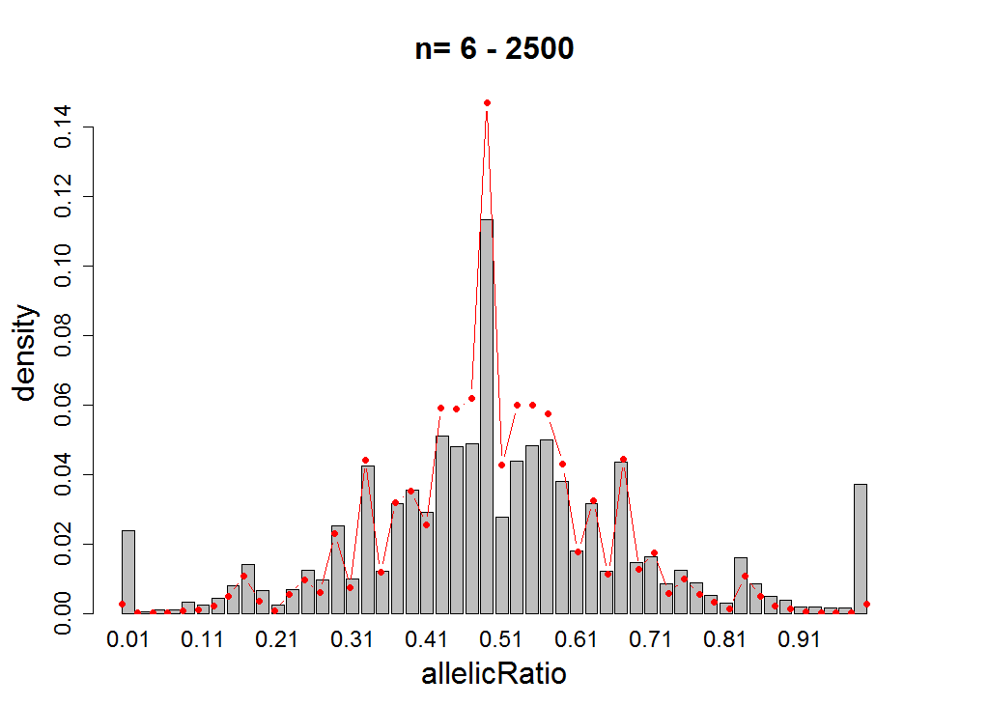

How well is the binomial null fit?
Binomial
Empirical
Allele-specific (binomial)
HG00096 RNA-seq

Slide 100

HG00096 RNA-seq b=0.02
Pooled
Binomial
Betabinomial

Slide 101

Distribution is broader
Heavy tails
Too many false positives
NA12891 MYC ChIP-seq
Binomial
Empirical
Allele-specific (binomial)

Slide 102

NA12891 MYC ChIP-seq; a=0.5, b=0.297
Binomial
Betabinomial

Slide 103
Allelic ratio distributions
Allelic ratio = ref/total
To detect allele-specific imbalance, use statistical test
-- deviation from allelic ratio of 0.5 (balance)
betabinomial
We use binomial test to test for deviation significance (p value)
H₀: allelic ratio = 0.5
H₁: allelic ratio ≠ 0.5

Slide 104
Implementing the betabinomial
Use b parameter in betabinomial as a measure of dataset quality
-- how broad the allelic ratio distribution is
-- the broader it is, the more false positives it will generate
Thresholding of p value to give enough “positives” for downstream analyses
Applied these to 1280 datasets for 383 individuals
New results on the way…

