Slide 1
Variant calling
To follow up on Kevin's comment, right now I have called ~80 unique tumor-normal pairs from TCGA breast using SwiftSeq.
For each pair, we have 3 sets of SNV calls (MuTect, Strelka, & Varscan 2) and two sets of indel calls (Strelka & Varscan 2).
Structural variant calls were made with Delly.
I'll also have copy number, purity, and ploidy calls from the WGS data using ASCAT.
Regarding germline, for 98 WGS BRCA samples I've performed single sample calling with Platypus and multi-sample calling with GATK HaplotypeCaller

Slide 2
Enhancers
If we just want to look at enhancer activity we can create a custom capture for the regions you want.
With 10000 sites it should be feasible.
Testing the mutants however will need to be done after the enhancer assay (pick the top 200 or so, perform wt vs mut) due to the time and costs of creating the mutated enhancers (similar to the data I produced a while back for Gersteins lab).

Slide 3
Variants Number estimates in PCAWG
In PCAWG, there are 207 BRCA samples
1,235,299 variants in total for these 207 samples, excluding the gap region and blacklist regions
Conservative estimation: average mutation rate =1,235,299/3billion = 0.0004117663

Slide 4
How many do we expect within the the enhancers
If enhancers are enriched in open chromatin regions -> slightly higher mutation rate than other
N_var_per_1k_enhancer = 1000 * 0.0004117663 = 0.4117663
On average , for 10k enhancers, in total we have 0.4117663 * 10,000 = 411.7663

Slide 5
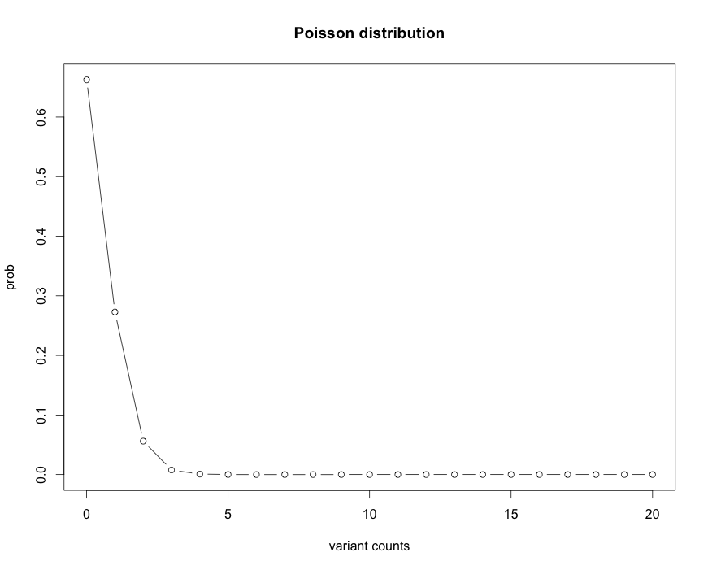

Slide 6
Number of variants | Expected Number of Enhancers
0 | 6625
1 | 2727
2 | 562
3 | 7.7
4 | 6
For sure, we will have more than 200 variants in total
Suppose, 10% of the 10k computationally predicted enhancers are positives, we will have 0.4117663 * 10,000 * 0.1 = 41.17663 in these active enhancers
Conclusion:
Possible to test all the variants in the + enhancers discovered by STAR-seq
Impossible to test all the variants in all enhancers

Slide 7
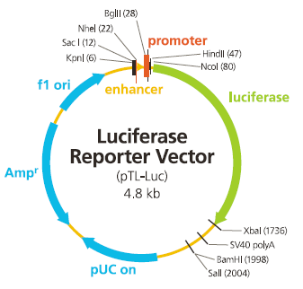
somatic
Strong promoter
250bp
mut
250bp
germline
Strong promoter
250bp
wild
250bp
Both are active, but no obvious difference in activities
Why must one germ line & one somatic? Why not both somatic?
Test both promoter & enhancers
Testing other regions:
Luciferase assay results for the wild-type and mutant versions of three regulatory regions repeatedly mutated in cancers.

