Slide 1
AlleleDB Figure Pack
Notes:
Allelic != allele-specific

Slide 2
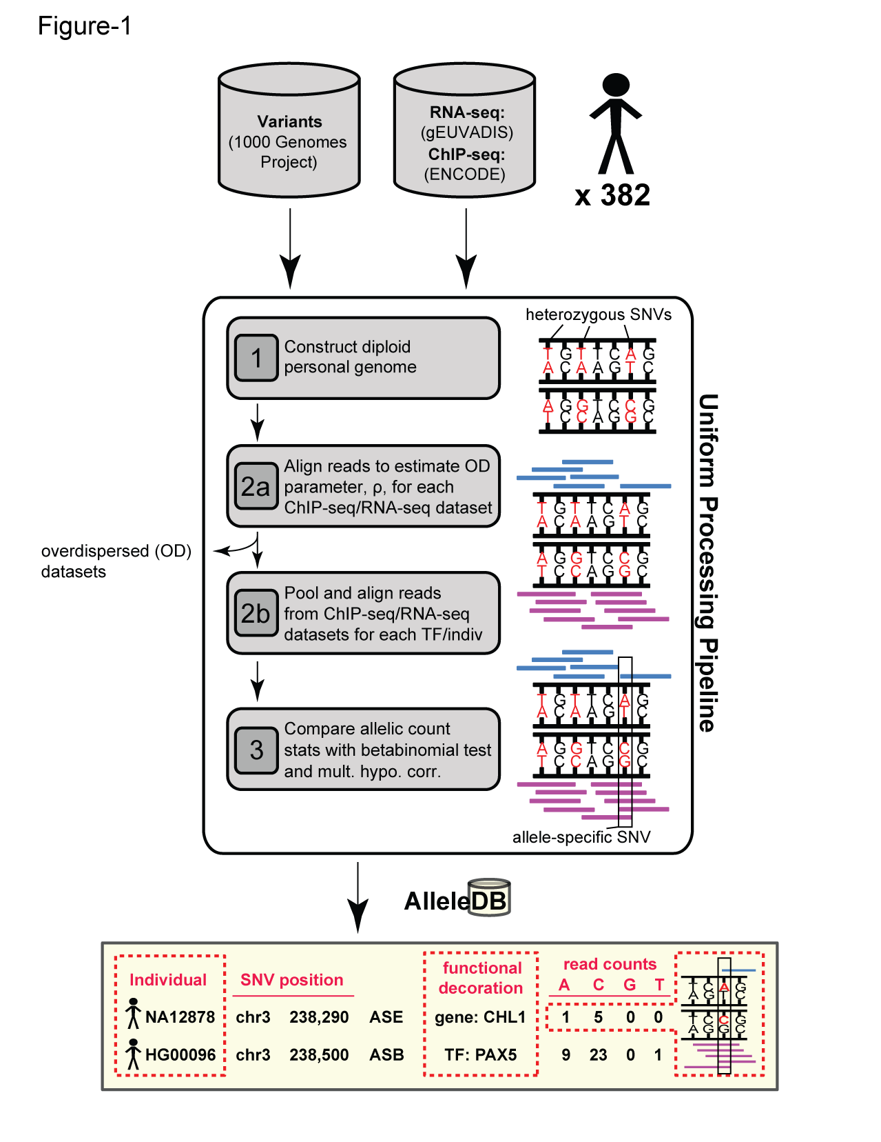
Figure 1. Workflow for uniform processing of data from 382 individuals and construction of AlleleDB.

Slide 3
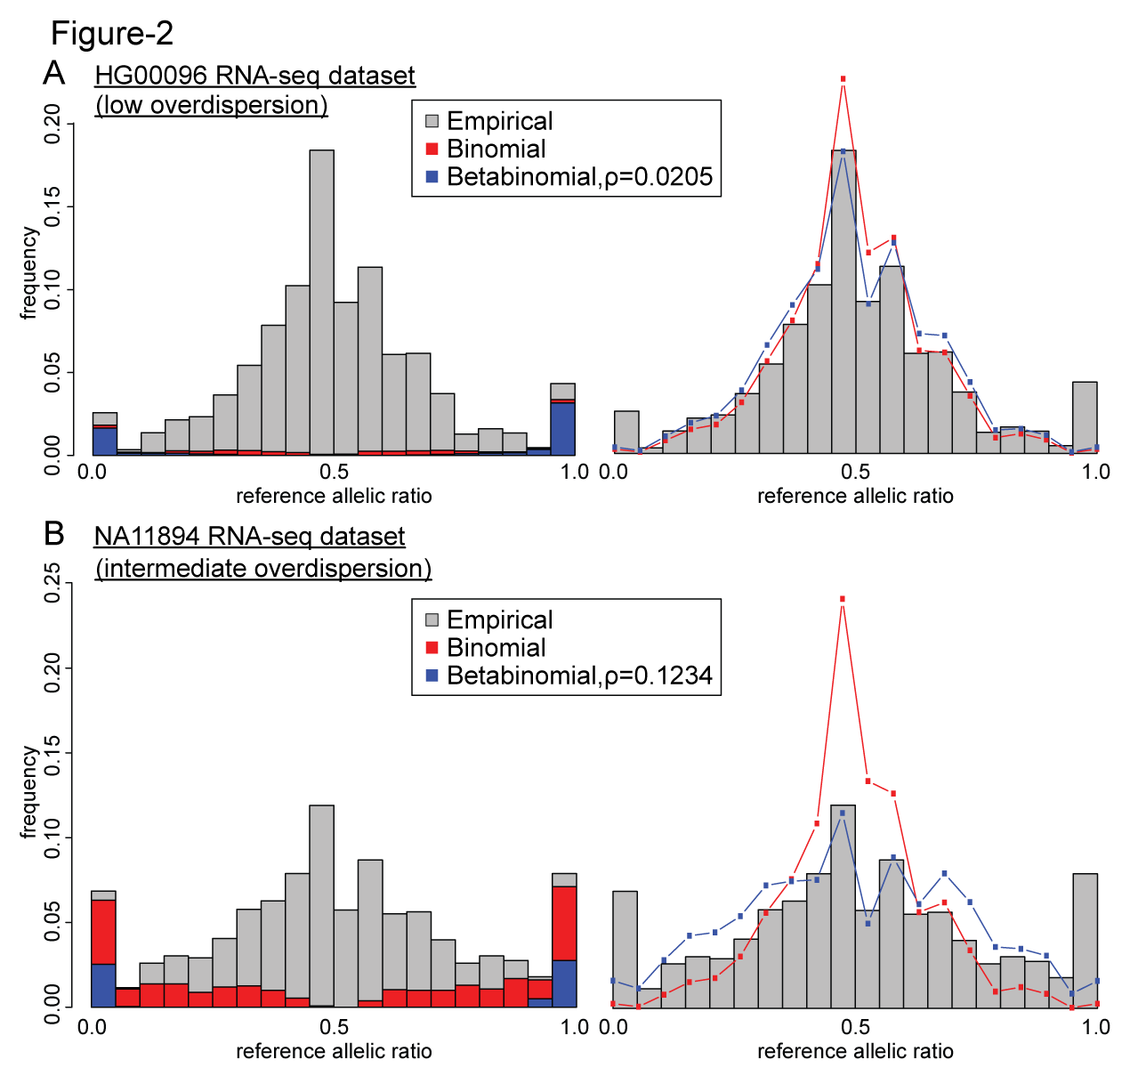
Figure 2. Comparing the effects of the binomial and beta-binomial tests in datasets with low and intermediate level of overdispersion.

Slide 4
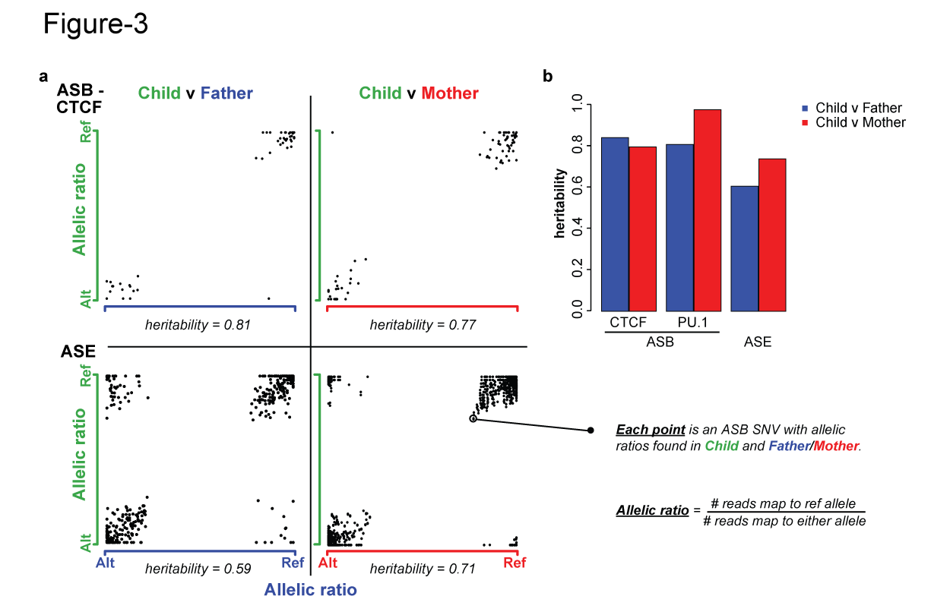
Figure 3. Inheritance of allele-specific behavior.

Slide 5
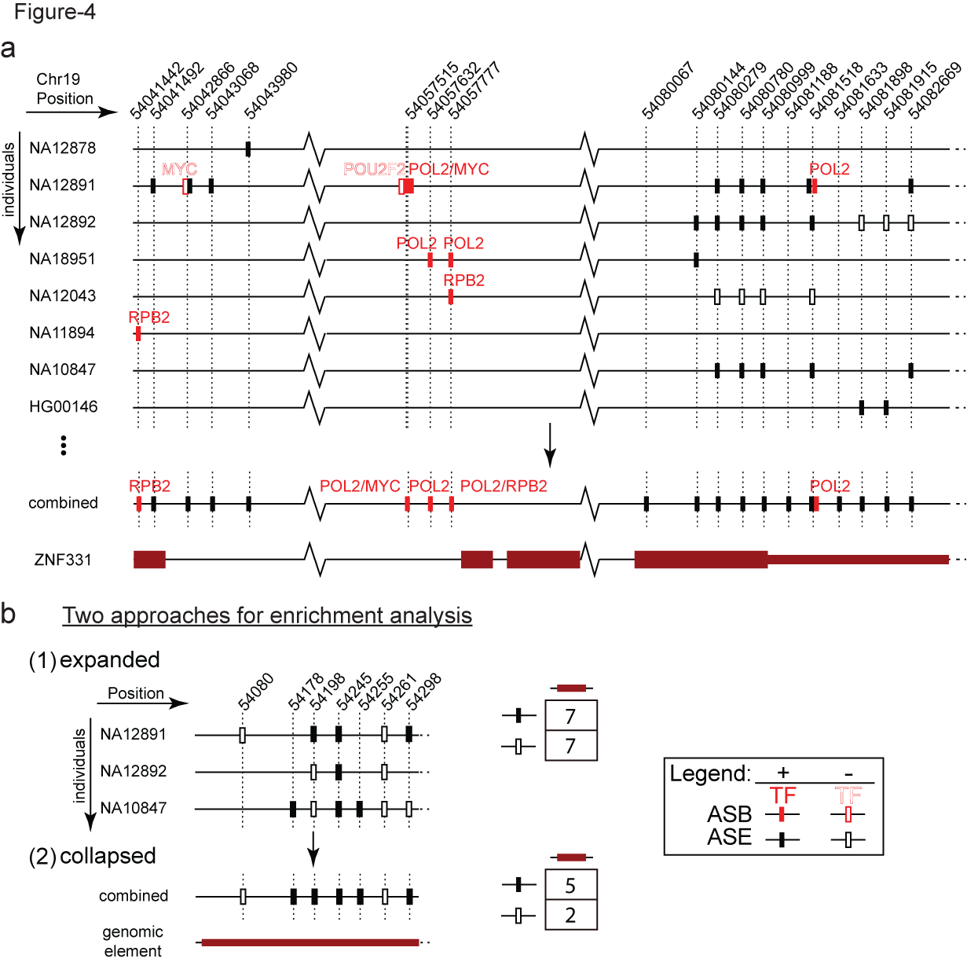
Figure 5. Visualization ASB and ASE in ZNF331 (chr19, position 54,041,333-54,083,523) in AlleleDB
Notes:
(54,041,333-54,083,523)

Slide 6
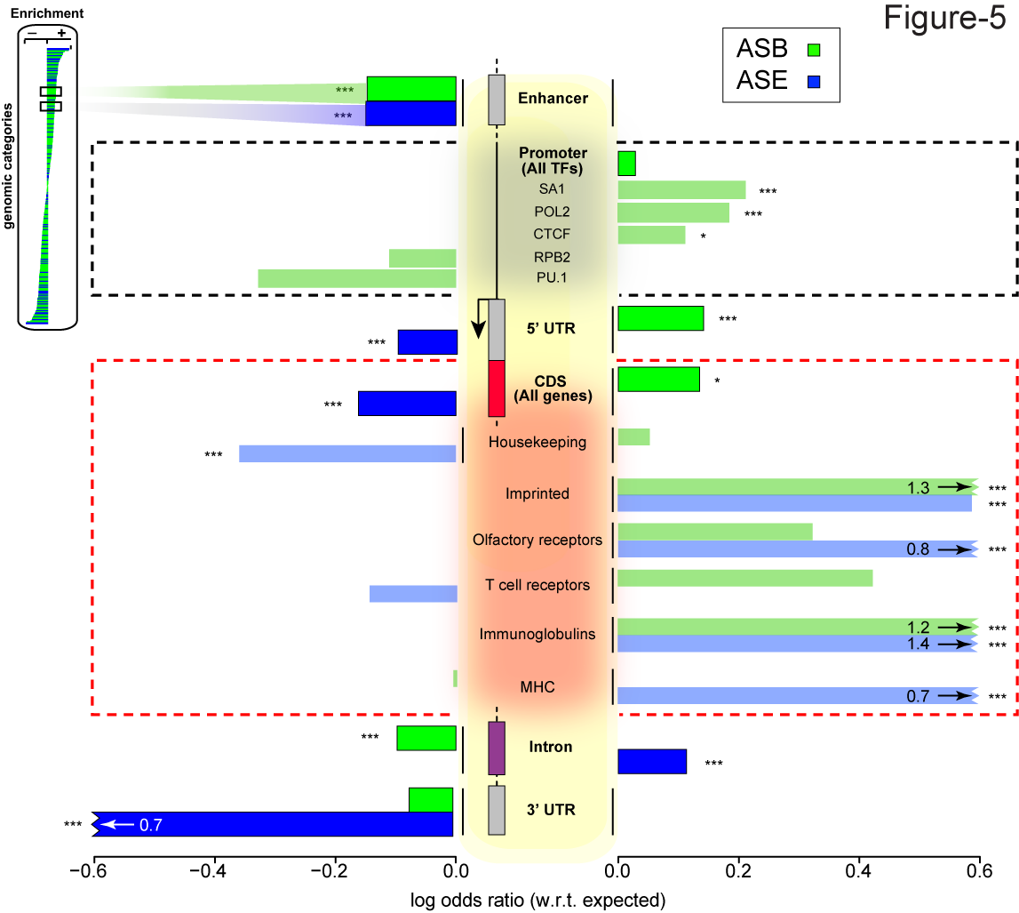
Figure 4. (a) 2 approaches to enrichment analysis (b) Some genomic regions are more inclined to allele-specific regulation. (expanded)
Notes:
Bonferonni corrected p

Slide 7
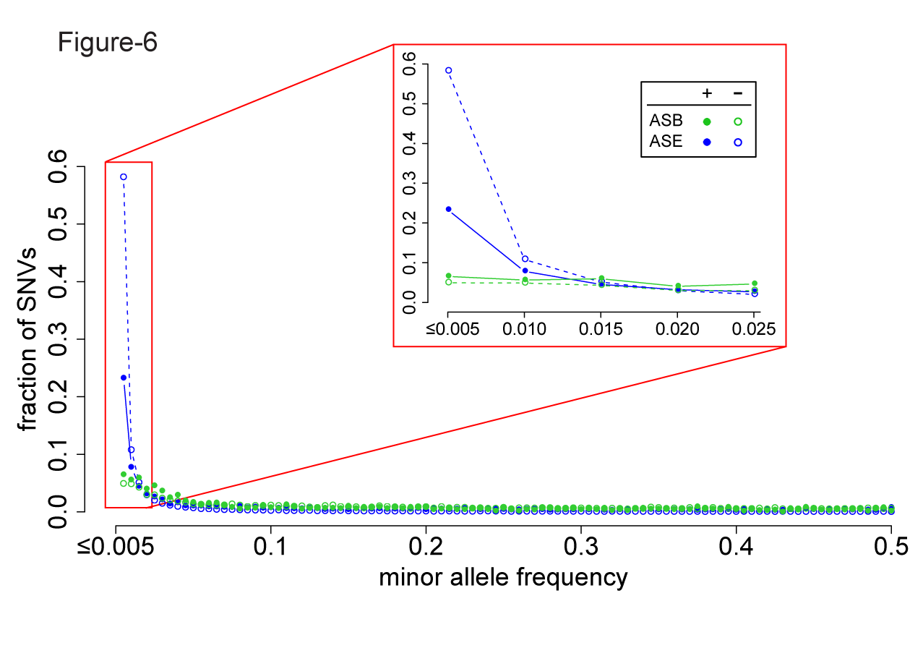
Figure 6. A considerable fraction of AS variants are rare but do not form the majority. Lesser proportion of ASE SNVs than non-ASE SNVs are rare, suggesting less selective constraints in ASE SNVs.

Slide 8
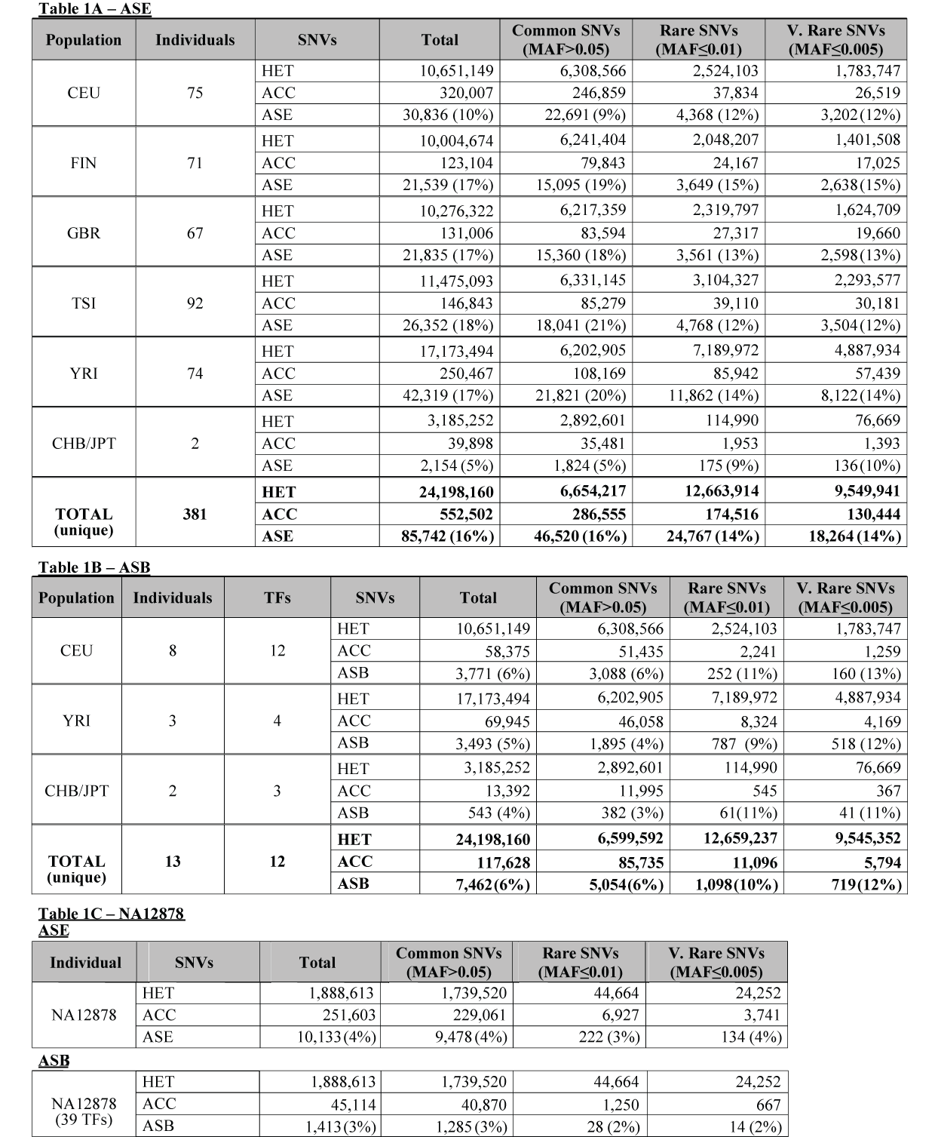
Table 1.

Slide 9
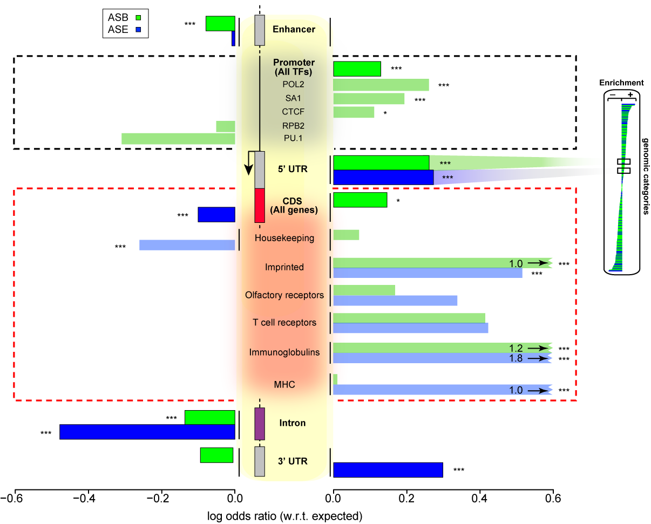
Supplementary Figure 1
Some genomic regions are more susceptible to allele-specific regulation (collapsed/unique SNVs).

Slide 10
%AS sites consistent across various read depths wrt accessible snvs

Slide 12
Overlap of ASE sites at various read depths

Slide 13
Number of AS SNVs consistent wrt accessible SNVs per individual

Slide 14
Supplementary Table 1 Inconsistencies in the original eight studies
Notes:
Add a row that says AlleleDB where everything is the same
Dup reads (RNA-seq/ChIP-seq)

Slide 15
Supplementary Table 2 Flagging of individual datasets

Slide 16
Supplementary Table 3 Allelic inheritance
Notes:
# sNVs

Slide 17
Supplementary File 1 708 unique non-coding categories, gene elements, enhancers
ASB, ASE and AS, with Bonferroni-corrected p values

Slide 18
Supplementary File 2 19,257 genes and MAE categories
 | AS.OR | AS.p.bon | AS | nonAS | ASB.OR | ASB.pbon | ASB | nonASB | ASE.OR | ASE.pbon | ASE | nonASE
FHIT | 0.13884 | 6.30E-07 | 6 | 262 | 0.00 | 1.00E+00 | 0 | 23 | 0.14 | 4.74E-07 | 6 | 242
SNURF | 186.1098 | 4.62E-45 | 61 | 2 | 0.00 | 1.00E+00 | 0 | 1 | 167.96 | 9.04E-43 | 61 | 2
ASB, ASE and AS, with Bonferroni-corrected p values

Slide 19
Supplementary File 3 ASB SNVs of 44 TFs in promoters
ASB, ASE and AS, with Bonferroni-corrected p values

Slide 20
Supplementary File 4 ASB SNVs in TF motifs

Slide 21
Supplementary File 5 R Pseudocode for bisection method to estimate overdispersion parameter

Slide 22
Supplementary File 6 More confident set

Slide 23
Supplementary File 7 Enhancers
VISTA + CHROMHMM_DRM TXT file
Based on expanded analysis

