Slide 1
exceRpt small RNA pipeline
Processed Kendall’s 523 samples
Providing support for other groups – Feng Li (Wong, UCLA), Wang Xue (Patel, Mayo) for FTP data submissions
Pipeline generates large result files – allow just CORE_RESULTS archive with key result files to be uploaded?
Prepared new Wiki page for Pipeline Version Updates:
http://genboree.org/theCommons/projects/exrna-tools-may2014/wiki/Version%20Updates
Pipeline tool page also shows version numbers and link to this Wiki
Results are uploaded under specific folders that have the version number

Slide 2
User requests
Rseqtools – ran a couple of long exRNA-seq samples from Feng Li (David Wong’s group at UCLA) –
How to update the gene names – currently it shows uc… as gene names
Need steps for adding spike-in library support
Add support for processing multiple samples – may need a separate manifest to group files from paired-end sequencing
Process pipeline runs tool – request from Olivia (Galas lab) to multi-select result samples
Question to Rob: Can we update the merge R script to allow addition of samples at a later time or combine results from multiple runs of the pipeline?
FTP access of large results files from Genboree database – requests from non-ERCC users – Useful generic feature
William is implementing a new feature that will allow accessing files from the user’s Genboree database from the FTP server
Allow faster upload/download
Save storage space – currently, it is redundant copies in both FTP as well Genboree db

Slide 3
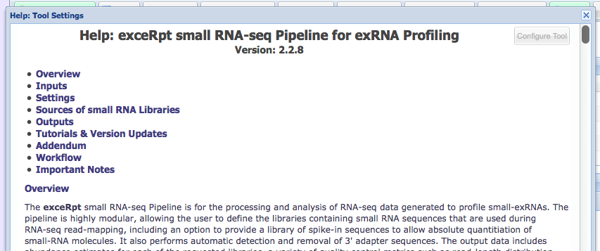
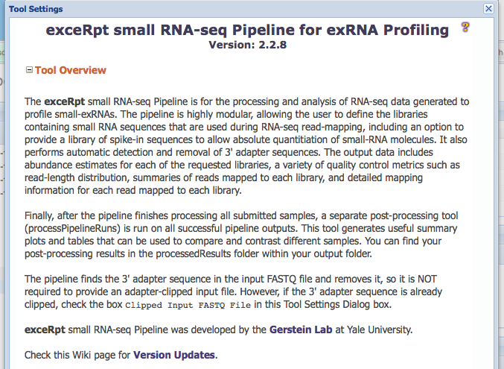
Tool Version Numbers

