Slide 1
Differential DNA mismatch repair underlies mutation rate variation across the human genome
Fran Supek & Ben Lehner, Nature, 2015

Slide 2
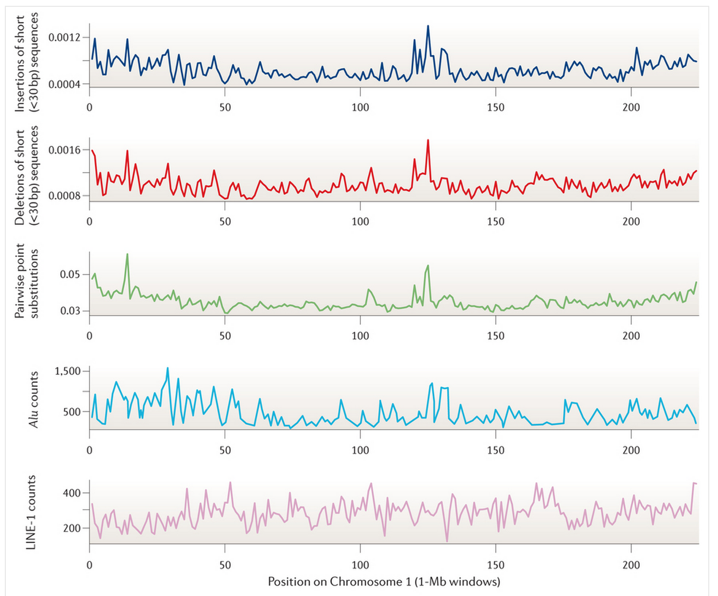
Ross C. Hardison, Nature Reviews Genetics, 2015
The effects of chromatin organization on variation in mutation rates in the genome
Notes:
with mutation rates elevated in heterochromatic late replicating regions and reduced in early replicating euchromatin

Slide 3
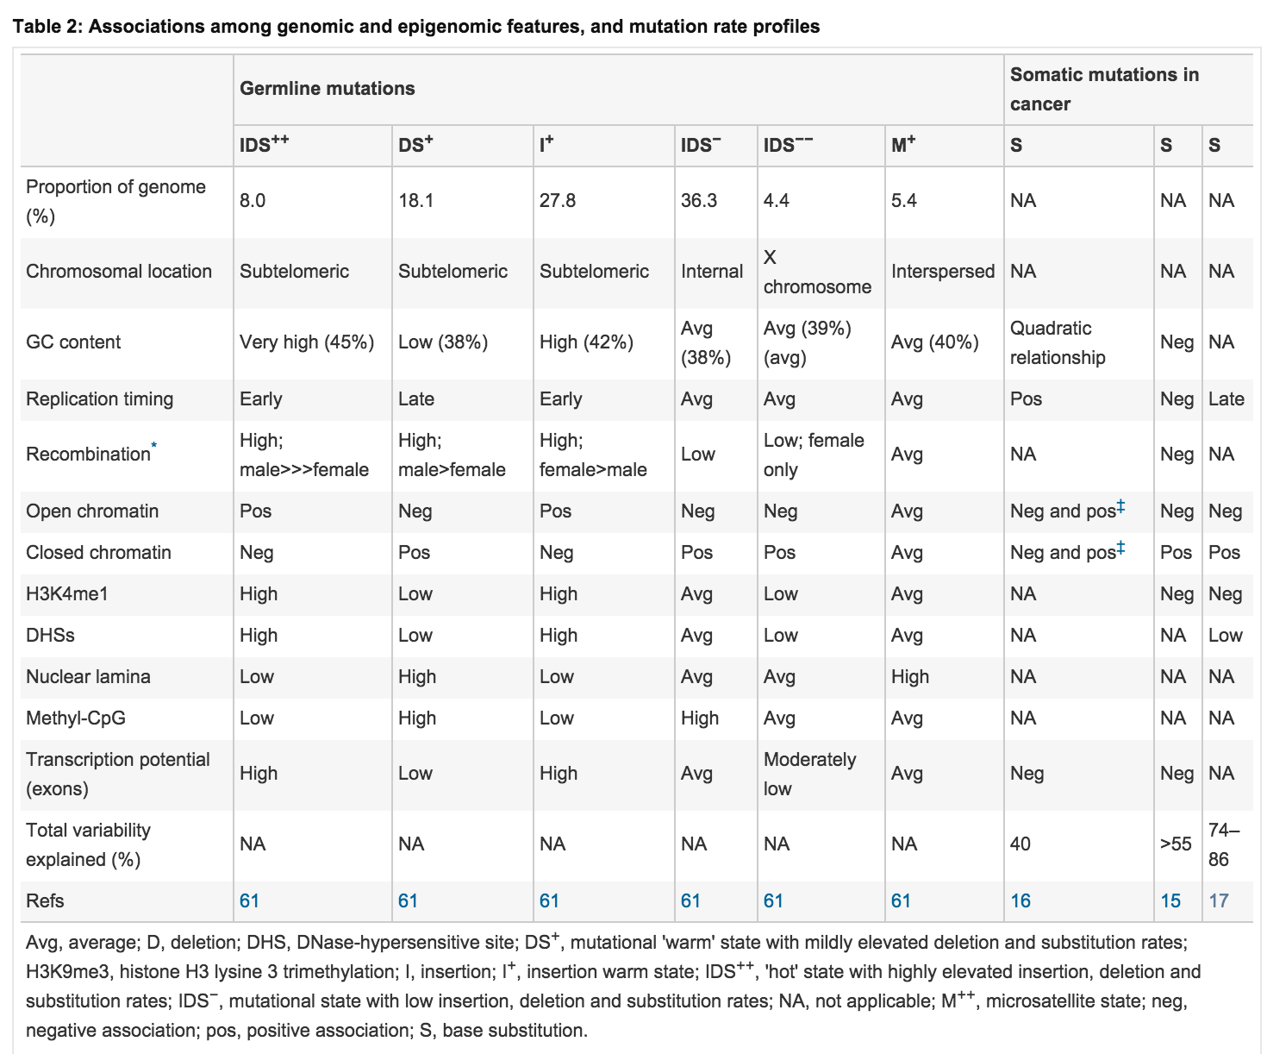
Ross C. Hardison Nature Reviews Genetics, 2015
Notes:
with mutation rates elevated in heterochromatic late replicating regions and reduced in early replicating euchromatin

Slide 4
Somatic mutation rates vary across the human genome. Correlated with e.g. replication timing & gene expression
What is the actual cause underlying this ??

Slide 5
Dataset
- 680 TCGA samples; somatic SNVs using Strelka
- 570 from Alexandrov et al.
- 150 from ICGC
mask out ‘CRG Alignability 36’ track; UCSC blacklists; discard exons
652 WGS (>3,000 SNVs after filtering), 17M SNVs, 16 tissues

Slide 6
1Mb bin; discard bins < 250kb
SNV density
- SNV counts divided by effective length
1Mb SNV density is normalized by dividing the mean SNV density in that sample
PCA: tumor samples – features; 1Mb windows - examples

Slide 7
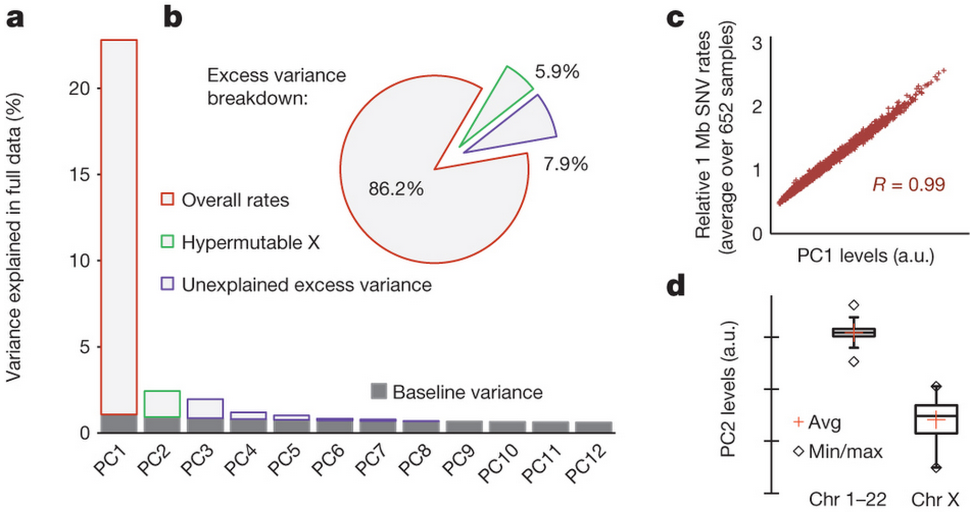
The relative regional densities were, overall, consistent between samples
Notes:
In a principal components analysis (PCA), the first principal component (PC1) corresponds closely to the average densities over all samples (R2 = 0.99) and captures 86.2% of the non-random variability between the 1 Mb windows (Fig. 1a–c).
baseline variability per PC (Methods) encompasses the non-biological sources of randomness in the dat

Slide 8
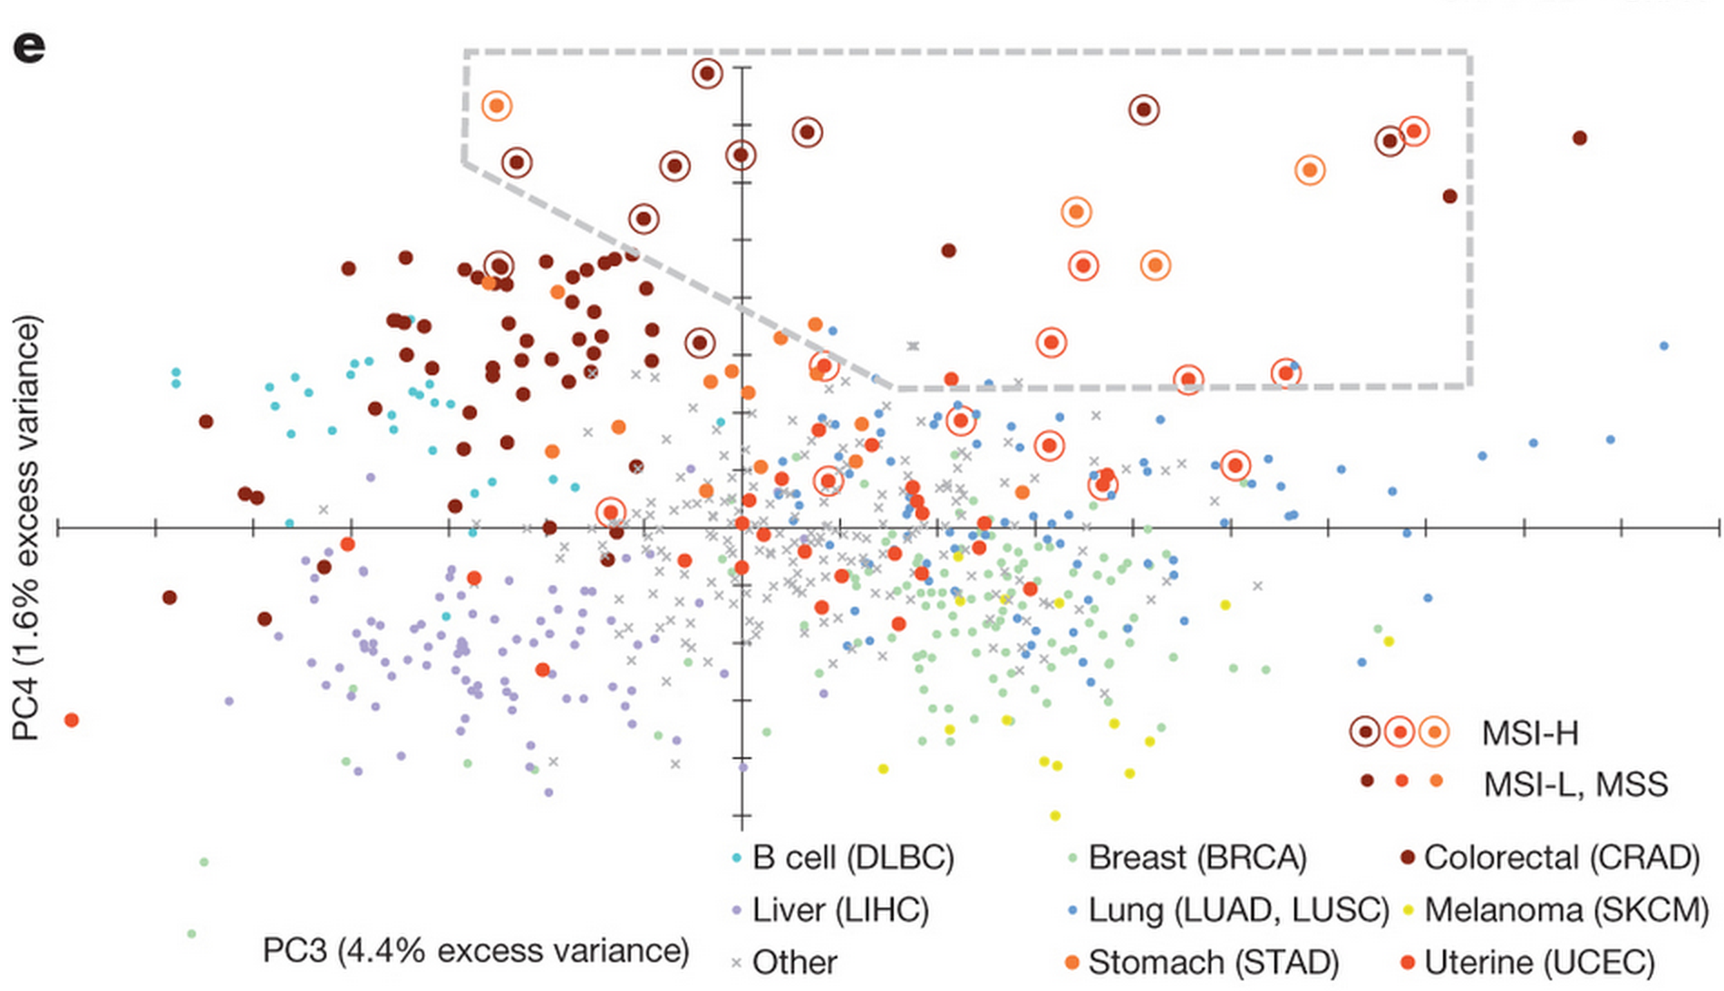
Tumor sample loadings on PC3/4
melanoma, breast, ovarian and lung tumours
Liver, colorectal and B-lymphocyte
Notes:
Liver, colorectal and B-lymphocyte tumours were differentiated by lower PC3 loading scores, whereas melanoma, breast, ovarian and lung tumours had higher PC3 loading

Slide 9
The difference between tumor types correlated with DNA replication timing changes?

Slide 10
Repli-Seq from 11 ENCODE cell lines.
- For each cell line: calculate average Repli-Seq signal within 1Mb
- cross tissue signal is the median signal across cell-lines
- TS (tissue-specific) replication time = signal_in_particular_cell_line – median_across_cell_lines
Gene expression data
- TPM (transcript_per_million) fromTCGA RnaSeqV2
- The TPM levels of genes overlapping (including partially) each 1 Mb window were averaged for a tumor sample
- TS = log2(TPM_in_particular_cancer/average_across_cancer)

Slide 11
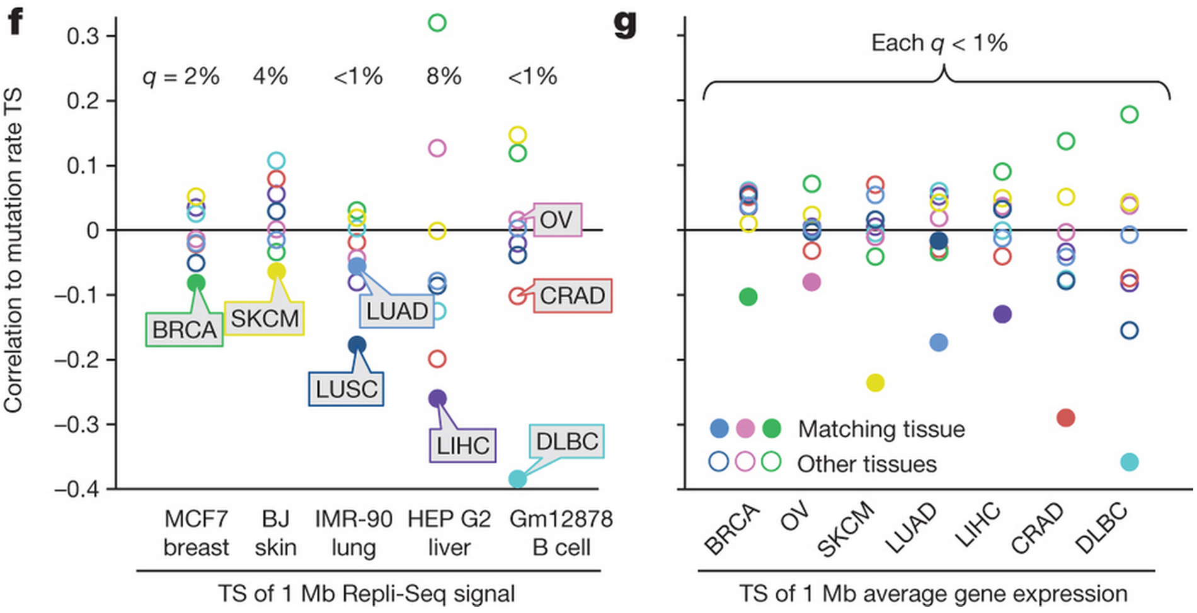
TS correlated with mutation density
Notes:
In all cases, the correlation of the cell-line-specific Repli-Seq signal to the cancer-type-specific 1 Mb mutation rates was most prominent in the cancer type matching the cell line,
The TS of replication timing in a cell line (in Fig. 1f) is the difference between the Repli-Seq signal of that cell line and the average signal across all cell lines

Slide 12
MMR deficiency as the cause of their unusual regional mutation rate variation.
MMR deficiency

Slide 13
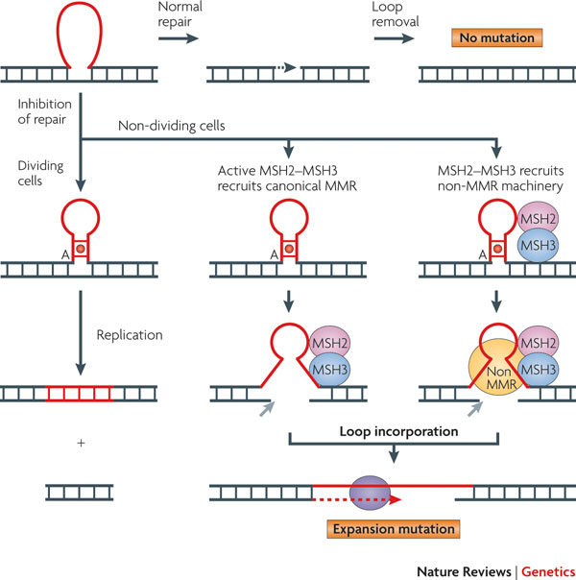
McMurray, Nature Review Genetics,2010
Notes:
inactivation of MMR results in a high incidence of small insertions and deletions (indels) at simple sequence repeats

Slide 14
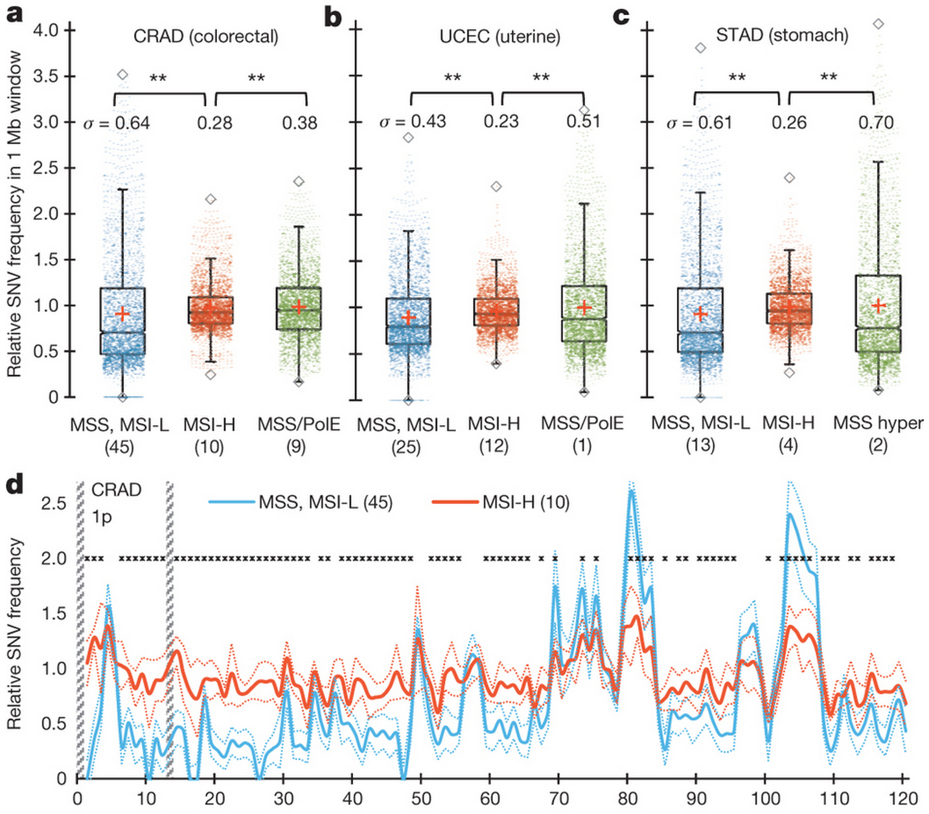
Regional mutation rate difference
Notes:
caused by inactivation of the proofreading domain of DNA polymerase ε13, 14 (PolE). Proofreading is a result of a 3′–5′ exonuclease activity that enhances the accuracy of PolE by excising incorrectly placed nucleotides during synthesis. MSS PolE tumours exhibited a significantly larger spread of the regional SNV density distribution than MSI tumours (Fig. 2a, b), even though their mutational load is typically higher (Extended Data Fig. 1c). Similar conclusions are reached with stomach cancer15 hypermutators of unknown aetiology (Fig. 2c).
Thus, increased mutation supply does not explain the loss of regional mutation rate variability in MSI cancers.

Slide 15
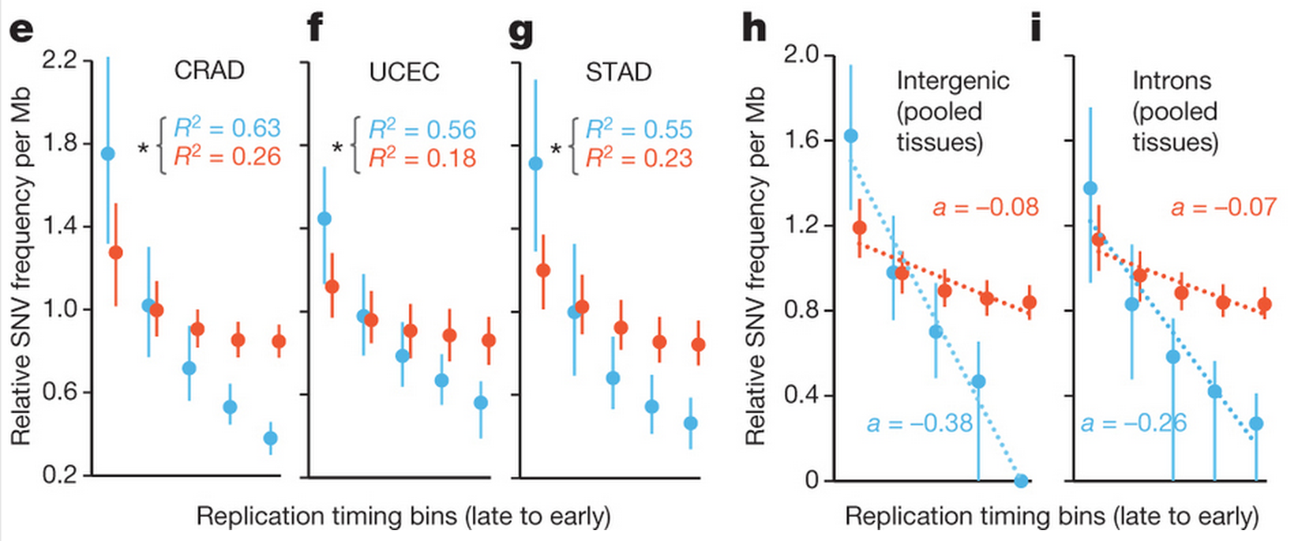
MSI – less correlated with replication timing, gene expression, heterochromatin

Slide 16
The mutation spectrum suggests mutational processes operative in a particular cancer type

Slide 17
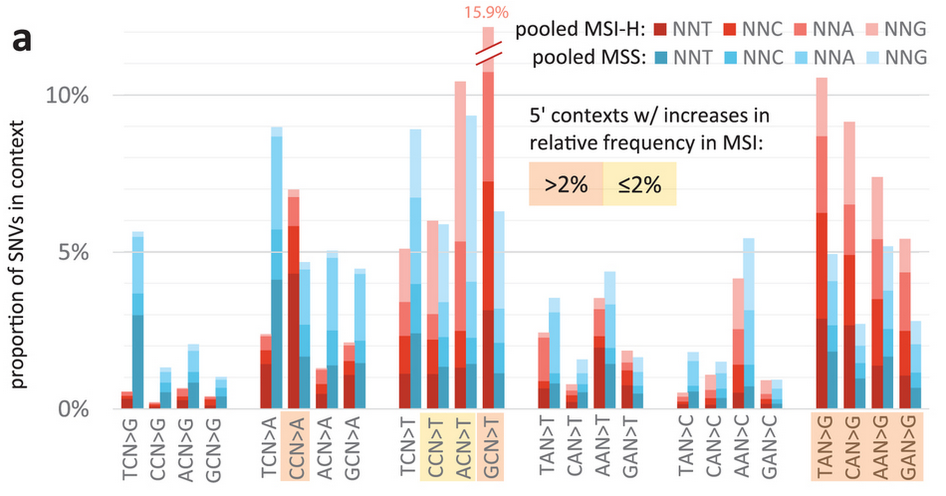
Mutation signatures in MSI
Signatures of MMR deficiency
Notes:
We observed the previously reported signatures of MMR deficiency in MSI cancers: C > T transitions in an NpCpG sequence context and
C > A transversions at CpCpC (all mutations considered strand symmetrically).
In addition, we report a general increase in the relative frequency of transitions in MSI genomes, wherein A > G increases preferentially when preceded or followed by a C, and C > T clearly increases most in the GpCpN context

Slide 18
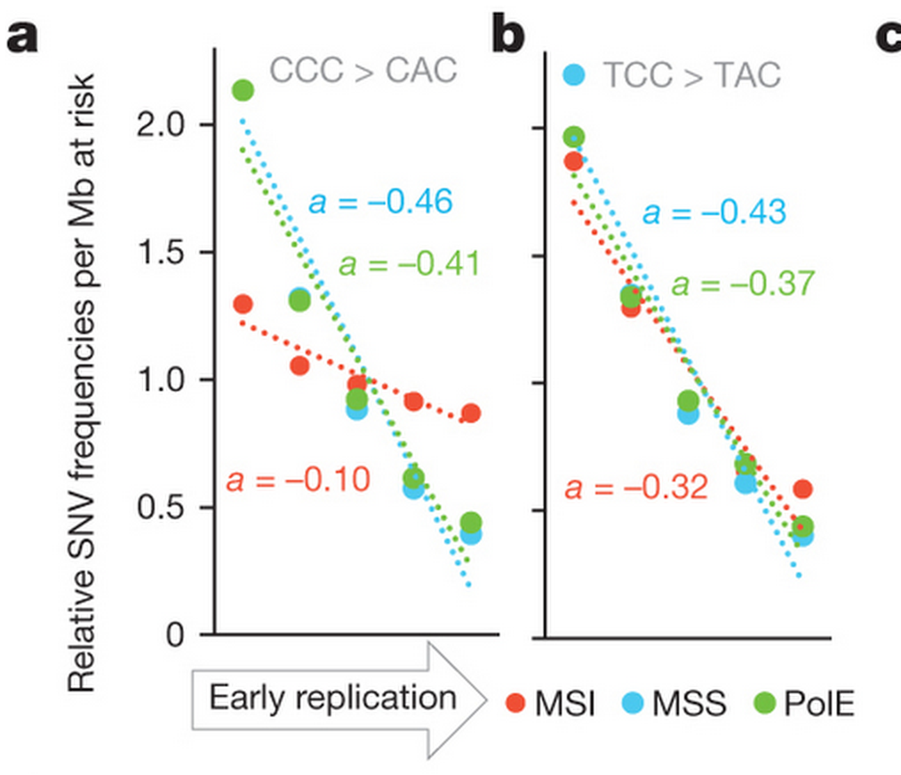
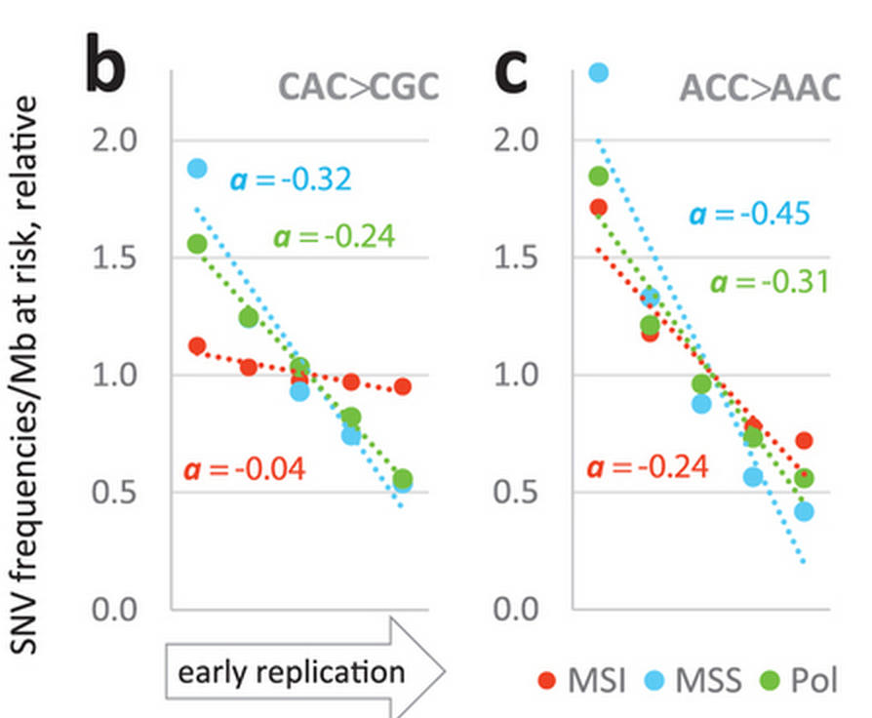
Signatures associated with MMR have flatter distributions
Mutation frequencies are normalized by sequence context
Notes:
We observed the previously reported signatures of MMR deficiency in MSI cancers: C > T transitions in an NpCpG sequence context and
C > A transversions at CpCpC (all mutations considered strand symmetrically).
In addition, we report a general increase in the relative frequency of transitions in MSI genomes, wherein A > G increases preferentially when preceded or followed by a C, and C > T clearly increases most in the GpCpN context

Slide 19
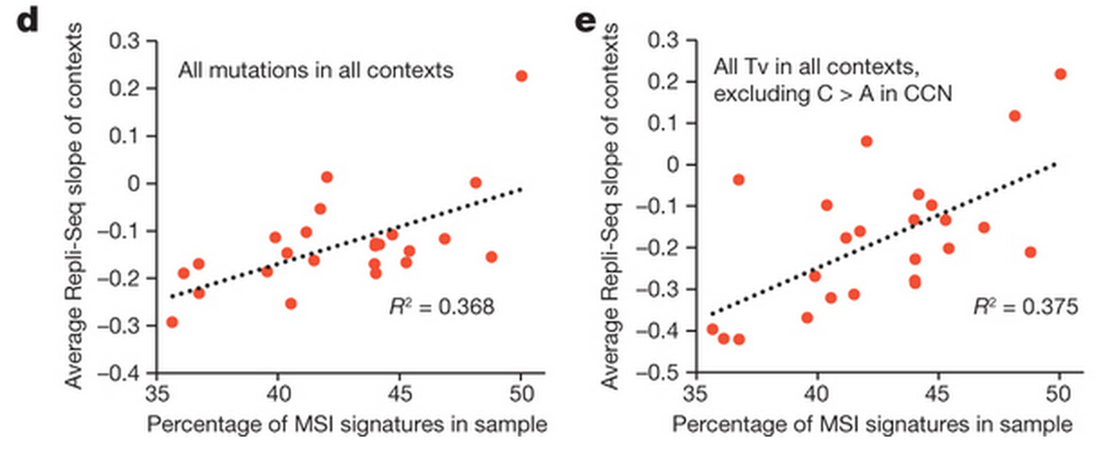
Residual correlation with replication timing in MSI cancers might derive purely from the mutations originating before MMR inactivation.
log2 ratio of the absolute mutation frequency (per Mb) of a context in the MSI samples to its mutation frequency in the MSS samples.
Notes:
The MSI propensities of contexts (in Fig. 3 and Extended Data Fig. 3) were defined as the log2 ratio of the absolute mutation frequency (per Mb) of a context in the MSI samples to its mutation frequency in the MSS samples
Thus, the greater the proportion of its history a tumour has spent in an MMR-deficient state, the flatter its distribution of mutations across the genome, and this flattening is observed for mutations in both MSI-associated and non-MSI-associated contexts.

Slide 20
Determine time of MMR failure in samples
- Mutation signatures de-convoluted to MSI and MSS states
- Genetic algorithm-based optimization to fit the data (rgenoud 5.7-12 )
- Captured 68% of the variance
% time in MSS state
Mutation signatures in MMR deficient
Mutation signatures in MMR proficient

Slide 21
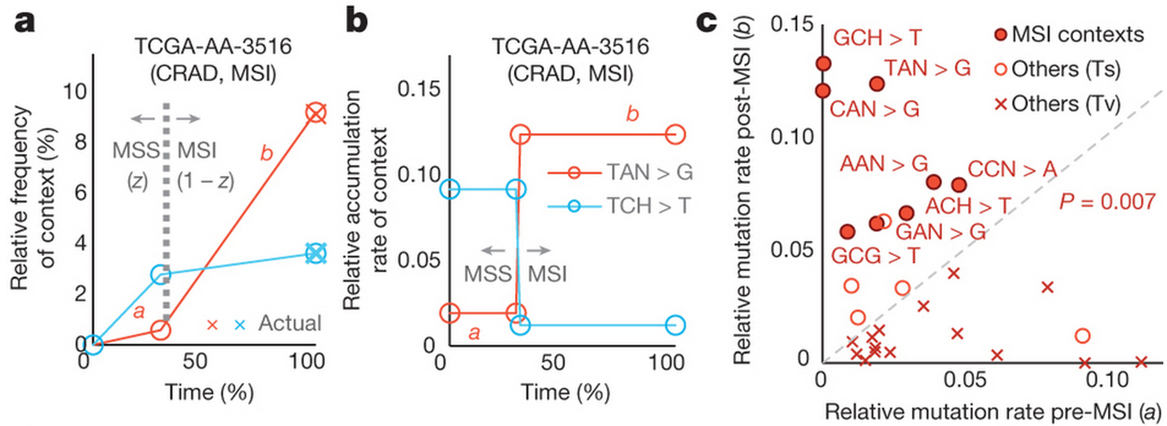

Slide 22
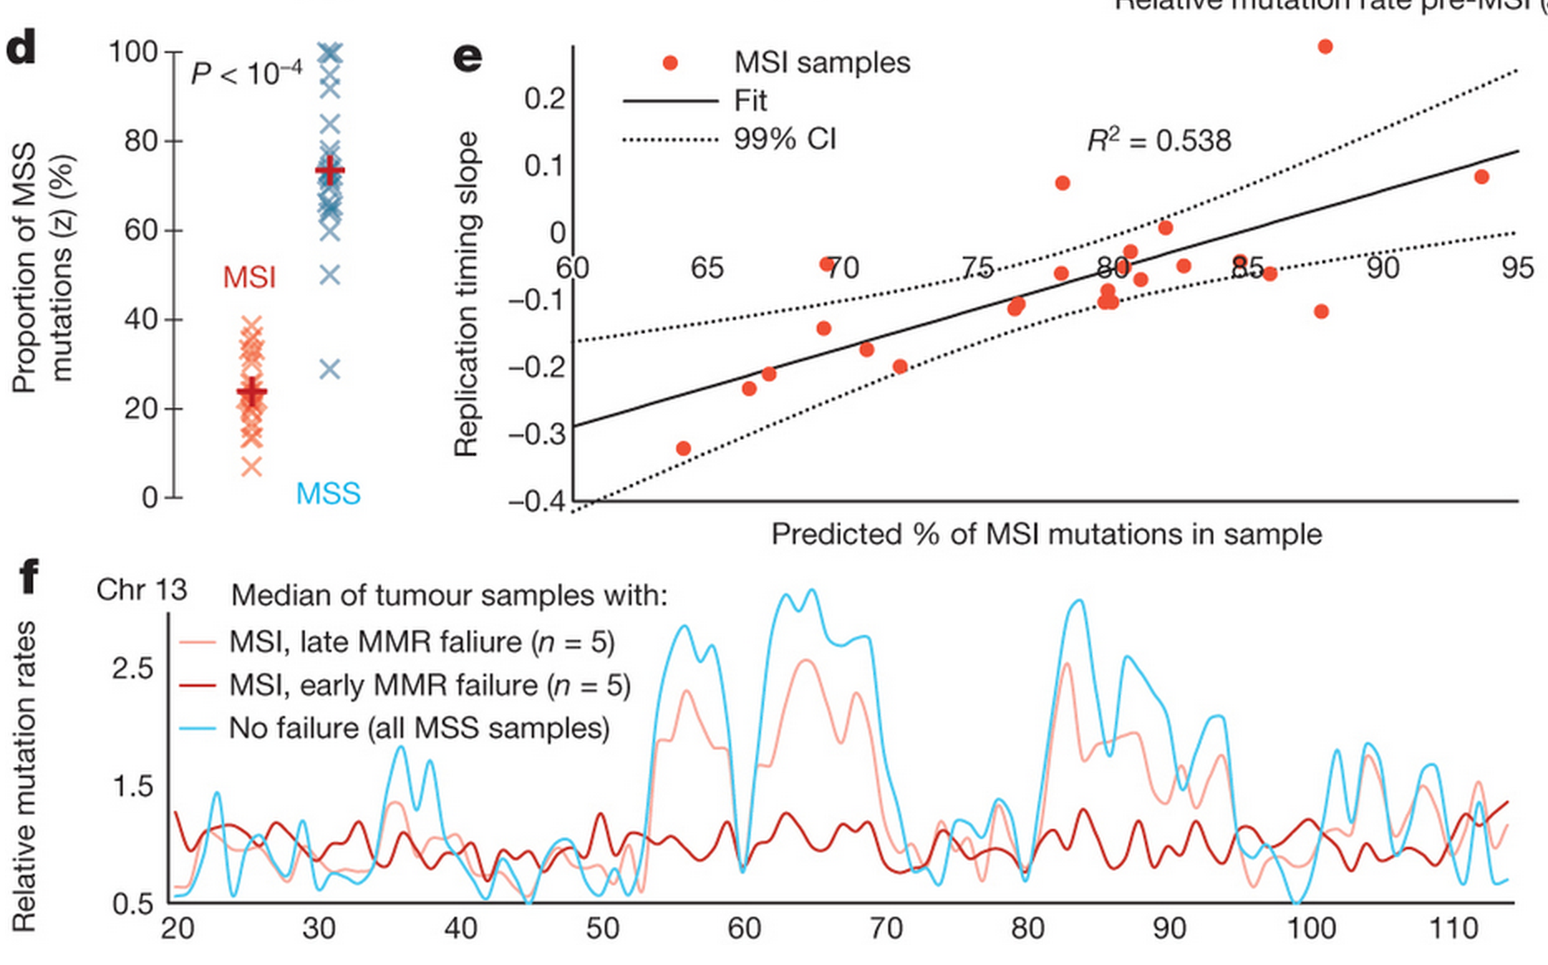

Slide 23
Conclusions
MMR is more effective in euchromatic early replicating regions of the genome, suppressing the accumulation of mutations in these regions
Differences in DNA accessibility to the repair machinery, the coupling of this machinery to the replication fork, or the time available for repair might contribute to the increased efficiency of repair in early replicating euchromatin
enhanced MMR in euchromatin is a beneficial trait and one that has been selected for during evolution
Notes:
Differences in DNA accessibility to the repair machinery, the coupling of this machinery to the replication fork, or the time available for repair might contribute to the increased efficiency of repair in early replicating euchromatin. Across cell types, most active genes performing essential functions are euchromatic and replicated early. It is thus sensible to envisage that enhanced MMR in euchromatin is a beneficial trait and one that has been selected for during evolution.

