Slide 1
Figure 1
Notes:
Figure 1A shows that sequencing data grows faster than structure data. Structure data contains of more protein subunits per structure in recent times.
Figure 1B will show that the number of folds are not growing much but the domain-domain interaction and complex structures are increasing at a fast rate.

Slide 2
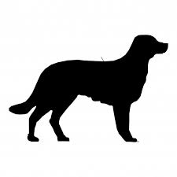
b
(1) Homology within human population
Figure 2
a
Homology across species
(2) Homology within a single human genome
Conservation
Typically defined by comparison across species
Human- or domain-specific ‘conservation’
Comparison between homologous sequences within or across humans
Notes:
Figure 2 shows the difference between inter-species conservation and intra-species conservation. 2b(2) shows how repeat domains can be compared.

Slide 3
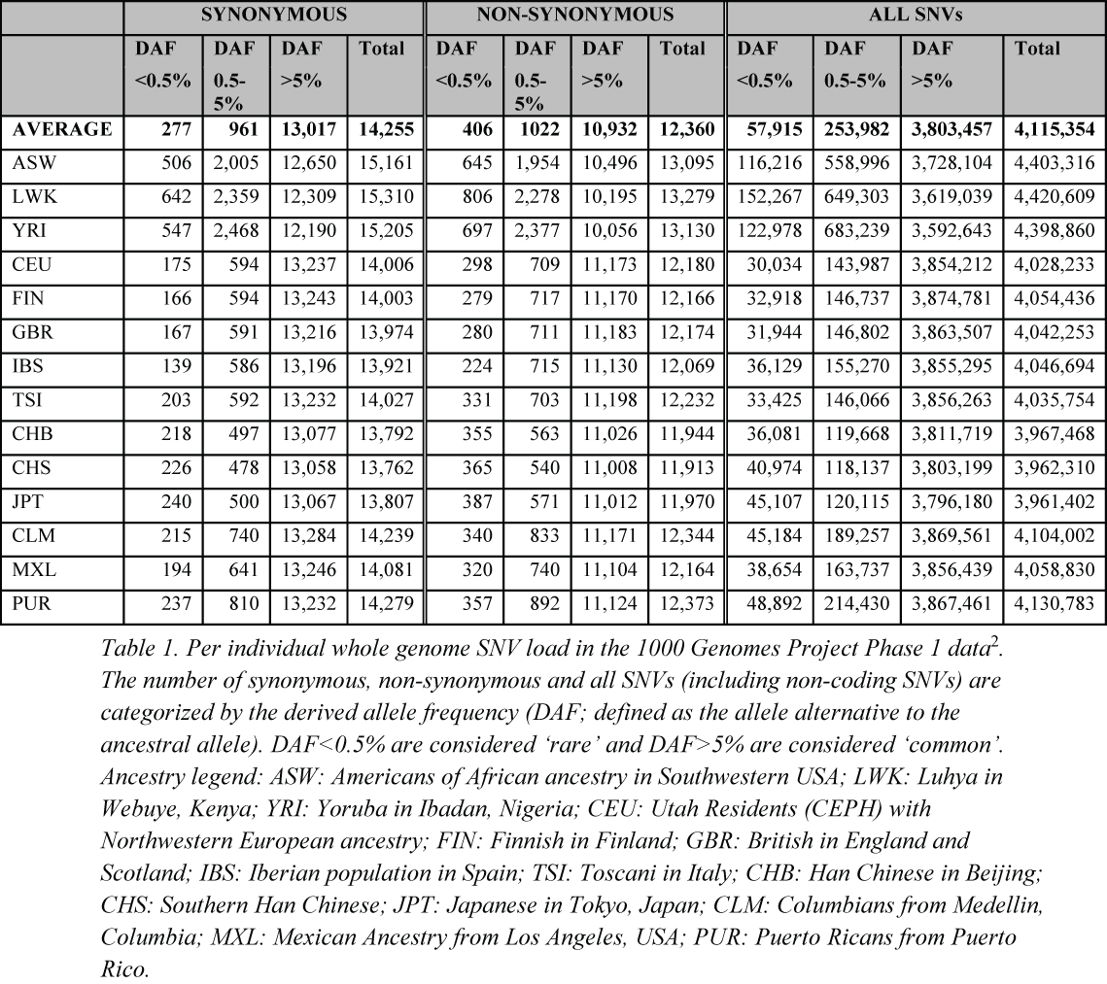
Notes:
Table 1 shows some key numbers regarding variants within populations in 1000G data.

Slide 4
Figure 3
Notes:
Need to add structure by side.
Figure 3 – stuructural explanation for disease causing mutations in FGF receptor.

Slide 5
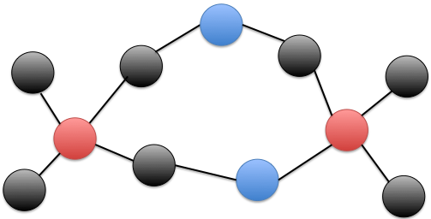
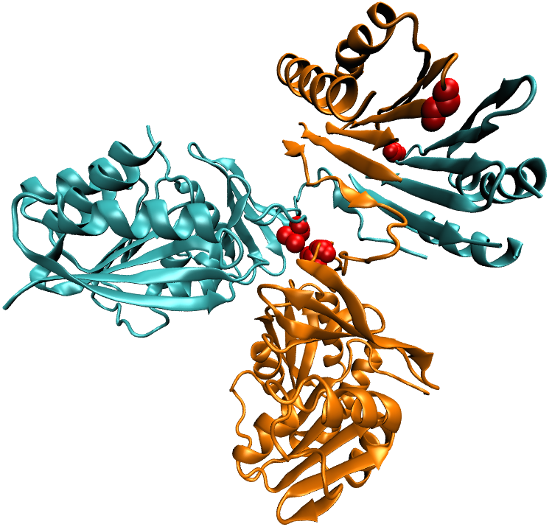
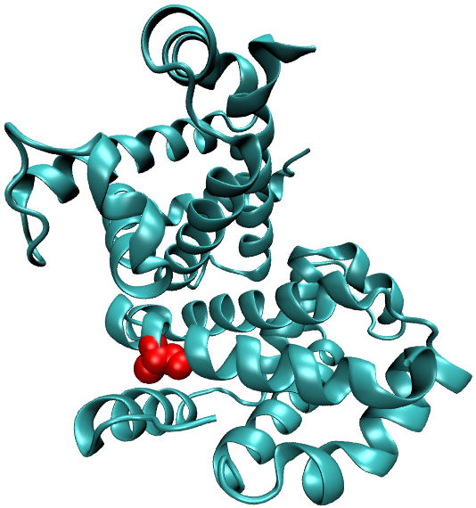
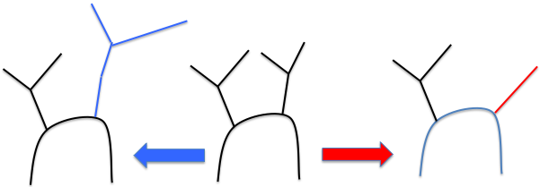
Figure 4
Impact on PPI topology
Impact on binding interactions
ATGCCGTAAATTCGTTAATCGTCG
ATGCCGAAAATTCGTTAATCGTCG
ATGCCGTAAATTCGTTAATCGTCG
ATGCCGTAAATTCGTTAATCGTCG
ATGCCGTAAATTCGTTAATCGTCG
ATGCCGTAAATTCGTTAATCGTCG
ATGCCGTAAATTCGTTAATCGTCG
ATGCCGTAAATTCGTTAATCGTCG
ATGCCGTAAATTCGTTAATCGTCG
Ensemble level changes
Global changes
Local transitions
Notes:
Figure 4 shows the different effect sequence changes can have on structure.

