Slide 1
PAWG WG-2,5,9,14
Candidate Cancer Drivers and Networks
(coding, lncRNAs, regulatory)
Network Presentation
Gad Getz, Esther Rheinbay, Ekta Khurana, Ben Raphael, Mark Gerstein (on behalf of the meta-group)

Slide 2
3 Pilots
Data: N=2013 patients (UCSC Pilot), Sanger SNV and INDEL mutation calls (Train 2), Oncotator Annotation
Pilot I: Positive selection (coding, promoters, lncRNA, enhancers)
data subsets: GBM (n=41), BRCA (n= 207), PanCan (n=1980)
Pilot II: Annotation (GENCODE v19, enhancers, promoters, TF binding sites, gene-regulatory elements associations, functional impact score)
Pilot III: Network and pathway analysis (+ copy number, SVs, and RNA seq data)

Slide 3
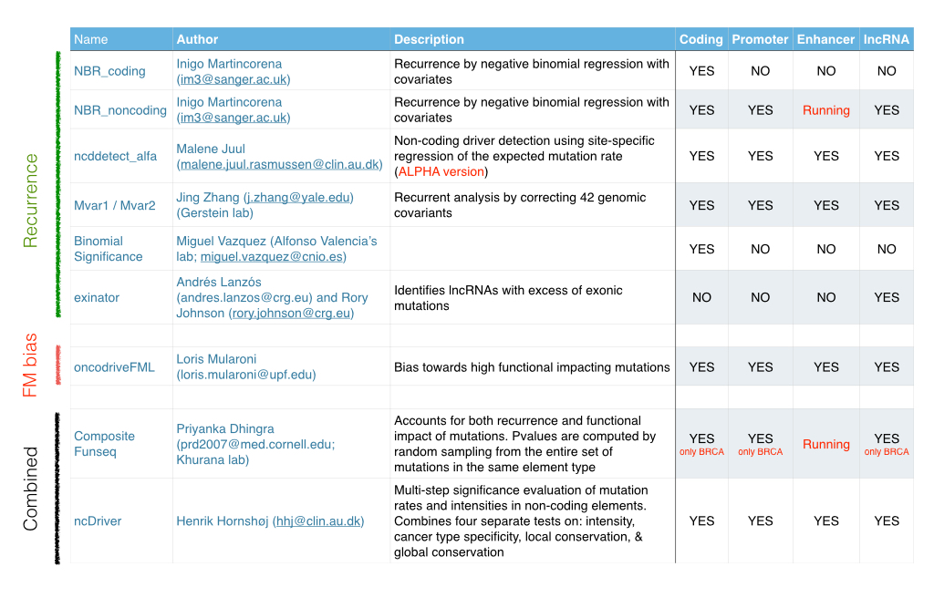
Pilot I: Methods
MutSig suite Julian Hess jhess@broadinstitute.org
Mike Lawrence lawrence@broadinstitute.org
Esther Rheinbay esther@broadinstitute.org
Mutational burden; Functional impact; Positional recurrence
YES YES YES YES
Nuria Lopez-Bigas

Slide 4
QQ plot: compare observed to expected p-value distribution
Inflated p-values
too many significant genes
Well calibrated with significant genes
Well calibrated, no significant genes
-log₁₀( sorted of observed p-values )
Deflated p-values
too few significant genes
-log₁₀( i / (N+1) )
Expected -log10(sorted p-values)
Gad Getz, Broad/MGH

Slide 5
(2) Simulated/permuted data set
Three different approaches to generate simulated / permuted dataset to test the methods:
Carl Herrmann (DKFZ)
Iñigo Martincorena (Sanger)
Yosi Maruvka (Broad)
-- maintain sample specific rates
-- maintain trinucleotide context
-- window size as a parameter for
local permutation or
mutation rate estimation
Not as challenging as true data but significant hits indicate inadequate background model.
QQ plot expected to be on the diagonal

Slide 6
(3) Enrichment of known cancer genes in that tumor type (e.g. CGC)
We annotate the results of each method with known cancer genes (e.g. CGC)
We will also distinguish between known cancer genes (in any tumor type) and ones that are known in the analyzed tumor type

Slide 7
(4) Comparison of results
Venn diagrams (overlaps)
More sophisticated methods to combine results to obtain a final list of significant genes/regions of interest
Discussed in next part of talk

Slide 8
Pilot I - positive selection/significance of genomic regions
Analyses on four sets of genomic regions:
coding genes (~20,000),
promoters (~20,000)
lncRNA (>7,000)
enhancers (~47,000)
Mutations:
Sanger calls for GBM, BRCA and pancan cohorts
Simulated dataset provided by DKFZ (Carl Herrmann)

Slide 9
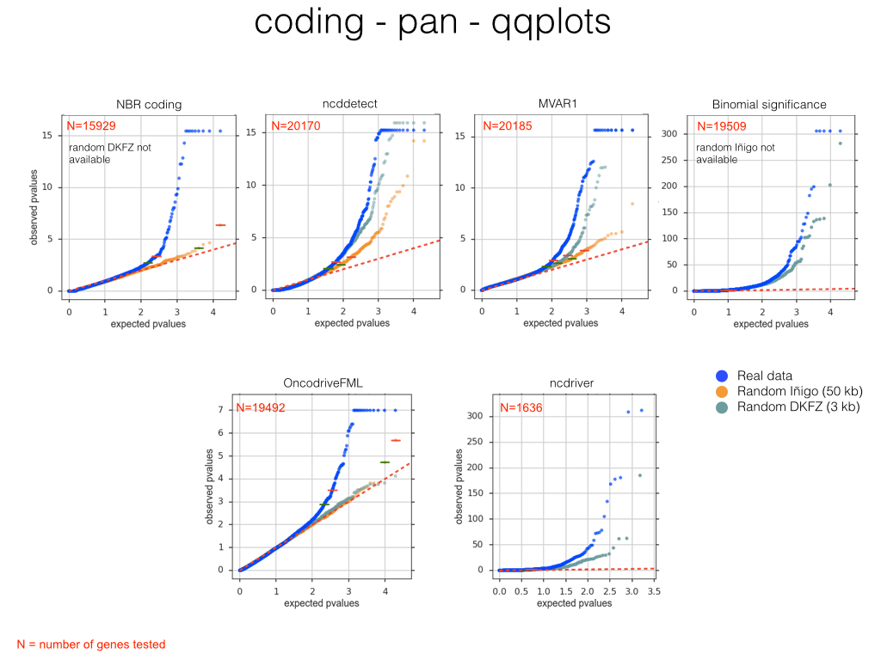
Pilot I - analysis of coding genes on pancan dataset
Nuria Lopez-Bigas

Slide 10
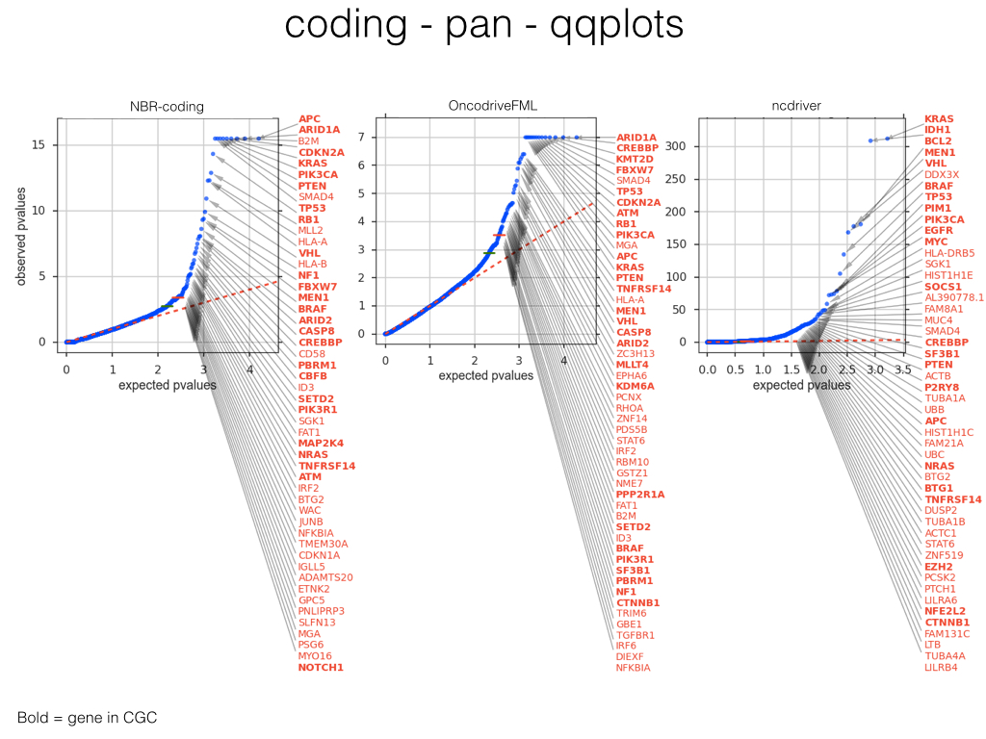
Recovery of known cancer genes
Nuria Lopez-Bigas

Slide 11
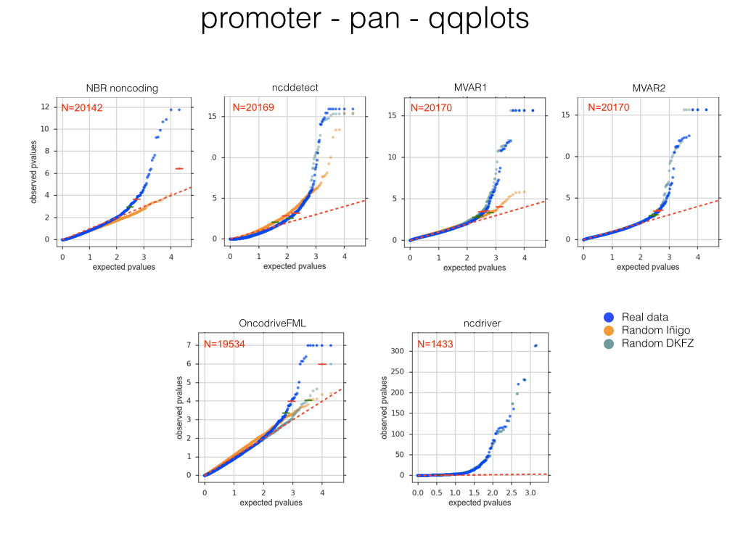
Pilot I - analysis of promoters in pancan dataset
Nuria Lopez-Bigas

Slide 12
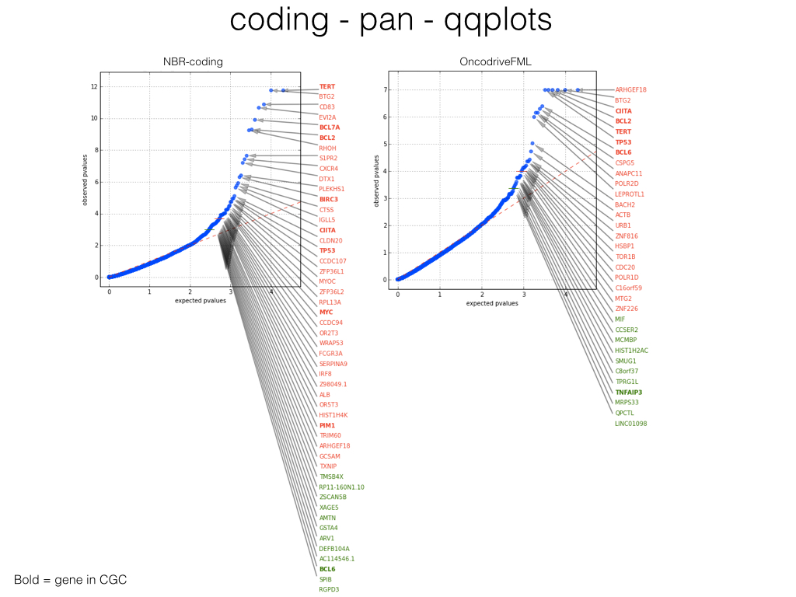
First results on promoter mutations
Caveat: some occur in lymphoma samples
with regions of hypermutations
Nuria Lopez-Bigas

Slide 13
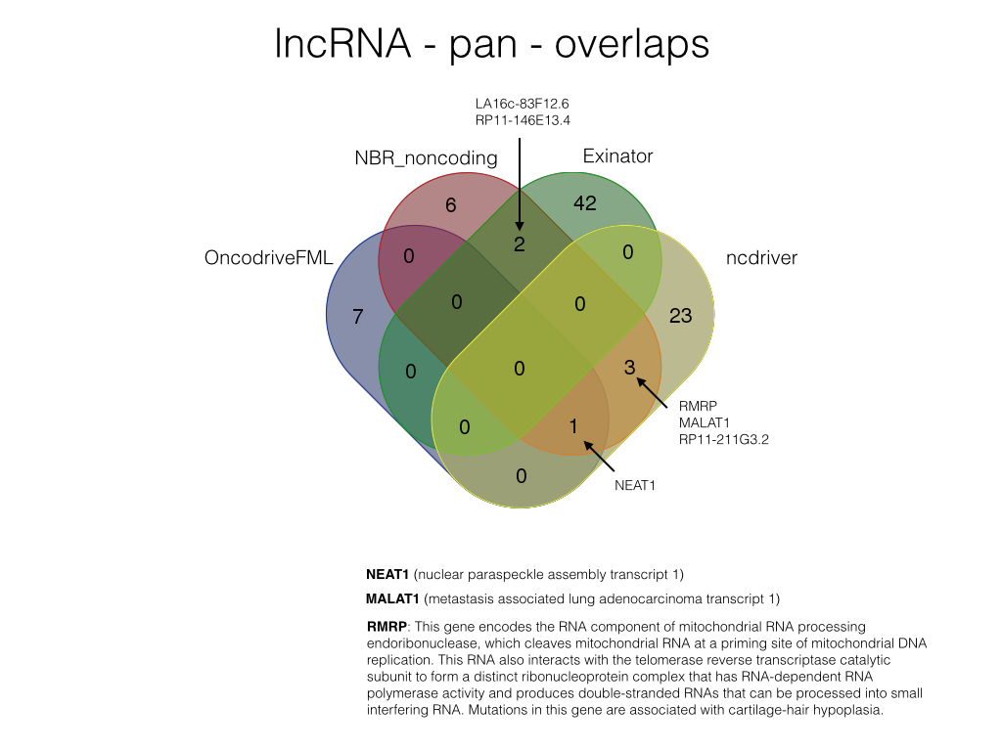
Small overlap between methods on lincRNA genes
Nuria Lopez-Bigas

Slide 14
Significance methods are based on different assumptions and statistical models
We need to combine signals from different methods with the goal of identifying a consensus list of significant hits
Need sophisticated way to assign composite scores/p-values based on multiple methods

Slide 15
Preliminary analysis: relationship between methods based on p-value similarity
p-value (-log10)
p-value (-log10)
Distance
Grace Tiao, Broad

Slide 16
Annotations Pilot II: Functional impact of mutations
Ekta Khurana

Slide 17
Description of Annotations Pilot Analysis
Variant set
Sanger workflow variants: https://www.synapse.org/#!Synapse:syn4013215
Annotations
Coding genes: syn3540011
Promoters: syn3789763
Enhancers: syn4040215
lncRNA: syn3540009
Gain and loss of TF motifs
Annotations submitted
Oncotator (Broad)
FunSeq (Yale, WCMC)
DKFZ (Two sets)
CNIO

Slide 18
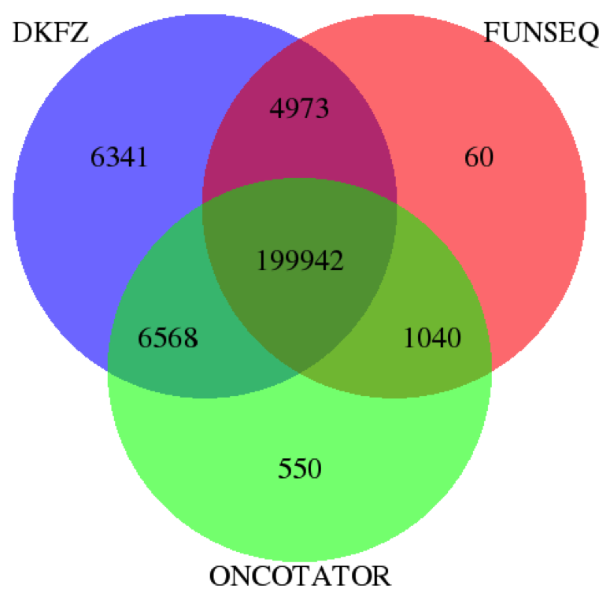
Comparison of nonsynonymous mutations annotated by DKFZ, FunSeq and Oncotator
FunSeq: Missense, Premature stop, Splice site disruption
Oncotator: Misssense, Nonsense, Nonstop, Start_codon
DKFZ: Nonsynonymous, Stop gain
Method | Nonsynonymous mutations
DKFZ | 217,824
FUNSEQ | 206,015
ONCOTATOR | 208,100
Priyanka Dhingra, Ekta Khurana (WCMC)

Slide 19
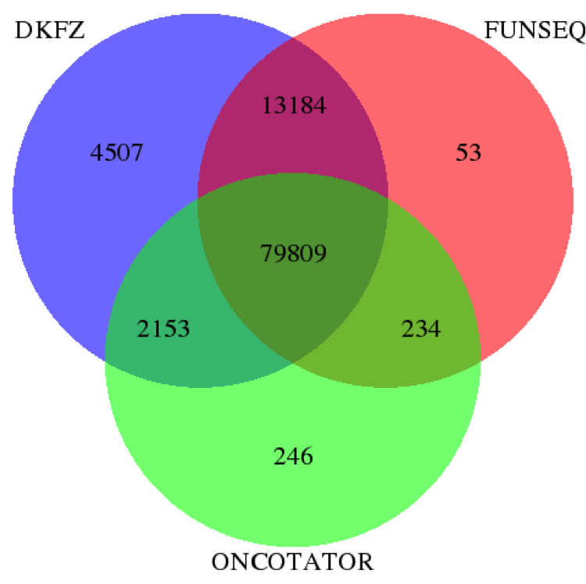
Comparison of mutations in lncRNA annotated by DKFZ, Oncotator and FunSeq
FunSeq removes germline & coding.
DKFZ also predicts ncRNA splicing effects.
Method | lncRNA mutations
DKFZ | 99653
FUNSEQ | 93280
ONCOTATOR | 82442
Priyanka Dhingra, Ekta Khurana (WCMC)

Slide 20
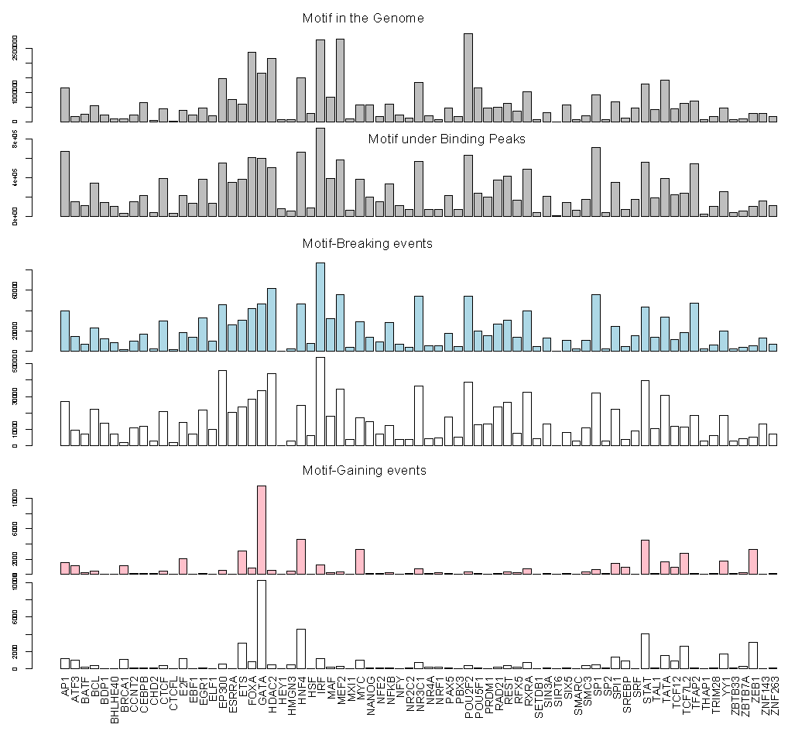
Motif gain and loss in different TF families by PanCancer variants
We can go higher resolution than promoters & enhancers.
More motifs created for some families like GATA
Relation w/ sequence context, mutational signatures
Possible driver events
Yao Fu (Gerstein lab)
Ekta Khurana

Slide 21
Pilot methods that use functional information to detect driver elements
Functional impact bias
OncodriveFML (Loris Mularoni and Nuria Lopez-Bigas, UPF Spain)
Combined recurrence and functional bias
Composite FunSeq (Priyanka Dhingra and Ekta Khurana, WCMC)
ncDriver (Henrik Hornshoj and Jakob Skou Pederson, Aarhus U. Denmark)
MutSig suite (Julian Hess, Mike Lawrence, Esther Rheinbay and Gad Getz, Broad Institute)

Slide 22
Pilot III: Networks and Pathways (PCAWG-5)
Ben Raphael
Josh Stuart

Slide 23
Networks & Pathways Pilot III: Goals
Test network-driven analysis of pan-cancer data on standardized networks*
Evaluate and compare diverse methods
Investigate construction of consensus networks
*collected by Jüri Reimand on Synapse

Slide 24
Preliminary Results in Santa Cruz
Pathway enrichment (KEGG, GO, Corum, NCI Pathways, etc.): [M. Vazquez and A. Valencia, CNIO Madrid]
HotNet2 mutated subnetworks [M. Leiserson and B. Raphael, Brown U.]
SSA.ME mutated subnetworks [L. Verbeke, S. Pulido, S. Van Laere, J. Fostier, K. Marchal: Ghent U. and U. of Antwerp]
NBDI mutations and gene expression [L. Verbeke, et al.]
Reactome mutated subnetworks: [G. Wu and L. Stein, OICR]
*All used only SNV calls and/or driver gene scores

Slide 25
PCAWG-5: Ongoing and Future Work
Incorporate additional data: CNAs, SVs, and RNA-Seq
Define set of outputs that can be compared/merged across methods
Significantly mutated pathways and protein complexes using existing annotations.
Significantly mutated subnetworks of protein-protein interaction (PPI) networks and regulatory networks.
Differentially regulated pathways/networks and their upstream mutations.
Determine how to incorporate signals from diverse methods (e.g. phosphorylation sites, etc.)

Slide 26
Next Steps
Explore results on other tumor types (in addition to pan, BRCA, GBM)
Develop a consensus significance analysis - Find ways of combining results from different methods
Run analysis on various sets of simulated mutations
Correlate potential driver mutations with changes in expression & methylation

Slide 27
Acknowledgements
PCAWG-2
Gad Getz
Mark Gerstein
Ekta Khurana
Esther Rheinbay
Benedikt Brors
Lars Feuerbach
Carl Herrmann
Jan Korbel
Yao Fu
Todd A. Johnson
PCAWG-5
Ben Raphael
Josh Stuart
Kevin White
Wei Jiao
Guanming Wu
Lucas Lochovsky
Mark Rubin
Rodero Guigo
Chis Benz
PCAWG-9
Michael Lawrence
Nuria Lopez-Bigas
Gad Getz
Julian Hess
Nick Haradhvala
Petar Stojanov
Abel Gonzalez-Perez
Li Ding
Hidewaki Nakagawa
Tatsuhiko Tsunoda
PCAWG-14
David Wheeler
Jakob Skou Pedersen
Todd A. Johnson
Samir B. Amin
Mark P. Hamilton
Hannah Cheung
Henrik Hornshøj
Morten Muhlig Nielsen
Johanna Bertl
Asger Hbolth
Jing Zhang
Sushant Kumar
Vasilia Rudneva
Hiroyuki Aburatani
Kenji Tatsuno
Hiroki Ueda
Jung Kyoon Choi
Woojin Yang
Youngil Koh
Jong-Sun Jung
Grace Tiao
Ewan Birney
Ian Dunham
Sandro Morganella
Alfonso Valencia
Federico Abascal
Li Ding
Matthew A. Wyczalkowski
Michael D. McLellan
Reyka Jayasinghe
Priyanka Dhingra
Nick Haradhvala
Petar Stojanov
Beifang Niu
Ivo Gut
Roderic Guigó
Rory Johnson
Jose MG Izarzugaza
Cenk Sahinalp
Ken Chen
Loris Mularoni
Sabari Radhakrishnan
Jose MG Izarzugaza
Andrés Arturo Lanzós
Simon C Heath
Keunchil Park
Alfonso Valencia
...
Abdullah Kahraman
Miguel Vazquez
Victor de la Torre
Marc Marti-Renom
Ivo Gut
Francisco Martinez-
Jimenez
David de Juan
Steven Van Laere
Jan Fostier
Kathleen Marchal
Hyung Lae-Kim
Sungsoo Yoon
Youngwook Kim
Kiejung Park
Guo Qianyun
Song Cao
Sean E. McGuire
Reyka Jayasinghe
Matthew Wyczalkowski
Michael D. McLellan
Richard Sallari
Tatsuhiko Tsunoda
Li Ding
Nuria Bigas-Lopez
Kimal Rajapakshe
Cristian Coarfa
Malene Juul Rasmussen
Keith A. Boroevich
Christina Yau
Ted Goldstein
Max Leiserson
Hsin-Ta Wu
Fabio Vandin
Gary Bader
Juri Reimand
Mohammed Helmy
Christian Von Mering

