Slide 1
TCGA
PanCanAtlas
Welcome!

Slide 2
Conduct
Charter (should have reviewed it)
Participate & contribute
Information shared is privileged
  Data/results made for the purpose of PanCanAtlas that is not already publicly available at the Data Portal/CGHub will remain private until the marker papers publish
  *MC3 is independent activity from PanCanAtlas. The results (vcfs/mafs) from that exercise will be made publically available when final.
Teleconferences
  Don’t put us on hold
  Mute your line (*6) when not speaking
Voluntary
Notes:
Insert a no scooping picture

Slide 3
What workspaces will the group be using?
Wiki
  Only open-access data
  PowerPoints, word documents for telecons
  If you don’t remember your wiki login & password or need to reset, contact CBIIT: ncicbiit@mail.nih.gov. DO NOT CONTACT THE PROGRAM OFFICE.
Synapse
  Register here: https://www.synapse.org/#!RegisterAccount:0
  Ask to join ‘TCGA PanCan’: https://www.synapse.org/#!Team:3325164
  PanCanAtlas Synapse Data page: https://www.synapse.org/#!Synapse:syn3241074
  You will need controlled-access permissions via dbGaP and access to the TCGA Jamboree site in order to upload/download files from Synapse.
    Instructions: https://wiki.nci.nih.gov/pages/viewpage.action?pageId=230621489.

Slide 4
PanCanAtlas wiki page
All available information
Link to the participant roster
Links to data resources
Schedule of calls and dial-in information and listserv information
FAQ
https://wiki.nci.nih.gov/display/TCGAM/PanCancerAtlas

Slide 5
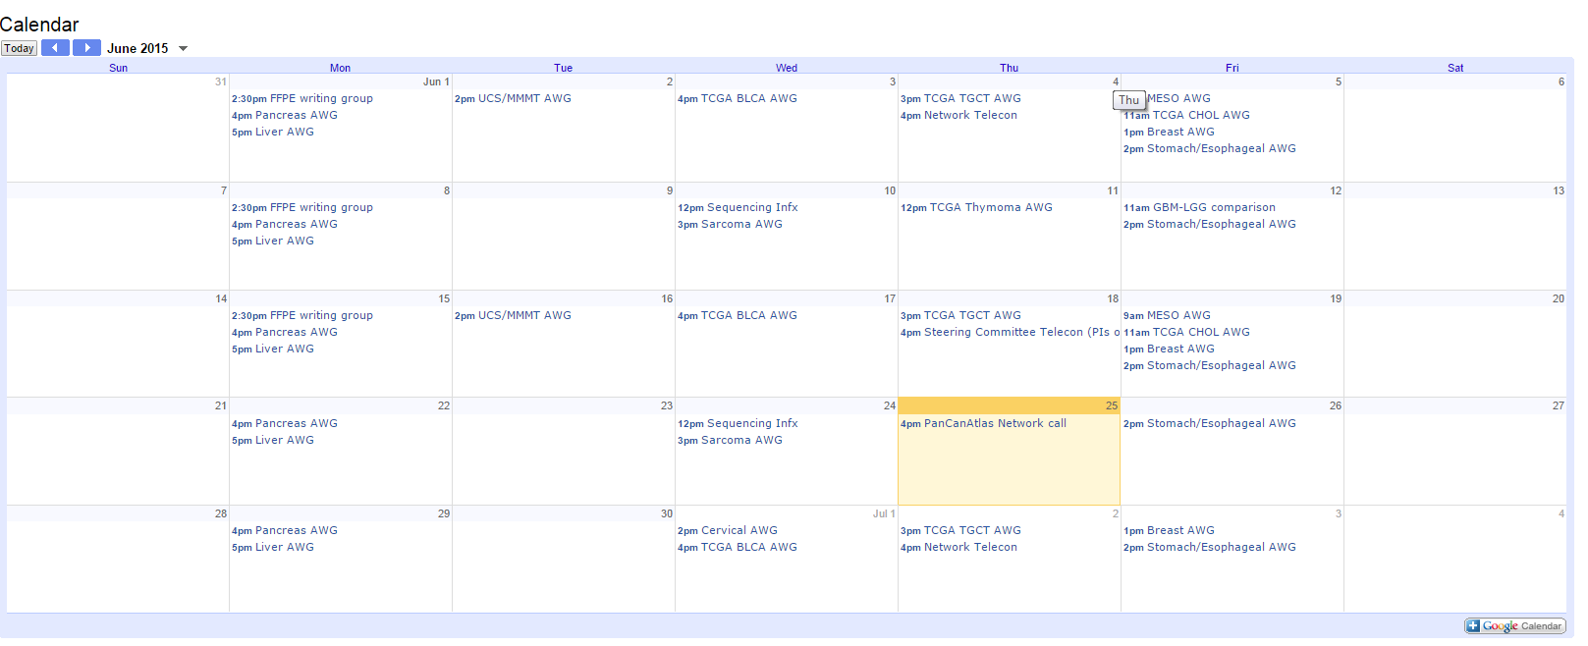
TCGA/PanCanAtlas Calendar
https://wiki.nci.nih.gov/display/TCGAM/PanCancerAtlas#PanCancerAtlas-Calendar

Slide 6
Adding participants to PanCanAtlas
Email me zhangjul@mail.nih.gov with a few sentences describing your potential contribution to PanCanAtlas
Forward you the participation form
Add you to listservs

Slide 7
Schedule of AWG calls so far…
Network/All (this call)
  2nd and 4th Thursdays at 4:00pm ET
Immune Response
  1st and 3rd Mondays at 11:00am ET
Stemness
  1st and 3rd Tuesdays at 2:30pm ET
Pan-Squamous
  Polling…

