Slide 1
Enrichment of GWAS and PGC SNPs in human brain H3K27ac peaks
Shuang Liu
For P2 TECH
July 1st, 2015

Slide 2
Datasets
GWAS dataset for selected Phenotypes (CAD, Height, etc.)
PGC2 dataset for Schizophrenia, Autism and Bipolar disorder
H3K27ac peaks for adult and fetal (DFC and CBC) from Sestan lab ChIP-seq dataset
The major histocompatibility complex locus (chr6: 25–35 Mb) was excluded

Slide 3
H3K27ac general peaks
All H3K27ac broad peaks identified by MACS2, in Adult or fetal, DFC or CBC.
PGC1 and PGC2 data were plotted with dashed line and triangles.
brain-related GRASP GWAS data were plotted by solid line and triangle.
GRASP GWAS data as control were plotted by dotted lines and circles.

Slide 4
H3K27ac general peaks TSS location
All H3K27ac broad peaks identified by MACS2, in Adult or fetal, DFC or CBC CBC in TSS locations.
PGC1 and PGC2 data were plotted with dashed line and triangles.
brain-related GRASP GWAS data were plotted by solid line and triangle.
GRASP GWAS data as control were plotted by dotted lines and circles.

Slide 5
H3K27ac general peaks non TSS location
All H3K27ac broad peaks identified by MACS2, in Adult or fetal, DFC or CBC in non TSS locations.
PGC1 and PGC2 data were plotted with dashed line and triangles.
brain-related GRASP GWAS data were plotted by solid line and triangle.
GRASP GWAS data as control were plotted by dotted lines and circles.

Slide 6
Adult DFC-specific peaks
Peaks presented in Adult.DFC but not in Adult.Fetal samples.
Adult.DFC - Adult.CBC

Slide 7
Adult CBC-specific peaks
In Adult.CBC, not in Adult.DFC

Slide 8
DFC adult-specific peaks
In DFC adult, not in DFC fetal

Slide 9
DFC fetal-specific peaks
In DFC fetal, not in DFC adult

Slide 10


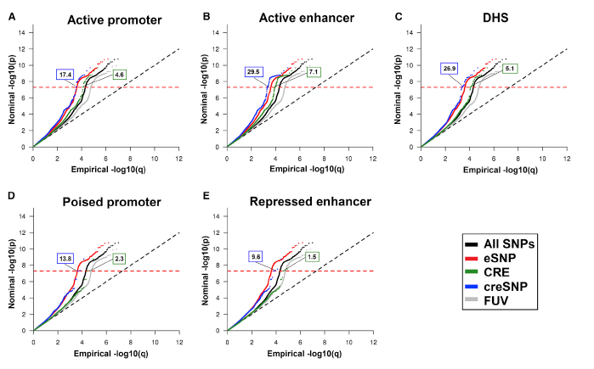

the global null hypothesis the theoretical distribution is uniform on the interval [0,1]
If nominal p-values are ordered from smallest to largest, so that p₍₁₎ < p₍₂₎ < … < p_{(N)}, the corresponding empirical cdf, denoted by “q”, is simply q_{(i)} = i/N, where N is the number of SNPs in the GWAS (or genic category)

Slide 11
9438238 SNPs
----- expected
-----p=5× 10⁻⁸

Slide 12
9493038 SNPs
----- expected
-----p=5× 10⁻⁸

Slide 13
11243 SNPs
----- expected
-----p=5× 10⁻⁸

Slide 14
91428 SNPs
----- expected
-----p=5× 10⁻⁸

