Slide 1
Journal club:
Recurrent somatic mutations in regulatory regions of human cancer genomes
JZ
06/2015

Slide 2
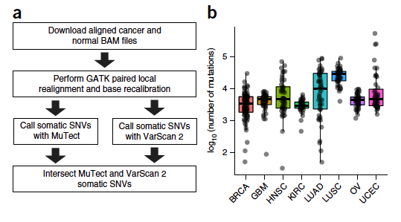
Variant Calling
This is either a smart or lucky choice

Slide 4
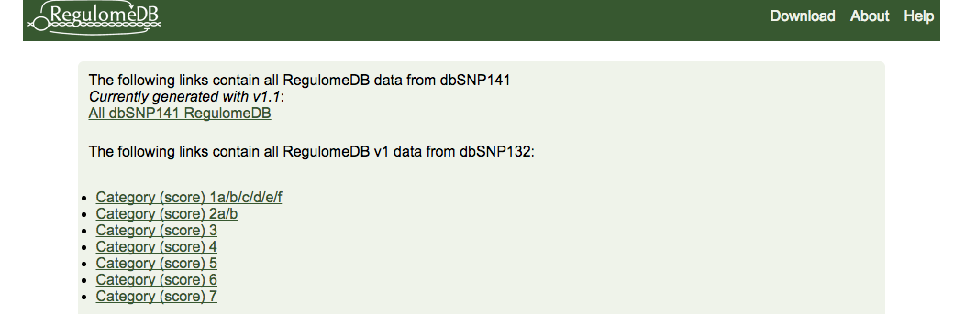
Annotation of variants
Gencode V19: transcript annotation and RegulomeDB
RegulomeDB: provides a score between 1 and 7 in order of decreasing regulatory evidence

Slide 5
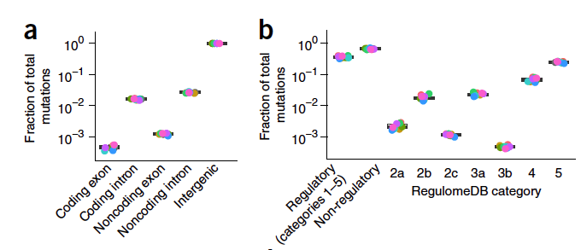
SNV QC
the potential false positive mutations due to mapping error filtered out of our analysis were highly enriched in non-regulatory regions
  Remove common SNPs from dbSNP141
  Mappability: 50mer score downloaded from ucsc, SNPS in score <0.5 were filtered out
somatic variation in cancer is governed less by purifying selection and more by positive selection.

Slide 6
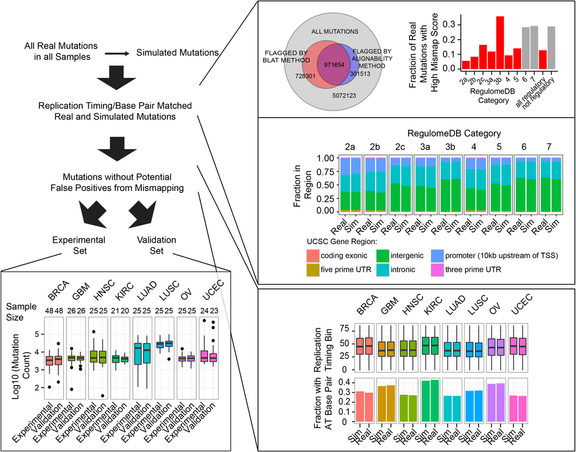
randomly sampling positions in the genome for each patient that could have been called as a mutation on the basis of the MuTect coverage output

Slide 7
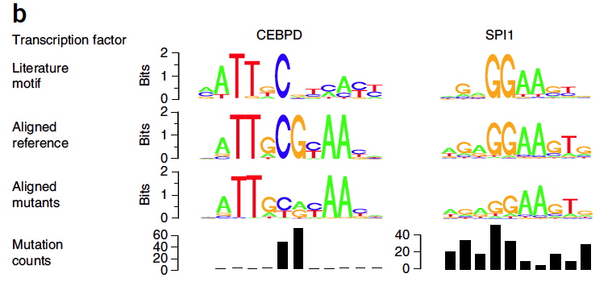
TFBS motif analysis
CEBPD: mutations were concentrated at the central CG dinucleotide
CEBPD binding site mutations pattern is highly suggestive of selection for mutation of a specific residue of the motif.
This selection might more effectively inhibit transcription factor binding, increase affinity of the transcription factor for the motif or allow the creation of a new motif
We favor the possibility that mutations in CEBP sites modulate but do not destroy the specificity of these sites, as many of the mutations did not decrease the matching of the motif to PWMs from the literature and previous reports showed that a CEBP binding site matching the mutant version identified here drove transcription in luciferase reporter assays.

Slide 8
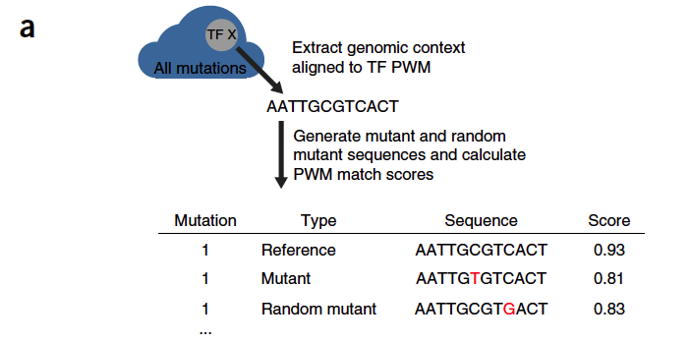
TFBS motif analysis
For each mutation, we generated a random mutation in the PWM with base conversion probabilities matching those in the original patient sample.
We then computed a match score for the reference, observed mutant and random mutant sequences with respect to the motif PWM.

Slide 9
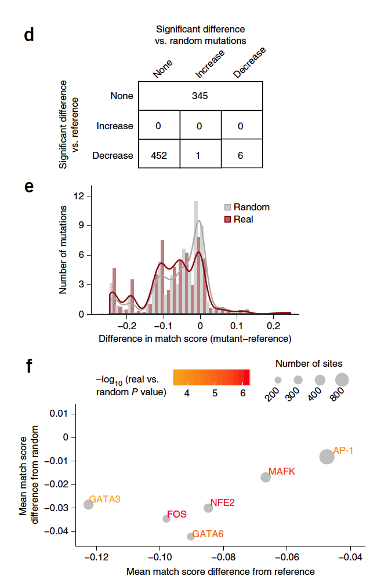
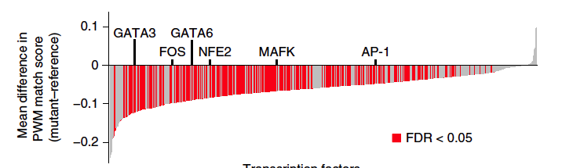
for the majority of transcription factors, the mutated sites significantly reduced the match score
Comparison of scores to those obtained for randomly mutated motifs showed that six of the transcription factors (GATA3, GATA6, MAFK, FOS, AP-1 and NFE2) had mutated sites with match scores significantly worse than with randomly generated mutated sites
Mutations in the binding sites for these factors tended to be concentrated at one or a few bases of the motif, suggesting selective pressure for these specific mutations

Slide 10
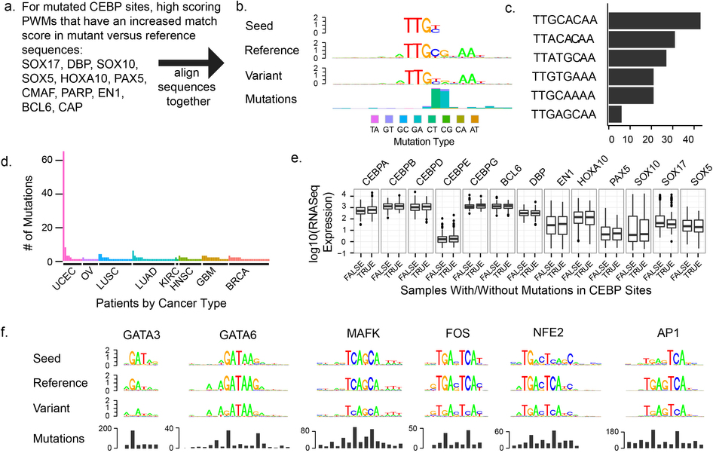
Motif creation event
Motif disruption event

Slide 11
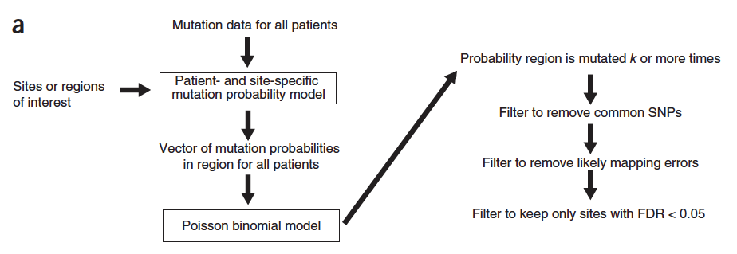


Identification of repeatedly mutated regulatory regions
Success vector:
PMF:
CDF:

Slide 12
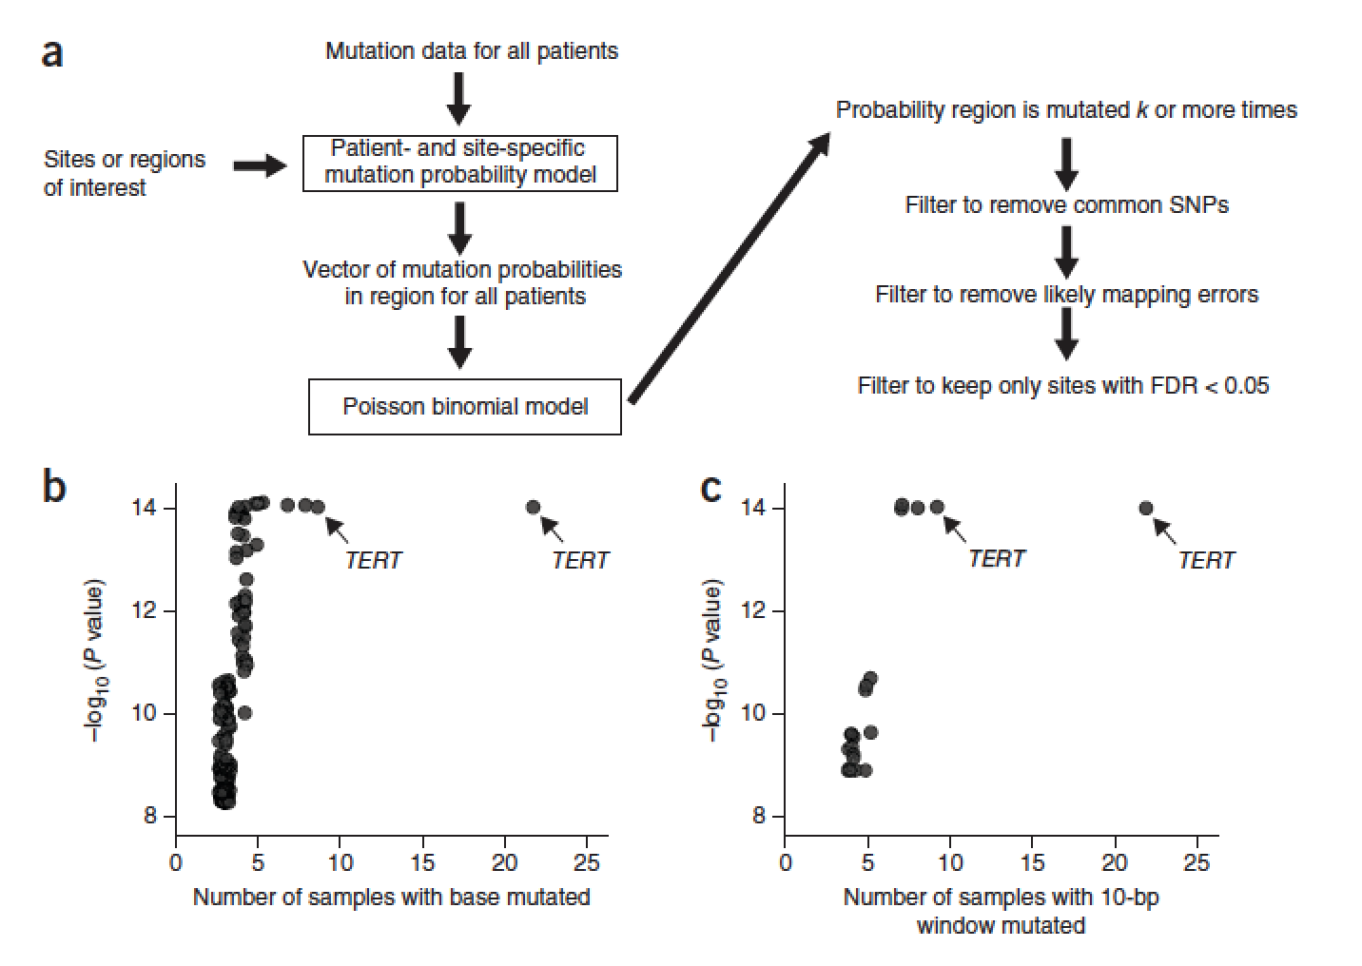

Slide 13
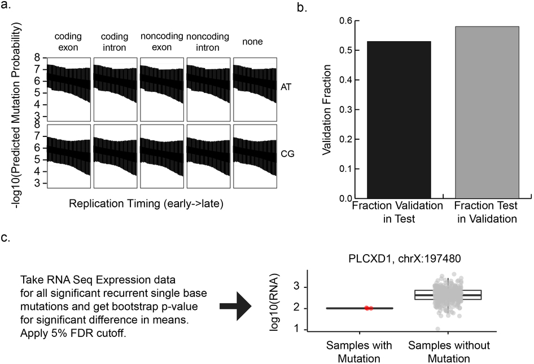

Slide 14
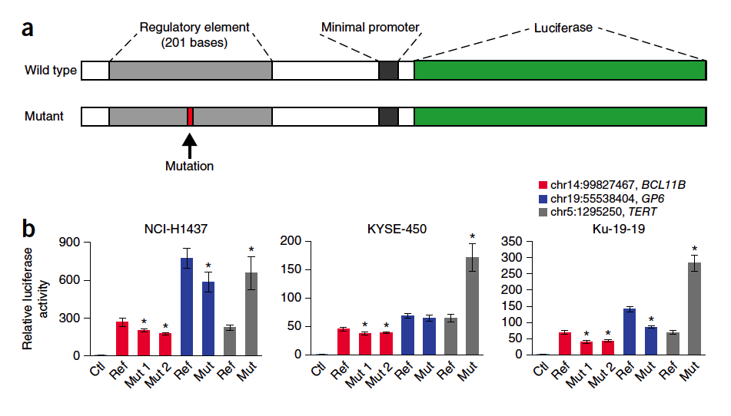
Validation

Slide 15

modeling the sparse cancer genome
Somatic variant counts per sample per cancer genome: 200~80,000
The corresponding mutation rate: (200~80,000)/3b = 6.666667e-09~2.666667e-05
How many samples we need for a robust proportion (p) estimation for rare events?
True event rate p+a, you have a chance of at least 1-d to have estimated rate at p?
When P=1e-4, with 10% error and 95%, need N=40821.99 samples for such precision

Slide 16
Regression Performance (not exactly) depends on
  Whether we have matched data
  Total number of variants we have
Total number of variants is highly correlated with the performance

Slide 17
1mb bin regression results
Low sample numbers and low mutation rate
Improvement of the NB1 over BI is huge in cancer types with lots of data

Slide 18
I0kb bin regression results
Performance of all cancer types degrades, but NB1 is still better than BI

Slide 19
Ikb bin regression results (chr17 only)
Performance of all cancer types is even worse, in most cases, not much difference in NB1 and BI

Slide 20
When to expect overdispersion
Overdispersion:
  cancer type, sample, region
  Dependence among neighboring regions (completely no control)
If you focus on 1 sample of a certain cancer type, length ~ 1kb -> no need to use Beta-binomial or Negative Binomial since is is basically no overdispersion
- on the p value evaluation
+ on the mutation rate estimation accuracy
+ on the p value evaluation
- on the mutation rate estimation accuracy
several samples, large bin resolution
1 sample, 1 nt resolution

Slide 21
Do you need to separate the cancer types?
Different cancer types may have completely different mutation patterns
The effect of covariates are dependent on cancer types

Slide 22
How to combine the p values?
X1, X2,…, Xk are independent random variables, what is the distribution of Y=X1+X2+..+Xk?
In the simplest case, Z=X1+X2
If we have m different p values to combine, and the complexity can be zm^3
Problem?
P1 >> P2, this convolution method can not handle it

Slide 23

Fisher’s method
Under the null hypothesis for test i, the p-value pi follows a uniform distribution on the interval [0,1]
-log(uniform) follows an exponential distribution.
-2*Sum(log(uniform)) follows of chi-square distribution with 2 df
Problem: when the test region is small pi does not follow a uniform distribution

Slide 24
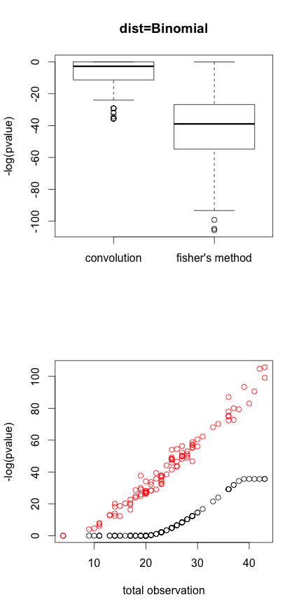
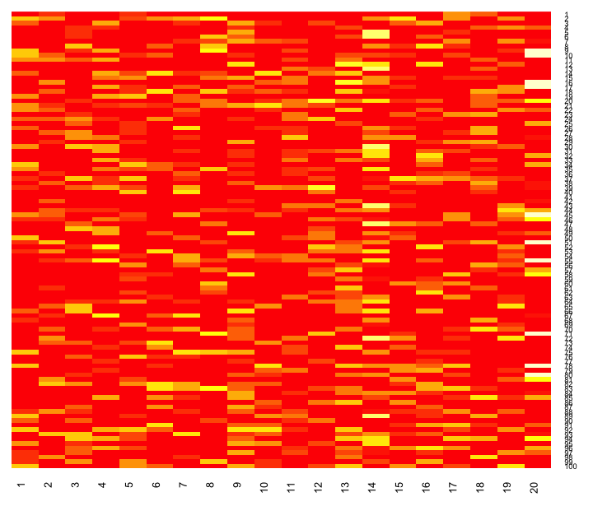
20 cancer types, mutation rate sampled from (1e-6, 1e-4)
Generate 100 case, for each cancer type generate a count with in the bin

