Slide 2
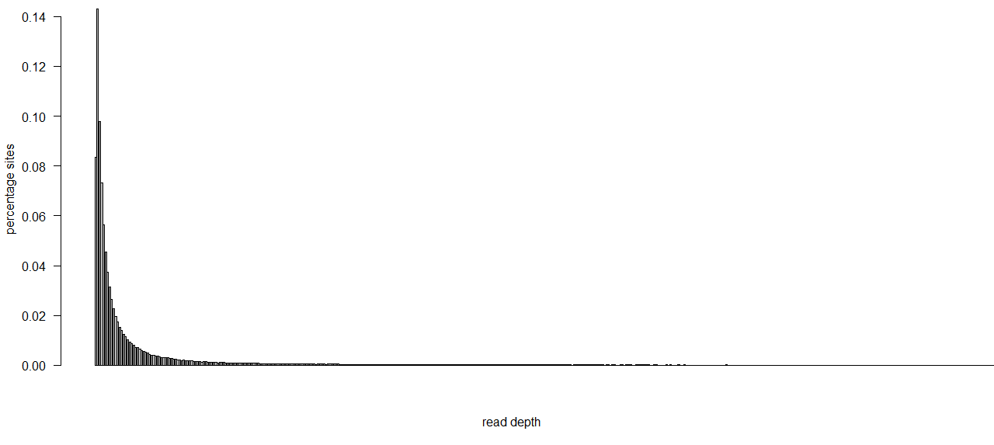
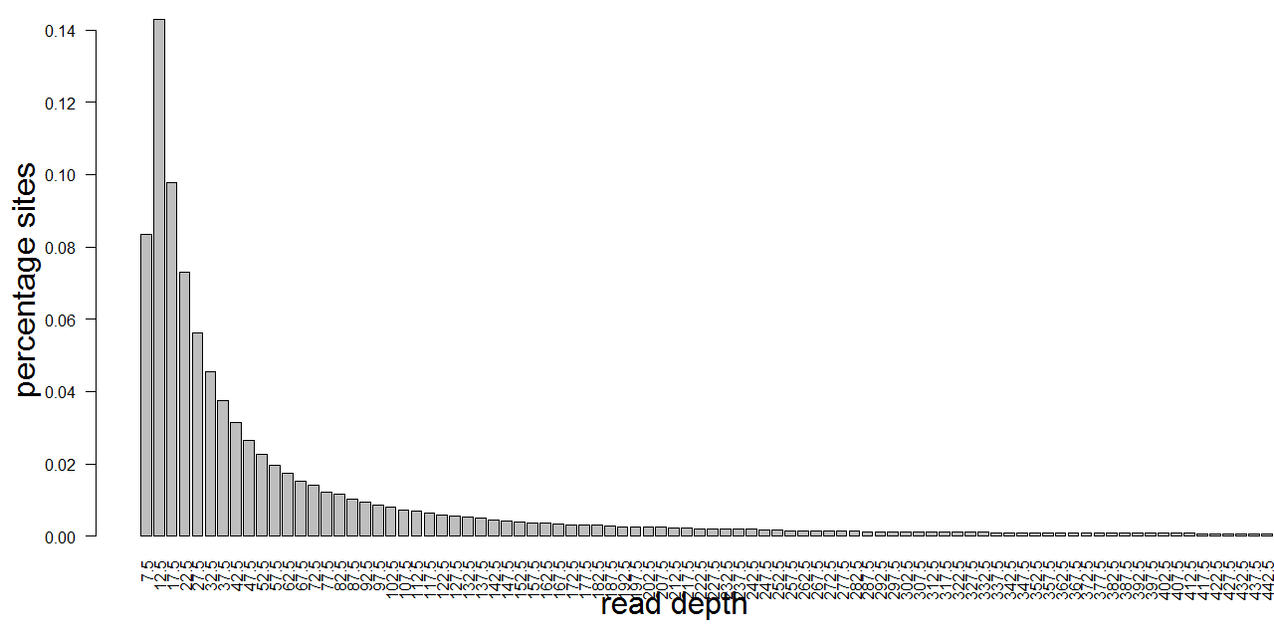
Enrichment of low read depth sites in ASE sites, but not the lowest read depth

Slide 3
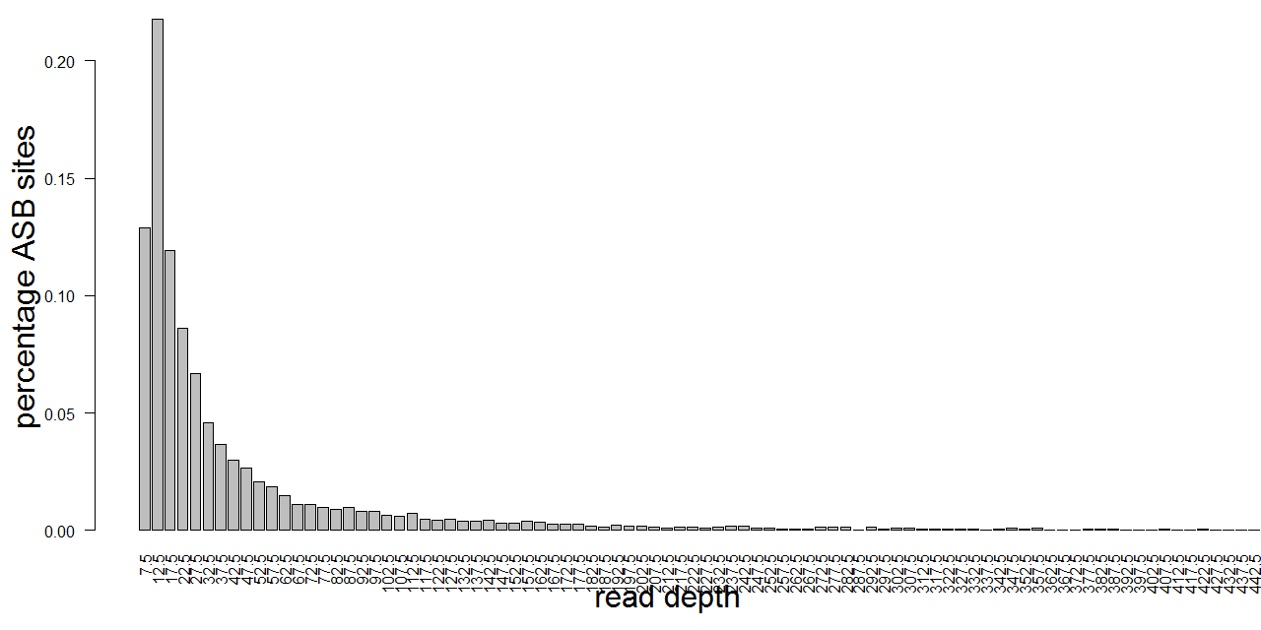
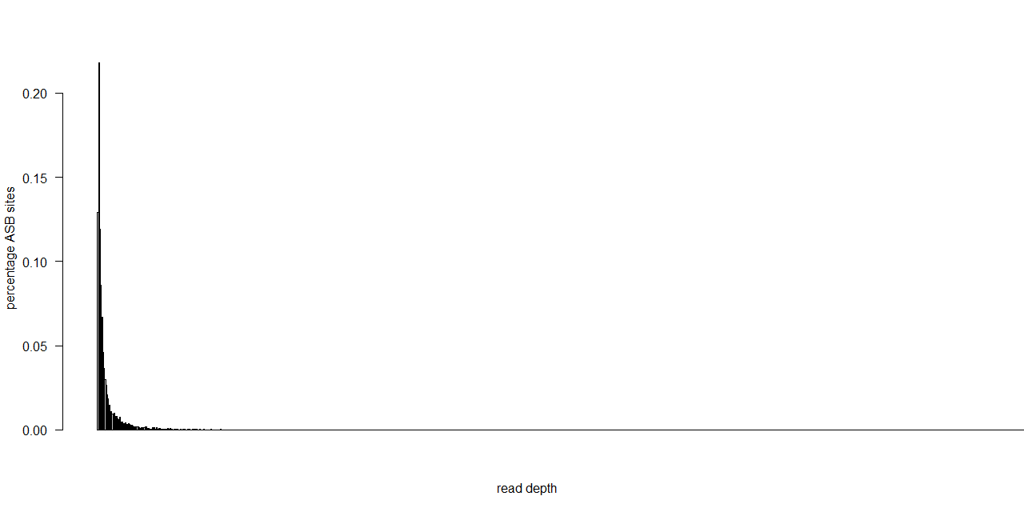
Enrichment of low read depth sites in ASB sites, but not the lowest read depth

Slide 4
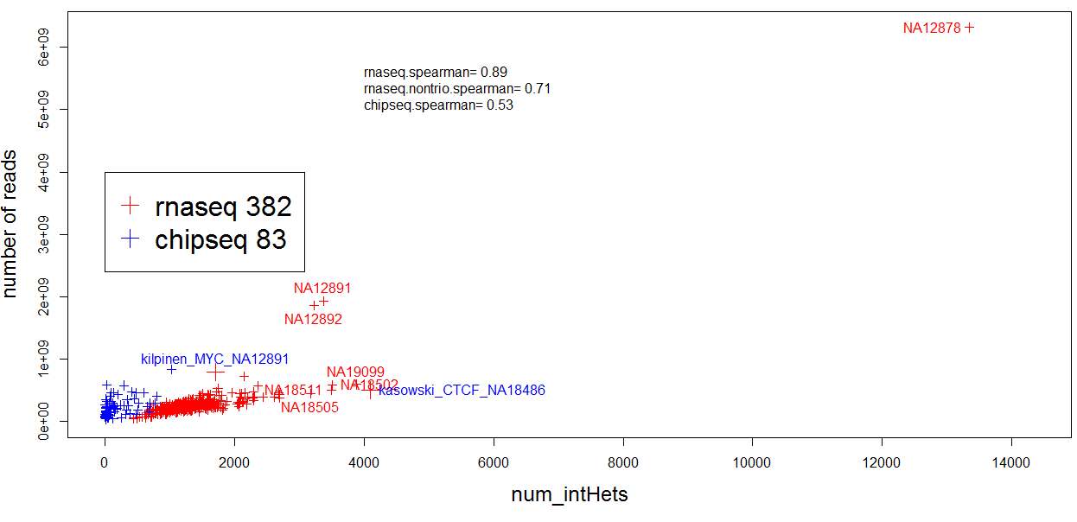
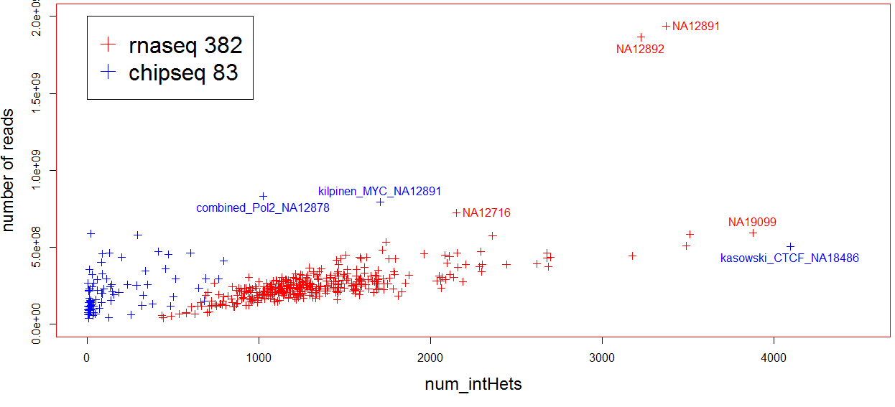
Individual: #IntHets vs #reads (datasetSize)
--strong correlation in RNA-seq sets but outliers exist: NA18502, NA19099 vs NA12891, NA12892
--weak correlation in ChIP-seq sets, might be more independent on read depth; e.g. CTCF_NA18486,

Slide 5
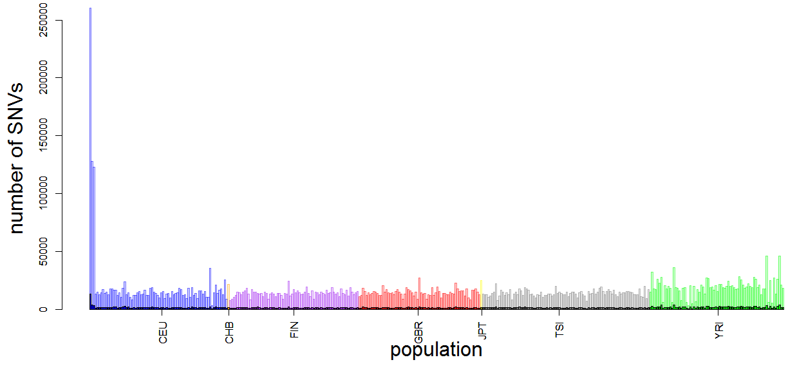
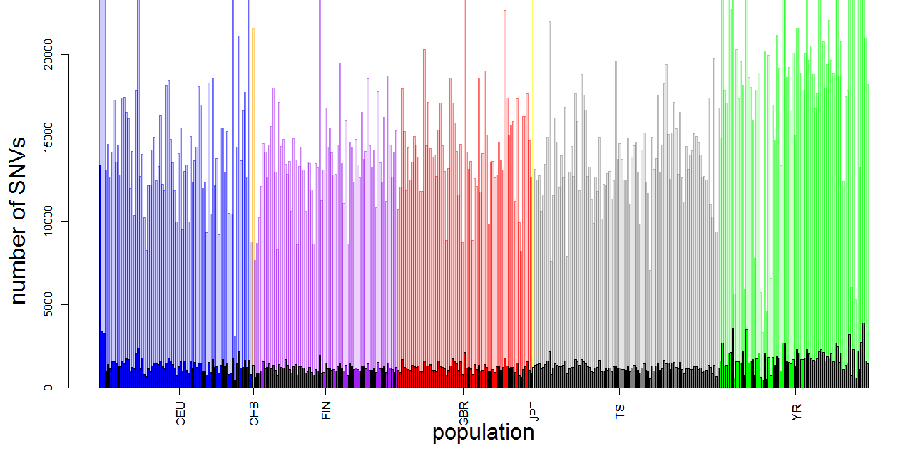
Pooled: histogram of #acc ASE SNVs (transparent) and # ASE per individual colored by population
Notes:
Any population-specific ASE patterns?

Slide 6
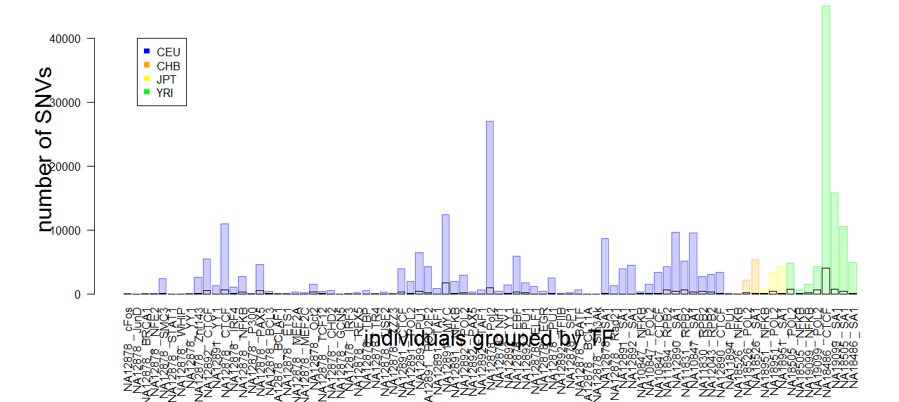
Pooled: histogram of #acc ASB SNVs (transparent) and # ASB (black boundaries) per individual colored by population, grouped by pop
Notes:
Pop specific ASB patterns?

Slide 7
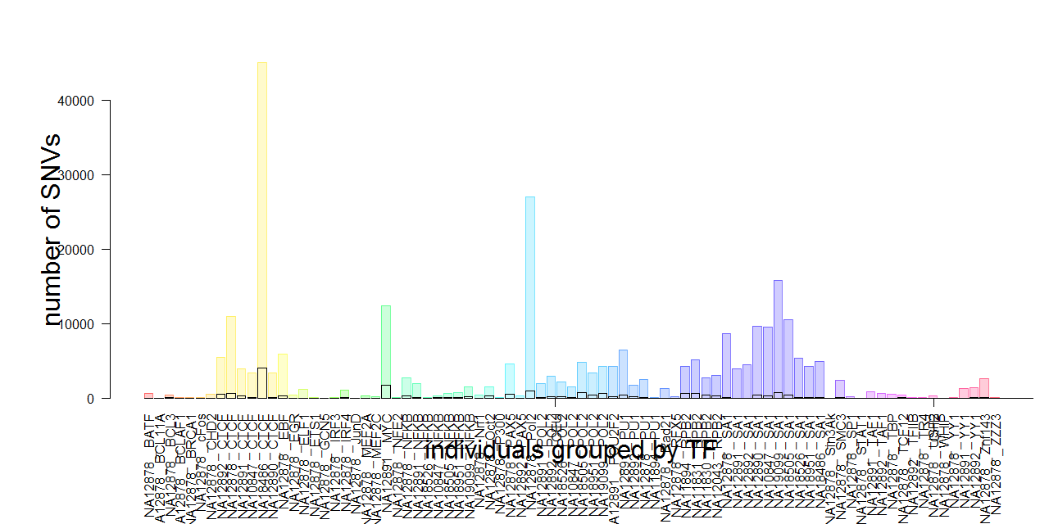
Pooled: histogram of #acc ASB SNVs (transparent) and # ASB (black boundaries) per individual colored by population, grouped by TF
Notes:
TF-specific ASB patterns?
Overdispersion 0.076 – NA18486_CTCF

Slide 8
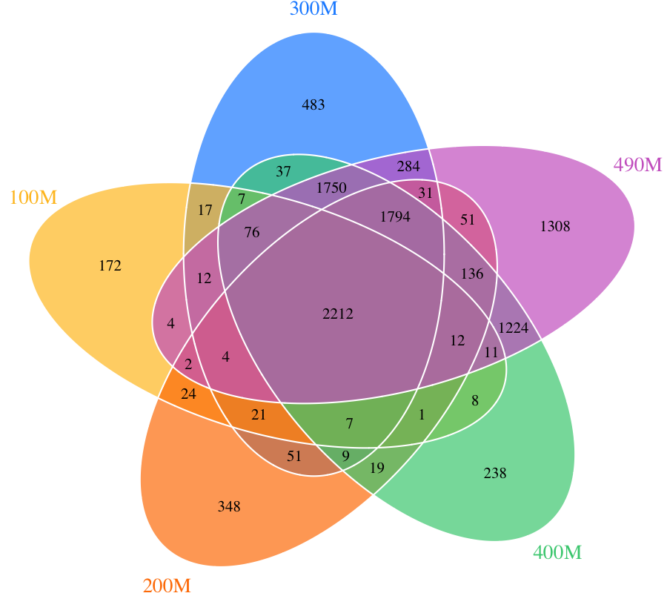
Reproducibility: how many ASE calls for various coverage in a NA12878 (subsampling)
Reads/M | # ASE SNVs called (bb; Bowtie1) | subset-specific (%)
100 | 2590 | 172 (6.6)
200 | 4722 | 348 (7.4)
300 | 6795 | 483 (7.1)
400 | 7541 | 1308 (17.3)
490 | 8911 | 238 (10.7)
Timur
Notes:
wgEncodeCshlLongRnaSeqGm12878NucleusPapFastqRd1Rep1.fastq.gz
wgEncodeCshlLongRnaSeqGm12878NucleusPapFastqRd2Rep1.fastq.gz
wgEncodeCshlLongRnaSeqGm12878NucleusPapFastqRd1Rep2.fastq.gz
wgEncodeCshlLongRnaSeqGm12878NucleusPapFastqRd2Rep2.fastq.gz

Slide 9
Relationship of read depths with
1) #aligned reads
2) #intHets in binomial and betabinom btween STAR (AS lesser calls) and Bowtie1
Timur
Notes:
No saturation!

Slide 10
Relationship of read depths with
1) #aligned reads
2) #intHets in binomial and betabinom btween STAR (AS lesser calls) and Bowtie1
Timur

Slide 11
A certain pair of replicates
 | indivDataset | b.grad | size_numReads | #intHets
A | wgEncodeCshlLongRnaSeqGm12878CellPapFastqRd1Rep1.fastq.gz.dir | 0.10 | 471505280 | 811
B | wgEncodeCshlLongRnaSeqGm12878CellPapFastqRd1Rep2.fastq.gz.dir | 0.07 | 527327588 | 1149
More reads win big rho? To give more intHets
A-B: 115
A&B: 696
B-A: 453

