Slide 1
TECH
Targeted Enhancer Prediction
Landon Chan
1 July 2015

Slide 2
Overview
Part 1: Cutoffs for matched filters
Part 2: Regulatory regions prediction

Slide 3
Part 1: Cutoffs for Matched Filters
Bayesian iterative approach
Super enhancers

Slide 4
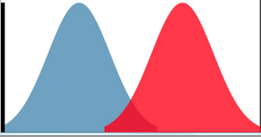
Bayesian approach
Posterior
Likelihood
Prior
Initial prior
(similar to expectation maximization):
P(+): # of positives in the genome in bp
P(-): # of negatives in the genome in bp
Posterior likelihood defines the new positives and negatives
The new positives and negatives give the new cutoff, a new posterior likelihood is generated

Slide 5
Number of positive regions
Tissue

Slide 6
Number of positive regions
Tissue

Slide 7
E003: Distance to TSS distribution of positive regions
(closest end to TSS)
Frequency
Distance to TSS

Slide 8
E003: Distance to TSS distribution of positive regions
(midpoint to TSS)
There is a slight positive predilection with the midpoint approach.
Using midpoint to TSS does not seem to change the distance distribution.
Frequency
Distance to TSS

Slide 9
Similar distance distribution is observed in other tissues
Closest end to TSS
Midpoint to TSS

Slide 10
log(RPKM)
Promoter
Non-promoter

Slide 11
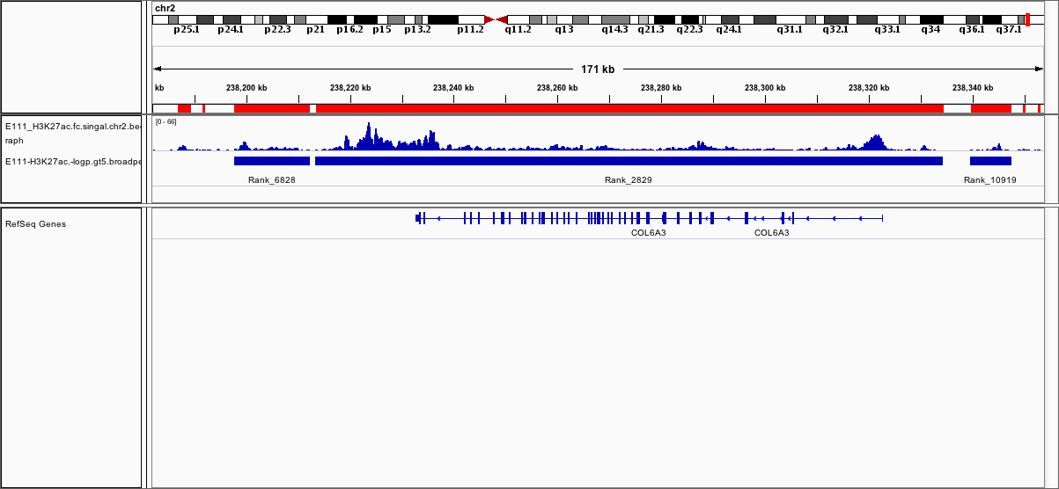
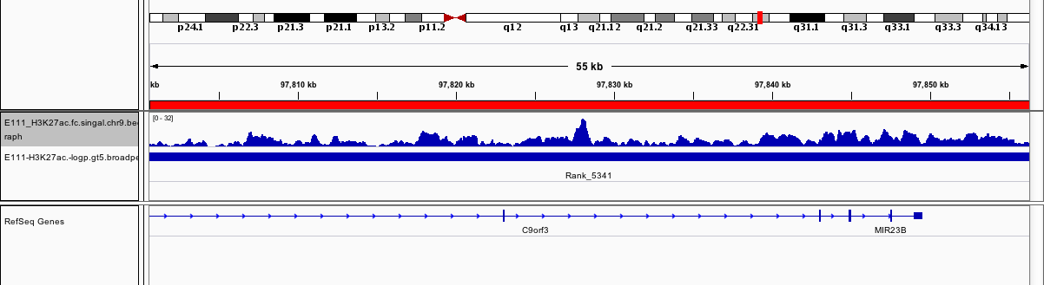
Super enhancer region?
Notes:
Seem to cover genes. Exons and introns?

Slide 12
Part 2: Regulatory regions prediction
Promoters
Enhancers
H3K4me3
H3K4me1
Signal
Signal
H3K4me1
H3K4me3
Genome Region
Genome Region
Promoter-type signal:
Enhancer-type signal:
Notes:
GC Hon. Predictive chromatin signatures in the mammalian genome. HMG 2009

Slide 13
Positive regions close to TSS has higher H3K4me3 scores than H3K4me1 scores
Posterior Probability Ratio
Log(H3K4me1/H3K4me3)
Distance to closest TSS
Notes:
Positive regions close to TSS has higher H3K4me3 scores than H3K4me1 scores

Slide 14
Positive regions far from TSS has higher H3K4me1 scores than H3K4me3 scores
Posterior Probability Ratio
Log(H3K4me1/H3K4me3)
Distance to closest TSS
Notes:
Put a bigger label on the axis
Regions far from it has higher H3K4me1 scores

Slide 15
ROC
Logistic regression:
glm(class ~ ratio, family=binomial)
Class: [Promoter, non-Promoter] or [Enhancer, non-enhancers]
Ratio: ln(H3K4me1/H3K4me3)
→ Fitted scores are used to generate True Positive Rates (TPR) and False Positive Rates (FPR)

Slide 16
ROC curve
Sensitivity: 0.86
Specificity: 0.76
E003: Promoter Prediction
E003: Enhancer Prediction
TPR
TPR
FPR
FPR
AUC=0.84
Sensitivity: 0.80
Specificity: 0.60
AUC=0.72
Notes:
Add a bigger AUC
Promoter classification vs enhancer classification
Maybe this can be used? → potential problems

Slide 17
Using H3K4me1 (enhancers) and H3K4me3 (promoters) broadpeaks
Sensitivity: 0.93
Specificity: 0.94
Although the conventional approach (using broadpeaks) appears to perform better than MF, MF predicts more enhancers..
E003: regulatory region
prediction using broadpeak file
TPR
Frequency
FPR
AUC=0.97
Matched Filter
BroadPeak

