Slide 1
Developmental ‘hourglass’ pattern at network level
DW
2015 07 01

Slide 2
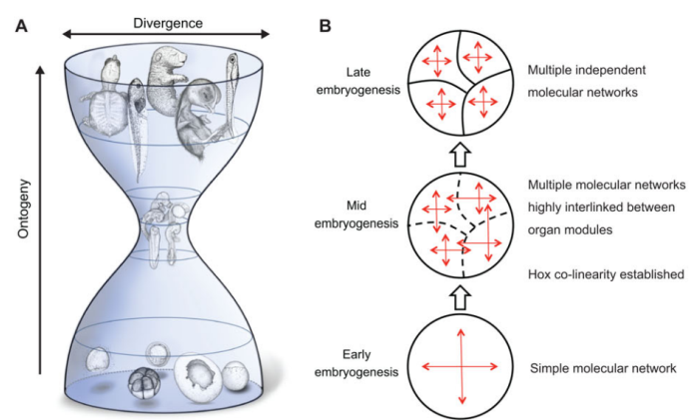
A hypothesized model from a recent publication(Irie&Kuratani, 2014 Development), using molecular network to explain hourglass pattern.
100 years
5-10 years
New, 2014
Hourglass at morpholohgy
Hourglass at transcription
Hourglass at
network modules
Those are previous knowledge

Slide 3

A model from a recent publication(Irie&Kuratani, 2014 Development), using molecular network to explain hourglass pattern.
The model argues:
1)network modules are not formed at the early embryogenesis.
2)network modules are tightly connected during mid embryogenesis.
3)network modules are independent of each other during late embryogenesis
‘Network modules’ can be considered as the coexpression modules identified in modENCODE papers.
‘Modules formed or not’ can be evaluated by modulePreservation in WGCNA, using time window.
‘tightly connected modules’ can be measured by the correlation between the eigenvectors of two modules

Slide 4
Data
Orthoclust for worm and fly only
  modENCODE RNA-seq RPKMs
  33 worm stages, 30 fly stages
29 worm-fly conserved modules
108 worm specific modules
52 fly specific modules

Slide 5
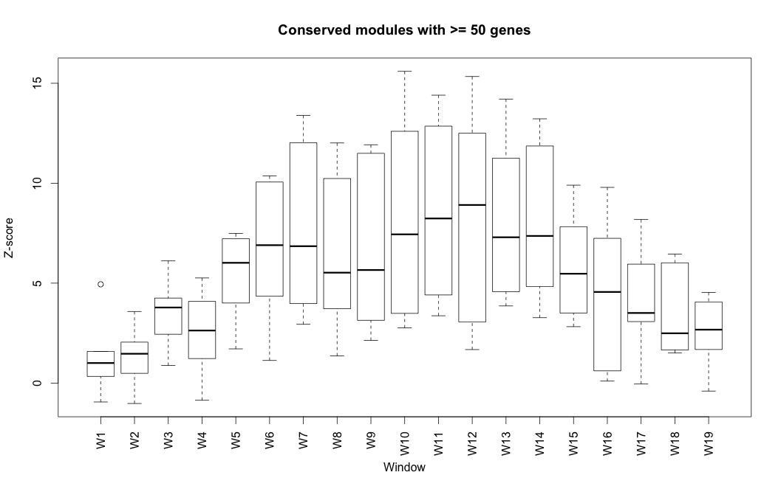
Evidence for ‘1)network modules are not formed at the early embryogenesis’
Conserved modules between worm and fly (>=50 genes, 5 modules)
Conservation Z score*
Z>4: module preserved
Phylotypic stage
19 time-windows during worm embryogenesis
Those modules preserve modularity during the middle of embryogenesis
* modulePreservation() in WGCNA
Notes:
http://labs.genetics.ucla.edu/horvath/CoexpressionNetwork/ModulePreservation/Tutorials/simulation-halfPreserved.pdf

Slide 6
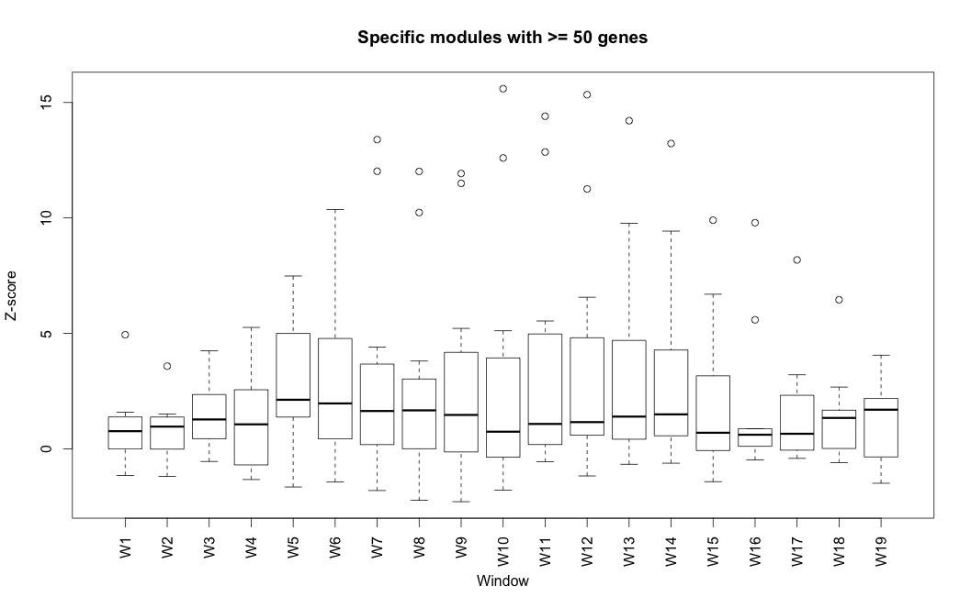
Worm-specific modules (>=50 genes, 36 modules)
Worm-specific modules are not preserved in any time window. Why?
Conservation Z score
Z>4: module preserved
Phylotypic stage
19 time-windows during worm embryogenesis
Those modules lose their modularity during all the time windows

Slide 7
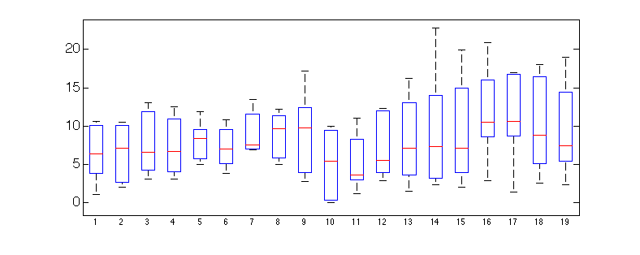
Worm-specific modules (Top 5 largest modules)
Conservation Z score
Z>4: module preserved
Phylotypic stage
If we only consider the top 5 largest worm-specific modules(>300 genes), they show largest preservation at the end of embryogenesis (window 16 ~19).
During polytypic stage (window 10 ~13), they show little preservation of their modularities.

Slide 8
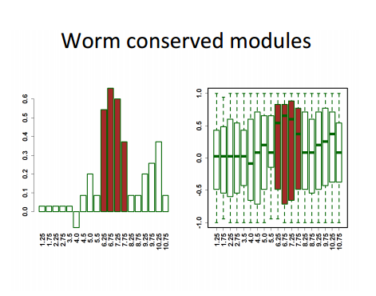
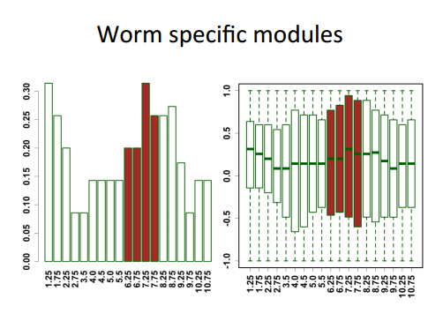
Evidence for ‘2)network modules are tightly connected during mid embryogenesis.’
Conserved modules are tightly connected during mid-embryogenesis
The connection between coexpression modules can be measured by the correlation between the eigenvectors of two modules
All pair-wise spearman correlation cofficient
Time-window
Worm-specific modules are not
Species-specific modules does not show tightly connection between each other during the mid-embryogenesis
All pair-wise spearman correlation cofficient
Time-window

Slide 9
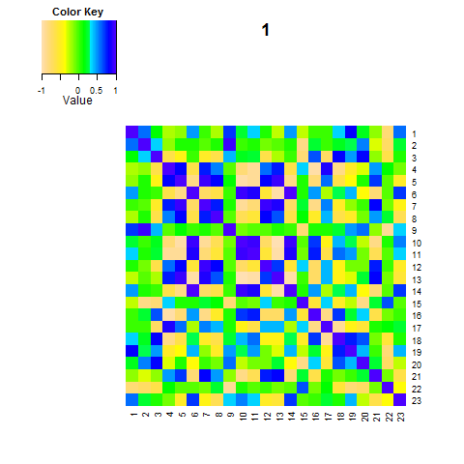
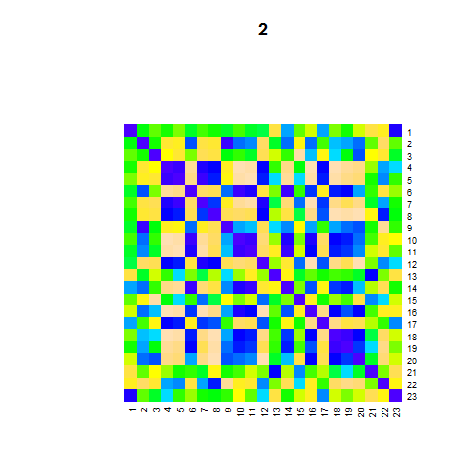
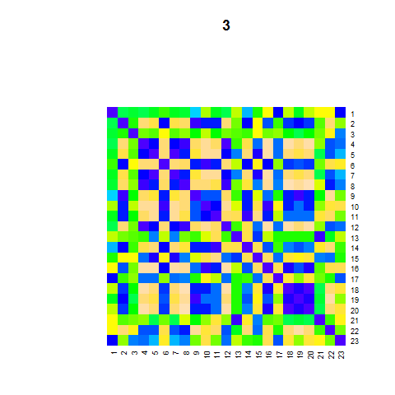
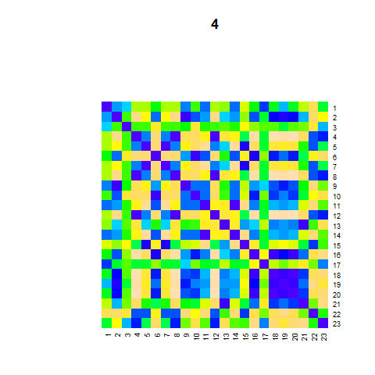
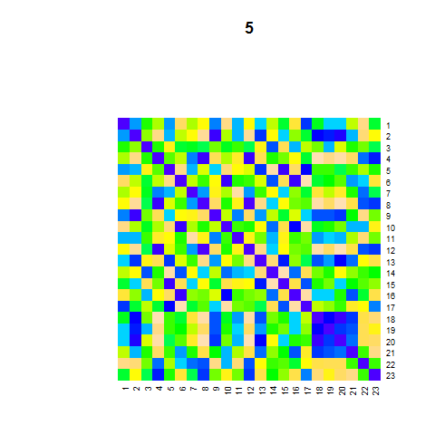
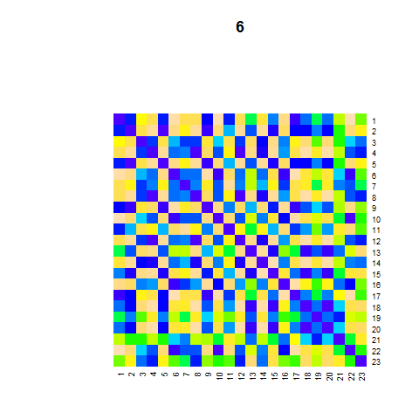
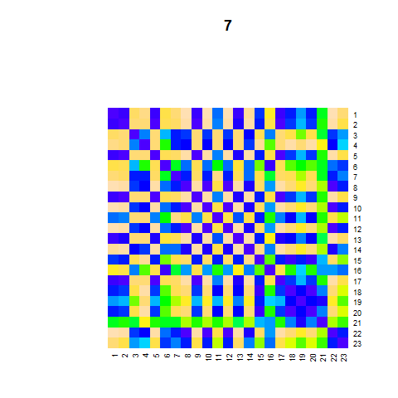
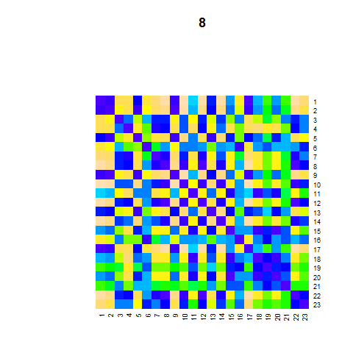
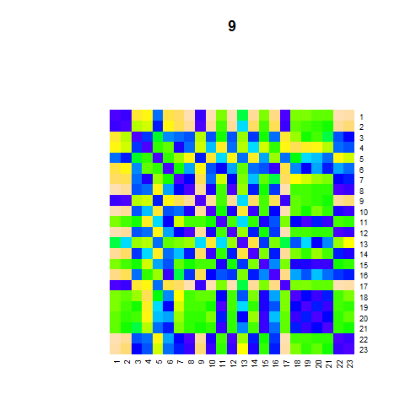
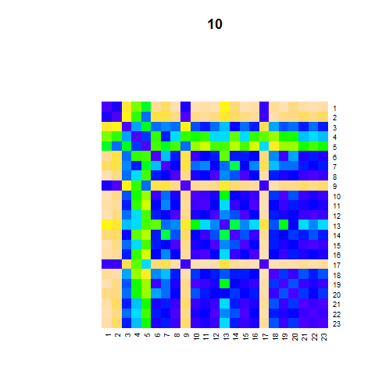
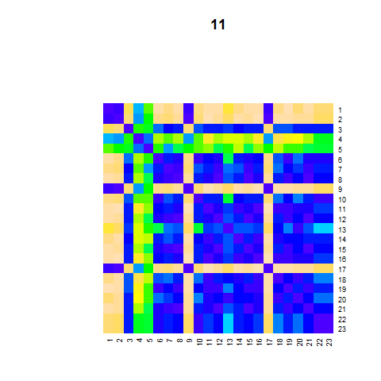
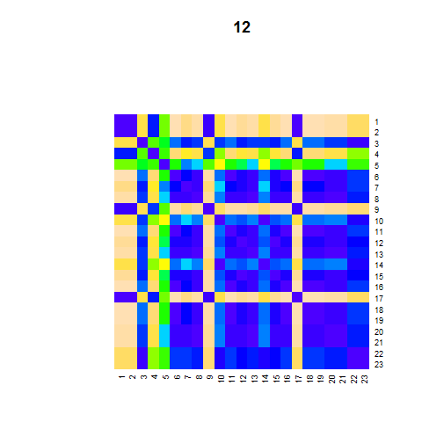
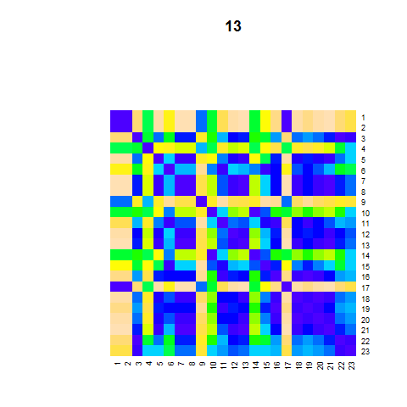
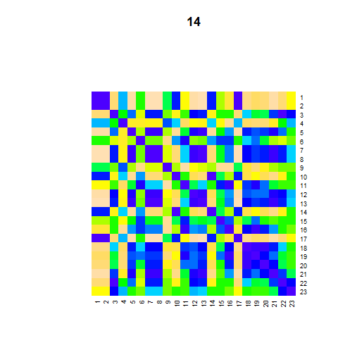
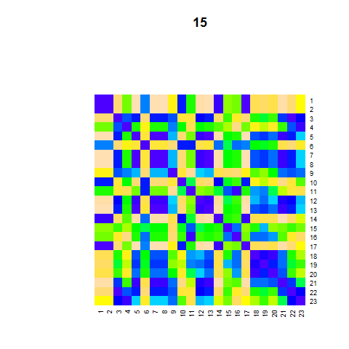
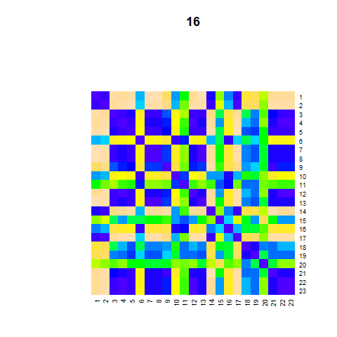
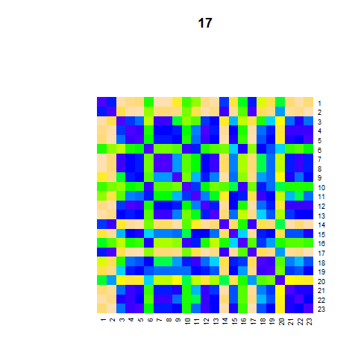
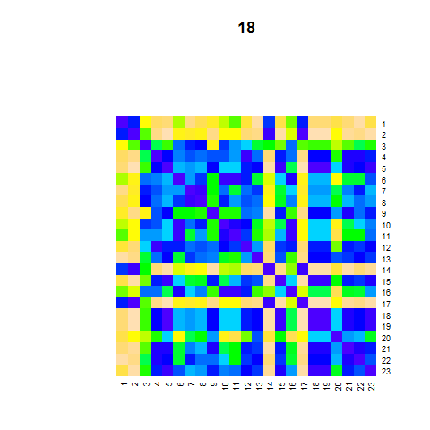
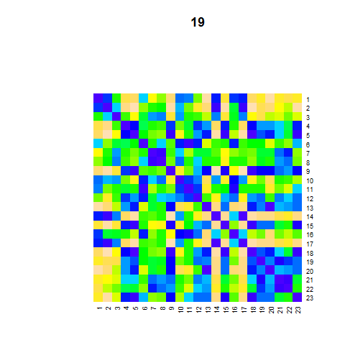
Worm sliding-window correlation matrices of all windows(1-19)
Phylotypic stages

Slide 10
3) network modules are independent of each other during late embryogenesis
Because our data during the late embryogenesis are based on a mixture of differentiated cells, it does not have the resolution to detect the molecular events for each tissue or organ.
Our data does not allow us to find evidence to support this hypothesis at the end of embryogenesis.
Notes:
gene co-expression is mixture.

Slide 11
Our evidence support this model only for conserved modules.
If the module is species-specific, we can not observe this pattern.
Our conclusion is slightly different with the concept proposed by Irie&Kuratani, 2014 Development.
We found that
Not all the network modules fit this hourglass pattern
Conclusion:
The hourglass pattern is controlled by the conserved molecular networks.
100 years old
5-10 years old
New, 2014
Hourglass at morpholohgy
Hourglass at transcription
Hourglass at
network modules
Those are previous knowledge
This is our contribution

