Slide 1

LARVA: an integrative framework for Large-scale Analysis of Recurrent Variants in noncoding Annotations
Coming soon to a Nucleic Acids Research near you…
Lucas Lochovsky
Group meeting
July 1, 2015
Notes:
Today, I’m going to present my PhD work, the bulk of which consists of the development of LARVA, a computational tool designed to identify genome elements with high mutation burden in cancer single nucleotide variant data.

Slide 2
Outline
Introduction
Data & Methods
Results
Discussion
Future Work
Notes:
My presentation will start with describing the motivating questions behind LARVA, and then cover the data collection and computational methods design. I will then describe my results with the publication version of LARVA, and wrap up with some discussion points related to the context of LARVA in the study of genetic disease, and describe some avenues for followup work.

Slide 3
LARVA Introduction
Increasing number of whole genome sequenced cancer patients
  Lots of data, but how does one turn this into an understanding of cancer biology that could lead to a cure?
Single nucleotide variants (SNVs)
  Which functional genome elements do they intersect?
  How to distinguish drivers from passengers?
Previous work is mostly exome-focused
  We want to address the lack of analysis of the whole genome
Goal: Develop a model for the whole genome background somatic mutation distribution in cancer to identify potential noncoding cancer driving elements
LARVA: Large-scale Analysis of Recurrent Variants in noncoding Annotations
Notes:
LARVA was built for the purpose of facilitating the study of the causes of genetic disease, especially cancer, which is the primary focus of the current iteration. The rise of high-throughput DNA sequencing has produced massive amounts of data that can be used to find the genetic causes of cancer, but this data doesn’t really help us if we don’t know how to make sense of it. I started with single nucleotide variant data, and wanted to develop software to make it easy to find which functional elements of the genome are intersected by these variants, and identify which elements are responsible for driving cancer. In other words, which elements are highly mutated due to a specific cancer disruption, and which are highly mutated due to background mutation processes. Another issue we wanted to address is the fact that many cancer studies to date have involved exome mutation analysis, with relatively little consideration to noncoding regulatory elements. With LARVA, we wanted to address the relative lack of understanding of noncoding cancer drivers by modelling the distribution of background somatic variants in cancer, so that we can pick out those noncoding elements with a higher-than-expected mutation burden, as these may be drivers of cancer. Hence, we created LARVA, which stands for Large-scale Analysis of Recurrent Variants in noncoding Annotations.

Slide 4
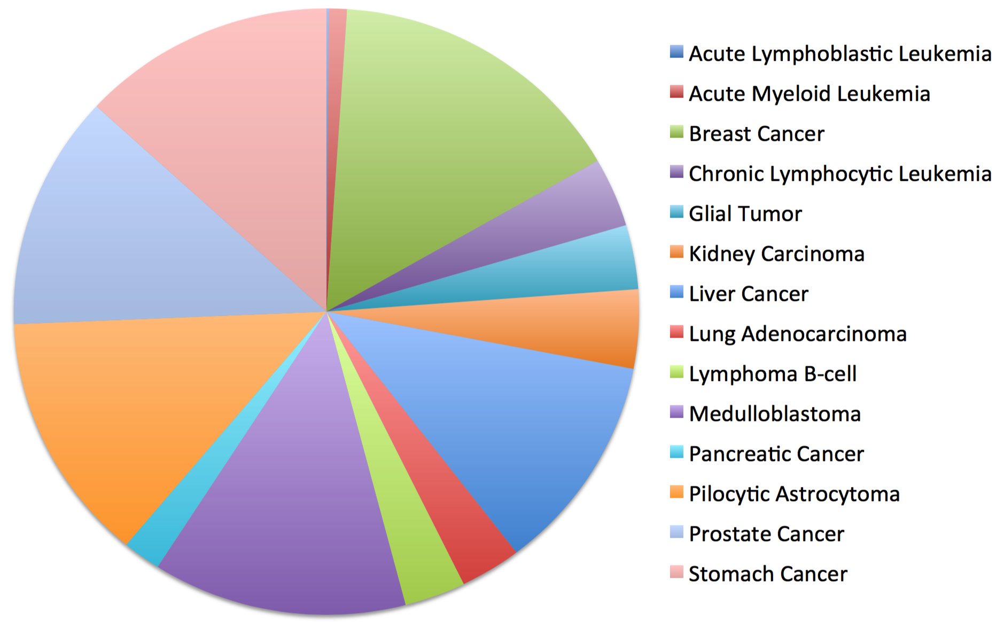
LARVA Data & Methods
Whole genome cancer variant data
Aimed for a pan-cancer analysis
  Number of samples for individual cancers is limited → Limited statistical power
760 genomes pulled from publications, collaborating labs, and online repositories
Cancer types include: breast, lung, bone, pancreatic, brain, liver, kidney, and stomach
Notes:
We started by collecting single nucleotide variant data for as many cancer genomes as were available at the time. We looked through published datasets, talked to our collaborating labs both within and outside of Yale, and applied for access to secure cancer data repositories. In total, we collected 760 genomes spanning breast, lung, bone, pancreatic, brain, liver, kidney, and stomach cancer. In the analyses I’m going to present in upcoming slides, we chose to pool all cancer variant data and analyze all cancer types together, so essentially we were looking for pan-cancer drivers.

Slide 5
LARVA Data & Methods
Noncoding annotations
GENCODE v16
  Promoters
  UTRs
  Transcription start sites (100bp upstream of each gene region)
Transcription factor binding sites (ENCODE ChIP-seq)
Distal regulatory modules (DRM)
Dnase I hypersensitive (DHS) sites (ENCODE)
Ultra-conserved sites
Ultra-sensitive sites
Notes:
As we wanted to identify noncoding cancer drivers, we also collected information on noncoding functional annotations. We processed a GENCODE annotation file and extracted the promoters, UTRs, and transcription start sites. We also looked up coordinates for transcription factor binding sites using ENCODE ChIP-seq data. Furthermore, we used a set of distal regulatory module enhancers, which were also derived from ENCODE ChIP-seq data. Dnase I hypersensitive sites is another class of regulator elucidated from the chromatin landscape—another set of experiments from the ENCODE project. The last two annotation classes are ultra-conserved sites, which are so-named because they are highly conserved across many species, and ultra-sensitive sites, so-named because they were found to be under strong purifying selection.

Slide 6
LARVA Computational Pipeline
Notes:
This is an overview of the entire LARVA workflow.

Slide 7
LARVA Computational Pipeline
Single nucleotide variant data spanning 760 cancer genomes.
Represents all available cancer genomes at the time. Will add more as they become available.
Cancer types span breast, lung, bone, pancreas, brain, liver, kidney, and stomach
VCF = variant call file
Noncoding regulators as established by the ENCODE and GENCODE consortia
Tasked with functionally annotating the human genome after completion of the Human Genome Project
Notes:
We started by collecting single nucleotide variant data for as many cancer genomes as were available at the time. We looked through published datasets, talked to our collaborating labs both within and outside of Yale, and applied for access to secure cancer data repositories, such as the The Cancer Genome Atlas. In total, we collected 760 genomes spanning breast, lung, bone, pancreatic, brain, liver, kidney, and stomach cancer. The cancer variant data is fed into the pipeline as VCFs, or variant call files. They are run through quality control filters, which mostly involves removal of variants from blacklist regions with poor read mappability. Hence, we only save the variants that are confidently mapped. Our collection of noncoding genome annotations, which are indicated as regulatory modules in this diagram, functions as the second input. We pulled these from various experiments conducted by the ENCODE and GENCODE consortia, which are tasked with performing experiments with the specific purpose of functionally annotating the human genome.

Slide 8
LARVA Computational Pipeline
Intersect all variants with all annotations
Each annotation has a mutation count
Correct for features known to influence the whole genome mutation rate
  That is, these features account for differences in the mutation rate of different regions
Notes:
The variants and the annotations are intersected, producing mutation counts for each annotation. These mutation counts serve as input to the background model in the next step, which I’ll be explaining in more detail in the coming slides. The confounding feature correction box represents factors such as DNA replication timing that influence the background mutation rate of annotations throughout the genome. Currently, replication timing is the only factor in LARVA, but I plan to incorporate additional factors in future versions.

Slide 9
LARVA Computational Pipeline
Use the mutation counts to fit a model that describes what mutation counts should be expected assuming only background mutation processes
  That is, if all mutations were passenger mutations
Significant p-values produced by comparing observed mutation counts to this model indicate potential cancer drivers.
Notes:
The mutation counts are fitted to a background mutation rate model. This model describes the distribution of mutations throughout the noncoding annotations that would be expected assuming those mutations arose due to background mutation processes. In other words, if all mutations were passenger mutations, how many would we expect to intersect each annotation. The annotations whose mutation counts deviate from this background model will produce significant p-values, and are indicative of potential cancer drivers.

Slide 10
LARVA Data & Methods
We tested 3 models evaluating the significance of a mutation burden of a genome element
Model 1: Constant Background Mutation Rate (Model from Previous Work¹)
Suppose there are k genome elements. For element i, define:
n_{i}: total number of nucleotides in i
x_{i}: the number of mutation within element i
p: the probability of observing a mutation in each position
x_{i}’s distribution in model 1 is:
1. Alexandrov, L. B. (2013) Signatures of mutational processes in human cancer. Nature 500, 415–421.
Notes:
The most important component of LARVA is accurately predicting the significance of a genome element by having an accurate model of the whole genome background somatic mutation rate. We evaluated three models, which I present here starting from the least sophisticated to the most sophisticated. The first model represents the background mutation rate model used in previous work, which serves as a comparison to the other two models designed and implemented for LARVA. Model 1 assumes that the background mutation rate is constant, and therefore the probability of an element i having a certain number of mutations is represented as a binomial function of the length of element I, and p, the probability of observing a mutation in a single nucleotide position.

Slide 11
LARVA Data & Methods
Model 2: Varying Mutation Rate
Our extension to model 1
Model p as a beta distribution to account for heterogeneity in mutation rates of different genome elements
Notes:
We extended model 1 into a version that assumes a varying mutation rate. Here, each genome element may have a different p, so p in model 2 is modelled as a beta distribution.

Slide 12
LARVA Data & Methods
Model 3: Varying Mutation Rate with Replication Timing Correction
Our extension to model 2
  Used in publication version of LARVA
Mutation rates are known to be confounded by a number of genomic factors, such as DNA replication timing
  Later replicating regions are more error-prone due to the depletion of free nucleotides
Divide all elements into 10 different ranks of replication timing (represented with R)
Distribution parameters are now conditioned on R
Notes:
We can further build upon this by accounting for various confounding factors in the background mutation rate. This third model takes into account the fact that the DNA replication timing of a region influences its background mutation rate, since later replicating regions are more error-prone due to the depletion of free nucleotides. Model 3 conditions the parameters of the beta distribution on R, which represents the replication timing rank of element i. This rank is one of 10 ranks that indicates which 10% replication timing quantile the element belongs to. This model is the version that is available in the code released alongside the LARVA publication.

Slide 13
LARVA Data & Methods
Implementation
Original prototype implemented in Perl with SQLite for data management
  Easy to design data manipulations in SQL
  Envisioned data exploration through SQL queries
  Poor scalability
Current version implemented in C++ and R
  R for statistical model fitting
  C++ for all other steps
Upcoming version will be fully C++
Notes:
LARVA started out as prototype that I built as a Perl script interfacing with an SQLite database. My previous experience with Perl made it easy to quickly prototype and test my ideas on small datasets. The involvement of SQL was motivated by two factors. First, I found it easy to think about how to manipulate genome data with SQL commands, and second, I had originally planned to enable users to explore the data by writing SQL queries, either manually or with a graphical user interface that asks a series of questions designed to elucidate the type and parameters of an SQL query. However, this design did not scale up to large datasets, so it was rewritten as a hybrid of C++ and R code. R was used to fit the input data to a beta-binomial distribution, and C++ was used for all the other steps. The next iteration of LARVA will be a fully C++ program, so that we have more control over the source code for the purpose of further finetuning our methods.

Slide 14
LARVA Results
Heterogeneity between cancer types
The distribution of variants throughout the genome indicates high mutation rate heterogeneity on many levels
Heterogeneity between samples
of the same type
Heterogeneity on 50
random 1Mb regions
Notes:
Now I’m going to go into LARVA’s results. We demonstrated that in our cancer variant data there is a high degree of heterogeneity, whether it is between different cancer types, between cancer samples of the same type, and even within a random sample of one megabase length regions. This impressive range of heterogeneity indicates the need for a background mutation model that properly models this heterogeneity.

Slide 15
LARVA Results
Comparison of mutation count frequency implied by the binomial model (model 1) and the beta-binomial model (model 2) relative to the empirical distribution
The beta-binomial distribution is significantly better, especially for accurately modelling the overdispersion of the empirical distribution
Notes:
Here, we graphed the mutation count frequency implied by empirical observation, represented by the black line, and compared it to the mutation count frequency implied by the binomial model, or model 1, represented by the pink line, and the beta-binomial model, or model 2, represented by the turquoise line. Here, it is clear that the beta-binomial distribution is a significantly better fit for the empirical distribution, especially in modelling the overdispersion that appears in the empirical distribution. We also backed up this finding with a Kolmogorov-Smirnov test comparing the binomial and beta-binomial models to the empirical distribution. The KS statistics also demonstrate that the beta-binomial model is a better fit.

Slide 16
LARVA Results
Demonstrate that adding the DNA replication timing correction (model 3) further improves the beta-binomial model (model 2)
Top 10% of replication timing bins requires little correction
Bottom 10% of replication timing bins requires massive correction
Demonstrate that the number of significant p-values is inflated under the binomial model
Neither the empirical or beta-binomial models exhibit this inflation
Notes:
Here, we demonstrate that incorporating the correction for DNA replication timing further improves the fit of the beta-binomial model to the empirical distribution. As I touched on earlier, we divided all noncoding annotations into 10 bins that represent the lowest 10% of replication timings, the top 10% of replication timings, and every 10% increment in between. The left figure indicates that accounting for the replication timing is important, as, when we compare the three distributions in the top 10% replication timing bin annotations, the binomial distribution is a fairly good fit for the observed distribution, but in the bottom 10% replication timing bin annotations, the binomial distribution is a poor fit, and the beta-binomial distribution looks better. With the right figure, we demonstrate that the number of significant p-values is inflated under the binomial model, a phenomenon that neither the beta-binomial or empirical models exhibit.

Slide 17
LARVA Results
Application of LARVA to promoters produced a number of results with literature-backed cancer associations
  TERT
  TP53
Other significant promoters serve as suggested targets for validation of cancer association
-log10(p-value)
Notes:
Finally, we wanted to evaluate LARVA on finding significantly mutated promoters associated with cancer. We found that LARVA marked the TERT and TP53 promoters as significant, both of which have well documented cancer associations in literature. The remaining promoters with significant p-values serve as priority targets for more rigorous validation for cancer association. Given the cost associated with cancer validation experiments, narrowing down the most likely positive results is quite valuable.

Slide 18
LARVA Discussion
Introduce LARVA, a new computational framework
  Address the lack of noncoding cancer driver understanding
  Properly models the heterogeneous mutation rate of cancer genomes
Can be applied to any genetic disease variant data
Can be applied to the discovery of germline variant burdens
  Germline variant distribution also requires heterogeneity correction
  Can discover risk alleles
Limitation: Uneven sequencing depth of WGS experiments
  Future WGS experiments are being planned with uniform depth
Notes:
In conclusion, LARVA is a new computational framework that addresses the current lack of noncoding cancer driver analyses, and properly models the heterogeneous mutation rate of cancer genomes. This framework is flexible enough that it can be applied to any genetic disease variant data, meaning we can explore the genetic causes of other diseases in the future. Another useful extension is applying LARVA to finding significant germline variant burdens. The germline variant distribution also requires heterogeneity correction, and this type of germline analysis could reveal risk alleles for genetic diseases. One way in which LARVA is limited is in the currently uneven sequencing depth of whole genome sequencing studies, which can bias variant detection. Fortunately, future experiments are being designed with uniform depth in mind, which will settle this problem.

Slide 19
LARVA Future Work
Incorporate correction for additional mutation rate confounding factors
Study drivers for specific cancer types
  So far, have only conducted pan-cancer analysis
Apply LARVA to other genetic disease variant data
Investigate use of parallel algorithms for improved speed
Notes:
Future directions for LARVA include the incorporation of additional mutation rate confounding factors, which will further improve LARVA’s modelling accuracy. We can also apply LARVA to finding the drivers of specific cancer types, rather than drivers applicable to a range of cancers, which we have done so far with our pan-cancer analysis. Furthermore, we can turn LARVA to uncovering the genetic causes of other diseases for which variant data is available. Finally, we plan to investigate the use of parallel algorithms to further improve LARVA’s speed. This will likely involve optimization for large CPU clusters, and possibly the use of general purpose GPU computing frameworks, such as Nvidia’s Compute Unified Device Architecture, or OpenCL.

Slide 20
Acknowledgements
Jing Zhang
Yao Fu
Ekta Khurana
Arif Harmanci
Jason Bedford
Sushant Kumar
Prof Mark Gerstein

Slide 21
The End
你有什麼問題嗎？
Notes:
And that’s it. Are there any questions?

