Slide 1
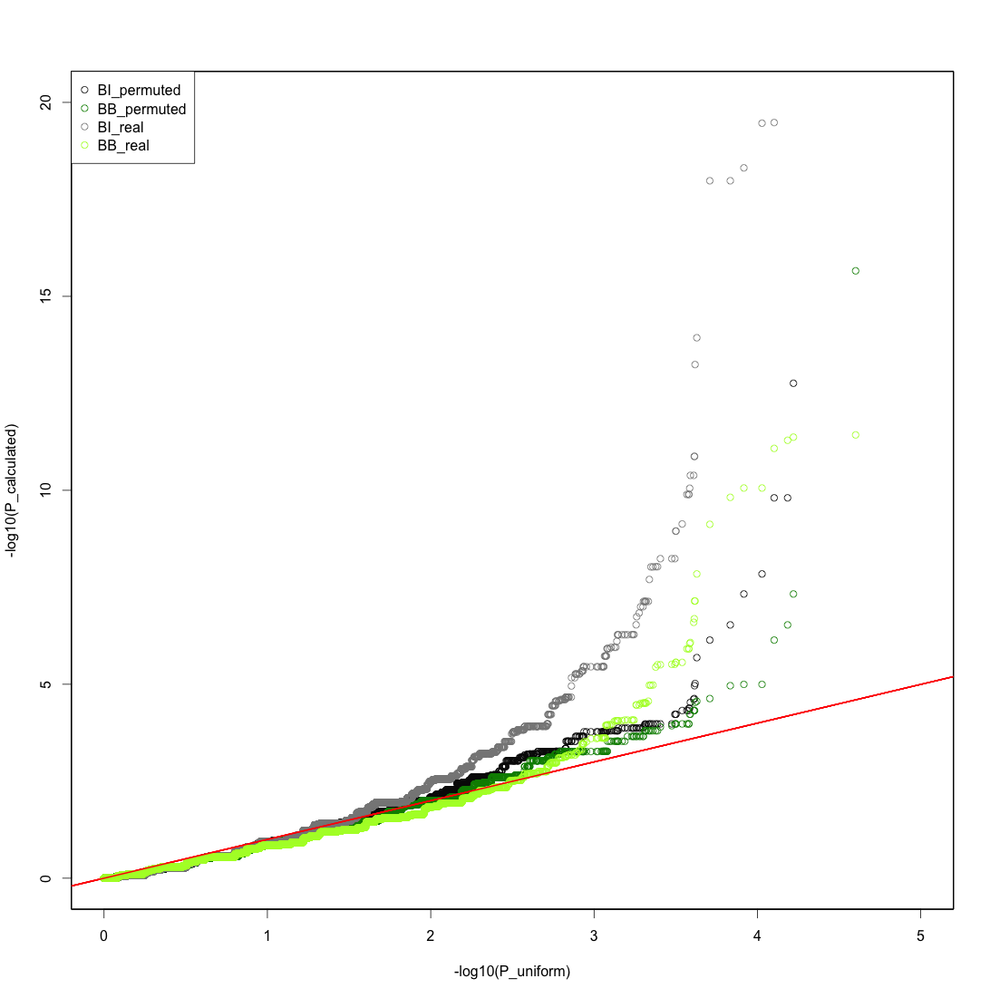
promoters

Slide 2
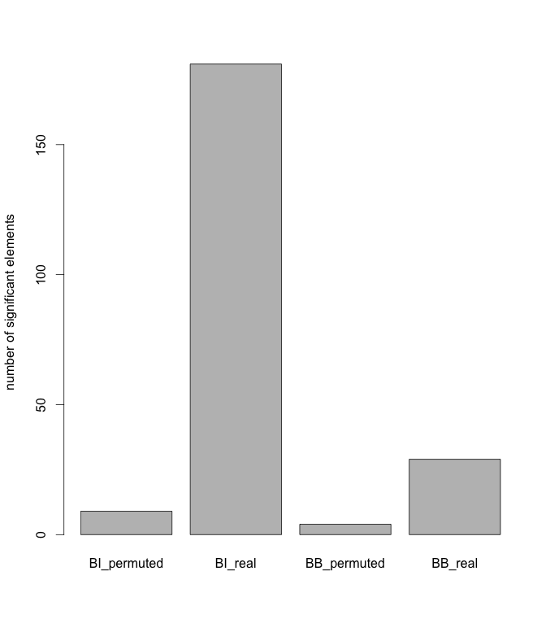
promoters
 | BI | BB
Permuted | 9 | 4
Real | 181 | 29
ratio | 0.050 | 0.138

Slide 3
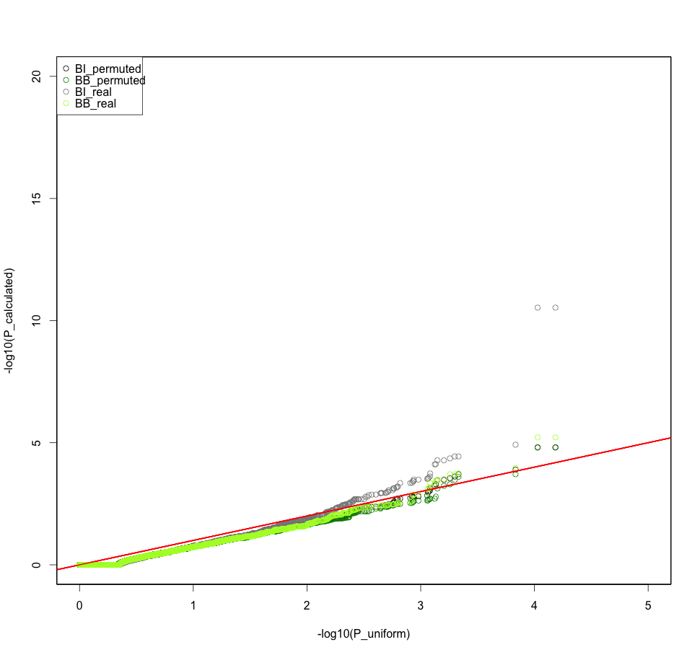
enhancers

Slide 4
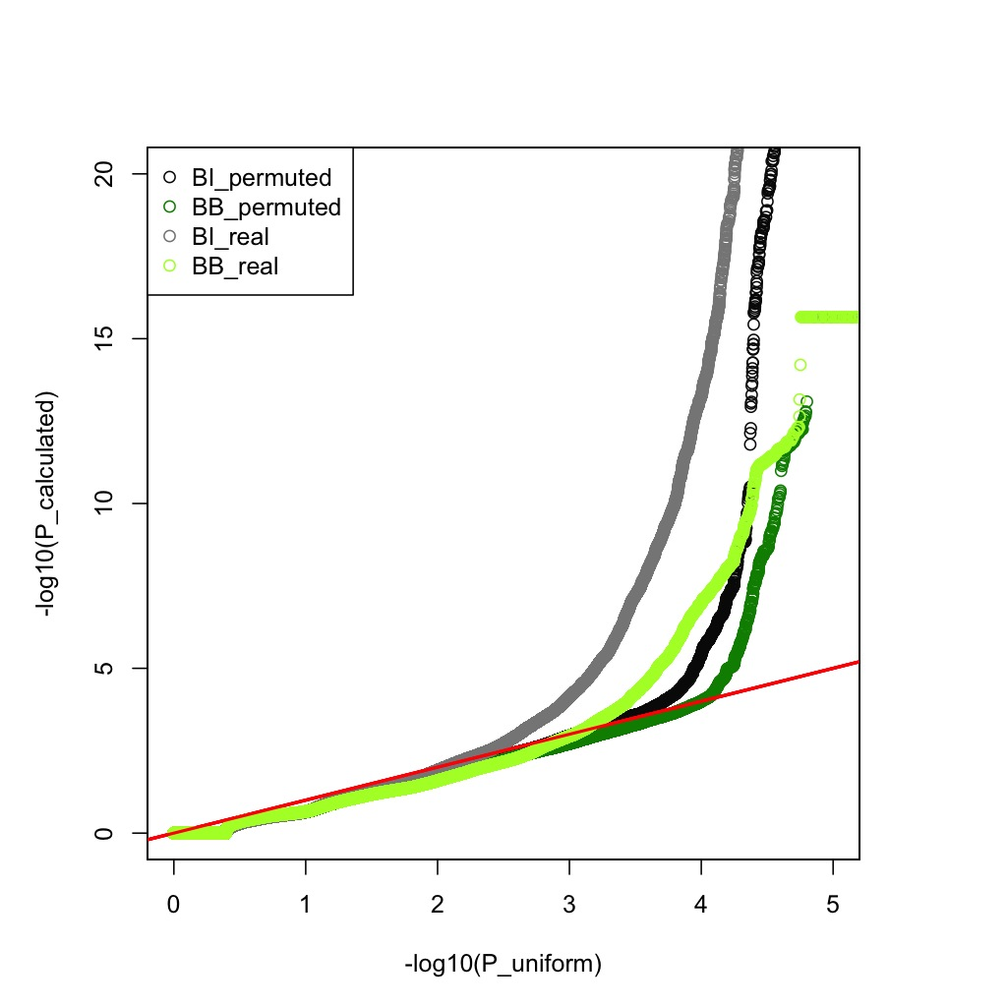
TF
 | BI | BB
Permuted | 565 | 294
Real | 4910 | 1198
ratio | 0.115 | 0.245

Slide 5
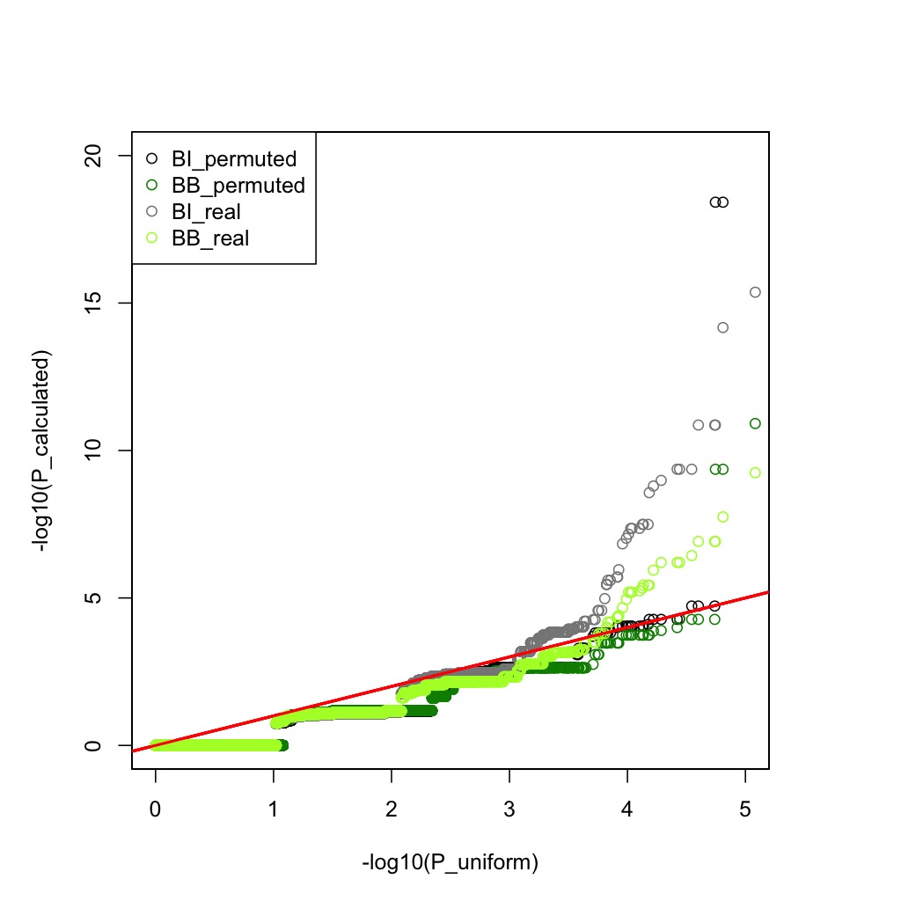
TSS: 200bp
 | BI | BB
Permuted | 4 | 4
Real | 29 | 11
ratio | 0.138 | 0.364

Slide 6
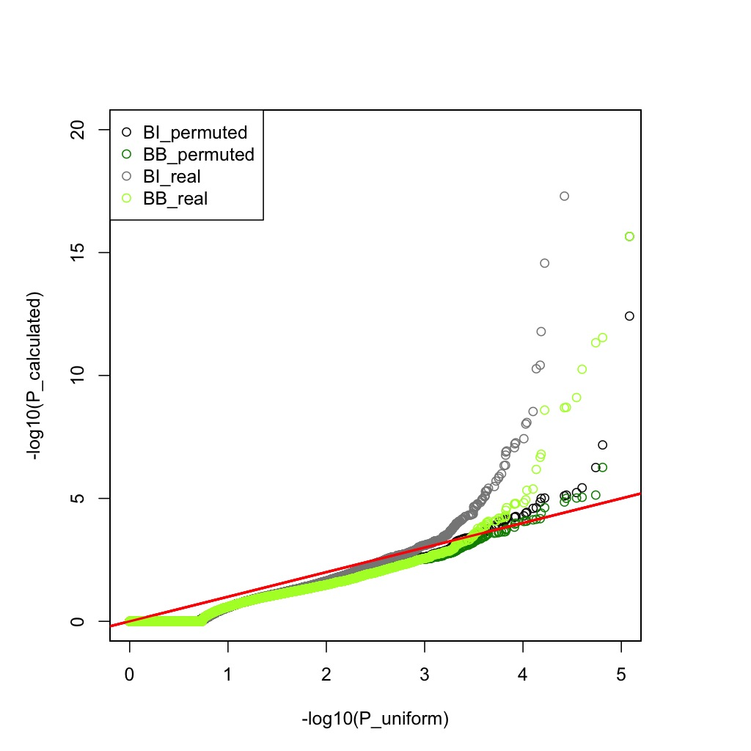
UTR
 | BI | BB
Permuted | 3 | 2
Real | 40 | 11
ratio | 0.075 | 0.182

Slide 7
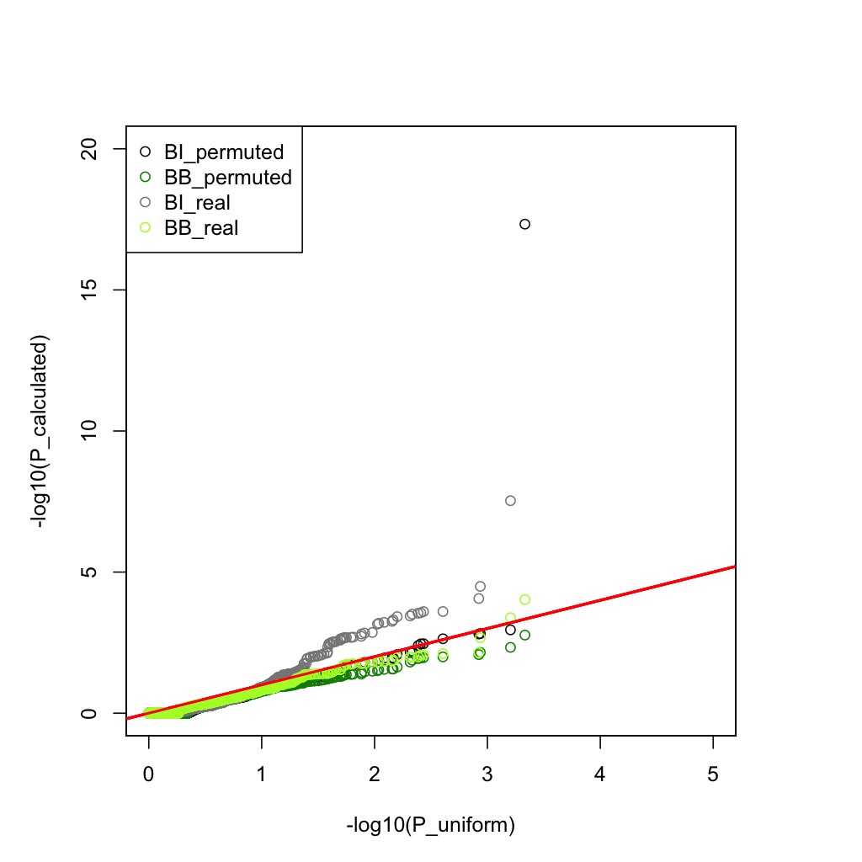
Ultra-sensitive
 | BI | BB
Permuted | 1 | 0
Real | 11 | 0
ratio | 0.091 | -

Slide 8
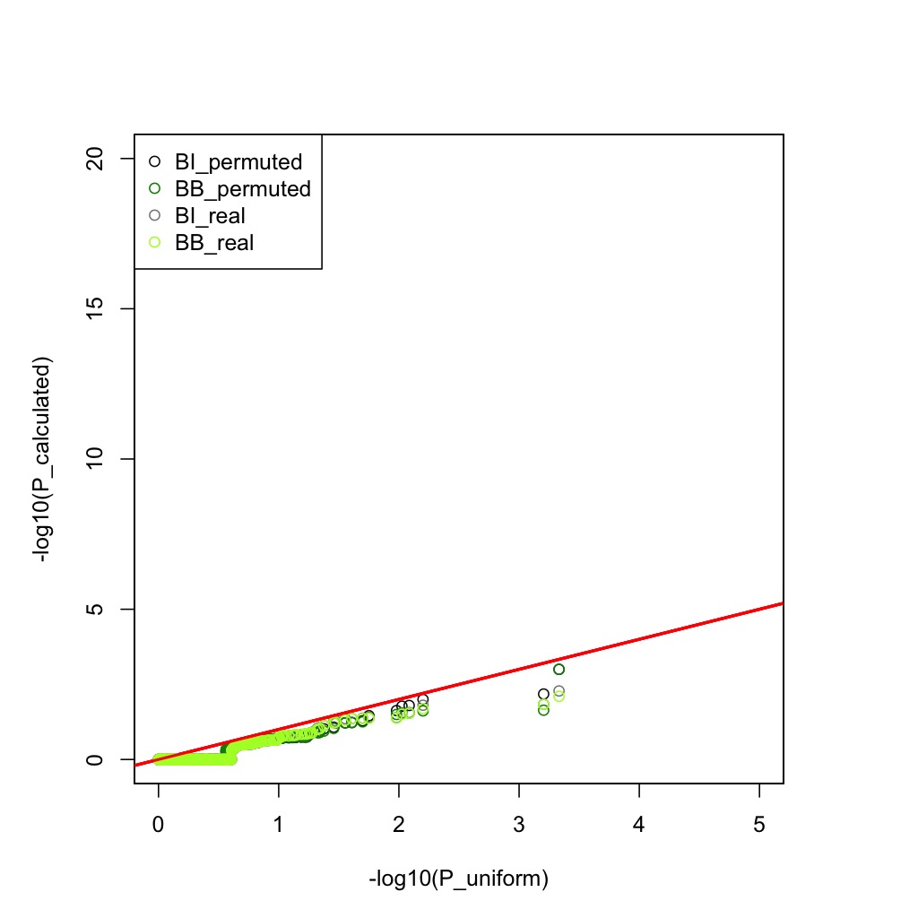
Ultra-conserved

Slide 9
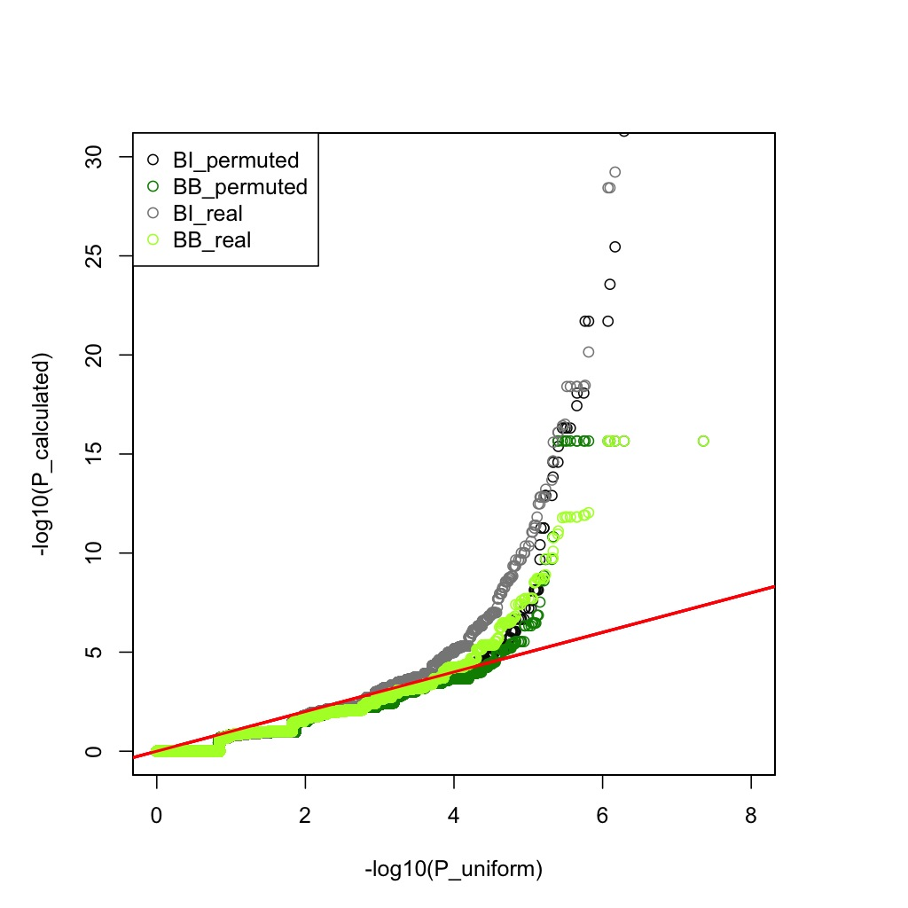
DHS
 | BI | BB
Permuted | 45 | 39
Real | 174 | 70
ratio | 0.259 | 0.557

