Slide 1
WG-2,5,9,14
Santa Cruz F2F
presentations
PCAWG
June 18, 2015

Slide 2
Schedule / outline
We were 105 minutes in the final program (10 min less the original schedule was based on). I have suggested some adjustements.
18’ : Driver detection (Nuria)
15’: Mutational annotation and impact ranking (Ekta)
5’ : Vignette: Computational method for variant prioritization and mutation burden analysis (Jing Zhang; Mark Gerstein’s group)
7’: Vignette: Functional mutations in CpG sites and data integration (Lars Feuerbach).
20’: Network analysis (Ben Raphael)
5’: Vignette: cancer gene prediction based on the Reactome functional interaction network using the SC pilot data. (Guanmingwu; Lincoln Stein’s group)
9’: Vignette: "Affinity modulation of non-coding variants” and "Convergence of non-coding variants” (Richard Sallari)
9’; Vignette: "Mutations in micro-RNA related elements and their impact on miRNA-seq gene expression profiles” (Todd Johnson)
3’: Vignette: "ncRNA expression profiling” from Samir Amin, Morten Muhlig, Jakob Pedersen, et al wg14/wg3 (presented by Jakob Pedersen)
3’: Vignette: "Overview of miRNA target prediction / CLiP-seq analysis based on PCAWG annotations” by Mark Hamilton (presented by Jakob Pedersen)
6’: Vignette: "Analysis of the site-specific neutral mutation rate for whole-genome cancer data” (Jakob Pedersen)
5’: Vignette: "ncdDetect: Non-coding driver detection using site-specific regression of the expected mutation rate” (Malene Juul)
total: 105'

Slide 3
Signals Pilot
Núria López-Bigas (UPF)

Slide 4
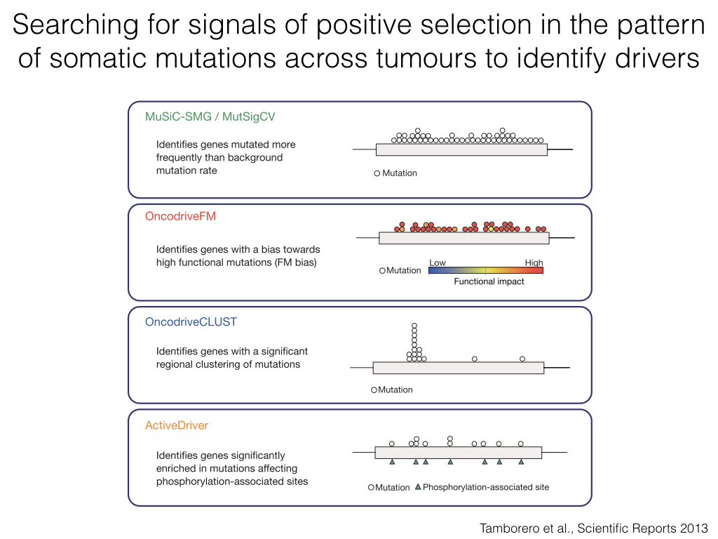

Slide 5
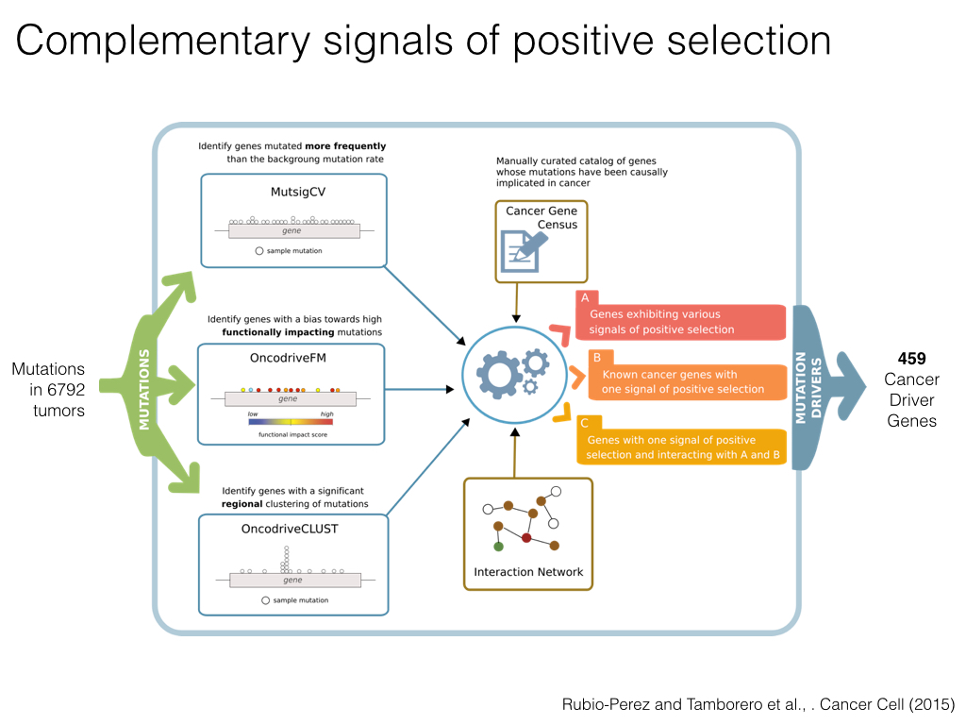

Slide 6
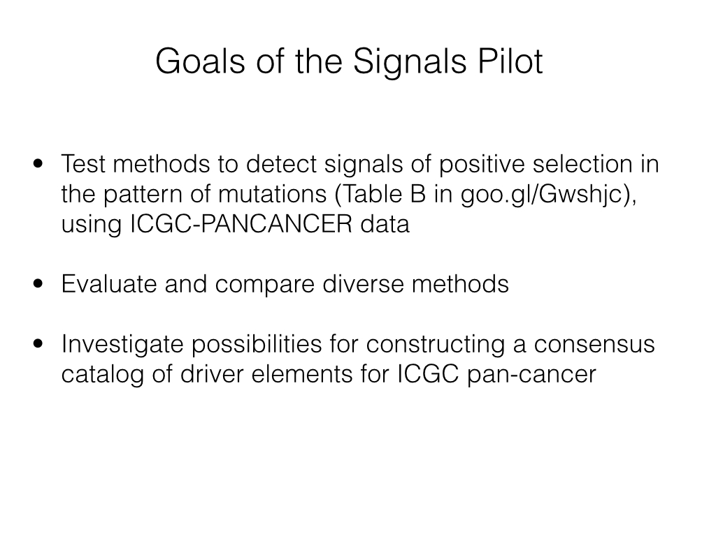

Slide 7
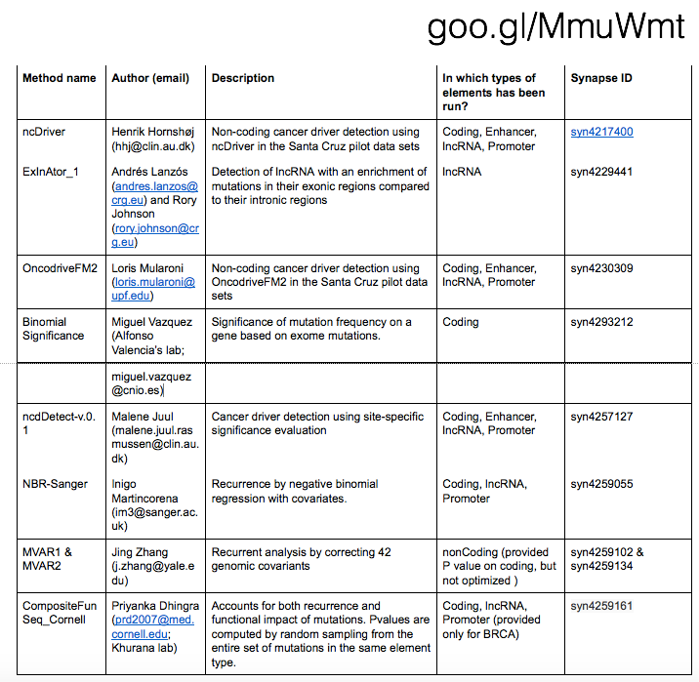
RESULTS

Slide 8
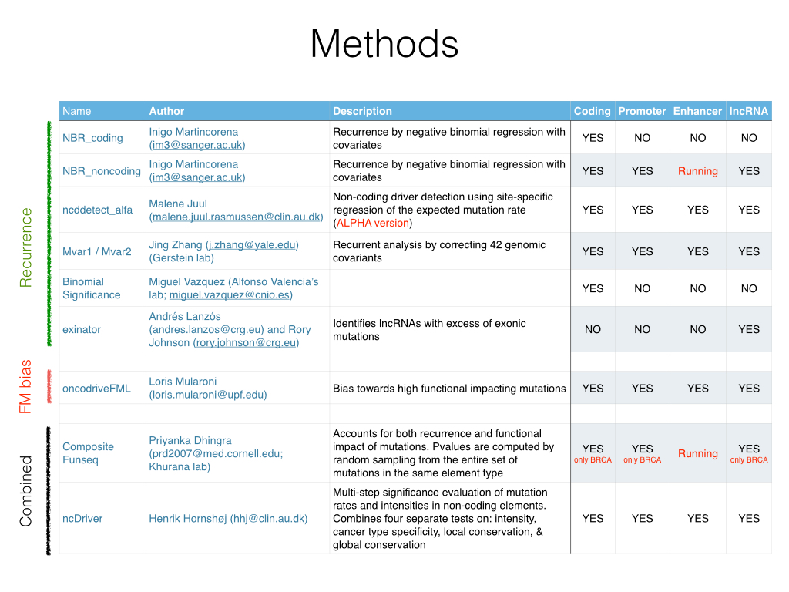
MutSig suite Julian Hess jhess@broadinstitute.org
Mike Lawrence lawrence@broadinstitute.org
Esther Rheinbay esther@broadinstitute.org
Mutational burden; Functional impact; Positional recurrence
YES YES YES YES

Slide 9
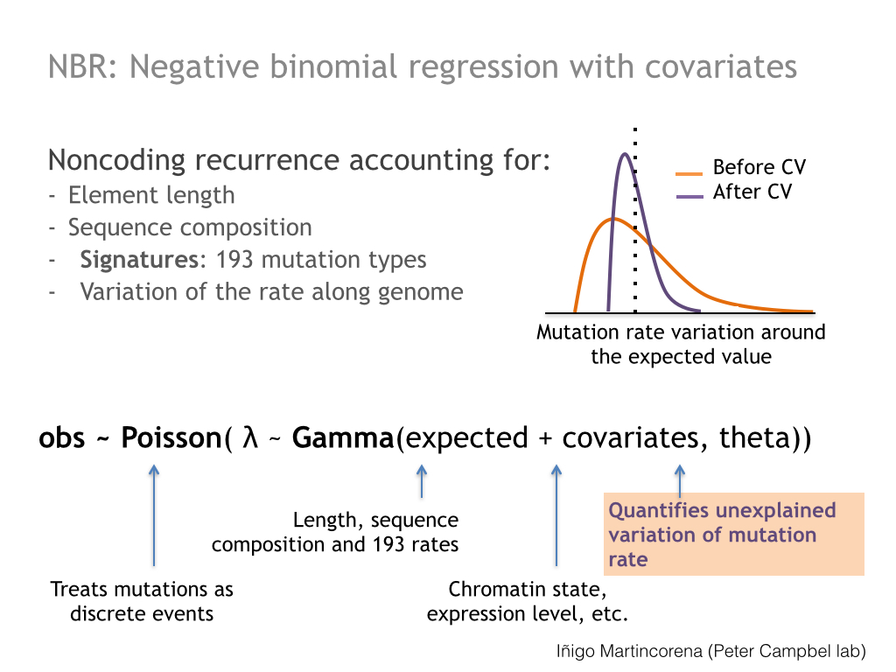

Slide 10
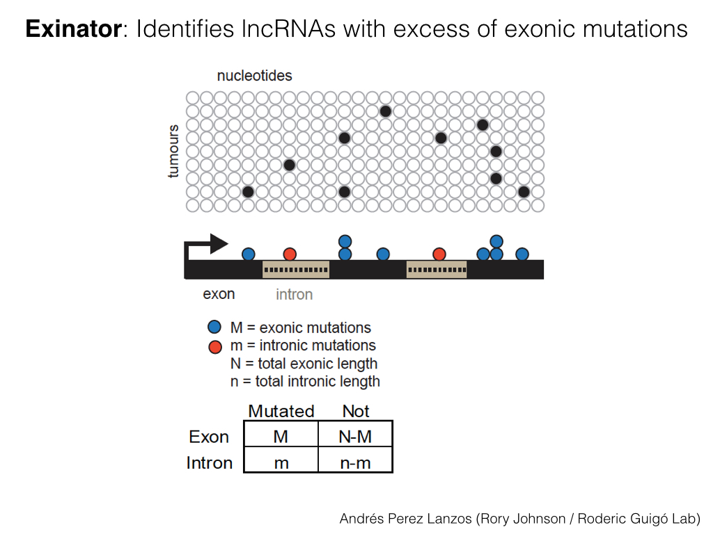

Slide 11
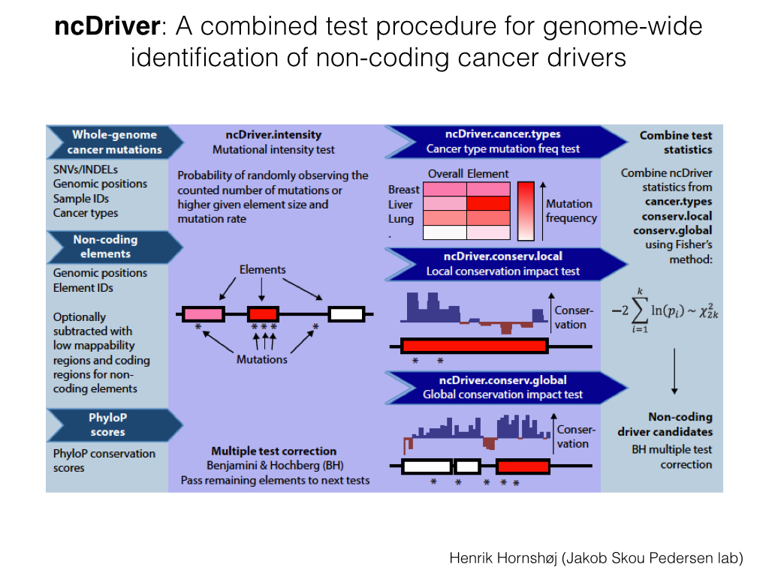

Slide 12
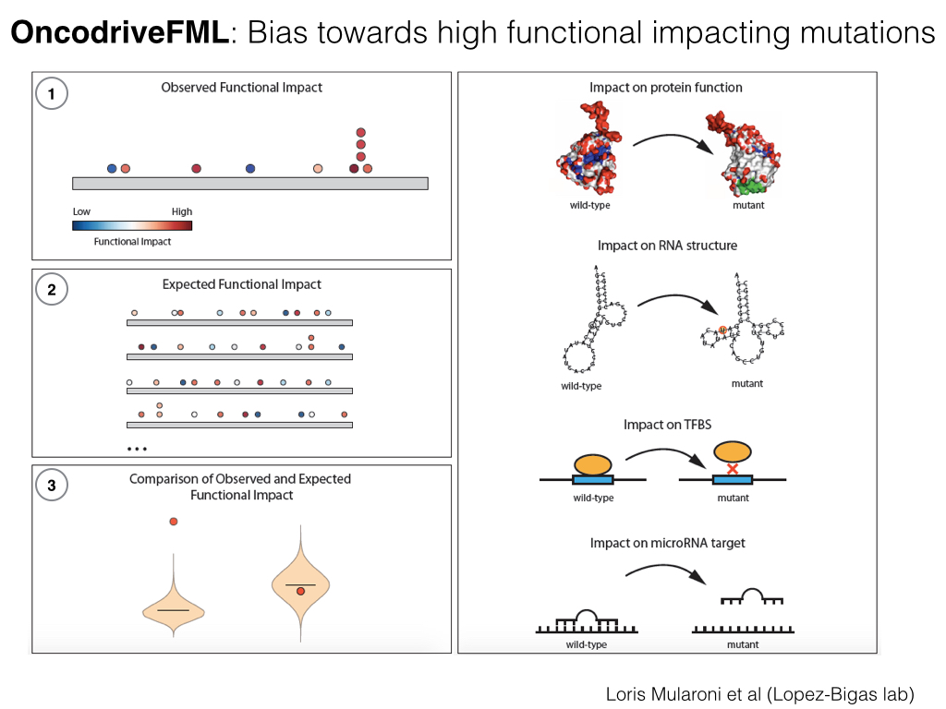

Slide 13
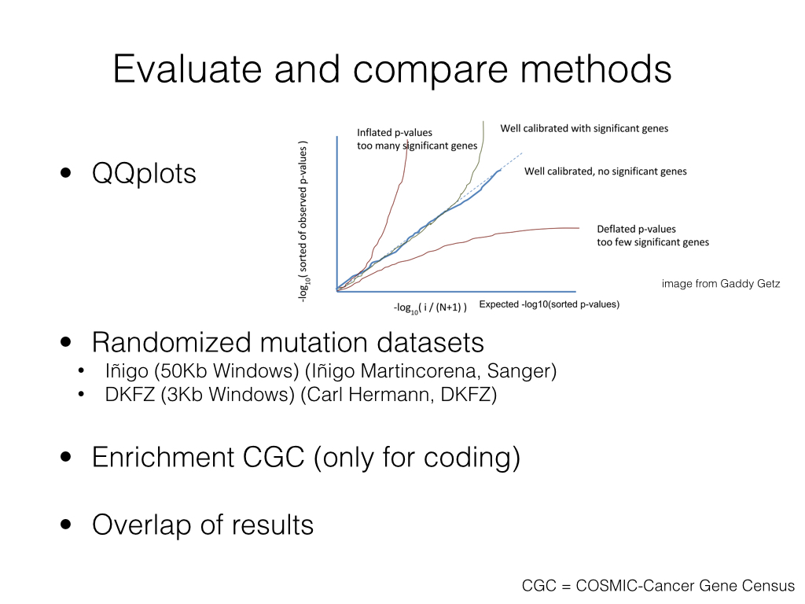

Slide 14
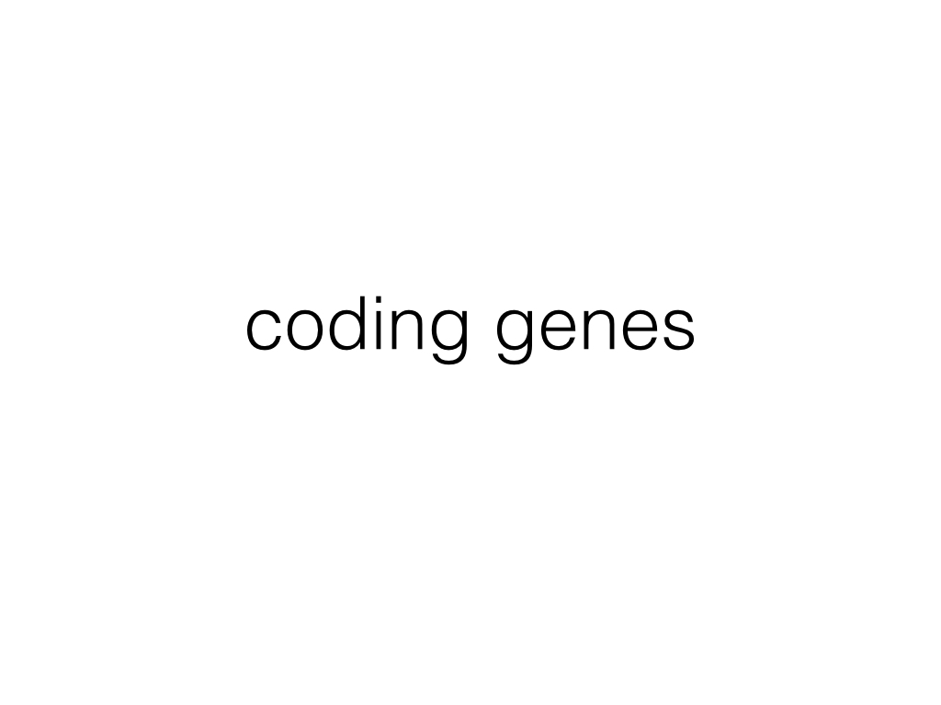

Slide 15
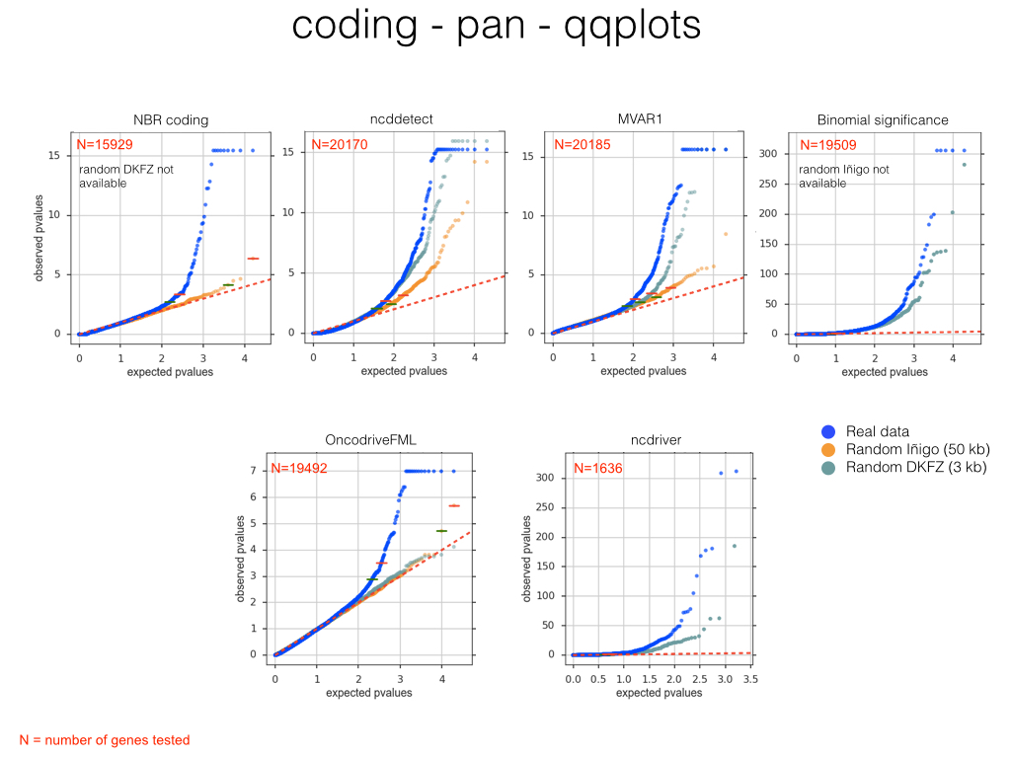

Slide 16
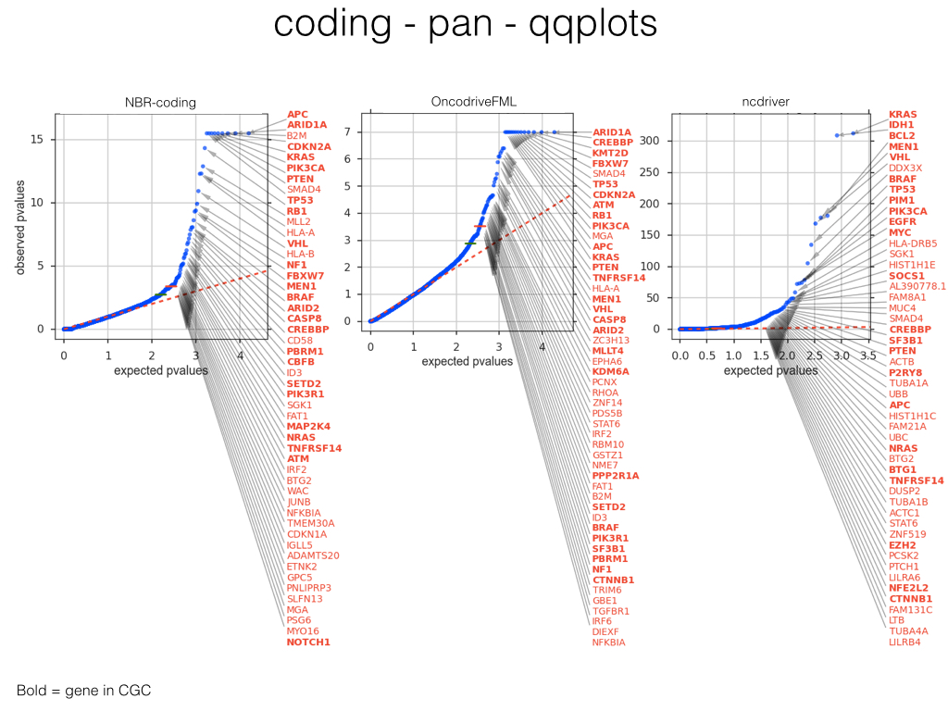

Slide 17
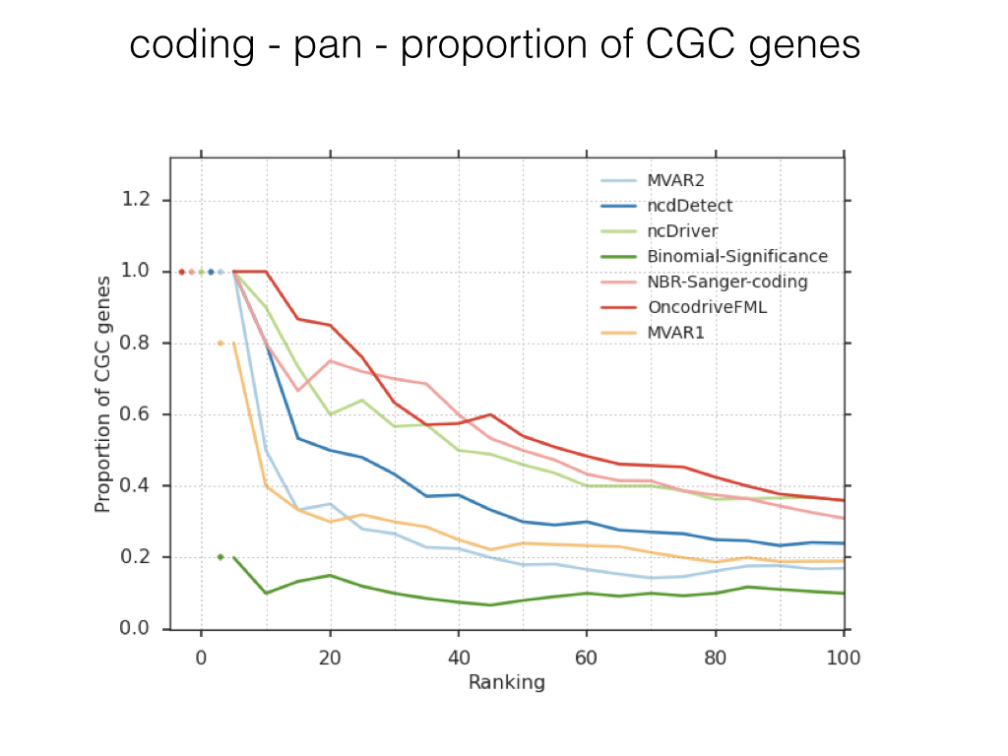

Slide 18
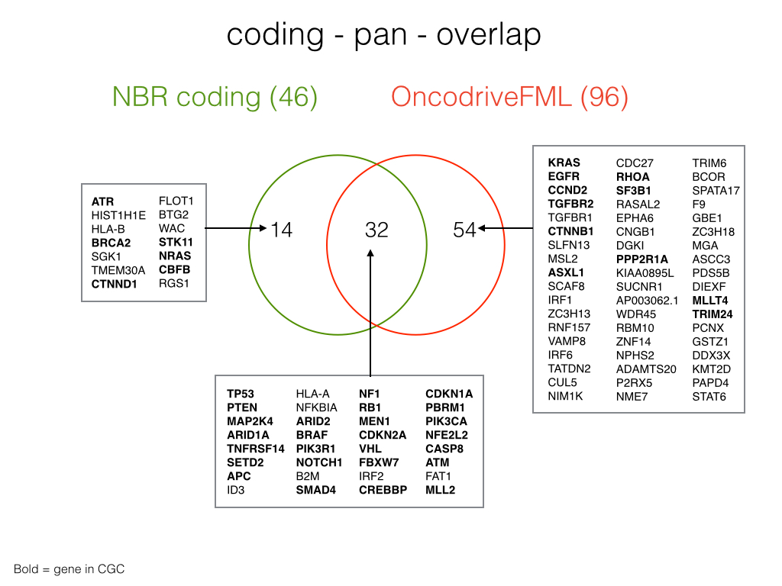

Slide 19


Slide 20
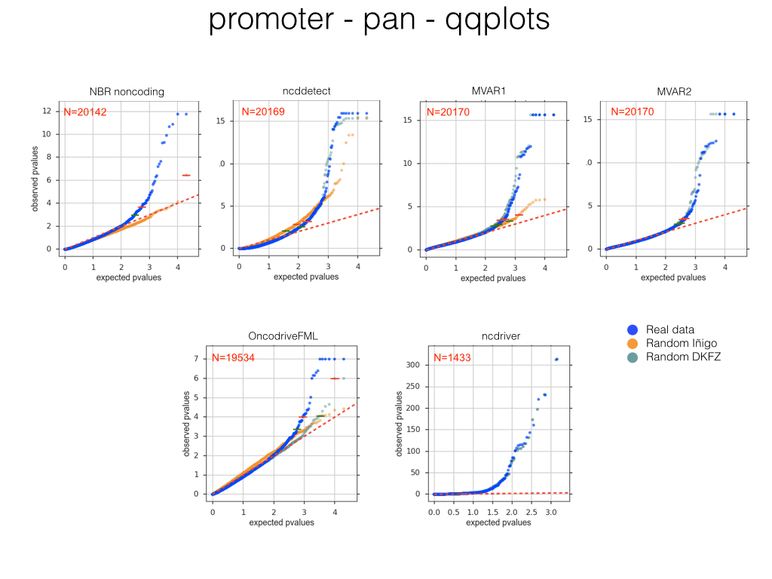

Slide 21
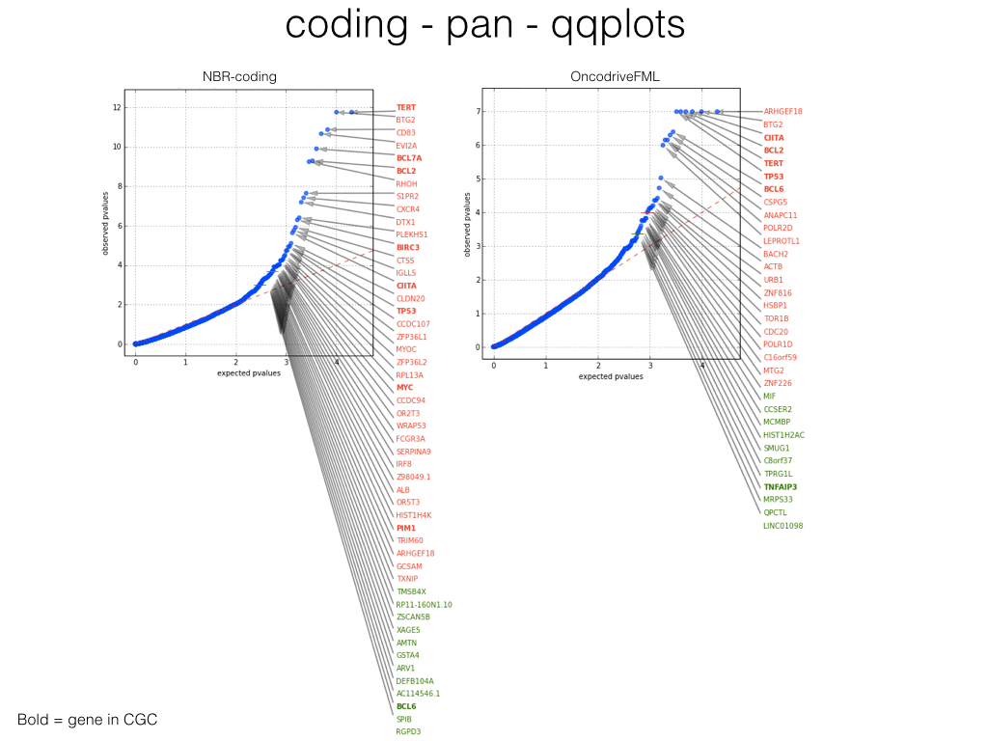

Slide 22
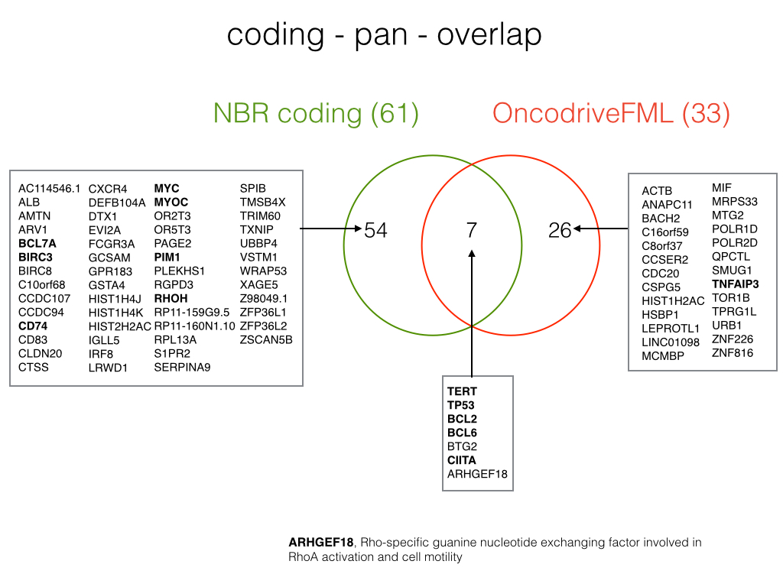

Slide 23
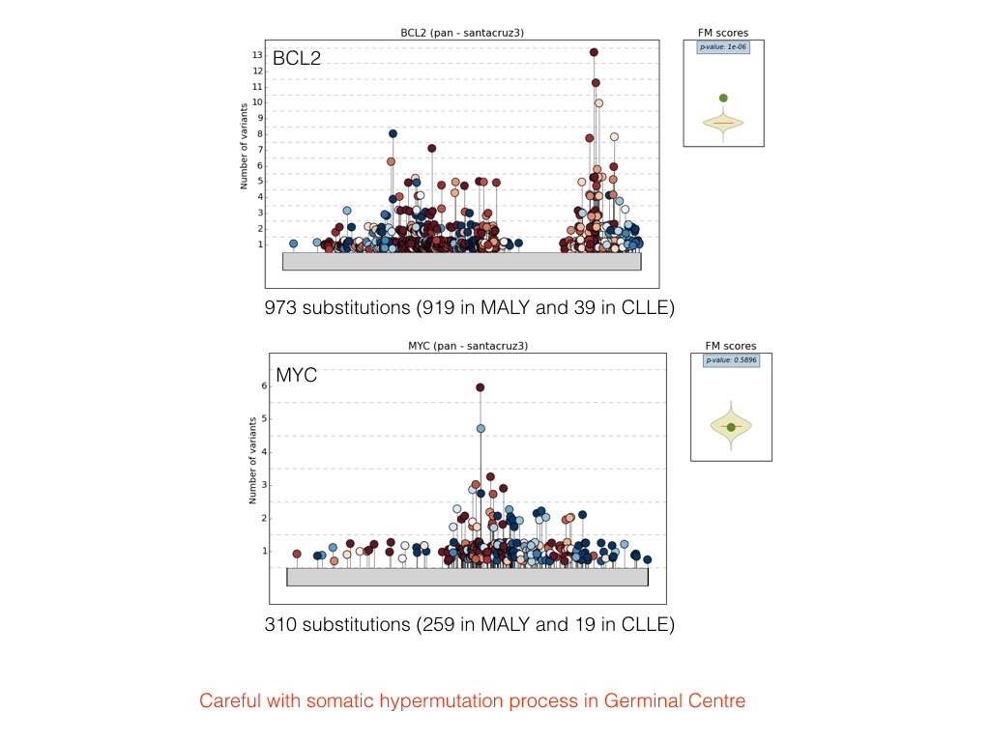

Slide 24
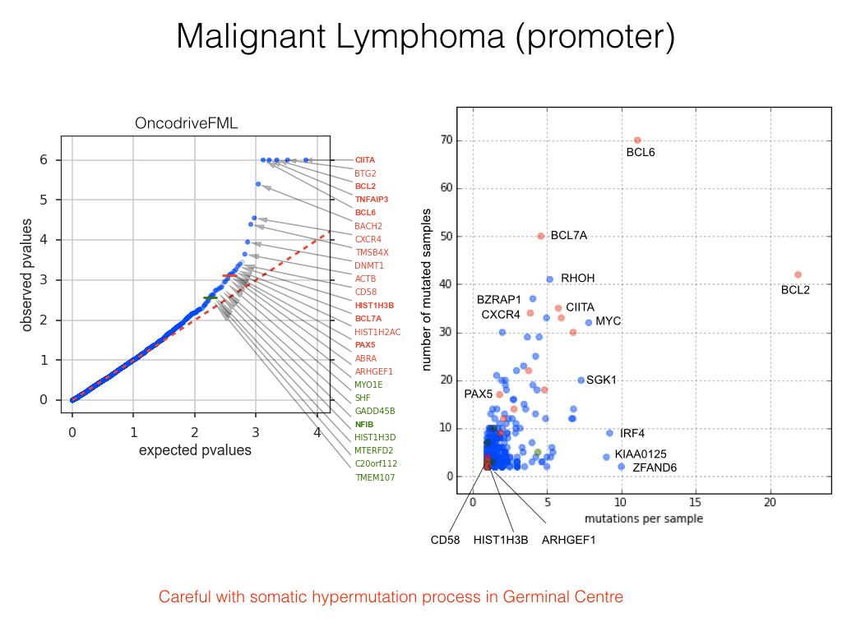

Slide 25
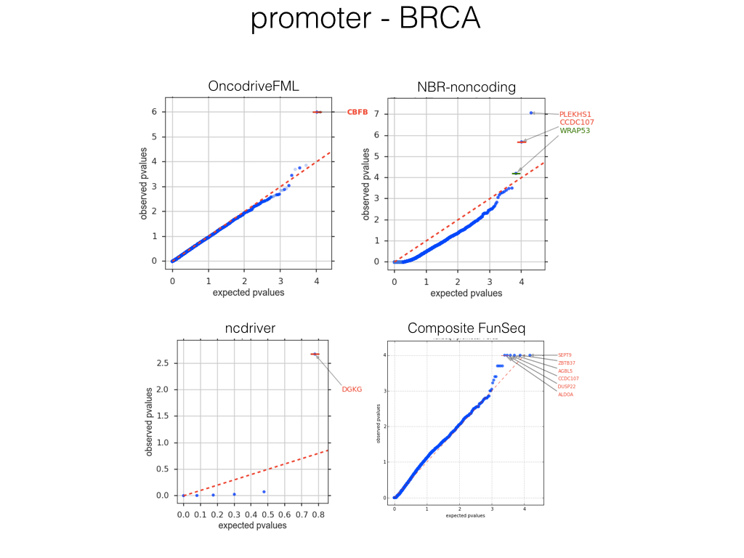

Slide 26
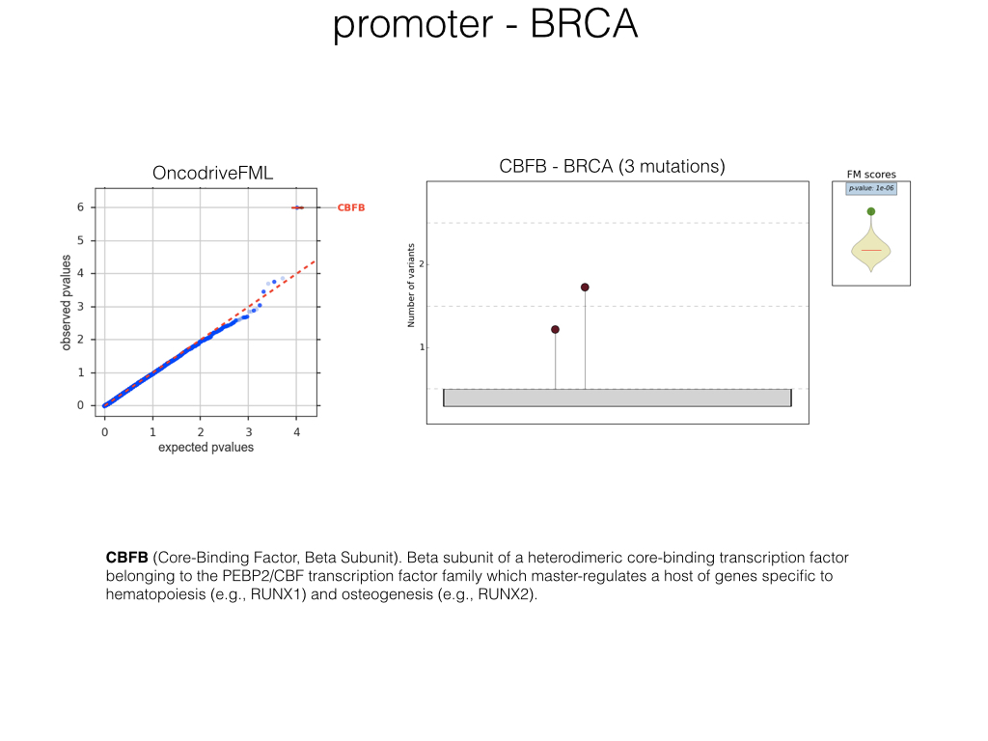

Slide 27
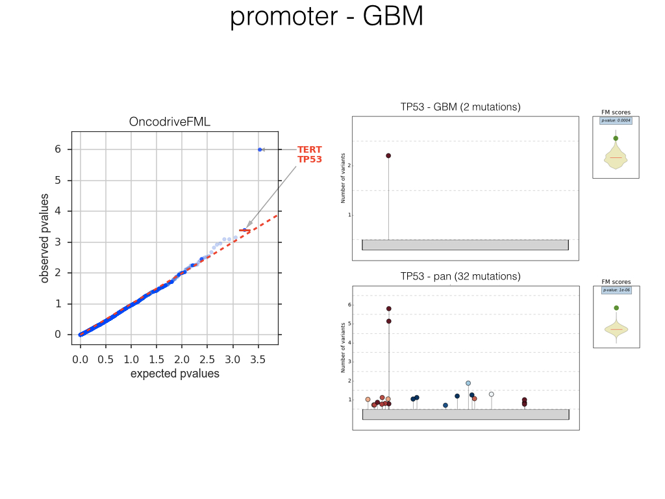

Slide 28
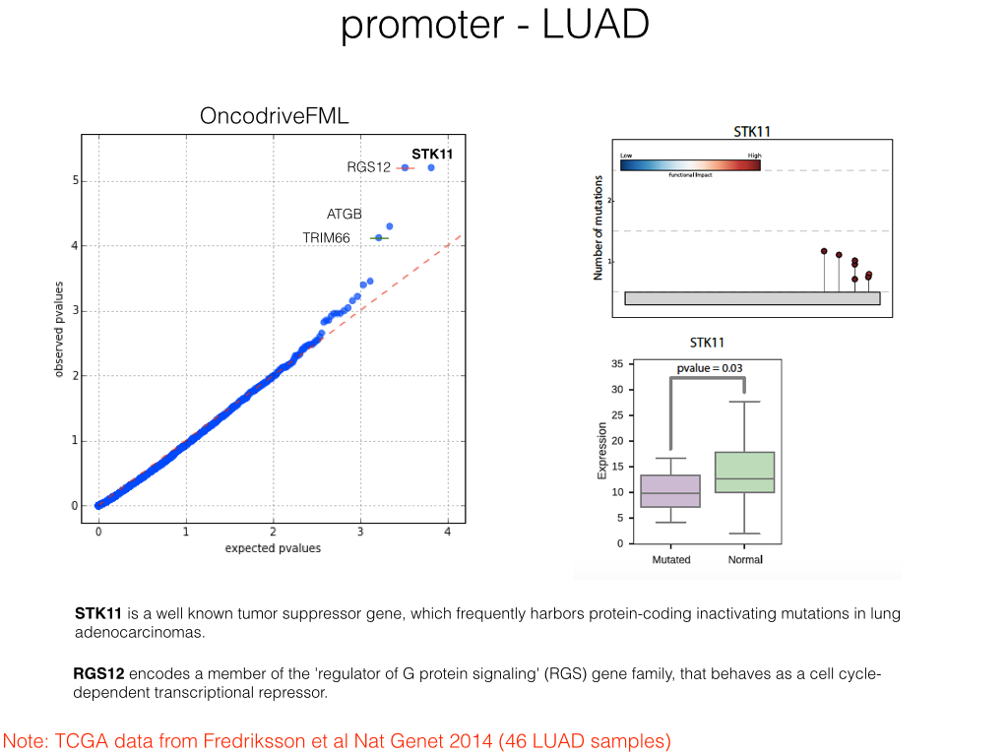

Slide 29
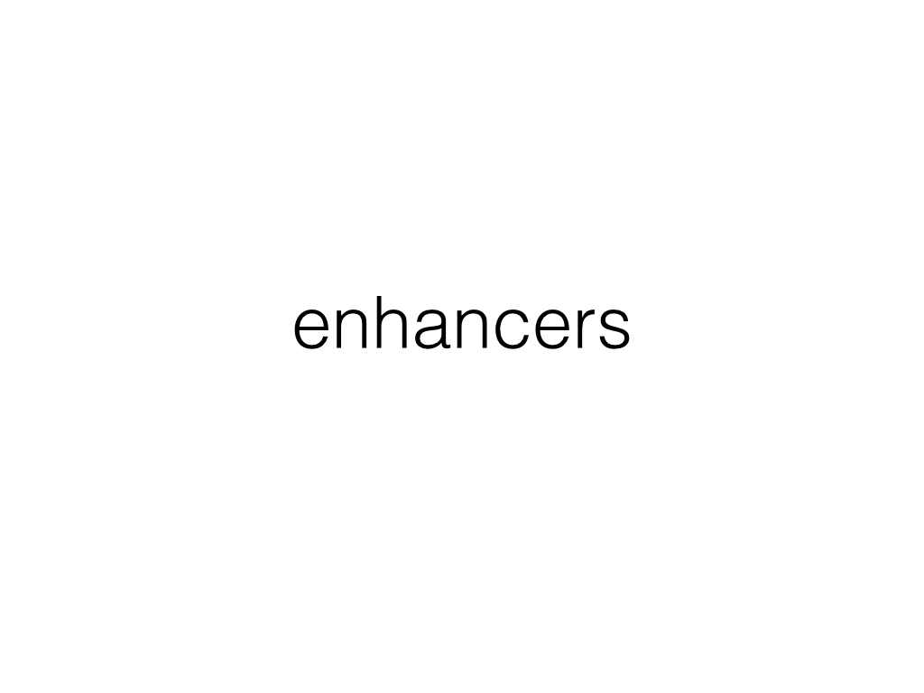

Slide 30
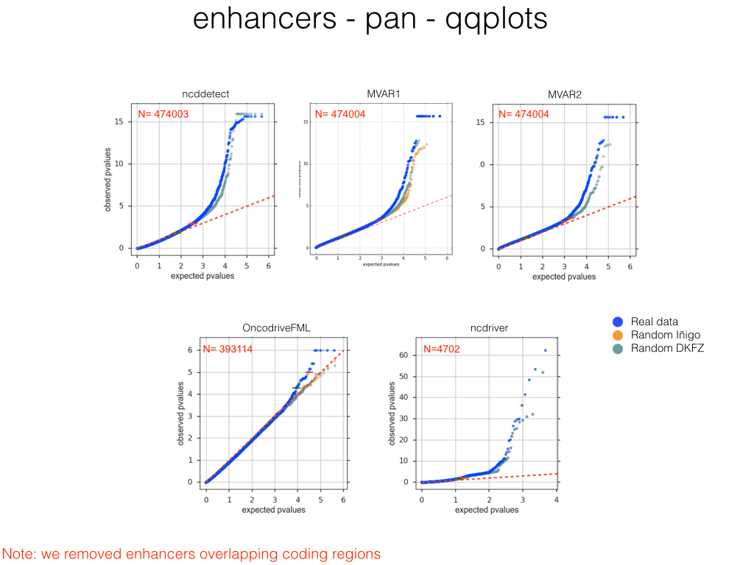

Slide 31


Slide 32
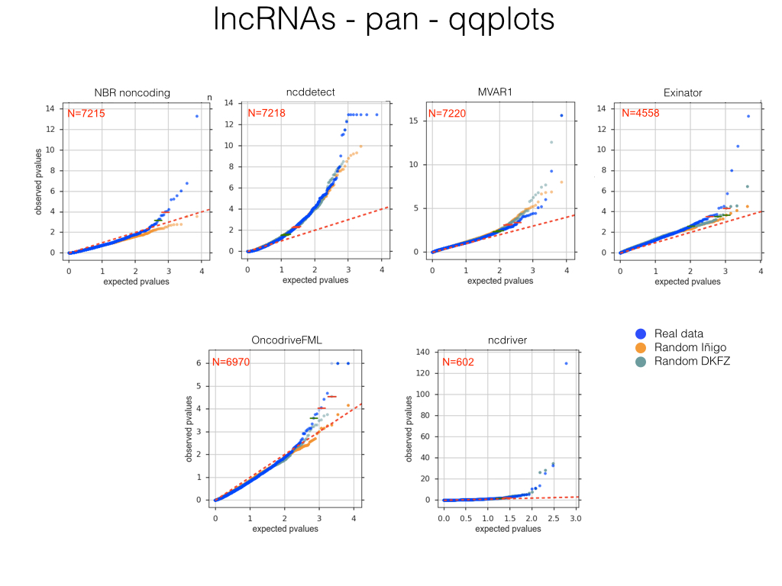

Slide 33
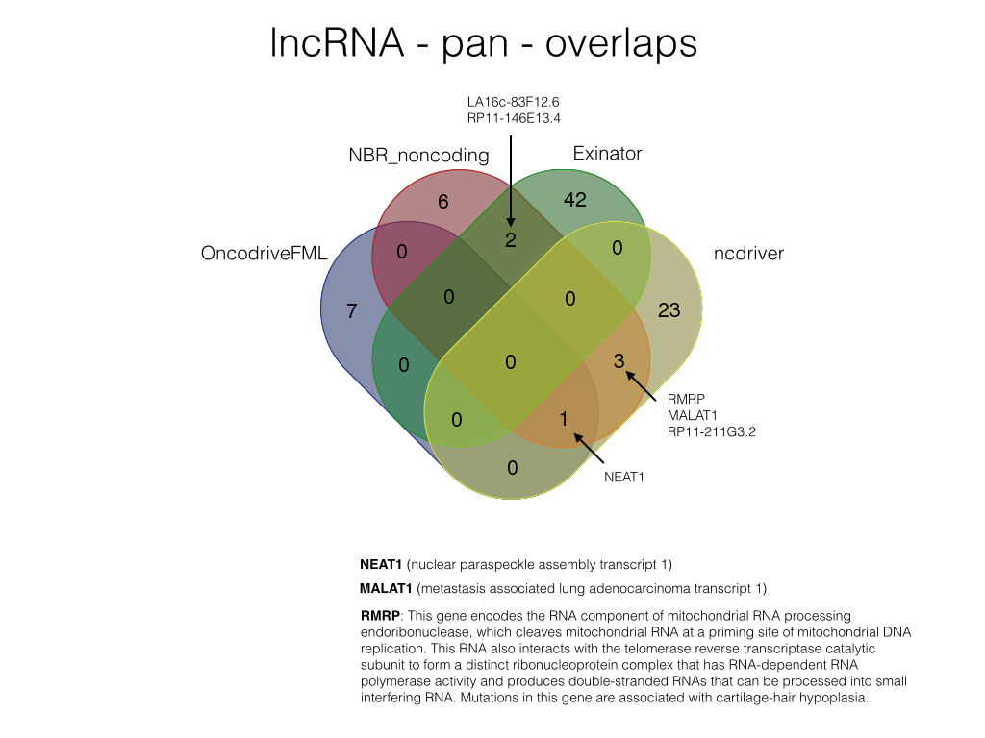

Slide 34
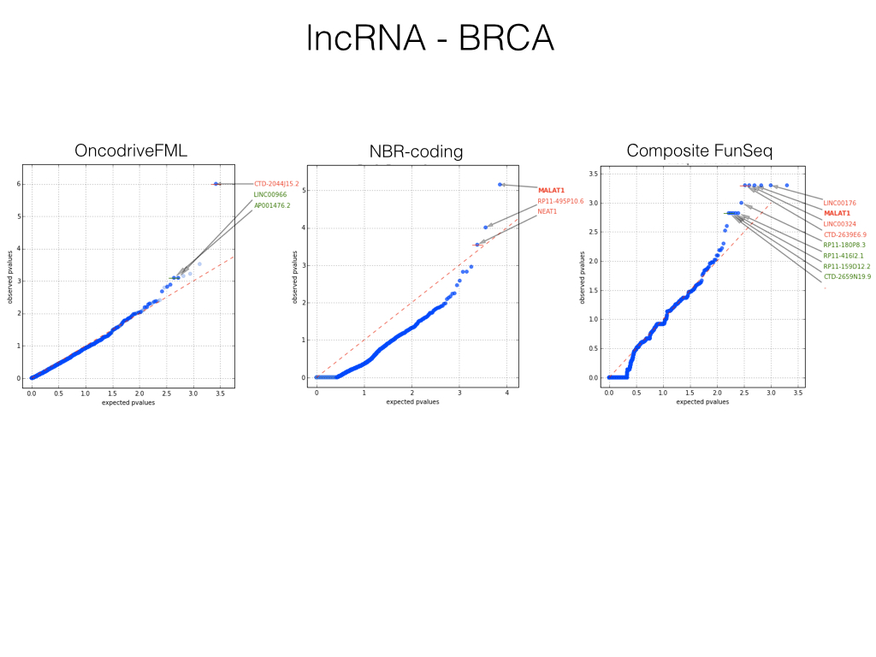

Slide 35
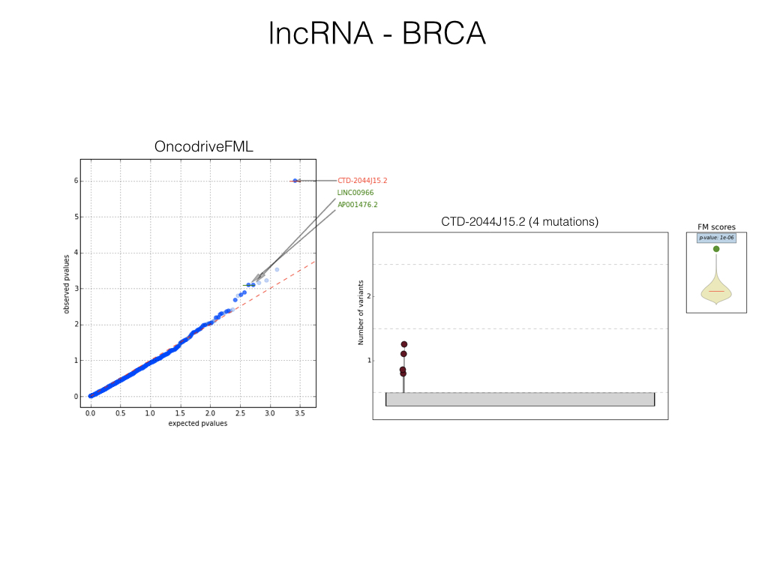

Slide 36
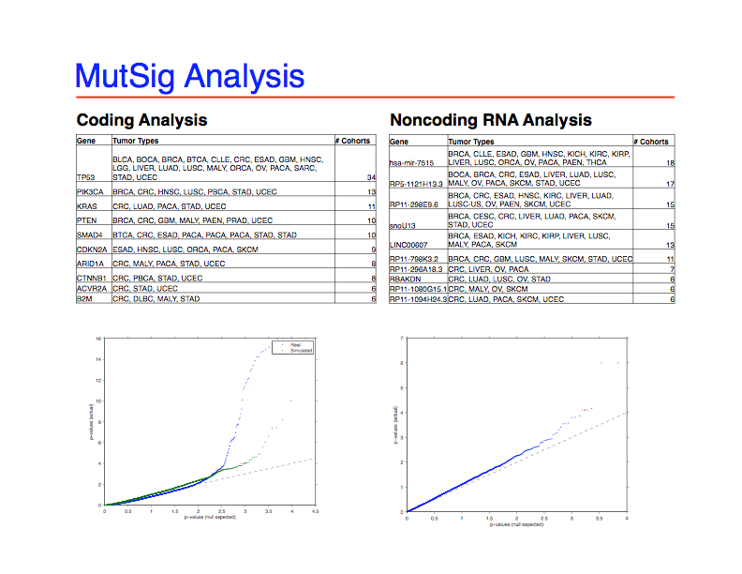
Julian Hess
Mike Lawrence
Esther Rheinbay

Slide 37
Next steps
Explore the results in more detail
Explore results of other tumor types (in addition to pan, BRCA, GBM)
Assay ways of combining results from different methods
Correlate mutations in significant elements with changes on expression
…

Slide 38
Annotations Pilot II:
Functional impact of mutations
Ekta Khurana
Notes:
Not all mutations with functional impact will be drivers but drivers will have functional impact

Slide 39
Description of Annotations Pilot Analysis
MUTATION DATASET:
Sanger workflow variants:
https://www.synapse.org/#!Synapse:syn4013215
ANNOTATIONS:
Coding genes: syn3540011
Promoters: syn3789763
Enhancers: syn4040215
lncRNA: syn3540009
Gain and loss of TF motifs
ANNOTATIONS CONSIDERED FOR COMPARISON:
Oncotator (Used some different annotations)
FunSeq
DKFZ (Two sets)

Slide 40
Oncotator: variant annotation tool
Python tool for annotating variants with variant- and gene-centric data relevant to cancer researchers
Input
Annotator
Output
File formats
*.tsv
*.vcf
*.seg
Web API
http request
File formats
*.tcga.maf.txt
*.vcf
*.bed
Web API
JSON response
Input
Creator
Input
Creator
Input
Creator
Input
Creator
Input
Creator
Output
Renderer
Annotator
Source formats
*.tsv
*.vcf
*.bigwig
…
Datasources
Reference: Ramos AH, Lichtenstein L, et al.
Human Mutation. 2015.
Web app: broadinstitute.org/oncotator_beta/
Github: github.com/broadinstitute/oncotator
Alex Ramos, Esther Rheinbay, Grace Tiao, Lee Lichtenstein, Gad Getz

Slide 41
Oncotator default datasources
Annotation Category | Resource | URL | Comments
Genomic | GENCODE | http://www.gencodegenes.org/ | GENCODE/ENSEMBL transcripts and annotations for hg19
 | ref_context |  | Can be used for artifact inference
 | gc_content |  | Can be used for artifact inference
 | Human DNA Repair Genes | http://sciencepark.mdanderson.org/labs/wood /DNA_Repair_Genes.html | Alteration in such genes can help explain higher overall mutation rates in specific samples
Protein | UniProt | http://www.uniprot.org/ | Includes Drugbank & GO annotations
 | dbNSFP | https://sites.google.com/site/jpopgen/dbNSFP | Contains pre-computed conservation scores, prediction classifications, and other information
Cancer Variant | COSMIC | http://www.sanger.ac.uk/genetics/CGP/cosmic/
 | Cancer Gene Census | http://www.sanger.ac.uk/genetics/CGP/Census/
 | CCLE | http://www.broadinstitute.org/ccle/home | Cancer cell line annotations. Can be used to identify cell line models containg variants of interest
 | Familial Cancer Database | http://www.familialcancerdatabase.nl/
 | ClinVar | http://www.ncbi.nlm.nih.gov/clinvar/
Non-Cancer Variant | dbSNP | http://www.ncbi.nlm.nih.gov/projects/SNP/ | b142 release for human (9606)
 | 1000 Genomes | http://www.1000genomes.org/data | Phase 3 variant set
 | NHLBI GO Exome Sequencing Project (ESP) | https://esp.gs.washington.edu/drupal/
*CLI tool includes framework for adding additional datasources.
Alex Ramos, Esther Rheinbay, Grace Tiao, Lee Lichtenstein, Gad Getz

Slide 42
Pilot annotation data sources
Gencode v19 gene model (built into Oncotator)
Promoter regions - non-flattened files used as input for Oncotator
Gencode v19 lincRNA set as additional column
Promoter-enhancer associations (Roadmap Epigenomics)
TF binding sites (ENCODE)
Esther Rheinbay, Gad Getz
Jakob Skou Petersen, Morten Muhlig Nielsen, Inigo Martincorena, Richard Sallari, Wouter Meuleman, Ekta Khurana; Annotation working group
Notes:
Say they used different set of annotations that Annotations Pilot

Slide 43
DKFZ annotation pipeline
Standard pipeline annotations (Buchhalter, Feuerbach):
- Gene Models: RefSeq and Gencode V19
- Relative orientation towards functional elements: exonic, intronic, 3'UTR, 5'UTR, upstream etc.
- Amino acid substitutions for all overlapping transcripts
- Blacklists for high sequencing depth, self-alignment and artifact regions
- Enhancer, Repeats, Sequence conservation, Sequence context, Conserved TFBS, CpG islands
- Confidence scores based on pileup and secondary annotations
ICGC PCAWG reference annotations – parallel to already applied annotations:
- syn3540011, syn3789763, syn3540009, syn3519868, syn3519986, syn3520028, syn3278665, syn3278665, syn3276119, syn3354357
Vignette study -
Effect of non-coding somatic mutation in CpG and CpG island context on gene expression (Feuerbach):
Motif creation and disruption – MEME software suite
ZDNA forming regions – direct assessment from sequence context
CpG status – CpG gain, loss or shift
RNA-seq (Koser, Hong)
Annotation of gene expression relative to cohort median
References for standard pipeline:
Jones*, Jäger*, Kool* et al., Nature 488:7409 (2012)
Richter*, Schlesner*, Hoffmann* et al., Nature Genetics 44, 1316–1320 (2012)
Weischenfeldt*, Simon*, Feuerbach* et al., Cancer Cell 23, 159-179 (2013)
Lars Feuerbach (DKFZ)

Slide 44
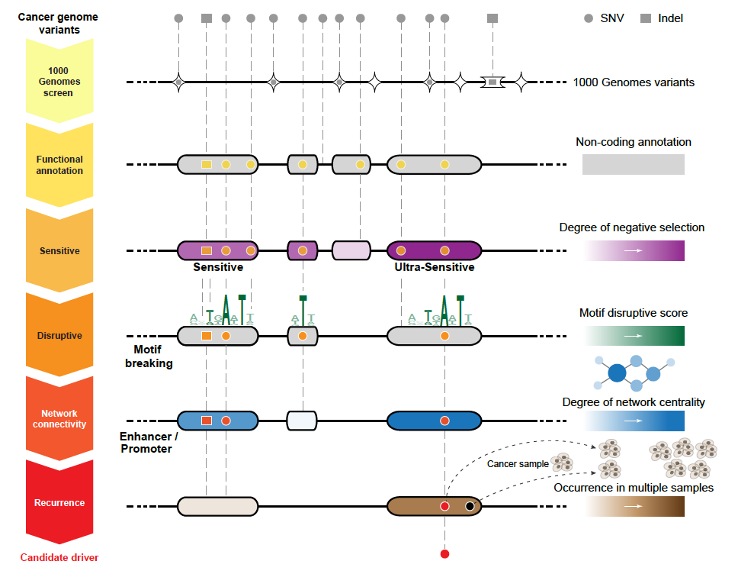
Identification of noncoding candidate drivers among somatic variants: FunSeq
Khurana et al, Science, 2013

Slide 45
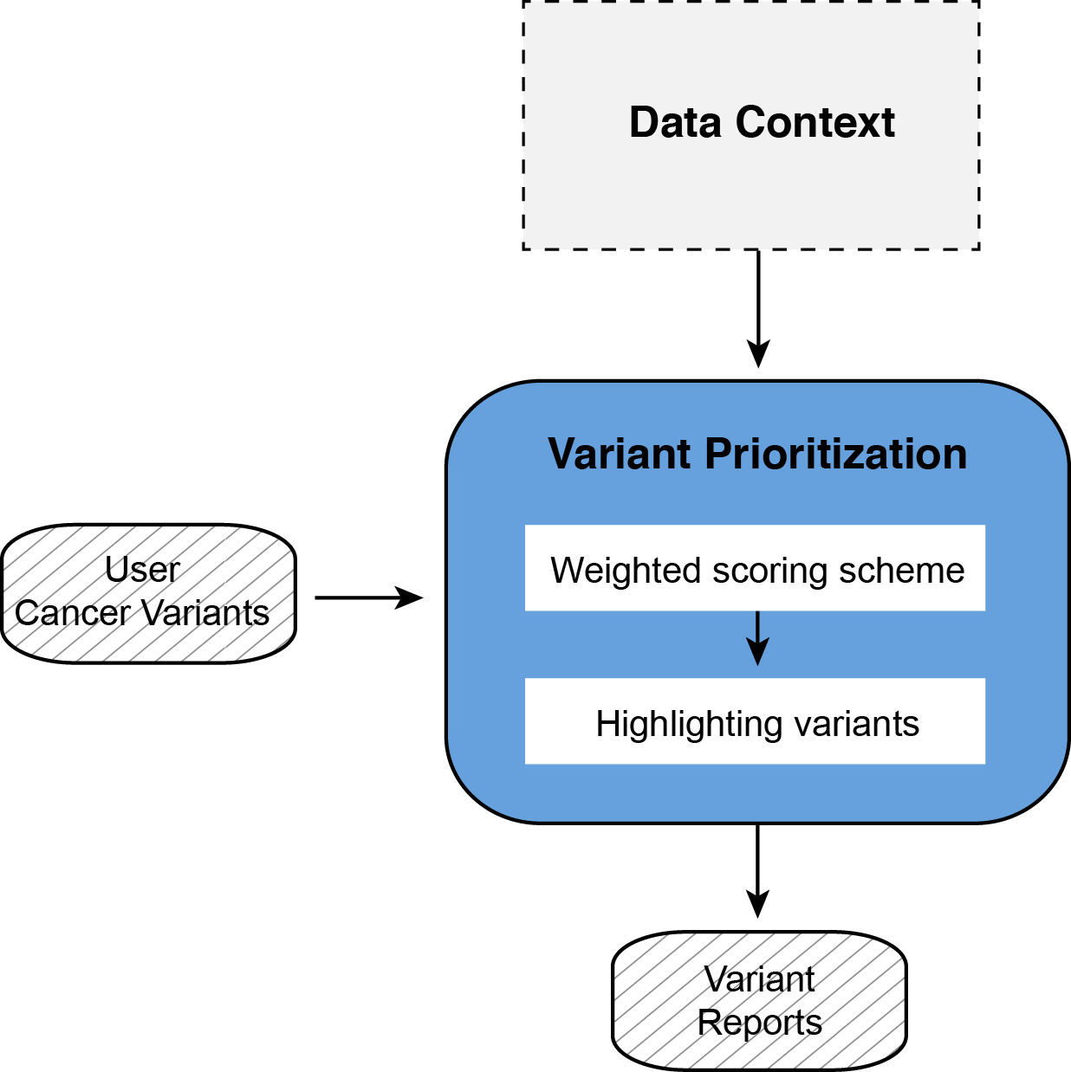
FunSeq Structure
0. Data Context
Weighted scoring scheme
  1.1 Core score
  1.2 recurrence module
2. Highlighting variants with
additional features
Fu et al, Genome Biology, 2014

Slide 46
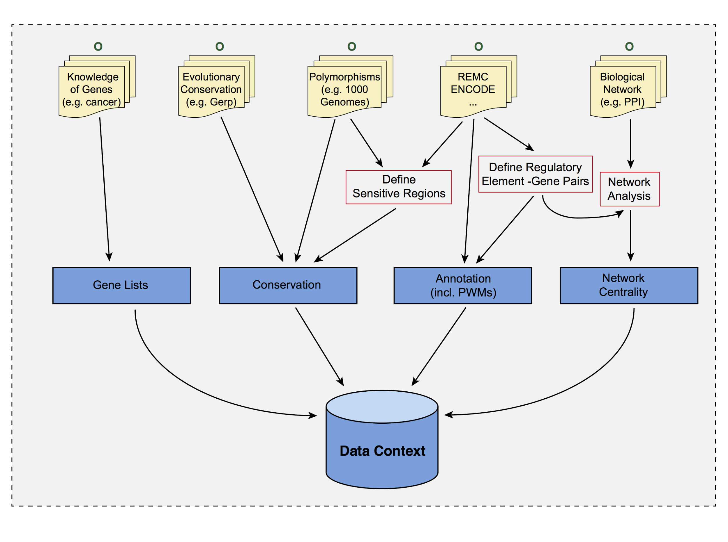
Data context
Fu et al, Genome Biology, 2014
Data context rebuild: Yao Fu (Gerstein lab)
Notes:
Size of data context

Slide 47



FunSeq2.5
Feature weight
- Weighted with mutation patterns in natural polymorphisms
(features frequently observed weighed less)
- entropy based method
HOT region
Sensitive region
Polymorphisms
Genome
Feature weight:
p = probability of the feature overlapping natural polymorphisms
For a variant:
Fu et al, Genome Biology, 2014
FunSeq2.5 on Santa Cruz Pilot: Priyanka Dhingra (Khurana lab)

Slide 48


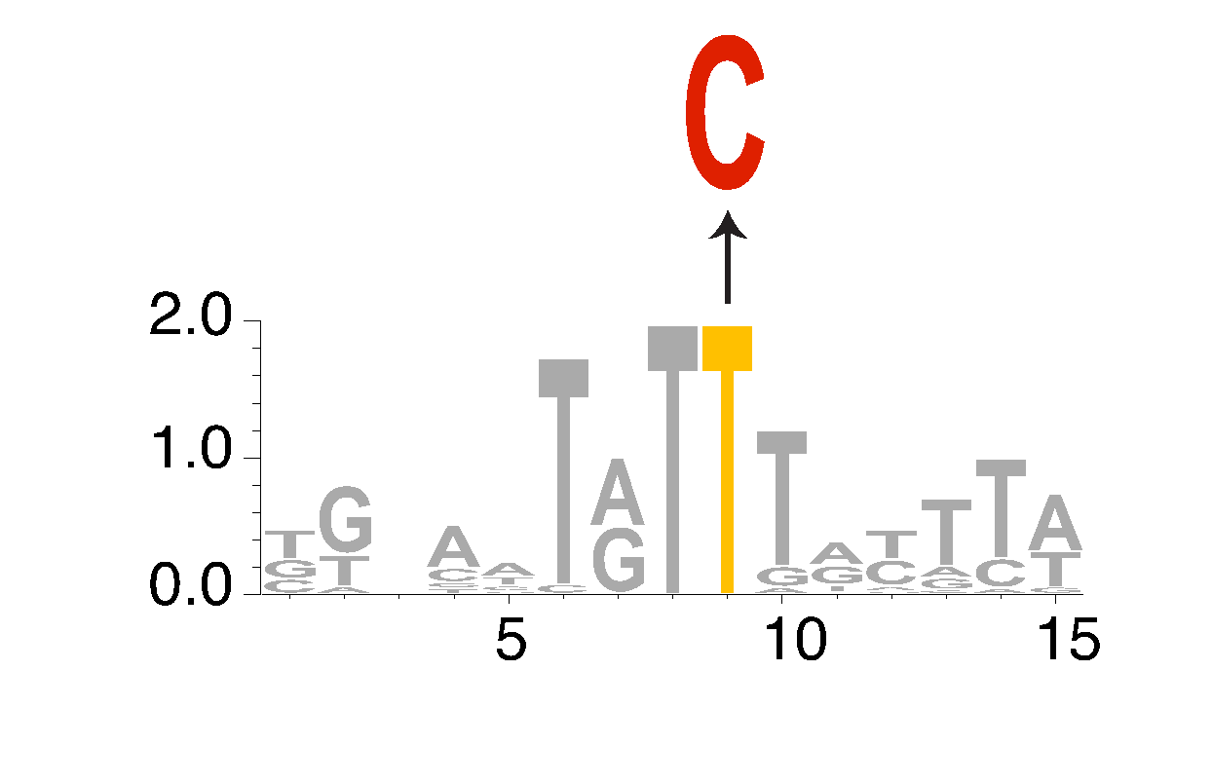





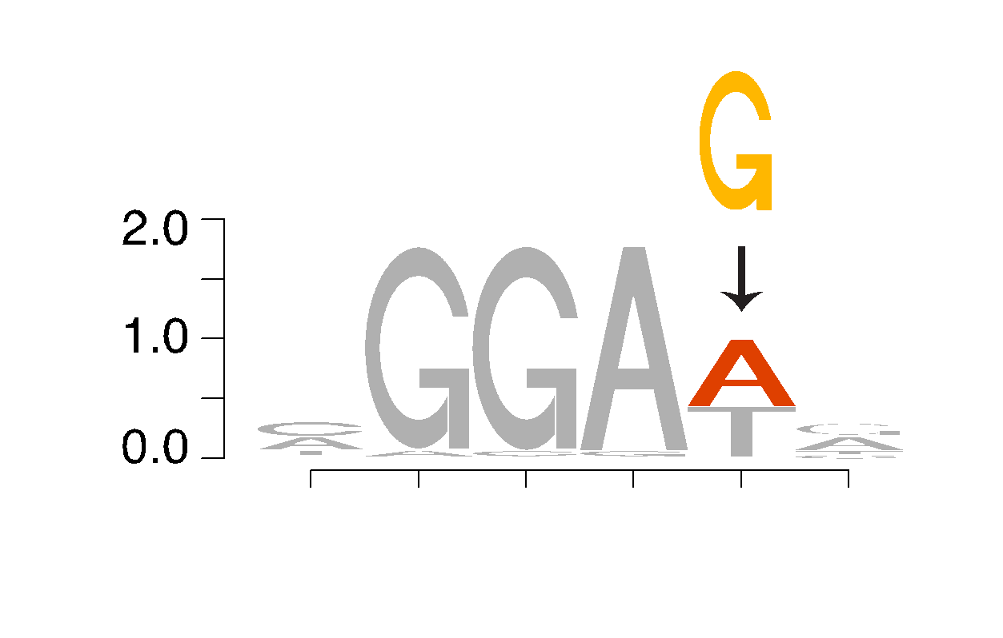



Loss- and gain- of motif mutations
Loss-of-motif
TF
mRNA
TATTTAT
Promoter
Gene
TF
Mutation
X
TATCTAT
Gain-of-motif
TF
CGGAGG
TF
mRNA
CGGAAG
Yao Fu, Ekta Khurana, Mark Gerstein
Notes:
telomerase reverse transcriptase
ETS TF binds in TERT promoter and gene is expressed.

Slide 49
Prediction of TFBS creation/disruption by somatic SNVs
C. Chan, A. Bietz, C. Herrmann (DKFZ, Heidelberg)
Submitted file :
/pancan/synapse/ICGC-TCGA Whole Genome Pan-Cancer Analysis/Analysis Themes/PCAWG 2, 5, 9, 14 Analysis of mutations/Annotated Mutations/Santa_Cruz_Pilot/DKFZ/ALLTYPES-BYTYPE.vcf.tgz
Goal :
  genome wide prediction of TFBS alterations (all non-coding SNVs are analysed, not just promoter/enhancer SNVs)
  Comparison of alteration frequencies with background model obtained from randomization
  → evidence for higher/lower TFBS alterations frequencies compared to background
  → positive/negative selection

Slide 50
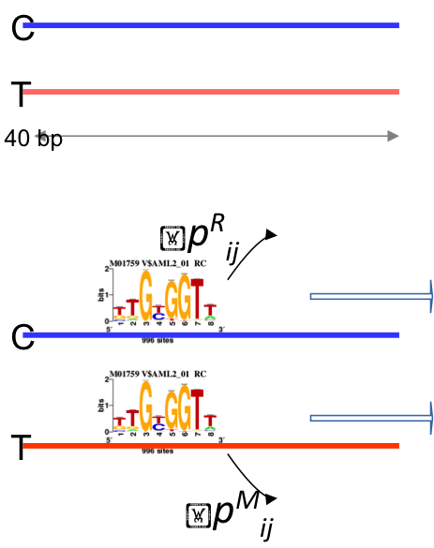
Procedure
For each SNV i, +/- 20 bp are extracted around SNV; Reference and mutated sequences are generated (R_{i} , M_{i})
As background, a Markov model of order 2 is generated from the complete set of sequences surrounding the SNVs
Both are scanned with TRANSFAC motifs (TF Pro, 2011) using the tool matrix-scan from the RSAT suite (Thomas-Chollier et al, NAR (2011))
For each PWM j the smallest p-value is computed
  Reference : p^{R}_{ij}
  Mutated : p^{M}_{ij}
TFBS alteration is defined as :
min(p^{R}_{ij,}p^{M}_{ij}) < 1e-4 & max(p^{R}_{ij,}p^{M}_{ij}) > 5e-3
Reported is the : log(p^{R}_{ij} / p^{M}_{ij})
  Positive if TFBS creation
  Negative is TFBS disruption
C. Chan, A. Bietz, C. Herrmann (DKFZ)

Slide 51
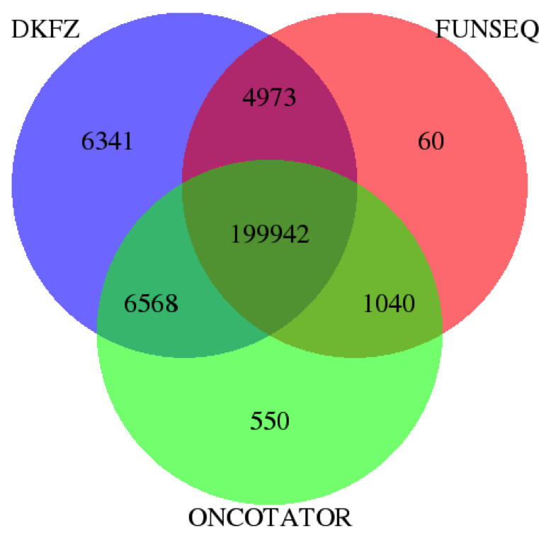
Comparison of nonsynonymous mutations annotated by DKFZ, FunSeq and Oncotator
FunSeq: Missense, Premature stop, Splice site disruption
Oncotator: Misssense, Nonsense, Nonstop, Start_codon
DKFZ: Nonsynonymous, Stop gain
Method | Nonsynonymous mutations
DKFZ | 217,824
FUNSEQ | 206,015
ONCOTATOR | 208,100
CNIO needs to check results
Priyanka Dhingra, Ekta Khurana (WCMC)
Notes:
Discordant results with CNIO. So Miguel wants to check his pipeline.

Slide 52
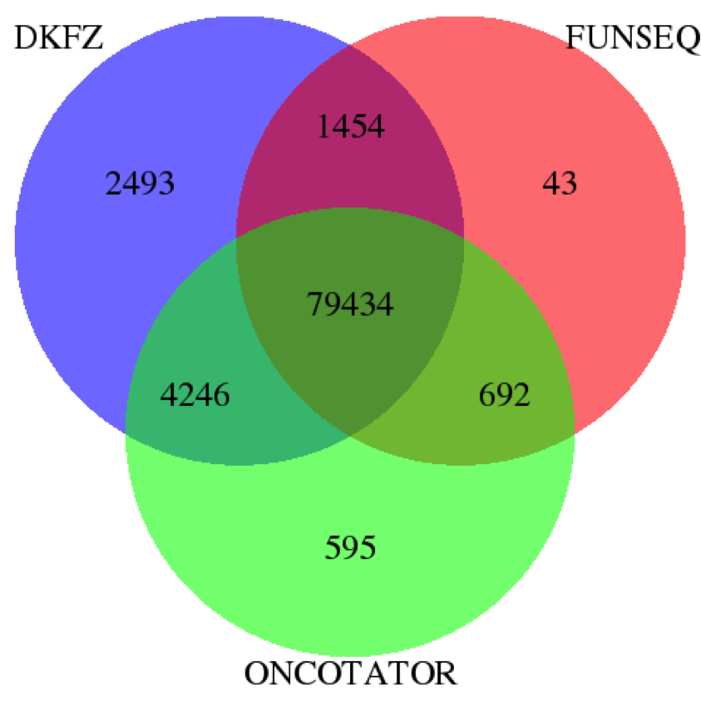
Comparison of synonymous mutations annotated by DKFZ, FunSeq and Oncotator
Germline removed by FunSeq
Method | Synonymous mutations
DKFZ | 87627
FUNSEQ | 81623
ONCOTATOR | 84967
Priyanka Dhingra, Ekta Khurana (WCMC)
Notes:
May be because some methods do by isoform. We need to discuss why different.

Slide 53
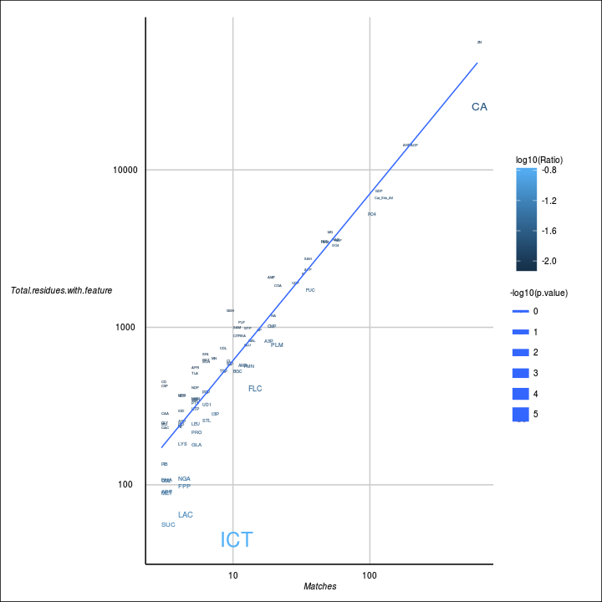
Firestar (CNIO)
Annotation:
Find ligand binding or catalytic site residues annotated in Firestar that are overlapping the mutated residue or its neighbors, the later determined using PDB structures and sequence alignments to fix inconsistencies.
Summary:
Mutations are sorted by their ligand they bind and compared with their abundance in the proteome and with their incidence in the random dataset (next slide)
The plot above shows the number of mutations affecting residues binding each ligand vs. the abundance of this kind of residue in the proteome (only principal isoforms are considered). PANCANCER dataset
Miguel Vazquez, Tirso Pons, Jose M. Rodriguez, Michael Tress, Alfonso Valencia (CNIO)
Notes:
The StructurePPI [http://structureppi.bioinfo.cnio.es/Structure] pipeline (rbbt) from CNIO takes care of annotating protein residues with several databases; for this pilot we restrict ourselves to Firestar annotations (i.e., ligand-bindind residues). We can find residues overlapping our mutations and in close proximity.
The plot is computed by counting the number of mutations affecting each type of residue, the number of residues with that type in the complete proteome, the total number of mutations affecting protein residues, and the total size of the proteome. The proteome considered is restricted only to principal isoforms (APPRIS). The p-value is calculated using a binomial test based on these numbers; it is indented to be used in comparisons between feature types and not taken by itself. The line is just the linear regression line across all features. The size represents how significant the p-value is and the color the ratio between the number mutations affecting residues of that type and the total number of residues of such type in the complete proteome. ICT (IDH1) is the most significant.
All the examples here are for direct overlaps, not for neighbors.

Slide 54
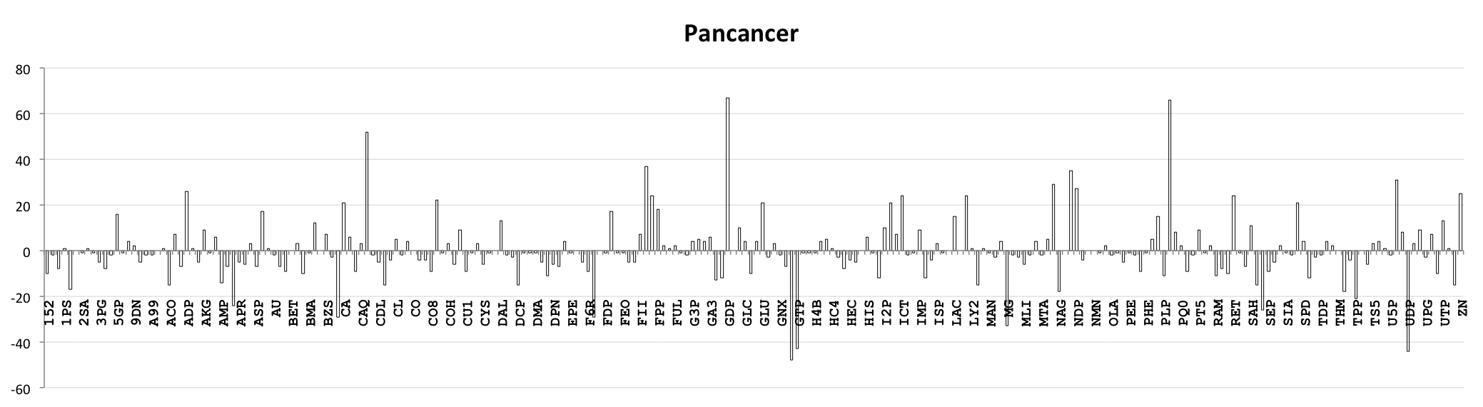
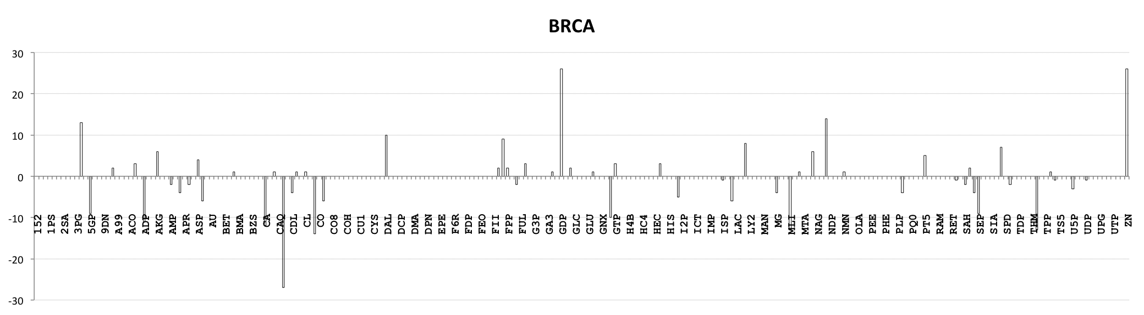
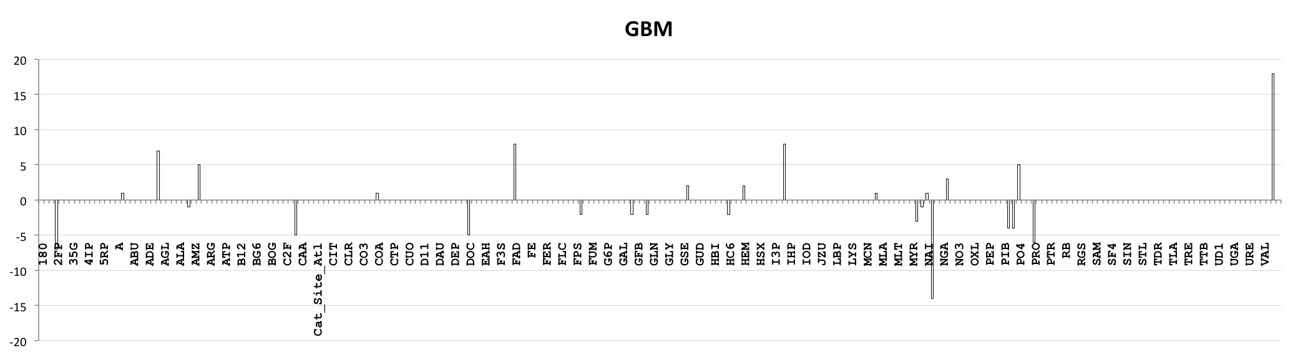
Firestar: normal counts – random counts
GDP
PO4
Cat_site
(KRAS)
(GNAI2)
(RRAS2)
(NRAS)
(PTEN)
(PTPN11)
(EZH2)
(NRAS)
(KRAS)
GDP
Zn
(GNAS)
(GNAT2)
4IP
NAP
diff(#mut_pilot - #mut_random)
Zn
ADP
FAD
ICT
PO4
ANP
(IDH1)
(PTEN)
Miguel Vazquez (CNIO)
compounds
Notes:
Here the counts for each type are compared between the original dataset and the random dataset. Long vertical bars indicate the largest discrepancies. We have highlighted the most significant and listed some of the most interesting genes harboring those mutations in parenthesis. Bold gene names represent recurrently mutated genes.

Slide 55
KinMut
Prediction of the pathogenicity of mutations in human protein kinases
Random-forest based classifier
Characterizes mutations at three levels:
  Kinase level: GO terms, Kinbase groups, …
  Domain level: PFAM domains
  Residue level:
    Functional annotations (FireDB, Uniprot, PhosphoELM…)
    Residue conservation
    Physical-Chemical properties
    Etc.
Top Kinases with disease predicted mutations in…
PANCANCER: TTN, FGFR2, FGFR1, PIK3CA, ERBB4, TGFBR1, FGFR3, LRRK2, NTRK1, RET
GBM: PIK3CA, PDGFRB, KDR, DCLK1, CDKL5
BRCA: FGFR2, PIK3CA, NTRK1, ERBB4, ZAP70, RET, AKT1
Study/Mutations | Total | Disease | Total (Rand.) | Disease (Rand.)
GBM | 206 | 7 | 185 | 4
BRCA | 770 | 66 | 732 | 45
PANCANCER | 14506 | 1056 | 14900 | 1043
Miguel Vazquez, Tirso Pons, Jose M. Izarzugaza, Alfonso Valencia (CNIO)
Notes:
Overview of the KinMut kinase damage predictor (URL). The performance of the classifier is the state-of-the-art using several test datasets of validated kinase mutations.

Slide 56
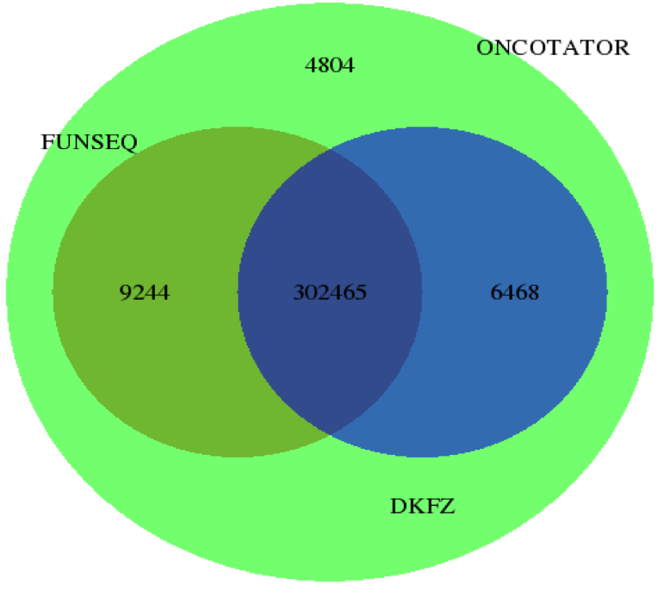
Comparison of mutations in promoters annotated by DKFZ, Oncotator and FunSeq
Method | Promoter mutations
DKFZ | 308,933
FUNSEQ | 311,709
ONCOTATOR | 322,981

Slide 57
Comparison of mutations in enhancer annotated by DKFZ and FunSeq
DKFZ
FunSeq
Germline and coding removed by FunSeq
9622
1,504,778
10
Method | Enhancer mutations
DKFZ | 1,524,400
FUNSEQ | 1,504,788
Oncotator used Union_link_sig_FDR01_Sep.txt from Roadmap. 1,233,179 mutations in enhancers.
Notes:
- Excluded enhancer overlapping with exons. Oncotator used different file to annotate enhancers. They have used Union_link_sig_FDR01_Sep.txt. We need total number of enhancers they used and we used. Their total number of mutations in enhancers= 1,233,179. Union link file num of enhancers = 249,344. We have used (Roadmap stringent) = 474,004.

Slide 58
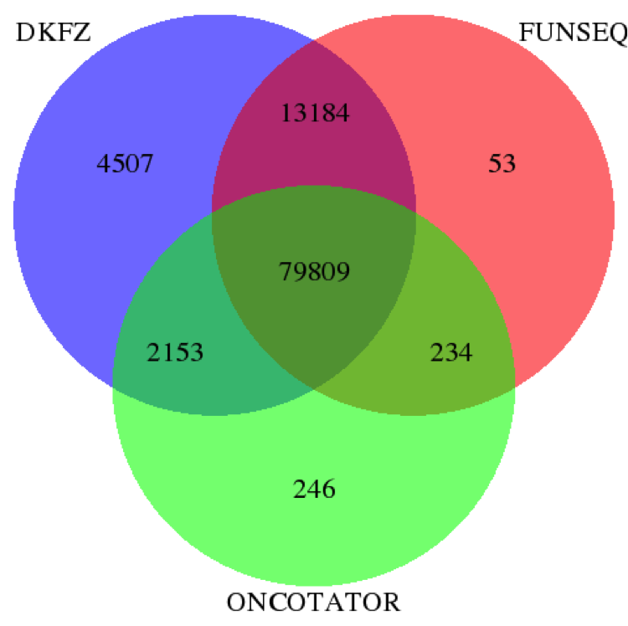
Comparison of mutations in lncRNA annotated by DKFZ, Oncotator and FunSeq
Germline & coding.
DKFZ also predicts ncRNA splicing effects.
Method | lncRNA mutations
DKFZ | 99653
FUNSEQ | 93280
ONCOTATOR | 82442
Notes:
Considered only exonic lncRNA from dkfz; DKFZ doing ncRNA splicing and Funseq doesn’t; FunSeq removes germline but DKFZ does not.

Slide 59
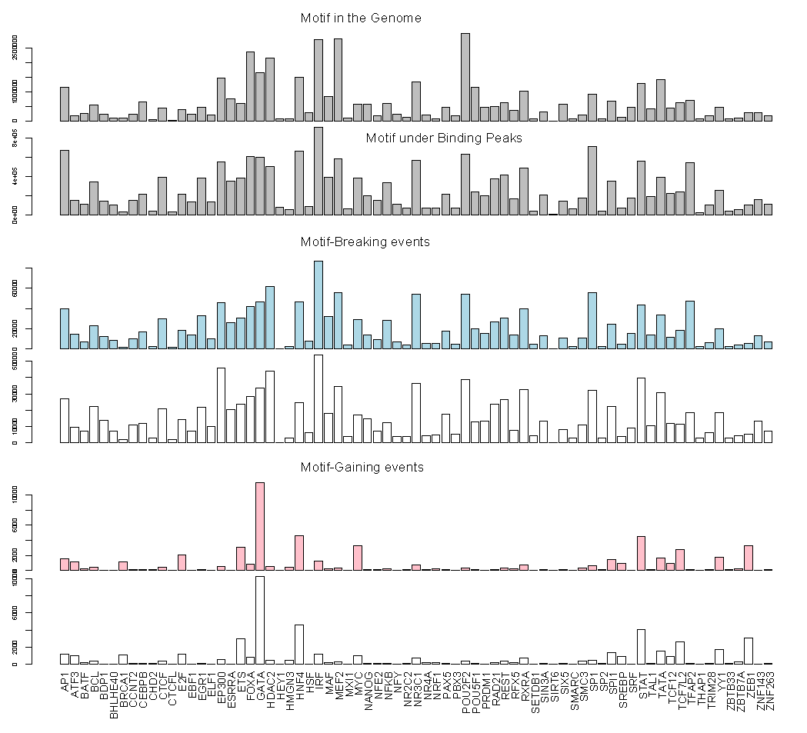
Motif gain and loss in different TF families by PanCancer variants
We can go higher resolution than just promoters & enhancers.
More motifs created for some families like GATA
Relation w/ sequence context, mutational signatures
Possible driver events
Yao Fu (Gerstein lab)
Ekta Khurana

Slide 60
Composite FunSeq approach for drivers detection
(A) Functionally annotate and score each mutation
FS1
FS2
FS3
FS4
FS5
FS6
FS7
FS8
FS9
FS=FunSeq2 score
(B) Check for positional recurrence of each mutation in samples
Sample 1
Sample 2
Sample 3
(C) Calculate composite funseq score for each element
Composite Funseq (CS_{r}) = Σ w_{i} FS_{i}
r= region (cds, promoter, enhancer and lncRNA)
n = number of variants in r
wi = number of samples with variant i
(D) Compute pvalues against null distribution to asses functional & recurrence bias of accumulation of variants in CDS, promoter, enhancer and lncRNA. For each element, random sampling of same num of muts. from all muts. in that element type.
Priyanka Dhingra (Khurana lab)

Slide 61
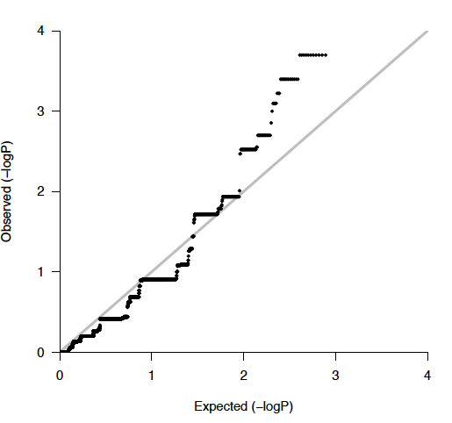
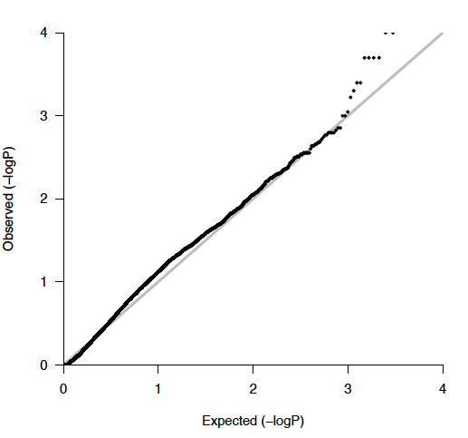
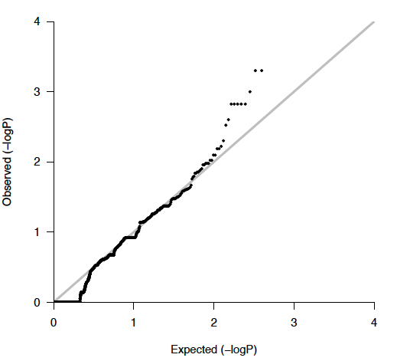
Coding genes
Promoters
GENES
AKT1
ARID1A
CTCF
DST
ERBB3
LRP2
PIK3CA
RB1
SF3B1
TP53
CFTR
HARS
HIST1H2BC
PROMOTERS
SEPT9
ZBTB37
AGBL5
CCDC107
DUSP22
ALDOA
HIST1H3D
MLL5
lncRNAs
lncRNA
ENSG00000270022.1
ENSG00000196421.3(LINC00176)
ENSG00000245532.3
ENSG00000251562.3 (MALAT1)
ENSG00000178977.3 (LINC00324)
ENSG00000267898.1 (CTD-2639E6.9)
ENSG00000266411.1 (RP11-180P8.3)
ENSG00000197989.8
ENSG00000264112.1(RP11-159D12.2)
CompositeFunSeq applied on
BRCA (207 donors)
Priyanka Dhingra (Khurana lab)

Slide 62
Future: Analyses for integrative drivers paper
Need to decide on final annotations and how we will generate consensus annotated variants file
Integrate w/ transcriptome: For each gene which element is most likely to be driver, coding drivers in some patients while noncoding in others but same result
Integrate w/ methylome: Sample specific annotation for regulatory regions: Is the region on or off in the sample that is mutated
Segmentation approach that combines RNA and methylation data to annotate active regions per sample
Even when methylation data not available for that sample, check variability in that cancer type
Ekta Khurana

Slide 63
SOMATIC MUTATION BURDEN ANALYSIS WITH MULTIPLE COVARIATES CORRECTION
Jing Zhang
The Gerstein Lab in Yale

Slide 64
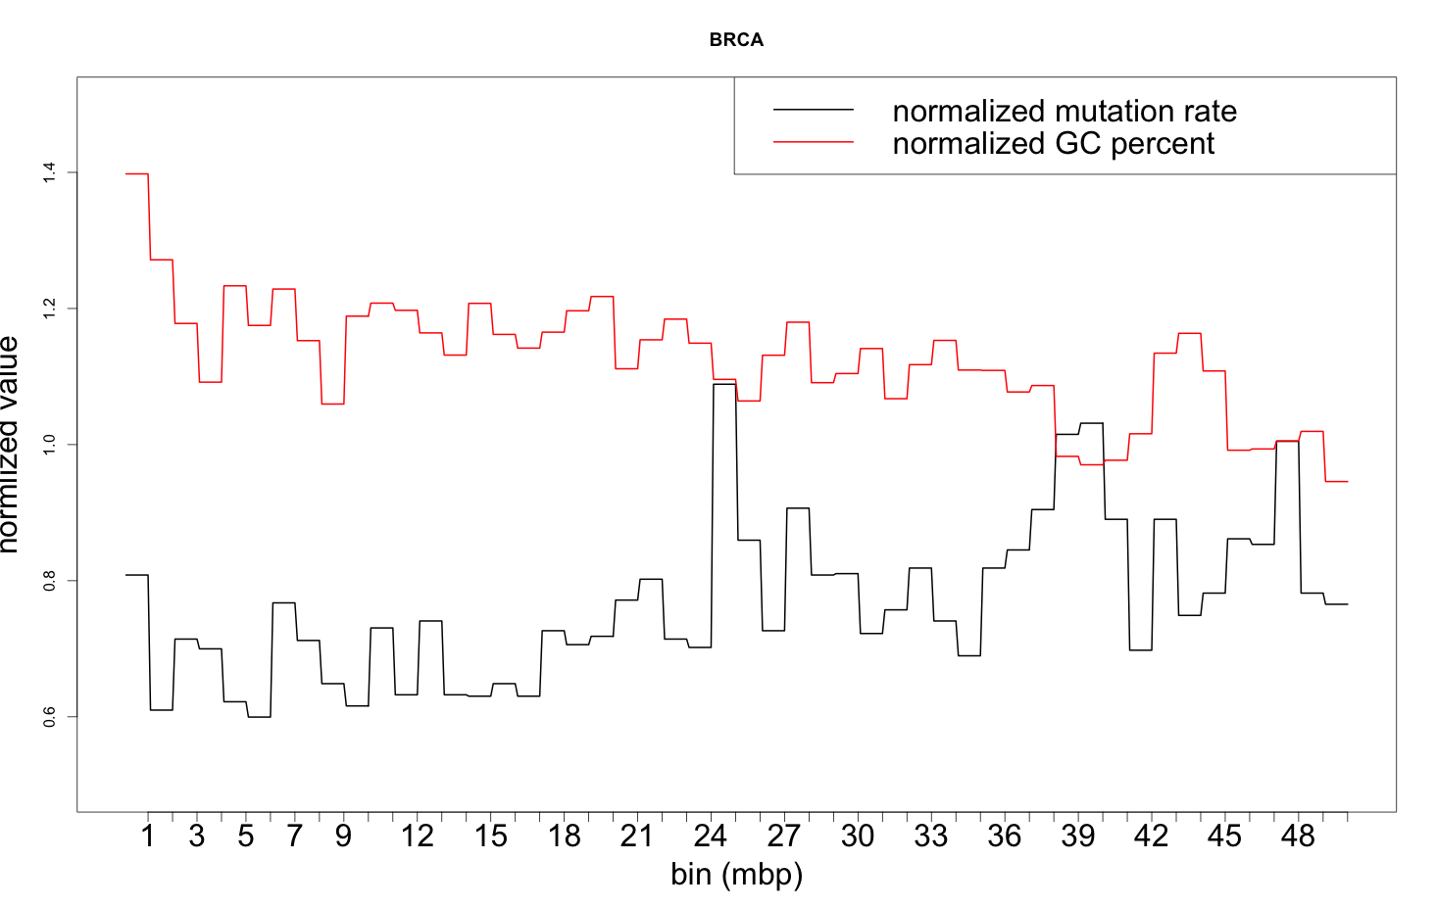
Challenges in identifying noncoding drivers
Noncoding variants may serve as drivers in many cancer types
  TERT, PLEKHS1, WDR74 and SDHD promoters
  miRNA-binding sites on BRCA1 and BRCA2
Goal: identify highly mutated noncoding regions
Challenges 1: lack of natural background mutation model
Challenges 2: cancer type, sample, and regional, mutation rate heterogeneity
Correlated genomic features:
GC content
Replication timing
Chromatin Accessibility
Histone modification marks
Expression level

Slide 65







Modeling the background mutation rate
1mb bins on the genome for a specific cancer type
  number of variants in the i^{th} 1mb bin
  total number of bases in that region
  probability of observing conditional on theta , with
  Generalized Additive models with location, scale, and shape, including binomial, Poisson, negative binomial, beta-binomial, and etc…
  List of covariant: 381 features from the Epigenetics Roadmap and ENCODE
    Several modification marks: Histone_H3K27ac, Histone_H3K27me3, Histone_H3K36me3, Histone_H3K4me1, Histone_H3K4me3, Histone_H3K9ac, Histone_H3K9me3
    Expression data from mRNA-seq, Chromatin accessibility
    GC content, CpG percentage, replication timing

Slide 66

Performance on 1mp bins

Slide 67

Multicollinearity due to highly correlated features

Slide 68


Lack of statistical power in smaller regions
Challenge: target regions are usually not large enough for accurate background mutation rate estimation
Nearest neighbor: in high dimensional space, difficult to find a neighbor
Solution: test region clustering based on predictions
10kb region Correlation: -0.1127
Mutations/total bases
Local cluster ID

Slide 69

Workflow of our analysis

Slide 70


Impact of non-coding somatic mutations in CpG and
CpG island context on gene expression (Part 1)
CpG dinucleotides are special
- CpG dinucleotides are methylation acceptors
- CpGs are underrepresented in the genome due to deamination
→ CpG-rich regulatory sequences are rare
→ Focused analysis on mutations in CpG context
Preliminary result:
Santa Cruz Pilot set → non-random distribution of CpG context mutations
In a nutshell:
Applying mRNA,
SNV and methylation data to analyze mutations in CpG context
CpG gain: AG → CG
CpG loss: CG → CT
CpG shift: CGG → CCG
Lars Feuerbach, Sandra Koser,
Benedikt Brors (DKFZ-Heidelberg)

Slide 71


Impact of non-coding somatic mutations in CpG and
CpG island context on gene expression (Part 2)
Original abstract
Santa Cruz Pilot data – Candidate selection
→ 36,385 SNVs in promoter CpG island cores
Expression level of onco-suppressor CD99 (chrX):
FPKM values for samples with promoter mutation (red) and without (blue).
De novo motifs in CpG islands
are accessible to trans-factors
Higher probability to contribute
to selection during cancer evolution
Deep Pileup
To compensate for low read coverage in CpG islands, promising positions are recalled (~10 min per SNV).

Slide 72

Integrative mutation analysis
Genes like TP53 are deactivated by multiple mechanisms (SNVs, deletions etc.)
Genes like TERT gain function by multiple mechanisms (promoter mutations, amplifications etc.)
Gene with same phenotype different genotype → convergent cancer evolution target (CCET)
Similarly, non-coding elements are subject to different genetic events.
To detect to convergent cancer evolution targets (CCETs), we apply a three step pipeline:
1) Cohort-based quality control for the removal of technology artifacts and biases
2) Integration of mutation, differentially methylation and expression callsets into a common datastructure
(in co-ordination with PCAWG 2, PCAWG 3, PCAWG 4 and PCAWG 6)
3) Statistical analysis of functional elements including coding genes, non-coding RNA, promoters and enhancers
Lars Feuerbach, Chen Hong, Qi Wang, Sandra Koser, Benedikt Brors (DKFZ)

Slide 73
PCAWG-5: Consequences of somatic mutations on network and pathway activity
Ben Raphael
Josh Stuart

Slide 74
Diverse Methods
17 different approaches recorded in Google doc. Additional contributions anticipated.
Identify gene sets/pathways/subnetworks enriched for mutations
Connect mutated networks to downstream expression changes.
Other: mutual exclusivity, drug-ligand interactions, etc.

Slide 75
Network Pilot: Goals
Test network-driven analysis of pan-cancer data
Evaluate and compare diverse methods
Investigate construction of consensus networks
Jüri Reimand, B. Raphael, J. Stuart

Slide 76
Standardized Data
Santa Cruz Pilot dataset: mutations and RNA-Seq
Randomized mutation data
Pathways and Networks
  Gene sets (GO Biological Process, KEGG and Reactome)
  Physical protein-protein interaction network (High-confidence network with 2+ PMIDs)
  Pathway-based network from PathwayCommons
  ENCODE regulatory network
Results from signals pilot (OncodriveFM2, ncDriver, etc.)
All on Synapse, with IDs on PCAWG-2-5-9-14 Google doc.
Jüri Reimand
Notes:
Builds on and hopefully enhances work of many others. Also requires

Slide 77
Preliminary Results
Pathway enrichment (KEGG, GO, Corum, NCI Pathways, etc.): Miguel Vazquez (A. Valencia group)
HotNet2 mutated subnetworks: Max Leiserson (Raphael group)
SSA.ME mutated subnetworks: Kathleen Marchal
NBDI mutations and gene expression: Kathleen Marchal
Reactome mutated subnetworks: Guanming Wu (L. Stein group)

Slide 78

HotNet2
Significantly Altered Subnetworks
Question: Given network labeled with vertex scores, are these scores clustered on network?
Gene score
Nodes = genes/proteins
Edges = (pairwise) interactions
Scores
Genes
Leiserson, Vandin, et al. Nature Genetics (2015)
Notes:
Network group has challenging task of analyzing combinations of genomic/transcriptomic alterations. This is difficult because the number of possible combinations is extremely large, information about which combinations to analyze is typically poorly represented. From a practical perspective, our analysis comes late in the process and data has already been examined by single gene/aberration tests so low hanging fruit has already been picked. So with these caveats in mind..
One approach we have taken is to use prior information about interactions, represented in a network, to analyze combinations of
The most recent iteration of our approach is the HotNet2 algorithm addresses general question: …

Slide 79


HotNet2
Significantly Mutated Subnetworks
Gene score
Nodes = genes/proteins
Edges = (pairwise) interactions
Mutation frequencies
Copy number
aberrations
multiple TCGA papers…
Leiserson, Vandin, et al. Nature Genetics (2015)
Notes:
In early applications of algorithm, we used HotNet2 to find subnetworks that were mutated more than expected by chance. Here scores were frequencies of SNVs, indels, or copy number aberrations. Network is PPI network. We’ve done this analysis in multiple TCGA projects and recently in a Pan-Cancer study of 12 TCGA cancer types, which I talked about briefly in Boston PCAWG meeting and you can read about here.

Slide 80

HotNet2
Significantly Mutated Subnetworks
Gene score
Nodes = genes/proteins
Edges = (pairwise) interactions
Mutation frequencies
Copy number
aberrations
Driver gene scores
MutSigCV, Music, Oncodrive-FM…
Leiserson, Vandin, et al. Nature Genetics (2015)

Slide 81
HotNet2
Preliminary Results on Santa Cruz Pilot
iRefIndex 14
15,497 nodes
162,382 edges
HINT+HI2014
13,557 nodes
77,246 edges
13 subnetworks with k ≥ 3 genes
(Oncodrive scores on iRefIndex network)
SWI/SNF complex
TGF-β signaling
NOTCH signaling
RAS/RAF
nsSNVs + indels
23,259 genes
Rb signaling
PI(3)K signaling
Oncodrive FM2 p-values
864 genes with FM2 q < 1
Leiserson, Vandin, et al. Nature Genetics (2015)

Slide 82

Network-based driver prioritization
L. Verbeke, S. Pulido, S. Van Laere, J. Fostier, K. Marchal
Dept. Information Technology, Ghent University, Belgium
CORE - Faculty of Medicine and Health Sciences - University of Antwerp
Exploit network information combined with expression data to prioritize cancer driver genes & cancer pathways
Complementary to using positional information of individual mutations (annotation, positive selection pilot)
Pulido et al. method based on reinforced learning (SSA-ME)
Verbeke et al. method based on global kernel similarities (NBDI)
Notes:
Resolutie individuele genen (loss of position information and therefore complementary)
As postprocessing /refinement or in combination
Resolutie op pathway niveau (bv mutual exclusivity) en niet op gen niveau
Resolution of our analysi ranges from gene to pathway leevel and there os compleme to …thatuse ppositional info

Slide 83



Reinforced learning method (description)
INPUT
PATHWAY-DRIVEN PRIORITIZATION REFINEMENT
Iterate until convergence
Interaction network
Seed
Nodes
INPUT
Selected
subnetworks
Gene specific p-values derived from tools applied in the positive selection pilot (ncDriver)
Exploit the network neighborhood i.e. joint network of genes carrying mutations in promoters, coding regions, enhancers and lncRNAs

Slide 84



Reinforced learning method (description)
Genes with low p-values are boosted by network analysis (complementing positive selection signal by network signal)
No results when using the p-values obtained from a randomized dataset: network connectivity helps in filtering false positives
Node Size: p-value
Real PANCANCER
Random PANCANCER
Notes:
Data geintegreerd over alle samples
En als die in netwerk samenhoort is het een netwerk dat abberant is in veel patienten
Selecteert genen die niet gemuteerd zijn involved in interconnecting mutated genes (the mnost likely connector genes -> bridging mutated genes)

Slide 85

Kernel-based similarity method (description)
INPUT
PRIORITIZE MUTATED PROMOTERS USING NETWORK CONNECTIVITY
Global interaction network
Prioritize mutated promoters
present in a pathway that contains other mutated genes
Of which the gene driven by the promoter is differentially expressed
is present in a pathway that contains differentially expressed genes
Notes:
Patient – mutation information is retained
Firrst step all available data are coverted to a global network representation
In a second step we addd known gene interactions as a prior gene interaction network
Abonormal genen states will be connected with their correspondong gene in the network
This global network is used to calculate a similarity metric to quantify how well the sample nodes connect to the gene nodes in the interaction network
Hereby assuming

Slide 86

Kernel-based similarity method (results)
Infrequent mutations with low p-values that strongly affect expression phenotype
Frequent mutation with low p-value

Slide 87
SC MAF Pilot Data Analysis Using Reactome Functional Interaction Network
Guanming Wu & Lincoln Stein
OICR

Slide 88


Reactome Functional Interaction (FI) Network
2014 Version: ~ 12,000 SwissProt Ids (58%), 336,000 FIs (3 times more than MultiNet)
6% of FIs are TF/Target interactions
Not physical protein-protein interactions
Workflow to construct Reactome FI Network
Notes:
Reactome functional interaction network was constructed mainly based on Reactome pathways and several currently available human curated biological databases, including KEGG, NCI-PID and Panther. We also include TF/target interactions from ENCODE and TRED, which is a TF/Target interaction database. In order to increase the coverage, we used Naïve Bayes Classifier to score protein pairwise relationships from multiple resources, including physical interactions, gene co-expression, and domain interaction.
The latest version of Reactome FI network covers close to 60% of total human genes, and more than 336 thousands functional interactions. The interactions in the network is direct functional relationships, not physical interactions. So our network is different from most of networks used by network-based data analysis, which usually use physical protein-protein interaction networks. We may be able to provide semantic annotations to Fis if they are extracted from pathways.

Slide 89
Using FI Network for Cancer Gene Prediction
Features
  Mutation rate / Protein length
  Mutation Assessor score
  Maximum of network scores from one-hop neighborhood
  Network score
  Mutation clustering score
Classifier
  logistic regression classifier
Training:
  Data: TCGA BRCA
  Positive: 40 known breast cancer genes (CGC + TCGA Pan Cancer)
  Negative: All other genes in the Reactome FI network
Results from 10-fold cross-validation
  Precision: 0.95
  Recall: 0.50
  AUC: 0.93
Current gene
Non-driver gene
Driver gene
Network score for a gene is calculated as:
NumberOfDriversInNeighors / NumberOfNeighbors
Score = 1 / 6 = 0.17
Notes:
We have tried to investigate if we can use Reactome FI network as a feature for cancer gene prediction. In our exploration, we define a cancer network score as a ratio of number of known drivers in a gene’s one hop-neighborhood to the total number of genes in that neighborhood. Based on this network cancer score, we built a simple logistic regression classifier by using these features:… Results based on the TCGA breast cancer seems not that bad: based on 10-fold cross-validation, we have precision 0.95, recall 0.50, and AUC 0.93. The recall rate is a little low.

Slide 90

Pre-Processing SC MAF File
Downloaded from Synapse
Filtered mutations to protein coding regions only
  Total samples: 2,008
  Total genes: 19,074
  Mutated genes per sample: 97 (sd: 356)
  Mutated samples per gene: 10 (sd: 12)
Annotated mutations using Mutation Assessor scores
Notes:
We tried this classifier with the SC MAF file. First we pre-processed this MAF file by filtering mutation to protein coding region only, and then annotating mutation using Mutation Assessor scores.

Slide 91

MutSigCV Analysis
Overlapping Analysis:
202 COSMIC CGC Cancer Genes (missense mutation)
FDR cutoff = 0.05
  35 genes from MutSigCV
  17 shared with CGC (49%)
FDR cutoff = 0.25
  39 genes from MutSigCV
  20 shared with CGC (51%)
Notes:
We did a MutSigCV analysis using the default setting and files provided in the MutSig’s download web site. Here are quick results from this MutSigCV. We compare these results with COSMIC cancer gene census gene list, which is assumed as a list of known cancer genes here. About 50% of MutSigCV signficant genes are shared with COSMIC CGC genes. The total significant genes from MutSigCV is about 40.

Slide 92

FI Subnetwork for 39 MutSig Genes
Notes:
Here is a Reactome FI sub-network constructed based on 39 MutSigCV genes. About half of them are not connected to others in our network. Cancer genes usually interact each other from a large number of patient samples. So we imagine that we may be able to find more cancer genes by using network based classifier.
19 genes are not connected to others.

Slide 93
MutSig Score as a new Feature in Classifier
Feature is calculated as –log(p-value)
Training (known cancer genes)
  202 COSMIC CGC Genes (187 in FI network) as positive
  Other genes in the FI network as negative
  Results from 10-fold cross-validation
    Precision: 0.87
    Recall: 0.32
    ROC: 0.89
    PRC: 0.45
Notes:
For SC MAF file, we used MutSig p-value as a new feature, in the place of mutation rate. We trained our classifier using 202 COSMIC CGC genes. The results based on 10-fold cross-validation are listed here: precision is 87% and recall 32%.

Slide 94

Reactome FI Sub-Network for Genes with Scores >= 0.5
Notes:
Here is a Reactome FI sub-network constructed based on genes having classifier scores greater than 0.5. Network clustering analysis results show that those genes into four major modules, which are displayed in different colors here. These four modules can be further annotated into three types: one module contains genes mainly in nucleus and another contains genes mainly in plasma membrane. This FI network contains 66 genes in total: 60 have been listed in COSMIC CGC already, 6 are new, which are highlighted in yellow.

Slide 95

Reactome FI Sub-Network for Genes with Scores >= 0.5
Notes:
Here are these 6 genes: 2 of them are significant based on MutSigCV. Another 3 have been proved based on mouse insertional mutagenesis experiments according to COSMIC’s annotation. One of them called NAPA may be just false positive?
In summary, we hope to use our method to search for cancer genes with low mutation rate that may be missed in mutation rate based algorithms, such as MutSig or Music.

Slide 96
Vignette: "Affinity modulation of non-coding variants” and "Convergence of non-coding variants” (Nicholas Sinnott-Armstrong, Richard Sallari)

Slide 97

BLADE: Binding and Local Affinity
Disruption Enrichment
Nicholas A. Sinnott-Armstrong (nasa@csail.mit.edu)
Richard Sallari (sallari@mit.edu)
Manolis Kellis – MIT & Broad Institute

Slide 98
What do we work on?
Contribute to regulatory annotations (enhancers, promoters, motifs) and analysis methods/tools
Intragenomic Replicates (IGR) to estimate binding affinity modulating mutations
BLADE for discovering functionally mutated regions
Plexus convergence recurrence test
Reg.
This talk is focused on three vignettes:
1 IGR
2 BLADE
3 Plexus

Slide 99



Estimating TF Sequence Affinity
1 - IGR
1
2
3
ChIP-Seq Signal
Open Chromatin
DNA Sequence
GAGCACAGATACCATCGATGACCAGTCATAGTTATTGATATCACCAGATTTAACCATA
1
ChIP-Seq
around each kmer instance
1
Signal
Signal
2
3
400 bp
around k-mer
400 bp
around k-mer

Slide 100

Example: FoxA1 in T47D
1 - IGR

Slide 101



1 - IGR
Intragenomic Replicates (IGR)
Breast cancer risk-associated SNPs
are enriched in affinity modulating variants.
Cowper-Sallari … Lupien Nature Genetics 2012
Notes:
For each allele and position over a sliding window we aggregate all matches of the k-mer genome wide to generate an affinity profile for that k-mer.
These are then placed in a lattice (top right) and the maxima for each value of k are compared to derive the final IGR score (maxima are underlined).

Slide 102

Intragenomic Replicates (IGR)
1 - IGR

Slide 103

1 - IGR
ChIP-qPCR Experimental validation: IGR >> PWMs
IGR r^2=0.89 with ChIP. PWMs r^2=0.45
Cowper-Sallari … Lupien Nature Genetics 2012
Notes:
Regression with ChIP-PCR for IGR (large) and PWM scores (inlay).

Slide 104

Case Study: IGHV2-70 Locus
2 - BLADE
Hypermutated: 1.1kb with 483 mutations from 101 patients across 13 cancer types

Slide 105

Case Study: IGHV2-70 Locus
2 - BLADE
Germline > Somatic
Somatic > Germline

Slide 106
Case Study: IGHV2-70 Locus
2 - BLADE
Germline > Somatic
Somatic > Germline
Permuted 10 samples of 483 mutations from the same cancer types, threshold affinity difference

Slide 107

Case Study: IGHV2-70 Locus
2 - BLADE

Slide 108
Regional Heterogeneity Correction
2 - BLADE
Locate putative
regulatory regions
Regulatory regions
divided into 25bp tiles
Annotate tiles with
chromatin states
per cell type, G/C,
& mutation rate
Resample tiles based
on state and mutation
rate distribution
18
18
17
18
17
18
18
17
17
18
17
17
18
17
15
17
17
15
17
17
17
16
15
17
16
15
17
15
17
16
15
17
16
15
16
19
17
16
19
17
16
17
23
19
17
23
19
17
19
23
23
19
23
23
19
23
20
23
23
20
23
23
23
20
20
23
20
20
23
20
20
20
20
20
20
20
20
18
20
20
18
20
20
20
18
18
20
18
18
20
18
15
18
18
15
18
18
18
15
18
15
18
15
15
15
IGR
IGR

Slide 109

3 - Plexus
Regulatory plexus
convergence
model
Notes:
Regulation is distributed

Slide 110

3 - Plexus
Regulatory plexus
convergence
model
Some patterns of recurrence might be hard to detect.

Slide 111

3 - Plexus
Hi-C dataset for matching cancer types

Slide 112

3 - Plexus
Cancer Genomics: IGR on a plexus
Germline > Somatic
Somatic > Germline
Roadmap annotations and
IGR scores as filters for mutations
Notes:
IGR scores for the ITM2A plexus. TODO: add red/blue legend
-log10 IGR p-values depicted in each cell. Only significant results shown.
Red: increased binding. Blue decreased binding.
Replicate ChIP-seq experiments are shown as nested cells (they are usually concordant).
The extra cell with the number shows a summary of Roadmap-wide chromatin states.
The number indicates additional low states.

Slide 113

3 - Plexus
Identify novel
recurrently
mutated
plexi:
Weaver

Slide 114
Mutations in micro-RNA related elements and their impact on miRNA-seq gene expression profiles
Todd A. Johnson, Keith A. Boroevich, Tatsuhiko Tsunoda
RIKEN, Center for Integrated Medicine Science
miRNA-seq expression profiling
Analysis of mutations in miRNA related elements

Slide 115
miRNA-seq expression profiling
Modifications to original BCGSC/TCGA pipeline
Expression in ICGC tumors and normal tissues

Slide 116
aln
Priority
Mature
Star
Precursor
Stemloop
Unannotated
Other ncRNA
Genes
Repeats
Unknown
≥3bp overlap?
yes
miRNA
no
FASTQ
Alignment
(bwa samse)
annotate.pl
Unannotated SAM
Annotated SAM
Reference Genome
(hs37d5)
mirbase
(v20)
no
alignment_stats.pl
multiple
miRNA?
X0 <= 3
yes
miRNA.txt
yes
NM == 0
yes
no
no
yes
Shared mature?
mirna_species.txt
primary alignment only
no
double counted
alignment_stats.csv
crossmapped.txt
expression_matrix.pl
expn_matrix*.txt

Slide 117
miRBase V20 + novel miRNA genes
miRBase V20
  1,870 stemloop sequences
  2,576 mature sequences
Londin PNAS report
  3,707 novel mature miRNAs
    From 1,323 samples of 13 cell types

Slide 118
aln.novel2015
Priority
Mature
Star
Precursor
Stemloop
Unannotated
Other ncRNA
Genes
Repeats
Unknown
≥3bp overlap?
yes
miRNA
no
FASTQ
Alignment
(bwa samse)
annotate.pl
Unannotated SAM
Annotated SAM
Reference Genome
(hs37d5)
mirbase
(v20 + novel2015)
no
alignment_stats.pl
multiple
miRNA?
X0 <= 3
yes
miRNA.txt
yes
NM == 0
yes
no
no
yes
Shared mature?
mirna_species.txt
primary alignment only
no
double counted
alignment_stats.csv
crossmapped.txt
expression_matrix.pl
expn_matrix*.txt

Slide 119

3’-end modified mature miRNAs
Non-templated addition (NTA) to the 3’-end of miRNAs has been reported over the last five years.
Literature not conclusive on impact of NTA
  Appears to represent a process for regulating miRNA levels and/or availability
  Adenylation of one miRNA may result in increased stability, while for another, it may lead to degradation

Slide 120
aln.trim
Priority
Mature
Star
Precursor
Stemloop
Unannotated
Other ncRNA
Genes
Repeats
Unknown
≥3bp overlap?
yes
miRNA
no
FASTQ
Alignment
(bwa samse)
annotate.pl
Unannotated SAM
Annotated SAM
Reference Genome
(hs37d5)
mirbase
(v20 + novel2015)
no
alignment_stats.pl
multiple
miRNA?
X0 <= 3
yes
miRNA.txt
yes
NM == 0
yes
no
remove all but primary
yes
Shared mature?
yes
3’ end mismatch
mirna_species.txt
primary alignment only
no
no
double counted
alignment_stats.csv
crossmapped.txt
trimmed_sequence.txt
expression_matrix.pl
expn_matrix*.txt

Slide 121

Percent of 3’-end modification in normal tissue versus tumor
For most tumors, normal tissue had a considerably higher proportion of NTA reads.

Slide 122


miRNA expression profiles:
533 Normal (84 tumor matched) versus 875 tumors
Original pipeline w/miRBase 20+novel
NTA trimming pipeline w/miRBase 20+novel
Proportion of upper-quartile normalized cpm

Slide 123
Mutations in miRNA related elements
miRNA related elements
2,728 Predicted miRNA promoter regions
miRBase 20
Mature or precursor
AGO CLIP targets
All or TS 3’-UTR
Other functional annotations
CDS/3’-UTR/5’-UTR
TFBS/TF Motif/DHS
SC Sanger variants
142,796 annotated variants

Slide 124

Distribution of variants by tumor type

Slide 125
Overlap of miRNA element annotated variants with coding gene elements
Coding region class | Mature miR | mir gene | miRNA promoter | miRNA target
None | 213 | 346 | 34711 | 505
01-Coding gene CDS | 36 | 1 | 10468 | 3767
02-Coding gene promoter (5-prime UTR) | 1 | 6 | 13388 | 254
03-Coding gene promoter | 8 | 21 | 26246 | 595
04-Coding gene 3-prime UTR | 7 | 29 | 3964 | 3968
05-Coding gene intronic | 173 | 291 | 44056 | 203
Intergenic | 0 | 0 | 0 | 504
Total= | 438 | 694 | 132833 | 9796

Slide 126


Proportion of total per-tumor variants by top annotation classes

Slide 127

Vignette study: AGO-CLIP-seq based analysis of miRNA targets in the PCAWG Transcriptome.
AGO-CLIP Atlas: miRNA binding data composed of 32 unique tissue types and treatments run on the PCAWG transcriptome in conjunction with TargetScan.
–Currently provides high confidence, filtered, 3’UTR and LincRNA targets.
miSNP Algorithm: Seeks to associate individual SNVs with mRNA expression changes in non-coding areas of the genome such as 3’UTR and lincRNAs.
–Overlaps with AGO-CLIP target sites to define potential mutations in miRNA target regions that could relieve microRNA mediated control of mRNA.
Mark Patrick Hamilton, Kimal Rajapakshe, Cristian Coarfa, David Wheeler, Sean McGuire, BCM

Slide 128

PCAWG-CLIP Transcriptome analysis defines putative ceRNA-lincRNAs.
LincRNA analysis of the PCAWG-CLIP transcriptome suggest there are a small number of recurrent miRNA-binding lincRNAs in GC19 and miTranscriptome.
Most highly bound lincRNAs target many different microRNAs families, rather than having recurrent target sites for the same miRNA family.
MicroRNA Targets: Syn4485000
Mark Patrick Hamilton, Kimal Rajapakshe, Cristian Coarfa, David Wheeler, Sean McGuire, BCM

Slide 129

3’UTR mutations in CLIP target sites are significantly associated with mRNA expression changes in 245 genes across individual tumor types.
COAD contains the most 3’UTR gene SNVs associated with expression change in CLIP target sites likely reflecting high mutation frequencies.
The majority of significant changes in COAD are driven by 5 samples indicating hypermutation in the 3’UTR may contribute to mRNA instability in some genes.
miSNP: Syn4485002; significance association defined by Welch T-test.
Mark Patrick Hamilton, Kimal Rajapakshe, Cristian Coarfa, David Wheeler, Sean McGuire, BCM.
Notes:
Input: miRNA unfiltered target file, Mutation: Sanger.PCAWG_train2.annotated.snv_mnv.maf; mRNA expression: joint_fpkm_uq.tsv

Slide 130
Next Steps in miSNP and CLIP analysis.
• Run analyses on pan-tumor mutation dataset to increase power.
• Run analysis on randomly permuted mutations.
• Run miSNP analysis on lincRNA annotated mutations, overlap with CLIP based lincRNA target sites.
• Run miSNP on full 3’UTR and miRNA annotated SNVs.
Mark Patrick Hamilton, Kimal Rajapakshe, Cristian Coarfa, David Wheeler, Sean McGuire, BCM

Slide 131


lncRNA expression profiling of PCAWG RNAseq samples
Goal: Provide expression profiling of comprehensive set of ncRNAs (GENCODE, MiTranscriptome, etc).
close collaboration between WG-14 & WG-3
same pipelines and normalization
status: pilot PCAWG RNAseq set profiled (n=939).
Docker image of pipeline:
http://dyndna.github.io/pcawg14_htseq
all profiling results will be available from Synapse
Samir Amin, Morten Muhlig, Nuno Fonseca, André Kahles, Alvis Brazma, Jakob Pedersen, et al. (WG-14 & WG-3)

Slide 132


Planned vignette study:
Functional relevance of tissue and subtype specific lncRNA expression
Clustering and regional expression of lncRNAs
( Fredriksson et al., 2014 dataset)
Data suggests lncRNA mediated interactions at promoter regions of protein-coding genes as suggested by:
Proximal lncRNAs (< 5kb upstream of mRNAs) are expressed more than intergenic lncRNAs.
lncRNAs expressed preferentially in early replication domains.
Ongoing analyses:
Estimate global & replication domain specific concordance of expression between promoters of mRNAs and lncRNAs.
Identification of motifs at recurrent interactions between lncRNAs and TFBS.
Identification of noncoding variants disrupting interactions or affecting lncRNA expression.

Slide 133


Slide 138


Slide 139


Slide 140


Slide 141


Slide 142


Slide 143


Slide 147


Slide 148


Slide 149


Slide 150


Slide 151


Slide 152


Slide 153


Slide 154


Slide 155


Slide 156


Slide 157


Slide 158


Slide 159


Slide 160


Slide 161


Slide 162


Slide 163


Slide 164


Slide 165


Slide 166


Slide 167


Slide 168


Slide 169
Acknowledgements
PCAWG-2
Gad Getz
Mark Gerstein
Ekta Khurana
Esther Rheinbay
Benedikt Brors
Lars Feuerbach
Carl Herrmann
Jan Korbel
Yao Fu
Todd A. Johnson
PCAWG-5
Ben Raphael
Josh Stuart
Kevin White
Wei Jiao
Guanming Wu
Lucas Lochovsky
Mark Rubin
Rodero Guigo
Chis Benz
PCAWG-9
Michael Lawrence
Nuria Lopez-Bigas
Gad Getz
Julian Hess
Nick Haradhvala
Petar Stojanov
Abel Gonzalez-Perez
Li Ding
Hidewaki Nakagawa
Tatsuhiko Tsunoda
PCAWG-14
David Wheeler
Jakob Skou Pedersen
Todd A. Johnson
Samir B. Amin
Mark P. Hamilton
Hannah Cheung
Henrik Hornshøj
Morten Muhlig Nielsen
Johanna Bertl
Asger Hbolth
Jing Zhang
Sushant Kumar
Vasilia Rudneva
Hiroyuki Aburatani
Kenji Tatsuno
Hiroki Ueda
Jung Kyoon Choi
Woojin Yang
Youngil Koh
Jong-Sun Jung
Ewan Birney
Ian Dunham
Sandro Morganella
Alfonso Valencia
Federico Abascal
Li Ding
Matthew A. Wyczalkowski
Michael D. McLellan
Reyka Jayasinghe
Priyanka Dhingra
Nick Haradhvala
Petar Stojanov
Beifang Niu
Ivo Gut
Roderic Guigó
Rory Johnson
Jose MG Izarzugaza
Cenk Sahinalp
Ken Chen
Loris Mularoni
Sabari Radhakrishnan
Jose MG Izarzugaza
Andrés Arturo Lanzós
Simon C Heath
Keunchil Park
Alfonso Valencia
...
Abdullah Kahraman
Miguel Vazquez
Victor de la Torre
Marc Marti-Renom
Ivo Gut
Francisco Martinez-
Jimenez
David de Juan
Steven Van Laere
Jan Fostier
Kathleen Marchal
Hyung Lae-Kim
Sungsoo Yoon
Youngwook Kim
Kiejung Park
Guo Qianyun
Song Cao
Sean E. McGuire
Reyka Jayasinghe
Matthew Wyczalkowski
Michael D. McLellan
Richard Sallari
Tatsuhiko Tsunoda
Li Ding
Nuria Bigas-Lopez
Kimal Rajapakshe
Cristian Coarfa
Malene Juul Rasmussen
Keith A. Boroevich
Christina Yau
Ted Goldstein
Max Leiserson
Hsin-Ta Wu
Fabio Vandin
Gary Bader
Juri Reimand
Mohammed Helmy
Christian Von Mering

