Slide 1

Human Genome Analysis -
SVs & Pseudogenes,
Tricky but Crucial Genomic Features,
Targeted by Long-read Sequencing:
Current Short-read Results
& Future Prospects
Slides freely downloadable from
Lectures.GersteinLab.org
& “tweetable” (via @markgerstein).
See last slide for references & more info.
M Gerstein
Yale

Slide 2
Why we want long reads?
Ability to better resolve SVs to a nucleotide resolution
  Breakpoints
  Complex events
Ability to better study repetitive elements
  Repeats not in reference
  Activity (eg transcription) of repeats
  Pseudogenes as a type of repeat
Other stuff
  Alt. splicing….

Slide 3
Human Genome Analysis – SVs & Pseudogenes, Tricky but Crucial Genomic Features, Targeted by Long-read Sequencing: Current Short-read Results & Future Prospects
SV Breakpoints
  ~9K deletions with breakpoints & mechanism classification from 1000G
  Small subset of tot. deletions, which could be greatly expanded by long reads
  More nearby SNPs than genomic average.
  From methylation, Hi-C , & his mods, NAHR breakpoints associated with open chromatin (perhaps occurring w/o replication & division)
  NHR breakpoints associated w/ sequence microinsertions, templated from later replicating sites, spaced at 2 characteristic distances
Pseudogenes
  Fundamentally repetitive elements
  Collaborative assignment in results in ~14K
  Impact of lineage-specific retro-transpositional burst – ie human v other metazoans is dominated (~80%) by retro-duplication ~40 MYA (Ribo. Proteins).
Intersection of Pseudogenes & SVs
  Enrichment of SVs in pseudogenes v genes, particularly for NAHR
Novel Processed Pseudogenes as a Form of SV
  Not in reference but in human population – could be improved by long reads
  Now found w/ splice junction mapping + clustering of unmapped PEs
  ~8 per person, often pop. specific
  Associated w/ G1/M expressed genes
Many Pseudogenes with Low Levels of Biochemical Activity
  Conservative assignment, mis-map issue, could be improved by long reads
  ~15% transcribed &
  80% w/ some activity

Slide 4
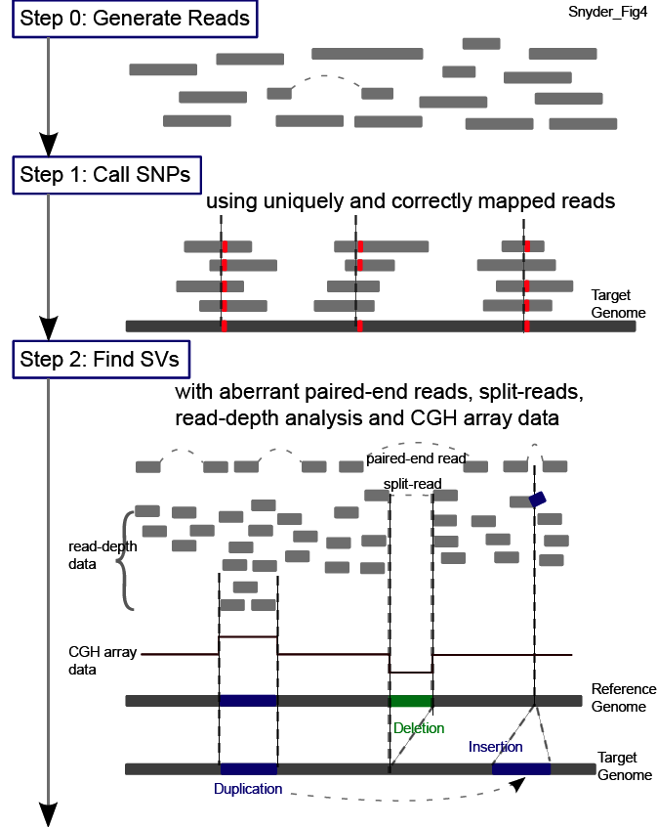
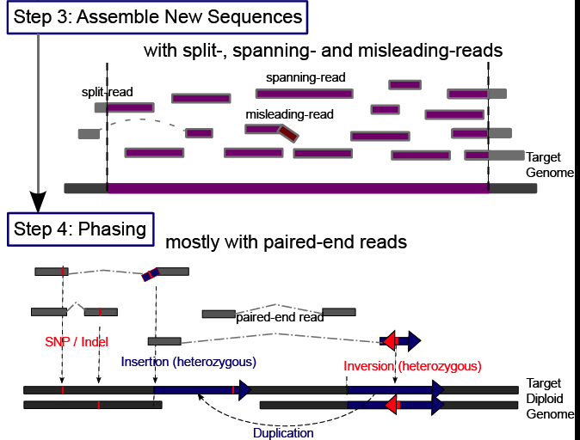
Main Steps in Genome Resequencing
[Snyder et al. Genes & Dev. ('10)]

Slide 5

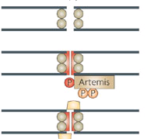
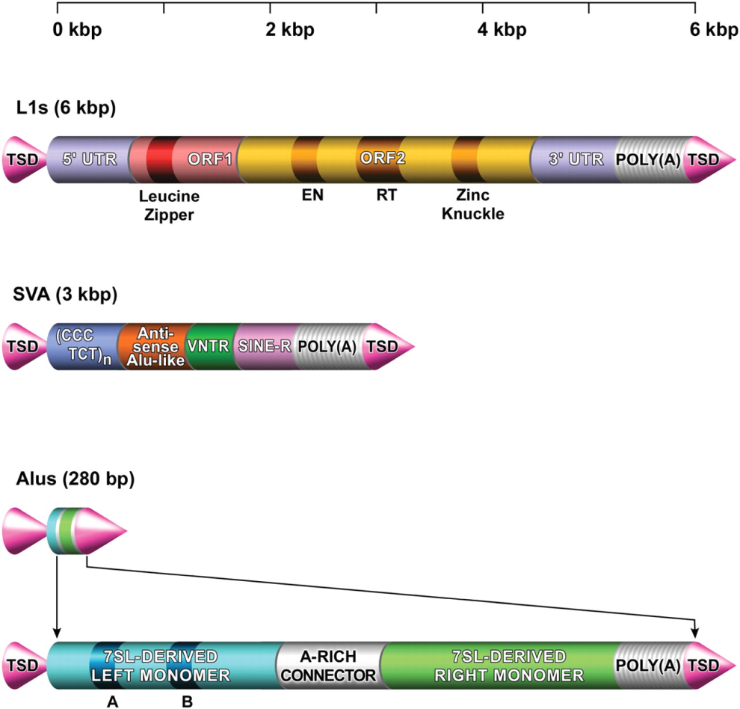
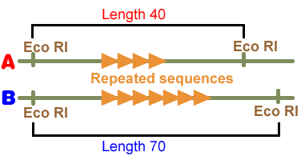
4 mechanisms for SV formation
NAHR
(Non-allelic homologous recombination)
Flanking repeat
(e.g. Alu, LINE…)
NHEJ (NHR)
(Non-homologous-end-joining)
No (flanking) repeats.
In some cases <4bp microhomologies
TEI
(Transposable element insertion)
L1, SVA, Alus
VNTR
(Variable Number Tandem Repeats)
Number of repeats varies between different people
Notes:
So how did they arise? There are couple proposed mechanisms.
NAHR is one of the major mechanisms which involves non-allelic homologous recombination between highly identical sequences.

Slide 6
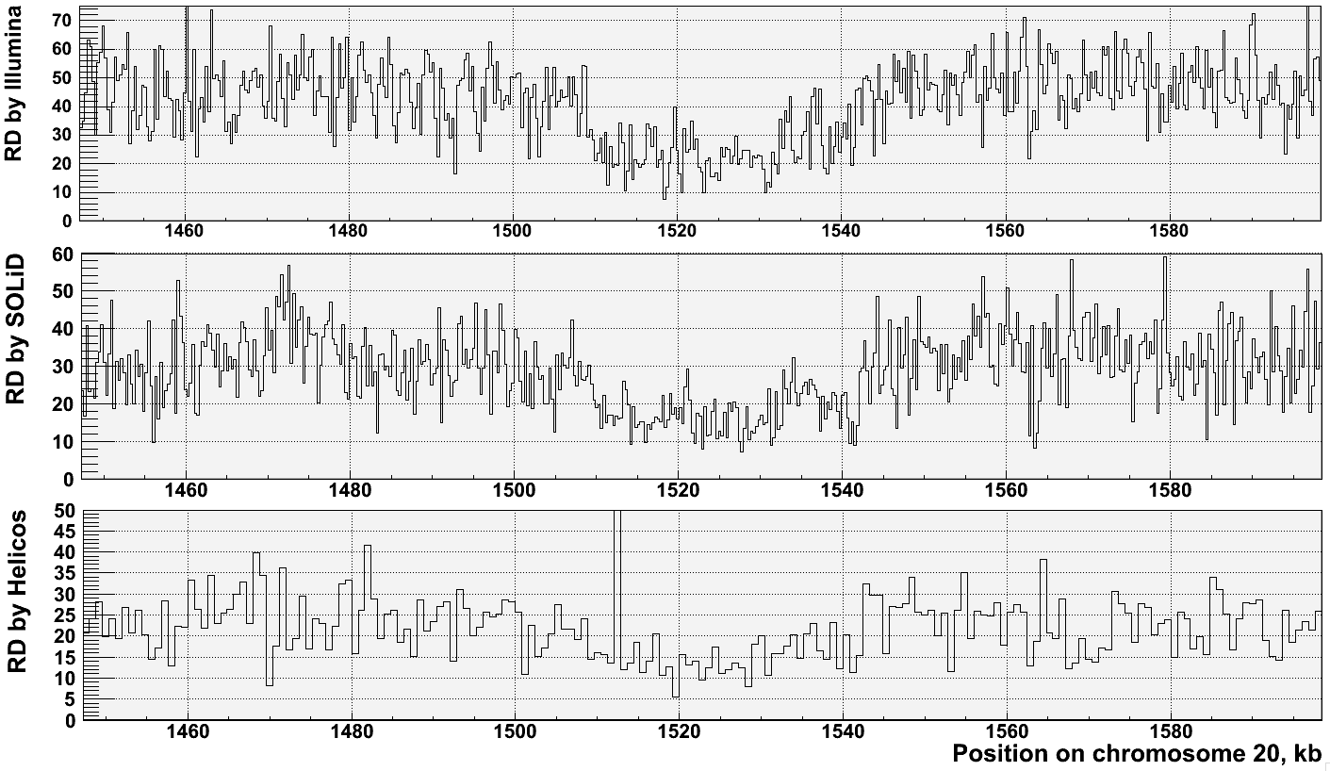
Read-depth works well on a variety of sequencing platforms but provides imprecise breakpoints
[Abyzov et al. Gen. Res. (’11)]
[NA18505]

Slide 7

1000G SV
(Pilot, Phase I & III)
Many different callers compared & used
  including SRiC & CNVnator but also VariationHunter, Cortex, NovelSeq, PEMer, BreakDancer, Mosaik, Pindel, GenomeSTRiP, mrFast….
Merging
Genotyping (GenomeSTRiP)
Breakpoint assembly (AGE & Tigra_SV)
Mechanism Classification
[1000 Genomes Consortium, Nature (2010, 2012); Mills et al., Nature (2011)]

Slide 8
8,943 Deletion Breakpoints
(Phase I Refined)
42K deletions in official Phase 1 release
  ~20% w/ breakpt
Breakpoint FDR from IRS, PCR, and high-coverage trios
  ~7% for site existence
  13% for site existence + sequence precision
Data for 1,092 samples
Multiple CNV callers
Call merging
Breakpoint assembly
Mapping to junctions

Slide 9
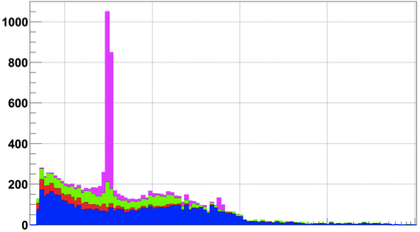
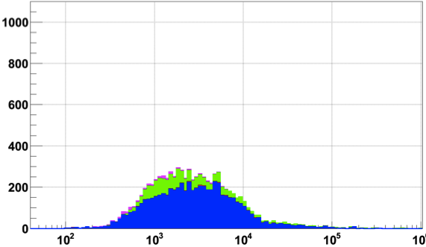
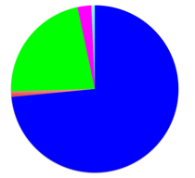
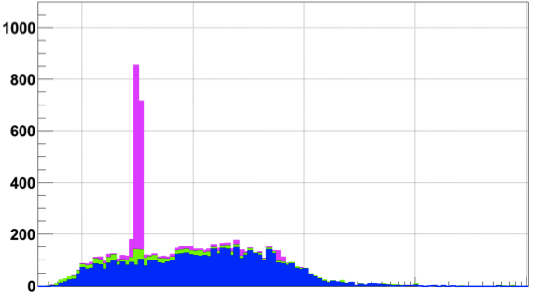
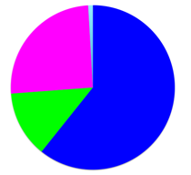
Breakpoint characterization in 1000G
Breakseq #1 w/ ~2000 breakpoints [Lam et al. Nat. Biotech. (‘10)]
Pilot
Phase 1 “Integrated” &
Phase 1 refined
Phase 3
Pilot set
Integrated set
TEI
NAHR
NH
VNTR
2,839
(2,644)
6,104
(6,299)
23,850
(23,655)
Phase 1
Count of deletions
Refined
Phase 1
Phase 3
Exact match
Number in parentheses: >50% reciprocal match
[Abyzov et al. (‘15) Nature Comm.]
Notes:
2839 unique Phase 1 events were b/c Phase 3 did assembly of only large events

Slide 10
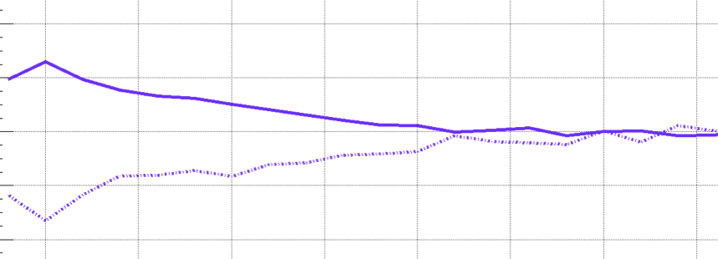
Higher SNP Density and Relaxed Selection at NH Breakpoints
+4%
NH
SNP density
-4%
Conservation score
0
700 Kbps
[Abyzov et al. (‘15) Nature Comm.]
Notes:
SNP density at NAHR bkpts is driven by excessive C>T
A consequence of high CpG%

Slide 11
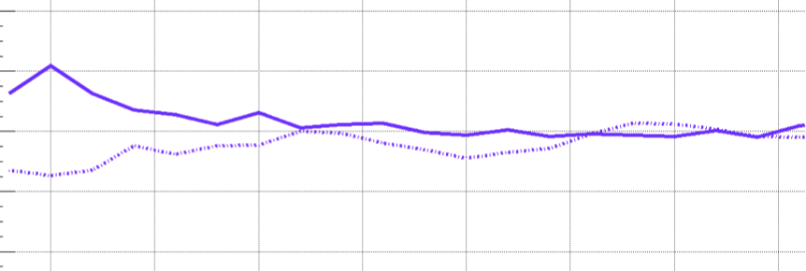
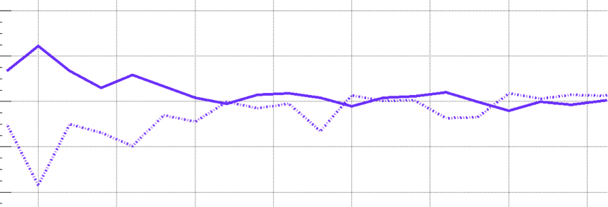
Higher SNP Density and Relaxed Selection at all Breakpoints
+4%
NH
SNP density
-4%
Conservation score
+4%
TEI
-4%
+4%
NAHR
-4%
0
700 Kbps
[Abyzov et al. (‘15) Nature Comm.]
Notes:
SNP density at NAHR bkpts is driven by excessive C>T
A consequence of high CpG%

Slide 12
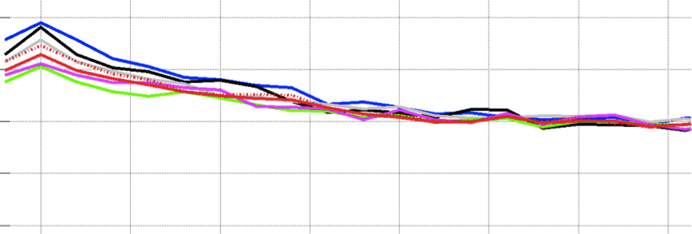
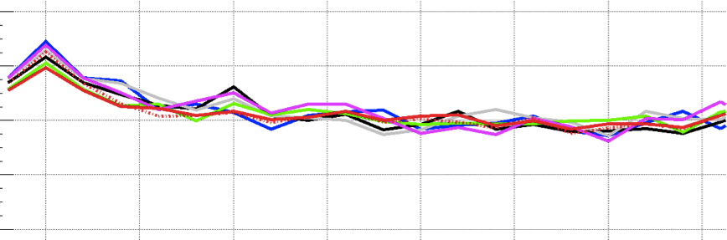
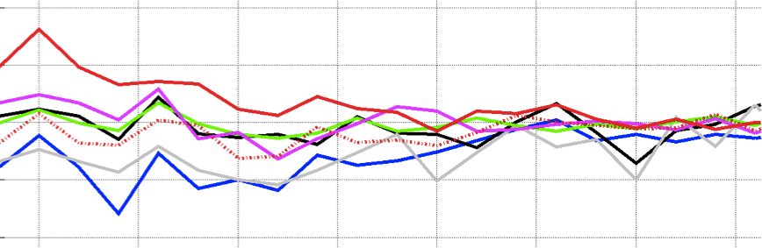
SNP Density at NAHR is Driven by High C>T
C>A C>G C>T
T>A T>C T>G
C>T outside CpG
+4%
NH
SNP density
-4%
Conservation score
+4%
TEI
-4%
+4%
NAHR
-4%
0
700 Kbps
[Abyzov et al. (‘15) Nature Comm.]
Notes:
SNP density at NAHR bkpts is driven by excessive C>T
A consequence of high CpG%

Slide 13
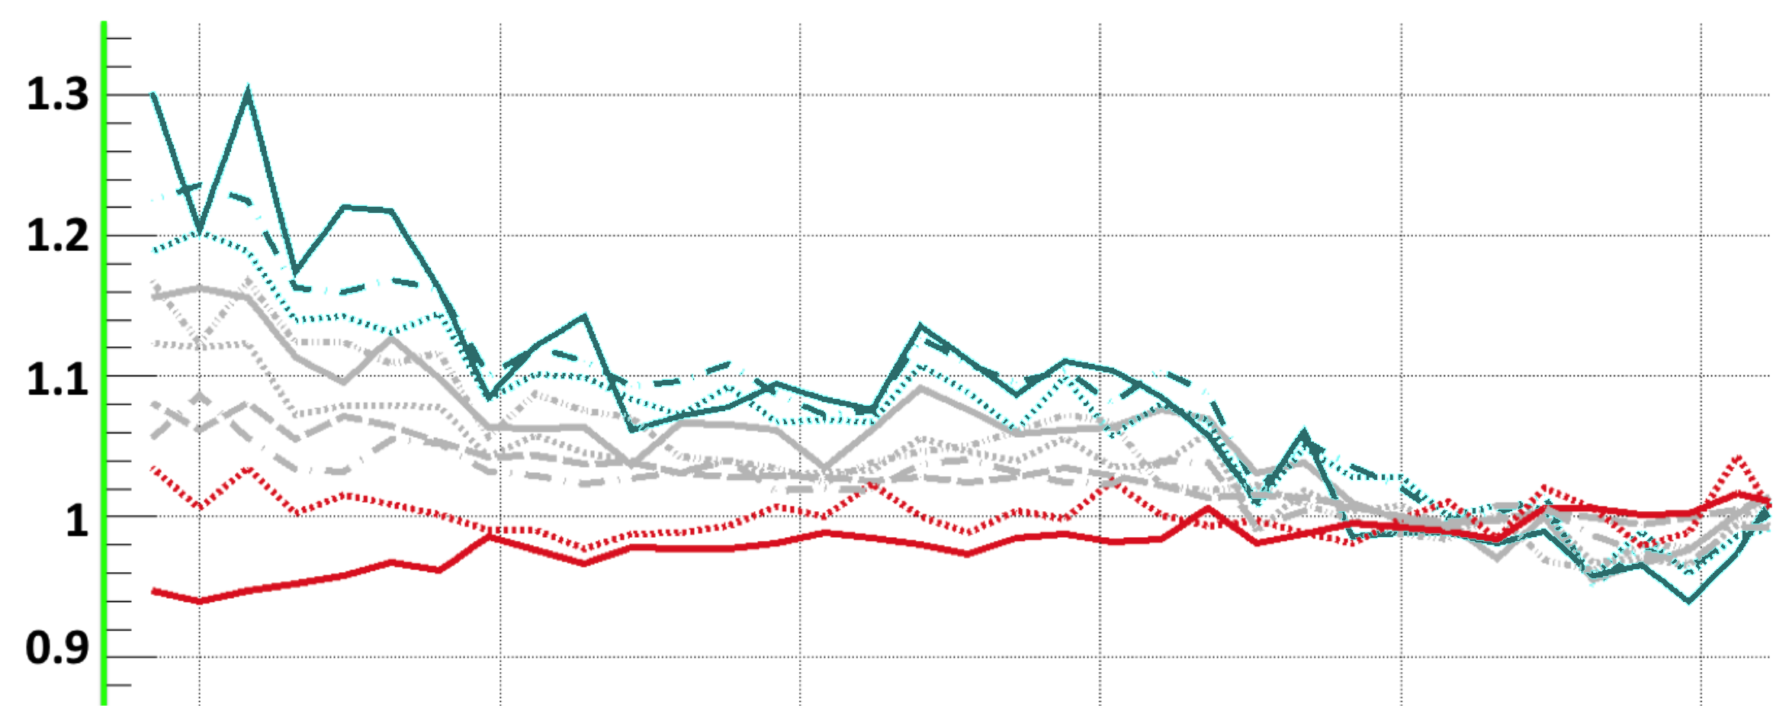

NAHR breakpoint are associated with open chromatin
TEI
NAHR
NH
Supported by Hi-C and
Histone modification
Hypothesis: Some NAHR
deletions occur w/o cell
Replication
* H1 & GM12878 cells
Closed
Open
0 ±0.5 ±1 ±1.5 ±2 ±2.5
Distance from breakpoints, Mbps
[Abyzov et al. (‘15) Nature Comm.]

Slide 14
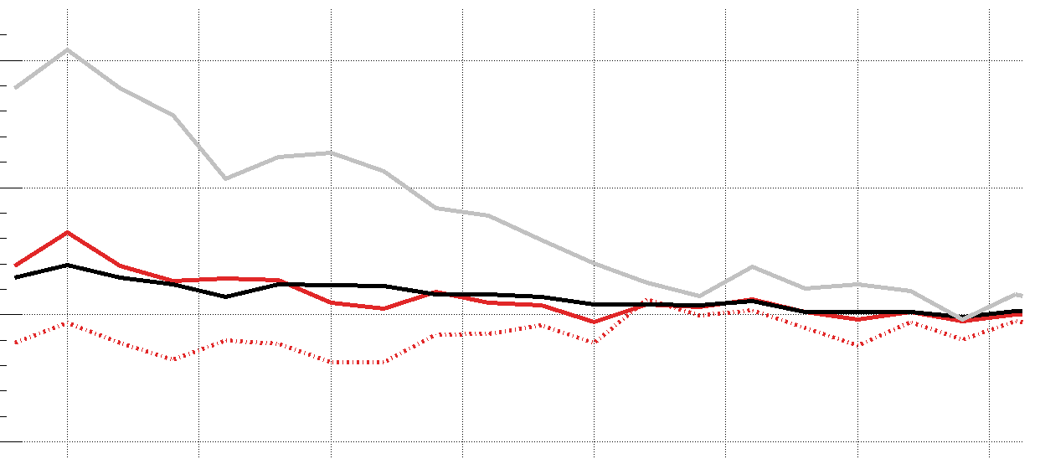
Methylation pattern associated with breakpoints mechanisms
Lower C>T in CpG around NAHR breakpoints
  indicates lower methylation level in germline & embryonic cells
Confirmed in male gamete
+10%
6
1
TEI
NAHR
NH
CpG%
NAHR
C>T(all)
Hypomethylated regions in sperm
GC%
C>T(CpG)
-5%
0
700 Kbps
-10 0 10
Distance from breakpoints, Kbps
[Abyzov et al. (‘15) Nature Comm.]

Slide 15
Micro-homologies
Identified around NH Breakpoints
Breakpoints have
Micro-homologous sequences
with the template sites.
[Abyzov et al. (‘15) Nature Comm.]

Slide 16
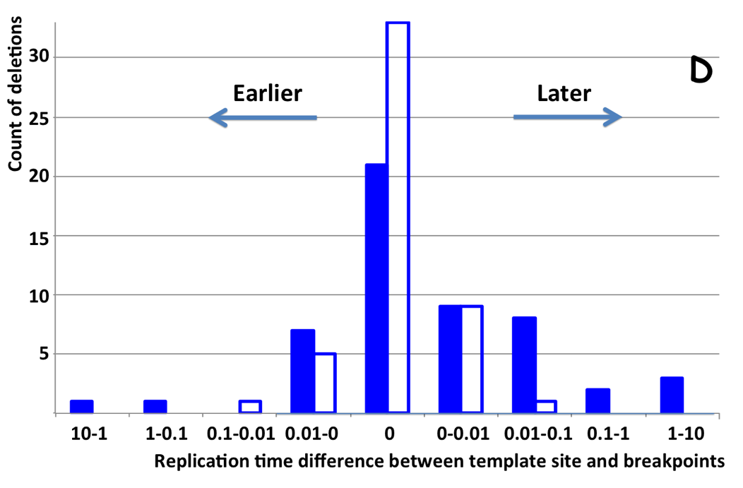
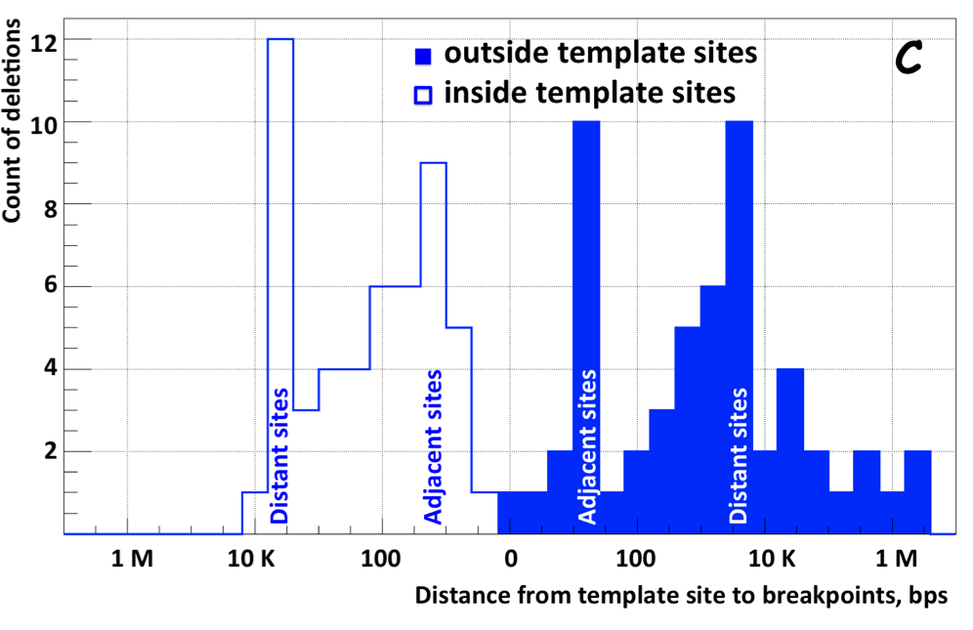
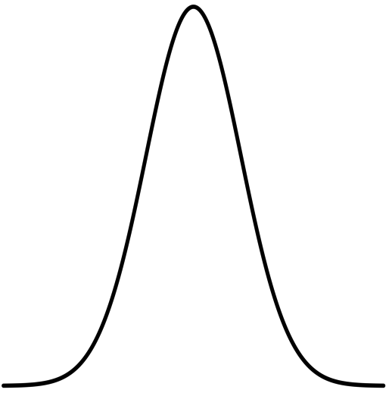
NH deletions are often coupled with micro-insertions
Templates located at 2 characteristic distances from breakpoints, which tend to replicate late
Suggests spatial & temporal configuration of DNA during template switching
[Abyzov et al. (‘15) Nature Comm.]

Slide 17
Human Genome Analysis – SVs & Pseudogenes, Tricky but Crucial Genomic Features, Targeted by Long-read Sequencing: Current Short-read Results & Future Prospects
SV Breakpoints
  ~9K deletions with breakpoints & mechanism classification from 1000G
  Small subset of tot. deletions, which could be greatly expanded by long reads
  More nearby SNPs than genomic average.
  From methylation, Hi-C , & his mods, NAHR breakpoints associated with open chromatin (perhaps occurring w/o replication & division)
  NHR breakpoints associated w/ sequence microinsertions, templated from later replicating sites, spaced at 2 characteristic distances
Pseudogenes
  Fundamentally repetitive elements
  Collaborative assignment in results in ~14K
  Impact of lineage-specific retro-transpositional burst – ie human v other metazoans is dominated (~80%) by retro-duplication ~40 MYA (Ribo. Proteins).
Intersection of Pseudogenes & SVs
  Enrichment of SVs in pseudogenes v genes, particularly for NAHR
Novel Processed Pseudogenes as a Form of SV
  Not in reference but in human population – could be improved by long reads
  Now found w/ splice junction mapping + clustering of unmapped PEs
  ~8 per person, often pop. specific
  Associated w/ G1/M expressed genes
Many Pseudogenes with Low Levels of Biochemical Activity
  Conservative assignment, mis-map issue, could be improved by long reads
  ~15% transcribed &
  80% w/ some activity

Slide 18
Pseudogenes are among the most interesting intergenic elements
Formal Properties of Pseudogenes (ΨG)
  Inheritable
  Homologous to a functioning element – ergo a repeat!
  Non-functional
    No selection pressure so free to accumulate mutations
      Frameshifts & stops
      Small Indels
      Inserted repeats (LINE/Alu)
    What does this mean? no transcription, no translation?…
[Mighell et al. FEBS Letts, 2000]

Slide 19
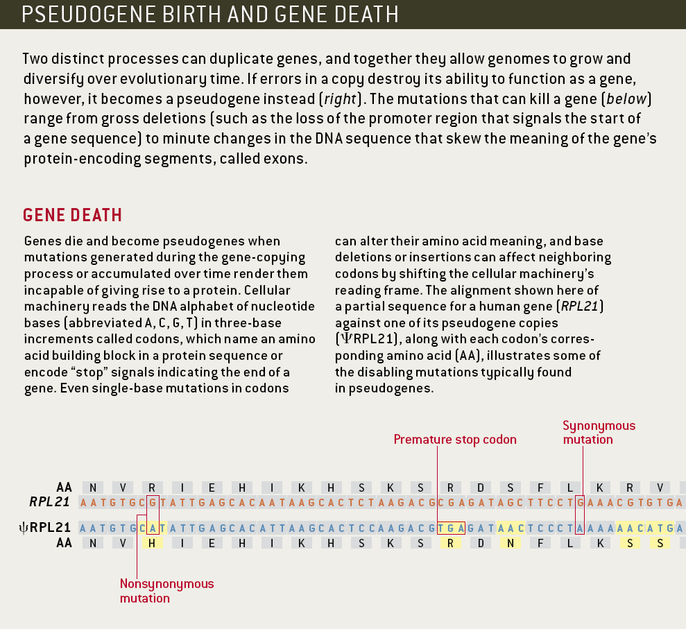
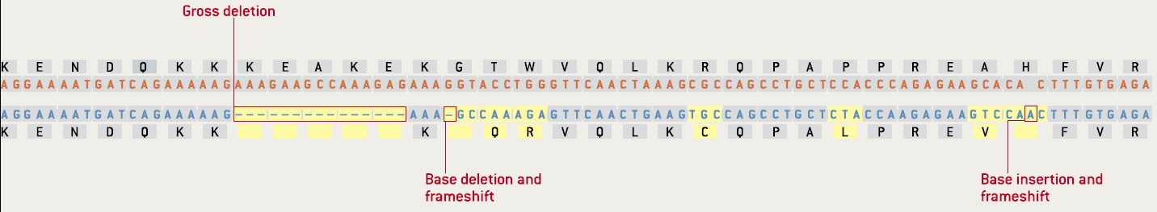
Identifiable Features of a Pseudogene (ψRPL21)
[Gerstein & Zheng. Sci Am 295: 48 (2006).]

Slide 20
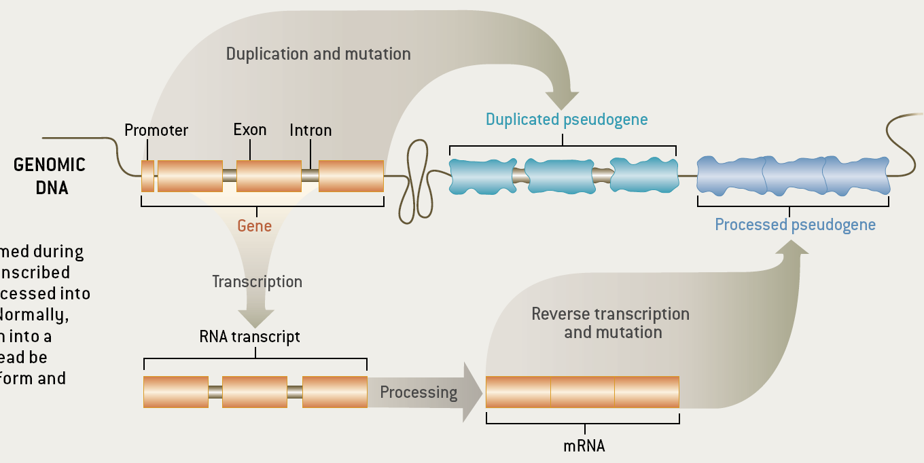
Two Major Genomic Remodeling Processes Give Rise to Distinct Types of Pseudogenes
[Gerstein & Zheng. Sci Am 295: 48 (2006).]

Slide 21
Genome-wide Annotation of Pseudogenes
Pseudogene Information Pool
PseudoPipe
16,653
14,520
14,206
PseudoPipe
RetroFinder
HAVANA
Protein
Sequence
Reference
Genome
2-way consensus
Six-frame blast
9,772
Feedback Loop
Eliminate redundant hits
Remove hits overlapping exon
````````
1000G
ENCODE
Δ2-way
Level 1
Level 2&3
Merge hits and identify parents
913
8,859
5,347
FASTA re-alignment
Polymorphic
Pseudogenes
45
````````
14,161
8,814 level 1
5,347 level 2&3
Processed
Pseudogenes
Duplicated
Pseudogenes
Pseudogene Decoration
Resource
12,358
[Pei et al., GenomeBiology (2012, 13:R51)]

Slide 22
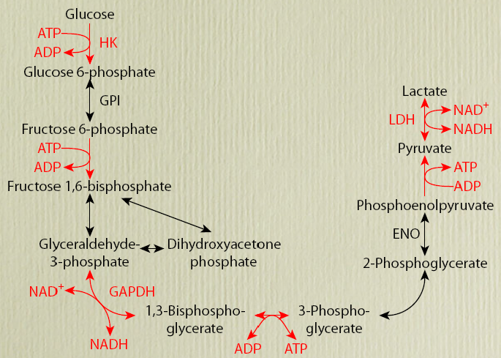
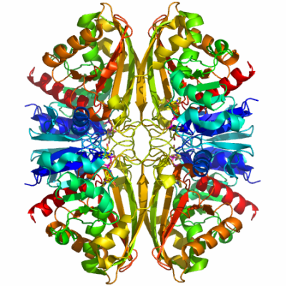
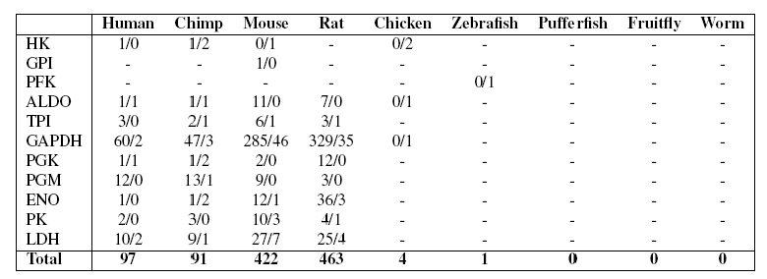
EX: Number of pseudogenes for each glycolytic enzyme
[Liu et al. BMC Genomics ('09)]
Large numbers of processed GAPDH pseudogenes in mammals comprise one of the biggest families but numbers not obviously correlated with mRNA abundance.
GAPDH
Processed/Duplicated
GAPDH

Slide 23
EX: Number of pseudogenes for each glycolytic enzyme
[Liu et al. BMC Genomics ('09)]
Large numbers of processed GAPDH pseudogenes in mammals comprise one of the biggest families but numbers not obviously correlated with mRNA abundance.
GAPDH
Processed/Duplicated
GAPDH
60 Proc/2 Dup

Slide 24
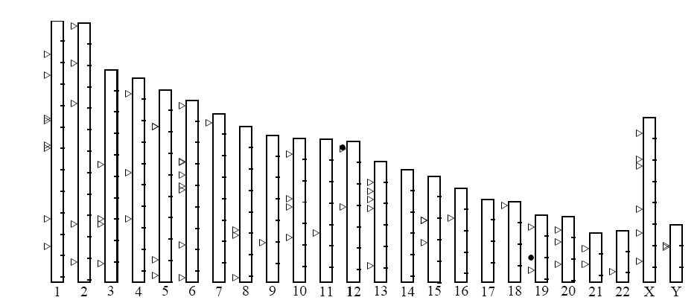
Distribution of human GAPDH pseudogenes
Large numbers of processed GAPDH pseudogenes in mammals comprise one of the biggest families but numbers not obviously correlated with mRNA abundance.
60 Proc/2 Dup
[Liu et al. BMC Genomics ('09, in press)]
Notes:
24

Slide 25
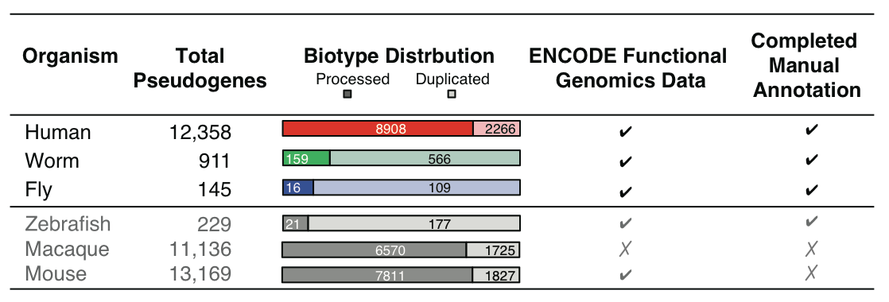
Annotation of Human Pseudogenes in Comparison to those in other Model Organisms
[Sisu et al. PNAS ('14); doi: 10.1073/pnas.1407293111 ]

Slide 26
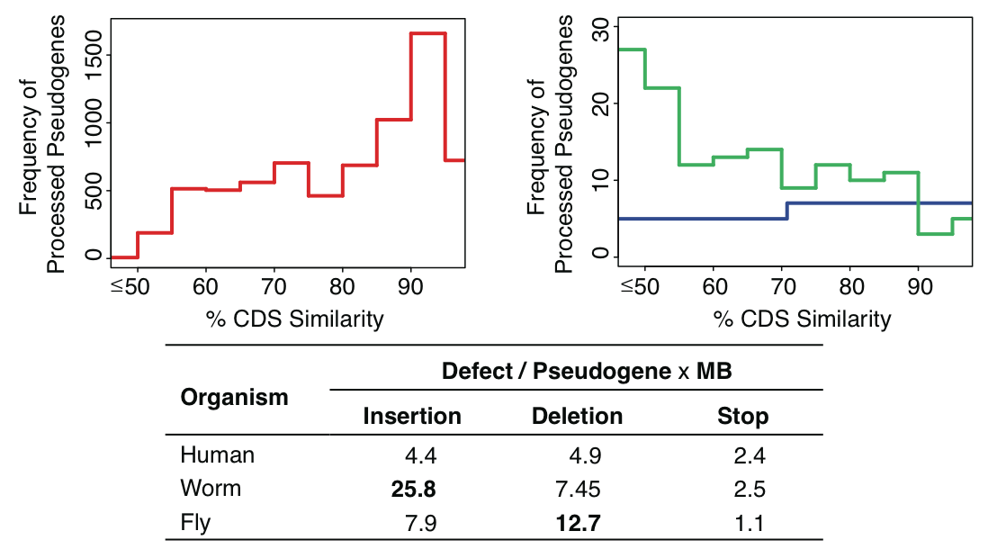
Evolution
Human
Worm
Fly
[Sisu et al. PNAS ('14); doi: 10.1073/pnas.1407293111 ]

Slide 27
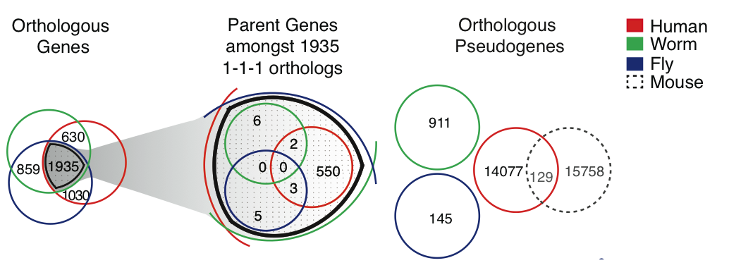
Great divergence in pseudogenes in terms of Orthologs & Paralogs
[Sisu et al. PNAS ('14); doi: 10.1073/pnas.1407293111 ]

Slide 28
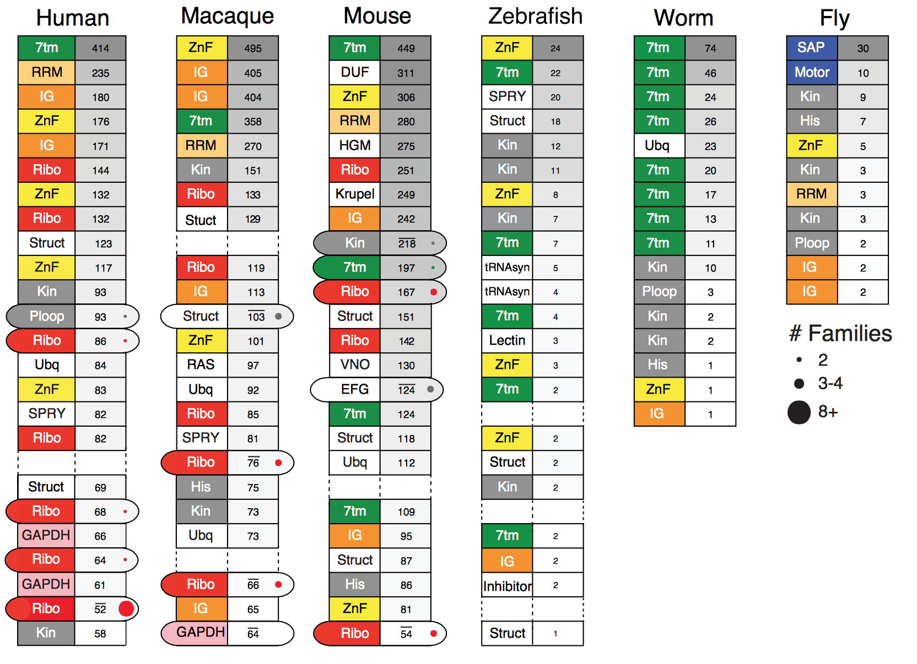
Divergence but
More interpretable Patterns in terms of Families
[Sisu et al. PNAS ('14); doi: 10.1073/pnas.1407293111 ]

Slide 29
Human Genome Analysis – SVs & Pseudogenes, Tricky but Crucial Genomic Features, Targeted by Long-read Sequencing: Current Short-read Results & Future Prospects
SV Breakpoints
  ~9K deletions with breakpoints & mechanism classification from 1000G
  Small subset of tot. deletions, which could be greatly expanded by long reads
  More nearby SNPs than genomic average.
  From methylation, Hi-C , & his mods, NAHR breakpoints associated with open chromatin (perhaps occurring w/o replication & division)
  NHR breakpoints associated w/ sequence microinsertions, templated from later replicating sites, spaced at 2 characteristic distances
Pseudogenes
  Fundamentally repetitive elements
  Collaborative assignment in results in ~14K
  Impact of lineage-specific retro-transpositional burst – ie human v other metazoans is dominated (~80%) by retro-duplication ~40 MYA (Ribo. Proteins).
Intersection of Pseudogenes & SVs
  Enrichment of SVs in pseudogenes v genes, particularly for NAHR
Novel Processed Pseudogenes as a Form of SV
  Not in reference but in human population – could be improved by long reads
  Now found w/ splice junction mapping + clustering of unmapped PEs
  ~8 per person, often pop. specific
  Associated w/ G1/M expressed genes
Many Pseudogenes with Low Levels of Biochemical Activity
  Conservative assignment, mis-map issue, could be improved by long reads
  ~15% transcribed &
  80% w/ some activity

Slide 30



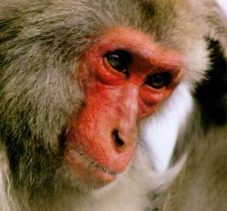
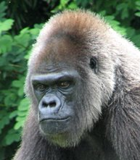
Fixed Genomic Variation
Alu
Gene
Non-allelic homologous recombination (NAHR)
Ancestral State
Alu
Gene
Alu
Gene
The Genome Remodeling Process
Segmental Duplication (SD)
Gene
Dup. Gene
Syntenic Ortholog
SD
Insertion
Insertion
Gene
Dup. Gene
VNTR
Pssd. ψgene
Paralog
duplicate
Deletion
Insertion
Gene
Dup. Gene
Dup. Gene
VNTR
L1
family
Retro-elements
Deletion
Inversion
Gene
Dup. ψgene
VNTR
Pssd. ψgene
Retro-transpose

Slide 31


Polymorphic Genomic Variation
Alu
Gene
Non-allelic homologous recombination (NAHR)
Ancestral State
Alu
Gene
Alu
Gene
The Genome Remodeling Process
Segmental Duplication (SD)
Gene
Dup. Gene
Syntenic Ortholog
CNV (type of SV)
Insertion
Insertion
Gene
Dup. Gene
VNTR
Pssd. ψgene
duplicate
Deletion
Insertion
Gene
Dup. Gene
Dup. Gene
VNTR
L1
Retro-elements
Deletion
Inversion
Gene
Dup. ψgene
VNTR
Pssd. ψgene
Retro-transpose
"Polymorphic" Genes & Pseudogenes

Slide 32
In comparison to other genomic elements, pseudogenes tend to overlap SVs
Structural variants are generally depleted for functional elements
[Khurana et al., Science (‘13)]

Slide 33
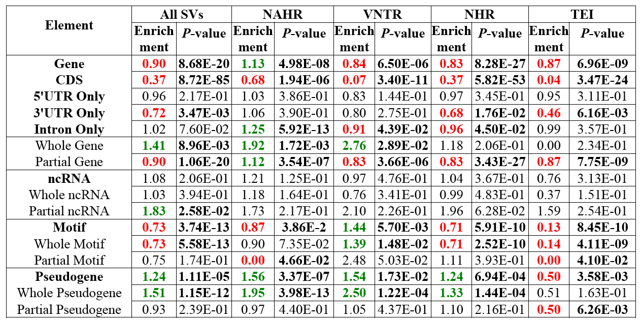
More detail on pseudogene overlap with SVs (enrichment wrt randomized control)
Duplicated Pseudogene | 1.14 | 9.94E-02
Processed Pseudogene | 1.46 | 1.14E-08
SVs are shuffled in the whole genome.
Significant P-values (<0.05) in black and bold
Significant enrichments in green
Significant depletions in red
[Mu et al., NAR (2011)]

Slide 34
Pseudogenes & CNVs
CNVs are the raw form of variation producing duplicated elements (SDs)
  SDs give rise to duplicated genes protein families
  SDs comprise ~5% of the human genome but contain ~18% genes, 46% duplicated and 22% processed pseudogenes
CNVs & SDs tend to be enriched in environmental response genes, matching patterns found for duplicated pseudogenes
Duplicated pseudogenes are associated in general with older SDs
[Lam et al., NAR DB Issue ('09)]
Duplicated pseudogenes
[Korbel et al., COSB ('08)]
[Kim et al. Gen. Res. ('08)]
Processed pseudogenes
Matching processed pseudogenes (sharing the parent gene) are enriched at SD junctions
Processed pseudogenes can serve
as repeats for mediating NAHR
Duplicated Segments
Matching pseudogenes
[Kim et al. Gen. Res. ('08)]

Slide 35
Human Genome Analysis – SVs & Pseudogenes, Tricky but Crucial Genomic Features, Targeted by Long-read Sequencing: Current Short-read Results & Future Prospects
SV Breakpoints
  ~9K deletions with breakpoints & mechanism classification from 1000G
  Small subset of tot. deletions, which could be greatly expanded by long reads
  More nearby SNPs than genomic average.
  From methylation, Hi-C , & his mods, NAHR breakpoints associated with open chromatin (perhaps occurring w/o replication & division)
  NHR breakpoints associated w/ sequence microinsertions, templated from later replicating sites, spaced at 2 characteristic distances
Pseudogenes
  Fundamentally repetitive elements
  Collaborative assignment in results in ~14K
  Impact of lineage-specific retro-transpositional burst – ie human v other metazoans is dominated (~80%) by retro-duplication ~40 MYA (Ribo. Proteins).
Intersection of Pseudogenes & SVs
  Enrichment of SVs in pseudogenes v genes, particularly for NAHR
Novel Processed Pseudogenes as a Form of SV
  Not in reference but in human population – could be improved by long reads
  Now found w/ splice junction mapping + clustering of unmapped PEs
  ~8 per person, often pop. specific
  Associated w/ G1/M expressed genes
Many Pseudogenes with Low Levels of Biochemical Activity
  Conservative assignment, mis-map issue, could be improved by long reads
  ~15% transcribed &
  80% w/ some activity

Slide 36
Retroduplication variation (RDV)
Retroduplications
(pot. retro-pseudogenes or retro-genes)
mRNA
Gene
Reference
…
Person 1
…
Person 2
…
Known retroduplication
Person 3
…
. . .
Reference
…
Person 1
…
Person 2
…
Novel retroduplication
Person 3
…
. . .
mRNA
[Abyzov et al. Gen. Res. ('13) ]

Slide 37
Gene
Novel retroduplication
Read pairs
1 2 3 4
…
…
Reference
Alignment to
the reference
…
3
1
Evidence
from alignment
Unaligned reads
Aligned
reads
Splice-junction library
…
2
4
Evidence
from cluster
1
[Abyzov et al. Gen. Res. ('13) ]
…
3
2 3 4
Evidence from
read depth
1
Pipeline to identify novel retro-dups. from 3 evidence sources
Zero level
Notes:
Split-read and paired-end approaches

Slide 38
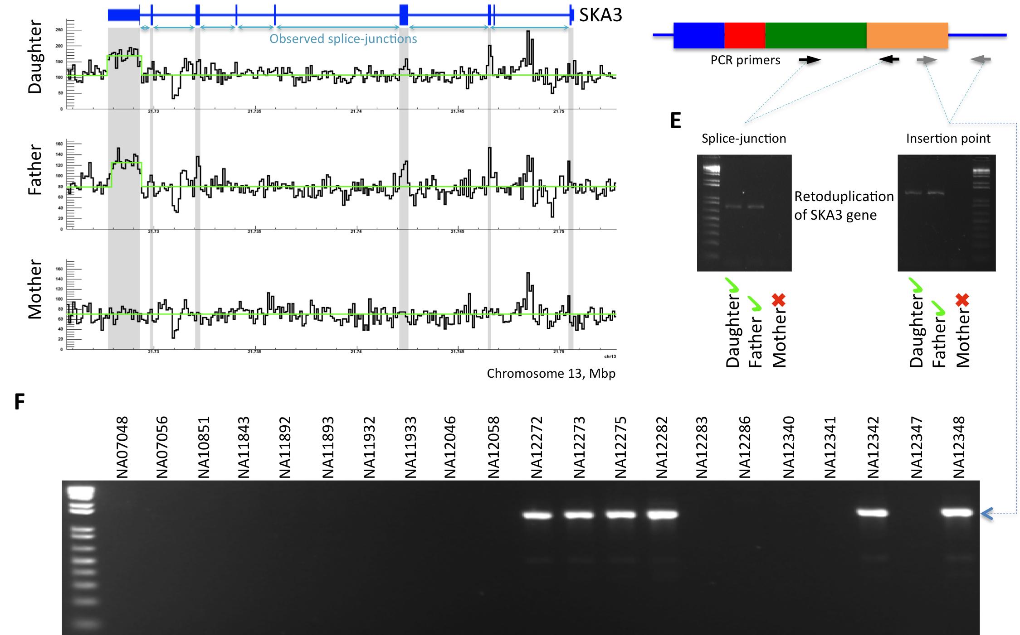
A typical individual (NA12878) with
10 validated retrodups
(by RD & PCR)
Parent gene with predicted novel retroduplication | Additional support |  |  | PCR validation
 | Read depth support | Insertion point support | Found in Venter genome
CDC27 | Yes |  | Yes | UN
BCLAF1 | Yes |  | Yes | UN
LAPTM4B | Yes | Yes |  | Yes
MTCH2 |  |  |  | Yes
CBX3 | Yes | Yes | Yes | Yes
TMEM66 | Yes | Yes |  | Yes
TDG | Yes | Yes | Yes | Yes
BOD1 |  |  |  | Yes
CACNA1B |  | Yes |  | Yes
SKA3 | Yes | Yes |  | Yes
AP3S1 | Yes |  | Yes | Yes
AC131157 |  |  |  | N/A
AL590623 | Centromere
On avg. 6-10 novel Retrodups per person in 1000G dataset. Also, 147 total genes with retrodups
[Abyzov et al. Gen. Res. ('13) ]

Slide 39
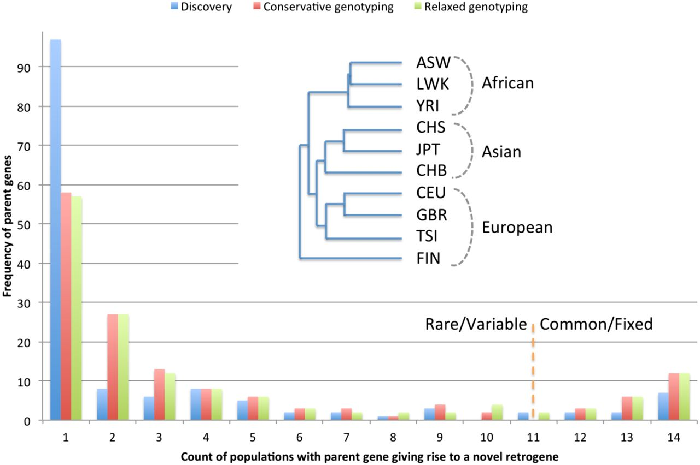
Frequency of novel retroduplications by populations.
Abyzov A et al. Genome Res. 2013;23:2042-2052
Notes:
Frequency of novel retroduplications by populations. Most of the novel retroduplications are discovered in only one population (due to conservative calling) but are present in a few more as evident from genotyping. The phylogenetic tree was constructed based on the overlap of novel retroduplications between different populations. The tree shows that, except in one case, populations separate perfectly by continental groups. Outlier clustering of the Finnish population (FIN) is likely due to its distinct data properties allowing discovery of more unique retroduplications (see text). Admixed populations and the Iberian population (with just a few sequenced individuals) were excluded from phylogenetic analysis.

Slide 40
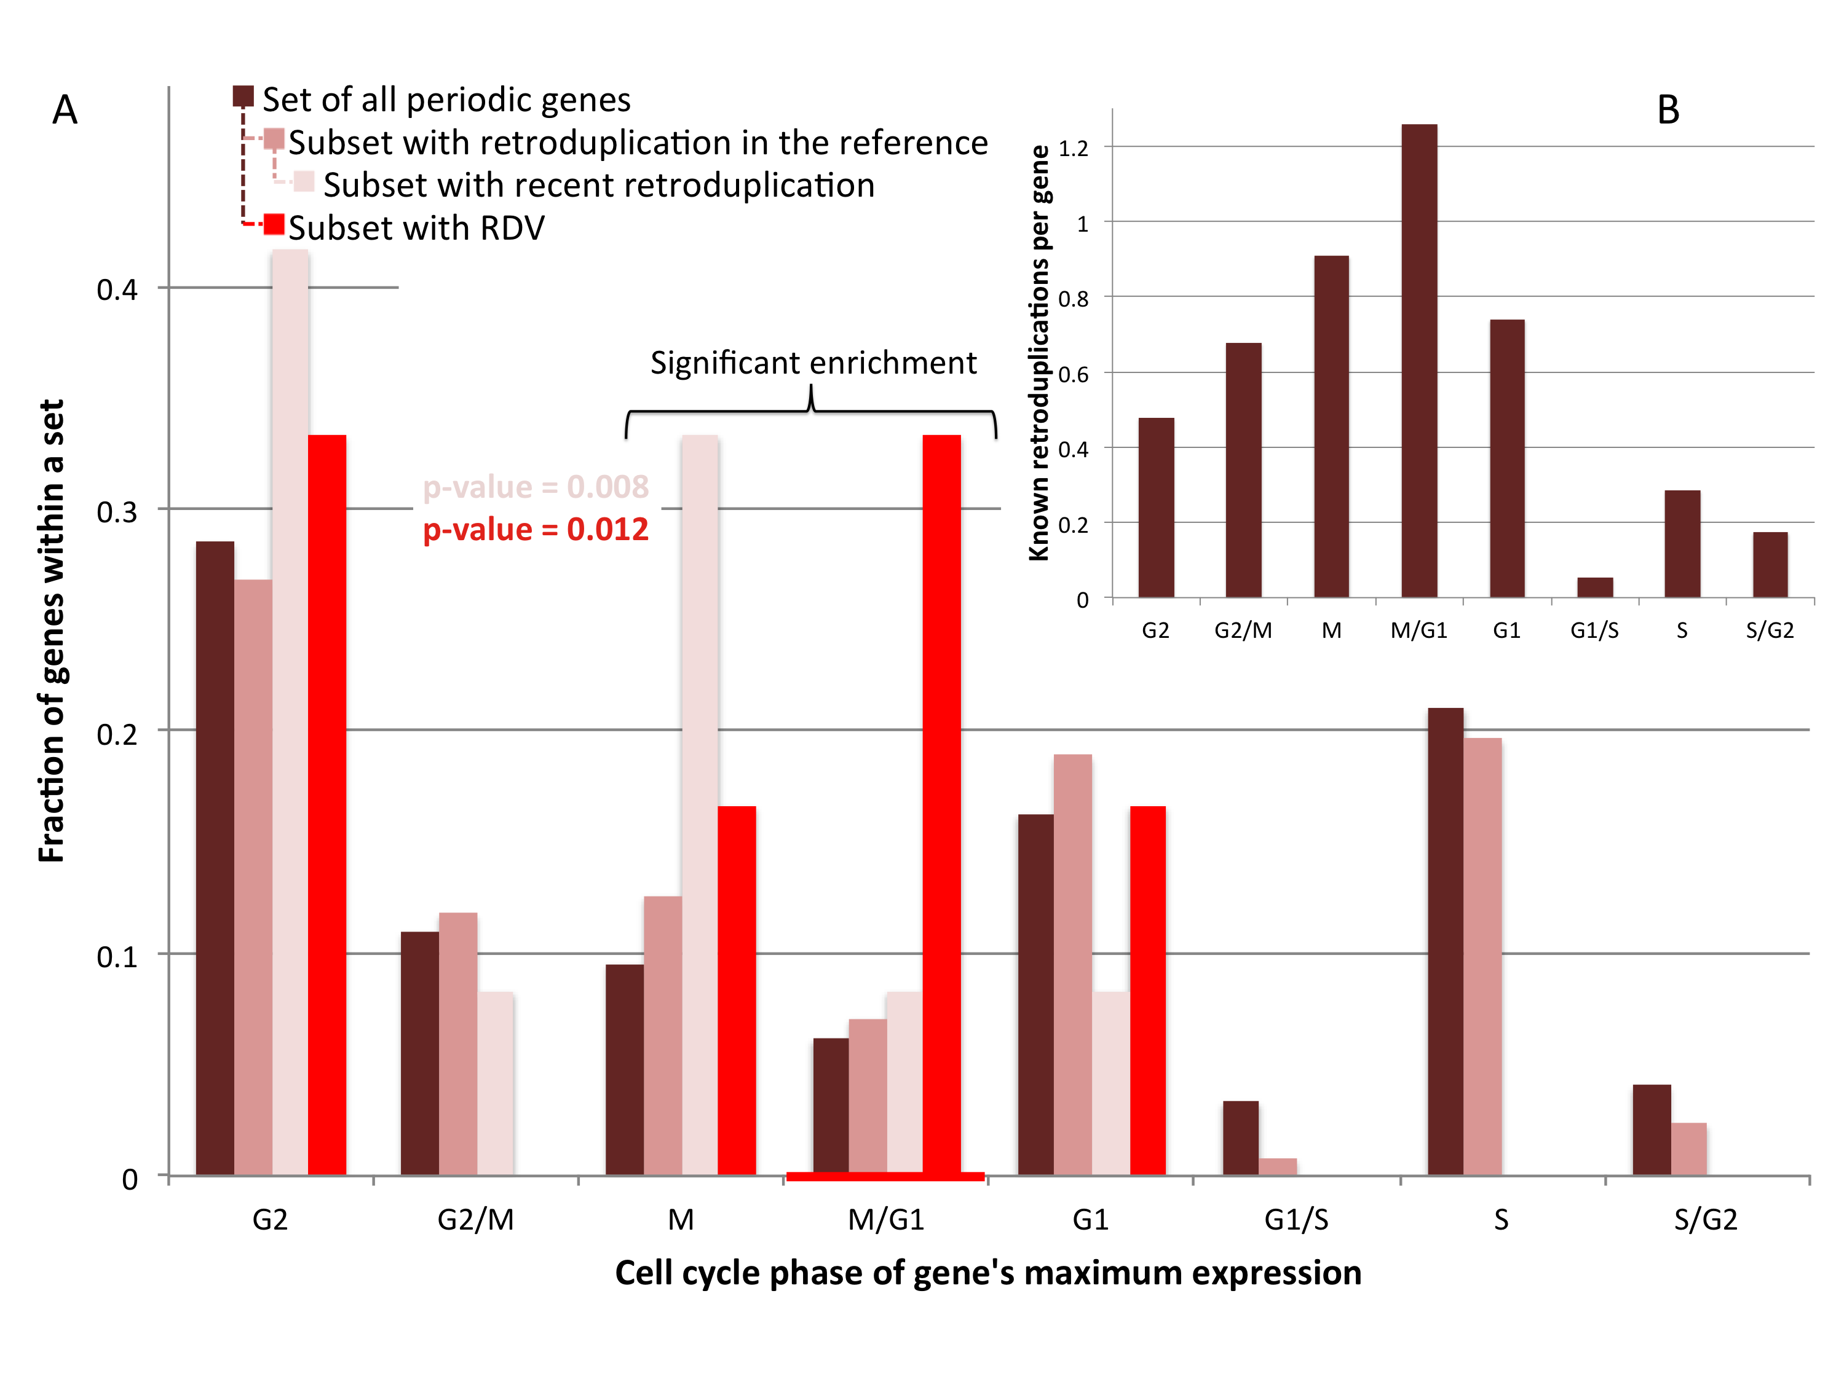
Hypothesis: retrotransposition is coupled to cell division (in germline)
[Abyzov et al. Gen. Res. ('13) ]

Slide 41
Human Genome Analysis – SVs & Pseudogenes, Tricky but Crucial Genomic Features, Targeted by Long-read Sequencing: Current Short-read Results & Future Prospects
SV Breakpoints
  ~9K deletions with breakpoints & mechanism classification from 1000G
  Small subset of tot. deletions, which could be greatly expanded by long reads
  More nearby SNPs than genomic average.
  From methylation, Hi-C , & his mods, NAHR breakpoints associated with open chromatin (perhaps occurring w/o replication & division)
  NHR breakpoints associated w/ sequence microinsertions, templated from later replicating sites, spaced at 2 characteristic distances
Pseudogenes
  Fundamentally repetitive elements
  Collaborative assignment in results in ~14K
  Impact of lineage-specific retro-transpositional burst – ie human v other metazoans is dominated (~80%) by retro-duplication ~40 MYA (Ribo. Proteins).
Intersection of Pseudogenes & SVs
  Enrichment of SVs in pseudogenes v genes, particularly for NAHR
Novel Processed Pseudogenes as a Form of SV
  Not in reference but in human population – could be improved by long reads
  Now found w/ splice junction mapping + clustering of unmapped PEs
  ~8 per person, often pop. specific
  Associated w/ G1/M expressed genes
Many Pseudogenes with Low Levels of Biochemical Activity
  Conservative assignment, mis-map issue, could be improved by long reads
  ~15% transcribed &
  80% w/ some activity

Slide 42
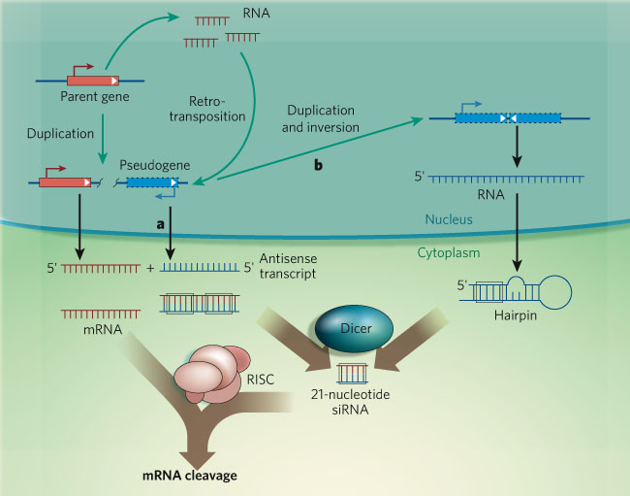
Examples & speculation on the function of pseudogene ncRNAs:
Regulating their parents
via acting as endo-siRNAs
[ex. in fly & mouse, ‘08 refs.]
via acting as miRNA decoys
[PTEN]
via inhibiting degradation of parent’s mRNA [makorin]
Functional candidates:
  SLIT-ROBO Rho GTPase activating protein 2B pseudogene
  PRKY-004, Y-linked protein kinase pseudogene
  Fer-1-like 4 (C. elegans), pseudogene
[Sasidharan & Gerstein, Nature ('08)]
Alternatively, just last gasps of a dying gene
Czech et al. Nature 453: 798 (‘08).
Ghildiyal et al. Science 320: 1077 (‘08).
Kawamur et al. Nature 453: 793 (‘08).
Okamura et al. Nature 453: 803 (‘08).
Tam et al. Nature 453: 534 (‘08).
Watanabe et al. Nature 453: 539 (‘08).
Poliseno et al. Nature 465:1033 (’10).

Slide 43
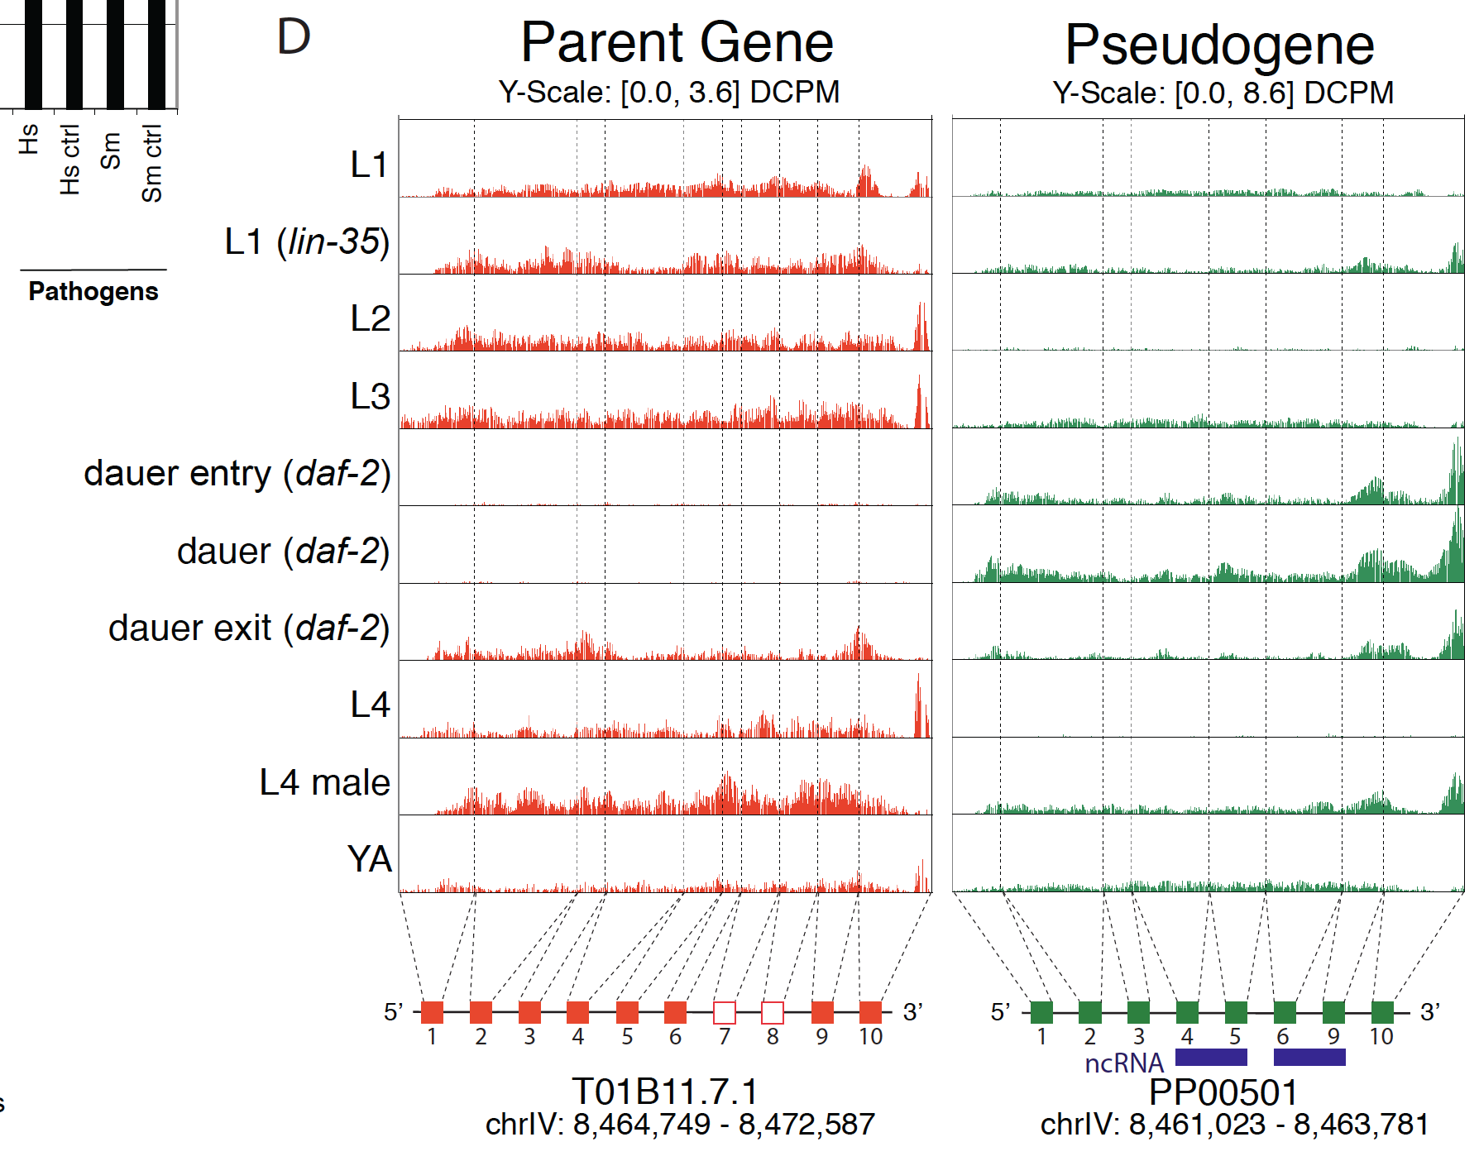
Pseudogene Transcription: interesting but tricky to ascertain
Difficulty in ascertainment because of mis-mapping v parent
One approach to this confound is look across mult. samples
[Science 330:6012]

Slide 44
Pseudogene Activity
H Highly-Active
P Partially-Active
D Dead
Yes
No
Human
Worm
Fly
[Sisu et al. PNAS ('14); doi: 10.1073/pnas.1407293111 ]
2381
1%
78%
21%
15% of pseudogenes are transcribed in each organism
4%
66%
30%
5%
63%
32%

Slide 45
Human Genome Analysis – SVs & Pseudogenes, Tricky but Crucial Genomic Features, Targeted by Long-read Sequencing: Current Short-read Results & Future Prospects
SV Breakpoints
  ~9K deletions with breakpoints & mechanism classification from 1000G
  Small subset of tot. deletions, which could be greatly expanded by long reads
  More nearby SNPs than genomic average.
  From methylation, Hi-C , & his mods, NAHR breakpoints associated with open chromatin (perhaps occurring w/o replication & division)
  NHR breakpoints associated w/ sequence microinsertions, templated from later replicating sites, spaced at 2 characteristic distances
Pseudogenes
  Fundamentally repetitive elements
  Collaborative assignment in results in ~14K
  Impact of lineage-specific retro-transpositional burst – ie human v other metazoans is dominated (~80%) by retro-duplication ~40 MYA (Ribo. Proteins).
Intersection of Pseudogenes & SVs
  Enrichment of SVs in pseudogenes v genes, particularly for NAHR
Novel Processed Pseudogenes as a Form of SV
  Not in reference but in human population – could be improved by long reads
  Now found w/ splice junction mapping + clustering of unmapped PEs
  ~8 per person, often pop. specific
  Associated w/ G1/M expressed genes
Many Pseudogenes with Low Levels of Biochemical Activity
  Conservative assignment, mis-map issue, could be improved by long reads
  ~15% transcribed &
  80% w/ some activity

Slide 46
Human Genome Analysis – SVs & Pseudogenes, Tricky but Crucial Genomic Features, Targeted by Long-read Sequencing: Current Short-read Results & Future Prospects
SV Breakpoints
  ~9K deletions with breakpoints & mechanism classification from 1000G
  Small subset of tot. deletions, which could be greatly expanded by long reads
  More nearby SNPs than genomic average.
  From methylation, Hi-C , & his mods, NAHR breakpoints associated with open chromatin (perhaps occurring w/o replication & division)
  NHR breakpoints associated w/ sequence microinsertions, templated from later replicating sites, spaced at 2 characteristic distances
Pseudogenes
  Fundamentally repetitive elements
  Collaborative assignment in results in ~14K
  Impact of lineage-specific retro-transpositional burst – ie human v other metazoans is dominated (~80%) by retro-duplication ~40 MYA (Ribo. Proteins).
Intersection of Pseudogenes & SVs
  Enrichment of SVs in pseudogenes v genes, particularly for NAHR
Novel Processed Pseudogenes as a Form of SV
  Not in reference but in human population – could be improved by long reads
  Now found w/ splice junction mapping + clustering of unmapped PEs
  ~8 per person, often pop. specific
  Associated w/ G1/M expressed genes
Many Pseudogenes with Low Levels of Biochemical Activity
  Conservative assignment, mis-map issue, could be improved by long reads
  ~15% transcribed &
  80% w/ some activity

Slide 47
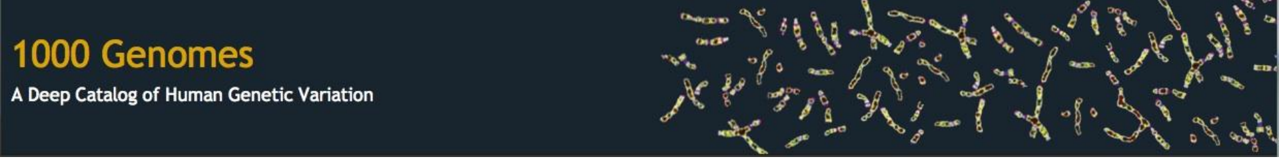

Consortium Acknowledgements
WashU - Ken Chen, Asif Chinwalla, Donald Conrad, Li Ding, Mike McLellan, John Wallis
WT Sanger Inst. – Ben Blackburne, Richard Durbin, Matt Hurles, Heng Li, Zemin Ning, Alywyn Scally, Klaudia Walter, Manuela Zanda, Yujun Zhang
Yale –Alexej Abyzov, Jieming Chen, Declan Clarke, Mark Gerstein, Rajini Haraksingh, Ekta Khurana, Joe Lee, Jing Leng, Cristina Sisu, Daifeng Wang
Stanford – Fabian Grubert Mark Kaganovich Phil Lacroute Hugo Lam Michael Snyder Alexander Urban
EMBL – Tobias Rausch, Andreas Schlattl, Adrian Stütz
Univ. of Washington – Tonia Brown, Arthur Ko, Peter Sudmant
EBI – Ewan Birney Laura Clarke Paul Flicek Matthias Haimel Paul Kersey Ilkka Lappalainen Lisa Skipper Richard Smith Daniel Zerbino Xiangqun Zheng-Bradley
Oxford – Zamin Iqbal, Gerton Lunter, Gil McVean
LSU – Mark Batzer, Miriam Konkel, Jerilyn Walker
Simon Fraser – Iman Hajirasouliha, Fereydoun Hormozdiari
Bilkent University – Can Alkan
Brigham – Xinghua Shi, Chengsheng Zhang
Cornell – Jeremiah Degenhardt
Harvard – Marcin Von Grotthuss
Rutgers – Jinchuan Xing
TGen – David Craig
AECOM – Kenny Ye
UCSD – Vineet Bafna, Jacob Michaelson, Jonathan Sebat
UCLA – Stan Nelson
Illumina – Bret Barnes, David Bentley, Michael Eberle, R. Keira Cheetham, Sean Humphray, Scott Kahn, Lisa Murray, Richard Shaw, Michael Stromberg
Life Tech. – Yutao Fu, Fiona Hyland, Heather Peckham, Yongming Sun, Daryl Thomas, Sowmi Utiramerur
BC – Erik Garrison Deniz Kural Wan-Ping Lee Gabor Marth Chip Stewart Alistair Ward Jiantao Wu
Broad Inst. – Guillermo del Angel, David Altshuler, Eric Banks, Mark DePristo, Menachem Fromer, Robert Handsaker, Chris Hartl, Steve McCarroll, James Nemesh, Khalid Shakir
Univ. of Michigan – Gonçalo Abecasis, Tom Blackwell, Jeffrey Kidd, Ryan Mills, Matthew Snyder
BGI – Yingrui Li, Srinka Ghosh, Aaron Halpern, Jason Laramie, Steve Lincoln
Leiden Univ. – Kai Ye
MS School of Medicine – Jayon Lihm, Vladimir Makarov, Elena Parkhomenko, Seungtai Yoon
Baylor – James Lu, Jeff Reid, Fuli Yu
Univ. of Maryland – Scott Devine
Univ. of Uath – David Witherspoon
Univ. of Virginia – Aaron Quinlan
NIH – Chunlin Xiao
Co-chairs – Charles Lee, Jan Korbel, Evan Eichler
Tim Hubbard, WT Sanger Inst.
Jennifer Harrow (lead PI), WT Sanger Inst.
Steve Searle, WT Sanger Inst.
Alexandre Reymond (PI), Univ. of Lausanne
Roderic Guigo (PI), CRG
David Haussler (PI), UCSC
Rachel Harte (Co-PI), UCSC
Manolis Kellis (PI), MIT
Mark Gerstein (PI), Yale
Alfonso Valencia (PI), CNIO
Michael Tress, CNIO

Slide 48

Acknowledgements
Breakpoints: A Abyzov, S Li, DR Kim, M Mohiyuddin, AM Stütz, NF Parrish, XJ Mu, W Clark, K Chen, M Hurles, JO Korbel, HY Lam, C Lee
GAPDH Pseudogene: Yuen-Jong Liu, Deyou Zheng, Suganthi Balasubramanian, Nicholas Carriero, Ekta Khurana, Rebecca Robilotto
Non-coding Variation: X Mu, Zhi J. Lu, Yong Kong, Hugo Y.K. Lam, Y Fu, E Khurana
Retroduplication Variation: A Abyzov, Yan Zhang, Shantao Li, Rebecca Iskow, Omer Gokcumen, David W. Radke, Suganthi Balasubramanian, Baikang Pei, Lukas Habegger, The 1000 Genomes Project Consortium, C Lee
Comparative Pseudogene: C Sisu, B Pei, Jing Leng, A Frankish, Yan Zhang, Suganthi Balasubramanian, Rachel Harte, Daifeng Wang, Michael Rutenberg-Schoenberg, Wyatt Clark, Mark Diekhans, Joel Rozowsky, Tim Hubbard, J Harrow
SV.gersteinlab.org + Pseudogene.org
Hiring Postdocs. See gersteinlab.org/jobs

Slide 50
Extra Slides

Slide 51
Lessons learned from comparing the human, worm, and fly pseudogenes
Mammalian pseudogenes are defined independently by a large event: the retrotransposition burst 40 MYA
Human pseudogenes are defined by:
  a majority of young processed pseudogenes
    highly transcribed
    located in regions of low recombination & near the centromeres
  old duplicated pseudogenes
    hints to the shared ancestry with worm & fly
Worm & Fly pseudogenes are defined by:
  selective sweeps
  large population size
  tandem duplications
There are NO pseudogenes orthologs between distant species, however there are human-mouse orthologous pseudogenes
  pseudogene families are lineage specific
  few universal families across distant species
Activity levels are conserved across all organisms
  15% of pseudogenes are transcribed in all organisms

Slide 52
Genomic Variation
Alu
Gene
Ancestral State
Alu
Gene
Alu
Gene
The Genome Remodeling Process

Slide 53
Genomic Variation
Alu
Gene
Non-allelic homologous recombination (NAHR)
Ancestral State
Alu
Gene
Alu
Gene
The Genome Remodeling Process
Segmental Duplication (SD)
Gene
Dup. Gene

Slide 54
Genomic Variation
Alu
Gene
Non-allelic homologous recombination (NAHR)
Ancestral State
Alu
Gene
Alu
Gene
The Genome Remodeling Process
Segmental Duplication (SD)
Gene
Dup. Gene
Syntenic Ortholog
SD
Gene
Dup. Gene
Paralog
duplicate
Gene
Dup. Gene
Dup. Gene
family
Gene
Dup. ψgene

Slide 55
Genomic Variation
Alu
Gene
Non-allelic homologous recombination (NAHR)
Ancestral State
Alu
Gene
Alu
Gene
The Genome Remodeling Process
Segmental Duplication (SD)
Gene
Dup. Gene
Syntenic Ortholog
SD
Gene
Dup. Gene
Paralog
duplicate
Gene
Dup. Gene
Dup. Gene
family
Gene
Dup. ψgene
Pssd. ψgene
Retro-transpose

Slide 56
SV Mechanism Classification
NAHR
Deletion
Highly similar with minor offset
Deletion
Single RETRO
Repeat Element
Multiple RETRO
RE1
RE2
[Lam et al., ('10) Nat. Biotech.]

Slide 57
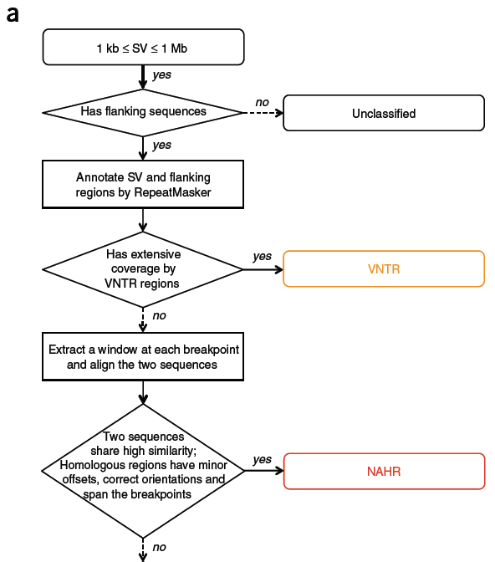
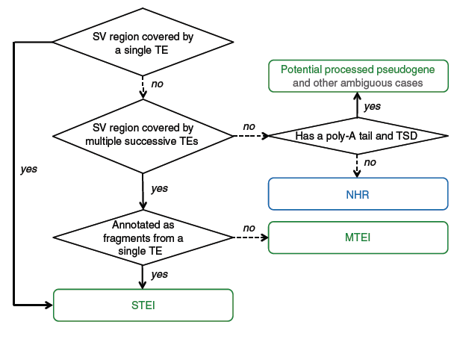
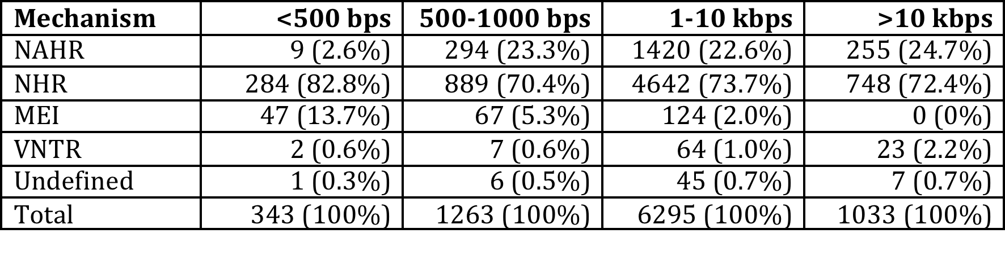
Summary of Mechanism Classification of ~8900 Deletion Breakpoints in 1000G Phase I
TEI
VNTR
Undefined
[1000 Genomes Consortium, Nature (2012)]
[Lam et al., ('10) Nat. Biotech.]

Slide 58
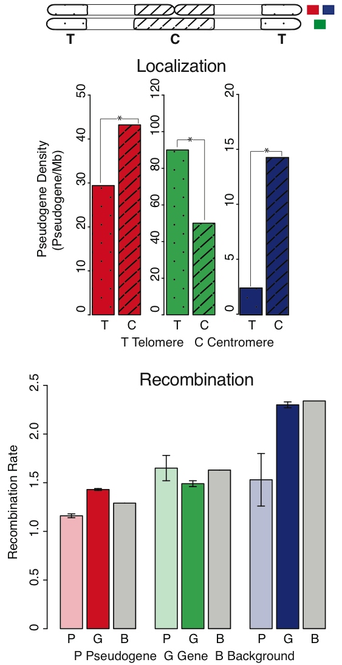
Localization
Human
Worm
Fly
[Sisu et al. PNAS ('14); doi: 10.1073/pnas.1407293111 ]

Slide 59
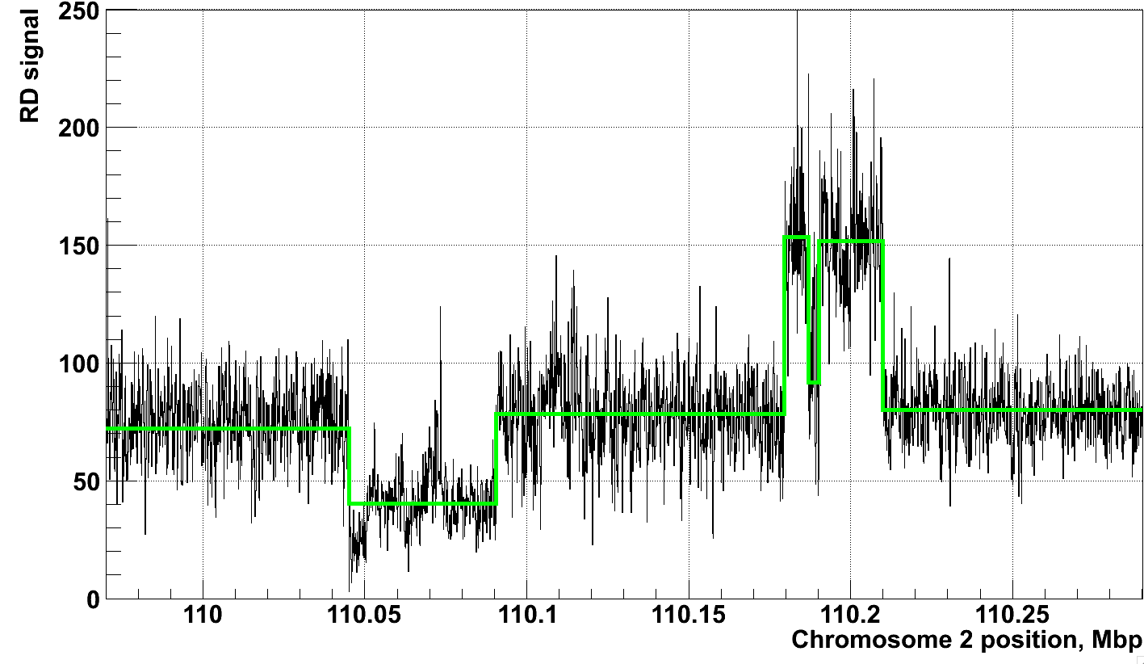
Example of Application of CNVnator to RD data
[Abyzov et al. Gen. Res. (’11)]
NA12878, Solexa 36 bp paired reads, ~30x coverage

Slide 60
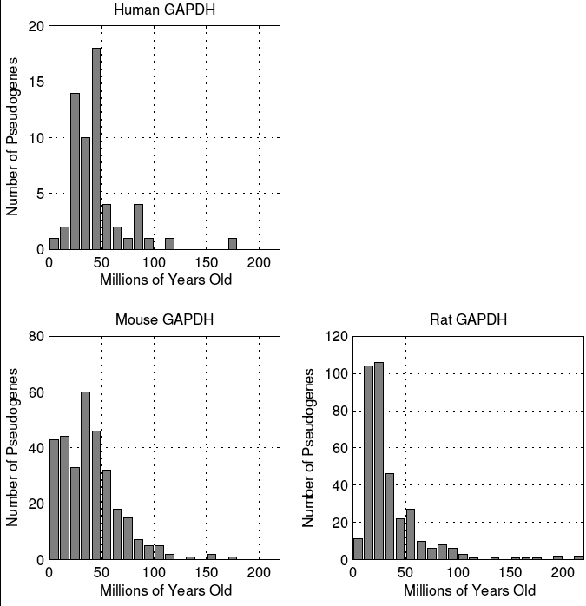
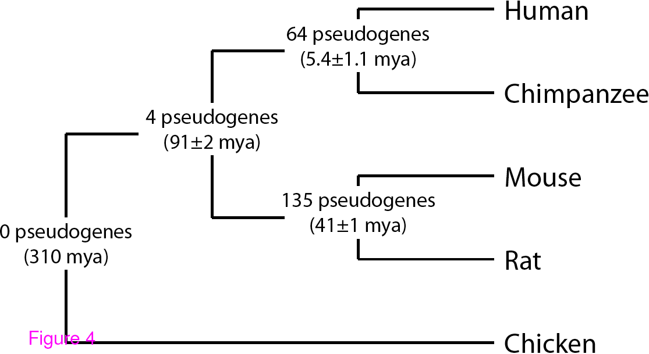
Mammalian GAPDH
Burst of Retrotranspositional Activity
40 MYA
GAPDH synteny
Similar patterns of pseudogene appearence across mammals.
However retro events are
independent for mammals.
[Liu et al. BMC Genomics ('09)]

Slide 61
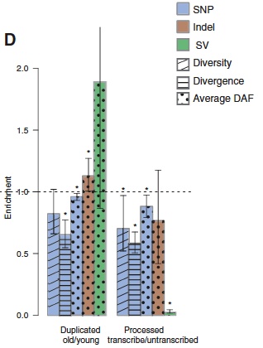


Hints of Selection on Some Pseudogenes
Ka/Ks conventional measure of selection for genes,
shows no signal for pgenes
Signature for selection on some SD pgenes (16%),
derived from intersecting with UW SD DB & looking for differential conservation of neighborhood vs. center of pgene
Weak signature for greater selection on transcribed pgenes using 1000G polymorphisms
[Khurana et al, NAR (’10)]
Segmental duplication
Parent gene
Duplicated ψgene
167
[Mu et al. NAR 39: 7058]
Comparison of nucleotide substitutions per site (N) in ψgenes and SDs
N (ψgene)< N (SD)
N (ψgene) ≈ N (SD)
N (ψgene) > N (SD)
negative selection
neutral evolution
positive selection
4
139
24
Notes:
Layout the legend

Slide 62
Info about content in this slide pack
General PERMISSIONS
  This Presentation is copyright Mark Gerstein,
  Yale University, 2015.
  Please read permissions statement at
  www.gersteinlab.org/misc/permissions.html .
  Feel free to use slides & images in the talk with PROPER acknowledgement
  (via citation to relevant papers or link to gersteinlab.org).
  Paper references in the talk were mostly from Papers.GersteinLab.org.
PHOTOS & IMAGES. For thoughts on the source and permissions of many of the photos and clipped images in this presentation see http://streams.gerstein.info .
  In particular, many of the images have particular EXIF tags, such as kwpotppt , that can be easily queried from flickr, viz: http://www.flickr.com/photos/mbgmbg/tags/kwpotppt

