Slide 1
ExAC
ClinVar
Server
Linearized Diagrams?

Slide 2
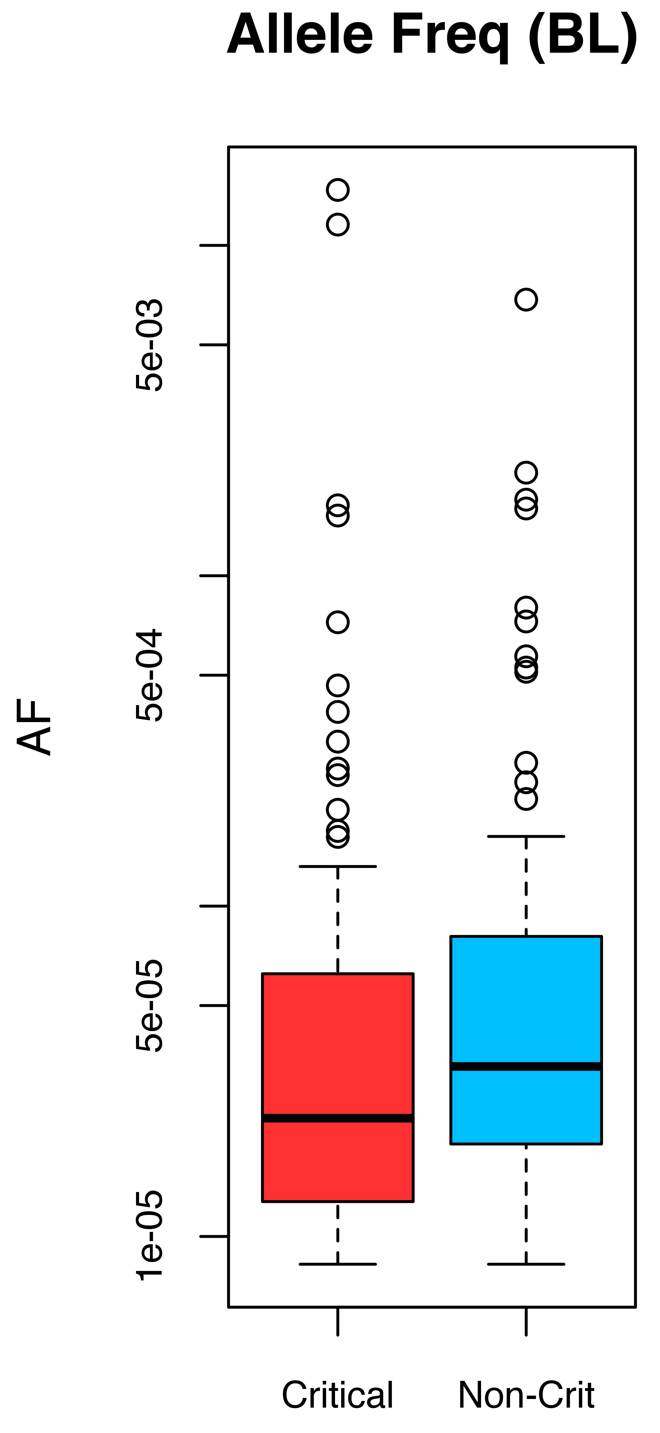
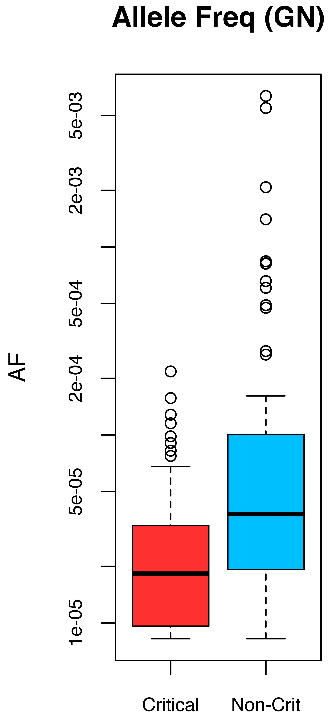
ExAC Analysis based on Avg Allele Frequencies
p-value = 1.493e-03
p-value = 7.983e-09
*Note: the ancestral allele is not provided in the ExAC dataset – thus, analysis is performed for AF rather than DAF
Avg: 4.09E-04 2.26E-04
Avg: 3.08E-05 3.27E-04

Slide 3
ExAC Analysis based on FRACTION of rare SNPs (BL)
BL RESULTS:
Avg allele freq for CRITIAL residues (on PDB-by-PDB basis): 4.09E-04
Avg allele freq for NON-CRITIAL residues (on PDB-by-PDB basis): 2.26E-04
For AF rarity thresh = 0.005
fract_num_times_fract_rare_in_bl_GRTR_than_non_crit: 0.095
fract_num_times_fract_rare_in_bl_LESS_than_non_crit: 0.060
For AF rarity thresh = 0.001
fract_num_times_fract_rare_in_bl_GRTR_than_non_crit: 0.298
fract_num_times_fract_rare_in_bl_LESS_than_non_crit: 0.131
Using either threshold to define rare SNPs, the fraction of rare SNPs hitting critical residues is greater than the fraction hitting NON-critical residues
→ This is a positive result (though at the higher threshold, the disparity is weak).
*Note: The only PDBs included in this analysis are PDBs for which at least one critical residue and one non-critical residue are hit by ExAC non-synonymous SNPs

Slide 4
ExAC Analysis based on FRACTION of rare SNPs (GN)
GN RESULTS:
Avg allele freq for CRITIAL residues (on PDB-by-PDB basis): 3.08E-05
Avg allele freq for NON-CRITIAL residues (on PDB-by-PDB basis): 3.27E-04
For AF rarity thresh = 0.005:
fract_num_times_fract_rare_in_gn_GRTR_than_non_crit: 0.156
fract_num_times_fract_rare_in_gn_LESS_than_non_crit: 0.0
For AF rarity thresh = 0.001:
fract_num_times_fract_rare_in_gn_GRTR_than_non_crit: 0.411
fract_num_times_fract_rare_in_gn_LESS_than_non_crit: 0.033
Using either threshold to define rare SNPs, the fraction of rare SNPs hitting critical residues is greater than the fraction hitting NON-critical residues
→ This is a positive result.
*Note: The only PDBs included in this analysis are PDBs for which at least one critical residue and one non-critical residue are hit by ExAC non-synonymous SNPs.

Slide 5
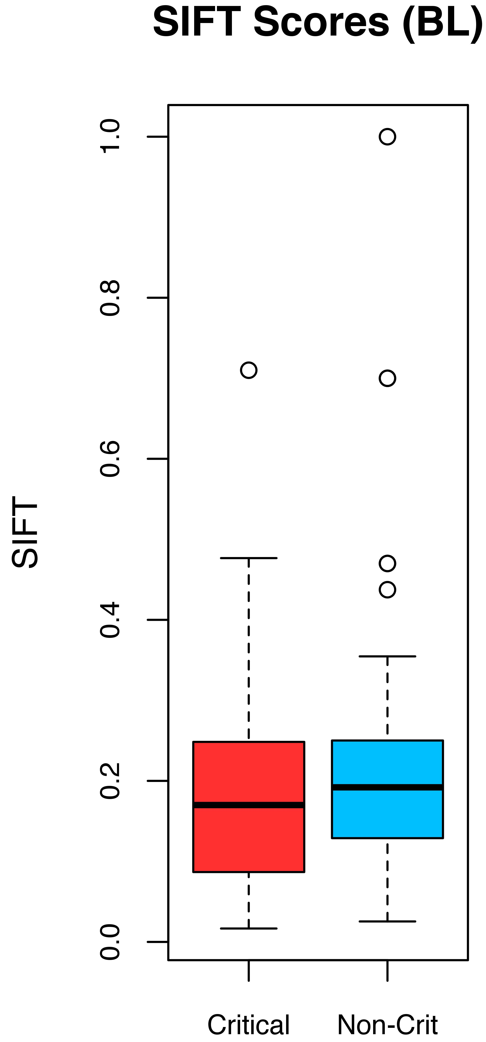
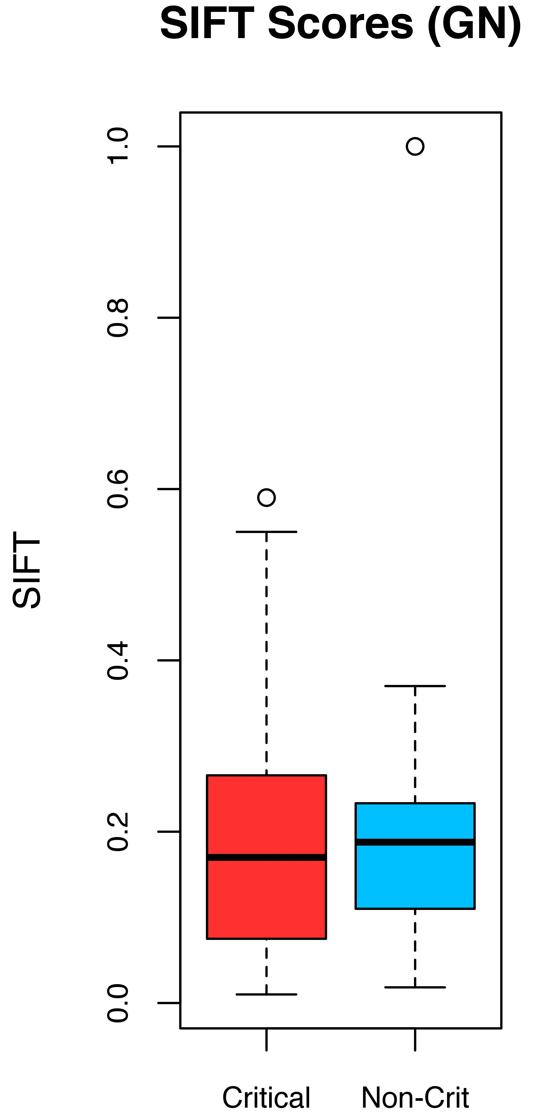
p-value = 0.089
p-value = 0.901
High score: benign
Low score: damaging
Avg: 0.188 0.221
Avg: 0.190 0.191
Notes:
## Avg BL SIFT CRIT: 0.18790253
## Avg BL SIFT NON-CRIT: 0.221353139
## p-value = 0.08889

Slide 6
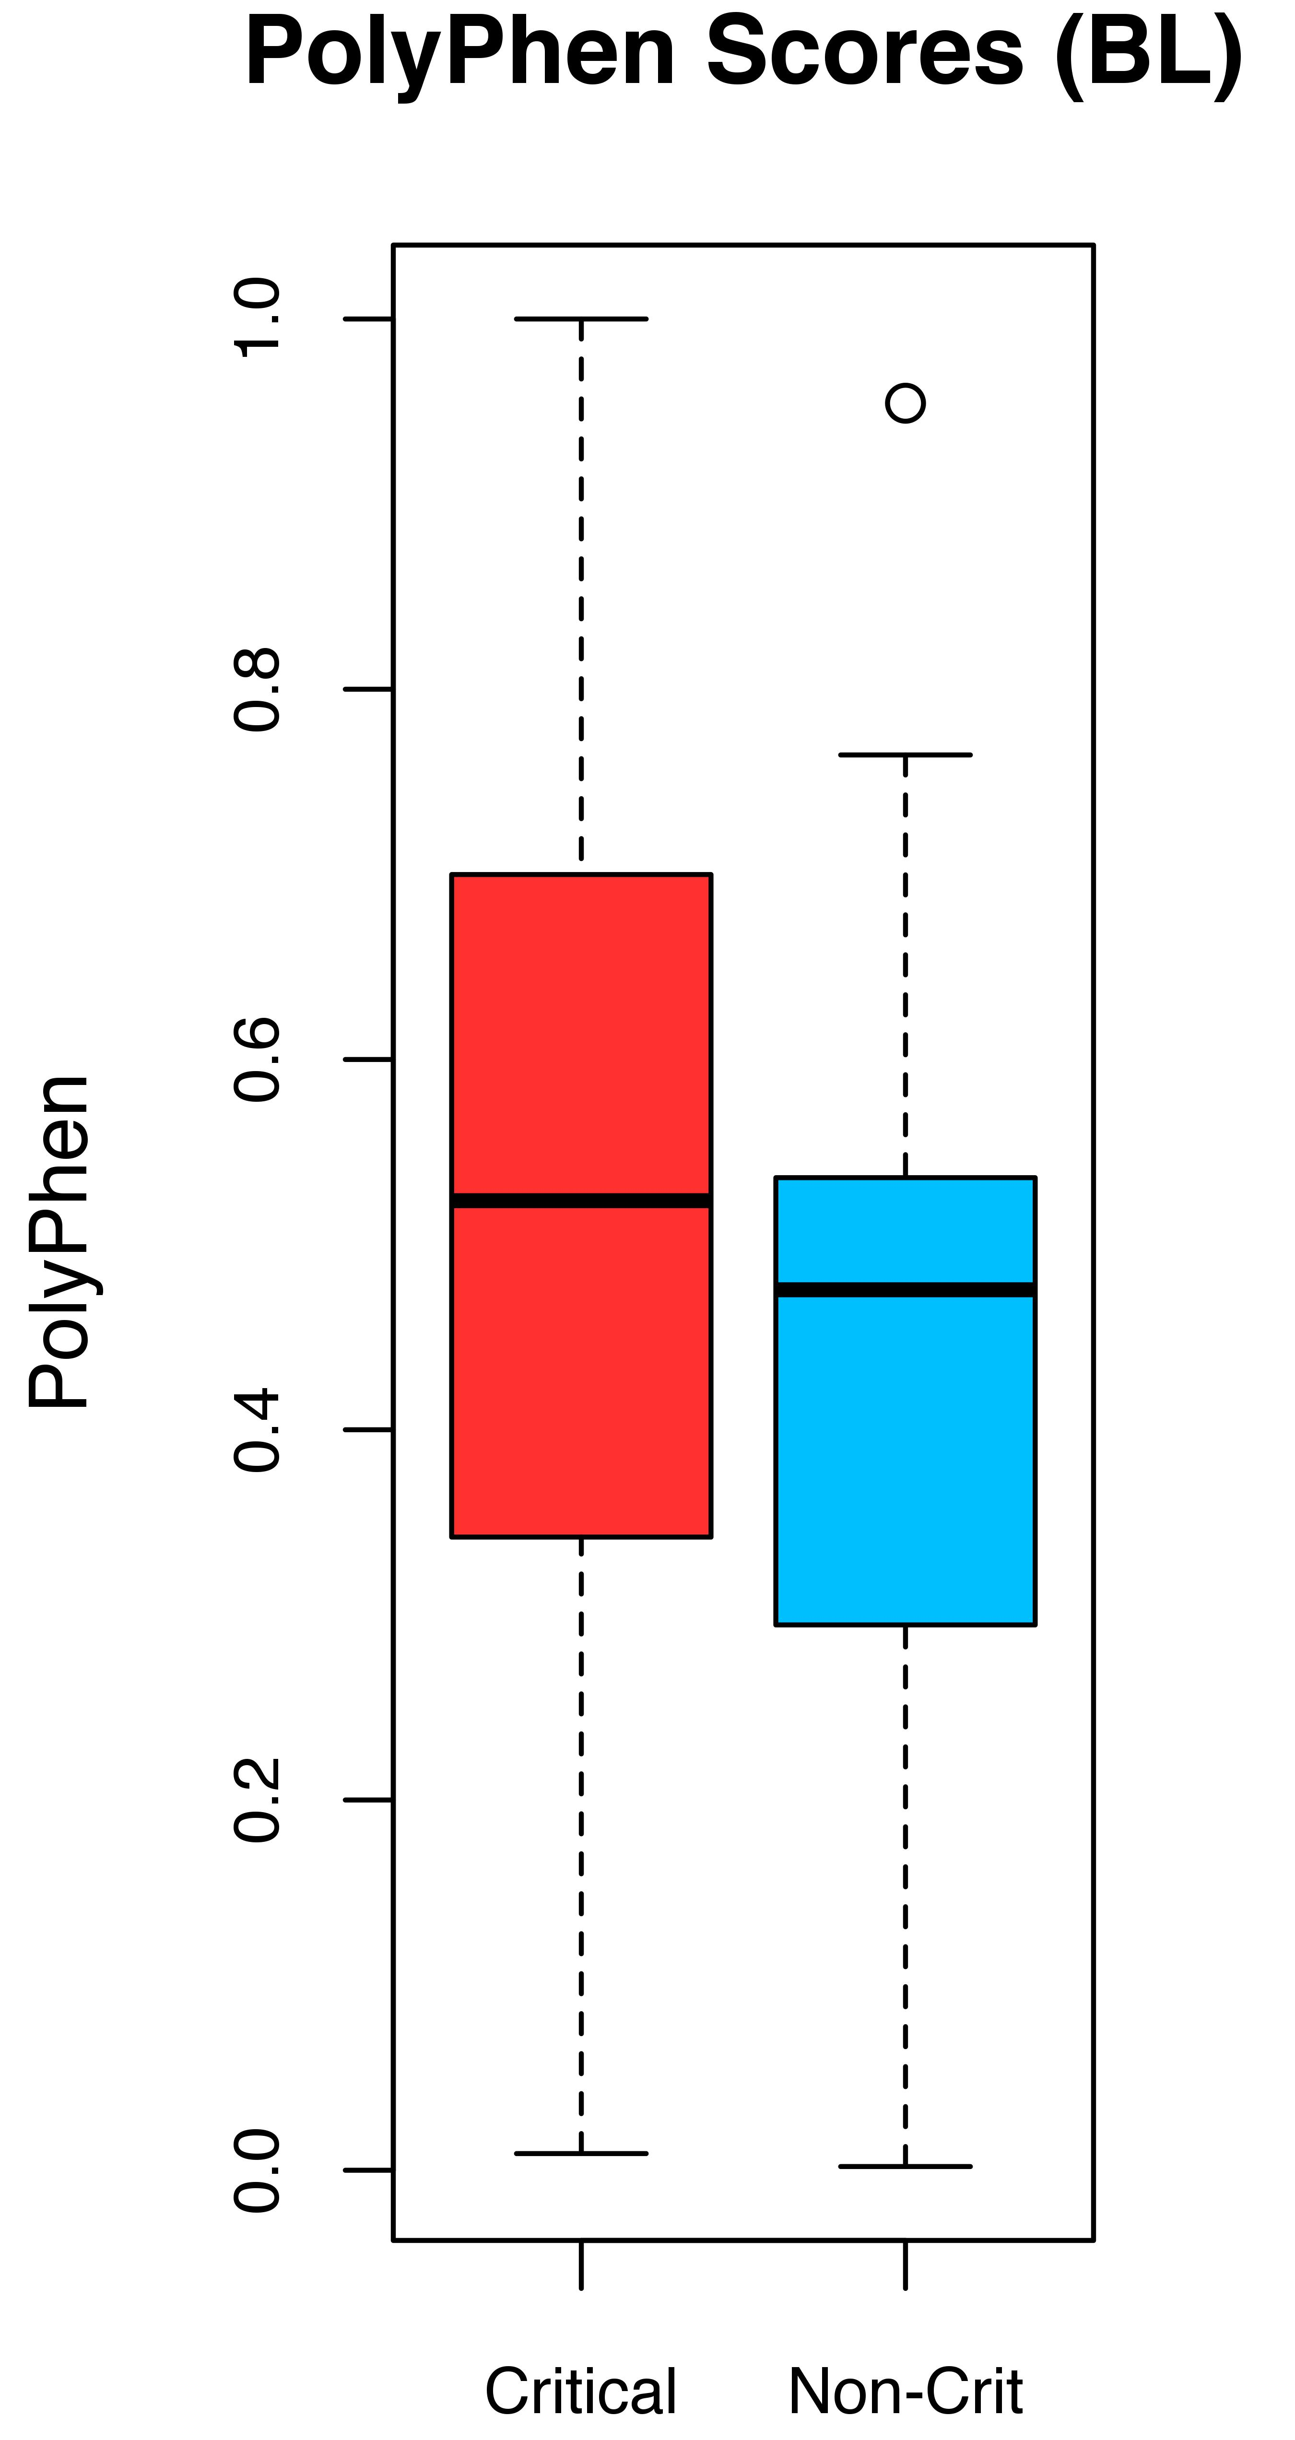
p-value = 1.9e-03
p-value = 3.3e-02
High score: damaging
Low score: benign
Avg: 0.523 0.422
Avg: 0.518 0.441
Notes:
## Avg BL PolyPhen CRIT: 0.522623289
## Avg BL PolyPhen NON-CRIT: 0.422250022
##

Slide 7
ClinVar vs. HGMD
BL Sites
ClinVar Annotations
0 - unknown
1 - untested
2 - non-pathogenic
3 - probable-non-pathogenic
4 - probable-pathogenic
5 - pathogenic
6 - drug-response
7 - histocompatibility
255 - other
Structs. w/ClinVar
SNPs hitting
critical residues
Structs. w/HGMD
SNPs hitting
critical residues
2
16
10
Notes:
## Avg BL PolyPhen CRIT: 0.522623289
## Avg BL PolyPhen NON-CRIT: 0.422250022
##

Slide 8
ClinVar vs. HGMD
GN Sites
ClinVar Annotations
0 - unknown
1 - untested
2 - non-pathogenic
3 - probable-non-pathogenic
4 - probable-pathogenic
5 - pathogenic
6 - drug-response
7 - histocompatibility
255 - other
Structs. w/ClinVar
SNPs hitting
critical residues
Structs. w/HGMD
SNPs hitting
critical residues
7
3
7
Notes:
## Avg BL PolyPhen CRIT: 0.522623289
## Avg BL PolyPhen NON-CRIT: 0.422250022
##

Slide 9
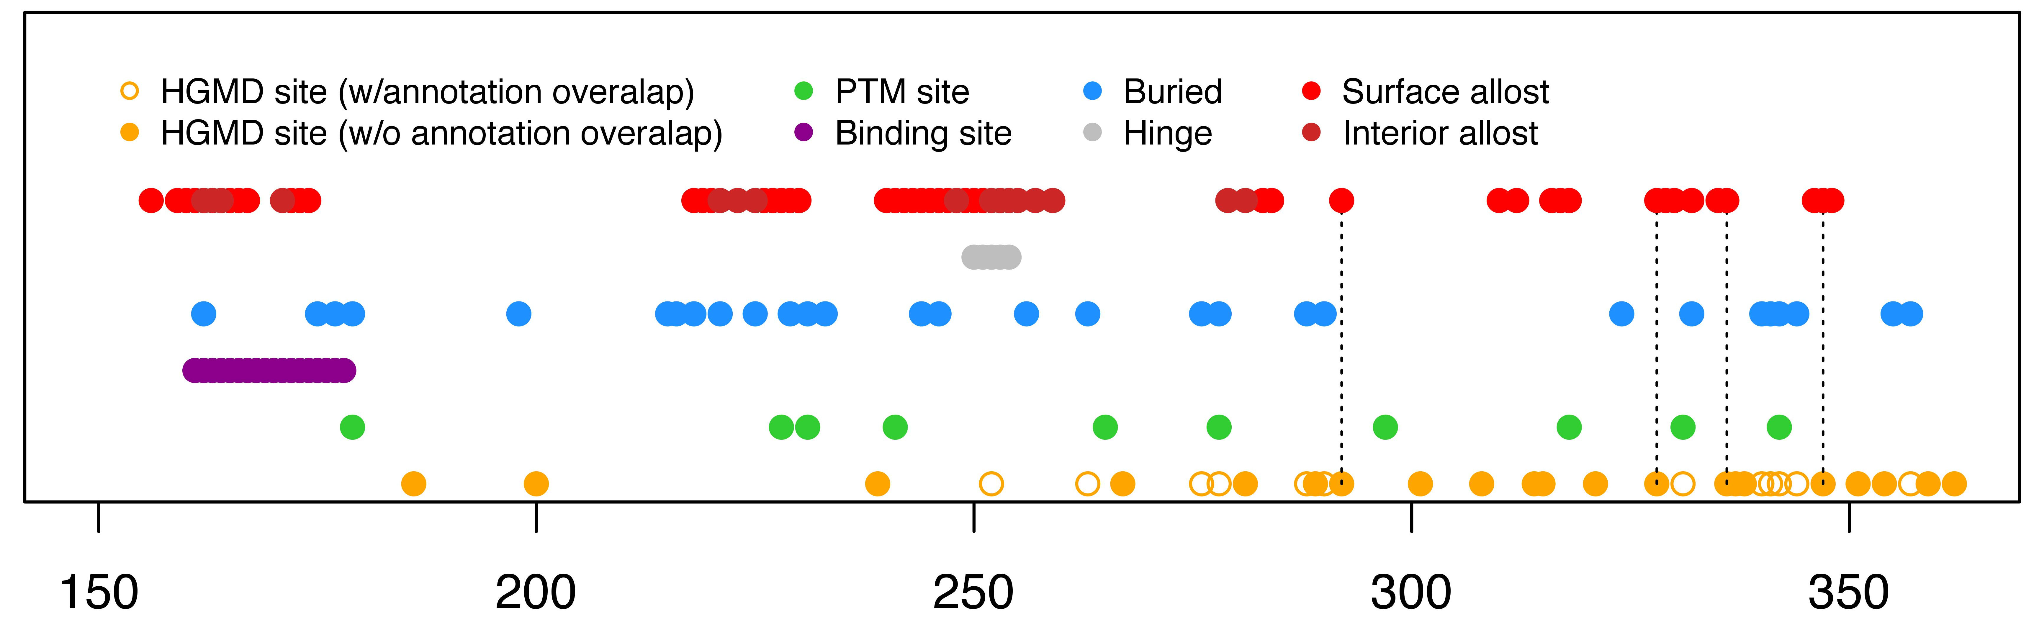
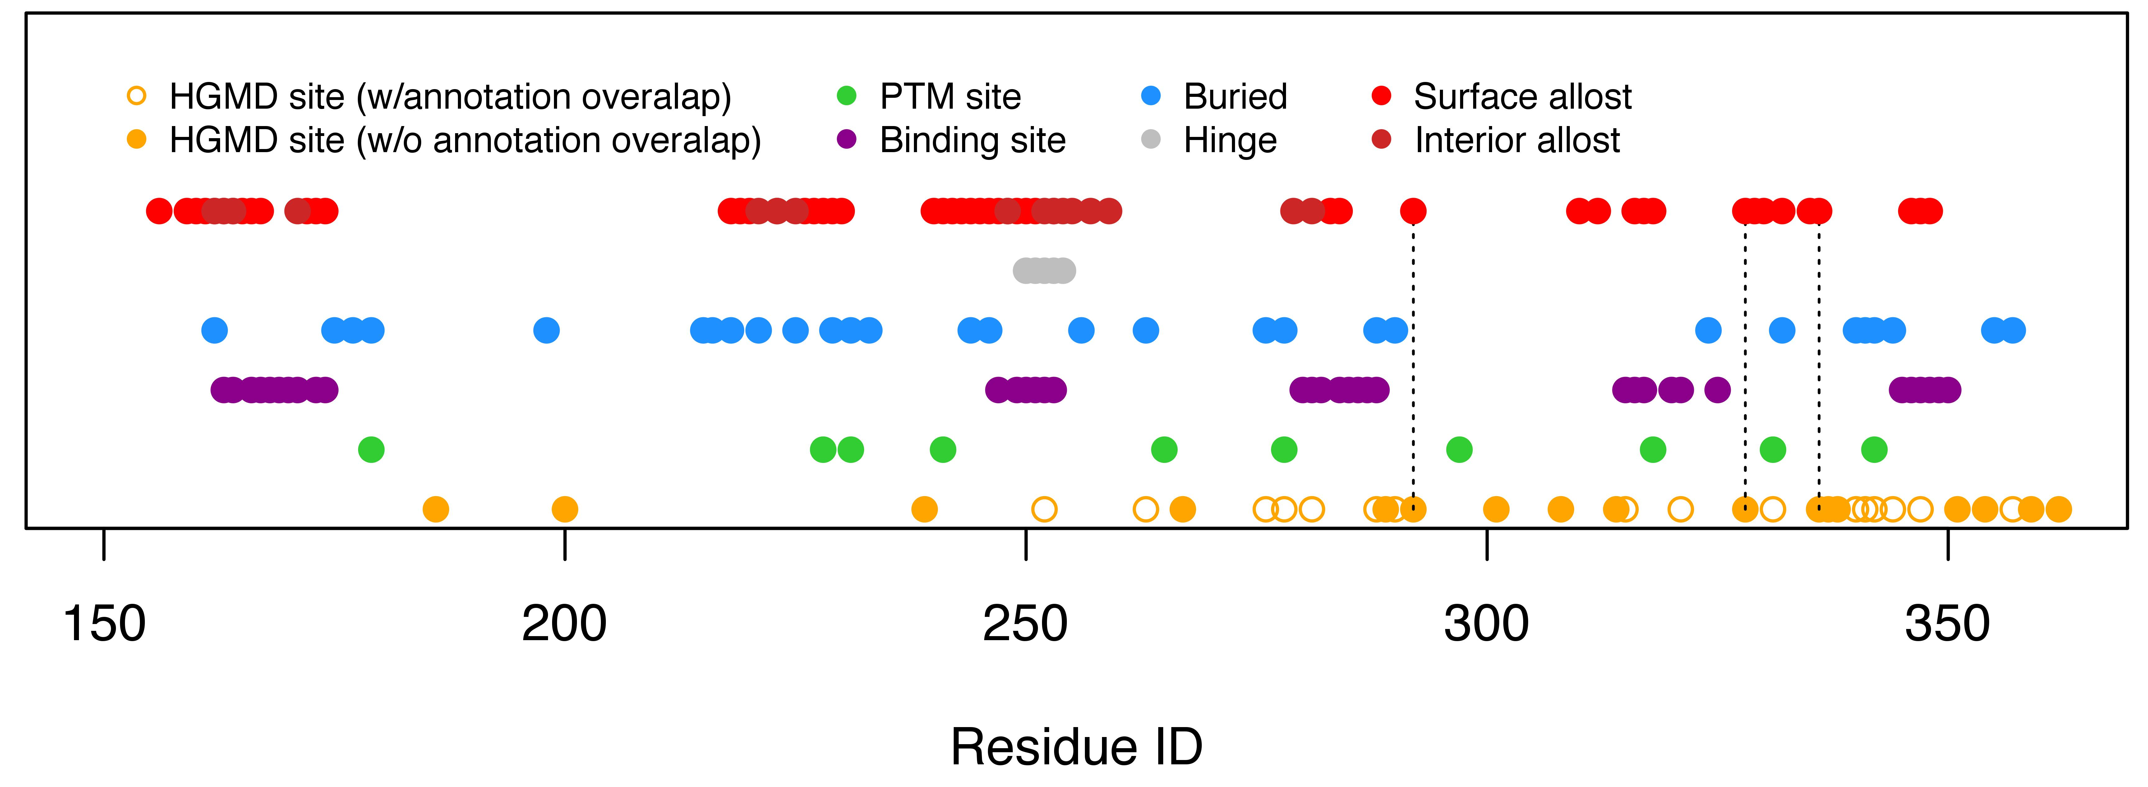
Linearized Annotation Diagram for FGFR2
Notes:
## Avg BL PolyPhen CRIT: 0.522623289
## Avg BL PolyPhen NON-CRIT: 0.422250022
##

Slide 10
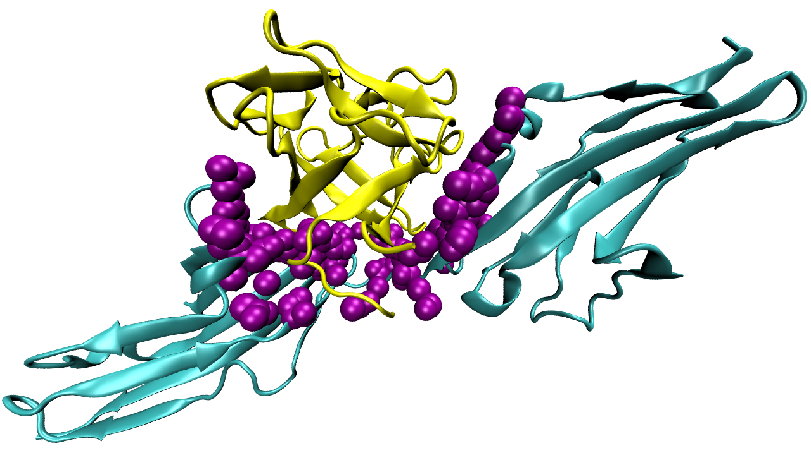
pdbID: 1IIL

