Slide 1
Genome Annotation of Coding Variants involved in Protein-protein interactions
Jieming
150603
Research
Gerstein/Regan Labs

Slide 2
Mapping of Coding Genomic Variation to Protein-Protein Interactions
Protein-protein interaction network
-- node: protein
-- edge: interaction
single nucleotide variant (SNV)

Slide 3
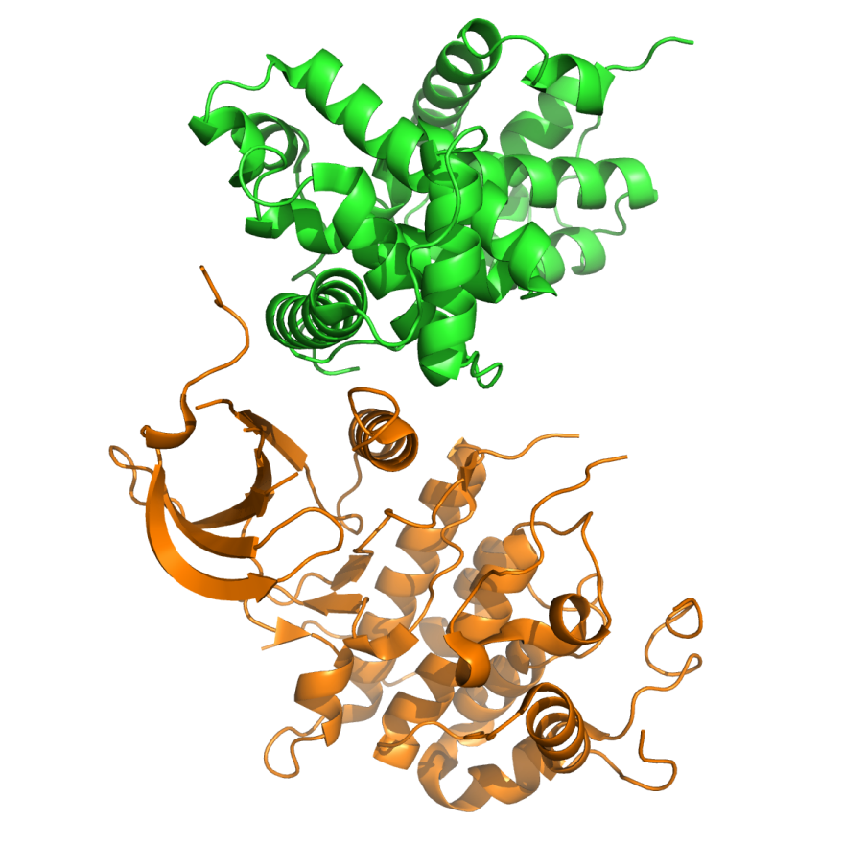
Mapping of Genomic Variation in Protein-Protein Interactions
Protein 1: cyclin T1
> single nucleotide variant (SNV)
Protein 2: CDK9
PDB: 3BLH
Human CDK9 interacts with cyclin T1

Slide 4
Protein interface annotation
Not all residues at protein interfaces are important in the interaction
→ Hotspots
→ Variable degrees of severity of mutations
etc.

Slide 5
Precise SNV effects important in personal genome annotation

Slide 6
Precise SNV effects important in personal genome annotation

Slide 7
Precise SNV effects important in personal genome annotation

Slide 8
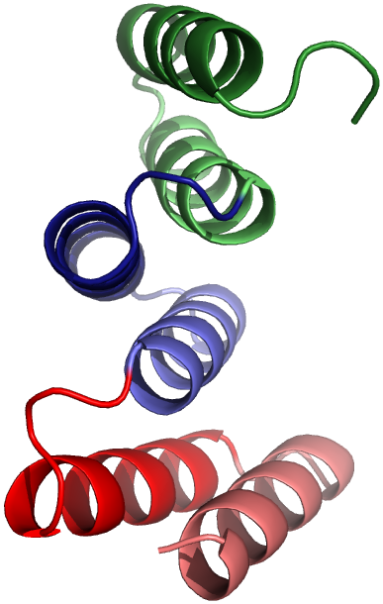
Strategy
Protein motifs/domains that mediate PPI
we focus on finding core or binding sites in PPI domains :
→ PPI domains: short binding domains (e.g. PDZ, SH3) or repeat domains (e.g. tetratricopeptide or TPR) that mediate PPI
What are repeat domains?

Slide 9
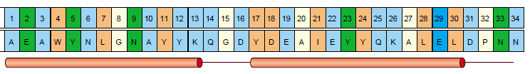
E.g. Tetratricopeptide repeat (TPR) : motifs & domains
B1
A1
B1
A1
Repeat proteins are classified by their structural folds.
→ 34-amino-acid repeat motif
→ 2 antiparallel helices + turns
Repeats usually in tandem
→ Each TPR “motif” can be repeated multiple times
to give a TPR “domain”
Each family of repeat domains are found in different
proteins
→ e.g. TPRs can be found in ubiquitination ligases,
enzymes and membrane-associated proteins
Notes:
thus mediate a diversity of protein-protein
interactions

Slide 10
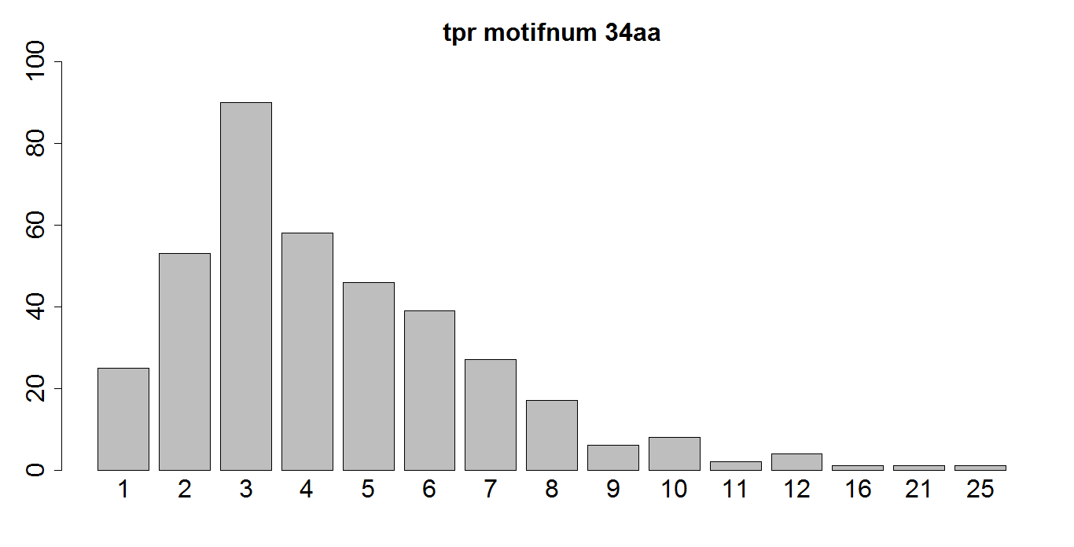
Number of TPR motifs in human TPR domains

Slide 11
Identifying important residues in repeat domains is important
14-20% human proteins have repeat domains (Marcotte et al. 1998; Alba et al. 2006)
Pinpoint residues important in diseases (e.g. Charcot-Marie-Tooth disease)
Able to tune specificity and affinity for protein engineering applications [Regan Lab]
-- clinical and basic research tools

Slide 12
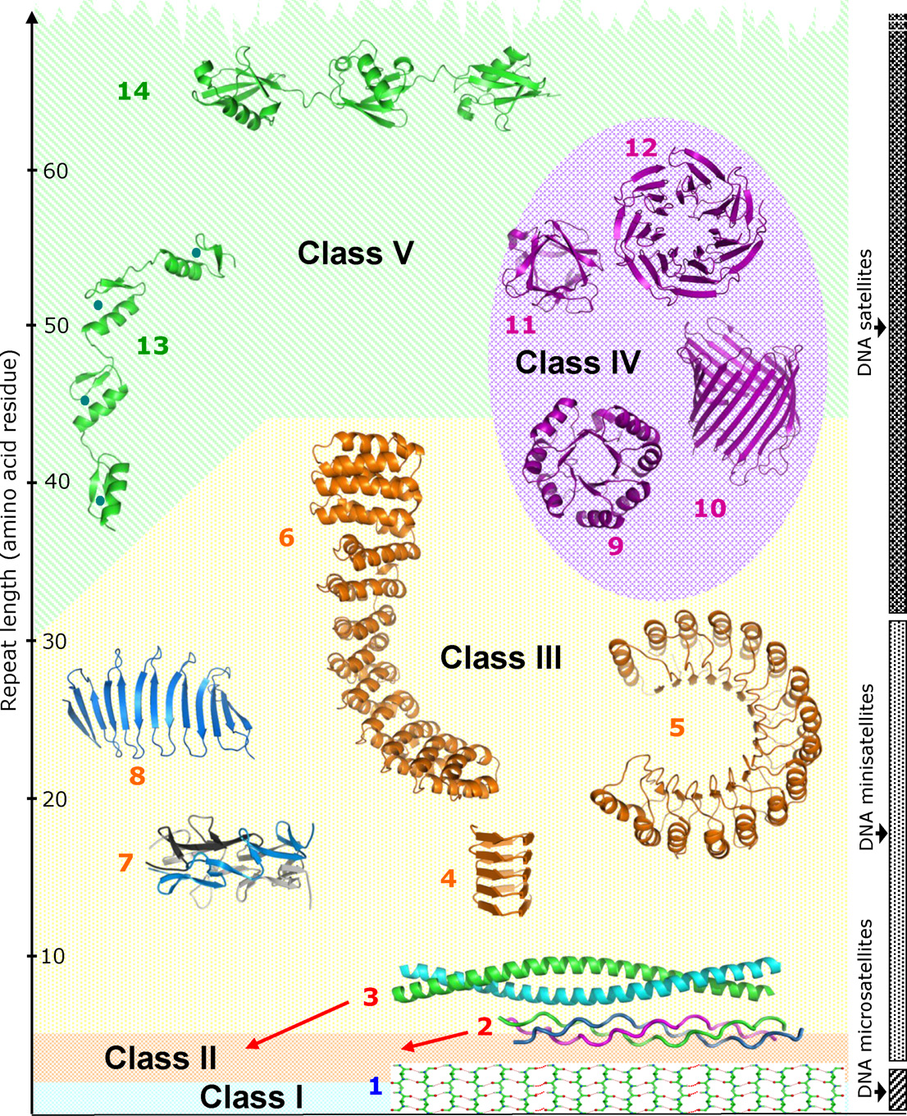
Kajava 2013 Journal of Struct Biol
V: repeats can fold indptly
e.g. Zn finger domain (13), polyubiquitin (14)
titin
IV: “closed” structures
e.g. TIM barrels (9), WD40/beta propeller (12),
beta barrels (10)
III: elongated structures
solenoid: e.g. TPR, ankyrins
Non-solenoid: e.g. beta structures
II; fibrous : e.g. collagen
I; homopolymers : e.g. polyQ tract HTT gene

Slide 13
Kajava 2013 Journal of Struct Biol
IV: “closed” structures
e.g. TIM barrels (9), WD40/beta propeller (12),
beta barrels (10)
III: elongated structures
solenoid: e.g. TPR, ankyrins
Non-solenoid: e.g. beta structures

Slide 14
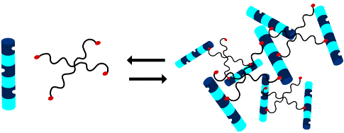
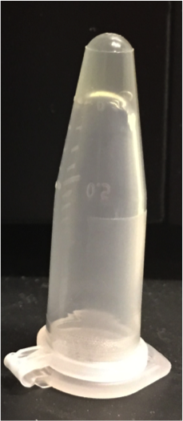


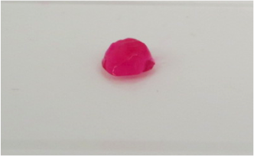
Regan Lab: Repeat domains in protein engineering & synthetic biology
http://www.yale.edu/reganlab/research.html
Grove et al. JACS Comm (2010)
Stimulus-responsive hydrogels
repeat domains
Ashley Schloss
Danielle Williams

Slide 15
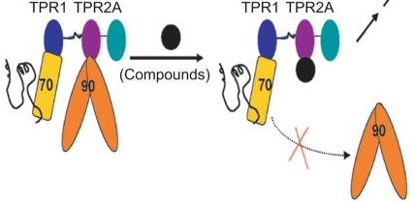

Regan Lab: Repeat domains in protein engineering & synthetic biology
http://www.yale.edu/reganlab/research.html
Hsp90 anticancer agent
Hsp-organizing protein
Biomarker detection/Drug design
Unfolded protein
Hsp70
Hsp90
Yi et al. ACS Chem Biol (2012)
repeat domains
Nicholas Sawyer

Slide 16
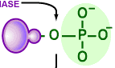
Regan Lab: Repeat domains in protein engineering & synthetic biology
http://www.yale.edu/reganlab/research.html
Hsp90 anticancer agent
Hsp-organizing protein
Biomarker detection/Drug design
Unfolded protein
Hsp70
Hsp90
Yi et al. ACS Chem Biol (2012)
repeat domains
Recognition tools for PTMs
Nicholas Sawyer
Sawyer et al. ACS Chem Biol (2014)

Slide 17


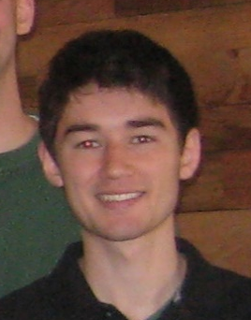
Regan Lab: Repeat domains in protein engineering & synthetic biology
http://www.yale.edu/reganlab/research.html
De novo scaffold construction
TPR 1
TPR 2
TPR 3
Pathway engineering
cell
repeat domains
Elizabeth Speltz
Michael Hinrichsen
Curran Oi

Slide 18
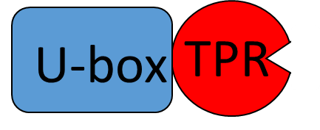
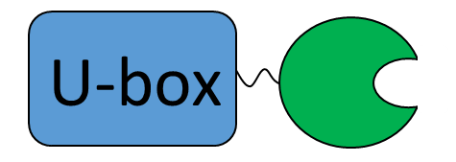
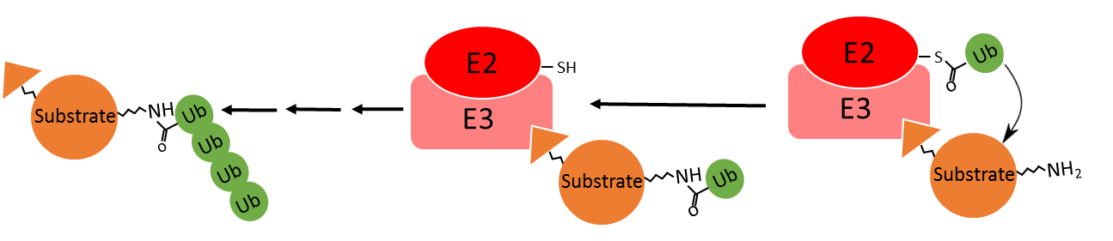
Regan Lab: Repeat domains in protein engineering & synthetic biology
http://www.yale.edu/reganlab/research.html
De novo scaffold construction
TPR 1
TPR 2
TPR 3
Pathway engineering
cell
Targeted protein degradation (yeast)
repeat domains
E3 ligase
Wildtype CHIP
Modified CHIP
Elizabeth Speltz
Michael Hinrichsen
Curran Oi

Slide 19
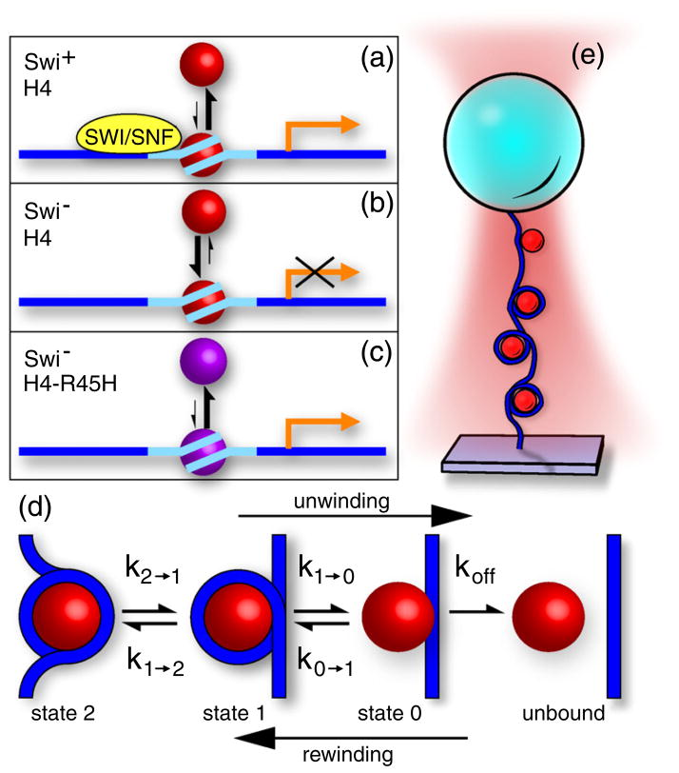

Regan Lab: Repeat domains in protein engineering & synthetic biology
http://www.yale.edu/reganlab/research.html
Chromatin structure and remodeling
-- effects of histone mutants on DNA-protein interactions and PTMs
-- effects of non-histone factors
Shaoyan Liang
Mack et al. J Mol Biol (2012)
Notes:
implying that a nucleosome containing H4-R45H is about 200-fold more likely to be unwound than a nucleosome containing H4. (done in yeast)
-- we have quantified, for the first time, what it means for a modification or variant to “loosen” the histone–DNA interaction sufficiently to allow transcription to proceed. The direct correlation between the binding free energy of the nucleosome inner turn and the change in transcription in the absence of SWI/SNF in yeast has important implications for transcriptional mechanisms, suggesting that, beyond partial unwinding, complete histone unwinding may play a role in transcriptional activation.

Slide 20
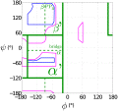
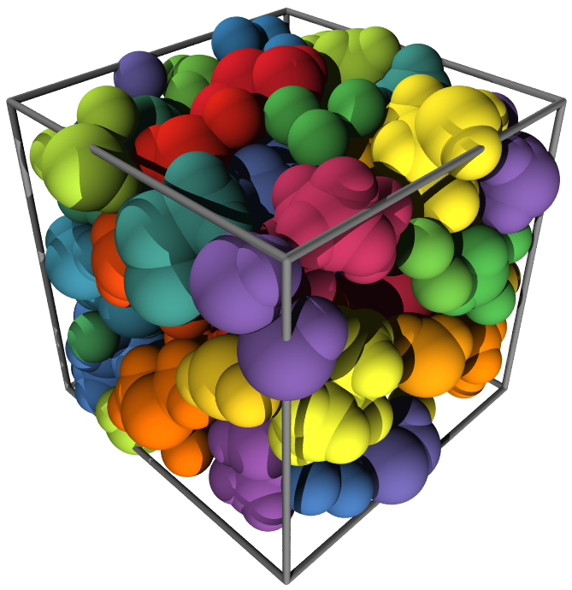
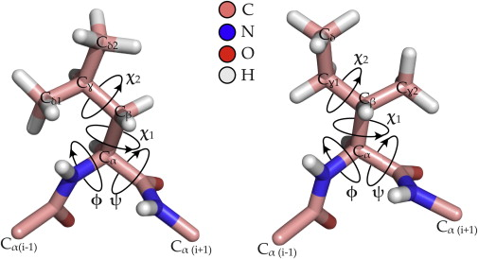



Regan Lab: Modeling amino acids, packing cores & protein-protein interfaces using hard sphere models to predict protein-protein interactions
http://www.yale.edu/reganlab/research.html
In collaboration with the O’ Hern Lab
Caballero et al. Prot Sci (2014)
Diego Caballero
Alejandro Virrueta
Jennifer Gaines

Slide 21

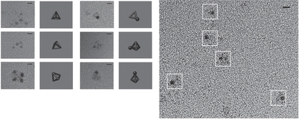
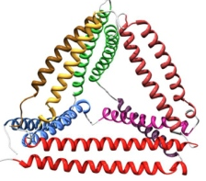
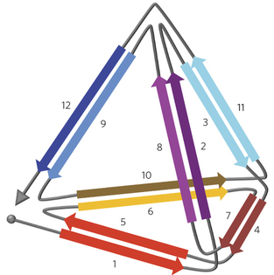
Regan Lab: Other projects
http://www.nature.com/news/2010/100310/full/464158a.html
DNA/protein origami
Gradisar et al. Nat Chem Biol (2013)

Slide 22
Regan Lab: Other projects
DNA/protein origami
Identifying possibly important residues in repeat
domains using exomes
→ potentially disruptive in protein-protein interactions
→ important in diseases

Slide 23
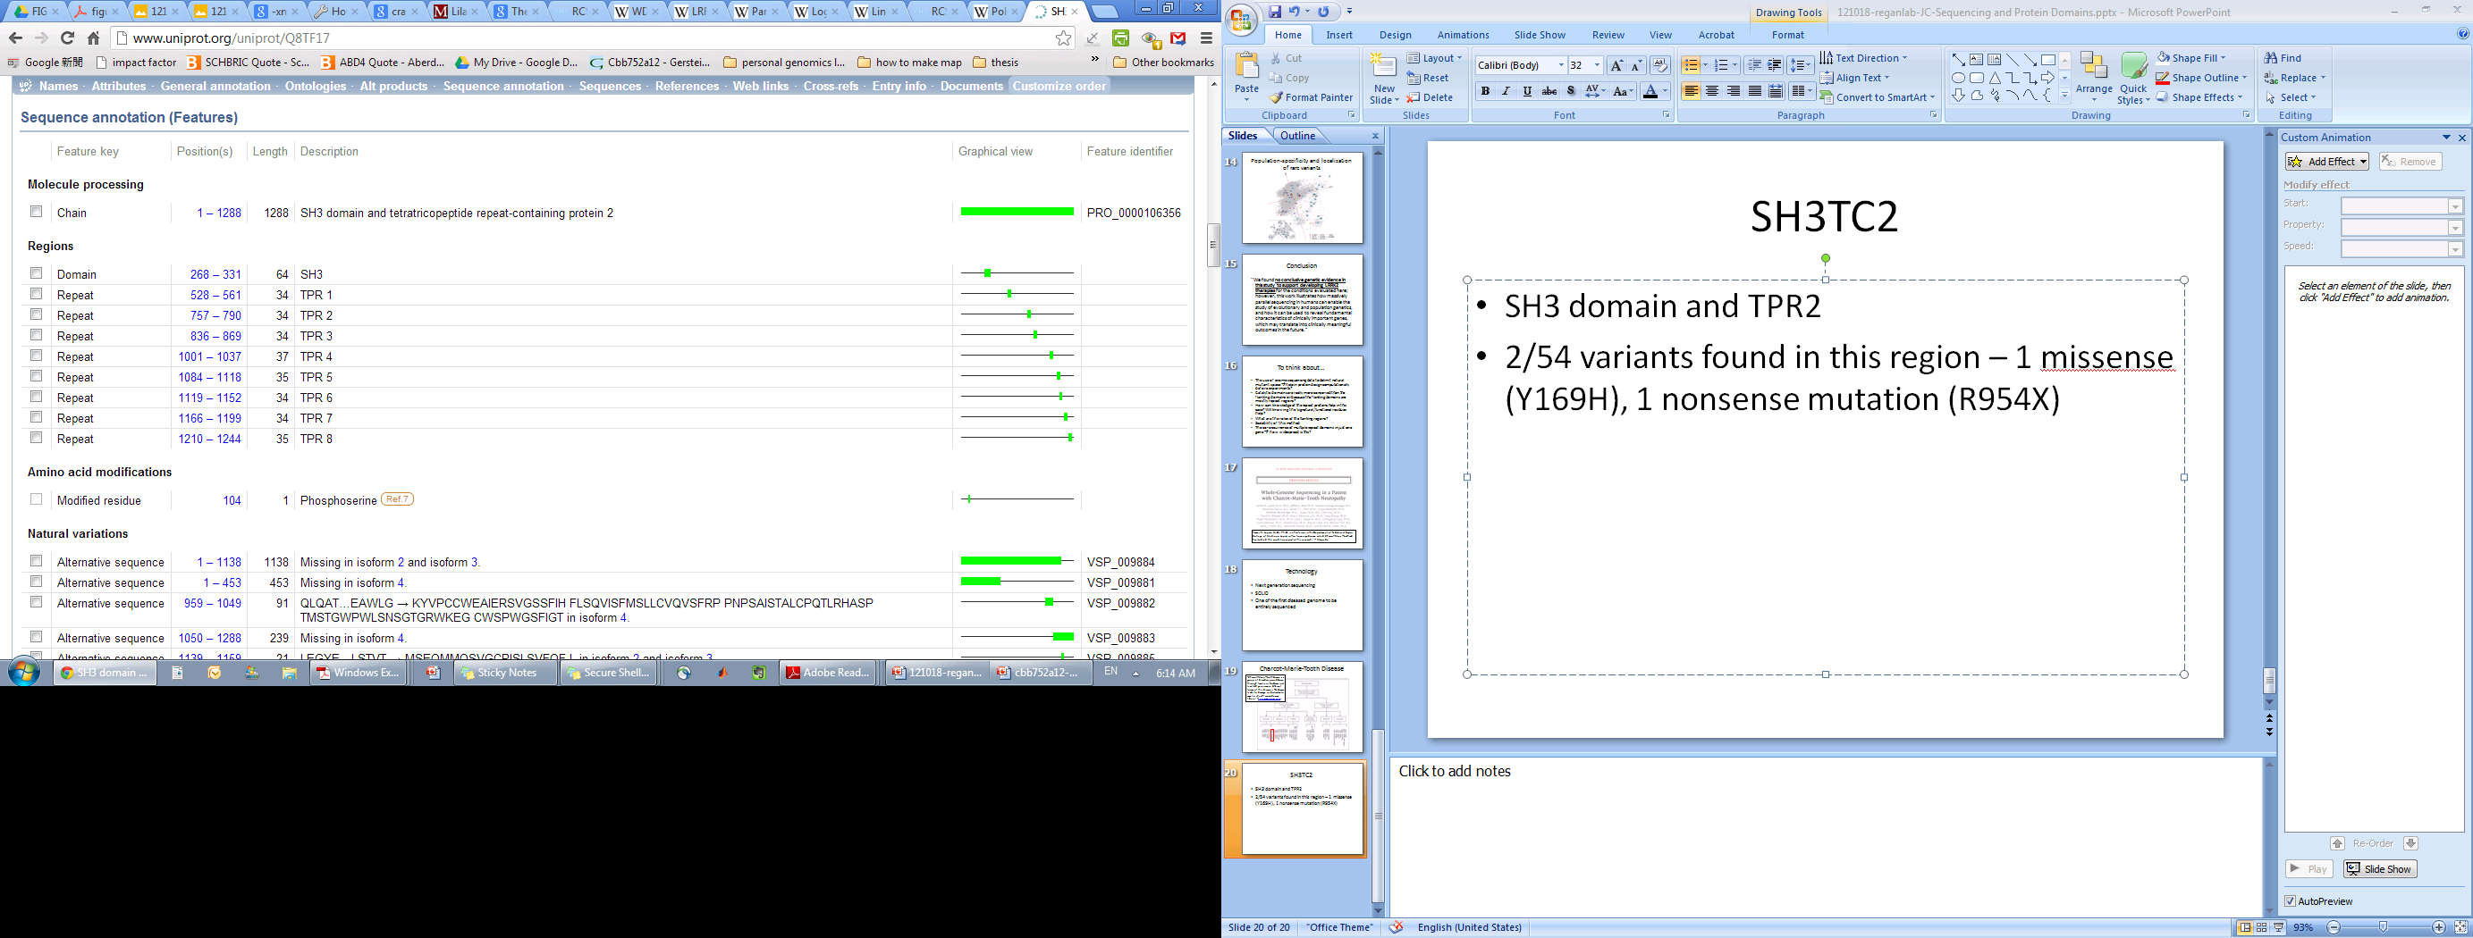
SH3TC2 – implicated in Charcot-Marie-Tooth disease
SH3 domain and TPR2 (Lupski et. al. 2010 NEJM; James Lupski)
2/54 variants found in this region – 1 missense (Y169H), 1 nonsense mutation (R954X)
Require both mutations for disease (compared with some family members who have either and did not have disease)
(Y169H)
(R954X)

Slide 24
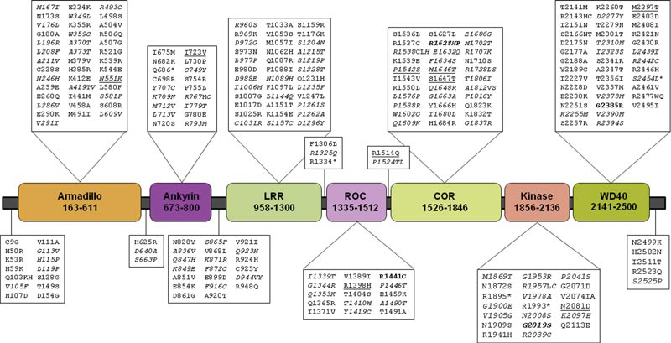
LRRK2
Rubio et. al. 2012 Human Mutation.
(Exome Sequencing Project)
Chr12: 40,689,229-40,763,086 (73,857 bp)
51 exons (including 5’ and 3’ UTRs)
14,227 bp (gene only)
Kinase
GTPase
449
128
343
358
Notes:
Importin armadillo ~40-45aa
Lrr – 20~30aa
Ankyrin ~ 33

Slide 25



Identify important residues:
Conservation in Multiple sequence alignment
‘Conservation’
Typically defined by comparison across species
Notes:
Baseline within human pop: 99.9% of the elements should be conserved

Slide 26
We cannot distinguish between more important positions because every position is conserved!!
TTC21B – 16 canonical TPRs, 287 SNVs
16TPR
Notes:
33 30 26 26 24 17 6 5 4 3 2 1

Slide 27
We cannot distinguish between more important positions because every position is conserved!!
TTC21B – 16 canonical TPRs, 287 SNVs
1
1
1
1
1
2
1
16TPR
1
1
1
1
1
1
1
2
1
1
1
1
1
1
1
1
1
1
1
1
1
2
1
1
Notes:
33 30 26 26 24 17 6 5 4 3 2 1

Slide 28
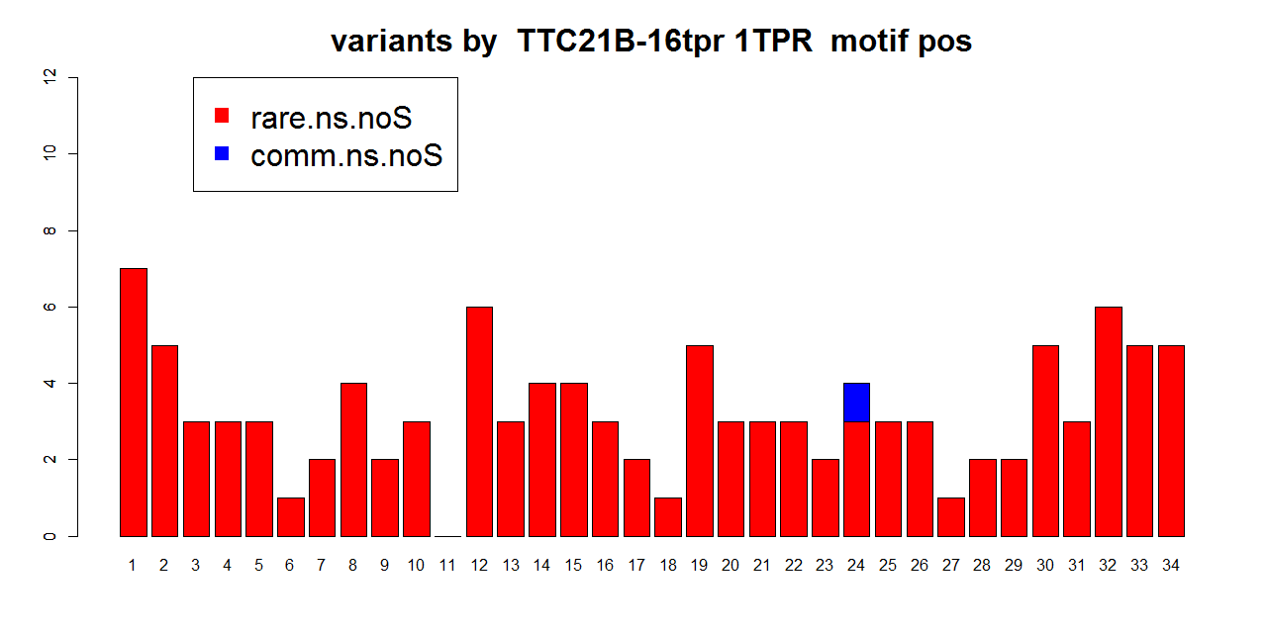
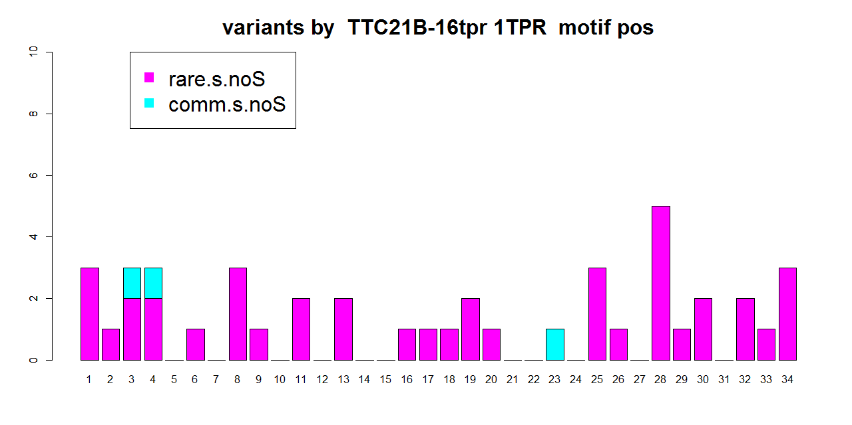

Slide 29
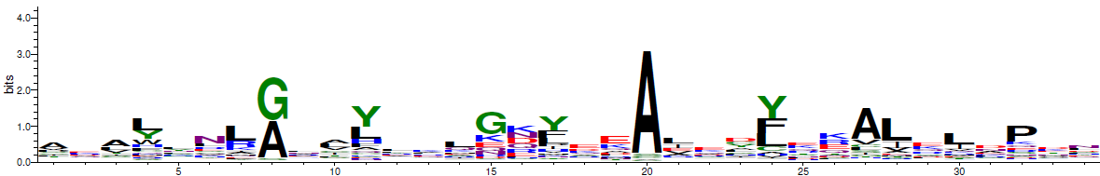
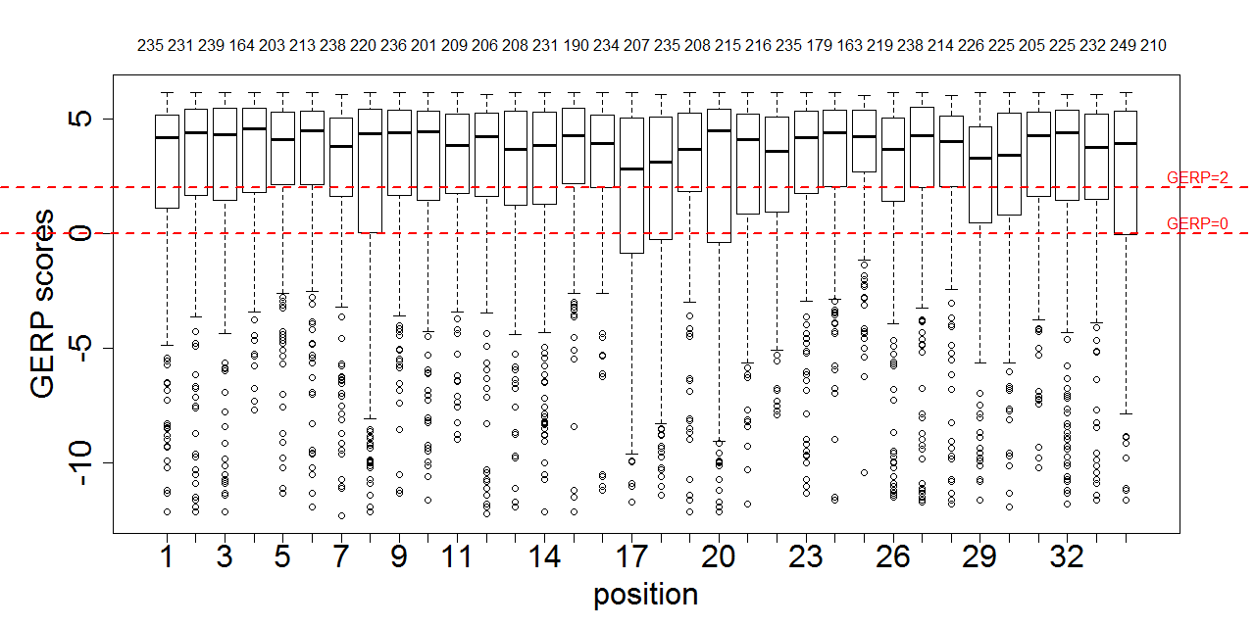
Comparing 1TPR alignment within (multiple proteins) & across species (1 protein)
allTPRs in proteome in Humans - 571 sequences
16TPRs in TTC21B across 44 species - 704 sequences

Slide 30
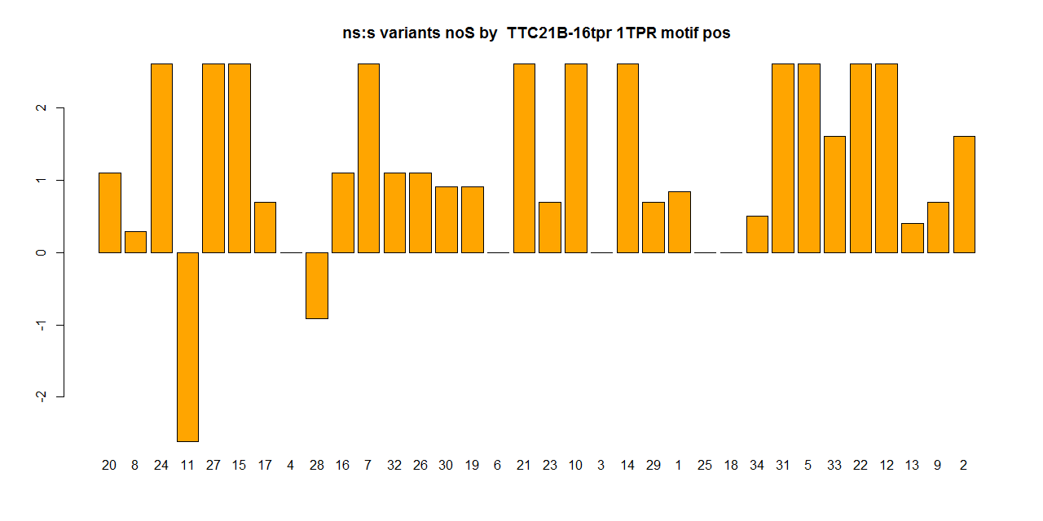
16 TPRs 1TPR-alignment statistics
20 8 24 11 27 15 17 4 28 16 7 32 26 30 19 6 21 23 10 3 14 29 1 25 18 34 31 5 33 22 12 13 9 2
16TPRs in TTC21B across 44 species - 704 sequences
20 8 24 11 27 15 17 4 28 16 7 32 26 30 19 6 21 23 10 3 14 29 1 25 18 34 31 5 33 22 12 13 9 2

Slide 31
2
1
1
1
1
1
1
1
2
1
1
1
1
1
1
1
1
1
1
1
1
1
1
2
2
1
1
1
1
1
1
1
1
1
1
1
1
1
1
1
1
1
1
1
1
1
1
1
1
1
Notes:
Non-consensus on the actual human TTC21B – no pattern it seems

Slide 32
2
1
1
1
1
1
1
1
1
2
1
2
1
1
1
1
1
1
1
1
16TPR
1
1
1
1
1
1
1
1
1
1
1
1
1
2
1
1
1
1
1
1
1
1
2
2
1
1
1
1
Notes:
34 32 31 27 25 20 19 16 14 13 12 12 8 3

Slide 33
1
1
1
1
1
1
1
1
1
2
1
1
1
1
1
1
1
1
1
1
1
2
2
1
1
2
1
1
1
1
2
1
1
1
1
1
1
1
1
1TPR
Notes:
34 33 33 32 28 27 22 20 17 15 14 12 4 2 1

Slide 34
Identify important residues:
Conservation in Multiple sequence alignment
1
2
3
‘Sensitivity’ within human population
  Alternatively, negative selection restricts the allele frequency of deleterious mutations.
  a depletion of common variants/an enrichment of rare variants
‘Conservation’
Typically defined by comparison across species
Notes:
Baseline within human pop: 99.9% of the elements should be conserved

Slide 35
1TPR
1
1
1
1
1
1
1
1
1
1
Notes:
33 32 30 20 17 15 14 13 10 5 3 2 1

Slide 36
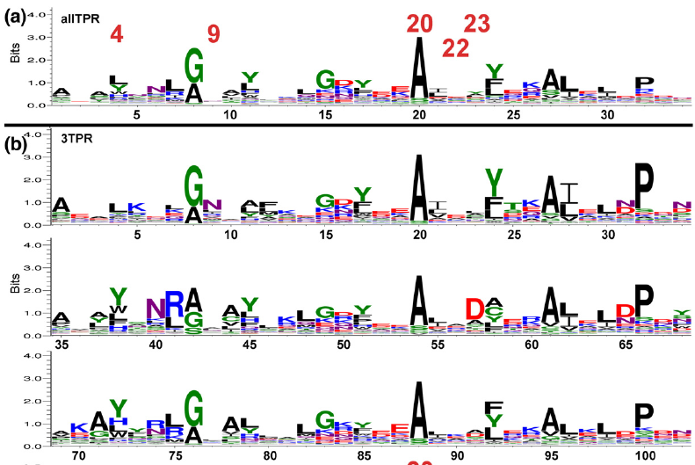
Strategy: Multiple Sequence Alignment e.g. TPR
Human only
Protein 1
TPR
TPR
TPR
Protein 2
TPR
TPR
Protein 3
TPR
TPR
TPR
Multiple Sequence Align
TPR
TPR
TPR
623 sequences
B1
A1
A1
B1
Notes:
Motif alignment across all TPRs from all species

Slide 37
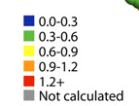
Strategy: Identify hypervariable and conserved positions
Hypervariable
Conserved sites
B1
A1
A1
B1

Slide 38
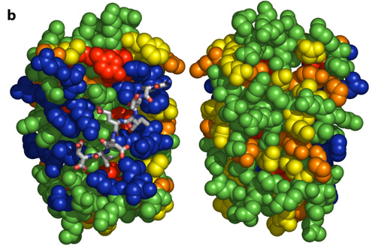
Strategy: Mapping onto known PDB structures
Magliery & Regan, BMC Bioinformatics, 2005
Hypervariable
Conserved sites
B1
A1
B1
A1

Slide 39
Strategy
Obtain list of repeat (e.g. TPR) and non-repeat domains (e.g. PDZ)
Do a multiple sequence alignment
Identify hypervariable positions and highly conserved positions
Can we distinguish functional from non-functional hypervariable positions at hypervariable positions?
Do these positions fall into binding pockets in available PDB structures?
SNVs falling onto these positions are assessed whether they are non-synonymous and deleterious (using SIFT and BLOSUM score)
We perform this on TPR first, since we know the most about it.

Slide 40
Sources of variants
1000 Genomes Project Phase 1 (1KG)
- 1092 individuals, ~500K exome variants
Exome Sequencing Project (ESP)
- 6500 individuals, ~1.3M
Exome Aggregation Consortium (ExAC)
- 60,706 individuals, ~7,2M
- contains all of 1KG and part of ESP6500

Slide 41
Compare ExAC with 1KG.ESP650
 | 1KG | 1KG.ESP6500 | ExAC | Fold change (1KG+ESP v ExAC)
Num of individuals (chrs) | 1,092 (2,184) | 7,592 (15,184) | 60,706 (121,412) | 8
# total PASS auto SNVs | 483,702 | 1,361,029 | 7,202,445 | 5.3
#chrs: Rare 0.5% | 10 | 76 | 607
Notes:
for i in combined-1KG.ESP6500.snps.nonmono.smartDomain2gPos.TPR.34aa.bed*; do echo $i ; awk '{OFS="\t"}{FS="\t"}{print $1"-"$2"-"$3}' $i | sort | uniq | egrep -v "chrX|chrY" | wc -l ; done
OR
awk '{OFS="\t"}{FS="\t"}{if($1 != "chrX" && $1 != "chrY"){print $1"-"$2"-"$3}}' ExAC.r0.3.sites.snps.pass.mod.ens73.TPR.34aa.bed | sort | uniq | wc –l

Slide 42
Compare ExAC with 1KG.ESP650
 | 1KG | 1KG.ESP6500 | ExAC | Fold change (1KG+ESP v ExAC)
Num of individuals (chrs) | 1,092 (2,184) | 7,592 (15,184) | 60,706 (121,412) | 8
# total PASS auto SNVs | 483,702 | 1,361,029 | 7,202,445 | 5.3
# TPR auto SNVs (incl. singletons) | 764 | 2,159 | 7,359 | 3.4
# TPR auto SNVs (excl. singletons) | 382 | 889 | 3,342 | 3.8
#chrs: Rare 0.5% | 10 | 76 | 607
Notes:
for i in combined-1KG.ESP6500.snps.nonmono.smartDomain2gPos.TPR.34aa.bed*; do echo $i ; awk '{OFS="\t"}{FS="\t"}{print $1"-"$2"-"$3}' $i | sort | uniq | egrep -v "chrX|chrY" | wc -l ; done
OR
awk '{OFS="\t"}{FS="\t"}{if($1 != "chrX" && $1 != "chrY"){print $1"-"$2"-"$3}}' ExAC.r0.3.sites.snps.pass.mod.ens73.TPR.34aa.bed | sort | uniq | wc –l

Slide 43
Properties of a SNV/mutation
Allele frequency in the population
→ how frequent it occurs in the population (by chromosomes)
Effect of the SNV on residues
→ synonymous/non-synonymous

Slide 44
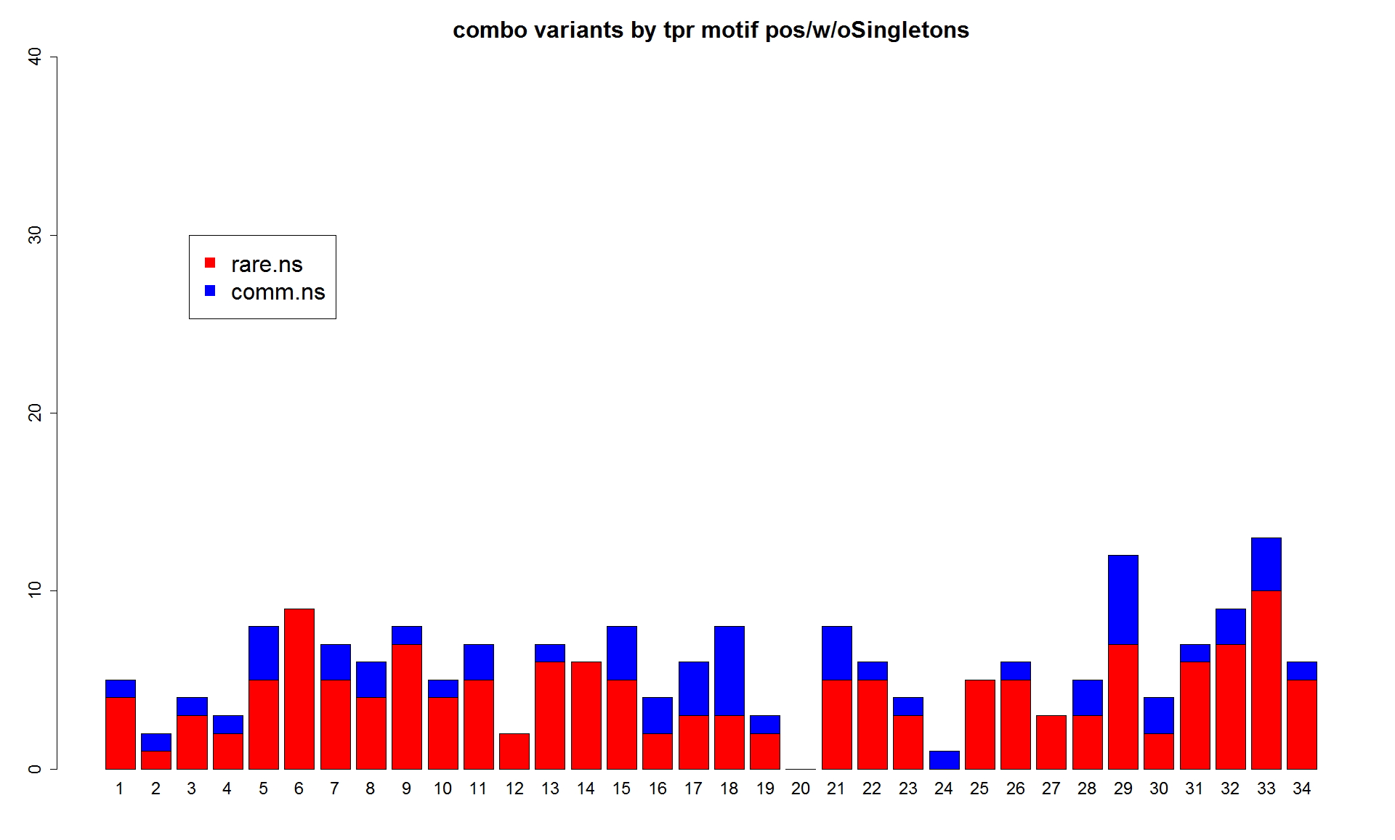
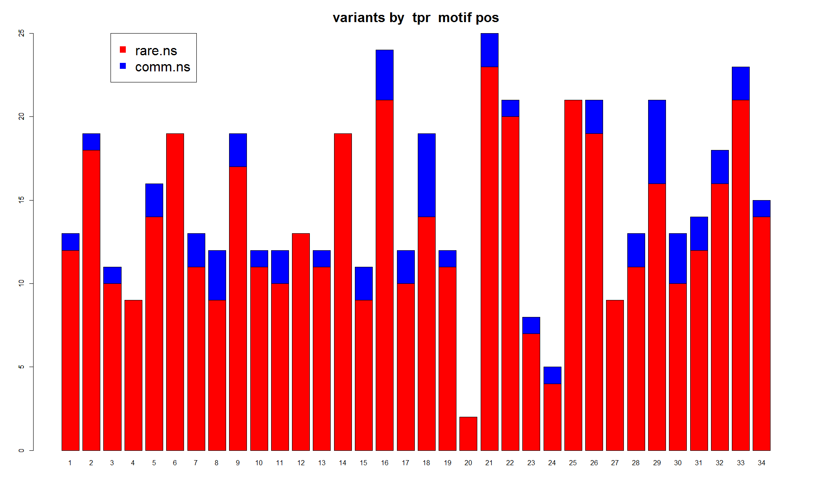
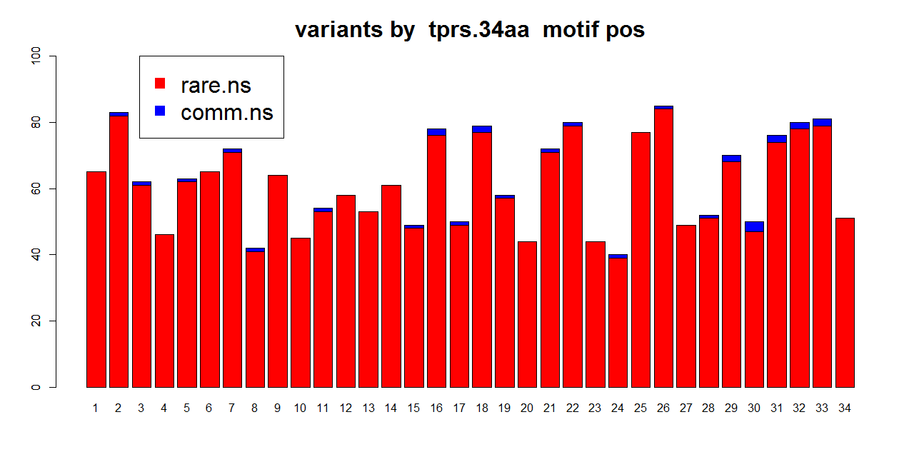
1KG
12
6
25
1KG.ESP6500
6
0
ExAC
Notes:
No S2 will remove the SNV at position 20

Slide 45
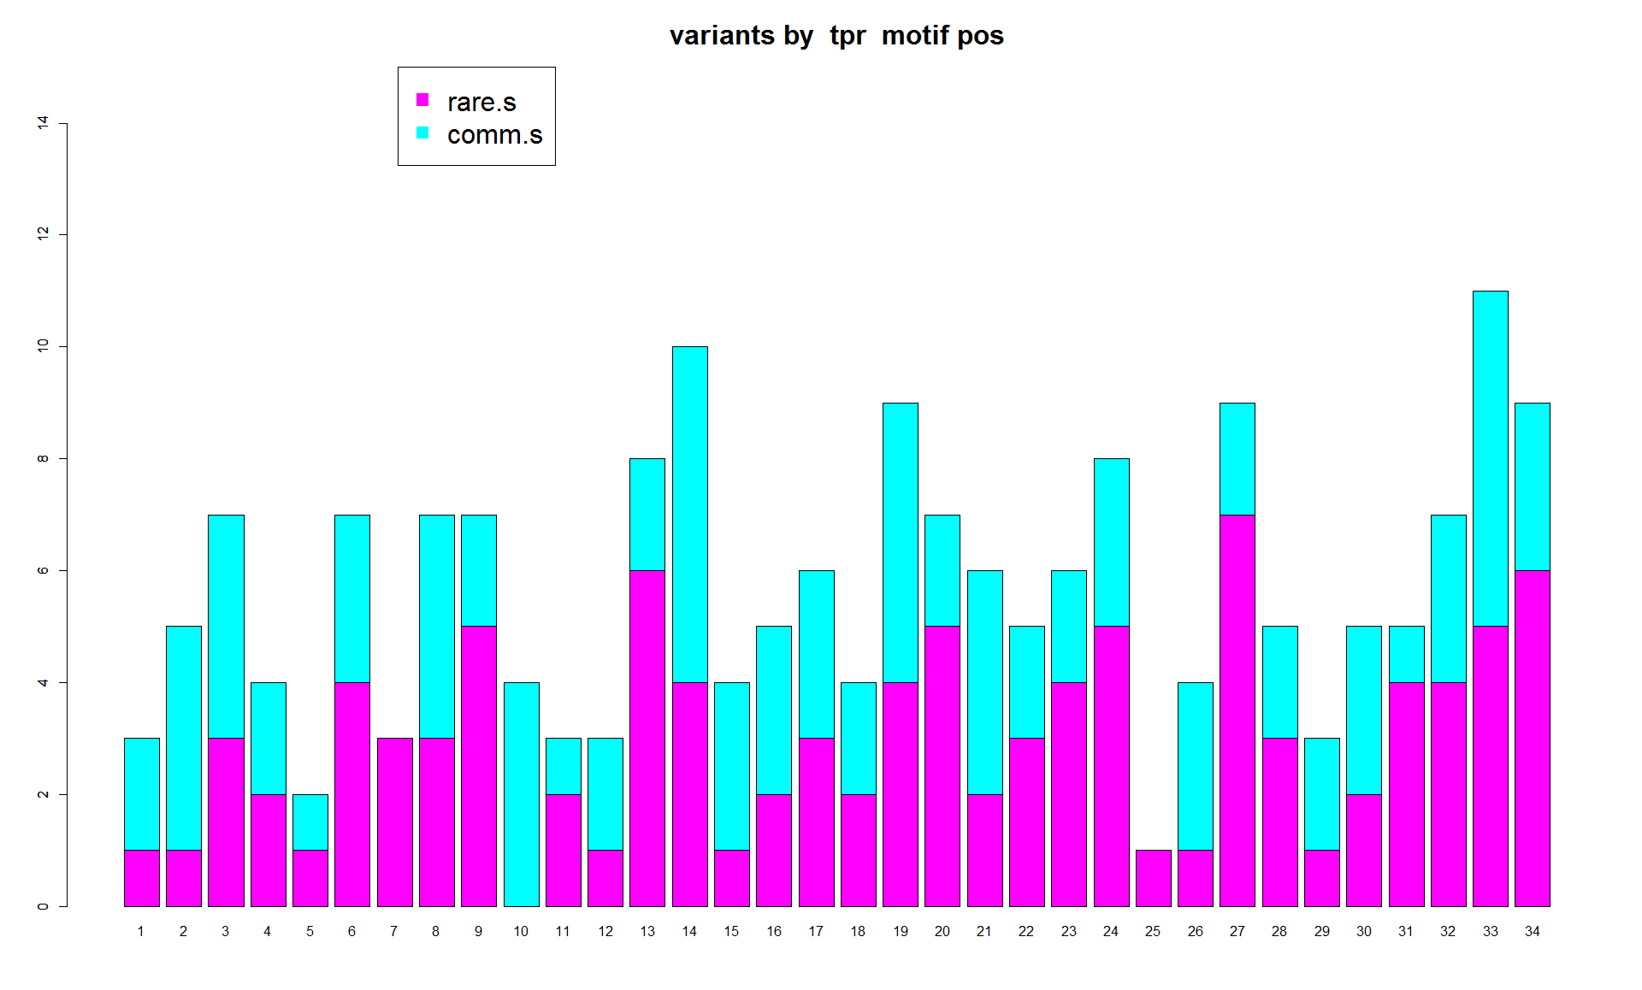
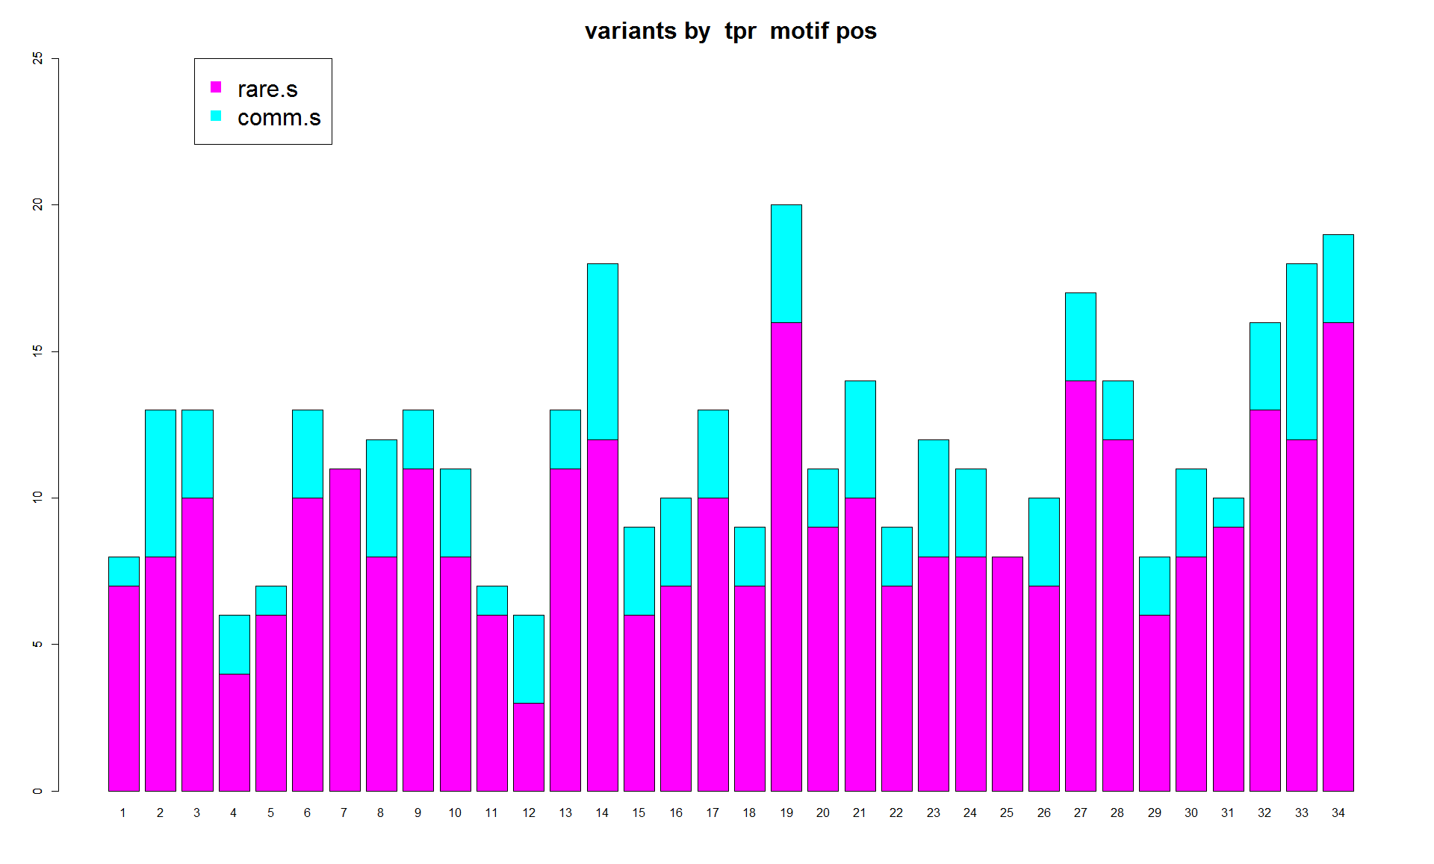
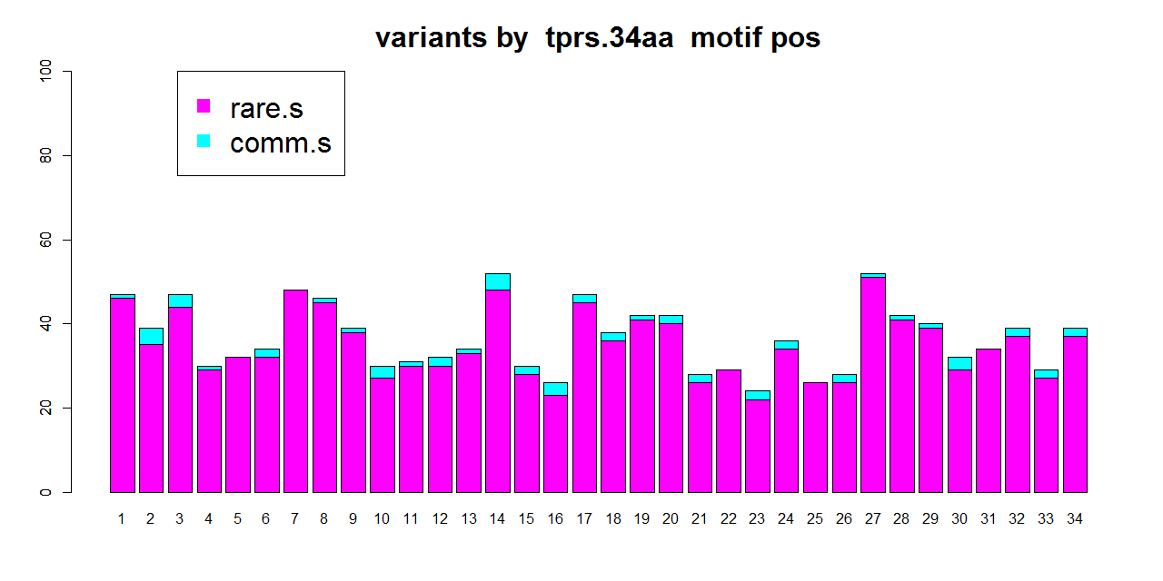
1KG
12
6
25
1KG.ESP6500
6
0
ExAC
Notes:
No S2 will remove the SNV at position 20

Slide 46
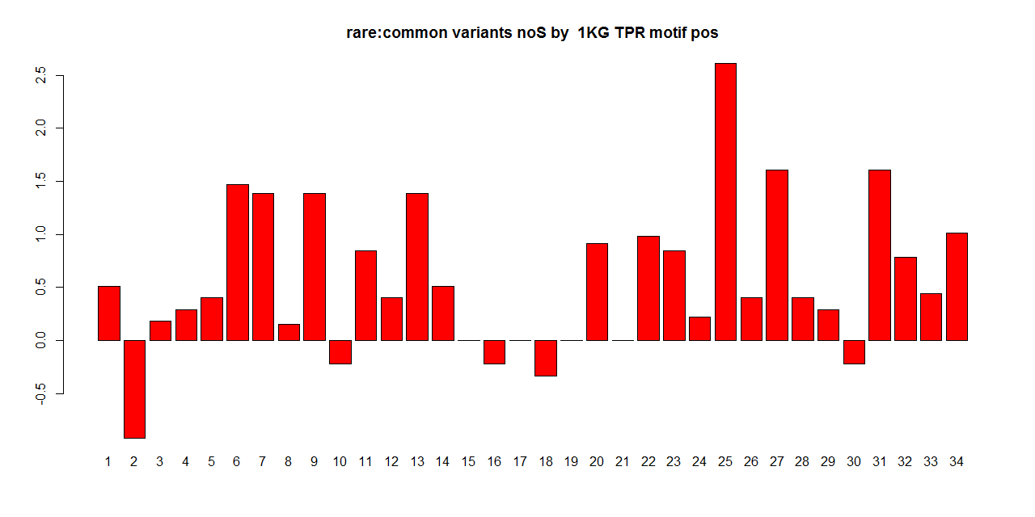
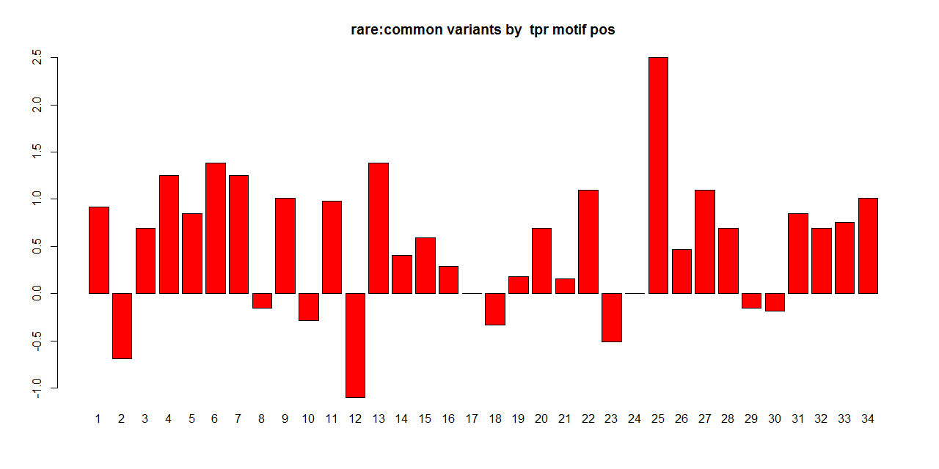
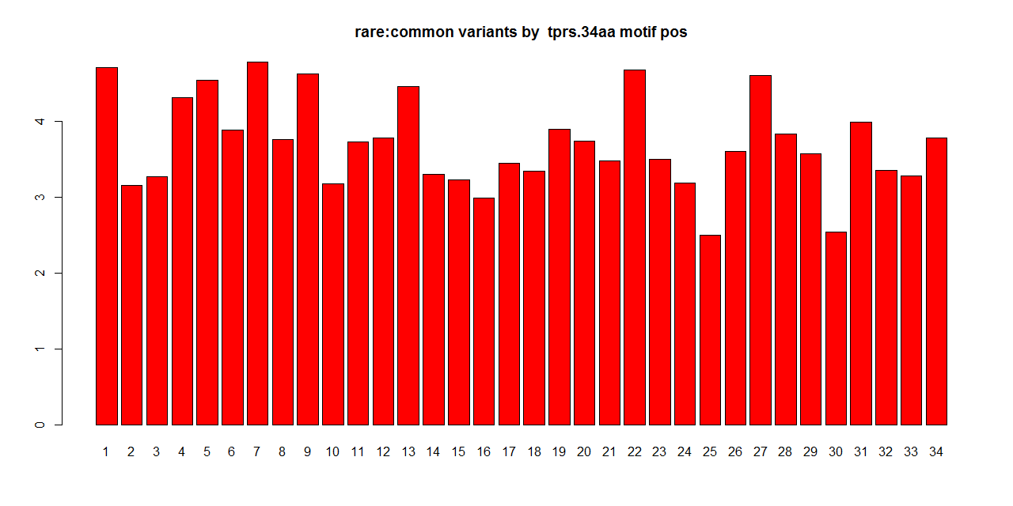
1KG
2.5
Rare2comm ratio
0
-1
2.5
1KG.ESP6500
0
-1
ExAC
4
0

Slide 47
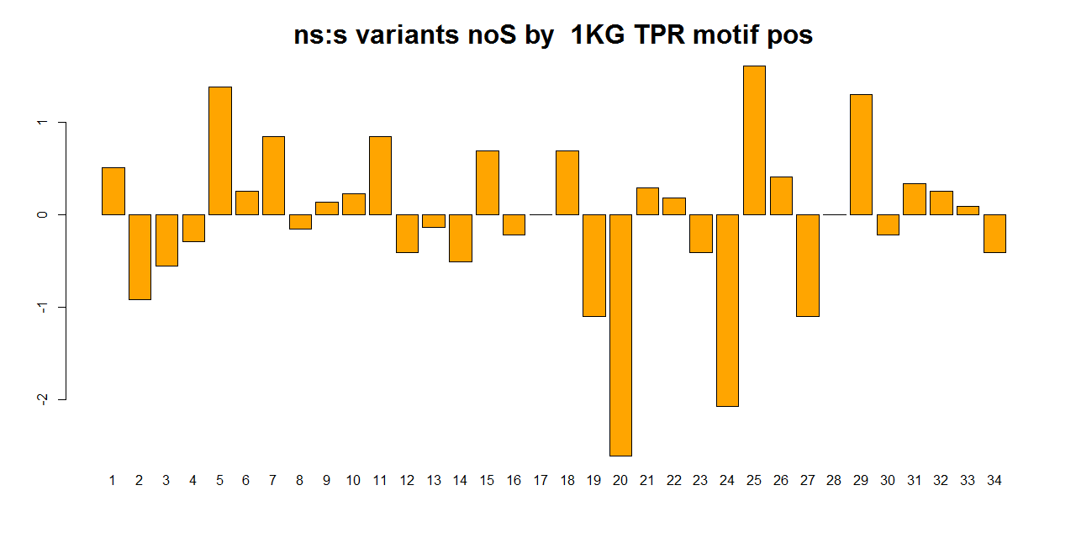
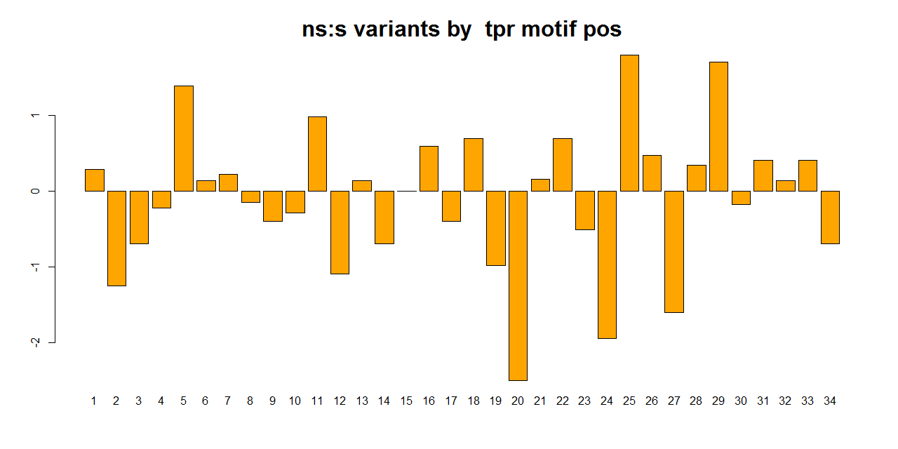
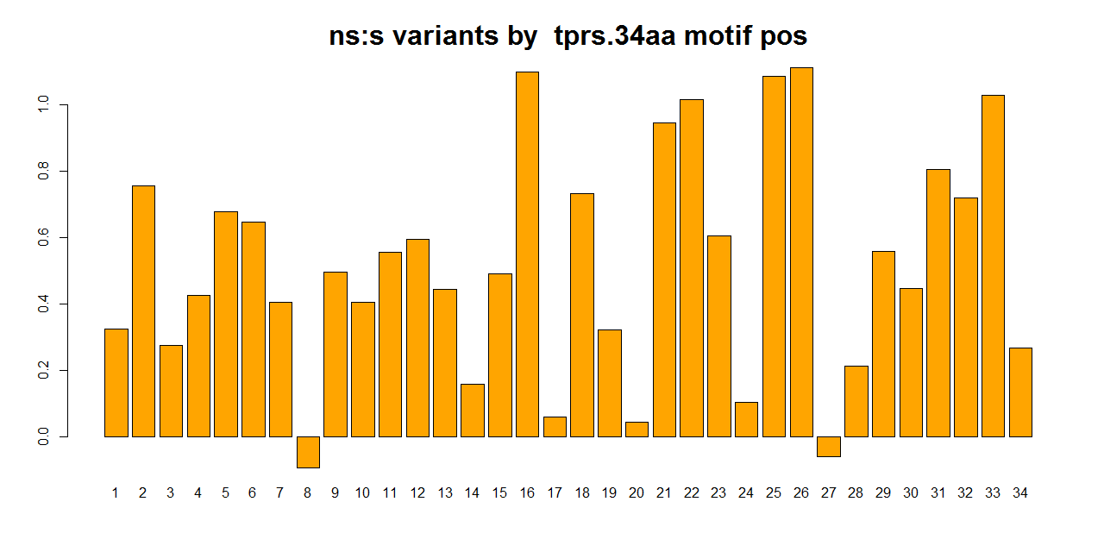
1KG
2
ns2s ratio
0
-2.5
1KG.ESP6500
1
0
-2.5
ExAC
1
0

Slide 48
So… MORE exomes
Many more exomes = more SNVs
Potentially introduces more noise, e.g. position 20
But provide much better signal-to-noise ratio
Focus on ExAC data

Slide 49
Important residues:
Structural versus Functional positions
Hypothesis:
Conserved positions :
structural (involved in motif folds)
Hypervariable positions :
functional (involved in binding)
+ nonfunctional random positions
→ Can we identify functional hypervariable
positions?
Hypervariable
Conserved sites
Magliery & Regan, BMC Bioinformatics, 2005

Slide 50
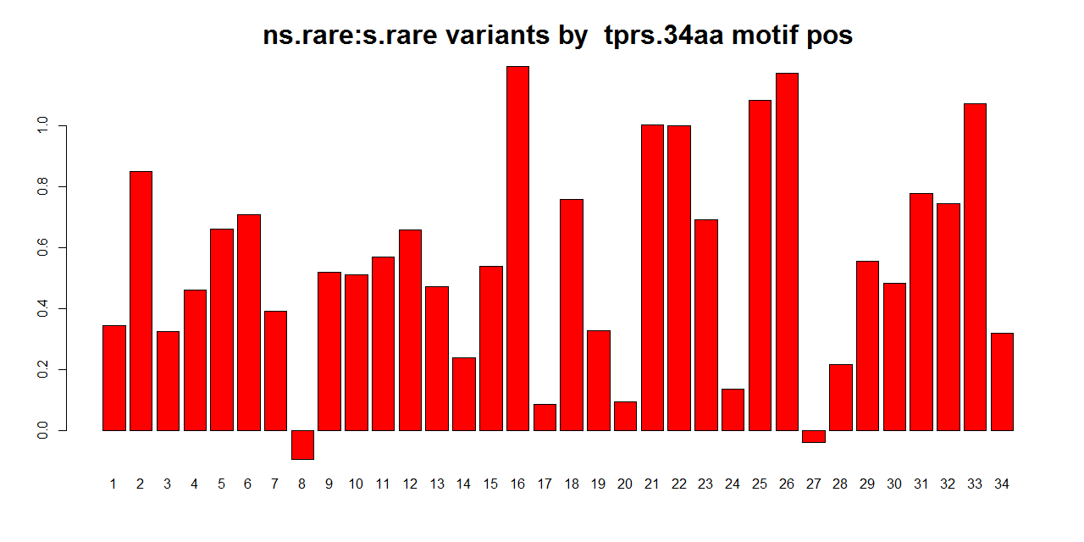
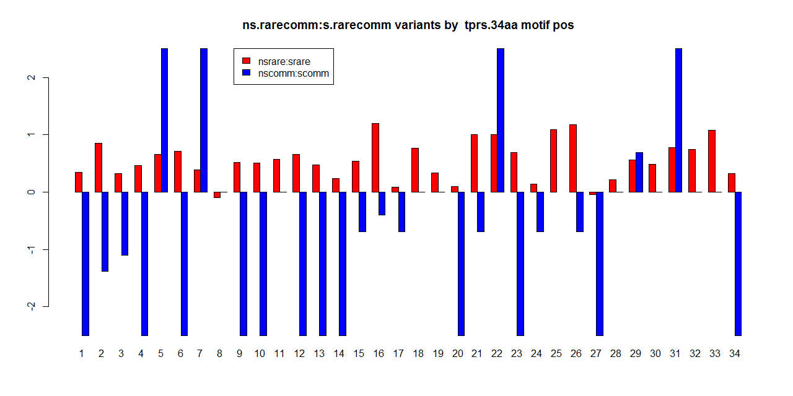

Slide 51
Rare2comm ratio

Slide 52
Ns2s ratio

Slide 53
Every position is enriched in rare variants!
Sequence conservation not correlated with enrichment of rare SNVs at each position
Trend : strong depletion of NS mutations at highly conserved positions (structurally important)
Driven largely by nature of mutations (NS/S) rather than by allele freq (rare/common)
Can we then distinguish functional hypervariable positions?

Slide 54
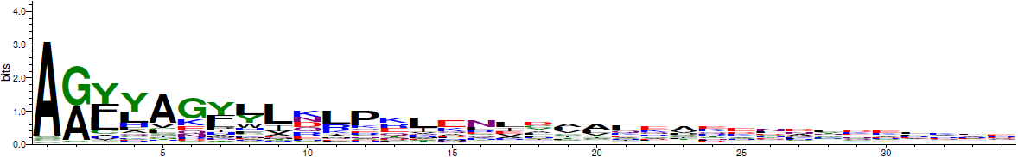
Decide conserved and hypervariable positions
20 8 24 11 27 15 17 4 28 16 7 32 26 30 19 6 21 23 10 3 14 29 1 25 18 34 31 5 33 22 12 13 9 2

Slide 55
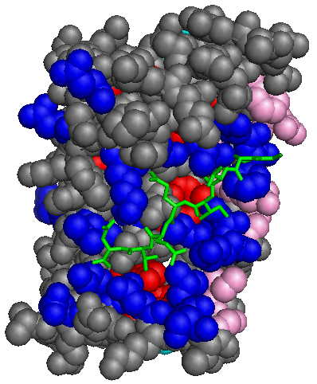
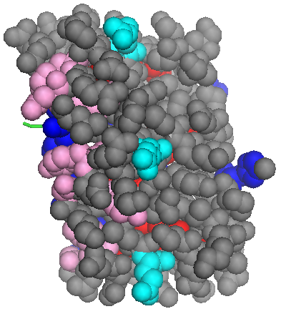
Decide conserved and hypervariable positions
concave
convex
PDB:1ELW
20 8 24 11 27 15 17 4 28 16 7 32 26 30 19 6 21 23 10 3 14 29 1 25 18 34 31 5 33 22 12 13 9 2

Slide 56
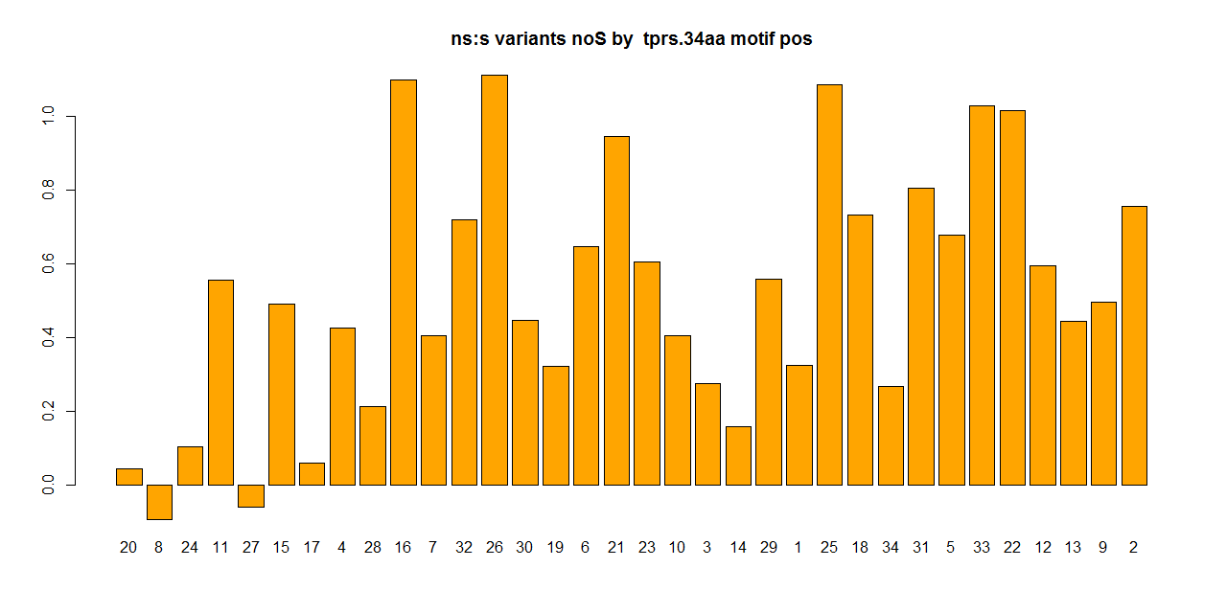
Ns2s ratio
20 8 24 11 27 15 17 4 28 16 7 32 26 30 19 6 21 23 10 3 14 29 1 25 18 34 31 5 33 22 12 13 9 2

Slide 57
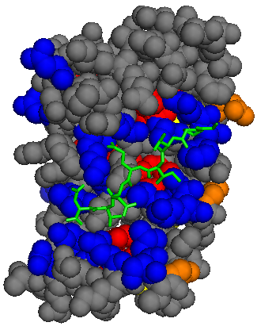

Ns2s ratio
20 8 24 11 27 15 17 4 28 16 7 32 26 30 19 6 21 23 10 3 14 29 1 25 18 34 31 5 33 22 12 13 9 2
Notes:
NS2S rato > check NS mutations : all hets? > BLOSUM score
Almost all, except 2
AC_Adj AC_Het
183 179 L>M
3479 2989 R>Q

Slide 58
ns2s ratio low at conserved positions
Except position 11 (at core??) and 15 (at surface)
Might be due to similarity in physicochemical nature of residue change

Slide 59

BLOSUM62
Notes:
Between BLOSUM 30, BLOSUM 62
What if we take away S?
NS changes concentrate around neutral or <neutral/deleterious changes in general in both matrices
Pos20 in BLOSUM 62 concentrates on neutral aa changes, while BLOSUM 30 has positive aa changes → why?
But it seems that physicochemical changes do not show as much information as conservation
What are these changes? Heatmaps….

Slide 60

Sequence identity among human TPR sequences

Slide 61

Notes:
All BLOSUM matrices seem similar
Between BLOSUM 30 to BLOSUM 62 from sequentially divergent to sequentially more conserved
Conserved positions concentrated with BLOSUM scores of 0s (more neutral) and 4/5s (probably dominated by synonymous changes)
Nothing much in the hypervariable positions
Pos 24 and 34 seem to be able to accommodate a large spread of aa changes; weird on pos24
Pos 28 has high number of positive aa changes accommodated (high S?)

Slide 62
Notes:
Between BLOSUM 30, BLOSUM 62
What if we take away S?
NS changes concentrate around neutral or <neutral/deleterious changes in general in both matrices
Pos20 in BLOSUM 62 concentrates on neutral aa changes, while BLOSUM 30 has positive aa changes → why?
But it seems that physicochemical changes do not show as much information as conservation
What are these changes? Heatmaps….

Slide 63
Each position can accommodate a wide range of aa changes
Physicochemical similarity does not seem to explain
What about potential functional impact of an amino acid change?
-- SIFT: if a SNV occurs at an aa conserved across species, it is probably disruptive

Slide 64

1-SIFT
Notes:
1-SIFT

Slide 65

Functional impact
20 8 24 11 27 15 17 4 28 16 7 32 26 30 19 6 21 23 10 3 14 29 1 25 18 34 31 5 33 22 12 13 9 2

Slide 66
Functional impact
20 8 24 11 27 15 17 4 28 16 7 32 26 30 19 6 21 23 10 3 14 29 1 25 18 34 31 5 33 22 12 13 9 2

Slide 67


Functional impact
20 8 24 11 27 15 17 4 28 16 7 32 26 30 19 6 21 23 10 3 14 29 1 25 18 34 31 5 33 22 12 13 9 2

Slide 68


Is functional impact a way to distinguish
between hypervariable functional vs
nonfunctional positions?
Functional impact
20 8 24 11 27 15 17 4 28 16 7 32 26 30 19 6 21 23 10 3 14 29 1 25 18 34 31 5 33 22 12 13 9 2

Slide 69
Future
Try on other repeat domains (e.g. ankyrins) and short linear domains (e.g. PDZ)

Slide 70
Acknowledgements
Gerstein Lab
Suganthi Balasubramanian,
Variation subgroup
Mark Gerstein
Regan Lab
Nicholas Sawyer
Lynne Regan

