Slide 1
Intratumor heterogeneity in localized lung adenocarcinomas delineated by multiregion sequencing
Science, 10 October 2014:
Vol. 346 no. 6206 pp. 256-259
DOI: 10.1126/science.1256930

Slide 2
Contents
Part I: Background
Part II: Materials & Methods
Part III: Results
Part IV: Conclusion & Discussion

Slide 3
Part I: Background
Intratumor heterogeneity (ITH)
a phenomenon that cancers are composed of populations of cells with distinct molecular and phenotypic features;
have impacts on tumor biopsy strategy, characterization of actionable targets, treatment planning, and drug resistance;
use of next-generation sequencing (NGS) approaches
A model of branched evolution
studies in clear cell renal carcinoma (ccRCC): ITH & mutation in cancer genes confined to spatially separated tumor regions;
a single biopsy may be inadequate;
extent to apply to other solid tumors is unclear

Slide 4
Part II: Materials & Methods
Whole-exome sequencing (WES)
localized lung adenocarcinomas;
48 tumor regions from 11 patients in stage I, II, and III (8/2/1);
matched peripheral blood leukocytes as germ line DNA control;
mean depth: 277x;
variant calling and validation by capture sequencing (mean depth: 863x)
Phylogenetic analysis
based on mutation profiles;
ancestor: germ line DNA assuming with no mutations
PHYLIP: Multistate discrete-characters Wagner parsimony method
Detection of copy number aberration, subclonal analysis, etc.

Slide 5
Part III: Results
In total, 7269 mutations were identified, and 7026 (97%) somatic mutations were validated;
Mutation identified in all regions of individual tumors:
76% of all mutations;
20 out of 21 known cancer gene mutations;
single-region sequencing may be adequate to identify the majority of known cancer gene mutations;
20 = 13 known cancer gene point mutations + 6 amplification + 1 deletion;
known cancer mutations: BRCA1, EGFR, TP53, etc.

Slide 6
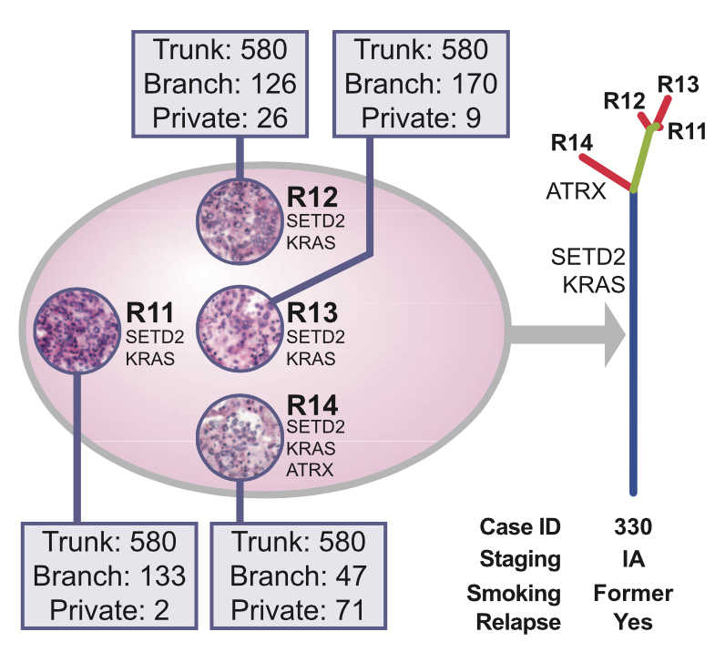
Part III: Results
Showing ITH by tree structure based on mutation profiles
Trunk: ubiquitous mutations present in all regions of the tumor;
Branch: heterogeneous mutations present in only some regions of the tumor;
Private branch: mutations present only in one region of the tumor.
Placement of mutations reflects relative molecular time of acquisition
“Branch” subsequent to “trunk”

Slide 7
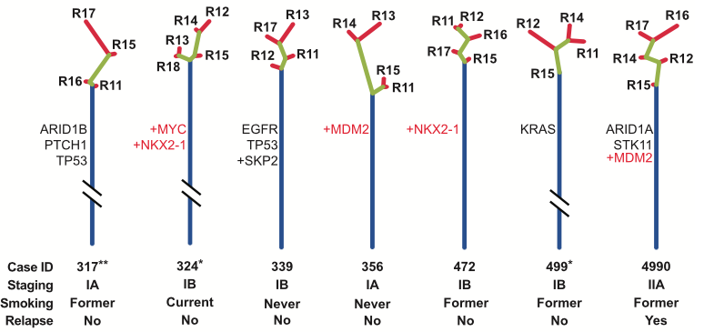
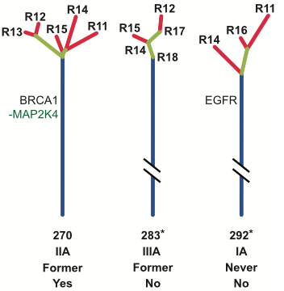
Part III: Results
Assessment of ITH of 11 lung adenocarcinomas by multiregion sequencing
Black: point mutation; ‘+’: amplification; ‘-’: deletion; Lengths of trunk & branch proportional to the number of mutations;
13/14 known cancer gene point mutations were mapped to the trunks of the phylogenetic trees;
acquired relatively early during evolution & shared by all subclones of individual cancer
Amplification and/or deletion of known cancer genes were also early molecular events;
Different cancer types may have different relative timing of acquisition of cancer gene mutations;
Patients had relapsed: larger proportion of subclonal nontrunk mutations; (P = 0.006);
larger subclonal mutation fraction may be associated with an increased likelihood of postsurgical relapse

Slide 8
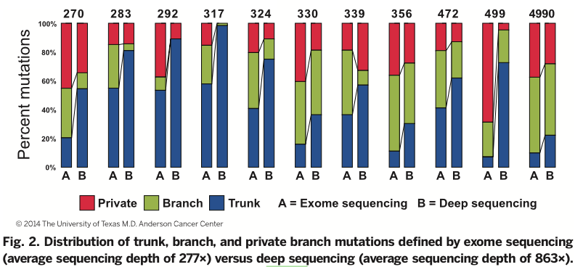
Part III: Results
Assesse effect of sequencing depth on detecting cancer gene mutations, in defining ITH
branch and private branch mutations defined by WES trunk mutation defined by deep sequencing;
considerable depth of sequencing will be necessary to detect cancer gene mutations & to accurately characterize ITH

Slide 9
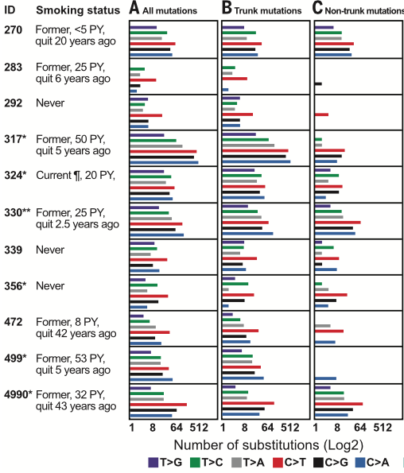
Part III: Results
Mutation spectrum of the 11 lung adenocarcinomas
C>T predominant in never smokers & people quit long time before;
C>A predominant in people quit shorter time before;
C>T (26%) & C>A (21%) in a current smoker
Mutation spectra reflect quantity of smoking exposure & time since smoking cessation
*/**: significant difference between trunk & non-trunk
Specific mutational processes were
likely operative at different times during development

Slide 10
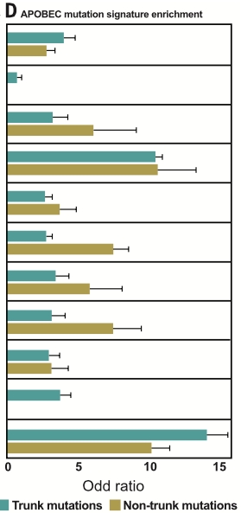
Part III: Results
APOBEC mutation signature enrichment
APOBEC activity: a major source for C>T and C>G mutations;
More pronounced for nontrunk mutations compared with trunk mutations in 7 of the 11 patients;
statistically significant only for case 330
APOBEC- like process tends to be more pronounced in later, subclonal mutations

Slide 11
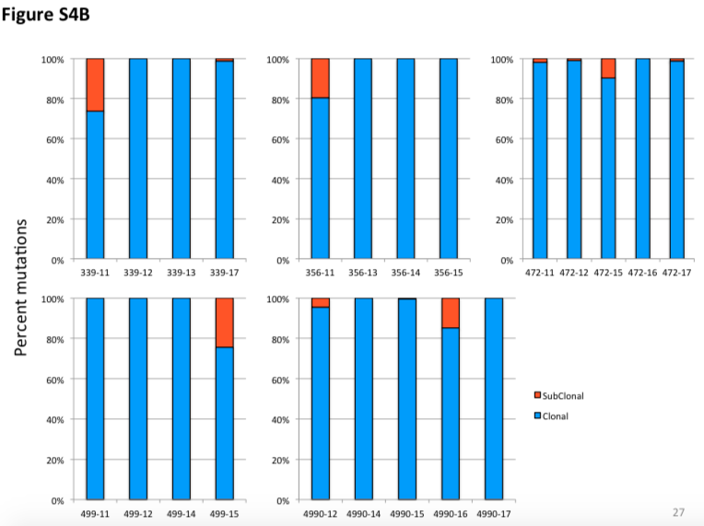
Part III: Results
More analysis:
Used ABSOLUTE algorithm to formally characterize subclonal fraction;
29/48 individual tumor regions showed evidence of intraregional subclonal populations;
distribution of clonal and subclonal mutations was different among the sampled regions within the same tumors in some patients
Single-biopsy analysis would be inadequate to fully represent ITH in these tumors.

Slide 12
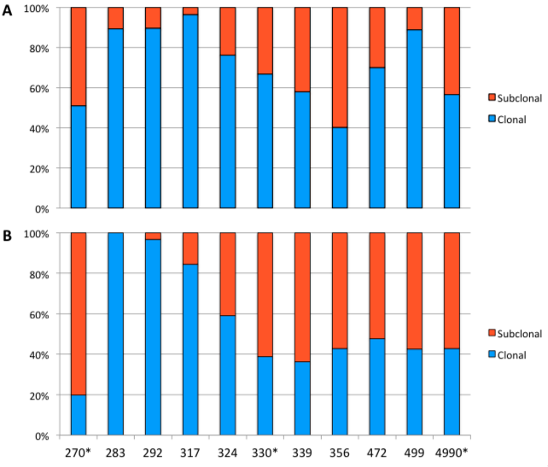
Part III: Results
More analysis:
repeated the ABSOLUTE analysis on the combined sequencing data from all tumor regions of each patient to assess the global ITH on a per-patient level;
relative proportion of subclonal mutations
All three patients with relapsed disease had larger subclonal fractions in their primary tumors
Figure A: ABSOLUTE results (41% vs. 24%; P=0.045)
Figure B: Dirichlet process (66% vs. 36%; P=0.035)
A measure of overall subclonal fraction may be of interest from a prognostic standpoint.

Slide 13
Part IV: Conclusion & Discussion
ITH patterns may be different between cancer types;
Single biopsy analysis at appropriate depth might be sufficient to identify the majority of known cancer gene mutations in this subset of lung adenocarcinomas;
A larger subclonal mutation fraction may be associated with increased likelihood of postsurgical relapse
Studies in much larger cohorts, ideally with comprehensive clinical annotation and repeat biopsy at relapse, are needed;
Extension of research to epigenetic and phenotypic assessment
regional DNA methylation;
chromatin state;
RNA and/or protein expression studies;
over time and under treatment;
Fully understand the impact of ITH on the biology of the cancer itself and its impact on the clinical phenotype of cancer patients

