Slide 1
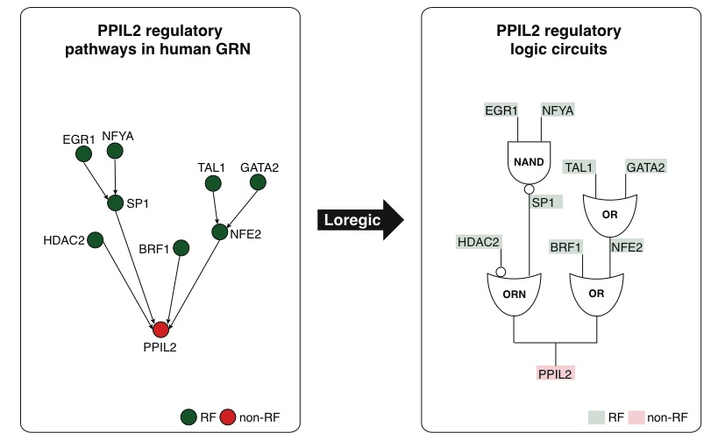
Gene regulatory pathways have logic-circuit behaviors
Hierarchical structure
Immunological gene, HIV
Wang, et al., PLoS Computational Biology, 2015
Notes:
Going beyond the prediction of the cooperative logics of individual RFs that directly regulate a target, we are interested in identifying all the logic gates matching triplets involved in the target regulatory pathway, in order to obtain a coherent logic circuit pathway. For example in Figure 7A, Loregic found that there are two regulatory pathways regulating the target gene, PPIL2 in human K562. PPIL2 is an important cyclophilin member in immunological suppression. These two pathways contain 4 logic-gate-consistent triplets forming a two-layer hierarchical structure. By replacing these triplets with corresponding matched logic gates, we obtain the logic circuit regulatory pathways for the target gene (Figure 7B).

Slide 2
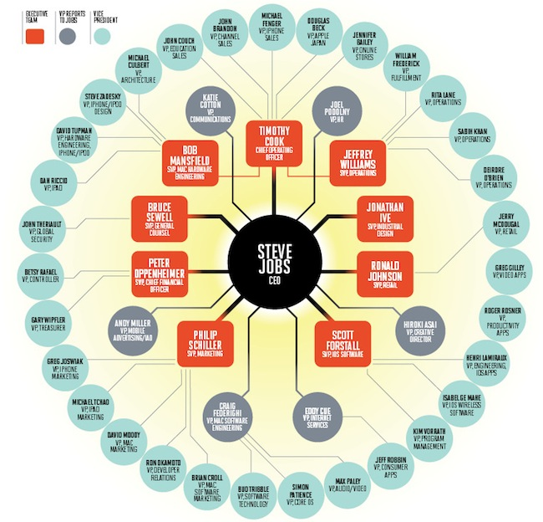
Network Stats to Identify Hierarchy
In-degree = 1
TF out-degree = 3
TF target
non-TF target
Hierarchy Height Statistic =
(normalized TF Out deg. – In deg.)

Slide 3
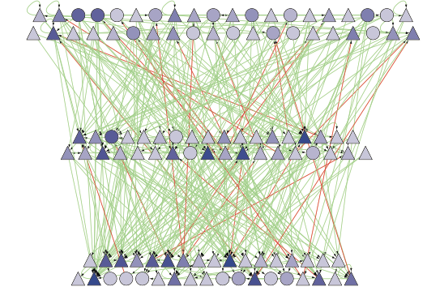
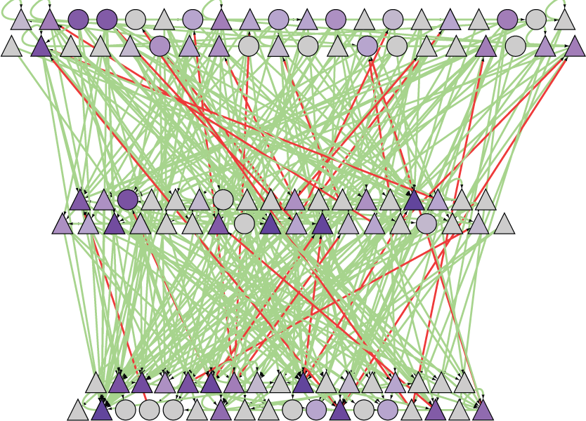
Strongest Proximal Regulatory Edges Can be Arranged into a Hierarchy
betweenness
Global wiring pattern of TFs
Middle level has highest betweenness, creating info. flow bottlenecks
[ Gerstein et al. Nature (in press, '12) ]

Slide 4
Methods
Breadth-first Search
Simulated annealing
Hierarchy Score Maximization (HSM)

Slide 5
Algorithms for Defining Hierarchical Structure
Breadth-first Search
Minimize upward edges
Maximize hierarchy score

Slide 6
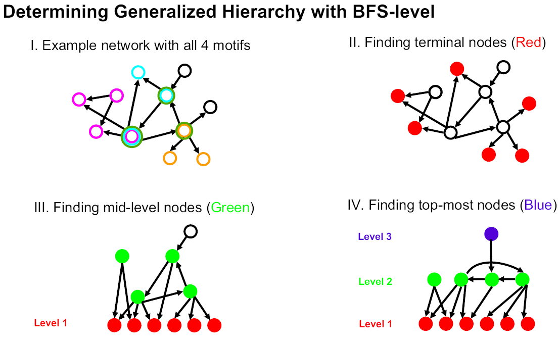
Breadth-first Search
[Yu et al., PNAS (2006)]
Notes:
We call this construction method "BFS-level" (Breadth-First Search to define Level). As
described in Figure 1B, it is based on a straightforward application of breadth-first search:
we first identified all TFs at the bottom level (i.e., level 1). A TF is at the bottom level if
and only if it does not regulate other TFs. TFs that only regulate themselves (i.e., autoregulation)
are also placed at the bottom. Starting from each bottom TF, we then
performed a breadth-first search to convert the whole network into a "breadth-first tree"
(18) (see Figure 2A and Table 1A). In other words, we define the level of a non-bottom
TF in the hierarchy as its shortest distance from a bottom one. Here, the construction
procedure is only focused on inter-regulation between TFs (or officials in social
networks). A top TF could directly regulate non-TF target genes (or a higher-ranked
official could have an assistant with no managerial responsibility), but this will not affect
the constructed hierarchy. If the resulted layered structure has a pyramidal shape (i.e.,
few nodes at the top and most nodes at the bottom), we, then, considered it as a
generalized hierarchy.

Slide 7
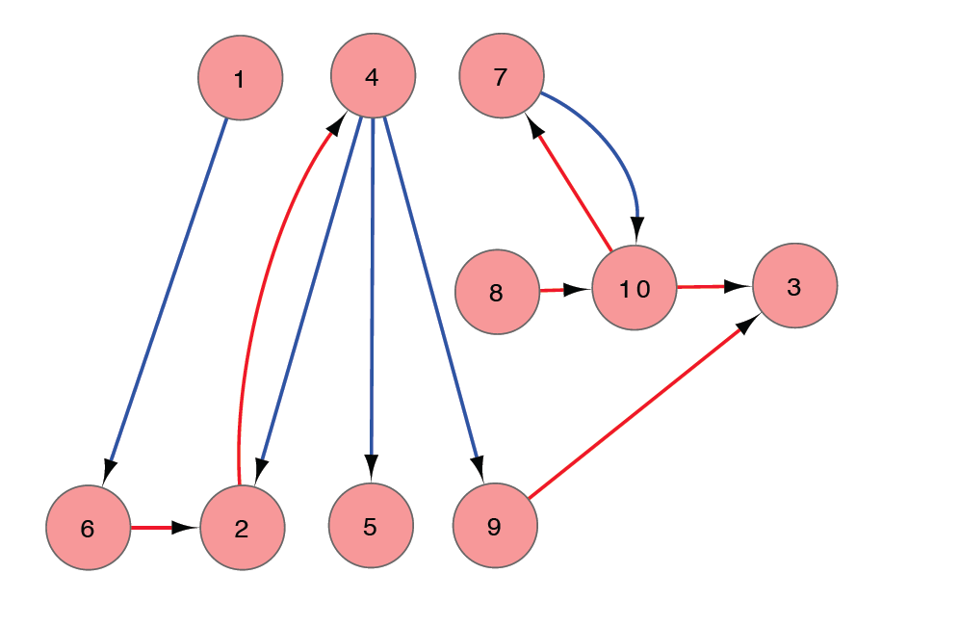
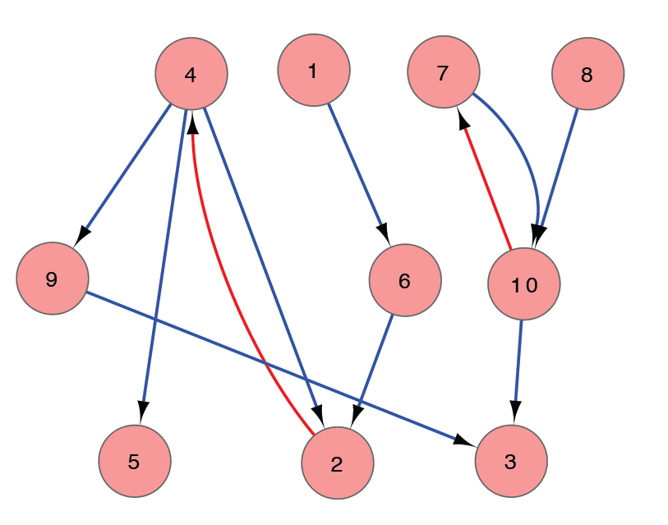
SIM ANNEALING -- KKY
Minimize Upward Edges
Hierarchy height distribution approximated by 3 levels
Probing direction framed as an optimization problem
simulated
annealing
[ Gerstein et al. Nature (in press, '12) ]

Slide 8
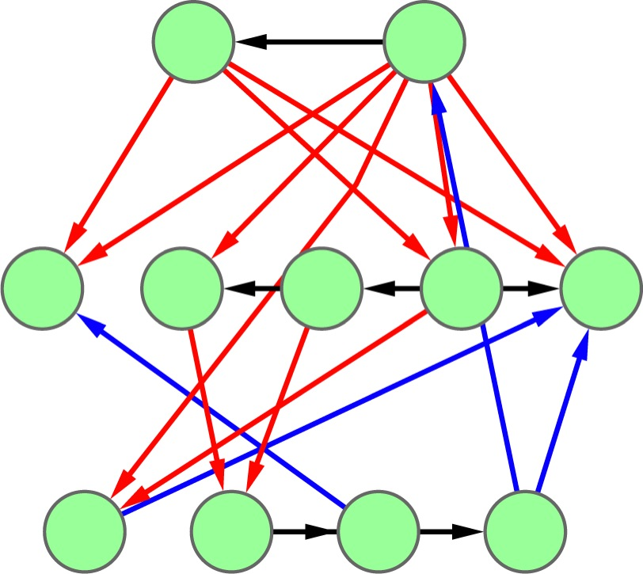
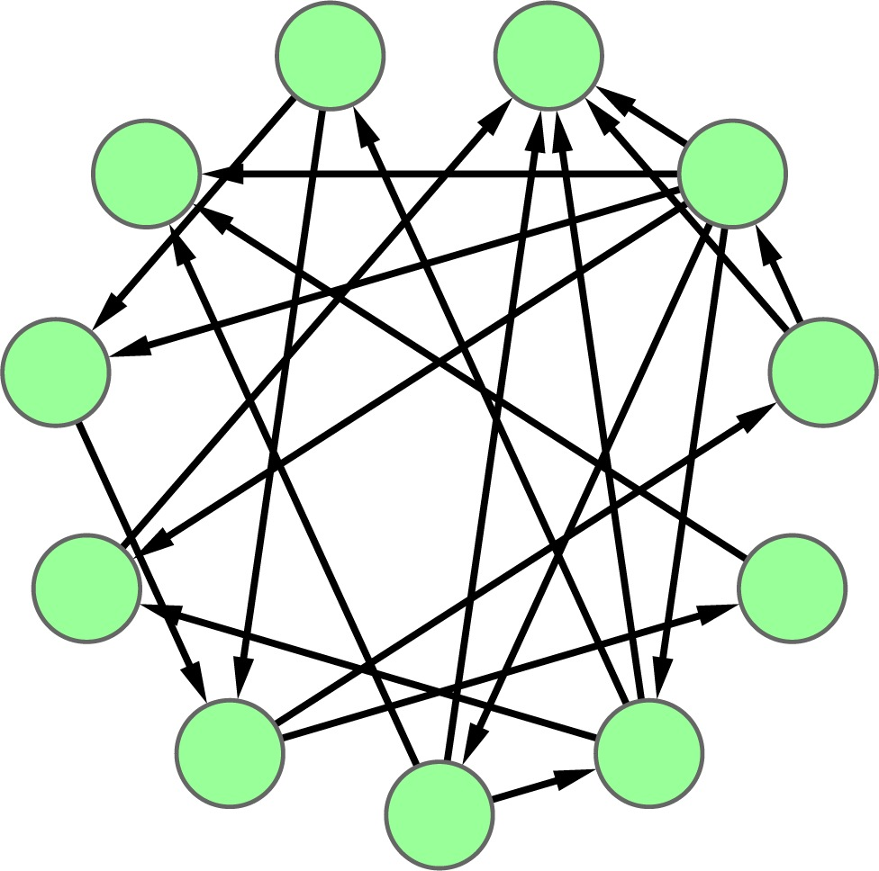
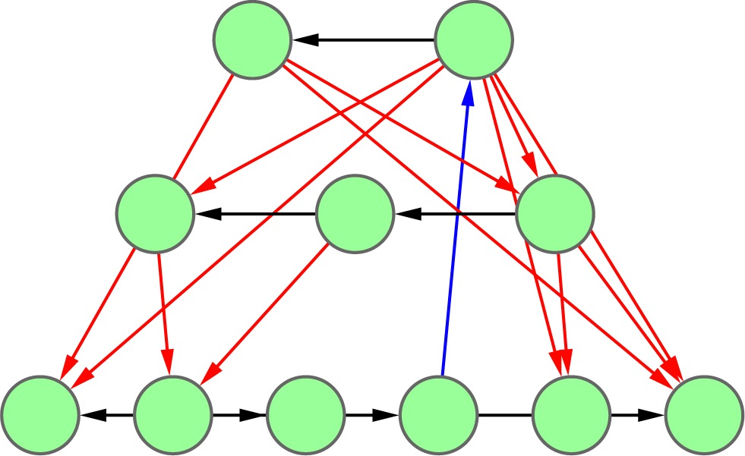
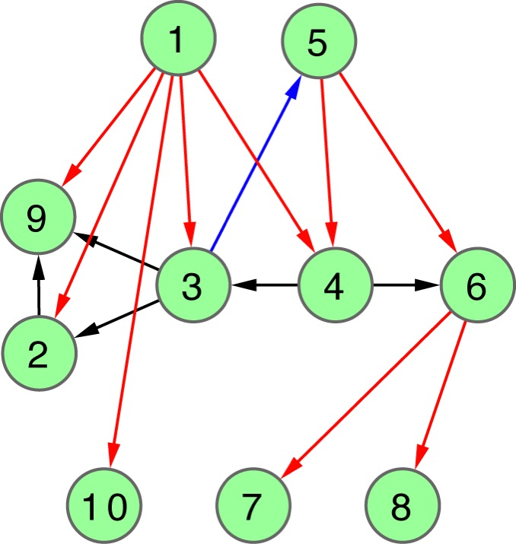
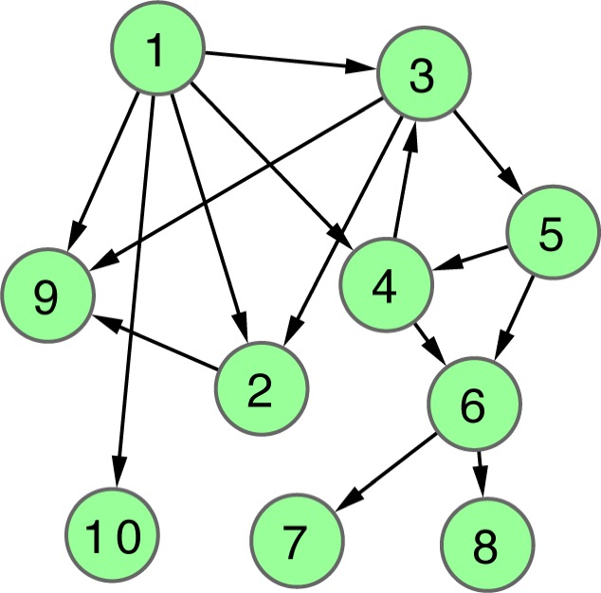
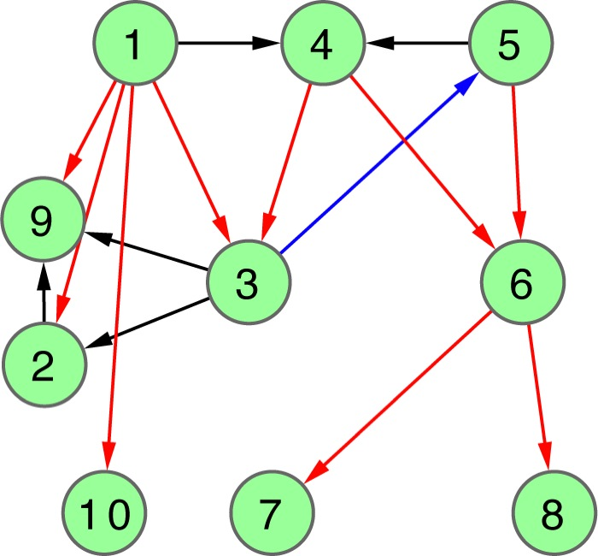
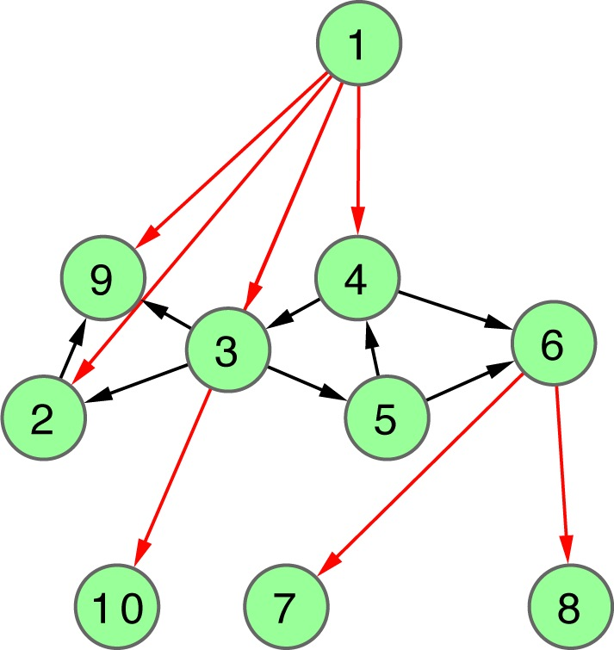
Hierarchy Score Maximization Algorithm
Definition
Simulated annealing
maximize HS
HSM algorithm
L1 L2 L3
N1
N2
N3
N4
N5
N6
N7
N8
N9
N10
L3
.
L2
.
repeat k times
.
L1
Discretized hierarchy network
Probabilistic hierarchy network
[ Cheng et al. GenomeBiol. (in press, ’15) ]

Slide 9
Hierarchy Score Maximization Algorithm
Definition
Simulated annealing
maximize HS
HSM algorithm
L1 L2 L3
N1
N2
N3
N4
N5
N6
N7
N8
N9
N10
L3
.
L2
.
repeat k times
.
L1
Discretized hierarchy network
Probabilistic hierarchy network
[ Cheng et al. Genome Biol. (in press, ’15) ]

Slide 10
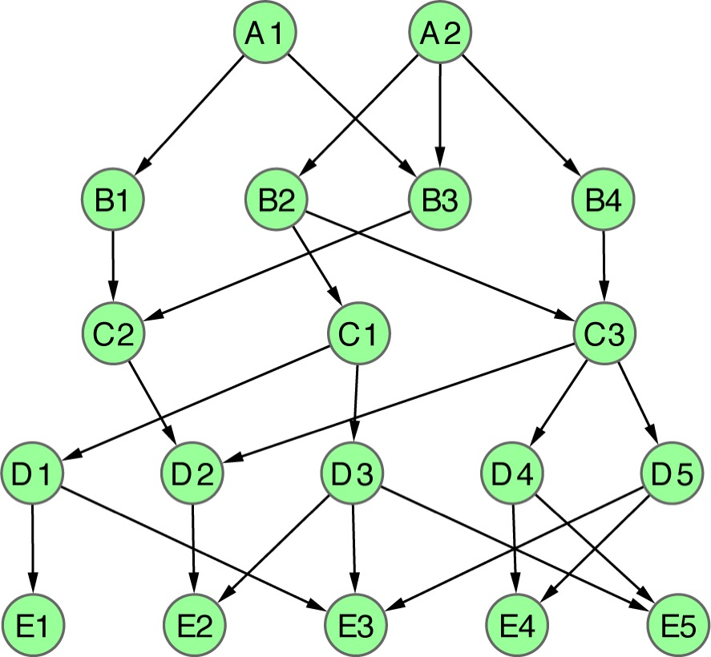
Apply HSM to a toy example
L=5
L=4
L=3
L=2
L=1
1 2
1 2 3
1 2 3 4
1 2 3 4 5
1 2 3 4 5 6
1 2 3 4 5 6 7
1 2 3 4 5 6 7 8
A1
A2
B1
B2
B3
B4
C1
C2
C3
D1
D2
D3
D4
D5
E1
E2
E3
E4
E5
[ Cheng et al. GenomeBiol. (in press, ’15) ]
|L|=2
HS=2.1
CHS=2.4
PHS=2.1
|L|=3
HS=5.5
CHS=5.5
PHS=5.5
|L|=4
HS=8.7
CHS=5.4
PHS=8.7
|L|=5
HS=∞
CHS=∞
PHS=∞
|L|=6
HS=∞
CHS=∞
PHS=16.1
|L|=7
HS=∞
CHS=∞
CHS=10.4
|L|=8
HS=∞
CHS=∞
PHS=9.4
Notes:
Fig. 2

Slide 11
Add Haiyuan’s result here???

Slide 12
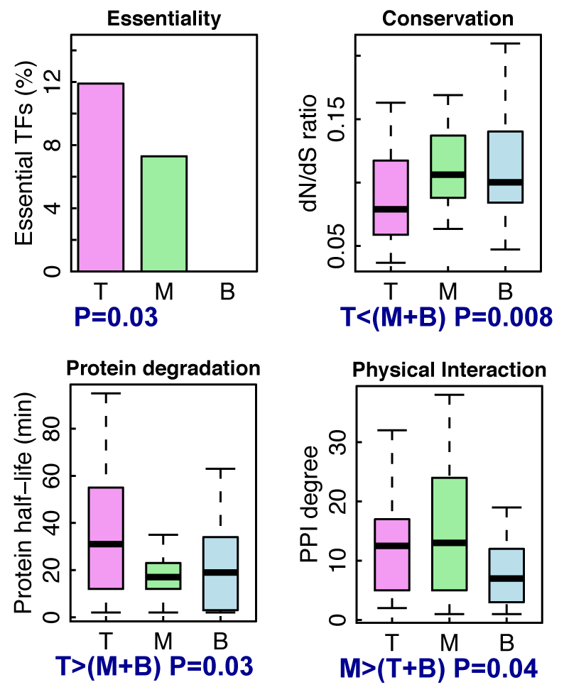
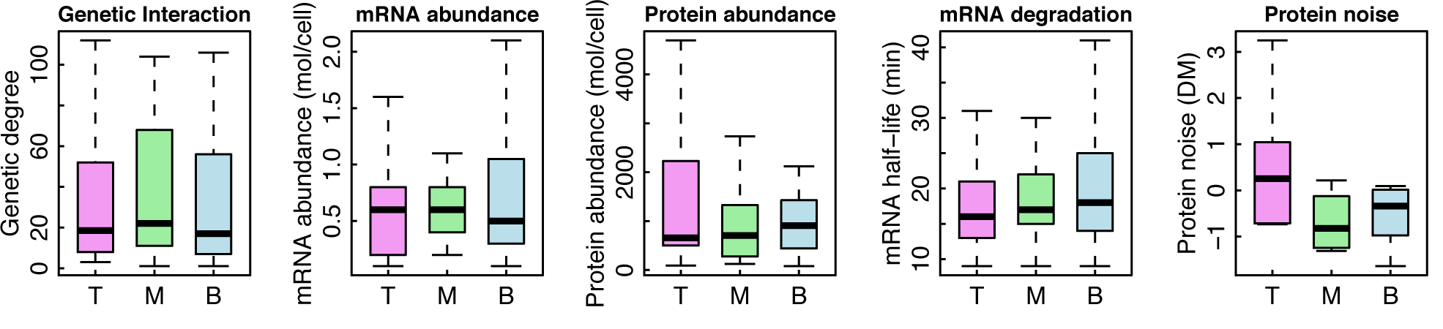
Biological Insights from Hierarchy in Yeast TF Regulatory Network
BFS(L=4)
VS(L=3)
HSM(L=4)
VS(L=7)
HSM(L=3)
up-edge
horizontal
down-edge
HSM(L=3)
BFS(L=4)
VS(L=3)
[ Cheng et al. GenomeBiol. (in press, ’15) ]

Slide 13
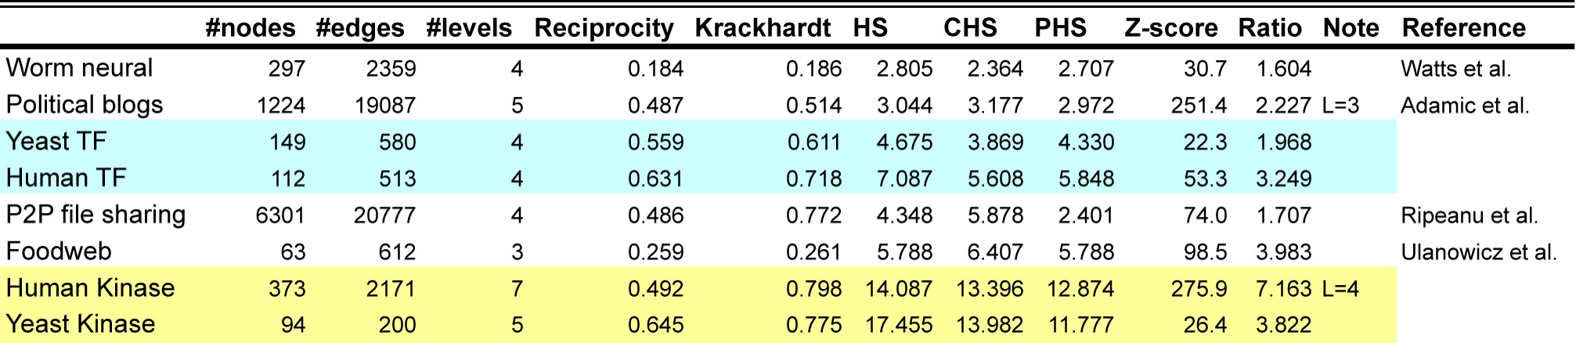
Kinase network is more hierarchical than the TF reg. network
[ Cheng et al. GenomeBiol. (in press, ’15) ]

Slide 14
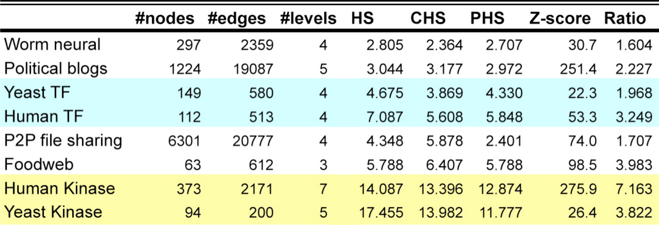
Kinase network is more hierarchical than the TF reg. network
[ Cheng et al. GenomeBiol. (in press, ’15) ]

Slide 15
Logical cooperativity across hierarchical layers in gene regulatory network
Hierarchical gene regulatory network in yeast
Consistency score
The regulations of middle and top TFs more likely follow logical operations than the bottom TFs.
Wang, et al., PLoS Computational Biology, 2015
Notes:
We also constructed the regulatory hierarchical networks with top, middle and bottom layers using yeast TFs [5], and found that the scores for the gate-consistent triplets targeting the bottom TFs are lower than the ones targeting middle and top TFs (Fig. S3), which implies that the regulations of middle and top TFs more likely follow logical operations than the bottom TFs. Also, this tells us that we may need more detailed models such as continuous models than boolean logics to study gene regulation.

Slide 16
Biological Network Analysis:
Hierarchies, Mutational Constraints & Logical Circuits in Regulation
Why Networks ?
  Representational sweet spot + Intuition from cross-disciplinary comparisons
Organizing the Regulatory Network into a Hierarchy
  Construction: local BFS v global simulated annealing
  Information flow bottlenecks in the middle & greater mid-level collaboration to ease them, esp. in more complex organisms
  Differences between kinase & TF hierarchy
Analyzing the Impact of Variation on the Network
  Node Variation: more connectivity = more constraint
  Useful analogies to designed systems
Going from Regulatory Networks to Logical Circuits
  Preponderance of OR gates in the human network v yeast
  Relation to cancer (myc)
  More logical structure at top of heirarchy

Slide 17
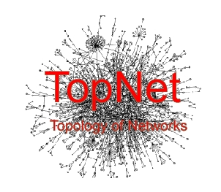

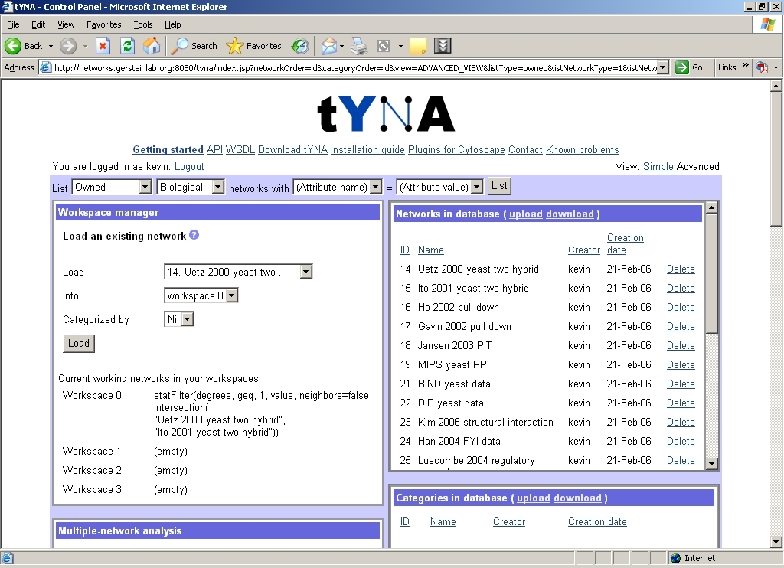
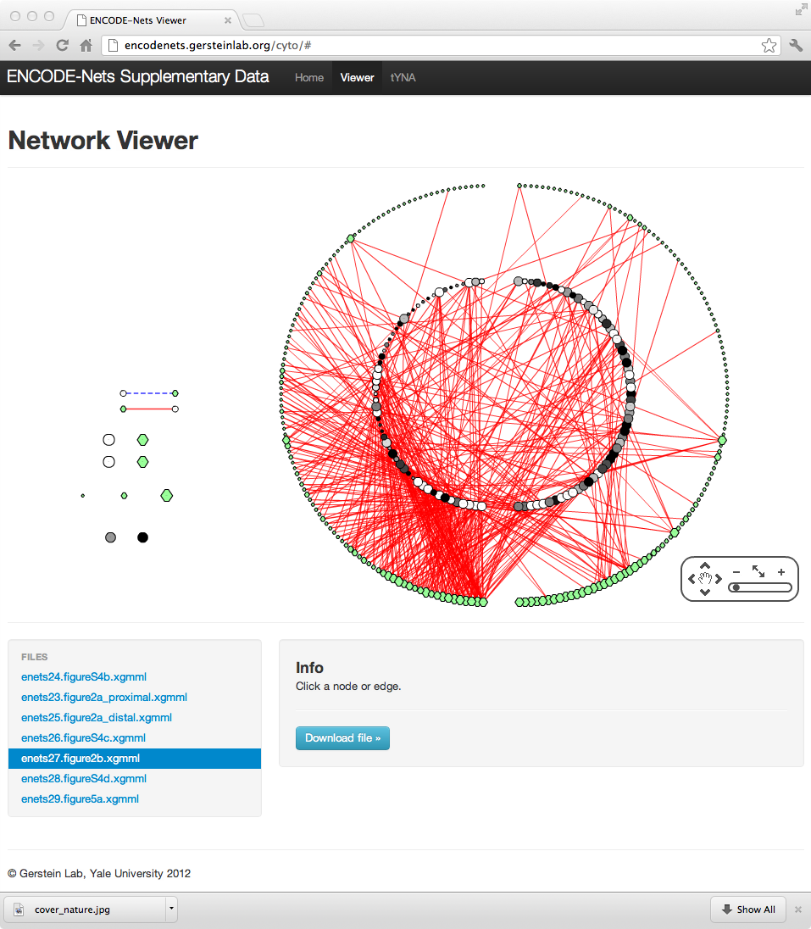
TopNet – an automated web tool
(vers. 2 :
"TopNet-like
Yale Network Analyzer")
  Encodenets.gersteinlab.org, networks.gersteinlab.org
  (tYNA: Normal website + Downloaded code (JAVA) + Web service (SOAP) with Cytoscape plugin)
[Yu et al., NAR (2004); Yip et al. Bioinfo. (2006);
Similar tools include Cytoscape.org, Idekar, Sander et al]

Slide 18


Network
Acknowledgements
A Kundaje, M Hariharan,
S Landt, K Yan, C Cheng,
X Mu, E Khurana,
J Rozowsky,
R Alexander, R Min, P Alves,
A Abyzov, N Addleman, N Bhardwaj,
A Boyle, P Cayting, A Charos, D Chen,
Y Cheng, D Clarke, C Eastman,
G Euskirchen, S Frietze, Y Fu, J Gertz,
F Grubert, A Harmanci, P Jain,
M Kasowski, P Lacroute, J Leng, J Lian,
H Monahan, H O'Geen, Z Ouyang,
E Partridge, D Patacsil, F Pauli, D Raha,
L Ramirez, T Reddy, B Reed, M Shi, T Slifer, J Wang, L Wu, X Yang, K Yip,
G Zilberman-Schapira, S Batzoglou,
A Sidow, P Farnham, R Myers,
S Weissman, M Snyder
(11 Main Projects, ~50 labs, >700 substantial contributors + NHGRI)
Networks/Elements
(~60 participants):
Hiring Postdocs. See gersteinlab.org/jobs !

Slide 19
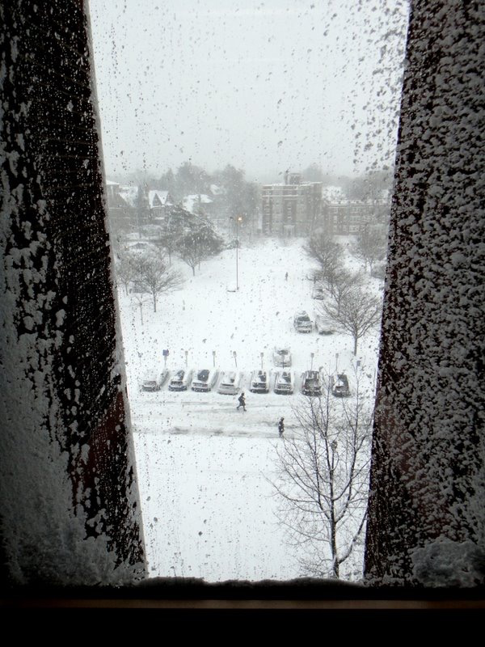
Acknowledgements
Hierarchy Construction –
Chao Cheng, Erik Andrews, Koon-Kiu Yan, Matthew Ung, Daifeng Wang
[papers.gersteinlab.org/papers/hinet coming soon]
Loregic –
Daifeng Wang, Koon-Kiu Yan, Cristina Sisu, Chao Cheng, Joel Rozowsky, William Meyerson [papers.gersteinlab.org/papers/loregic coming soon]
Net hierarchy analysis –
N Bhardwaj, KK Yan
[papers.gersteinlab.org/netheir]
Call graph analysis –
KK Yan, G Fang, N Bhardwaj, RP Alexander [papers.gersteinlab.org/callgraph]
Network Sci. Analogies –
Koon-Kiu Yan, Daifeng Wang, Anurag Sethi, Paul Muir, Robert Kitchen, Chao Cheng
[papers.gersteinlab.org/papers/netessay coming soon]
Hiring Postdocs. See gersteinlab.org/jobs !

Slide 20
Info about content in this slide pack
General PERMISSIONS
  This Presentation is copyright Mark Gerstein,
  Yale University, 2014.
  Please read permissions statement at
  http://www.gersteinlab.org/misc/permissions.html .
  Feel free to use slides & images in the talk with PROPER acknowledgement
  (via citation to relevant papers or link to gersteinlab.org).
  Paper references in the talk were mostly from Papers.GersteinLab.org.
For SeqUniverse slide, please contact Heidi Sofia, NHGRI
PHOTOS & IMAGES. For thoughts on the source and permissions of many of the photos and clipped images in this presentation see http://streams.gerstein.info .
  In particular, many of the images have particular EXIF tags, such as kwpotppt , that can be easily queried from flickr, viz: http://www.flickr.com/photos/mbgmbg/tags/kwpotppt

