Slide 1
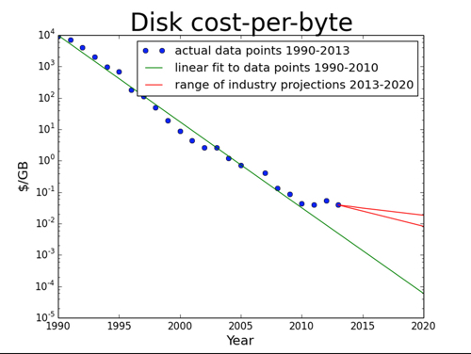
The ”Kryder’s Law" declares that disk drive areal density would more than double every two years, meaning disk drive capacity would do likewise.

Slide 2
Data Transfer timing
TCGA: 2.5PT
2.5 PB is 20,000,000 Gigabits (Gb). At 10 Gb/sec, this equates to a 23 day download time
As a practical matter, transfers over such lines are unlikely to exceed 1-3 Gb/sec

Slide 3
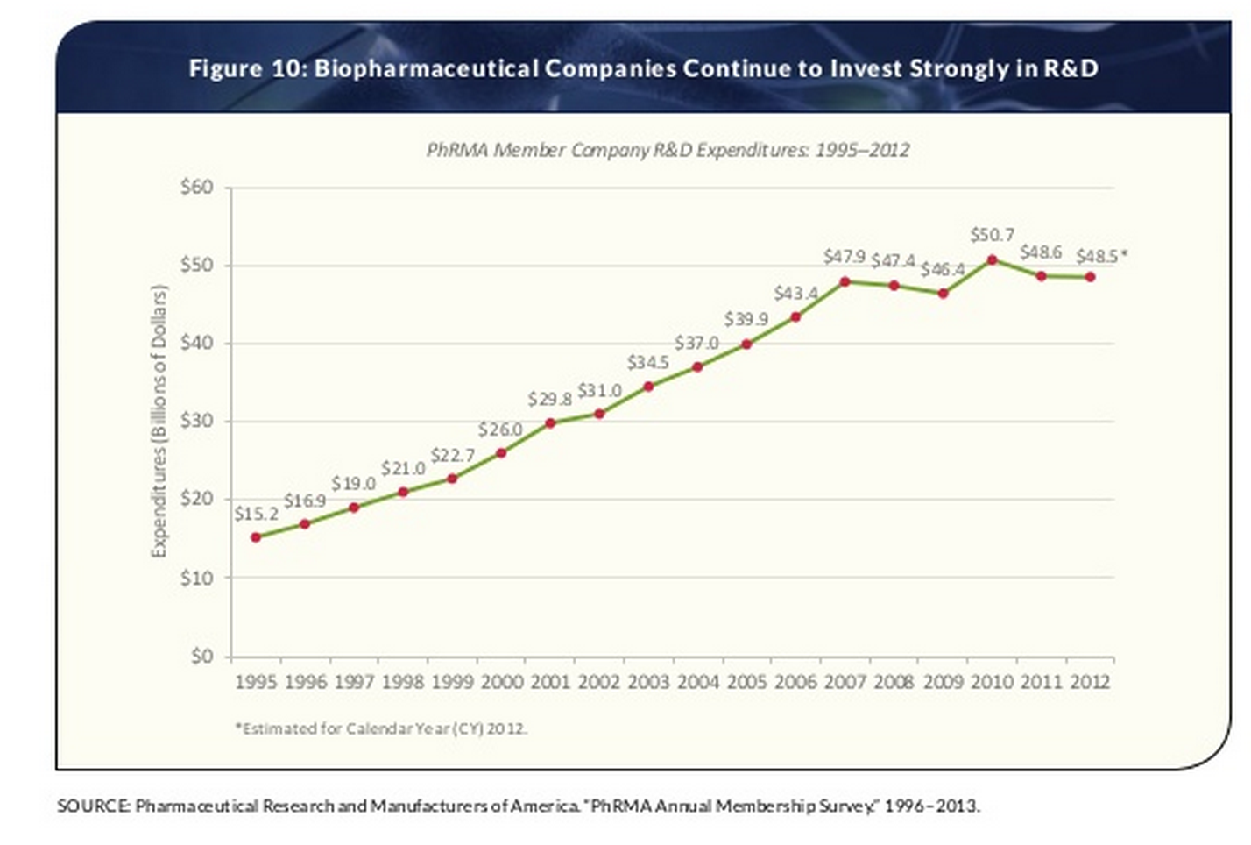
42% of all compounds – and 73% of oncology compounds – in the pipeline have the potential to be personalized medicines.
20% of 2014 Drug Approvals Were Personalized Medicines

Slide 4
Rough storage and data transfer time
The total size of the BAM files of a single patient may approach 1 terabyte (TB)
As of July 2012, there were approximately 1400 TB of raw BAM data in NCBI, 1100 TB in EGA, 312 TB in CGHub, and approximately 35 TB of research data at BGI/GigaScience.
A million TB is 1,000 petabytes (PB), which is roughly the size of all the videos in YouTube
Our national backbone fiber operates at 10 Gigabits per second, at most half of which would be available for any particular transfer, which translates into 50 terabytes per day, or 20 days per petabyte

Slide 5
Query time
1.6M people diagnosed each year -> 4,500 queries of this type.
13M people living withcheckup every six months -> 70,000 times daily.
let us assume that we need to run 80,000 queries per day, or 1 query per second

Slide 6
Query time
Assuming a query takes 30 seconds on average, we need to execute roughly 30 queries in parallel.
Furthermore, assume that the input of each query is 1 petabyte and that each query executes in parallel on 1,000 cores
we need 3 PB DRAM and 30,000 cores to run 80,000 queries/day with an average query response time of 30 sec.
Note that assuming 16-32 cores per server we need 1000-2000 servers to satisfy the computation demands.
However, even assuming each server had 512 GB DRAM, we need as many as 6000 servers to satisfy the memory demands

