Slide 1
Analysis of Biological Networks:
Integrating a Structural Interaction Network
with Motion Dynamics
slides at
Lectures.GersteinLab.org
(See Last Slide for References
& More Info.)
Mark B Gerstein
Yale

Slide 2
Objective: Use Structure to Interpret Human Disease-Associated Mutations and Protein-Protein Interactions
Growing exome data provides a better understanding of the distributions, frequencies, and potential impacts of variants in coding regions.
Growing numbers of crystallographically resolved complexes may be used to elucidate the mechanisms of deleterious variants.
Multimeric structures may also be used to address questions at higher levels of biological organization – i.e., protein-protein interaction networks.
Allostery provides an interpretive framework for understanding how rare variants may impart deleterious effects on protein function.

Slide 3
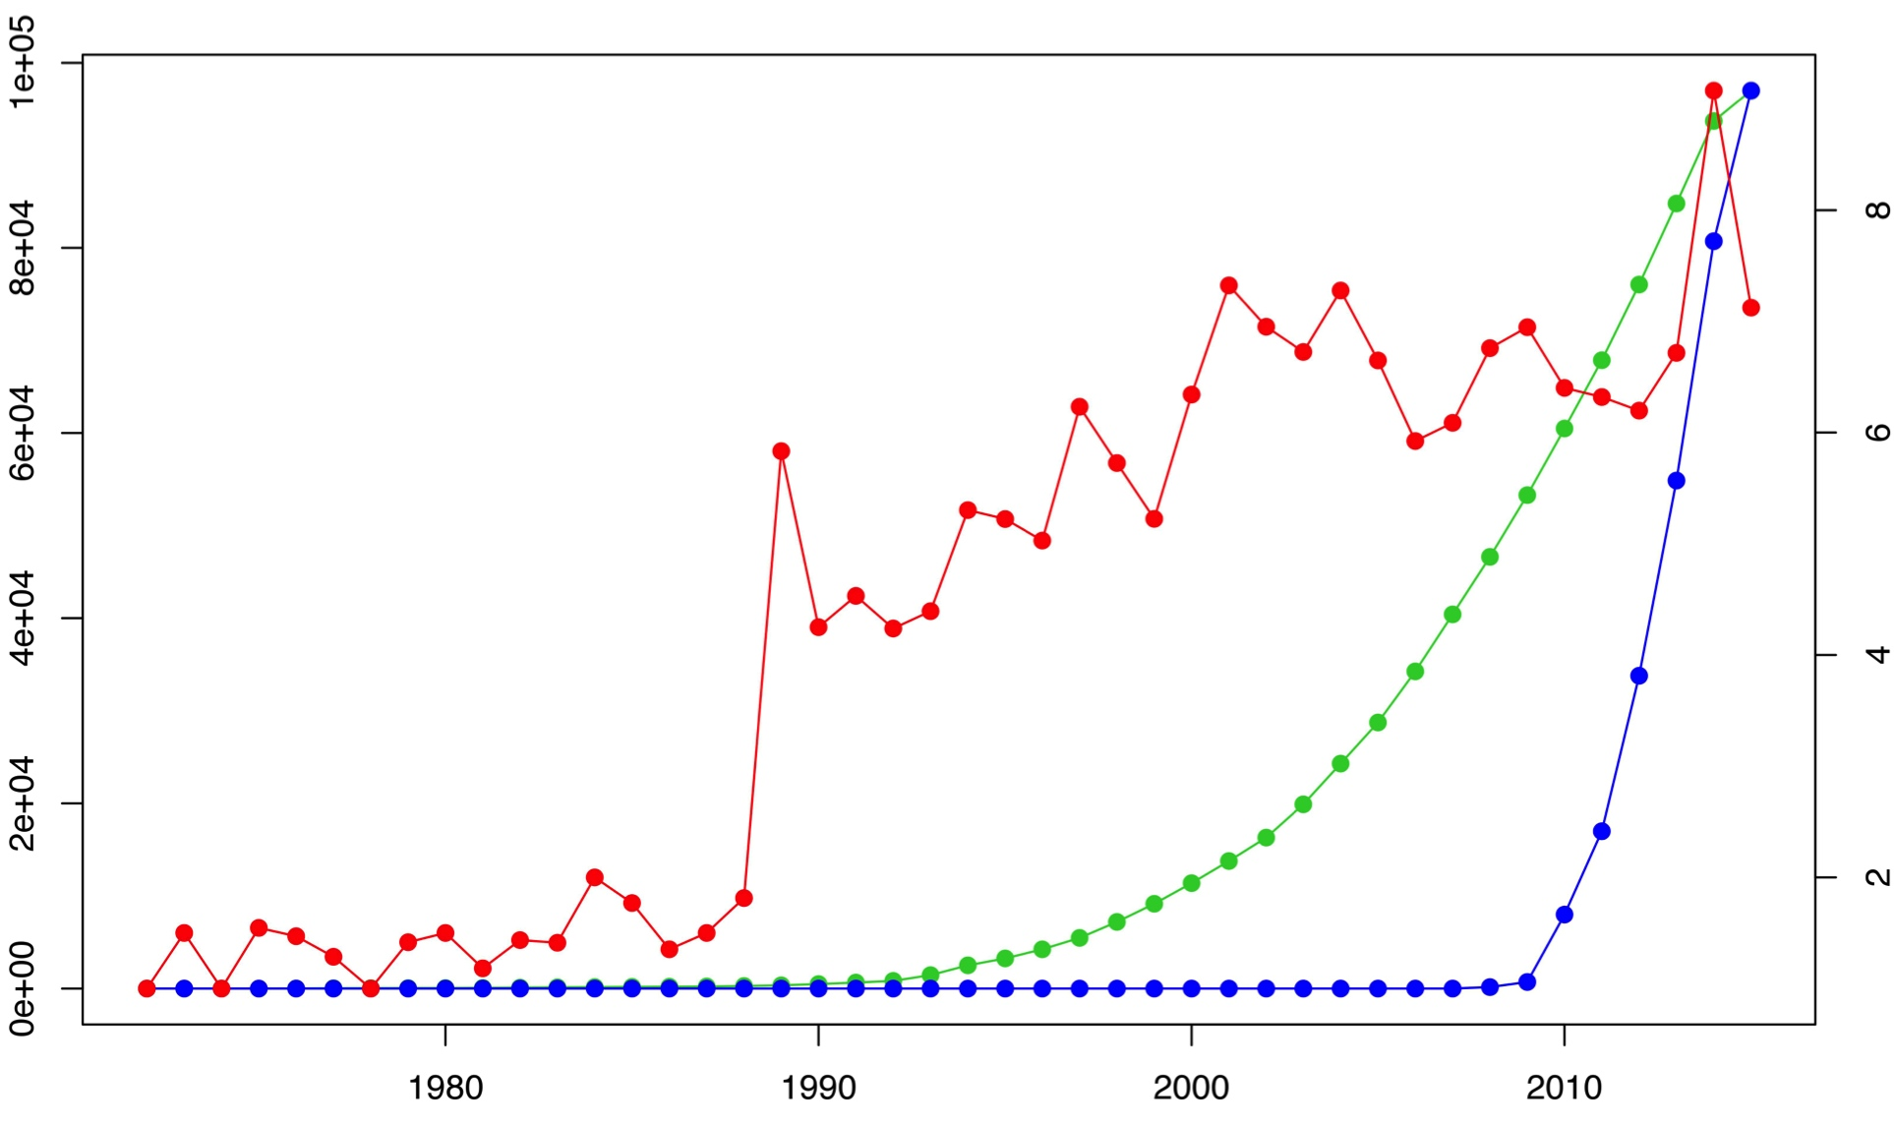
Trends in data generation point to growing opportunities for leveraging sequence variants to study structure (and vice versa)
The volume of sequenced exomes is outpacing that of structures, while solved structures have become more complex in nature.
Cumulative # of X-ray structures and # exomes
Avg # chains per PDB (top 10% for each year)
Year
Exome data hosted on NCBI Sequence Read Archive (SRA)

Slide 4
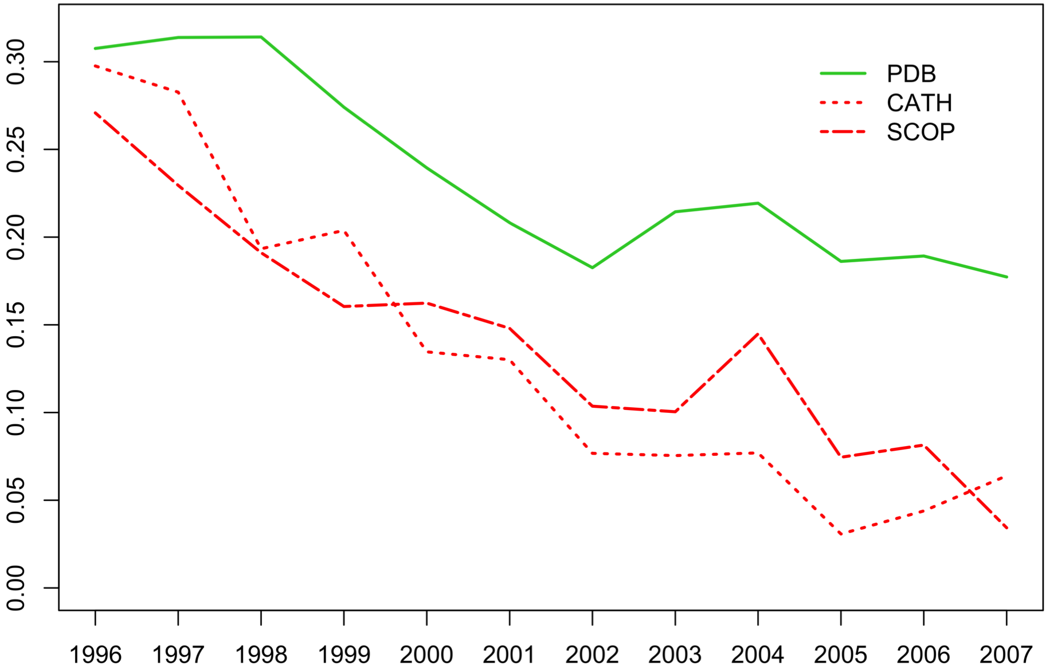
Growing sequence redundancy in the PDB (as evidenced by a reduced pace of novel fold discovery) offers a more comprehensive view of how such sequences occupy conformational landscapes
% Increase
Year
PDB: Berman HM, et al. NAR. (2000)
CATH: Sillitoe I, et al. NAR. (2015)
SCOP: Fox NK et al. NAR. (2014)

Slide 5
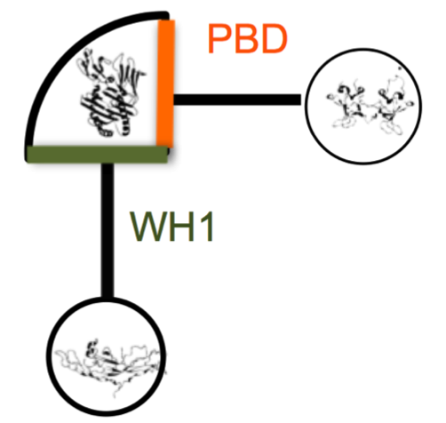
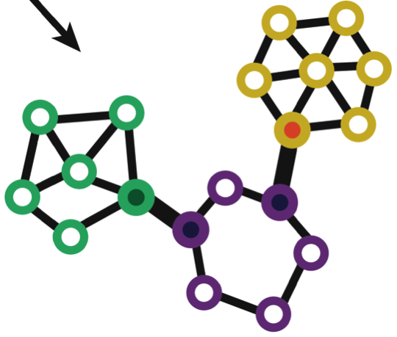
Using Structure to Interpret Human Disease-Associated Mutations & PPIs
Networks-based strategies provide a natural means of merging structure, function, and selective pressures in the context of regulation and protein conformational changes
  Networks & protein motions (DynaSIN)
  2) Variation at PPI interfaces and in the context of network topology
  3) Deleterious variants in regions predicted to be important for allostery

Slide 6

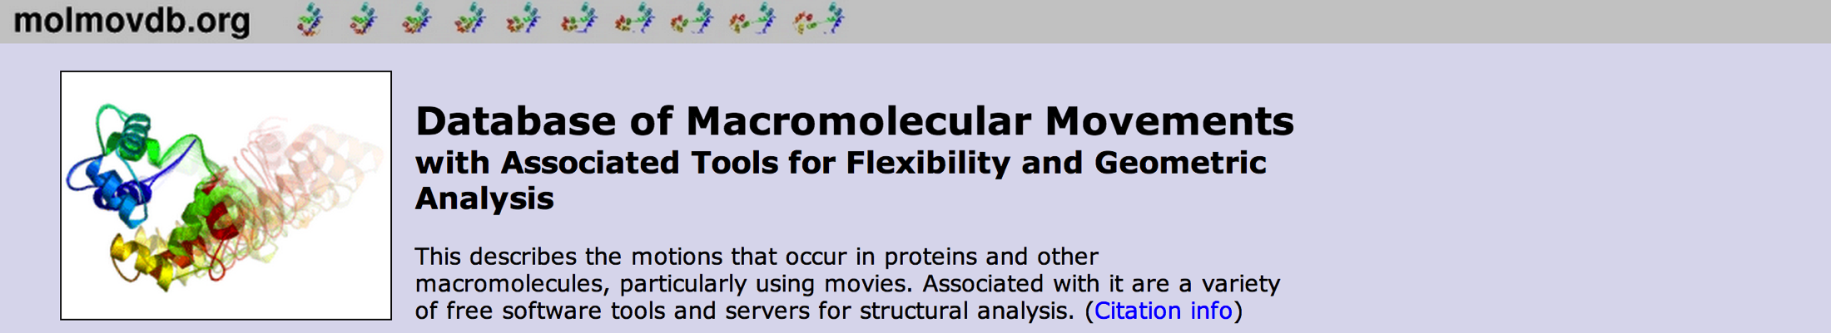

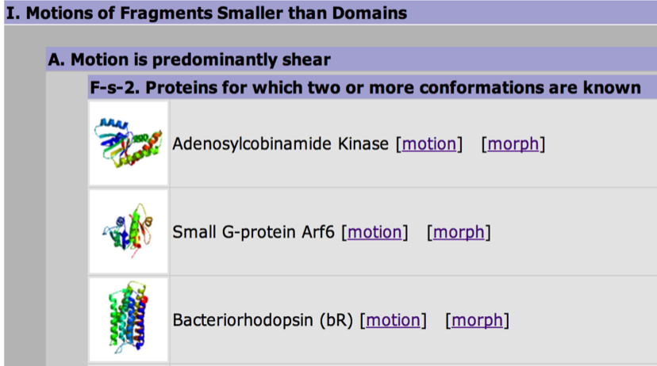
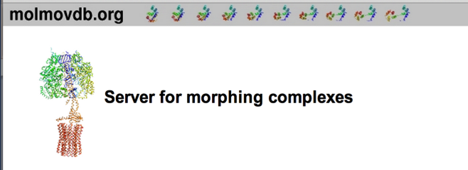
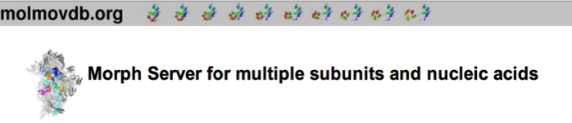


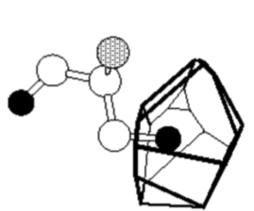
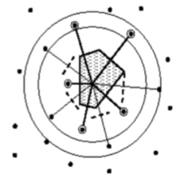
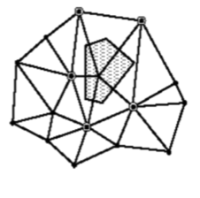
Movies of Conformational Changes
Database of Alternative Conformations
Quantifying Internal Packing of Residues
Identification of Protein Cavities

Slide 7
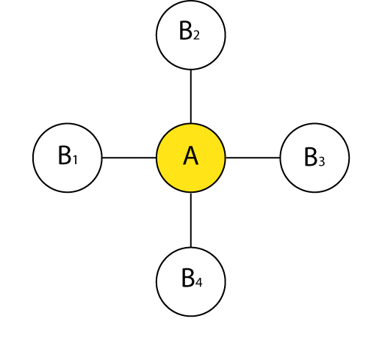
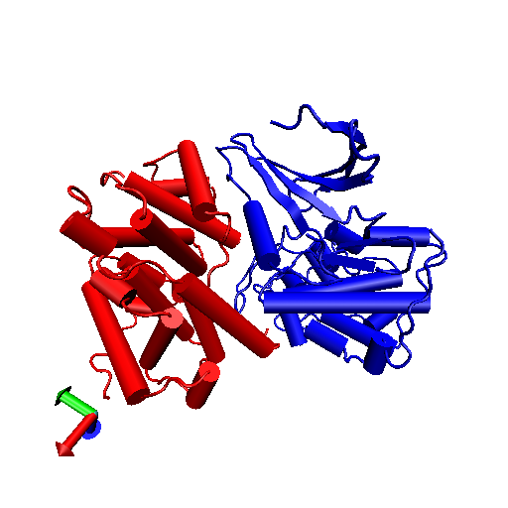
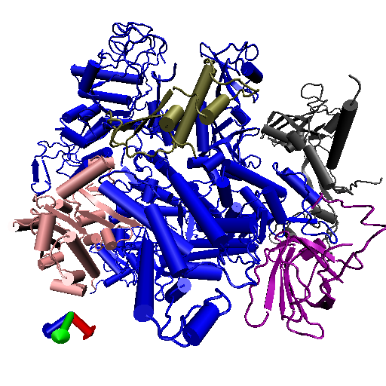
ILLUSTRATIVE
Network perspective:
=
There remains a rich source
of knowledge unmined by network
theorists!
Structural biology perspective:
B4
B1-4
A
B3
≠
B1
A
B2
Cdk/cyclin complex
Part of the RNA-pol complex
Source: Kim et al. Science (2006)

Slide 8
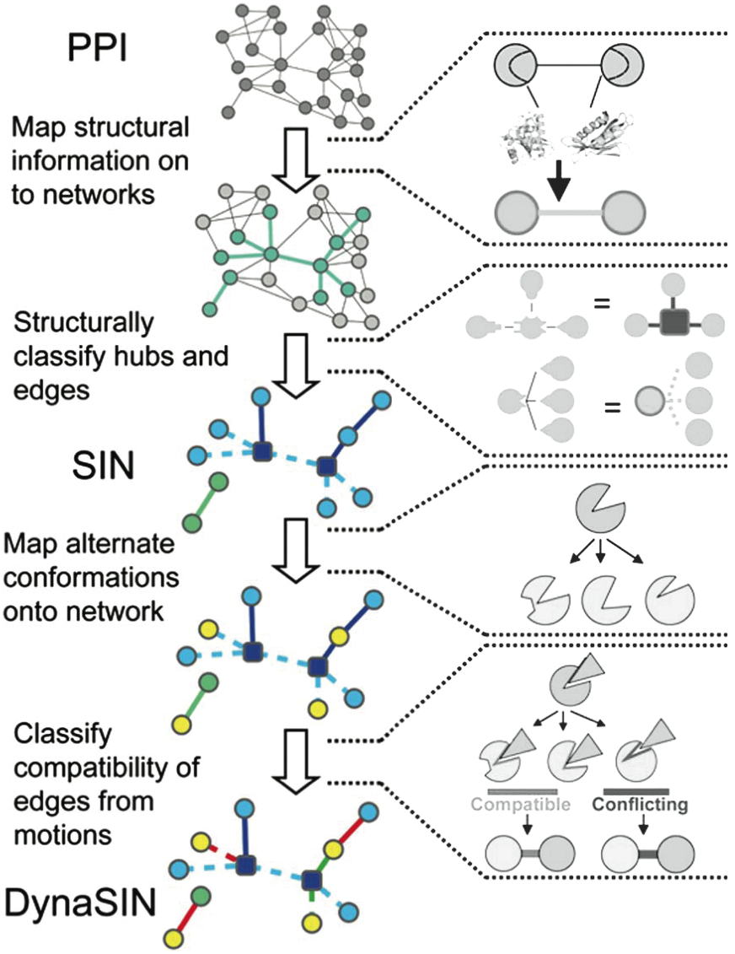
Overview of DynaSIN
Construction
DynaSIN.MolMovDB.org
[Bhardwaj et al. (’11) Prot Sci]
Notes:
Flip red and green

Slide 9
Overview of DynaSIN
Construction
“Permanent”
interactions
“Transient”
interactions
DynaSIN.MolMovDB.org
[Bhardwaj et al. (’11) Prot Sci]
Notes:
add trans

Slide 10
Overview of DynaSIN
Construction
‘Compatible’
motions
‘Conflicting’
motion
DynaSIN.MolMovDB.org
[Bhardwaj et al. (’11) Prot Sci]
Notes:
Flip red and green

Slide 11
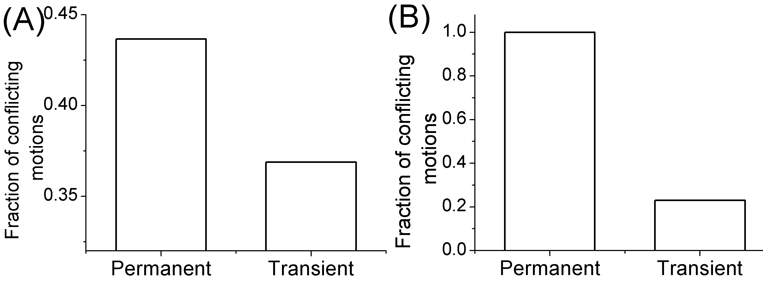
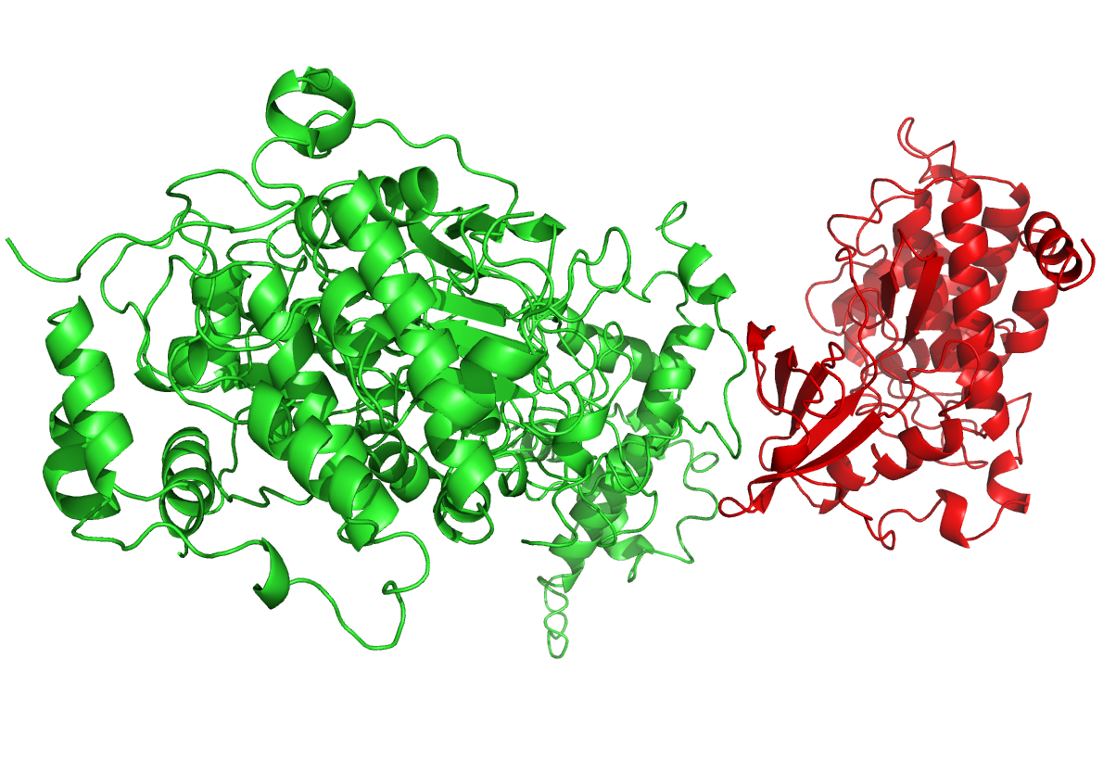
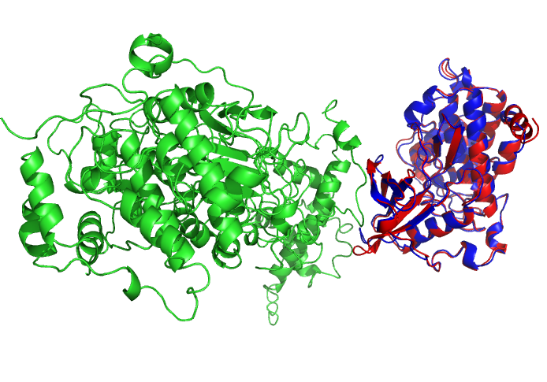
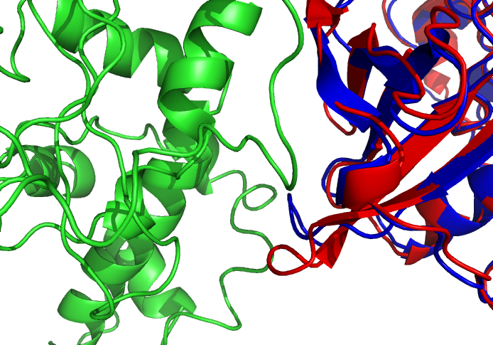
Conflicting and compatible interactions
Protein Kinase CK2 β
Protein Kinase CK2 α
“Permanent” “Transient”
Blue: alternate conformation
[Bhardwaj et al. (’11) Prot Sci] dynasin.gersteinlab.org
Notes:
Supplement figure: real example.

Slide 12
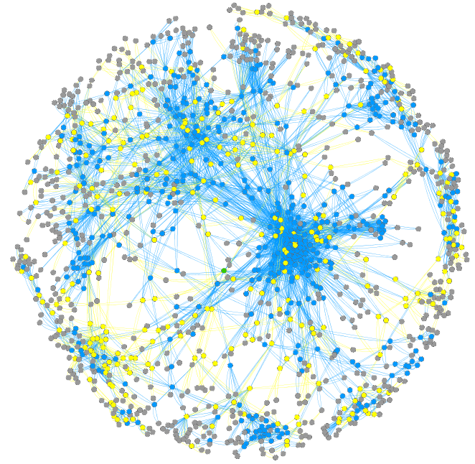
Structural Interaction Network
(v2.0, ‘11, available for yeast, human, E coli)
Non-hub
Multi-interface hub
Singlish-interface hub
Simultaneously possible
interaction: “Permanent”
Mutually exclusive
interaction: “Transient”
~8.5K Human & ~1.5K yeast edges
[Bhardwaj et al. (’11) Prot Sci]
dynasin.molmovdb.org
sin.gersteinlab.org
Notes:
supplement:

Slide 13
The degree of conformational change correlates with hub properties
hubs >
non-hubs
multi-interface >
singlish-interface
many-interface proteins >
few-interface proteins
non-hubs
hubs
singlish-
interface
multi-
interface
3 5 7 9 11
Num. Interfaces
* Note: All p-values < 4E-3
[Bhardwaj et al. (’11) Prot Sci] dynasin.gersteinlab.org
Notes:
Human only

Slide 14
Rationalization: “Permanent” vs “Transient” Interactions
“Permanent” interactions
→Only need to pay high
energetic costs for larger
changes infrequently
“Transient” interactions
→Less interface modification
(lower energy barrier) for
frequently-changing
interactions
[Bhardwaj et al. (’11) Prot Sci] dynasin.gersteinlab.org

Slide 15
Conformational changes associated with “transient” interactions
Conformational changes associated with “permanent” interactions
[Bhardwaj et al. (’11) Prot Sci] dynasin.gersteinlab.org

Slide 16
  Variation at PPI interfaces and in
  the context of network topology
Using next-generation sequencing and networks to study negative selection in the context of protein structure
How may networks be used to make sense of deleterious mutations?
Using network measures as a means of predicting and understanding human disease mutations

Slide 17
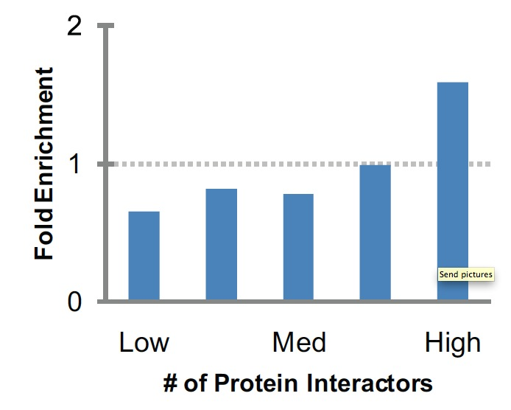
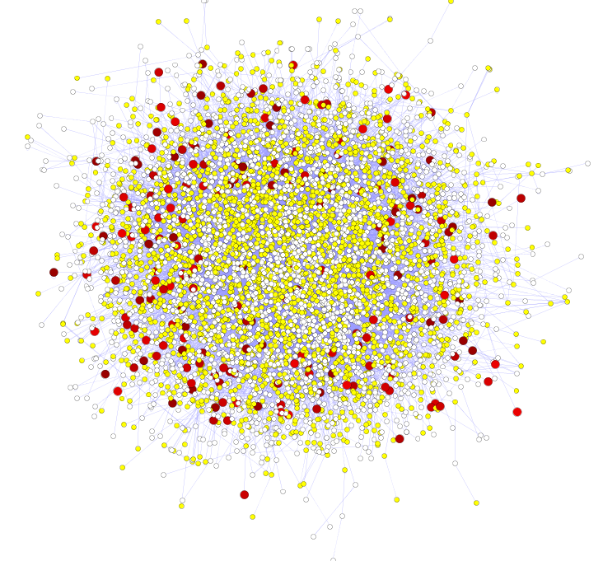
More Connectivity, More Constraint : A theme borne out in many studies
Result for Yeast PPI
[Xia et al. PLOS CB ('09)]
Seq. Conservation
High likelihood of positive selection
Not under positive selection
Lower likelihood of positive selection
No data about positive selection
Sequence variation v. centrality
  Nonsyn / synonymous SNPs v. deg. centrality
  ρ = -.1, P < 4.0e-4
  ρ = -.3, P < 2.2.0e-16
  (updated to 1000G phase I)
[Nielsen et al. PLoS Biol. (2005), HPRD, Kim et al. PNAS (2007)]

Slide 18
Quantifying Sensitivity within the genome
inter- and intra-species approaches
Figure by Jieming Chen

Slide 20
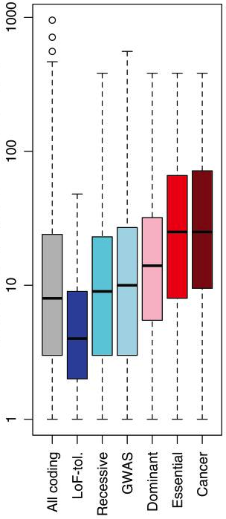
Enrichment of rare SNPs as a metric for Negative Selection
Degree centrality in protein interaction network
(rare=derived allele freq < 0.5%)
LOF-tol (Loss-of-function tolerant): least negative selection
Cancer: most selection
Gene categories
[Khurana et al., Science (‘13)]

Slide 21
Recasting Association of Connectivity with Constraint in terms of Gene Essentiality Categories:
Application to Regulatory & Protein Interaction Networks
Higher
Centrality
More interaction interfaces
PPI degree (log scale)
Num. interfaces
LoF-tolerant
Essential
LoF-tolerant
Essential
Khurana et al., PLoS Comp. Bio., 2013

Slide 22
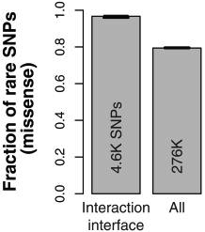
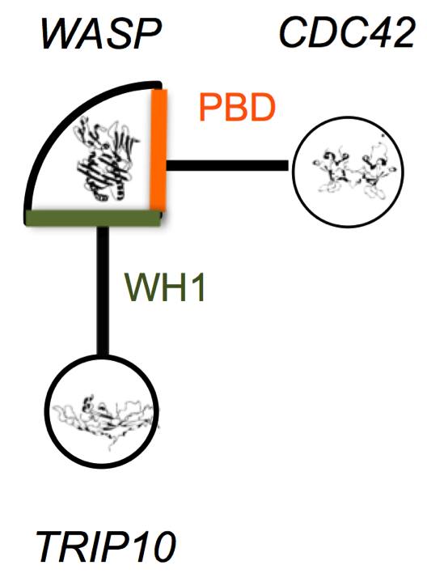
Direct Experimental Testing
Collaborated with H Yu Cornell
WASP interactions tested using yeast two-hybrid experiments
Khurana* and Fu* et al., PLoS Comp. Bio., 2013
Khurana* and Fu* et al, Science, 2013
Wang et al, Nature Biotech, 2012

Slide 23
Genes participate in many networks and no single network captures the global picture of gene interactions
Multinet – the ultimate hairball!
Combine regulatory, physical protein-protein, signaling, metabolic, phosphorylation and genetic interactions to create a unified network (Multinet)
Nodes: ~15,000 genes
Edges: ~110,000 interactions
Khurana* and Fu* et al., PLOS Comp. Bio. ’13
Notes:
Explain better: may be show just the hairball and then show nodes on it

Slide 24
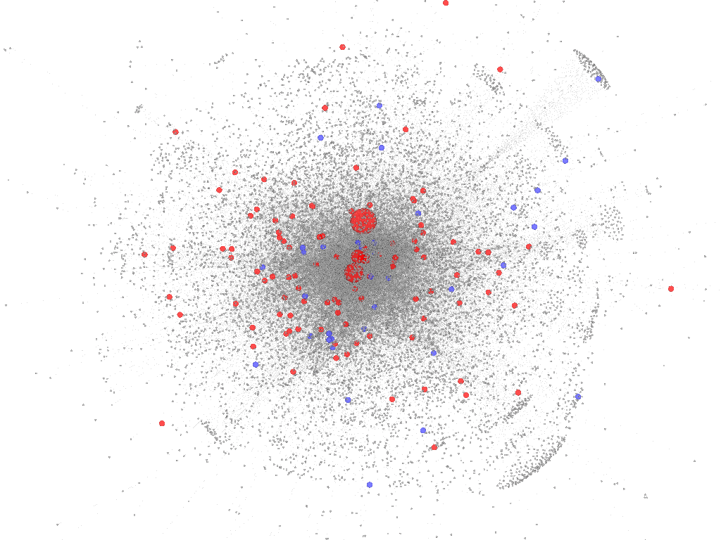
Gene properties in Multinet
Essential genes are
Unified network
degree (log scale)
Connected to more genes
Num of networks
Involved in more networks
LoF-tolerant genes
Essential genes
LoF-tolerant
Essential
Z Gumus
iCAVE movie
Size of nodes scaled by total degree
[Khurana et al., PLOS Comp. Bio. ’13]

Slide 25
Integration of network properties to predict systems-level effects of deleterious mutations
Train logistic regression model using network and evolutionary properties
Can distinguish between LoF-tolerant and Essential genes with high accuracy
Application of the model on all genes
AUC=0.91
dN/dS (log scale)
True positive rate
Predicted score
False positive rate

Slide 26
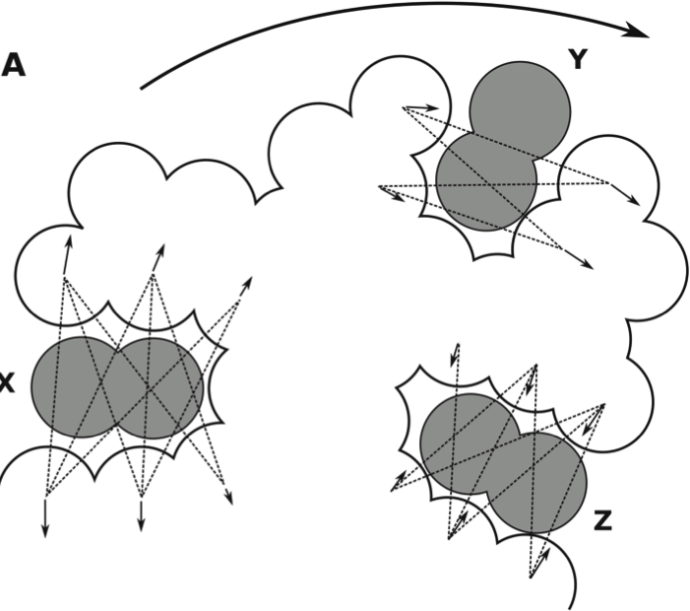

  Deleterious variants in regions predicted to be important for allostery
Predicting allosteric
residues on the surface
Predicting allosteric
residues in the interior
Mitternacht, S. et al. (2011)

Slide 27
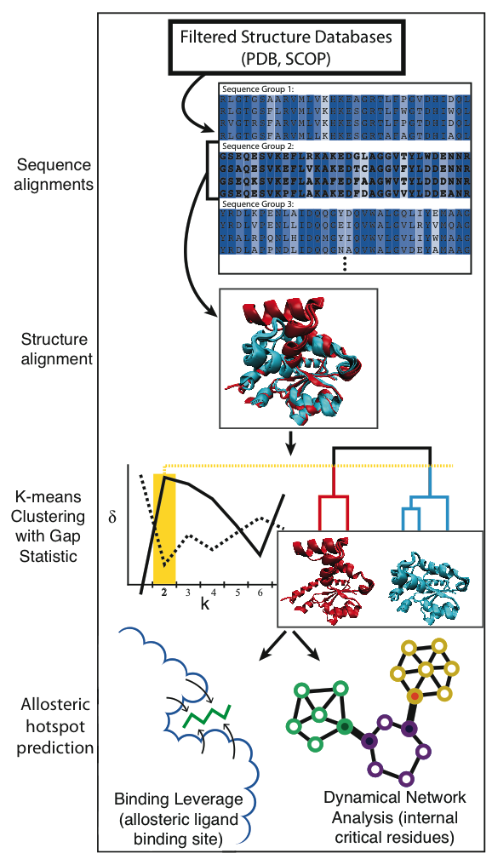
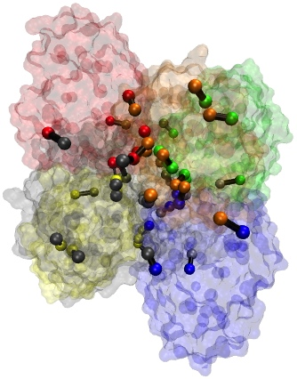
Pipeline for culling alternative
conformations and predicting
allosterically important residues

Slide 28
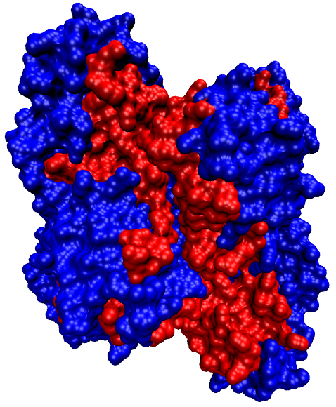
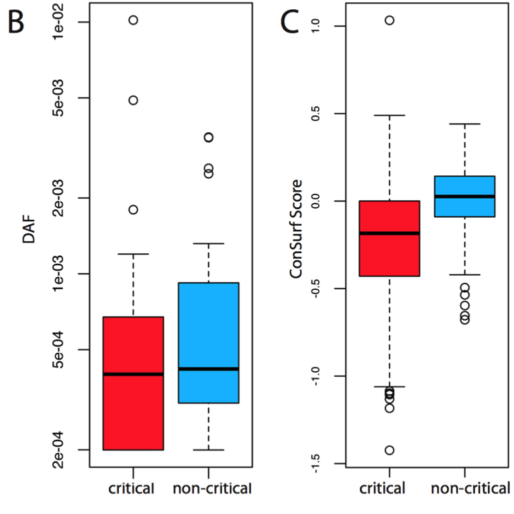
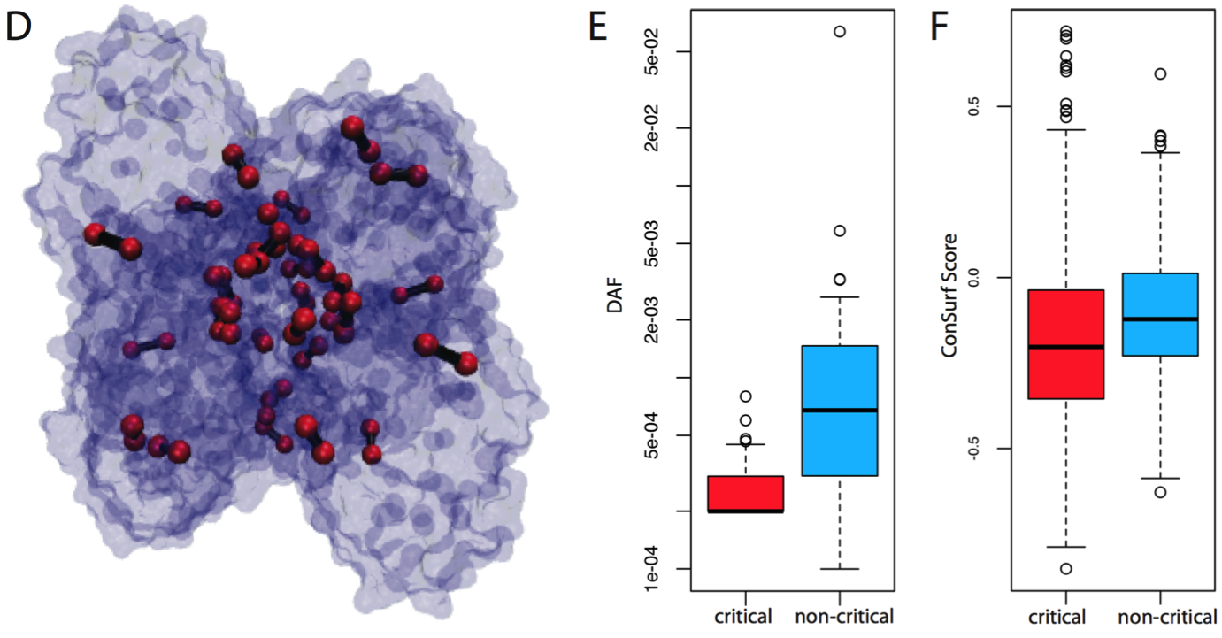
Conservation of network-identified residues implicated in allosteric signal transmission

Slide 29
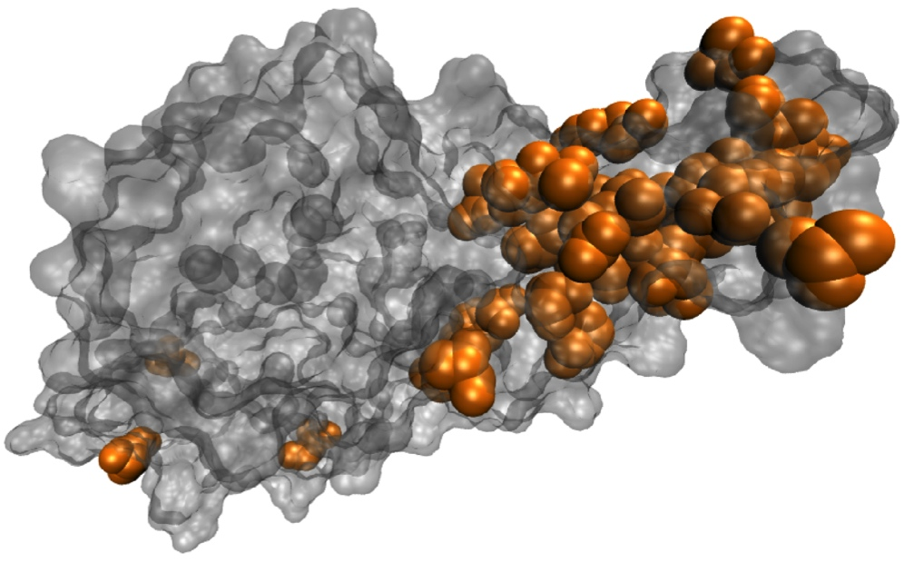
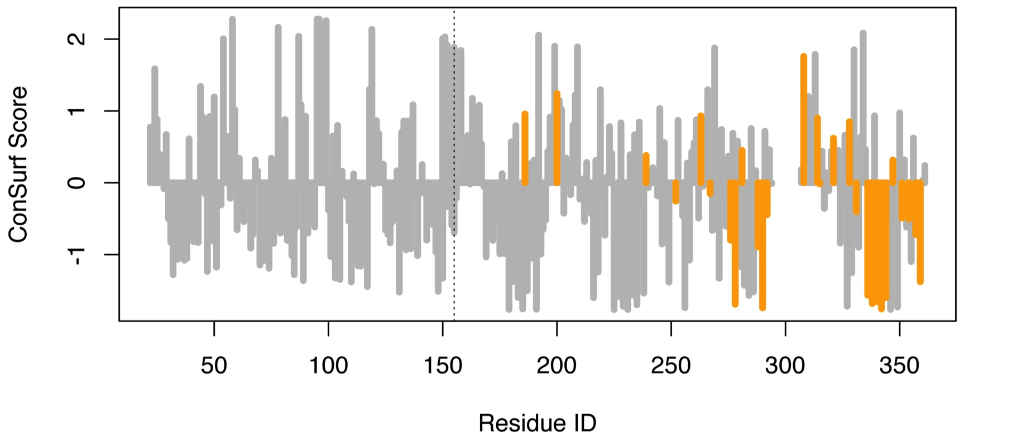
Conservation, allosteric hotspots, and disease variants in sequence space
Fibroblast growth factor receptor (pdb 1IIL)
Sites of HGMD
mutations in orange
Notes:
Cartoon – linear plot

Slide 30
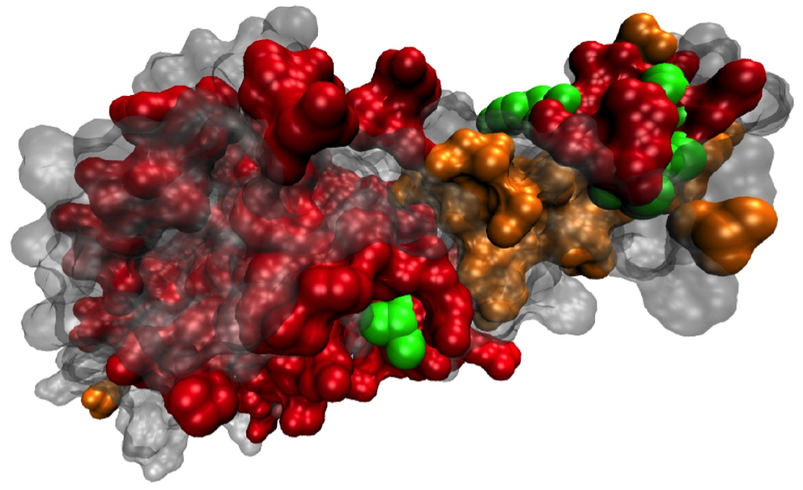
Conservation, allosteric hotspots, and disease variants in sequence space
Fibroblast growth factor receptor (pdb 1IIL)
Notes:
Cartoon – linear plot

Slide 31
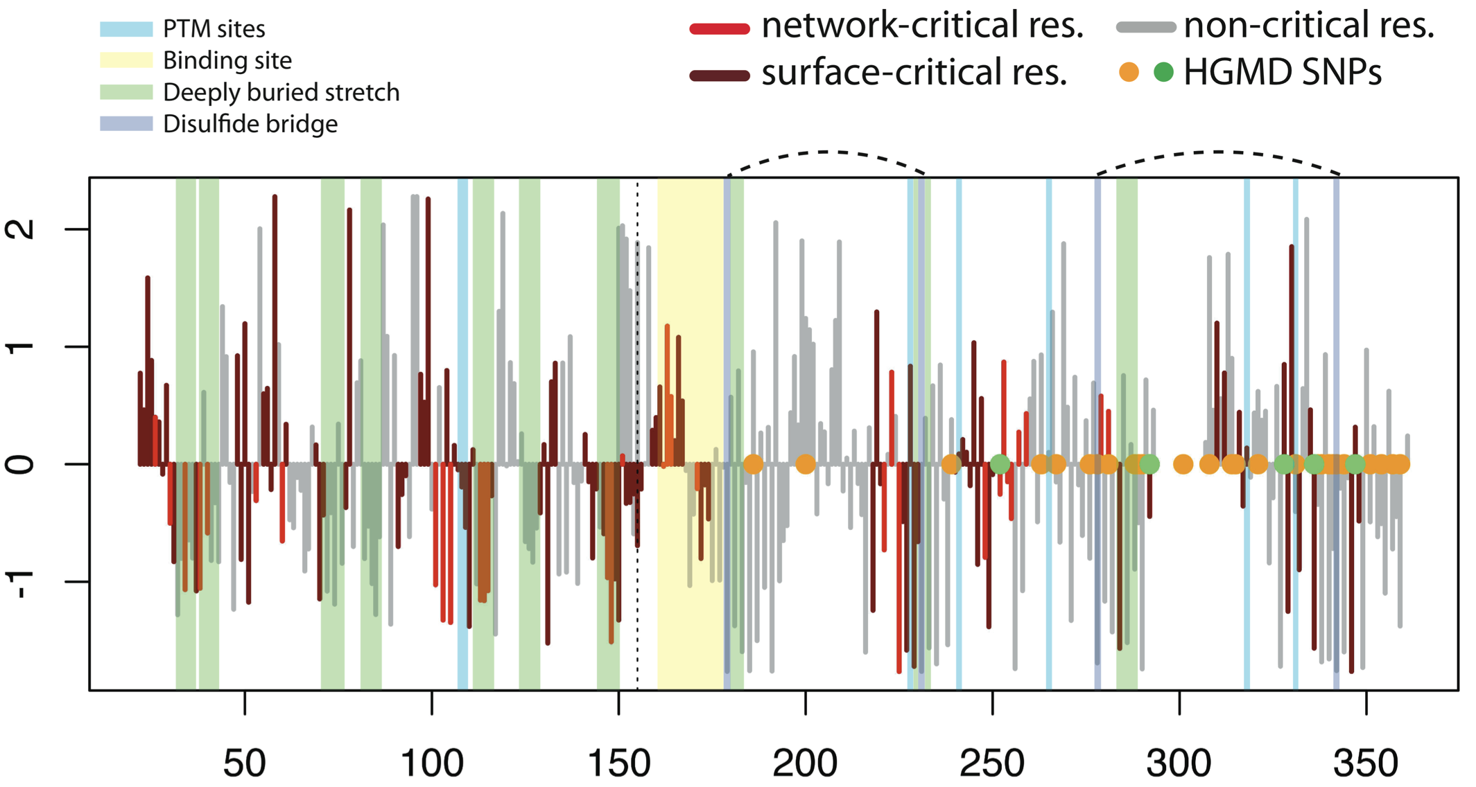
ConSurf Score
Res ID

Slide 32
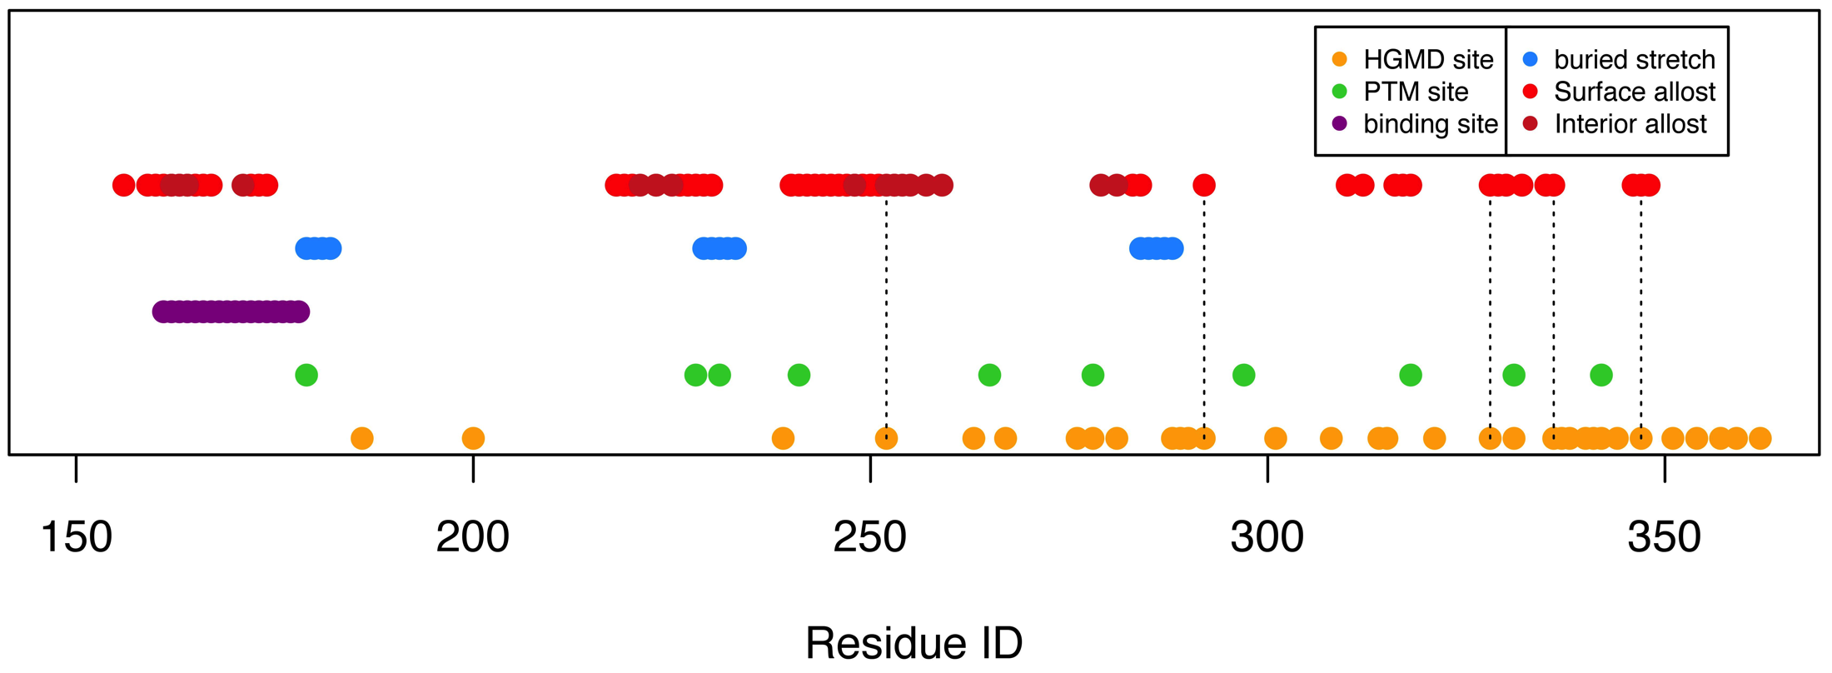
Conservation, allosteric hotspots, and disease variants in sequence space
Fibroblast growth factor receptor (pdb 1IIL)
Dotted lines designate HGMD sites without clear biophysical mechanisms of pathogenicity, but which are nevertheless captured by our pipeline.

Slide 33
DynaSIN Summary
Molecular interaction networks can be integrated with structure and motions, giving more realistic connectivity patterns
Hubs (particularly multi-interface hubs) are more mobile
“Permanent” interactions (which tend to occur in multi-interface hubs) more often involve conflicting motions than “transient” ones

Slide 34
  Summarizing variation at PPI interfaces & in network topology
Greater network connectivity is strongly correlated with selective constraints
Negative selection restricts allele frequency of deleterious variants -- enrichment of rare alleles is indicative of negative selection
Essential genes in PPIs exhibit higher centrality than do LoF-tolerant genes
Essential proteins in PPIs tend to have more interaction interfaces than do LoF-tolerant genes
No single network captures the global picture of gene interactions. Our multinet integrates the various types of interactions between genes (regulatory, physical, metabolic, etc), and it recapitulates the result that higher network centrality correlates with selective pressures
Using the network and evolutionary properties studied here, we train a logistic regression model to discriminate between LoF-tolerant and essential genes with high accuracy.

Slide 35
  Summarizing deleterious variants in regions predicted to be important for allostery
An automated approach for collecting instances of alternative conformations in the PDB is developed and applied to study systems that may be allosteric in nature
We search for residues within protein structures (both on the surface and the interior) which may be important for coordinating allosteric behavior
The residues we predict to be allosteric are generally shown to be more conserved than are other residues. This conservation manifests in both cross-species and human-specific measures for selection.
Using these methods, we identify residues in several key proteins of biomedical interest which coincide with disease loci. Notably, no known or plausible mechanism for pathogenicity for the disease-associated mutations has been described.

Slide 36
Acknowledgments
archive.gersteinlab.org/proj/DynaSIN
- N Bhardwaj, A Abyzov, D Clarke, C Shou
http://archive.gersteinlab.org/proj/NetSNP
- E Khurana, Y Fu, J Chen
FunSEQ.gersteinlab.org
- E Khurana, Y Fu, V Colonna, XJ Mu, HM Kang, T Lappalainen, A Sboner, L Lochovsky, J Chen, A Harmanci, J Das, A Abyzov, S Balasubramanian, K Beal, D Chakravarty, D Challis, Y Chen, D Clarke, L Clarke, F Cunningham, US Evani, P Flicek, R Fragoza, E Garrison, R Gibbs, ZH Gumus, J Herrero, N Kitabayashi, Y Kong, K Lage, V Liluashvili, SM Lipkin, DG MacArthur, G Marth, D Muzny, TH Pers, GR Ritchie, JA Rosenfeld, C Sisu, X Wei, M Wilson, Y Xue, F Yu, 1000 Genomes Project Consortium, ET Dermitzakis, H Yu, MA Rubin, C Tyler-Smith
STRESS
- A Sethi, D Clarke, S Kumar, S Li, R Chang, KK Yan, J Chen

Slide 37
[[Misc. extra slides]]

Slide 38
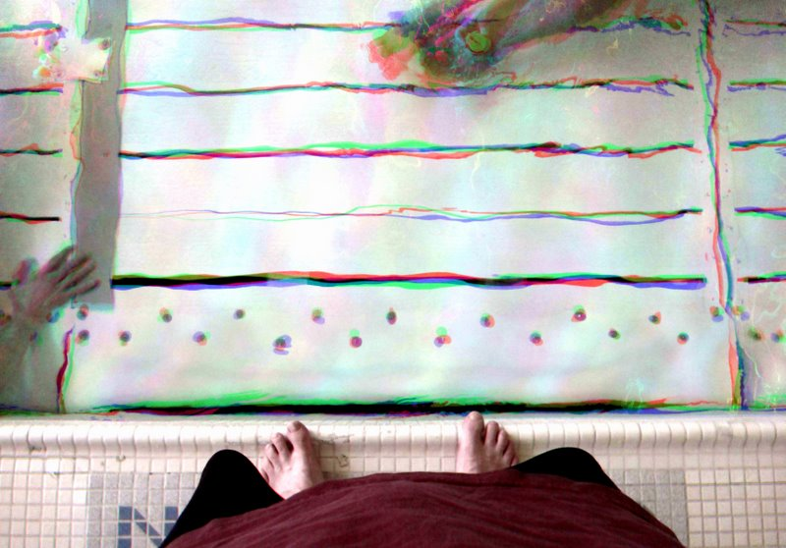
Acknowledgements
(Job opportunities currently for postdocs & students)
Molmovdb.GersteinLab.org
N Bhardwaj
D Clarke
C Shou
P Kim

Slide 39
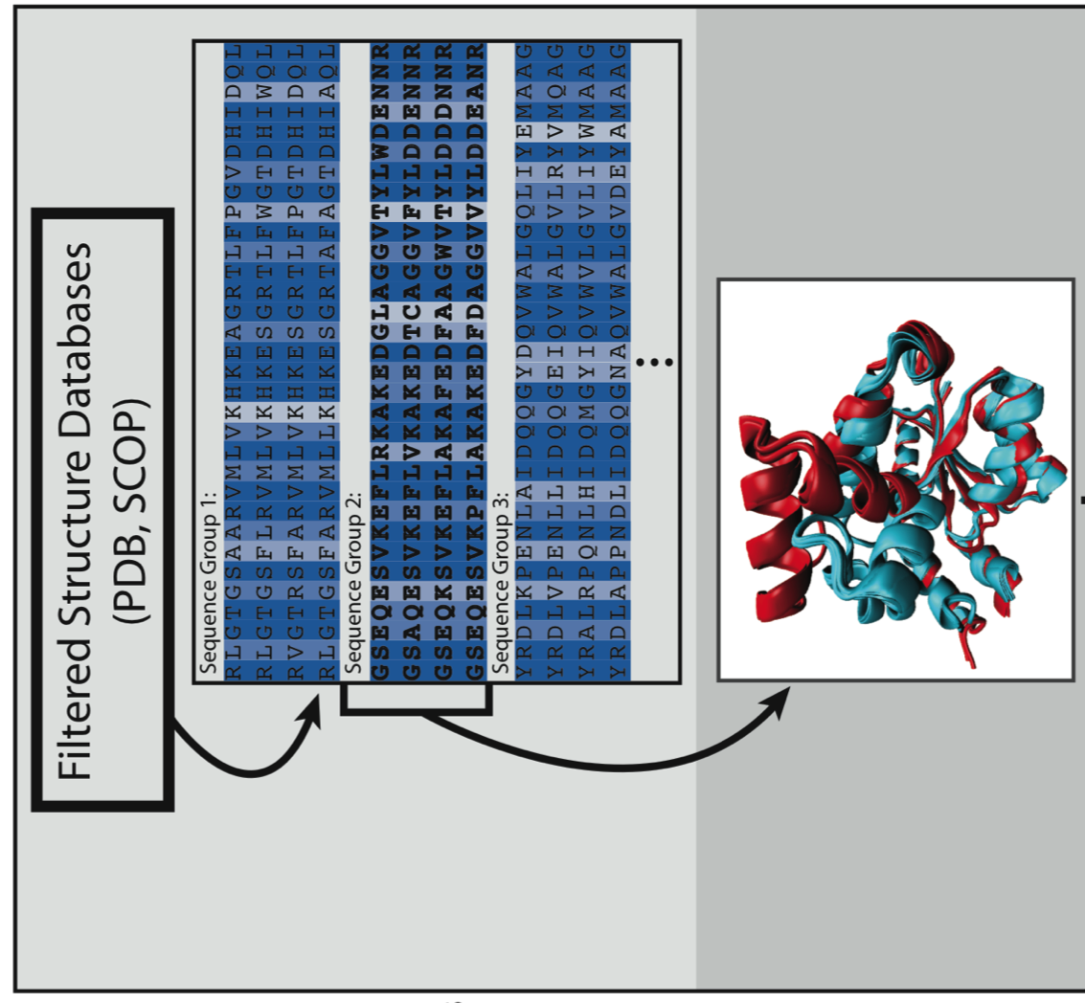
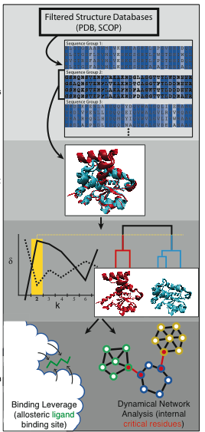
Processing Raw Data: Sequence & Structure Alignments

Slide 40
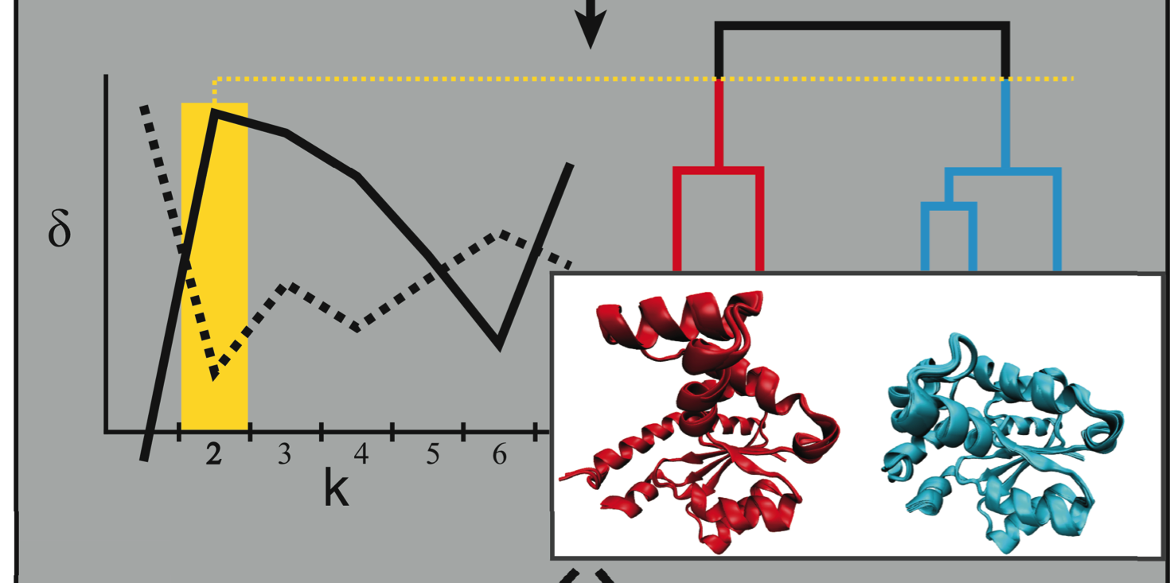
Automated Identification of Alternative Biological States

Slide 41
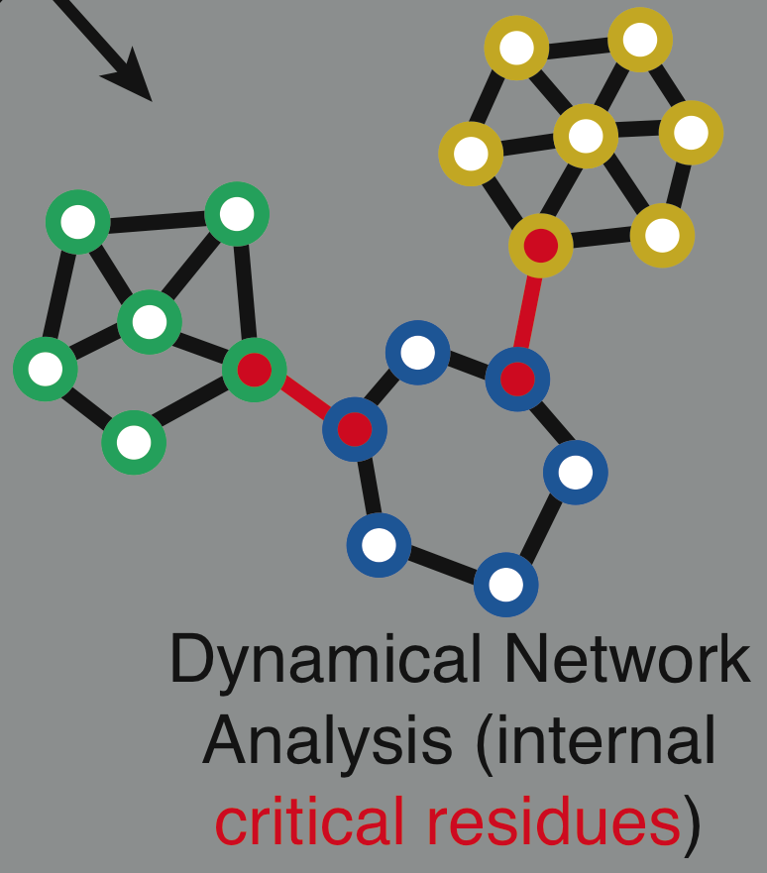
Identification of Allosteric Hotspots: Networks

Slide 42
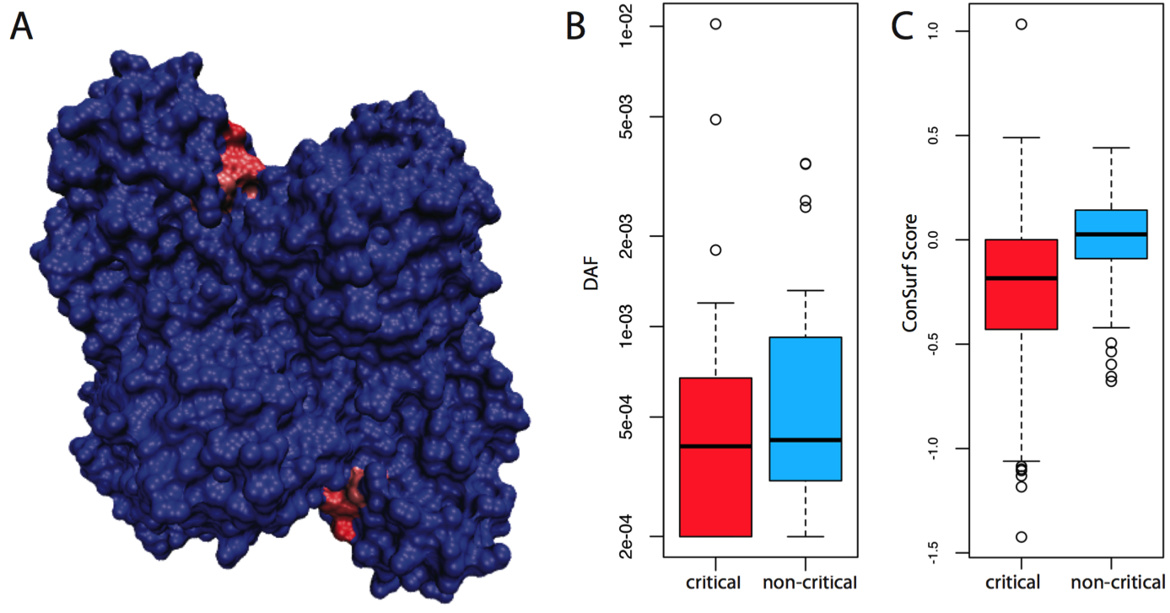
Conservation of network-identified residues implicated in allosteric signal transmission

Slide 43
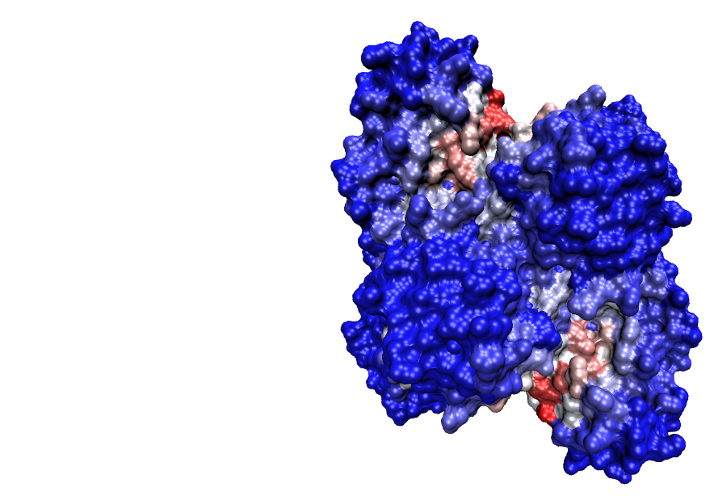
Note: this slide is for our internal use only – we will discuss in person why I included it here.

Slide 44
Betweenness
Freeman LC (1977) Set of measures of centrality based on betweenness.
Sociometry 40: 35–41.
Girvan & Newman (2002) PNAS 99: 7821.

Slide 45
Bottlenecks & Hubs
[Yu et al., PLOS CB (2007)]

Slide 46
Girvan and Newman, PNAS 2002
Edge Betweenness: Number of shortest paths passing through a pair of nodes
Define essential residues as those which connect communities (identified through GN) and exhibit the greatest edge betweenness.
Sethi et al, 2009

Slide 47
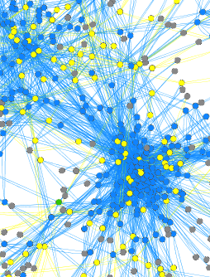
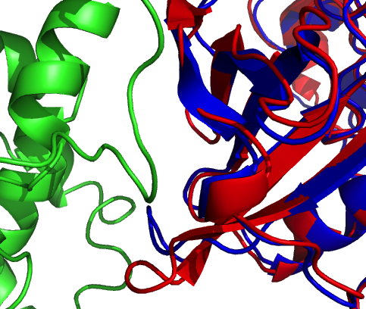
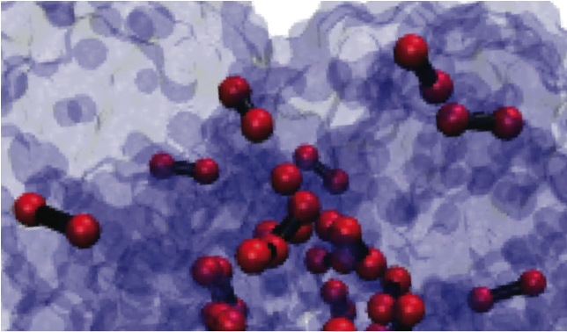
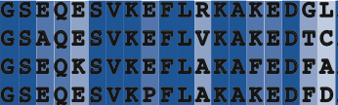

Slide 48
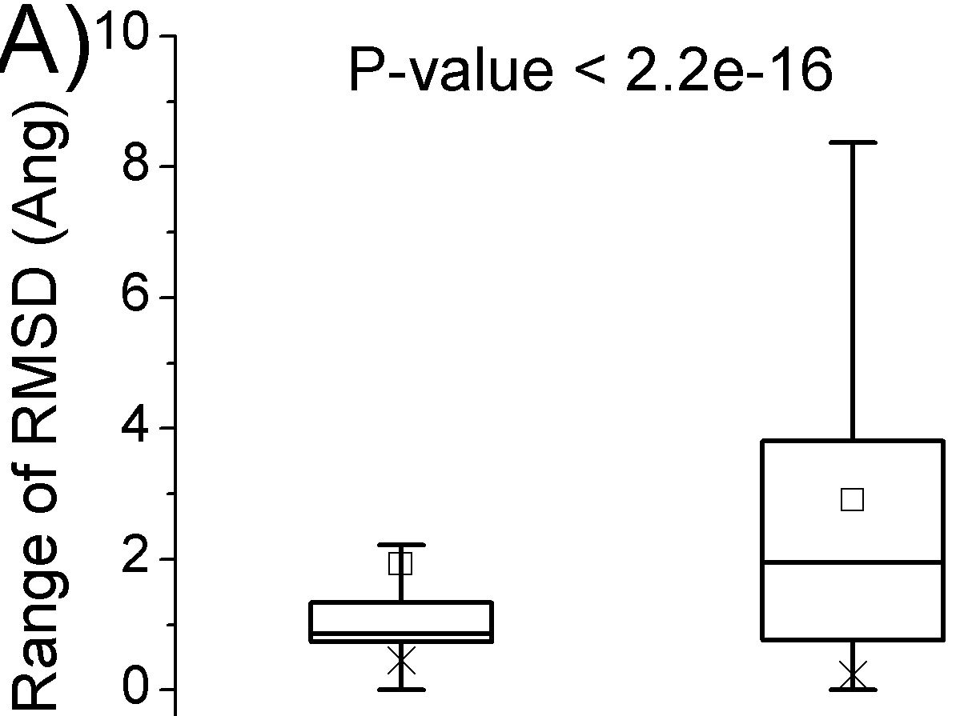
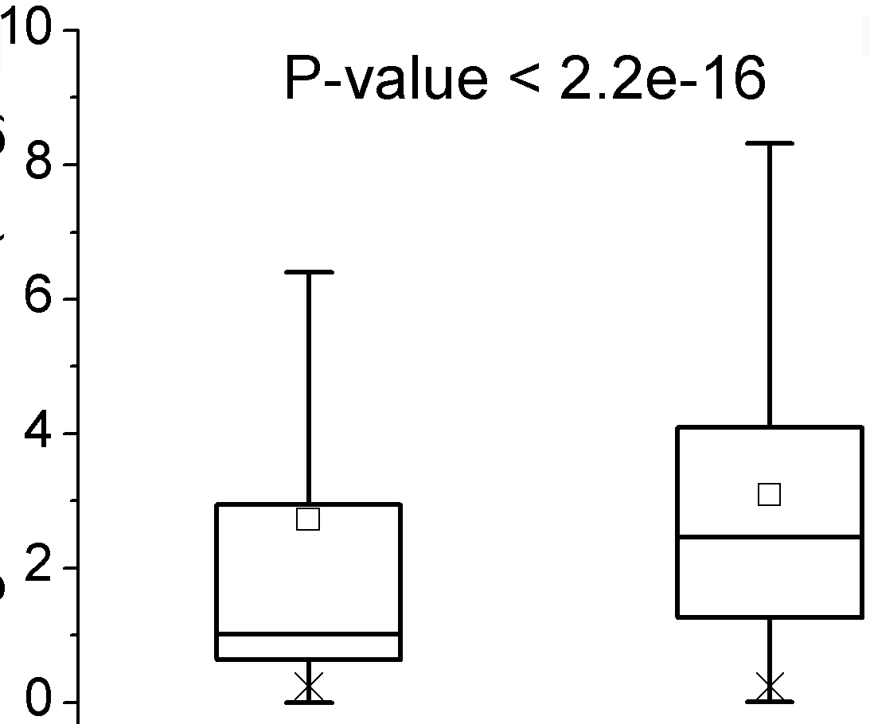

The degree of conformational change correlates with hub properties
Hubs show more motion
than non-hubs
Multi-interface hubs show more
motion than singlish-interface hubs
More unique interfaces
result in higher RMSD
Color the y axis (Motion)…. Make pvalue smaller
Motion hubs nonhub
Motion single mult
Motion more multi v less multi
non-hubs
hubs
singlish
multi-interface
Number of unique interfaces
[Bhardwaj et al. (’11) Prot Sci] dynasin.gersteinlab.org
Notes:
Human only

Slide 49
The degree of conformational change correlates with hub properties
hubs >
non-hubs
multi-interface >
singlish-interface
many-interface proteins >
few-interface proteins
non-hubs
hubs
singlish-
interface
multi-
interface
3 5 7 9 11
* Note: All p-values < 4E-3
[Bhardwaj et al. (’11) Prot Sci] dynasin.gersteinlab.org
Notes:
Human only

Slide 50

Rationalization: Permanent vs Transient Interactions
i0isgc-draft-13may_ORIG.p
Interface modifcation for perm interactiosn
Less interface modification (ergo lower energy ) for rapid trans. interactiosn
Simplified
i0isgc-draft-13may_ORIG.p
[Bhardwaj et al. (’11) Prot Sci] dynasin.gersteinlab.org

Slide 51
Default Theme
Default Outline Level 1
  Level 2

Slide 52
More Information on this Talk
SUBJECT: Networks
DESCRIPTION:
NOTES:
This PPT should work on mac & PC. Paper references in the talk were mostly from Papers.GersteinLab.org.
PERMISSIONS: This Presentation is copyright Mark Gerstein, Yale University, 2010. Please read permissions statement at http://www.gersteinlab.org/misc/permissions.html . Feel free to use images in the talk with PROPER acknowledgement (via citation to relevant papers or link to gersteinlab.org).
PHOTOS & IMAGES. For thoughts on the source and permissions of many of the photos and clipped images in this presentation see http://streams.gerstein.info . In particular, many of the images have particular EXIF tags, such as kwpotppt , that can be easily queried from flickr, viz: http://www.flickr.com/photos/mbgmbg/tags/kwpotppt .
Notes:
52

