Slide 1
Debrief 2015 Great Lakes Bioinformatics Conference (GLBIO)
Journal Club
DW
May 27 2015

Slide 2
~300 attendees
4 keynotes
10 invited talks
4 tutorials and 2 workshops
45 oral presentations
  Loregic
~120 poster presentations
  OrthoClust, F1000 best poster presentation award!
http://www.iscb.org/glbio2015

Slide 3

Keynote 1, Dr. Nancy Cox, University of Chicago
PrediXcan (with Im Lab)
  a gene-based association test that prioritizes genes that are likely to be causal for the phenotype
  GTEx data
  PredictDB, hosting genetic prediction models of transcriptome levels for PrediXcan
  G2Pdb, Gene to Phenotype database, hosts the results of PrediXcan
  GTEx companion paper, 2nd round revision in Nature Genetics
  https://github.com/hakyimlab/PrediXcan

Slide 4

Keynote 2, Dr. Mona Singh, Princeton
Data-driven approaches to uncover variations
in PPI networks
  Discovered significantly mutated binding sites, among which known cancer genes are enriched
  PPI networks change over evolutionary time (www.capralab.org), proteins prefer to interact with proteins of same age and origin
  Variations of gene regulatory networks across organisms (12 Drosophila, Nadimpali et al, PLoS Genetics, 2015), computational pipeline, diverged zinc finger TFs DNA-contacting residues
  zf.princeton.edu, Protein-DNA interaction for ZF proteins

Slide 5


Keynotes 3 and 4
Dr. Jian-Kang Zhu, Purdue (NAS member)
  DNA (de)methylation in plants
  demethylation is more complex, feedback
  lots of plant epigenetics data, seeking collaborators
Dr. Tandy Warnow, UIUC
  new method to infer species trees in avian phylogenomics: gene tree is not species tree
  1KP project: 1000 plants

Slide 6

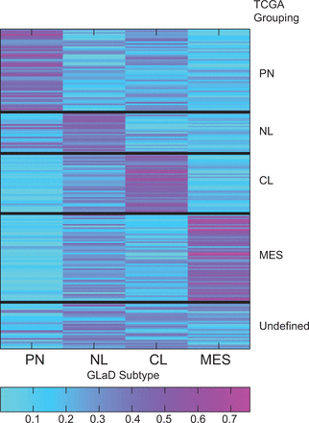
GLAD: a mixed-membership model for heterogeneous tumor subtype classification
Bioinformatics (2015) 31 (2): 225-232.
Patrick Flaherty Group, UMass-Amherst
TCGA GBM, 4 subtypes: CL, PN, NL, MES
TCGA GBM gene expression data
  202 samples
Mixed membership model
  beat mixture models
  intra-tumor heterogeneity
useful for sputum project!

Slide 7
Mixed Membership Models
Basic ideas
  data are grouped
  each group is modeled with a mixture
  same mixture components across groups (homogeneity)
  mixture proportions vary from group to group (heterogeneity)
topic modeling
  one keyword vs. topics
Traditional mixture models: one group, one component

Slide 8
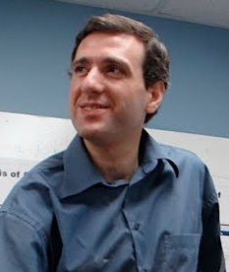
More about Intra-tumor heterogeneity
Intra-tumour heterogeneity: a looking glass for cancer? Nature Reviews Cancer, 2012
Intratumor heterogeneity and branched evolution revealed by multiregion sequencing. N. Engl. J. Med. 366, 883–892 (2012)
Mixed membership geometric unmixing of tumor data (Schwartz Group, CMU)
  fit model to geometric objects
  based on phylogenies

Slide 9
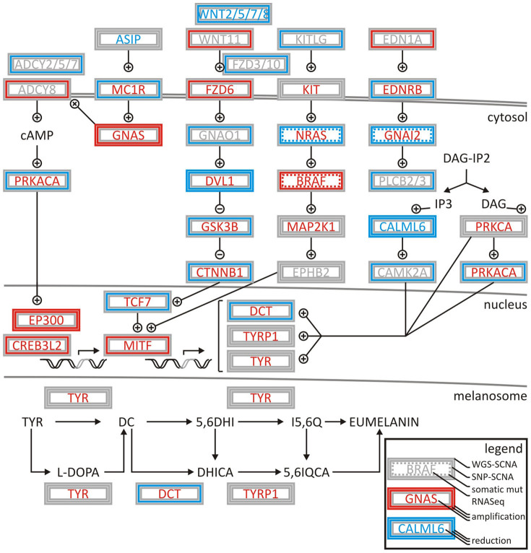

Cancer drivers in melanoma via TCGA
Cancer systems biology of TCGA SKCM: efficient detection of genomic drivers in melanoma, Scientific Report, 2015
Deregulation of melanogenesis by G-protein and cyclin pathway signalling in TCGA SKCM patient samples by integrating
  somatic CNVs
  SNPs
  gene expression
  in TCGA
Filipp Group, UC Merced

Slide 10
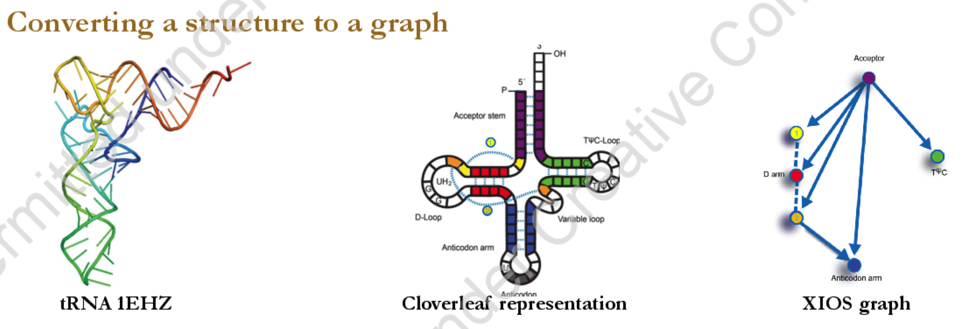

RNA structural motifs via subgraph random sampling
Jiajie Huang, Michael Gribskov’s Lab, Purdue, http://cdn.f1000.com/posters/docs/261444849
RNA XIOS graph, http://xios.genomics.purdue.edu/html/index.html
Michael Griskov, former ISCB president

Slide 11
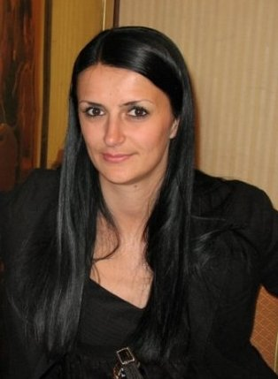
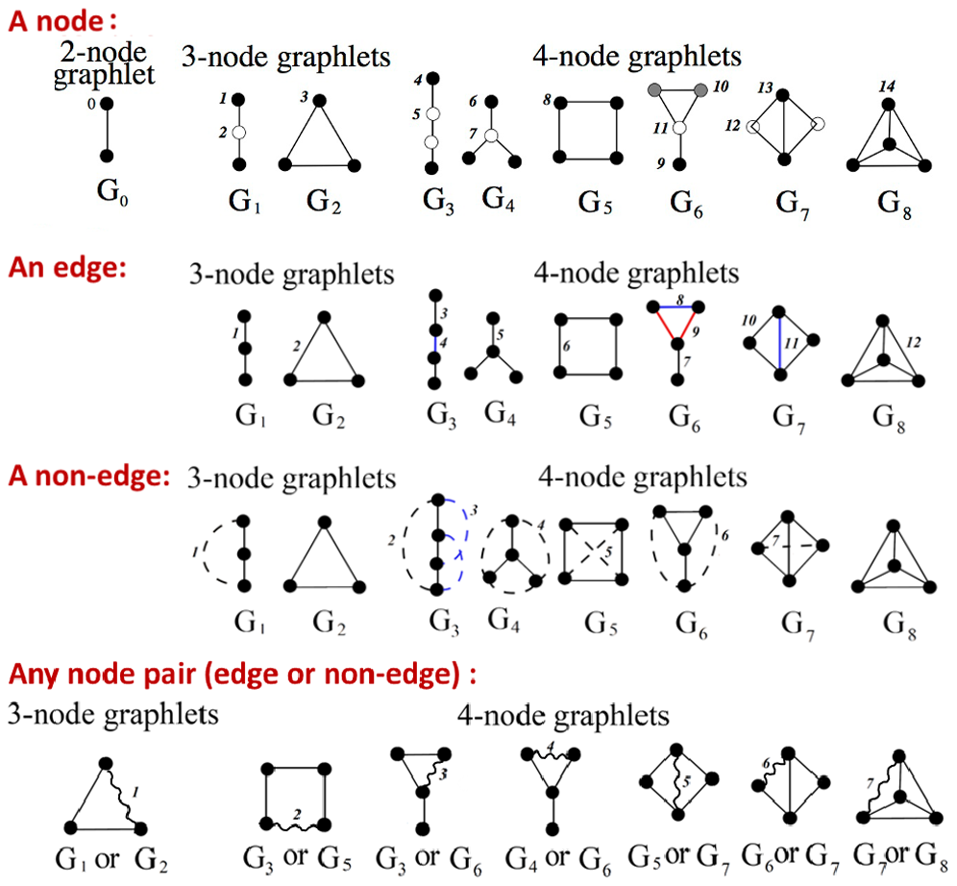
PPI missing link prediction via graphlets
Yuriy Hulovatyy, Tijana Milenkovic’s group, University of Notre Dame, PLoS One, 2014

Slide 12
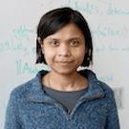
Integrative Reconstruction of the Regulatory Network Controlling Host Response to Influenza Infections
Deborah Chasman, Sushmita Roy’s lab, UWisconsin-Madison
Step 1 – learn host regulatory networks using MERLIN (plos cb 2013)
Step 2 – Identify protein regulators in each network module
Step 3 – Predict physical regulatory subnetworks connecting mRNA and protein based on the modules enriched for immune response genes and known influenza host factors
Core regulatory networks conserved in two host systems

Slide 13

Roles of Regulatory Variants in Complex Disease
Yunlong Liu, Indiana University School of Medicine
Prioritizing disease causing non-frameshift INDELs, Genome Biology 2013,genomebiology.com/2013/14/3/R23
  positive 2833 indels causing diseases in Human Gene Mutation Database (HGMD)
  negative from 1000 Genomes
  SVM
http://sparks-lab.org/ddig/

Slide 14
Multisample Variant Format ToolKit
mvftools for compact storage and efficient analysis of multi-genome and multi-transcriptome datasetshttps://github.com/jbpease/mvftools
With conversion utilities, filtering and transformation programs, and data analysis and visualization modules.
MVF vs. VCF
  bioanalysis utilities
  high compression rate
  flexible structure

Slide 15

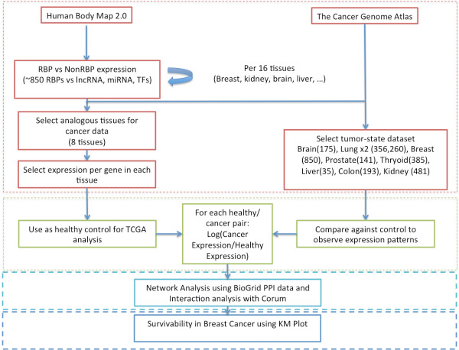
RNA-binding Proteins in Human Cancers
Sarath Chandra Janga, Indiana University
Genome Biology 2014

Slide 16

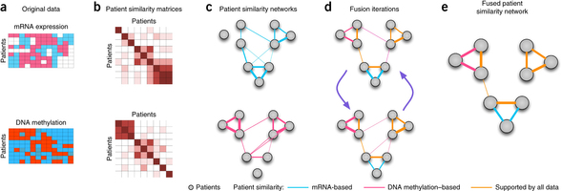
Omic Data Integration - Striving Towards Personalized Medicine
Anna Goldenberg, University of Toronto
Similarity network fusion for aggregating data types on a genomic scale, Nature Methods 2014, http://compbio.cs.toronto.edu/SNF/SNF/Software.html
Integrate mRNA & miRNA expression and DNA methylation data
better identify cancer subtypes and predict survival rates
Notes:
similarity network fusion, nature methods, 2014, SNFtool on CRAN
construct sim. networks in each data source
combine networks by fusion, random walks across networks -> fused sim. network

Slide 17

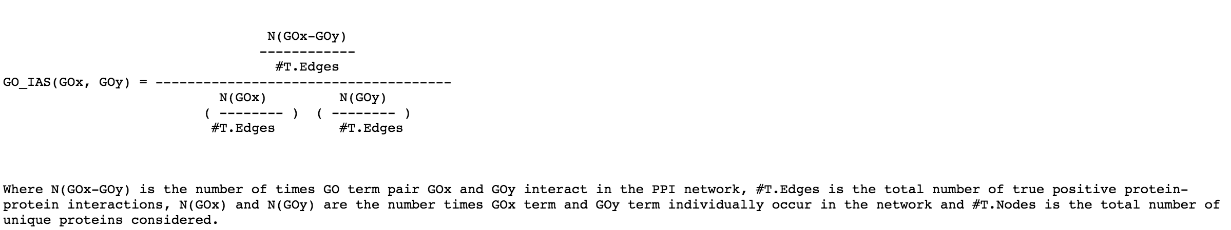
Interaction Specific GO Term Associations for Predicting Protein-Protein Interaction Networks
Daisuke Kihara, Purdue
GO term Interaction Association Score (GO_IAS), dragon.bio.purdue.edu/IAS
GO similarity as signature of protein interactions
vs. Co-occurrence association score (CAS) and Pubmed association score (PAS)

Slide 18


Real “Music” genes
Poster 91
RNA-Seq to study music perception
Preethy Sasidharan Nair, Anju Philips, Harri Lähdesmäki, and Irma Järvelä

Slide 19

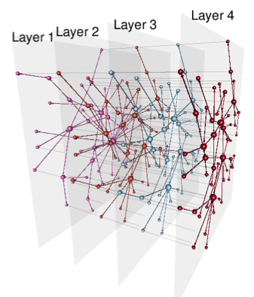
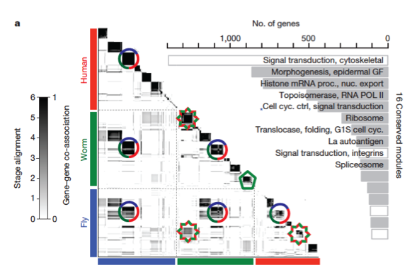
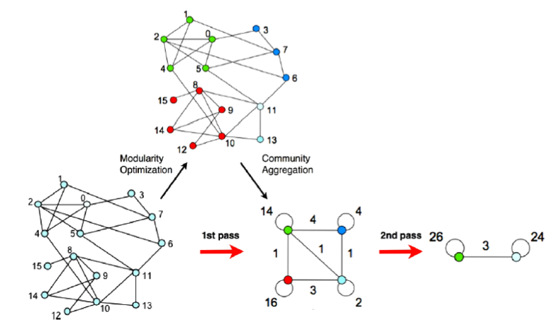


OrthoClust: A multi-layer network framework for clustering high-throughput biological data across species
Koon-Kiu Yan, Daifeng Wang, Paul Muir, Joel Rozowsky, Mark Gerstein
Department of Molecular Biophysics and Biochemistry, Program in Computational Biology and Bioinformatics, Yale University
Multi-layer network
Optimization Procedures
Simultaneous clustering of expression profiles
Simulated annealing
Other Applications
Layer 1 | Family | Transcription regulation | Co-expression (species 1) | PPI (species 1)
Layer 2 | LinkedIn | Regulation by miRNAs | Co-expression (species 2) | PPI (species 2)
Layer 3 | Facebook | Phosphory-lation | Co-expression (species 3) | PPI (species 3)
Coupling | Same individual | Same gene | orthology | orthology
Alternate heuristic
Louvain algorithm
To identify regions that are common across layers, and regions that are specific.
Apart from co-expression networks, OrthoClust can be applied to other networks such as PPI networks, probing the evolution of protein complexes.
Easily generalized to N species
The network based modularity function can be generalized to a correlation based modularity function:
for data like Hi-C interaction matrices.
OrthoClust: cross species network clustering
Simultaneous clustering of expression profiles
Modules are densely connected regions in a network.
Code Availability
MATLAB and R code can be downloaded from Github
https://github.com/gersteinlab/OrthoClust
References
Yan et al. OrthoClust: an orthology-based network framework for clustering data across multiple species, Genome Biology 2014
Gerstein, Rozowsky, Yan et al. Comparative analysis of the transcriptome across distant species, Nature 2014
Blondel et al. Fast unfolding of communities in large networks, J. Stat. Mech. 2008

