Slide 1
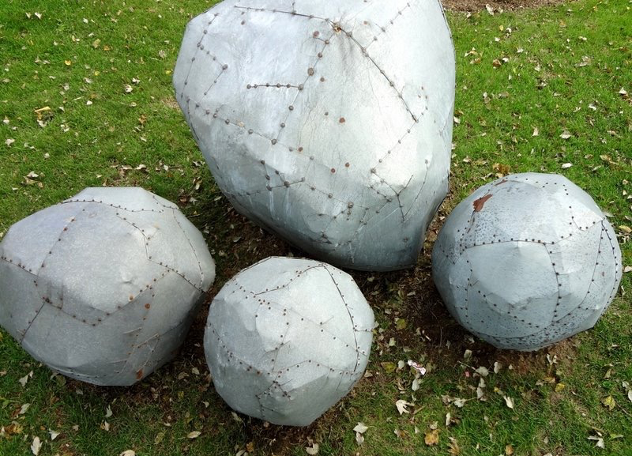
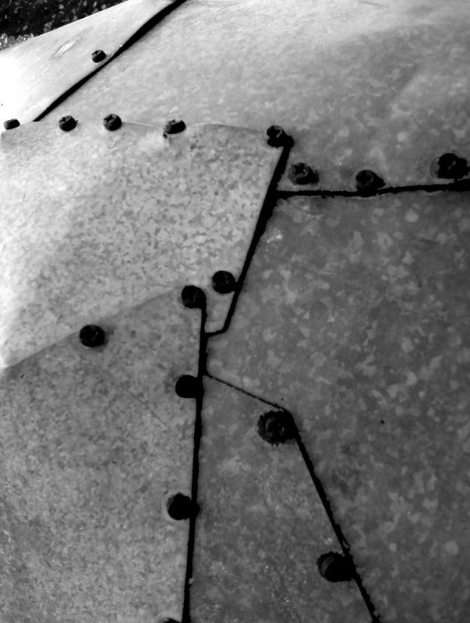
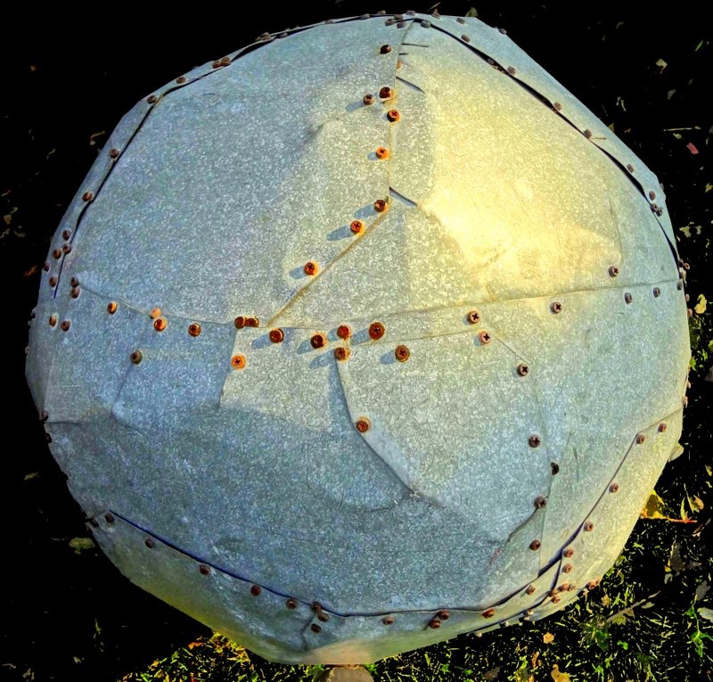
Comparative Genome Analysis:
Comparing Transcriptomes of Distant Organisms
M Gerstein, Yale
Slides freely downloadable from Lectures.GersteinLab.org
& “tweetable” (via @markgerstein).
See last slide for
references & more info.

Slide 2
How might we annotate a human text?
Color is Function
Lines are Similarity
[B Hayes,
Am. Sci.
(Jul.- Aug. '06)]

Slide 3
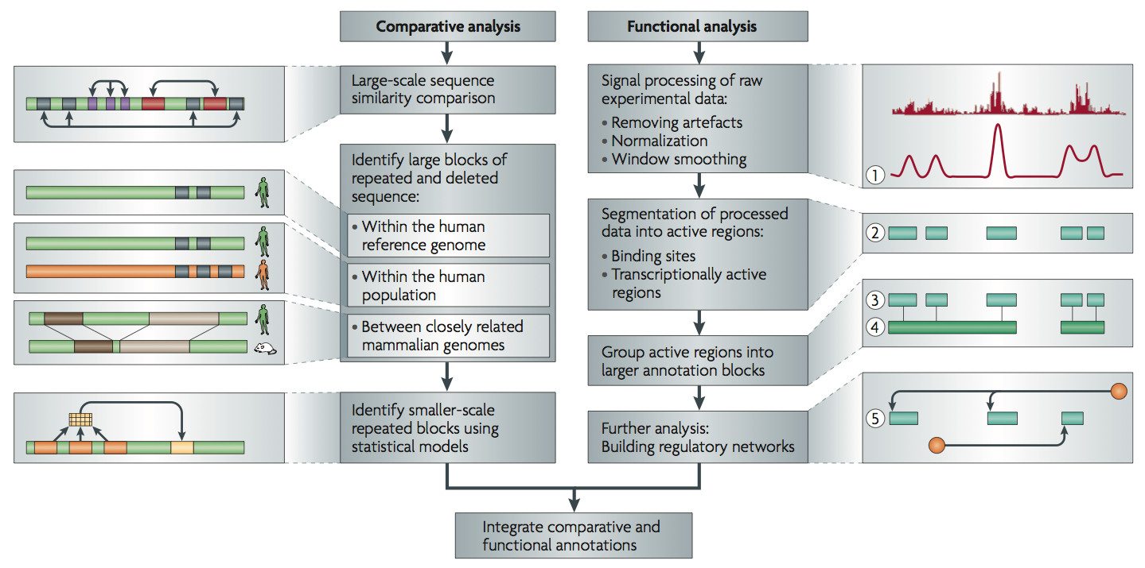
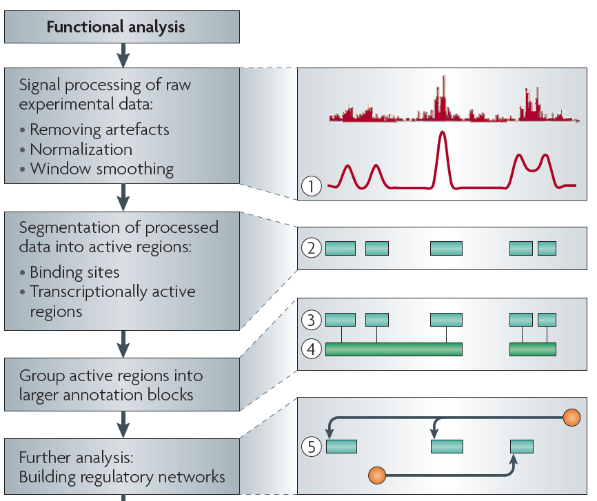
Non-coding Annotations: Overview
There are several collections of information "tracks" related to non-coding features
Sequence features, incl. Conservation
Functional Genomics
ChIP-seq (Epigenome & seq. specific TF) and ncRNA & un-annotated transcription
[Nat. Rev. Genet. (2010) 11: 559]

Slide 4
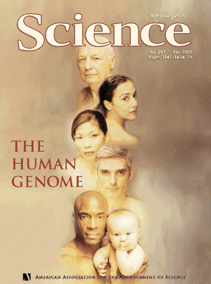
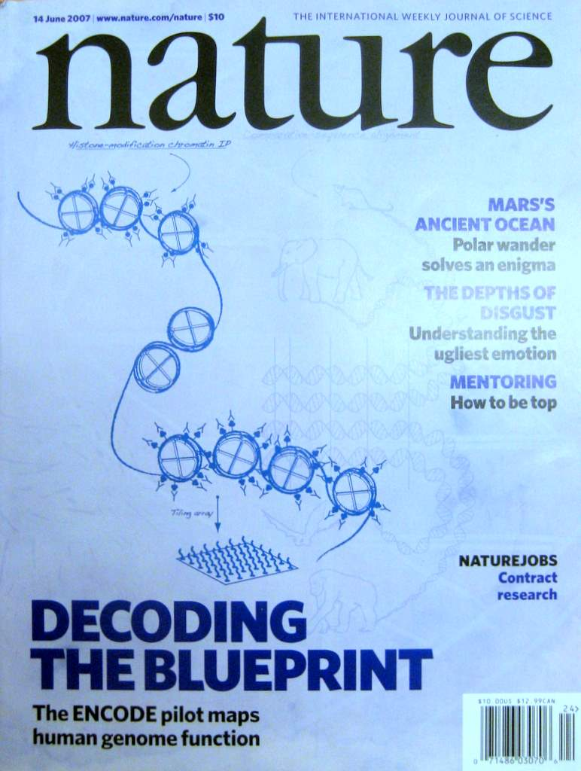

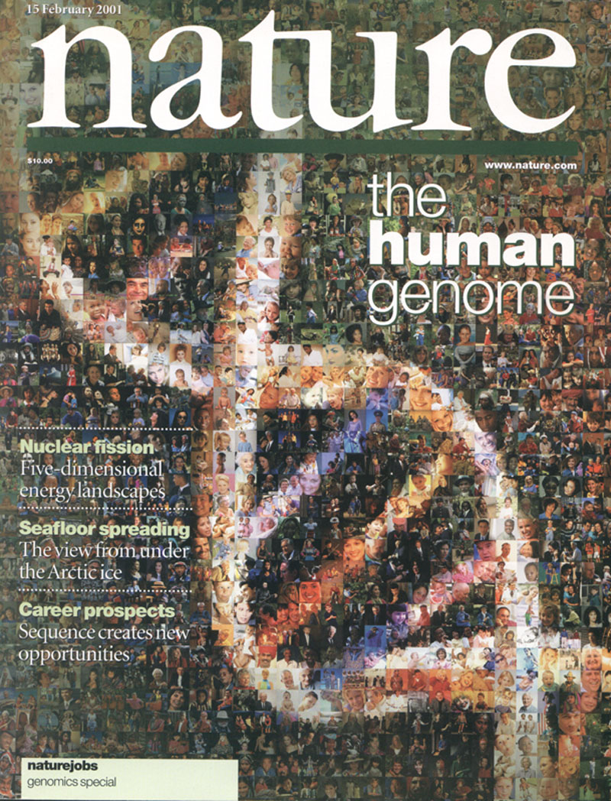
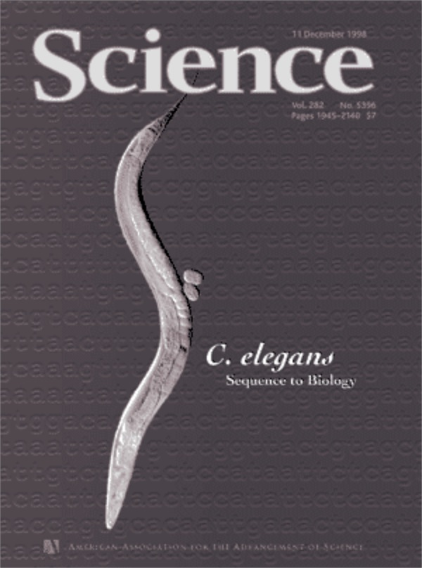
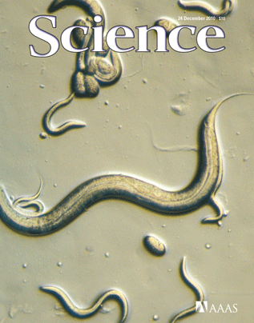
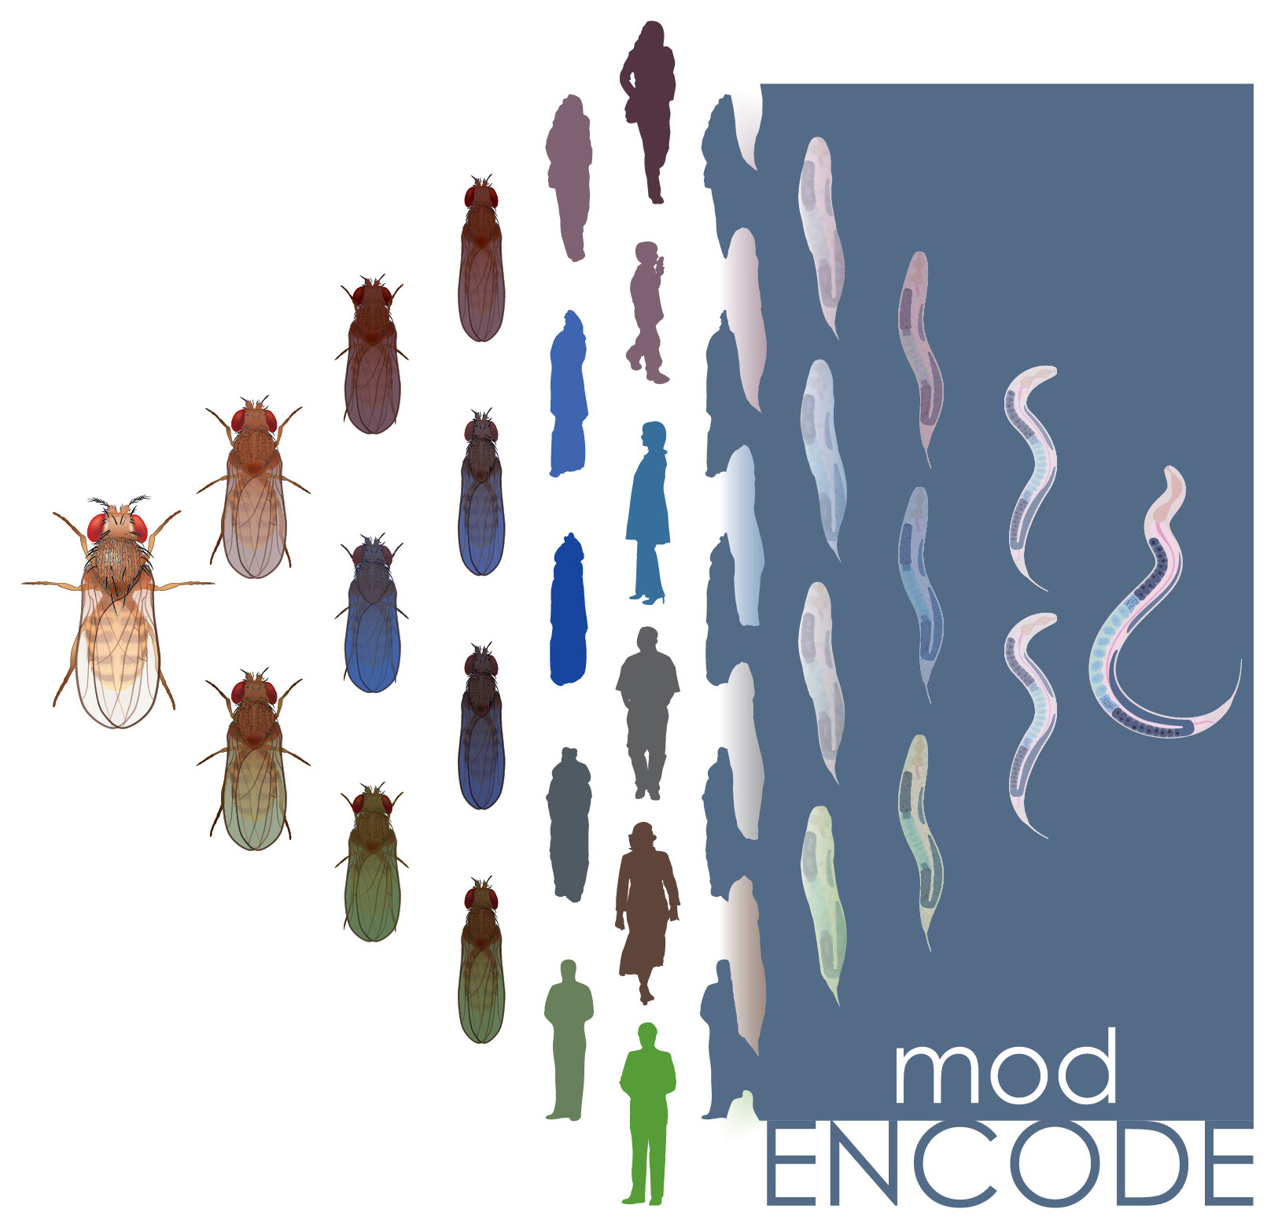
ENCODE
Consortium
& various
annotation
rollouts
1998
1999
2000
2002
2003
2004
2005
2006
2008
2009
2010
2011
2012
2013
2014
2001
2007

Slide 5
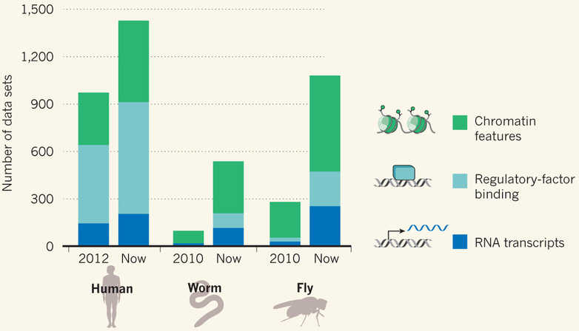
Comparative ENCODE Functional Genomics Resource
(EncodeProject.org/modENCODE.org)
Broad sampling of conditions across transcriptomes & regulomes for human, worm & fly
  embryo & ES cells
  developmental time course (worm-fly)
In total: ~3000 datasets (~130B reads)

Slide 6
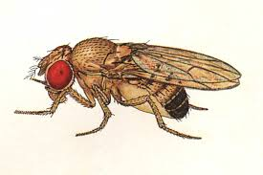
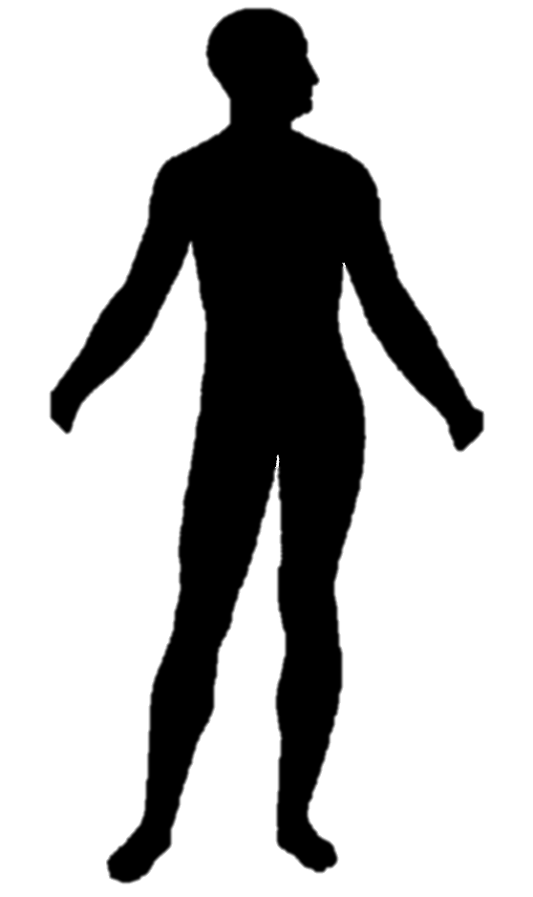
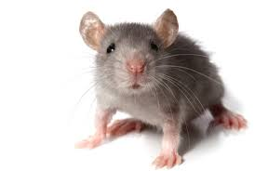
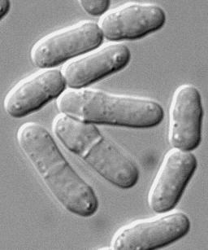
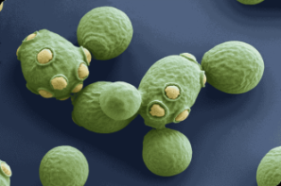

Comparative ENCODE
Previous studies have compared RNA transcription between closely related organisms (e.g. RNA-seq within mammals, Brawand et al. '11) …
EUKARYOTES
ANIMALS
MAMMALS
YEAST
500 MYO
75 MYO
Fly
Worm
Human
Mouse
Fission Yeast
Budding Yeast
RNA

Slide 7
Comparative ENCODE
Previous studies have compared RNA transcription between closely related organisms (e.g. RNA-seq within mammals, Brawand et al. '11) …
… or integrated diverse –omic information within each of several species (eg modencode '10)
EUKARYOTES
ANIMALS
MAMMALS
YEAST
500 MYO
75 MYO
Fly
Worm
Human
Mouse
Fission Yeast
Budding Yeast
RNA
TF
chromatin

Slide 8
Comparative ENCODE
Previous studies have compared RNA transcription between closely related organisms (e.g. RNA-seq within mammals, Brawand et al. '11) …
… or integrated diverse –omic information within each of several species (eg modencode '10)
EUKARYOTES
ANIMALS
A first effort to
comprehensively integrate diverse data across distantly related species
MAMMALS
YEAST
500 MYO
75 MYO
Fly
Worm
Human
Mouse
Fission Yeast
Budding Yeast
RNA
TF
chromatin

Slide 9
Applications of Machine Learning for
Comparing Transcriptomes of Distant Organisms
Intro to Comparative ENCODE
  Lots of Matched Data for Comparative Analysis
App. #1: Characterizing ncRNAs & TARs
  Not much news in canonical gene models
  Simple contig search (TARs) finds uniform density of non-canonical transcription
  ML model shows few TARs similar to existing ones, but some enrichment for eRNAs
App. #2: Expression Clustering, Cross-species
  Potts-model optimization gives 16 conserved co-expression modules (which can potentially annotate ncRNAs/TARs)
  Developmental 'hourglass' genes in 12 of these. They also exhibit intra-organism hourglass behavior.
  Stage alignment of worm & fly development, strongest with hourglass genes
App. #3: HM Models Relating Gene Expression to Promoter Activity
  Works for ncRNAs as well as genes
  Universal cross-species model uses same set of parameters across diverse phyla
App. #4: Similarly constructed TF Models
  Variable importance of regions around genes for HMs & TFs
  TF & HM signals are redundant for ‘prediction'
  Surprisingly, a few TFs are quite predictive

Slide 10
Protein-coding gene counts in worm, fly & human have stabilized & have remained fairly constant
[Nature 512:445 ('14);
doi: 10.1038/nature13424]

Slide 11
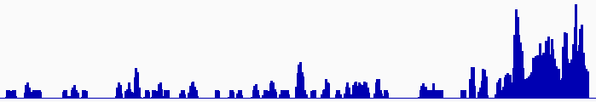
Discovering Transcriptionally Active Regions (novel RNA contigs)
Cluster reads setting minimum-run and maximum gap parameters for newly identified transcribed regions (TARs)
Assess exon discovery rates for known genes and noncoding RNAs
Known exon
Known exon
TAR
TAR
TAR
novel TAR
correct identification
possible exon extension
ENCODE RNA-Seq Data

Slide 12
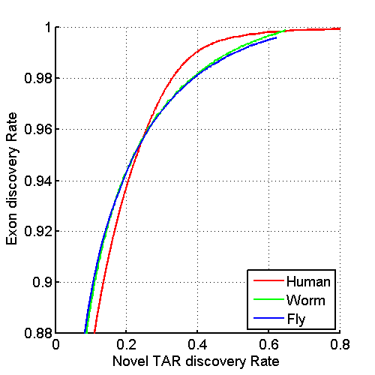
Uniform Annotation of non-coding Elements
Uniformly processed the RNA-seq expression compendium and for identification of pervasively transcribed regions
[Nature 512:445 ('14); doi: 10.1038/nature13424]

Slide 13
Annotated ncRNAs
 |  |  | Human |  |  | Worm |  |  | Fly
 |  |  | Elements | Genome Coverage |  | Elements | Genome Coverage |  | Elements | Genome Coverage
 |  |  |  | Kb | % |  | Kb | % |  | Kb | %
mRNAs (exons) |  |  | 20,007 | 86,560 | 3.0 | 21,192 | 34,437 | 34.3 | 13,940 | 35,970 | 28.0
Pseudogenes |  |  | 11,216 | 27,089 | 0.95 | 881 | 1,343 | 1.3 | 145 | 155 | 0.12
Annotated ncRNAs | Comparable ncRNAs | pri-miRNA | 58 | 1,158 | 0.04 | 44 | 16 | 0.02 | 43 | 300 | 0.23
 |  | pre-miRNAs | 1,756 | 162 | 0.006 | 221 | 20 | 0.02 | 236 | 22 | 0.02
 |  | tRNAs | 624 | 47 | 0.002 | 609 | 45 | 0.04 | 314 | 22 | 0.02
 |  | snoRNAs | 1,521 | 168 | 0.006 | 141 | 16 | 0.02 | 287 | 34 | 0.03
 |  | snRNAs | 1,944 | 210 | 0.007 | 114 | 14 | 0.01 | 47 | 7 | 0.006
 |  | lncRNAs | 10,840 | 10,581 | 0.37 | 233 | 184 | 0.18 | 852 | 868 | 0.68
 | Other ncRNAs |  | 5,411 | 3,268 | 0.11 | 40,104 | 2,329 | 2.3 | 376 | 2,103 | 1.6
 |  | nc-piRNA loci | 88 | 1,272 | 0.04 | 35,329 | 449 | 0.45 | 27 | 1,473 | 1.1
Total |  |  | 22,154 | 17,770 | 0.62 | 41,466 | 2,611 | 2.6 | 2,155 | 3,279 | 2.6
Identify non-canonical transcription in regions of the genome excluding mRNA exons, pseudogenes or annotated ncRNAs.
[Nature 512:445 ('14); doi: 10.1038/nature13424]

Slide 14
& Non-Canonical Transcription
 |  |  | Human |  |  | Worm |  |  | Fly
 |  |  | Elements | Genome Coverage |  | Elements | Genome Coverage |  | Elements | Genome Coverage
 |  |  |  | Kb | % |  | Kb | % |  | Kb | %
Total ncRNAs |  |  | 22,154 | 17,770 | 0.62 | 41,466 | 2,611 | 2.6 | 2,155 | 3,279 | 2.6
Regions Excluding mRNAs, Pseudogenes or Annotated ncRNAs |  |  | 283,816 | 2,731,811 | 95.5 | 143,372 | 63,520 | 63.3 | 60,108 | 89,445 | 69.6
 | Transcription Detected (TARs) |  | 708,253 | 916,401 | 32.0 | 232,150 | 37,029 | 36.9 | 83,618 | 44,256 | 34.5
 |  | Supervised Predictions | 104,016 | 13,835 | 0.48 | 2,525 | 392 | 0.39 | 599 | 164 | 0.13
Similar fraction of non-canonical transcription of non-canonical transcription in human, worm and fly
  32-37% of each genome
[Nature 512:445 ('14); doi: 10.1038/nature13424]

Slide 15
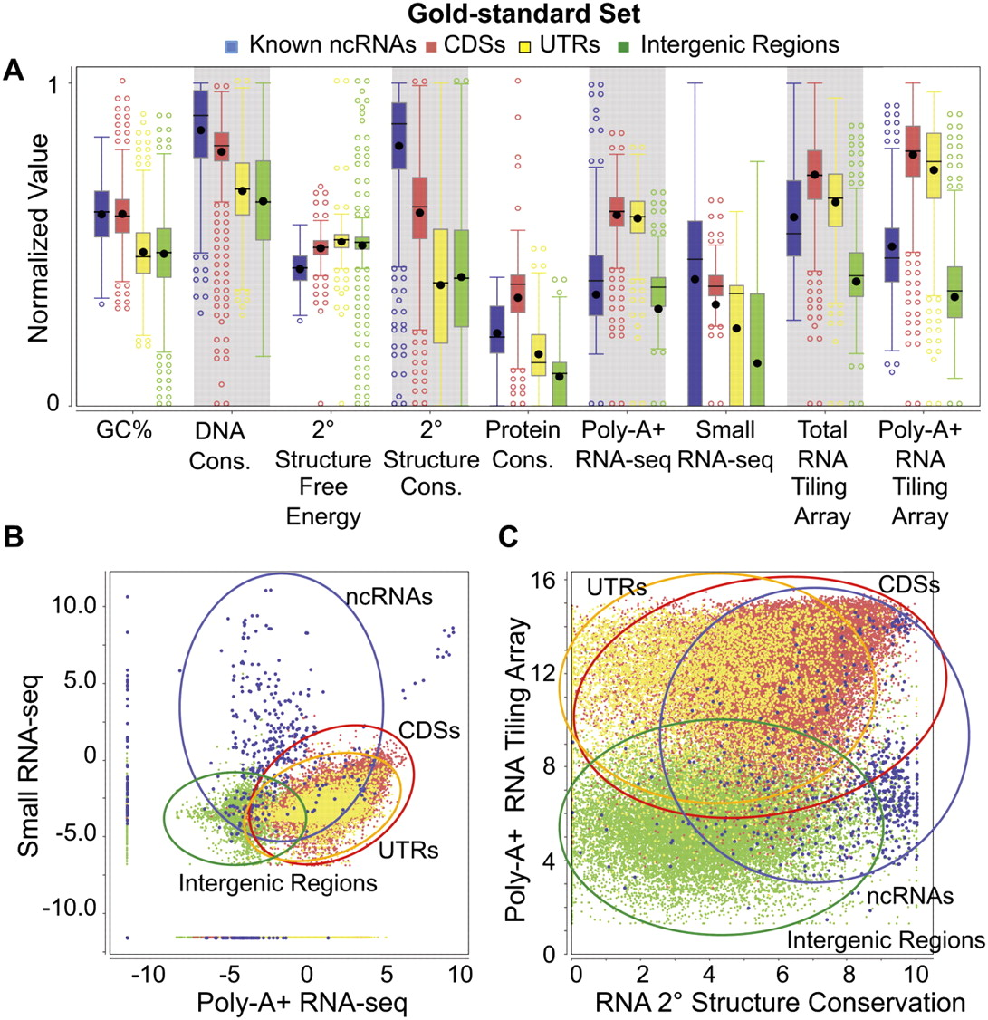
IncRNA:
Machine-learning Identification of many candidate ncRNAs through evidence integration
No single feature (e.g. expr. expts., conservation, or sec. struc.) finds all known ncRNAs => combine features in stat. model
90% PPV, 13 of 15 tested validate
[Lu et al. Genome Res. 2011;21:276-285]
Notes:
Distributions of nine genomic feature values. The distributions of values of the nine features are shown for the gold-standard set (for the definition of the gold-standard set, see Supplemental Methods) of the four types of genomic elements: known ncRNAs, coding sequences (CDSs), untranslated regions (UTRs), and intergenic regions. The values of each expression feature are the maximum of the corresponding values from all the expression data sets of the same type. (A) Box plots of individual features (normalized values). (B) Two-dimensional scatter-plot of the maximum small RNA-seq signal against the maximum poly-A+ RNA-seq signal. (C) Two-dimensional scatter-plot of the maximum poly-A+ RNA tiling array signal against the predicted secondary structure conservation. Expression values in B and C are the log-transformed normalized read counts (DCPM, depth of coverage per million reads).

Slide 16
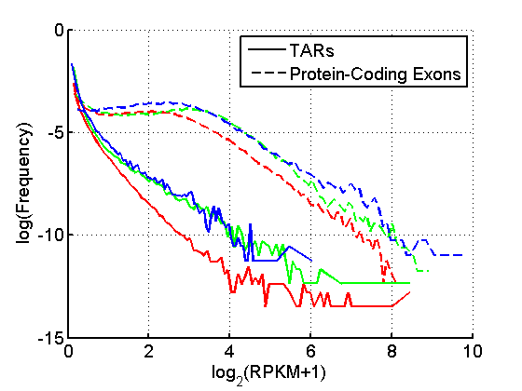
TAR Characterization
Non-canonical transcription (TARs):
Mostly transcribed at lower levels than protein-coding genes.
Enrichment for overlap of TARs with ENCODE enhancers and distal HOT regions -> potential enhancer RNAs (eRNAs).
Human, Worm & Fly
[ENCODE-modencode Transcriptome paper, Nature (in press), doi: 10.1038/nature13424]
HOT Regions = High TF Co-occupancy

Slide 17
Applications of Machine Learning for
Comparing Transcriptomes of Distant Organisms
Intro to Comparative ENCODE
  Lots of Matched Data for Comparative Analysis
App. #1: Characterizing ncRNAs & TARs
  Not much news in canonical gene models
  Simple contig search (TARs) finds uniform density of non-canonical transcription
  ML model shows few TARs similar to existing ones, but some enrichment for eRNAs
App. #2: Expression Clustering, Cross-species
  Potts-model optimization gives 16 conserved co-expression modules (which can potentially annotate ncRNAs/TARs)
  Developmental 'hourglass' genes in 12 of these. They also exhibit intra-organism hourglass behavior.
  Stage alignment of worm & fly development, strongest with hourglass genes
App. #3: HM Models Relating Gene Expression to Promoter Activity
  Works for ncRNAs as well as genes
  Universal cross-species model uses same set of parameters across diverse phyla
App. #4: Similarly constructed TF Models
  Variable importance of regions around genes for HMs & TFs
  TF & HM signals are redundant for ‘prediction'
  Surprisingly, a few TFs are quite predictive

Slide 18
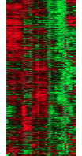
Expression clustering:
revisiting an ancient problem
Species A
Species B
Clustering
algorithm
Clustering
algorithm
co-expressed genes
responsible for the same
function in a species
co-expressed genes
responsible for the same
function in a species
two independent sets
of modules
Cross species
co-expression modules

Slide 19
Expression clustering:
revisiting an ancient problem
Species A
Orthologous pairs
between species
Species B
A novel unified framework to integrate co-expression data across species
OrthoClust
cross species modules
Cross species
co-expression modules

Slide 20
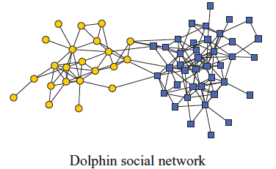
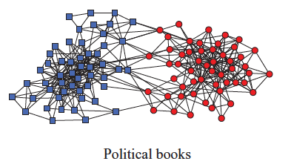
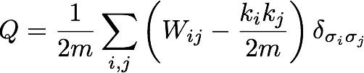
Network modularity
Newman Phy. Rev. E 2013
degree of i
adjacency matrix
whether or not
i, j are in the
same module
number of edges
expected number of
edges between i and j

Slide 21

Network modularity
degree of i
adjacency matrix
whether or not
i, j are in the
same module
number of edges
expected number of
edges between i and j

Slide 22

Network modularity
Optimization problem
degree of i
adjacency matrix
whether or not
i, j are in the
same module
number of edges
expected number of
edges between i and j

Slide 23
A toy example [orthoclust]
[Yan et al. GenomeBiol 15:R100 ('14)]
2
Every node i is assigned with a spin value σ_{i} (labels of modules: 1,2,…q).
4
4
co-expressed
1
1
2
2
orthologs
Species A
3
3
Species B
reward an orthologous pair
with the same value
4
4
4
1
2
1
3
1
reward a co-expressed
pair with the same value
punish a non co-expressed
pair with the same value
Favorableness = "Modularity" in species A + "Modularity" in species B + consistency betw. A & B

Slide 24
A toy example [orthoclust]
[Yan et al. GenomeBiol 15:R100 ('14)]
2
2
4
co-expressed
2
4
2
4
orthologs
Species A
2
4
Species B
4
1
4
1
4
4
1
1
species A specific
conserved modules
species B specific
The ground state configuration correspond to three modules: 1, 2, 4.

Slide 25
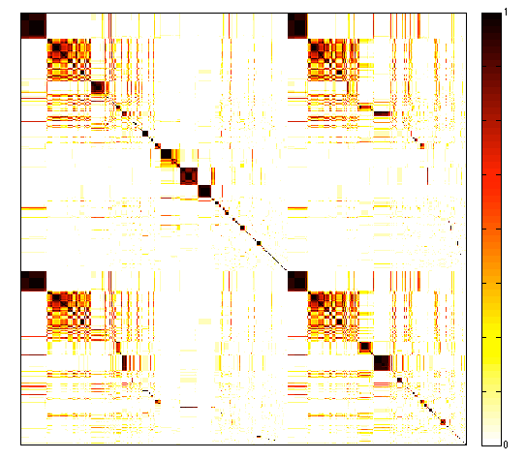
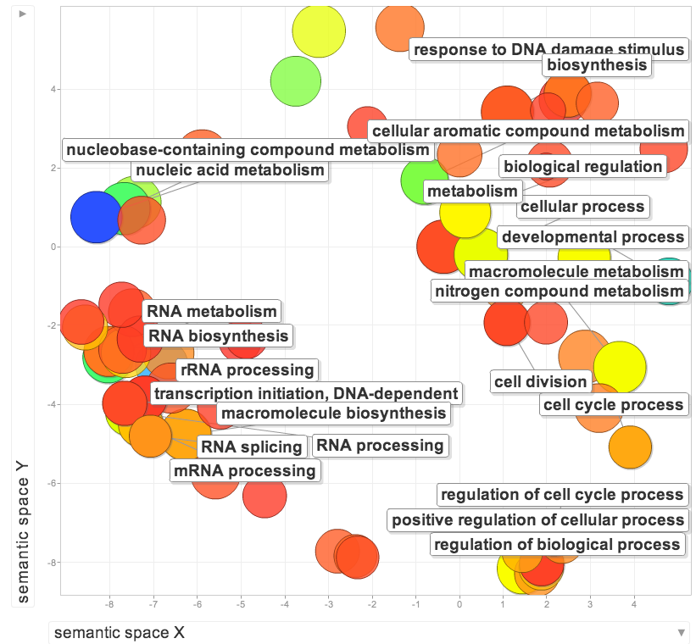
Cross-species clusters for worm and fly
9
GO terms of conserved modules
Worm genes (20377)
Fly genes (13623)
GO terms of specific modules
worm specific | dauer entry
fly specific | chitin activities
co-association
frequency
Yan KK et al. Genome Biology. 2014

Slide 26
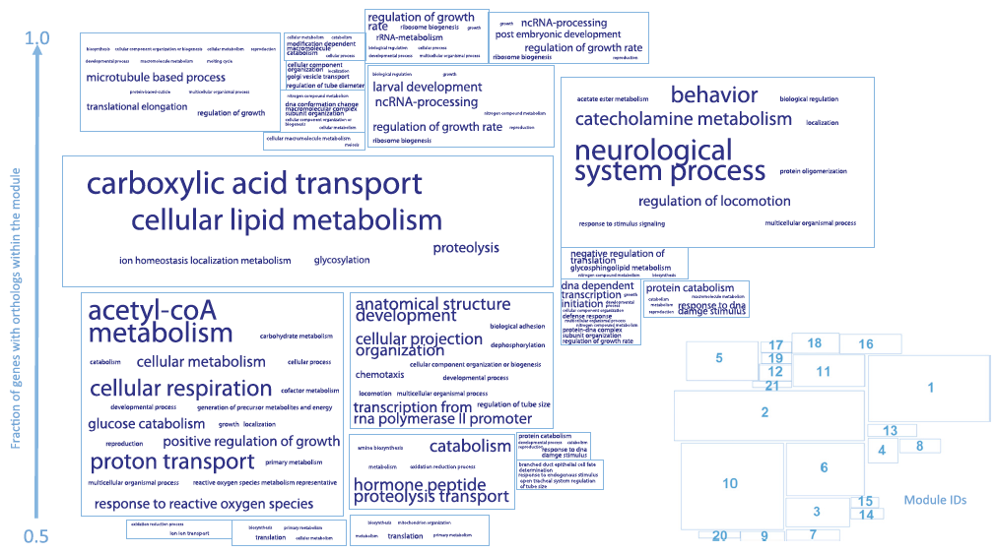
More conserved modules
Heidi Sofia
Yan KK et al. Genome Biology. 2014

Slide 27
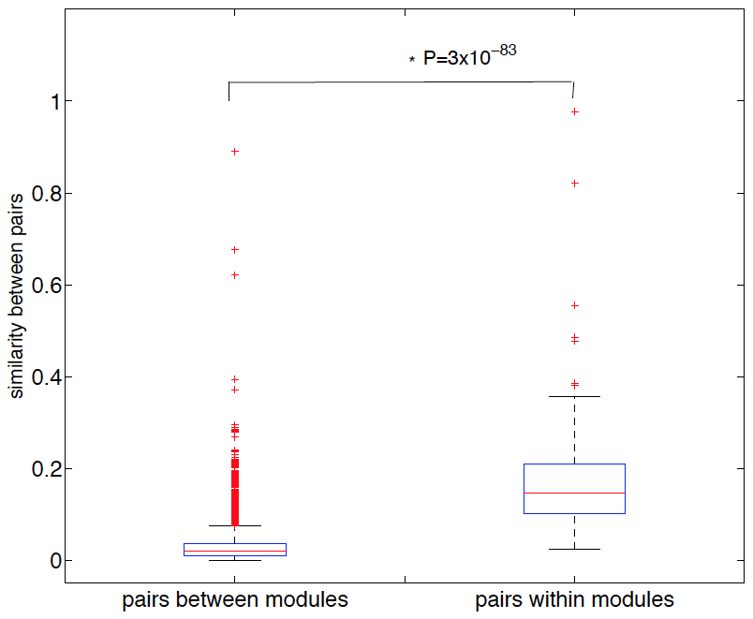
Separation of modules in terms of GO
Yan KK et al. Genome Biology. 2014

Slide 28
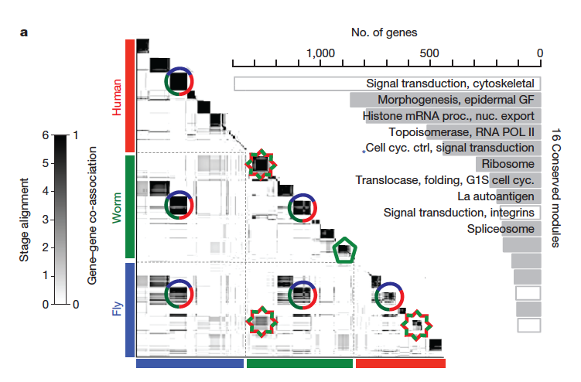
Application for more than 2 species
~55000 genes
Gerstein M*, Rozowsky J*, Yan KK* et.al. Nature 2014

Slide 29
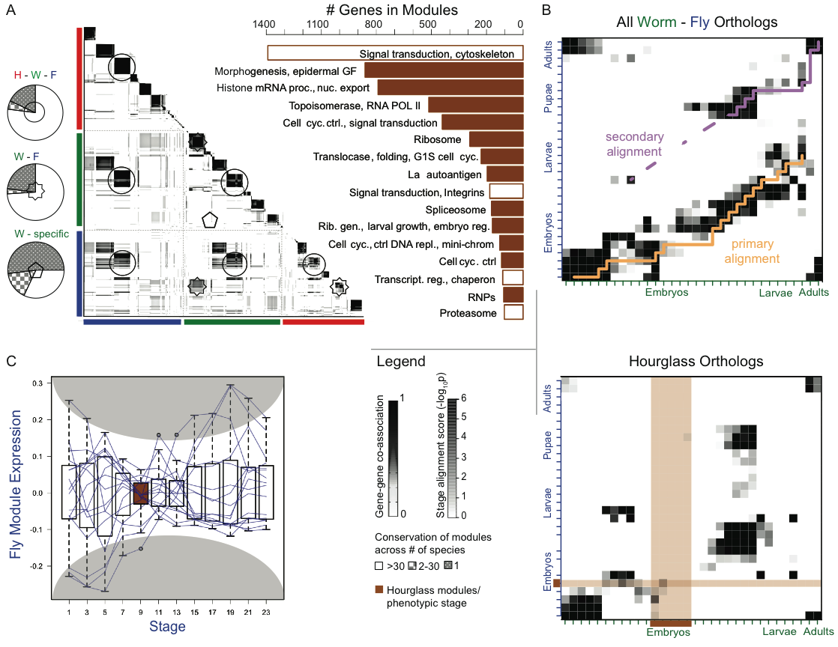
Cross-Species Co-expression Clustering
Use Potts model (generalized Ising model) to simultaneously cluster co-expressed genes within an organism as well as orthologs shared between organisms.
Conservation of module across number of species
[Nature 512:445 ('14); doi: 10.1038/nature13424]

Slide 30
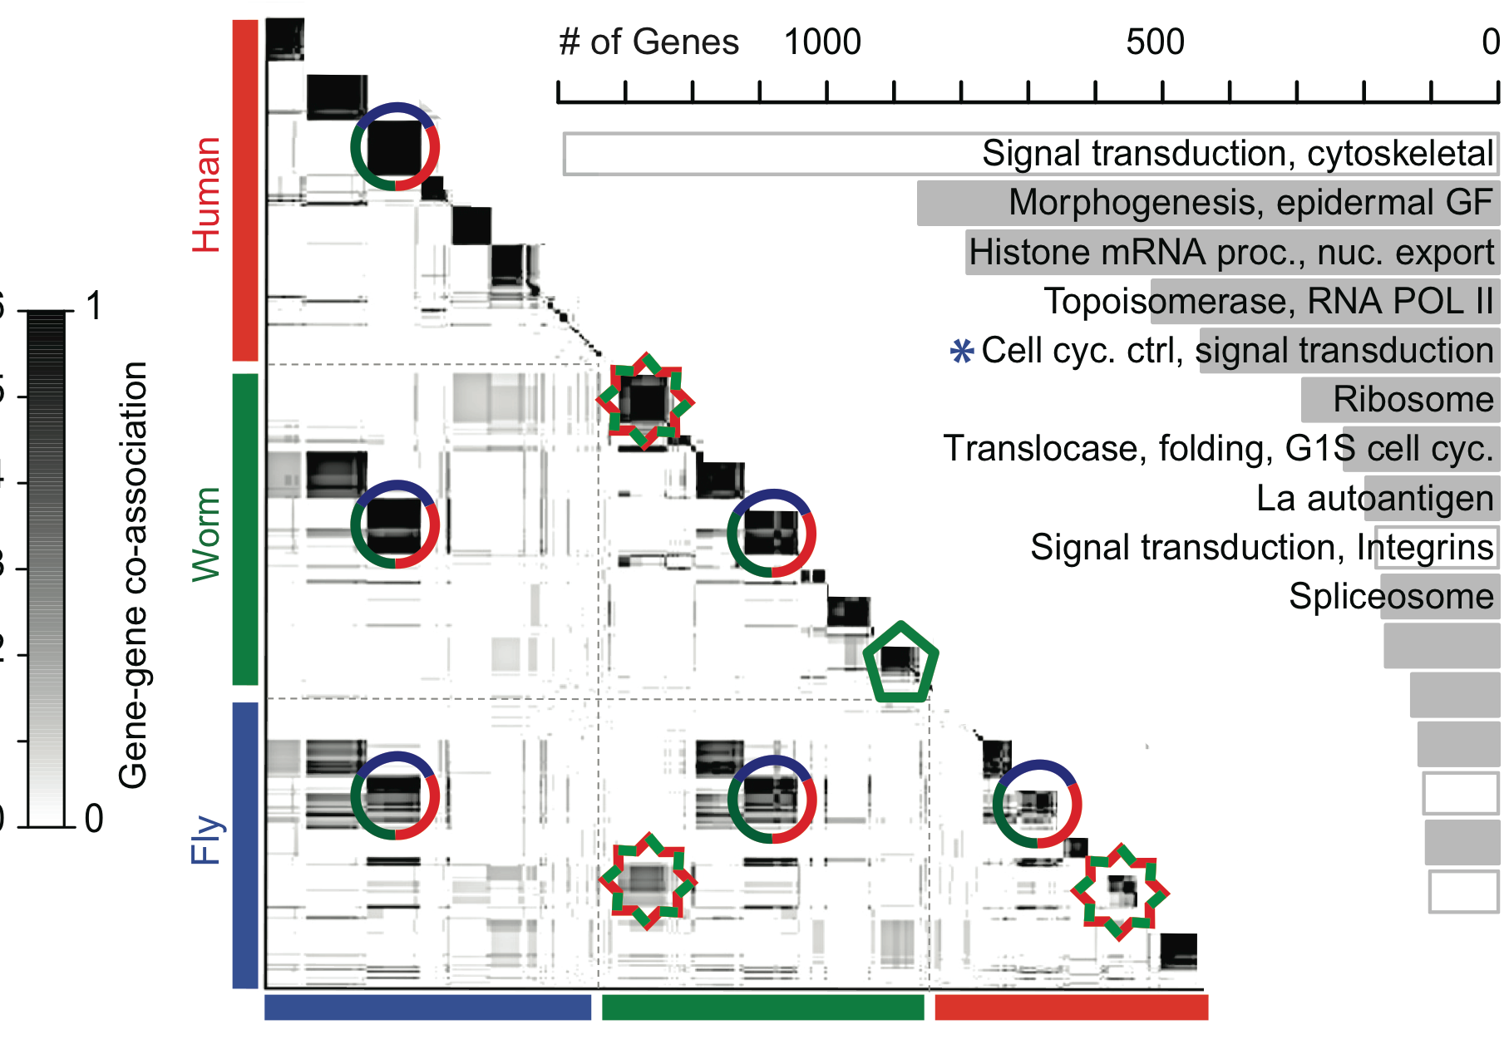
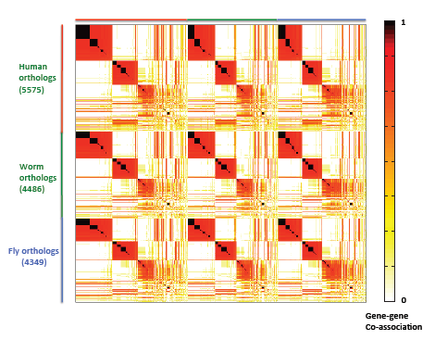
16 Conserved Modules
16 Conserved Modules
Conservation of module across number of species
[Nature 512:445 ('14); doi: 10.1038/nature13424]

Slide 31
ncRNAs associated with modules
Non-canonical transcription (TARs):
Identify TARs that are significantly correlated and anti-correlated with genes in the 16 modules.
Human, Worm & Fly
[Nature 512:445 ('14); doi: 10.1038/nature13424]

Slide 32
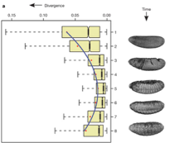
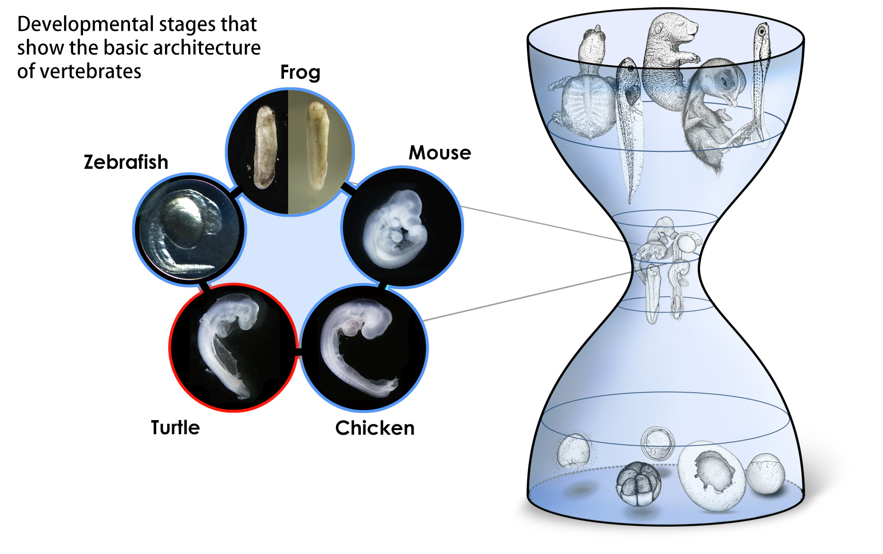
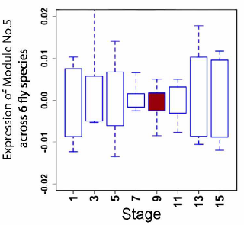
Conserved modules exhibit the hourglass pattern
Phylotypic stage
Illustrations courtesy Naoki Irie
Expression divergence across species is minimized during phylotypic stage (Kalinka et al. Nature 2010)
Canonical Inter-organism Behavior
“Hourglass hypothesis”: all organisms go through a particular stage in embryonic development ("phylotypic" stage) where
inter-organism expression differences of orthologous genes are smallest.
We identify modules (12 out of 16) which have this behavior at the phylotypic stage.
[Nature 512:445 ('14); doi: 10.1038/nature13424]
phylotypic stage

Slide 33
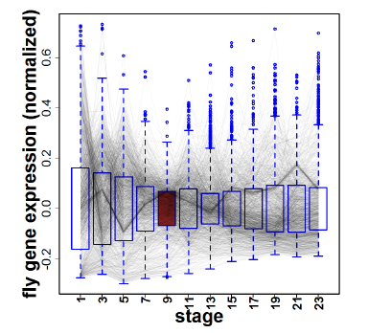
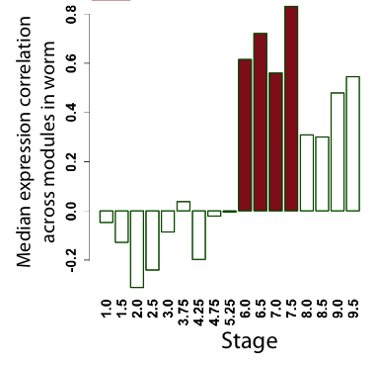
Hourglass Behavior
phylotypic stage
Intra-organism Behavior also Present
We observe that the expression of genes across 12 modules are the most tightly coordinated at the phylotypic stage (fly).
Strongly correlated correlation at phylotypic stage (worm).
[Nature 512:445 ('14); doi: 10.1038/nature13424]

Slide 34
Potential Application: inference of ncRNAs/transcription active regions (TARs)
Guilt by association
ncRNA/TAR
module of
protein-coding
genes
conventional definition
module 1:
sphinx (expressed in brain antennal lobe, regulating male courtship behavior)
Dai H et al. PNAS 2008, Chen et al. PLoS One 2011

Slide 35
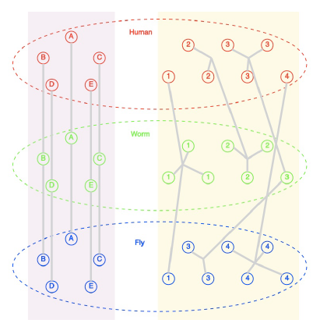
Potential Application: inference of ncRNAs/transcription active regions (TARs)
Guilt by association
ncRNA/TAR
module of
protein-coding
genes
conventional definition
human
ncRNA/TAR
module 1:
sphinx (expressed in brain antennal lobe, regulating male courtship behavior)
worm
ncRNA/TAR
Dai H et al. PNAS 2008, Chen et al. PLoS One 2011
fly
ncRNA/TAR
Module defined by OrthoClust
Gerstein M*, Rozowsky J*, Yan KK* et.al. Nature 2014

Slide 36
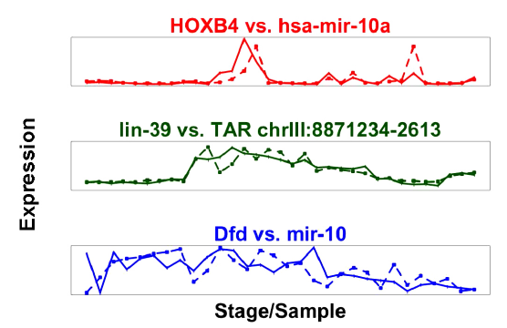
Potential Application: inference of ncRNAs/transcription active regions (TARs)
Guilt by association
ncRNA/TAR
module of
protein-coding
genes
conventional definition
human
ncRNA/TAR
module 1:
sphinx (expressed in brain antennal lobe, regulating male courtship behavior)
worm
ncRNA/TAR
Dai H et al. PNAS 2008, Chen et al. PLoS One 2011
fly
ncRNA/TAR
Module defined by OrthoClust
Gerstein M*, Rozowsky J*, Yan KK* et.al. Nature 2014

Slide 37
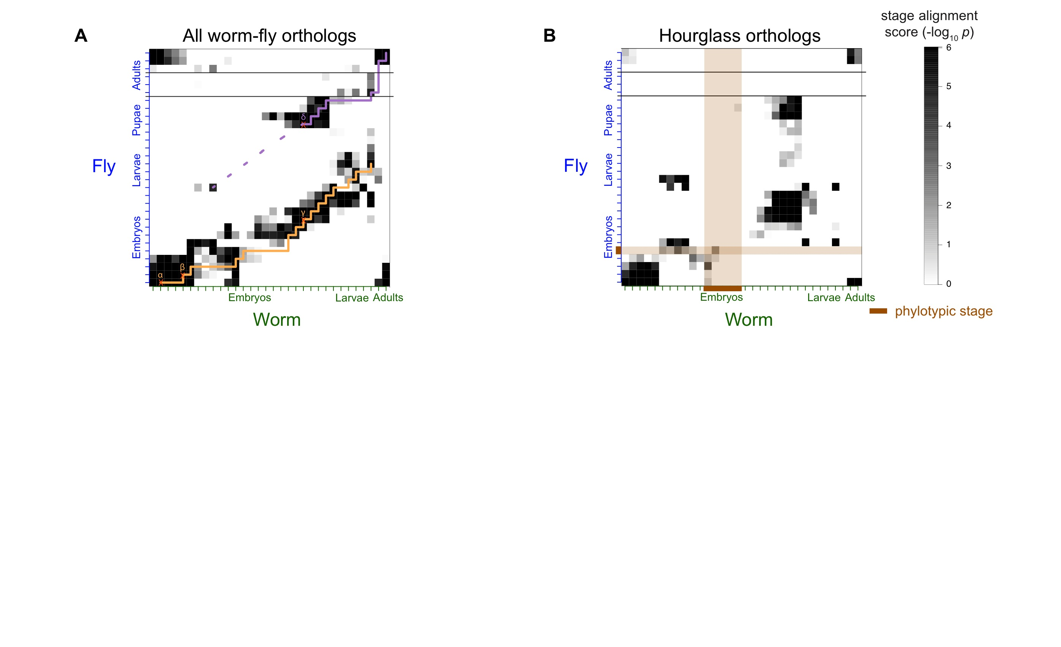
Alignment of Developmental Time-Course
For worm & fly find stage-specific genes
We can align developmental stages using fraction of shared orthologs between worm and fly amongst these
Reuse of genes from LE in worm in fly pupa
Fly
Align developmental stages using shared orthologs between worm and fly
  Reuse of genes from LE in worm in fly pupa
Using only orthologs in hourglass modules we find similar behavior except for absence of genes at the phylotypic stage
primary alignment
secondary alignment
Worm
[Nature 512:445 ('14); doi: 10.1038/nature13424]

Slide 38
Alignment of Developmental Time-Course
Using only orthologs in 12 "hourglass" modules show stronger alignment except for absence of genes at the phylotypic stage
  By definition genes in hourglass modules are not phylotypic stage specific, hence the gap
[Nature 512:445 ('14); doi: 10.1038/nature13424]

Slide 39
Other applications and generalizations
expression networks:
worm vs fly vs human
orthology
relationship
￼
image courtesy http://muxviz.net/

Slide 40
Other applications and generalizations
orthology
relationship
use modules to refine
orthology relationship
use orthology to
define modules
modules
expression networks:
worm vs fly vs human
orthology
relationship
￼
image courtesy http://muxviz.net/

Slide 41
Other applications and generalizations
protein-protein interaction networks
evolution of protein complexes
orthology
relationship
￼
image courtesy http://muxviz.net/

Slide 42
Other applications and generalizations
Facebook
LinkedIn
same
individual
Family
￼
image courtesy http://muxviz.net/

Slide 43
Other applications and generalizations
oral cavity
stomach
same
bacterial
species
colon
￼
image courtesy http://muxviz.net/

Slide 44
Applications of Machine Learning for
Comparing Transcriptomes of Distant Organisms
Intro to Comparative ENCODE
  Lots of Matched Data for Comparative Analysis
App. #1: Characterizing ncRNAs & TARs
  Not much news in canonical gene models
  Simple contig search (TARs) finds uniform density of non-canonical transcription
  ML model shows few TARs similar to existing ones, but some enrichment for eRNAs
App. #2: Expression Clustering, Cross-species
  Potts-model optimization gives 16 conserved co-expression modules (which can potentially annotate ncRNAs/TARs)
  Developmental 'hourglass' genes in 12 of these. They also exhibit intra-organism hourglass behavior.
  Stage alignment of worm & fly development, strongest with hourglass genes
App. #3: HM Models Relating Gene Expression to Promoter Activity
  Works for ncRNAs as well as genes
  Universal cross-species model uses same set of parameters across diverse phyla
App. #4: Similarly constructed TF Models
  Variable importance of regions around genes for HMs & TFs
  TF & HM signals are redundant for ‘prediction'
  Surprisingly, a few TFs are quite predictive

Slide 45
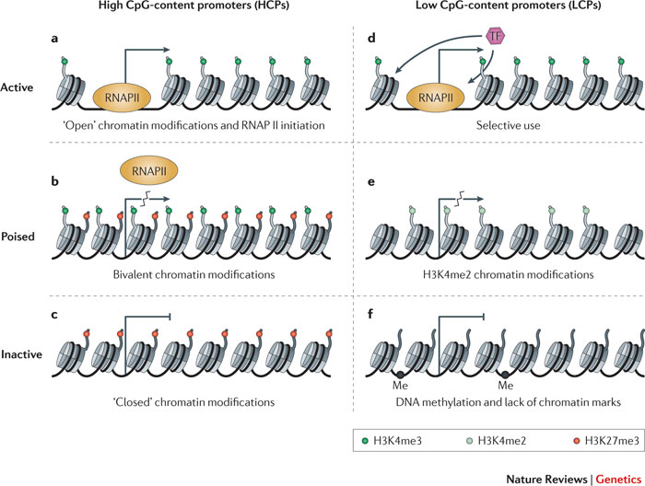
Focus on Promoters
Active Promoter
Key Questions
  How do we define the active regions of promoter?
  For an active promoter, how do we relate it bound TFs, its epigenetic marks & its chromatin state to the level of transcription?
  Are these definitions & relationships conserved between very different species?
Histone modifications
Repressed Promoter
Zhou et al. Nat. Rev. Genetics 2011

Slide 46
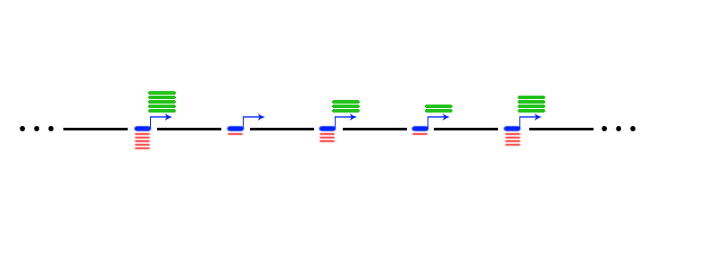
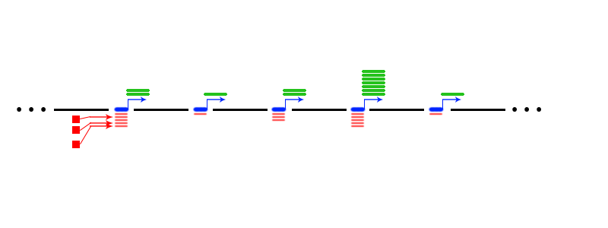
Relating Genomic Inputs to Outputs
Cell Type 1
Cell Type 2

Slide 47
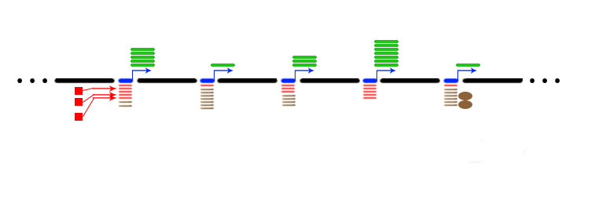
Y = aX₁ + bX₂ + c

Slide 48
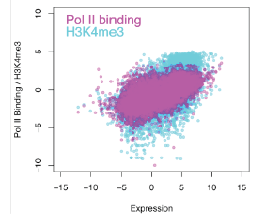
Inputs v Outputs:
Upstream Binding/Modification v Expression
PCC: Pol II,
0.33; H3K4me3, 0.28
for Worm
[Nature 512:445 ('14); doi: 10.1038/nature13424]

Slide 49
Histone Modification (HM) model
TSS
TTS
Gene k
40
1
80
120
81
[Cheng et al. (’11) Genome Biol. 12: R15]
4 …
41 ….44
121
160
Bin 40-1
(TSS-4kb to TSS)
Bin 41-80
(TSS to TSS+4kb)
Bin 120-81
(TTS-4kb to TTS)
Bin 121-160
(TTS to TTS+4kb)
RNA-Seq data
Chromatin features:
Histone modifications
Prediction target:
Gene expression level
Predictors
~10000 refseq genes
HM1, 2, 3, ……
……
Bin 1
Bin 2
Bin160

Slide 50
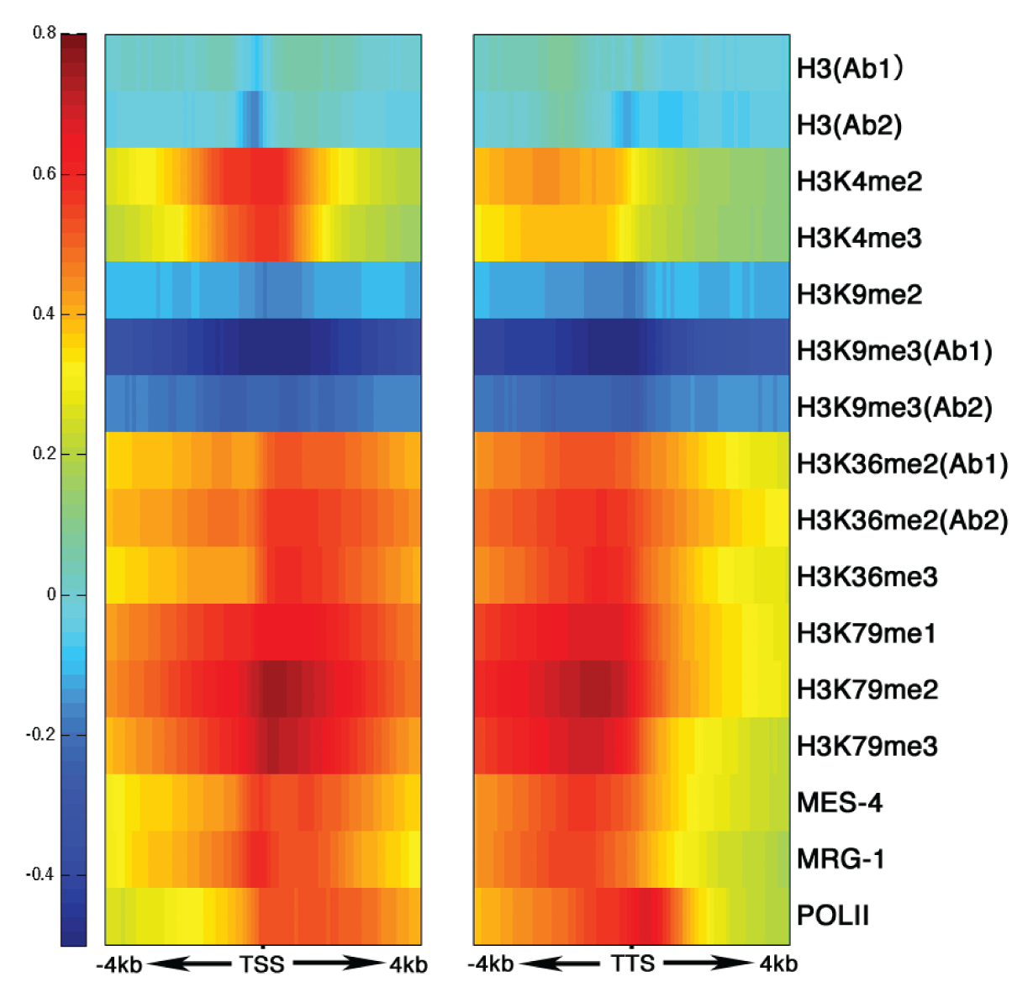
His. mods around TSS & TTS are clearly related to level of gene expression, in a position-dependent fashion
START
STOP
Early work in '09/'10
Science 330:6012 [here]
Also:
Ouyang, Zhou, Wong (’09) PNAS;
Karlic et al. & Vingron (‘10) PNAS

Slide 51
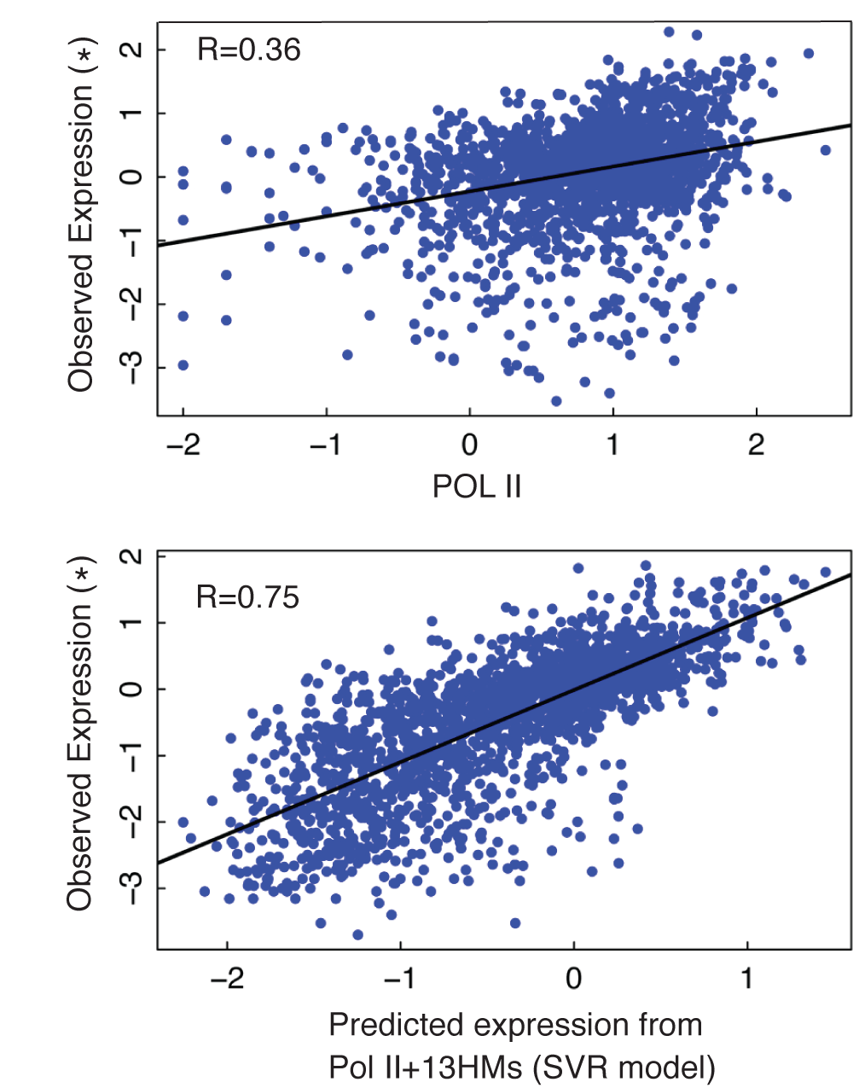
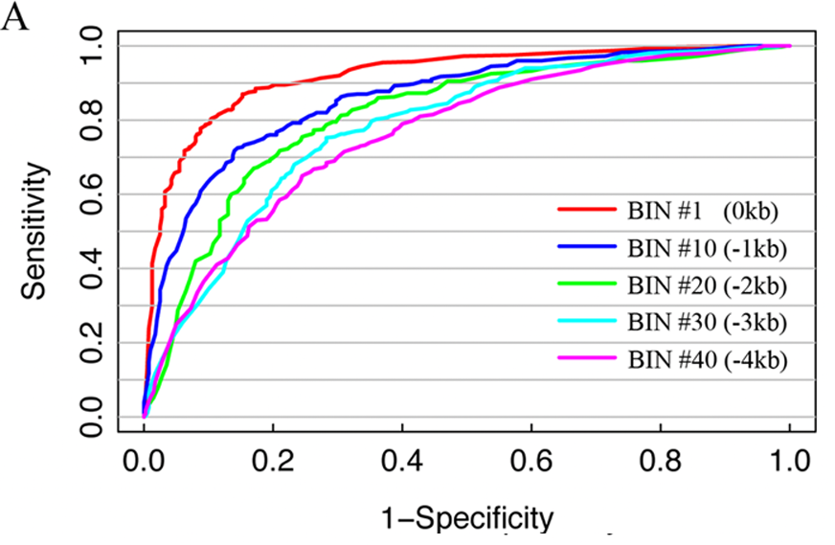
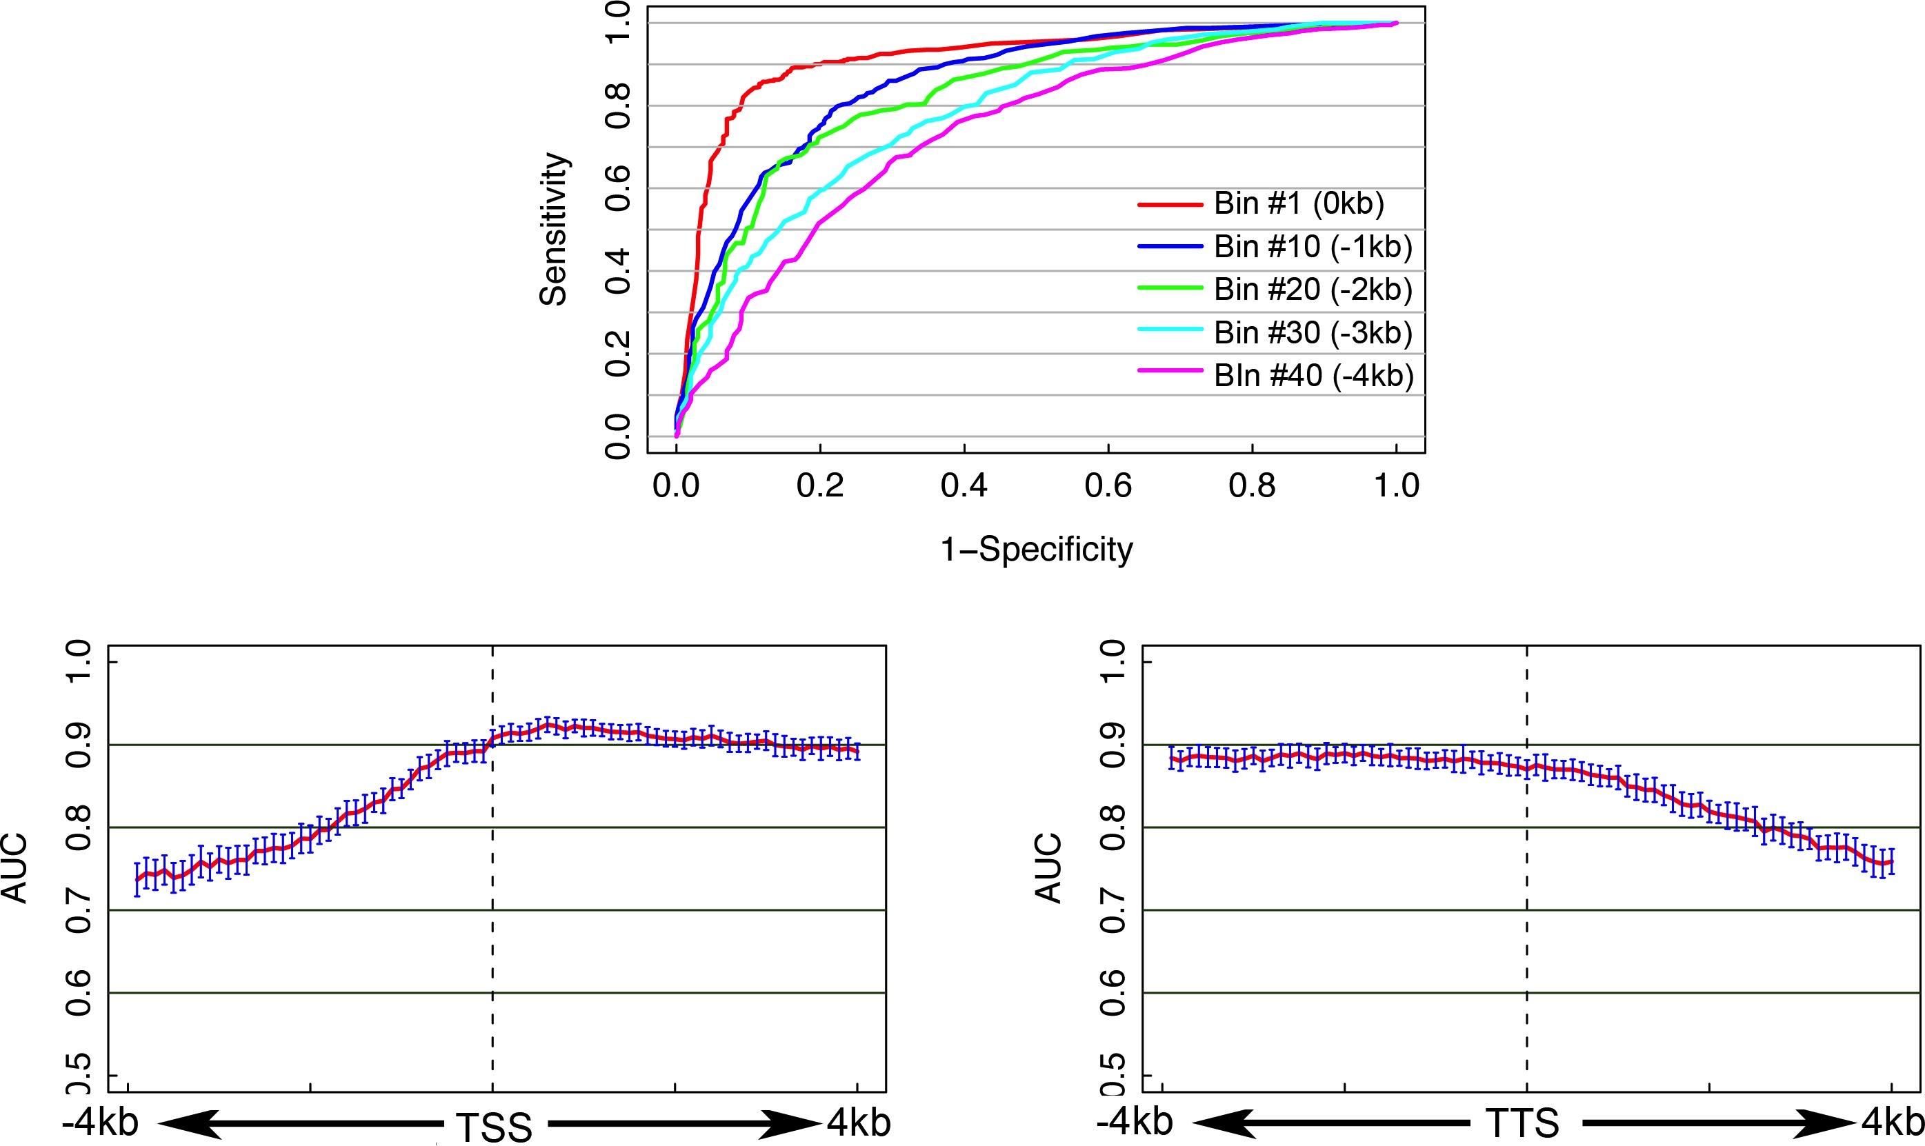

Integrate all histone modifications to predict gene expression levels
Classify H/L genes (SVM)
Predict expression values
[Cheng et al. (’11) Genome Biol. 12: R15]
#Bin1
Magnitude of Prediction from a “bin” around the TSS

Slide 52

Human
ENCODE
Results
[Encode Consortium, Nature ('12)]

Slide 53
Comparison of Models for Gene Expression, Building a Universal Model
Human, Worm & Fly
Universal Model is Built Simultaneously on Data from all 3 Organisms & Predicts on all 3 with a Single Set of Parameters
-2Kb
TSS
+2Kb
[Nature 512:445 ('14); doi: 10.1038/nature13424]

Slide 54
Performance of Universal, cross-organism Model
Human
Worm
Fly
Fly
Worm
Human
works almost as well as species specific models
works for both mRNAs and ncRNAs
[Nature 512:445 ('14); doi: 10.1038/nature13424]

Slide 55
Applications of Machine Learning for
Comparing Transcriptomes of Distant Organisms
Intro to Comparative ENCODE
  Lots of Matched Data for Comparative Analysis
App. #1: Characterizing ncRNAs & TARs
  Not much news in canonical gene models
  Simple contig search (TARs) finds uniform density of non-canonical transcription
  ML model shows few TARs similar to existing ones, but some enrichment for eRNAs
App. #2: Expression Clustering, Cross-species
  Potts-model optimization gives 16 conserved co-expression modules (which can potentially annotate ncRNAs/TARs)
  Developmental 'hourglass' genes in 12 of these. They also exhibit intra-organism hourglass behavior.
  Stage alignment of worm & fly development, strongest with hourglass genes
App. #3: HM Models Relating Gene Expression to Promoter Activity
  Works for ncRNAs as well as genes
  Universal cross-species model uses same set of parameters across diverse phyla
App. #4: Similarly constructed TF Models
  Variable importance of regions around genes for HMs & TFs
  TF & HM signals are redundant for ‘prediction'
  Surprisingly, a few TFs are quite predictive

Slide 56

Doing a Model with TFs:
Positive and negative regulators from correlating TF signal at TSS with gene expression
worm TFs
[Nature 512:445 ('14); doi: 10.1038/nature13424]
[Cheng et al. (’11) PLOS CB]

Slide 57

Predictor v2:
2-levels, now with TFs
[Cheng et al. NAR ('11)]

Slide 58
Human Results
[Encode Consortium, Nature ( '12)]

Slide 59

Models Illuminates Different Regions of Influence for TFs vs HMs
Datasets
  ChIP-Seq for 12 TFs
  (Chen et al. 2008)
  ChIP-Seq for 7 HMs
  (Meissner et al.’08; Mikkelsen et al. ’07)
  RNA-Seq (Cloonan et al. 2008)
A TF+HM model that combine TF and HM features does NOT improve accuracy!
Cheng et al. 2011, Nucleic Acids Res.

Slide 60
TF model accuracy only needs a small number of TFs for high accuracy (>90%)
[Nature 512:445 ('14); doi: 10.1038/nature13424]

Slide 61
Applications of Machine Learning for
Comparing Transcriptomes of Distant Organisms
Intro to Comparative ENCODE
  Lots of Matched Data for Comparative Analysis
App. #1: Characterizing ncRNAs & TARs
  Not much news in canonical gene models
  Simple contig search (TARs) finds uniform density of non-canonical transcription
  ML model shows few TARs similar to existing ones, but some enrichment for eRNAs
App. #2: Expression Clustering, Cross-species
  Potts-model optimization gives 16 conserved co-expression modules (which can potentially annotate ncRNAs/TARs)
  Developmental 'hourglass' genes in 12 of these. They also exhibit intra-organism hourglass behavior.
  Stage alignment of worm & fly development, strongest with hourglass genes
App. #3: HM Models Relating Gene Expression to Promoter Activity
  Works for ncRNAs as well as genes
  Universal cross-species model uses same set of parameters across diverse phyla
App. #4: Similarly constructed TF Models
  Variable importance of regions around genes for HMs & TFs
  TF & HM signals are redundant for ‘prediction'
  Surprisingly, a few TFs are quite predictive

Slide 62
Applications of Machine Learning for
Comparing Transcriptomes of Distant Organisms
Intro to Comparative ENCODE
  Lots of Matched Data for Comparative Analysis
App. #1: Characterizing ncRNAs & TARs
  Not much news in canonical gene models
  Simple contig search (TARs) finds uniform density of non-canonical transcription
  ML model shows few TARs similar to existing ones, but some enrichment for eRNAs
App. #2: Expression Clustering, Cross-species
  Potts-model optimization gives 16 conserved co-expression modules (which can potentially annotate ncRNAs/TARs)
  Developmental 'hourglass' genes in 12 of these. They also exhibit intra-organism hourglass behavior.
  Stage alignment of worm & fly development, strongest with hourglass genes
App. #3: HM Models Relating Gene Expression to Promoter Activity
  Works for ncRNAs as well as genes
  Universal cross-species model uses same set of parameters across diverse phyla
App. #4: Similarly constructed TF Models
  Variable importance of regions around genes for HMs & TFs
  TF & HM signals are redundant for ‘prediction'
  Surprisingly, a few TFs are quite predictive

Slide 63



Acknowledgements
modENCODE/ENCODE Transcriptome subgroup
Joel Rozowsky, Koon-Kiu Yan, Daifeng Wang,
Chao Cheng, James B. Brown, Carrie A. Davis, LaDeana Hillier, Cristina Sisu, Jingyi Jessica Li, Baikang Pei, Arif O. Harmanci, Michael O. Duff, Sarah Djebali, Roger P. Alexander, Burak H. Alver, Raymond K. Auerbach, Kimberly Bell, Peter J. Bickel, Max E. Boeck, Nathan P. Boley, Benjamin W. Booth, Lucy Cherbas, Peter Cherbas, Chao Di, Alex Dobin, Jorg Drenkow, Brent Ewing, Gang Fang, Megan Fastuca, Elise A. Feingold, Adam Frankish, Guanjun Gao, Peter J. Good, Phil Green, Roderic Guigó, Ann Hammonds, Jen Harrow, Roger A. Hoskins, Cédric Howald, Long Hu, Haiyan Huang, Tim J. P. Hubbard, Chau Huynh, Sonali Jha, Dionna Kasper, Masaomi Kato, Thomas C. Kaufman, Rob Kitchen, Erik Ladewig, Julien Lagarde, Eric Lai, Jing Leng, Zhi Lu, Michael MacCoss, Gemma May, Rebecca McWhirter, Gennifer Merrihew, David M. Miller, Ali Mortazavi, Rabi Murad, Brian Oliver, Sara Olson, Peter Park, Michael J. Pazin, Norbert Perrimon, Dmitri Pervouchine, Valerie Reinke, Alexandre Reymond, Garrett Robinson, Anastasia Samsonova, Gary I. Saunders, Felix Schlesinger, Anurag Sethi, Frank J. Slack, William C. Spencer, Marcus H. Stoiber, Pnina Strasbourger, Andrea Tanzer, Owen A. Thompson, Kenneth H. Wan, Guilin Wang, Huaien Wang, Kathie L. Watkins, Jiayu Wen, Kejia Wen, Chenghai Xue, Li Yang, Kevin Yip, Chris Zaleski, Yan Zhang, Henry Zheng, Steven E. Brenner, Brenton R. Graveley, Susan E. Celniker, Thomas R Gingeras, Robert Waterston
Hiring Postdocs. See gersteinlab.org/jobs !

Slide 64

TF-v-expr:
Cheng C, Yan KK, Hwang W, Qian J, Bhardwaj N, Rozowsky J, Lu ZJ, Niu W, Alves P, Kato M, Snyder M
worm-HM:
Cheng C, Yan KK, Yip KY, Rozowsky J, Alexander R, Shou C
ENCODE:
Chao Cheng, Roger Alexander, Renqiang Min, Kevin Y. Yip, Jing Leng, Joel Rozowsky, Koon-kiu Yan, Xianjun Dong, Sarah Djebali, Yijun Ruan, Carrie A Davis, Piero Carninci, Timo Lassman, Thomas R. Gingeras, Roderic Guigó Serra, Ewan Birney, Zhiping Weng, Michael Snyder
Orthoclust :
KK Yan, D Wang, J Rozowsky, H Zheng, C Cheng
Models Acknowledgements
Hiring Postdocs. See gersteinlab.org/jobs !

Slide 65
Default Theme
Default Outline Level 1
  Level 2

Slide 66
Info about content in this slide pack
PERMISSIONS: This Presentation is copyright Mark Gerstein, Yale University, 2012 (and beyond). Please read statement at
http://www.gersteinlab.org/misc/permissions.html . Feel free to use images in the talk with PROPER acknowledgement (via citation to relevant papers or link to appropriate place on gersteinlab.org).
Paper references in the talk were mostly from Papers.GersteinLab.org.
PHOTOS & IMAGES. For thoughts on the source and permissions of many of the photos and clipped images in this presentation see http://streams.gerstein.info . In particular, many of the images have particular EXIF tags, such as kwpotppt , that can be easily queried from flickr, viz: http://www.flickr.com/photos/mbgmbg/tags/kwpotppt

