Slide 1
LARVA2 results on PCAWG variants
JZ
05/27/2015

Slide 2
Summary of samples
1981 samples in total
Some donors were removed due to duplication
33838166 variants in all these samples

Slide 3
Annotation files
CDS:
extracted from gencode
One ‘transcript like’ annotation per gene
Don’t know how to handle alternative splicing
lincRNA
Similar to cds, some lincRNA has length 1
Promoter
Provide all promoters associated with a gene,
not sure how to provide p values of the promoter region
Enhancer
From the roadmap data

Slide 4
Covariant Overview –(1)

Slide 5
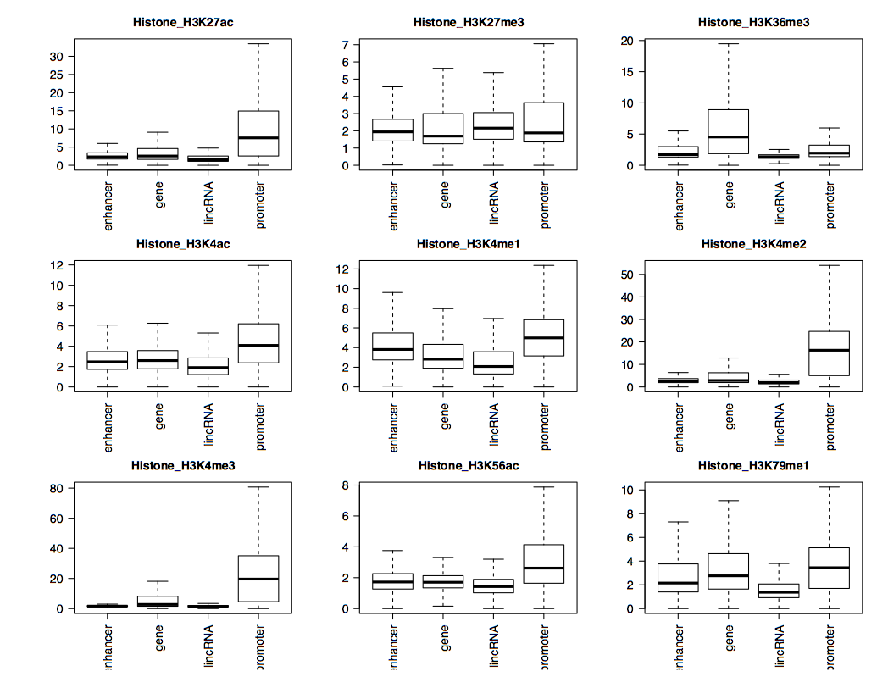
Covariant Overview –(2)

Slide 6
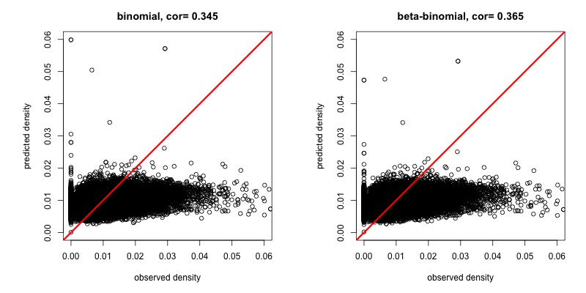
Mutation density overview
10% of data for training
Best way is to use all data for training, but it takes time
Use 42 covariants for background mutation rate correction
Model performance is moderate, not as well as the bin processing
Still large among of variation of mutation counts data can be explained (up ~0.6)
Correlation of remaining prediction and observation is around 0.3
Problem: not enough correction for the high mutation rate regions, subject to more false positives

Slide 7
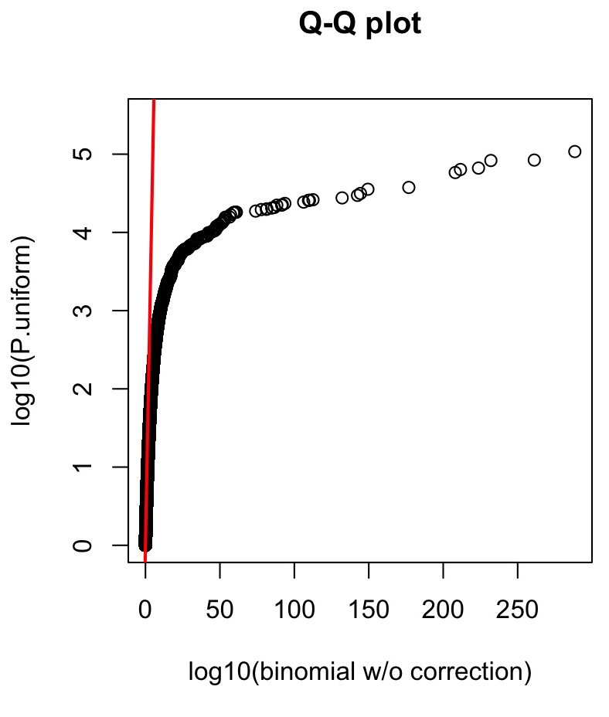
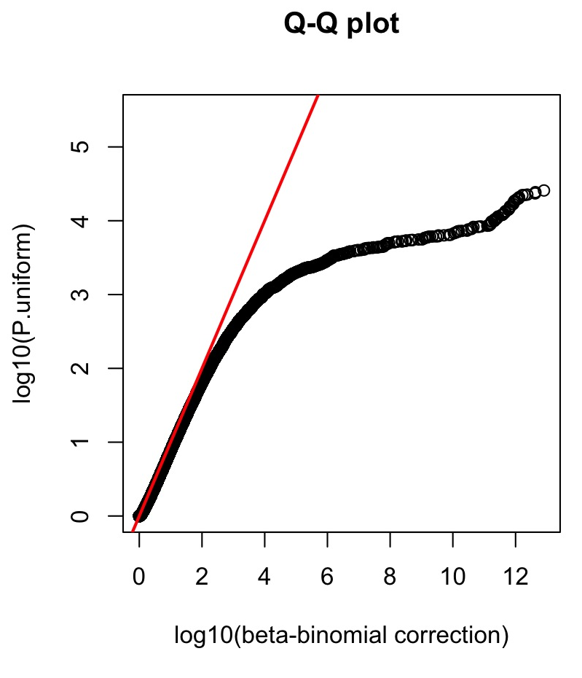
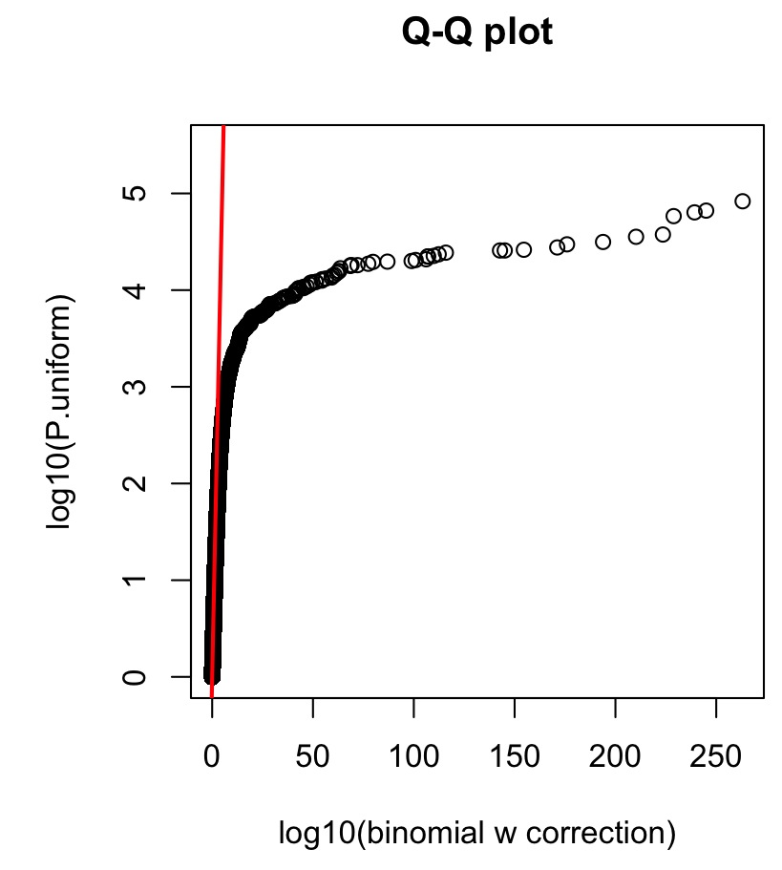
Q-Q plots for P values

Slide 8
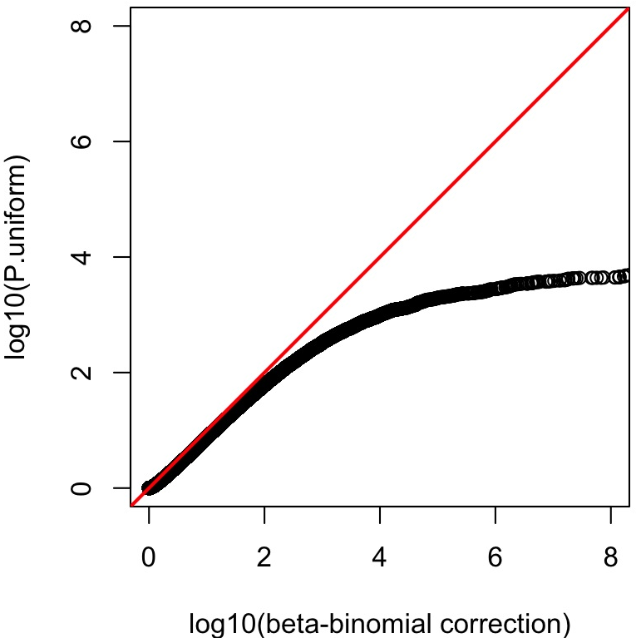
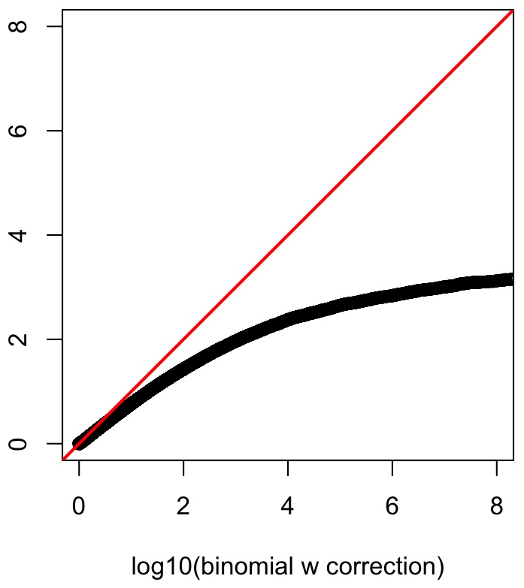
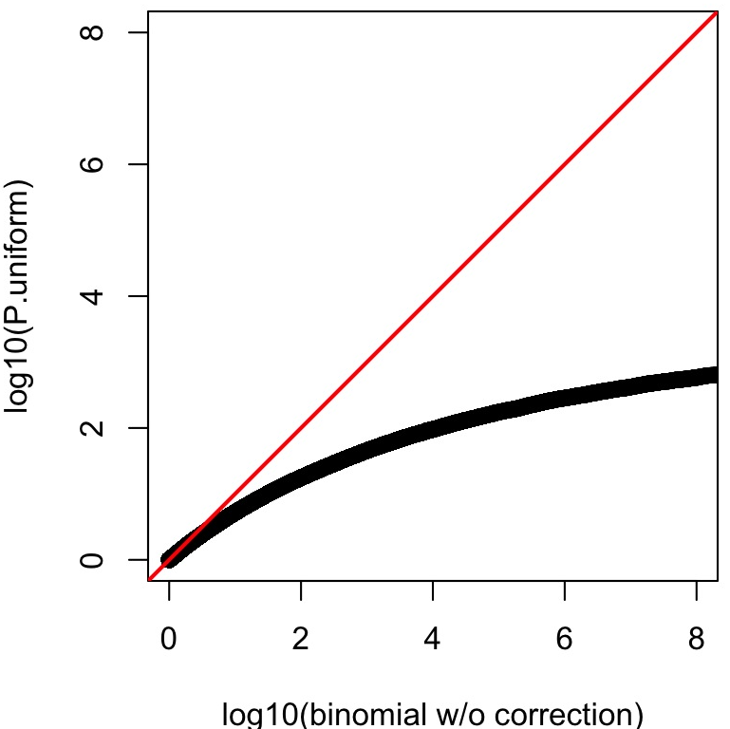
Zoom-in Q-Q plots for P values

Slide 9
Number of significant elements in different methods
12393: binomial w/o covariant correction
3526 binomial w/ covariant correction
387 beta-binomial w/ covariant correction
Covariant correction helped binomial to decrease more than 70% of positives
387 positives from LARVA2
Famous onco genes: TP53 and others
Some enhancers are heavily mutated

Slide 10
Problem 1: numerical problem
P value calculation in R for beta-binomial gives negative values
When coding needs to use lchoose, lbeta and then take the exponential, otherwise of out of range
Sum(p(0:n)) > 1 due to numerical problems, although its usually < 2.2e-16

Slide 11
Problem 2: larger effect of heavily mutation genomes
As mentioned, P values will be dominated by cancers with larger sample size or higher mutation rate
Don’t have to time to finish the analysis and need the original variant file

Slide 12
Problem3: BRCA and GBM analysis
Don’t have the matched tissue variants

