Slide 1
Biological Network Analysis:
Hierarchies, Mutational Constraints & Logical Circuits in Regulation
Why Networks ?
  Representational sweet spot + Intuition from cross-disciplinary comparisons
Organizing the Regulatory Network into a Hierarchy
  Construction: local BFS v global simulated annealing
  Information flow bottlenecks in the middle & greater mid-level collaboration to ease them, esp. in more complex organisms
  Differences between kinase & TF hierarchy
Analyzing the Impact of Variation on the Network
  Node Variation: more connectivity = more constraint
  Useful analogies to designed systems
Going from Regulatory Networks to Logical Circuits
  Preponderance of OR gates in the human network v yeast
  Relation to cancer (myc)
  More logical structure at top of heirarchy

Slide 2

Loregic: A method to characterize the cooperative logic of regulatory factors
Wang, et al., PLoS Computational Biology, in press, 2015
Notes:
we called our method Loregic, which uses logic gate models to characterize the cooperative logic of gene regulatory factors. we published Loregic in Plos comp. bio.

Slide 3
Modeling cooperativity between RFs to target gene using logic gates
A regulatory triplet
2-input-1-output logic gate
10110101…
10110101…
RF1
RF1
?
T
00110101…
T
00110101…
10110101…
01110111…
RF2
RF2
0 – gene off
1 – gene on
after binarizing gene expression data*
Input type (RF1, RF2) | RF1 | 0 | 0 | 1 | 1
 | RF2 | 0 | 1 | 0 | 1
Output | T | X | X | X | X
Binarized expression
X can be 0 or 1, so there are 2⁴=16 possible output combinations, each of which corresponds to a unique 2-input-1-output logic gate
…
*BoolNet, R package
Notes:
let’s look at a particular triplet, TF1 and TF2 regulate Gene 1. At logical level, gene expression has two states, gene is on or off, i.e., 1 represents gene is expressed or 0 represents gene is not expressed. So, then we can look at the triplet as 2-input-1-output system. TF1 and TF2 are inputs, and Gene 1 are output, and then use a 2-input-1-output logic gate to model this triplet. As shown in a truth table, there are 4 different types of input of TF1 and TF2, 00, 01, 10, 11, and for each input type, there are 2 possible output types, 1 or 0. so in total, we have 2^4 = 16 possible logic gates that can be used to describe the triplet.

Slide 4
An example: selection of the best-matched logic gate
Laplace’s rule of succession
s=(# of selected output state for the input type + 1)
/(# of input type + 2)
Wang, et al., PLoS Computational Biology, in press, 2015
Notes:
*********************************************
This toy example demonstrates that how we choose the best matched logic gates. first, for each input type of TF1, TF2 like 01, green, we count numbers of 0 and 1 output from Gene 1 data. and select the most state as output of this input type. e.g., we have 4 zeros and 1 one, then 0 is considered as output of input type 01. we also calculate the output’s succession prob using laplace’s rule of succession derived from Bayes' theorem, like 5/7. after we go thru all four input types, we get a truth table. Here, it’s the table for the AND gate. Also, we define production of four output succession probs as consistency score to the matched logic gate. e.g. the consistency score is 0.37 for AND gate.

Slide 5
Application 1 – transcription factor cooperativity in Yeast cell cycle
Target gene | 2464
TF | 176
Triplet | 39,011
Time point | 59
Wang, et al., PLoS Computational Biology, 2015
Notes:
First, we apply Loregic to characterize TF cooperativity during yeast cell cycle, and found AND gate matches the most triplets, which implies that yeast TFs need to cooperate during cell cycle.

Slide 6
Application – transcription factor cooperativity in Acute Myeloid Leukemia (AML)
number of logic-gate consistent triplets
Target gene | 1824
TF | 70
Triplet | 50,865
Patient | 197
Wang, et al., PLoS Computational Biology, in press, 2015
Notes:
Then, we apply Loregic to the human cancer data. e.g., we characterized the TF cooperativity in leukemia cancer using 70 TF chip-seq data in ENCODE and gene expression data across 200 patients in TCGA. it is interesting to find that OR gate matches the most triplets, which implies that TF may not cooperate with each other in human cancer.

Slide 7

Cancer-related TF, MYC universally amplifies target expression
2,153 (RF1=MYC, RF2=other TFs, T=all common targets) triplets
RF1
OR(RF1, RF2)
OR(RF1, NOT RF2)
High expression of MYC is sufficient for high target gene expression
Predict outcomes of genome engineering in leukemia
Wang, et al., PLoS Computational Biology, in press, 2015
Notes:
So, we then look at triplets with cancer-related TFs, e.g., MYC. biologists found that MYC universally amplifies target gene expressions in lymphocytes. we checked 2000 MYC associated triplets where MYC is 1st RF, and found the most MYC associated triplets are consistent with three logic gates, RF1, RF1+RF2 and RF1+~RF2 with significant enrichments. all three logic gates mean that high expression of MYC is sufficient for high target gene expression, which supports that MYC is a universal amplifier.
then use MYC to slince targe gene expresison in cancer

Slide 8
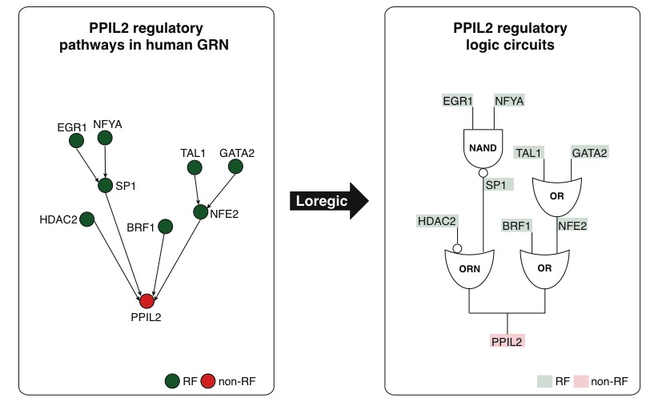
Gene regulatory pathways have logic-circuit behaviors
Immunological gene, HIV
Wang, et al., PLoS Computational Biology, in press, 2015
Notes:
Going beyond the prediction of the cooperative logics of individual RFs that directly regulate a target, we are interested in identifying all the logic gates matching triplets involved in the target regulatory pathway, in order to obtain a coherent logic circuit pathway. For example in Figure 7A, Loregic found that there are two regulatory pathways regulating the target gene, PPIL2 in human K562. PPIL2 is an important cyclophilin member in immunological suppression. These two pathways contain 4 logic-gate-consistent triplets forming a two-layer hierarchical structure. By replacing these triplets with corresponding matched logic gates, we obtain the logic circuit regulatory pathways for the target gene (Figure 7B).

Slide 9
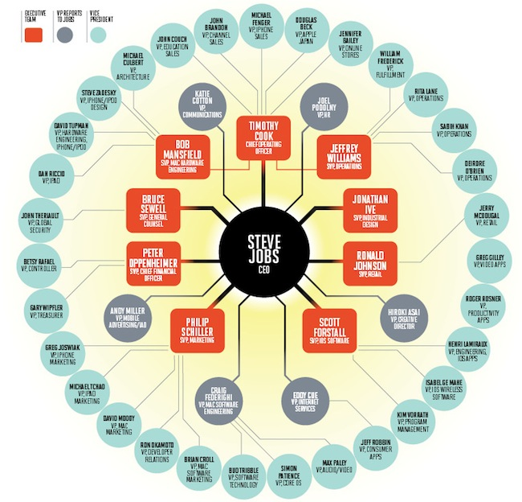
Network Stats to Identify Hierarchy
In-degree = 1
TF out-degree = 3
TF target
non-TF target
Hierarchy Height Statistic =
(normalized TF Out deg. – In deg.)

Slide 10
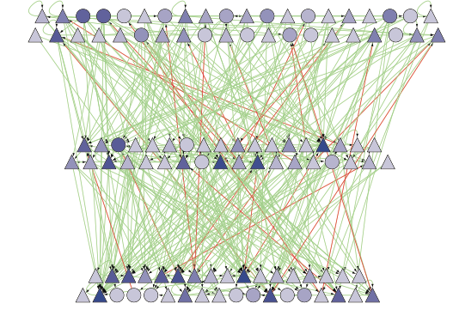
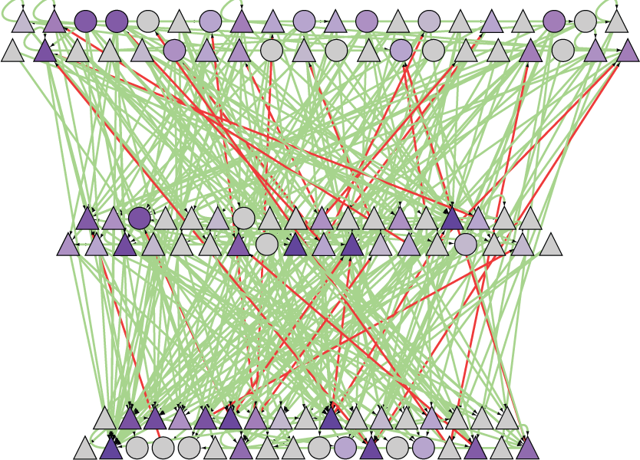
Strongest Proximal Regulatory Edges Can be Arranged into a Hierarchy
betweenness
Global wiring pattern of TFs
Middle level has highest betweenness, creating info. flow bottlenecks
[ Gerstein et al. Nature (in press, '12) ]

Slide 11
Methods
Bfs
Sim annealing
hsm

Slide 12
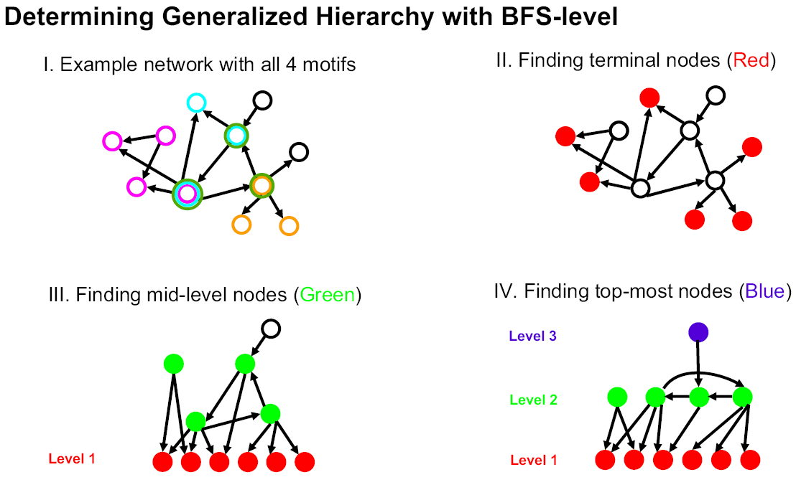
Determination of "Level" in Regulatory Network Hierarchy with Breadth-first Search
[Yu et al., PNAS (2006)]
Notes:
We call this construction method "BFS-level" (Breadth-First Search to define Level). As
described in Figure 1B, it is based on a straightforward application of breadth-first search:
we first identified all TFs at the bottom level (i.e., level 1). A TF is at the bottom level if
and only if it does not regulate other TFs. TFs that only regulate themselves (i.e., autoregulation)
are also placed at the bottom. Starting from each bottom TF, we then
performed a breadth-first search to convert the whole network into a "breadth-first tree"
(18) (see Figure 2A and Table 1A). In other words, we define the level of a non-bottom
TF in the hierarchy as its shortest distance from a bottom one. Here, the construction
procedure is only focused on inter-regulation between TFs (or officials in social
networks). A top TF could directly regulate non-TF target genes (or a higher-ranked
official could have an assistant with no managerial responsibility), but this will not affect
the constructed hierarchy. If the resulted layered structure has a pyramidal shape (i.e.,
few nodes at the top and most nodes at the bottom), we, then, considered it as a
generalized hierarchy.

Slide 13
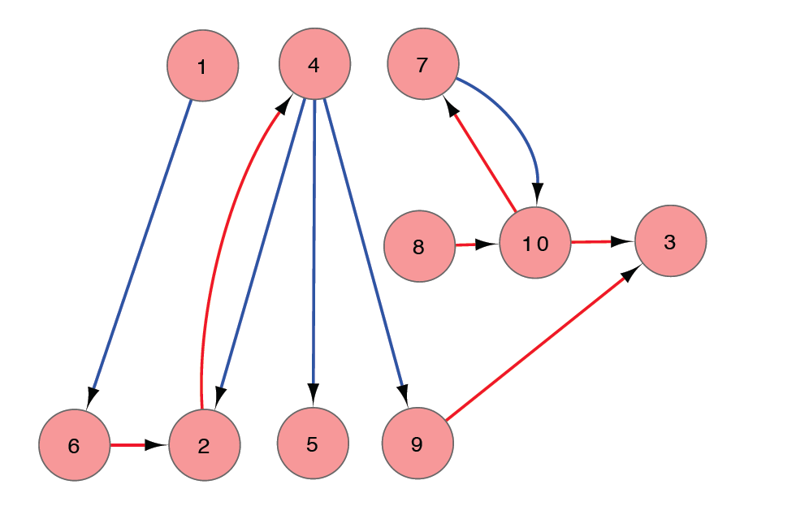
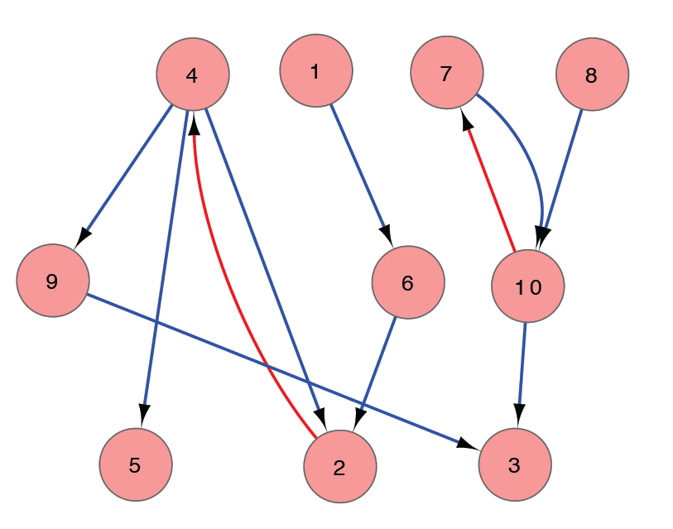
SIM ANNEALING -- KKY
Hierarchy height distribution approximated by 3 levels
Probing direction framed as an optimization problem
simulated
annealing
[ Gerstein et al. Nature (in press, '12) ]

Slide 14
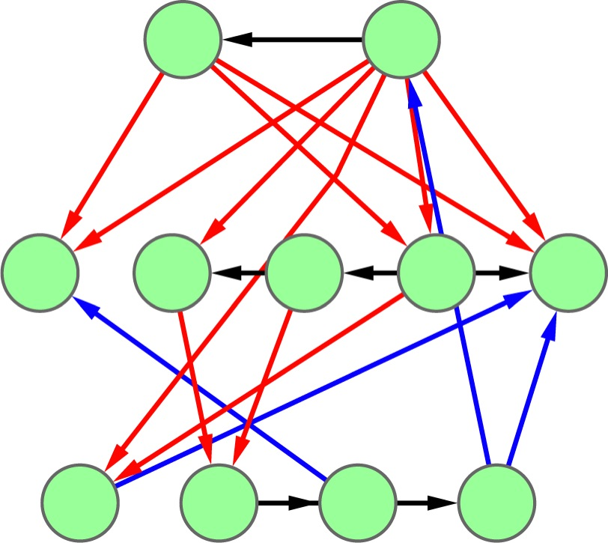
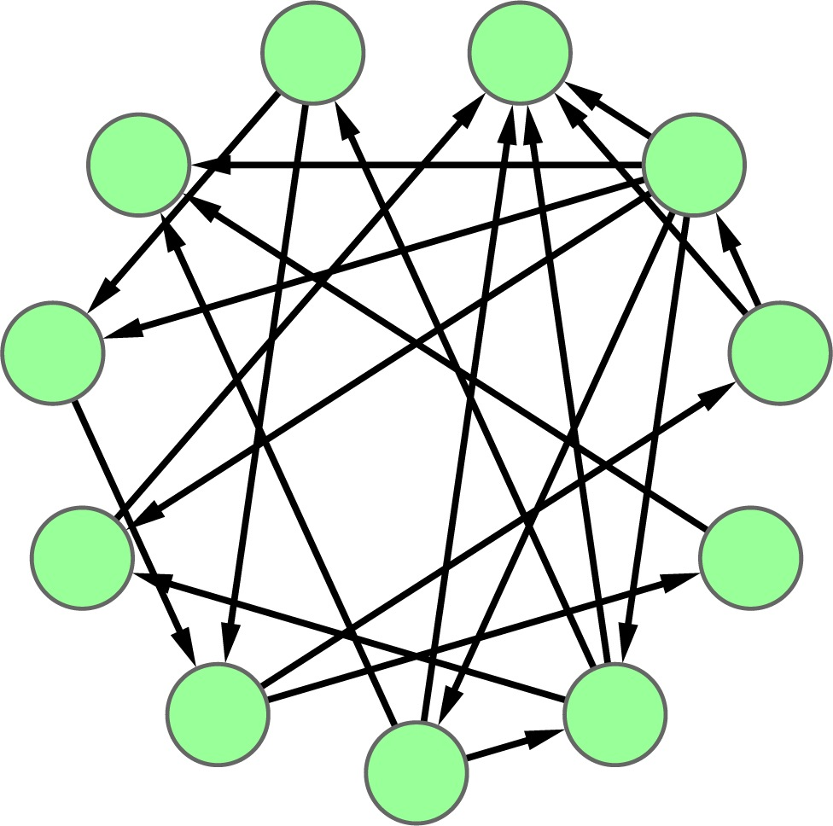
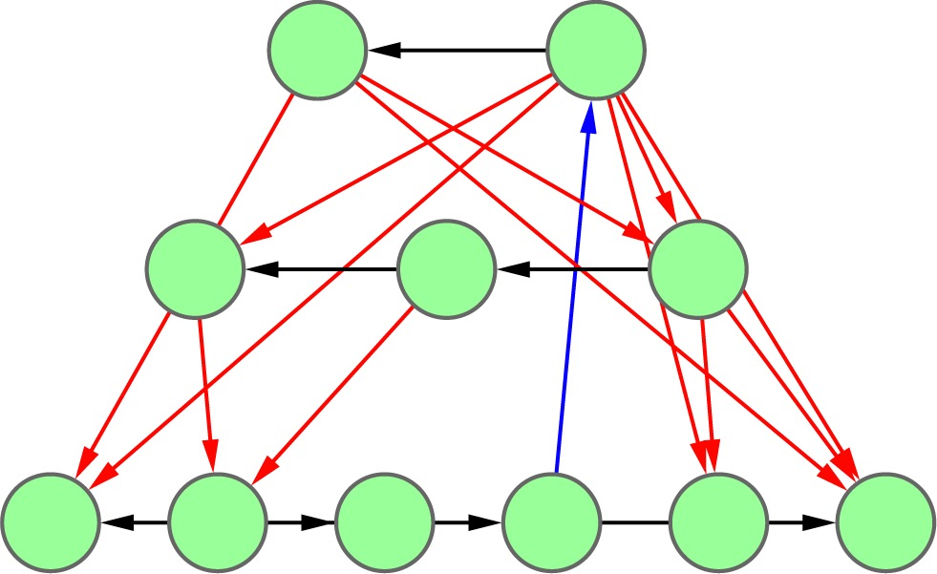
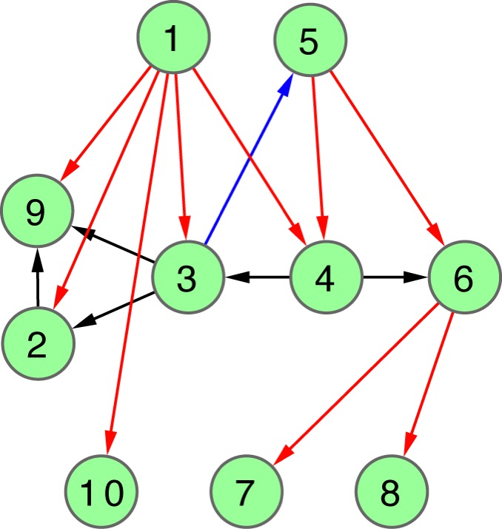
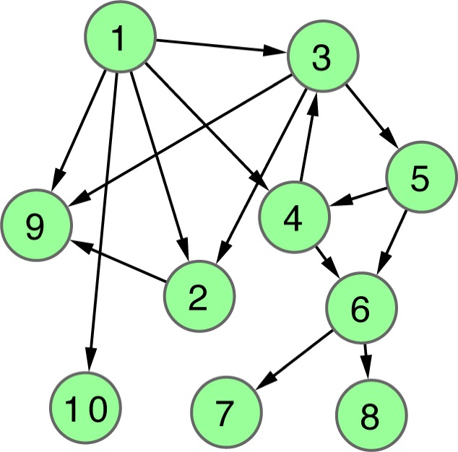
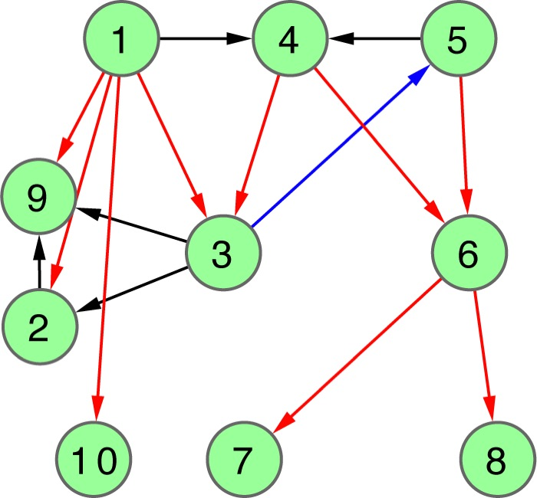
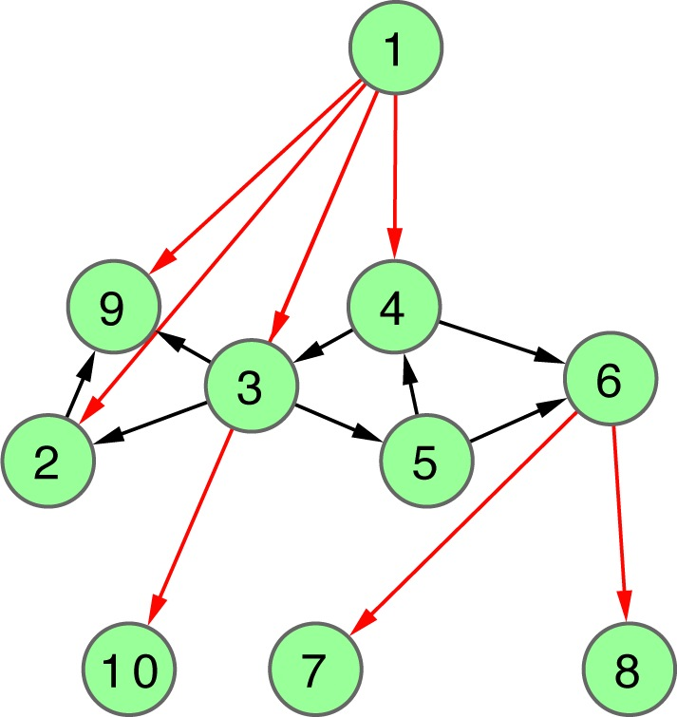
Hierarchy Score Maximization Algorithm
Definition
Simulated annealing
maximize HS
HSM algorithm
L1 L2 L3
N1
N2
N3
N4
N5
N6
N7
N8
N9
N10
L3
.
L2
.
repeat k times
.
L1
Discretized hierarchy network
Probabilistic hierarchy network
[ Cheng et al. GenomeBiol. (in press, ’15) ]

Slide 15
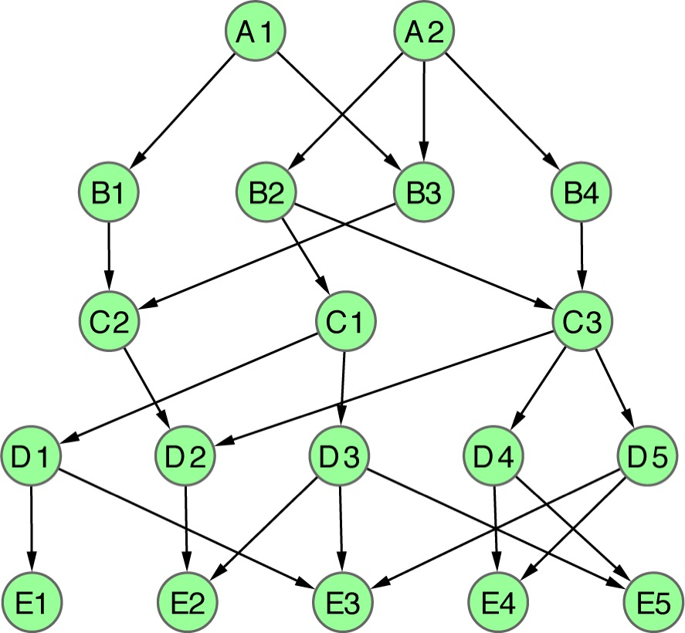
Apply HSM to a toy example
L=5
L=4
L=3
L=2
L=1
1 2
1 2 3
1 2 3 4
1 2 3 4 5
1 2 3 4 5 6
1 2 3 4 5 6 7
1 2 3 4 5 6 7 8
A1
A2
B1
B2
B3
B4
C1
C2
C3
D1
D2
D3
D4
D5
E1
E2
E3
E4
E5
[ Cheng et al. GenomeBiol. (in press, ’15) ]
|L|=2
HS=2.1
CHS=2.4
PHS=2.1
|L|=3
HS=5.5
CHS=5.5
PHS=5.5
|L|=4
HS=8.7
CHS=5.4
PHS=8.7
|L|=5
HS=∞
CHS=∞
PHS=∞
|L|=6
HS=∞
CHS=∞
PHS=16.1
|L|=7
HS=∞
CHS=∞
CHS=10.4
|L|=8
HS=∞
CHS=∞
PHS=9.4
Notes:
Fig. 2

Slide 16
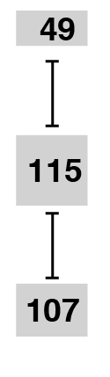
Strongest Proximal Regulatory Edges Can be Arranged into a Hierarchy
betweenness
Global wiring pattern of TFs
Middle level has highest betweenness, creating info. flow bottlenecks
[ Gerstein et al. Nature (in press, '12) ]

Slide 17
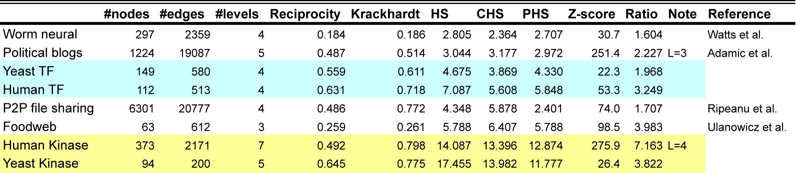
Kinase network is more hierarchical than the TF reg. network
[ Cheng et al. GenomeBiol. (in press, ’15) ]

Slide 18
Application: yeast TF regulatory network
P=0.03
T<(M+B) P=0.008
M>(T+B) P=0.04
BFS(L=4)
VS(L=3)
HSM(L=4)
VS(L=7)
HSM(L=3)
up-edge
horizontal
down-edge
HSM(L=3)
BFS(L=4)
VS(L=3)
T>(M+B) P=0.03
[ Cheng et al. GenomeBiol. (in press, ’15) ]

Slide 19
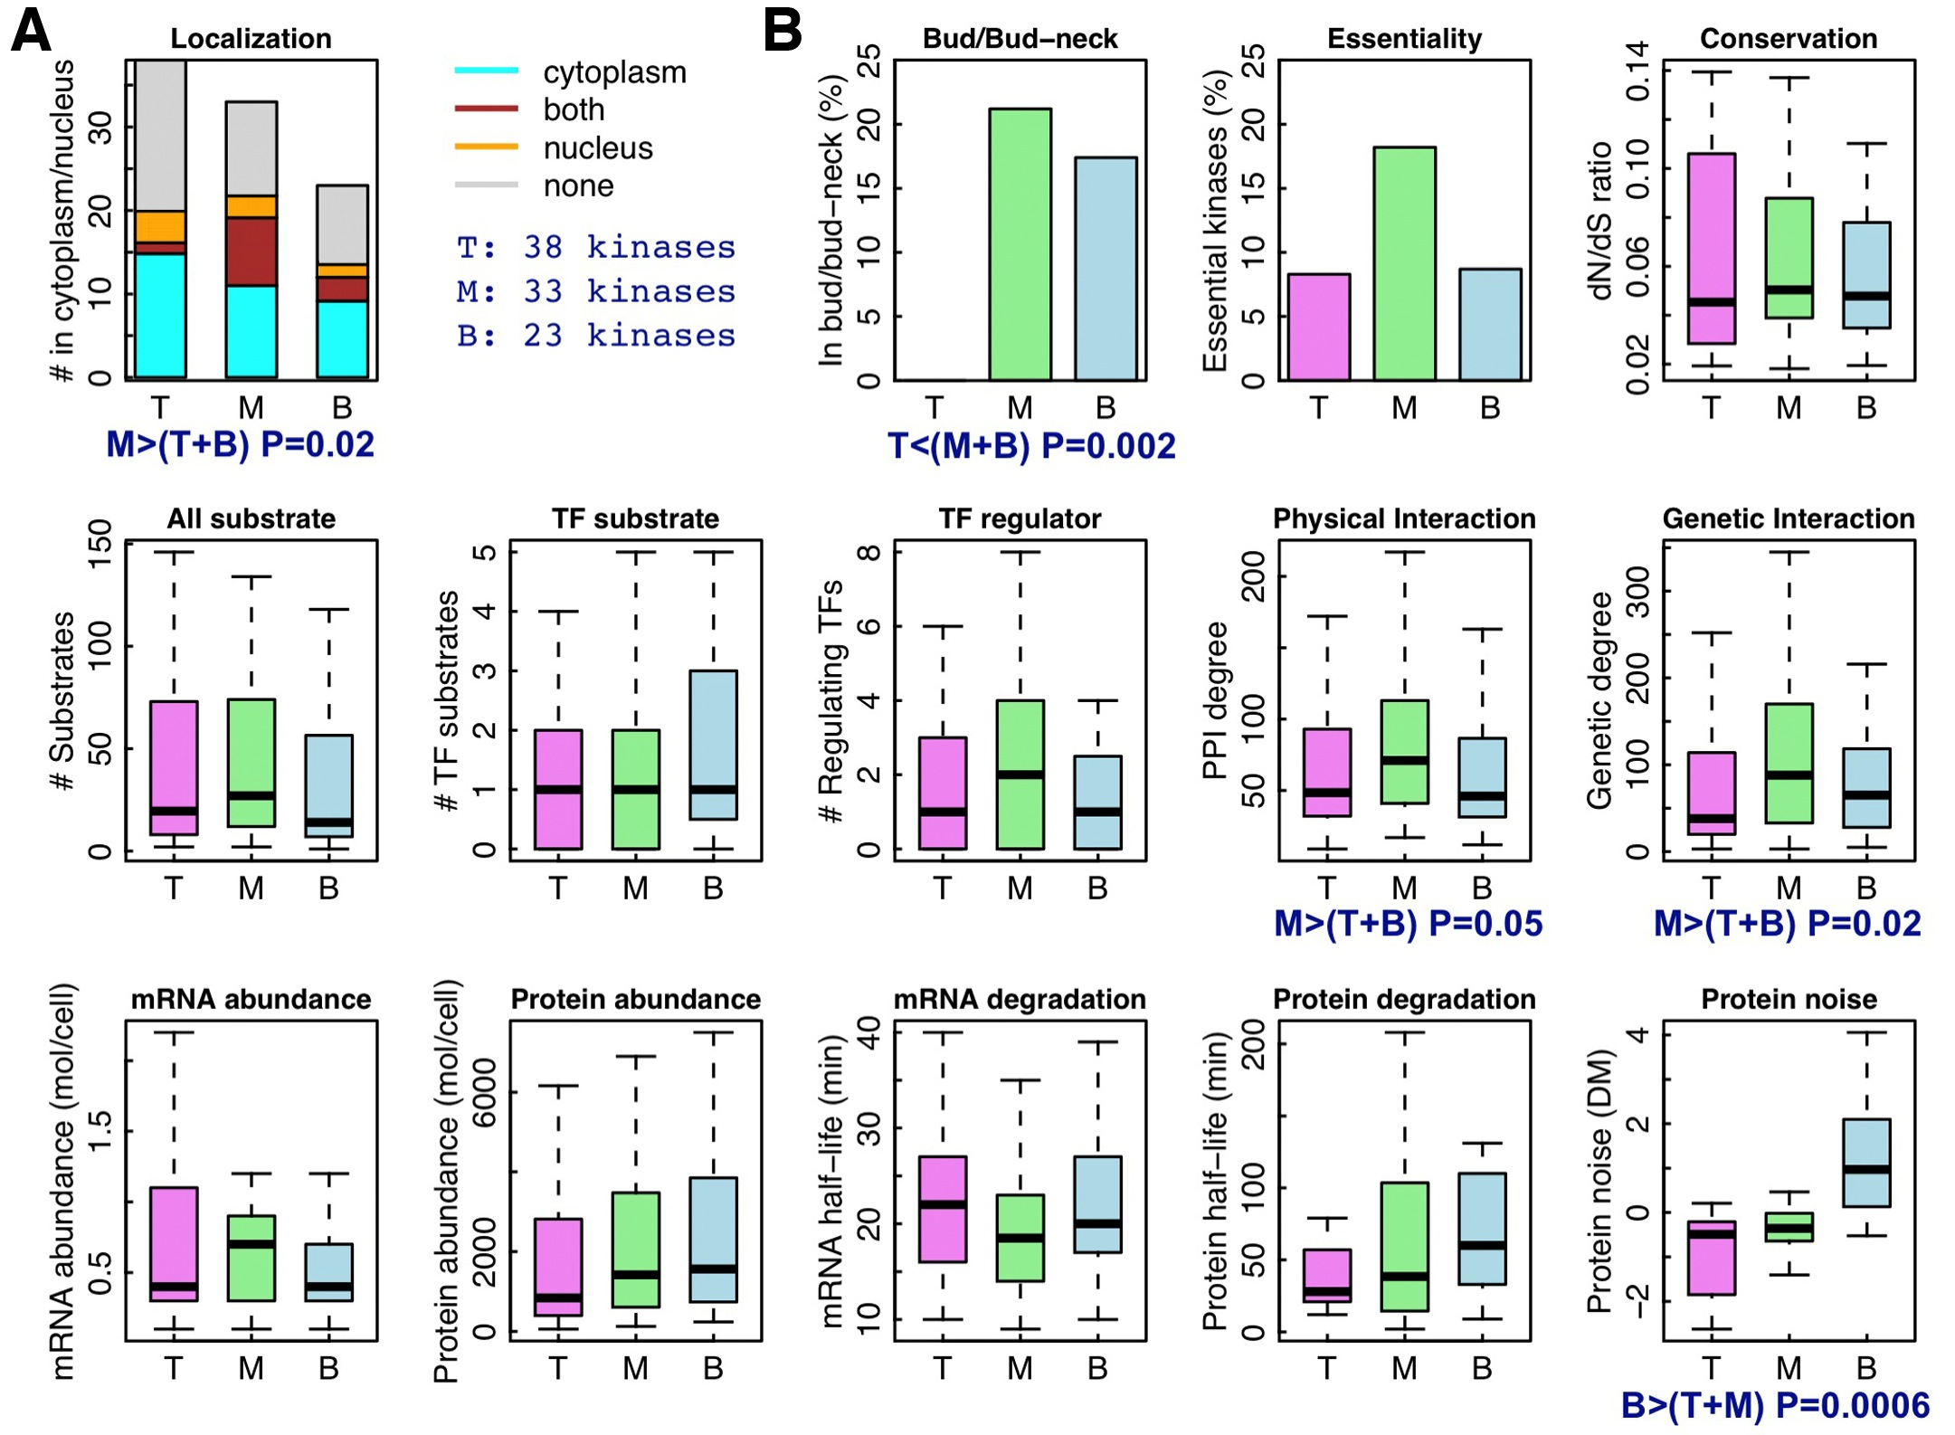
Application: yeast kinase network
[ Cheng et al. GenomeBiol. (in press, ’15) ]

Slide 20
Logical cooperativity across hierarchical layers in gene regulatory network
Hierarchical gene regulatory network
Consistency score
The regulations of middle and top TFs more likely follow logical operations than the bottom TFs.
Wang, et al., PLoS Computational Biology, in press, 2015
Notes:
We also constructed the regulatory hierarchical networks with top, middle and bottom layers using yeast TFs [5], and found that the scores for the gate-consistent triplets targeting the bottom TFs are lower than the ones targeting middle and top TFs (Fig. S3), which implies that the regulations of middle and top TFs more likely follow logical operations than the bottom TFs. Also, this tells us that we may need more detailed models such as continuous models than boolean logics to study gene regulation.

Slide 21
Biological Network Analysis:
Hierarchies, Mutational Constraints & Logical Circuits in Regulation
Why Networks ?
  Representational sweet spot + Intuition from cross-disciplinary comparisons
Organizing the Regulatory Network into a Hierarchy
  Construction: local BFS v global simulated annealing
  Information flow bottlenecks in the middle & greater mid-level collaboration to ease them, esp. in more complex organisms
  Differences between kinase & TF hierarchy
Analyzing the Impact of Variation on the Network
  Node Variation: more connectivity = more constraint
  Useful analogies to designed systems
Going from Regulatory Networks to Logical Circuits
  Preponderance of OR gates in the human network v yeast
  Relation to cancer (myc)
  More logical structure at top of heirarchy

Slide 22
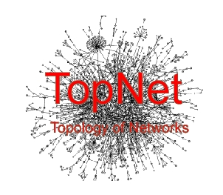

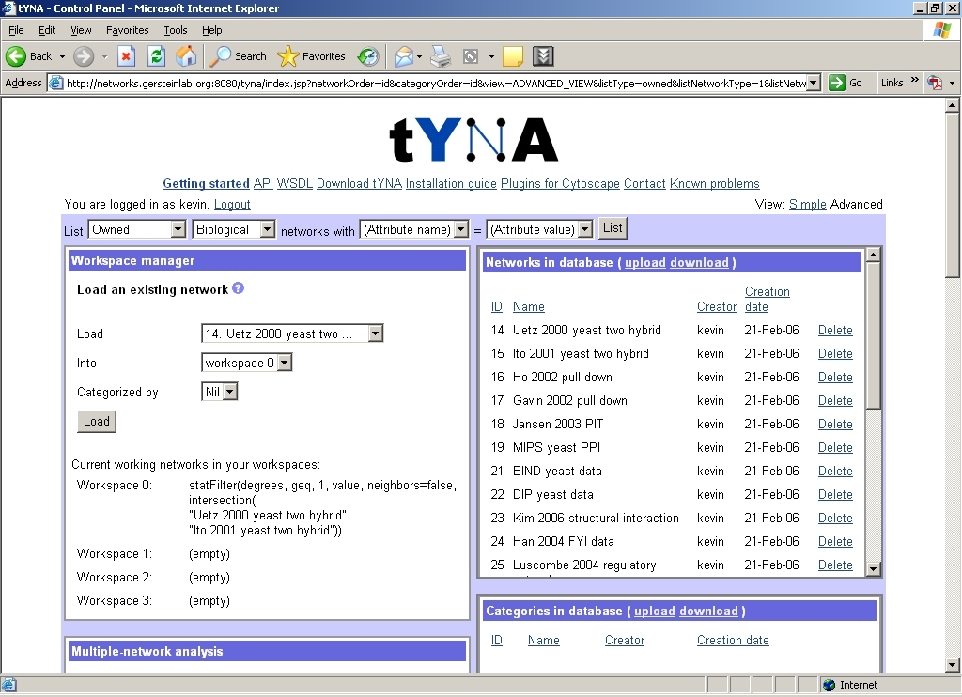
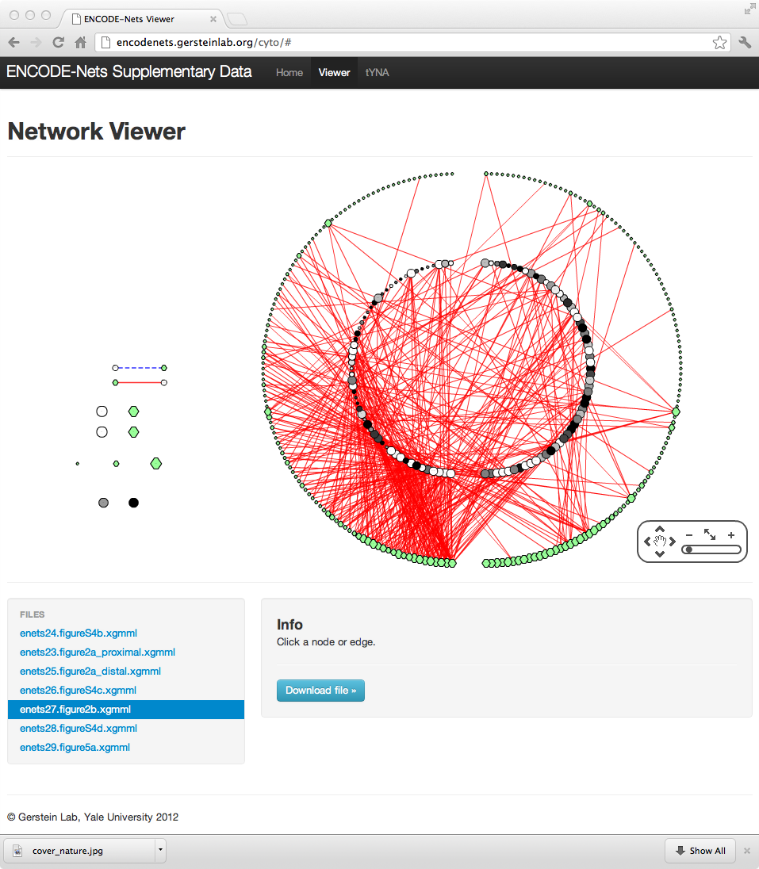
TopNet – an automated web tool
(vers. 2 :
"TopNet-like
Yale Network Analyzer")
  Encodenets.gersteinlab.org, networks.gersteinlab.org
  (tYNA: Normal website + Downloaded code (JAVA) + Web service (SOAP) with Cytoscape plugin)
[Yu et al., NAR (2004); Yip et al. Bioinfo. (2006);
Similar tools include Cytoscape.org, Idekar, Sander et al]

Slide 23


Network
Acknowledgements
A Kundaje, M Hariharan,
S Landt, K Yan, C Cheng,
X Mu, E Khurana,
J Rozowsky,
R Alexander, R Min, P Alves,
A Abyzov, N Addleman, N Bhardwaj,
A Boyle, P Cayting, A Charos, D Chen,
Y Cheng, D Clarke, C Eastman,
G Euskirchen, S Frietze, Y Fu, J Gertz,
F Grubert, A Harmanci, P Jain,
M Kasowski, P Lacroute, J Leng, J Lian,
H Monahan, H O'Geen, Z Ouyang,
E Partridge, D Patacsil, F Pauli, D Raha,
L Ramirez, T Reddy, B Reed, M Shi, T Slifer, J Wang, L Wu, X Yang, K Yip,
G Zilberman-Schapira, S Batzoglou,
A Sidow, P Farnham, R Myers,
S Weissman, M Snyder
(11 Main Projects, ~50 labs, >700 substantial contributors + NHGRI)
Networks/Elements
(~60 participants):
Hiring Postdocs. See gersteinlab.org/jobs !

Slide 24
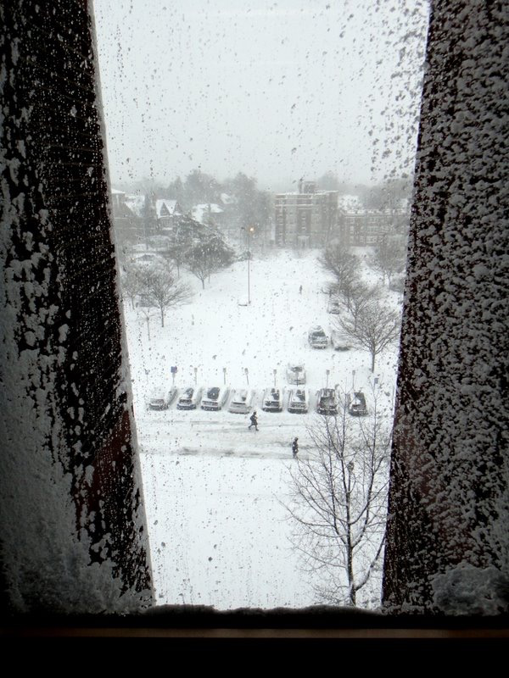
Acknowledgements
Hierarchy Construction –
Chao Cheng, Erik Andrews, Koon-Kiu Yan, Matthew Ung, Daifeng Wang
[papers.gersteinlab.org/papers/hinet coming soon]
Loregic –
Daifeng Wang, Koon-Kiu Yan, Cristina Sisu, Chao Cheng, Joel Rozowsky, William Meyerson [papers.gersteinlab.org/papers/loregic coming soon]
Net hierarchy analysis –
N Bhardwaj, KK Yan
[papers.gersteinlab.org/netheir]
Call graph analysis –
KK Yan, G Fang, N Bhardwaj, RP Alexander [papers.gersteinlab.org/callgraph]
Network Sci. Analogies –
Koon-Kiu Yan, Daifeng Wang, Anurag Sethi, Paul Muir, Robert Kitchen, Chao Cheng
[papers.gersteinlab.org/papers/netessay coming soon]
Hiring Postdocs. See gersteinlab.org/jobs !

Slide 25
Info about content in this slide pack
General PERMISSIONS
  This Presentation is copyright Mark Gerstein,
  Yale University, 2014.
  Please read permissions statement at
  http://www.gersteinlab.org/misc/permissions.html .
  Feel free to use slides & images in the talk with PROPER acknowledgement
  (via citation to relevant papers or link to gersteinlab.org).
  Paper references in the talk were mostly from Papers.GersteinLab.org.
For SeqUniverse slide, please contact Heidi Sofia, NHGRI
PHOTOS & IMAGES. For thoughts on the source and permissions of many of the photos and clipped images in this presentation see http://streams.gerstein.info .
  In particular, many of the images have particular EXIF tags, such as kwpotppt , that can be easily queried from flickr, viz: http://www.flickr.com/photos/mbgmbg/tags/kwpotppt

