Slide 1
Evaluation
Compare MNPs with deconstructed SNPs
Notes:
0.29 VS 1.54

Slide 2
New Pipeline
TFP, DHS…
Scanning and determine motif br/g events
Stringent p-value (but faster)

Slide 3
Result
232
162
50
Notes:
16+394
1/50 GERP = 5.22…all rest is <0.8 14/50 missing
21 FUNSEQSCORE > 2
1 FUNSEQSCORE if no break
===
14/162
38 FUNSEQSCORE>2
4 FUNSEQSCORE if no MOTIF

Slide 4
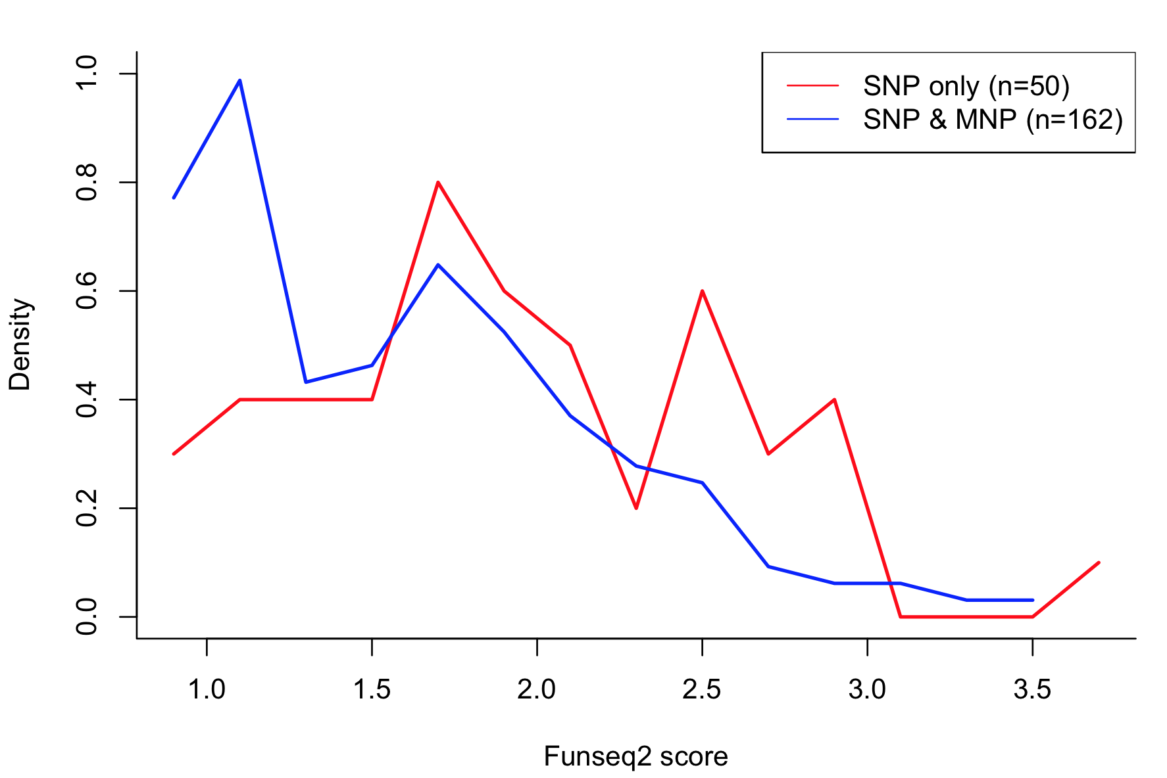
MNP has protective effects?
p-value < 0.0005
two-sided wilcoxon rank sum test
Notes:
\\
\\
$MNP_i = \{SNP_{i1}, SNP_{i2}...SNP_{in}\} \Leftrightarrow SNP_{ik} \in MNP_i, 0 \leq k \leq n$ \\
\\
$\mathcal{E}(MNP_i) = neg \wedge \exists SNP_{ik} \in MNP_i$, $\mathcal{E}(SNP_{ik}) = poz$\\
$\mathcal{E}(MNP_i) = poz \wedge \forall SNP_{ik} \in MNP_i$, $\mathcal{E}(SNP_{ik}) = neg$\\

Slide 5
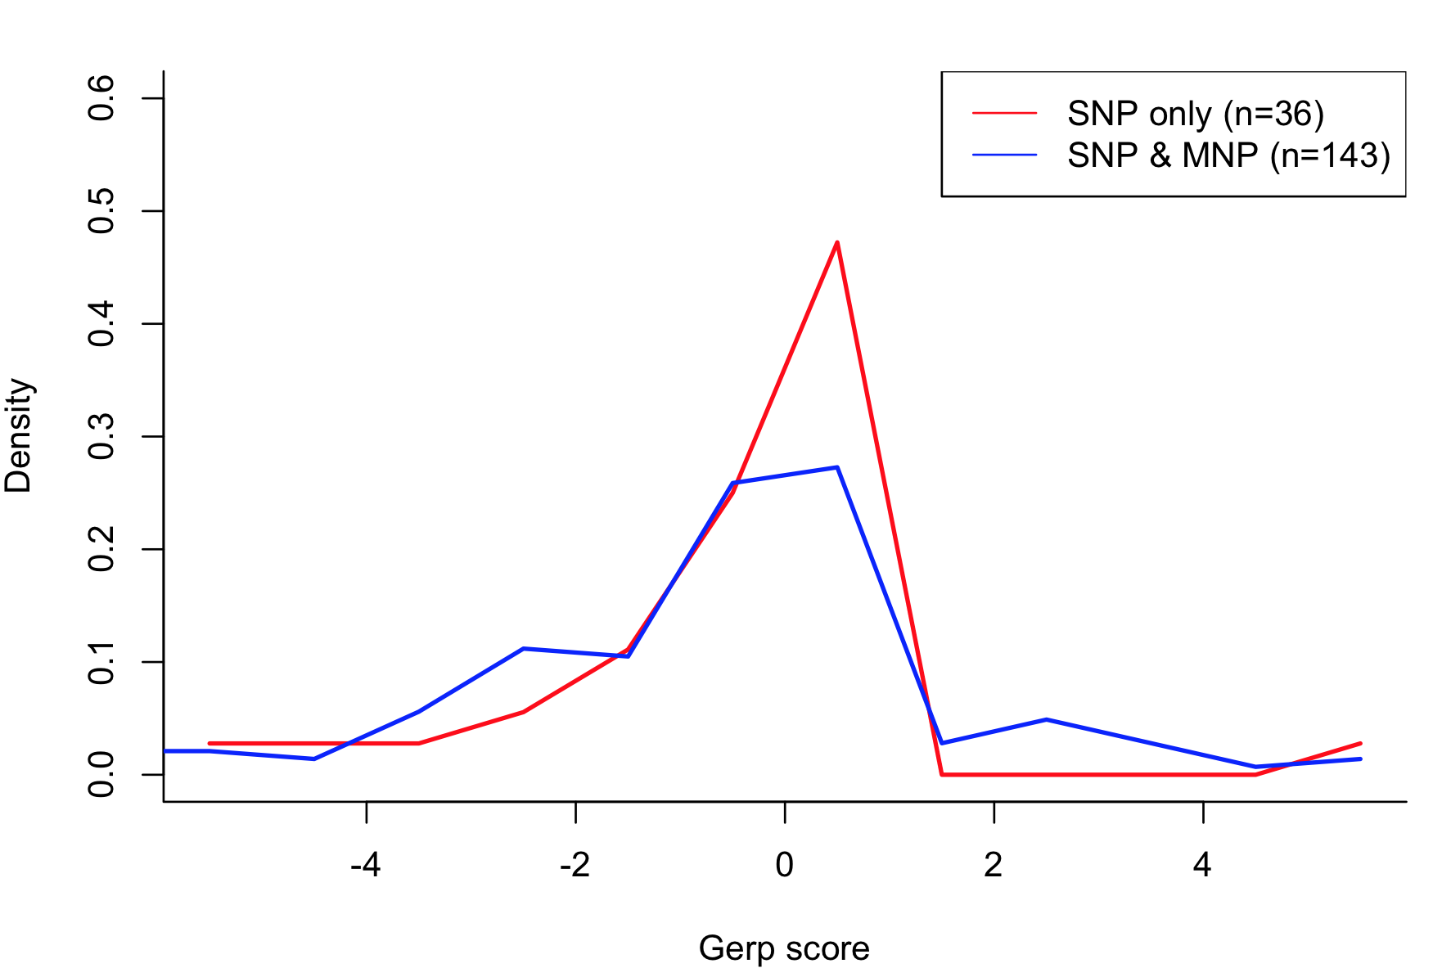
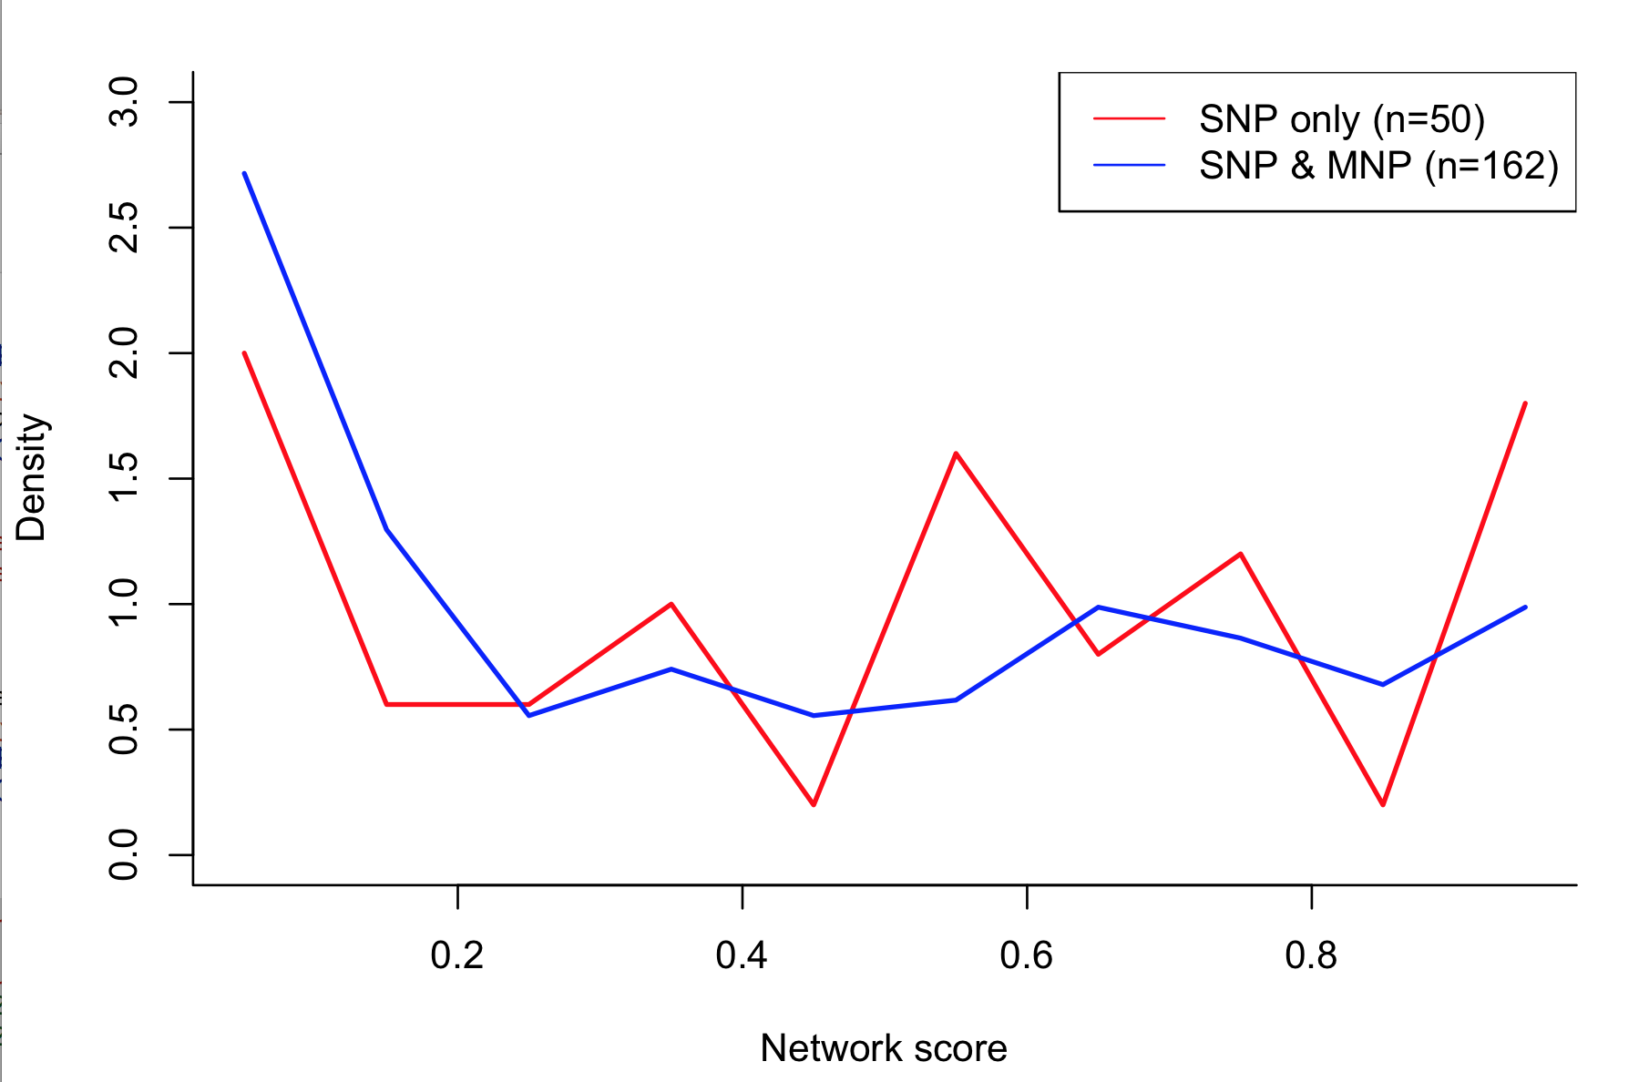
Funseq score difference not driven by Gerp or Network score or …
p-value > 0.6
two-sided wilcoxon rank sum test
p-value > 0.1
two-sided wilcoxon rank sum test
hot.region
7/50
23/162
Notes:
7/50 23/162

Slide 6
Next step
Motif score driven?
More detailed analysis in motifs
Review the approach and scale to whole genome

