Slide 1
GROUP MEETING PRESENTATION
GERSTEIN LAB
Dan Spakowicz
20 May 2015

Slide 2
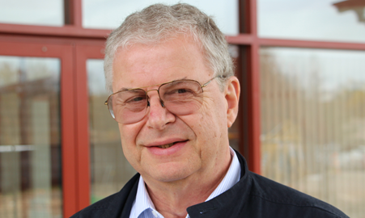
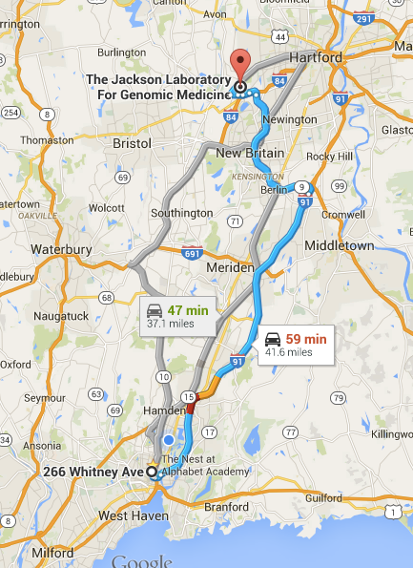

BACKGROUND
Jointly advised by Mark and George Weinstock
  One of the first bacterial genome projects (Treponema pallidum) 1998
  Genomes of rat, mouse, macaque, cow, sea urchin, honey bee, fruit fly
  Human genome project 2010
  Human microbiome project 2012
  Collaborative lab environment

Slide 3
GOAL FOR INCORPORATING THE GERSTEIN LAB
Learn microbiome research in Weinstock Group
Identify an area of shared interest
Identify / develop new techniques for microbiome research and the integration of host and microbe data

Slide 4
OUTLINE
General overview of microbiome workflow
Data analysis projects
  Integrated Human Microbiome Project (HMP2)
  JAX mouse study
  The effect of Pneumococcal vaccination on the infant nasopharyngeal microbiome
Data production projects
  JAX building sampling

Slide 5
Microbiome Workflow – DNA
Stool and Saliva Samples
Participant self-samples at home – no nucleic acid preservation buffer used but samples placed on ice packs immediately
DNA from stool extracted with MoBio PowerSoil Kit
DNA from saliva extracted with Epicentre MasterPure Gram Positive DNA Purification Kit
Participant ships samples overnight to lab on ice. Once received, samples stored in lab at -80°C
DNA is quantified & used for 16S sequencing (PCR amplification using Illumina indexes) and WGS (Illumina’s TruSeq Nano Kit)
Sequencing data is trimmed, human contaminants are removed, and reads are mapped for taxonomic assignment
16S libraries are sequenced on MiSeq
mWGS libraries are sequenced on NextSeq or HiSeq

Slide 6
Microbiome Workflow – RNA
Stool and Saliva Samples
Participant self-samples at home –samples are placed immediately into RNALater and placed on ice packs immediately
RNA from both saliva and stool extracted with MoBio PowerMicrobiome Kit
RNA is checked for quantity (Qubit) and quality (Bioanalyzer)
Participant ships samples overnight to lab on ice. Once received, samples stored in lab at -80°C
rRNA is removed, cDNA is synthesized, and a RNA-Seq library is prepared using Epicentre’s ScriptSeq Complete Gold Kit (Epidemiology)
Sequencing data is trimmed, human contaminants are removed, and reads are mapped for taxonomic assignment & functional analysis
RNA-Seq libraries are sequenced on MiSeq or NextSeq

Slide 7
Microbiome Analysis Workflow
16S
Illumina Sequencing
WGS
Assemble & remove chimeras
Pre-Processing
Read Q/C, human screen, dusting
OTU
Direct Read Align
Taxonomic Abundance
RTG Map & Species GOLD db
RTG
Mapx-KEGG protein db
PICRUSt
HUMAnN
Functional Prediction
HUMAnN
R + iPath
Analysis and
Visualization
RTG & HTML
R + iPath

Slide 8
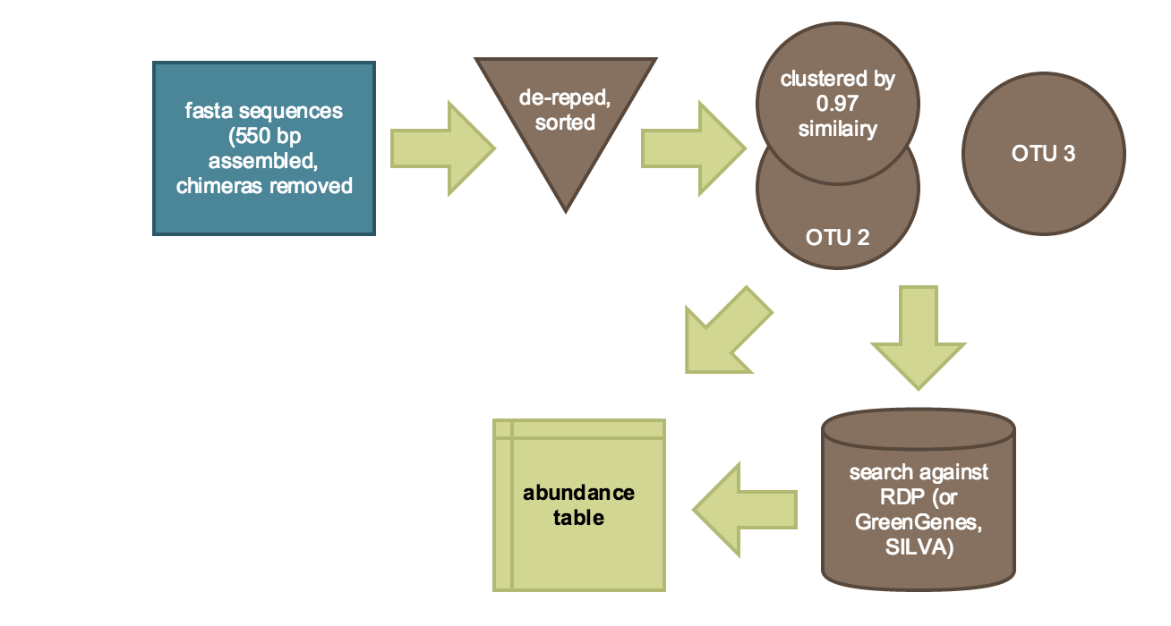
OTU GENERATION WORKFLOW

Slide 9
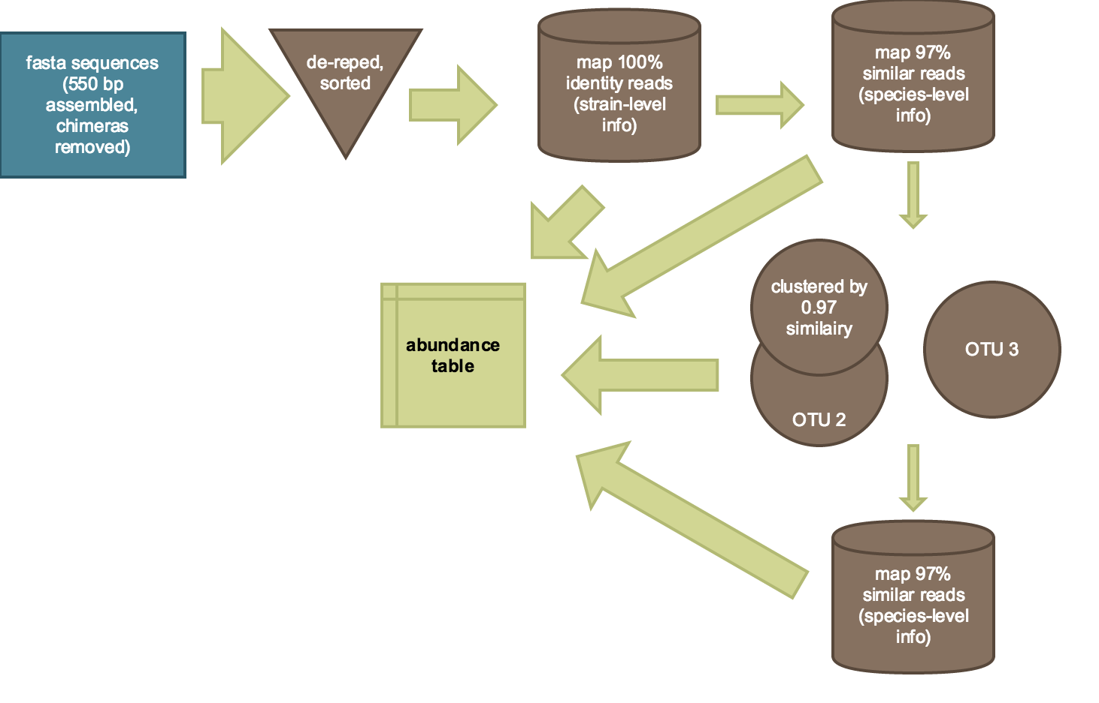
PREFERRED METHOD FOR OTU GENERATION

Slide 10
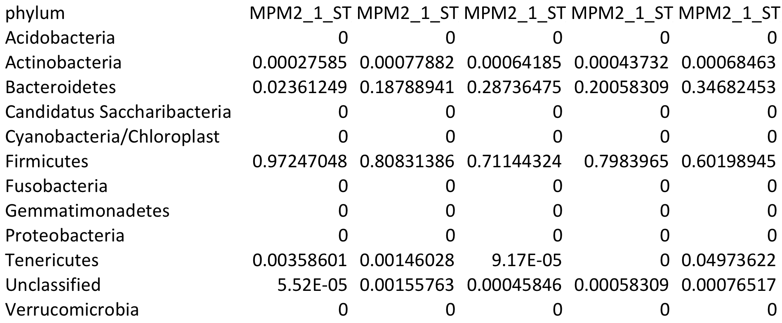
Summary of the data
OTU count table
 | 1_14_778 | 1_15_461 | 1_15_463 | 1_15_464 | 1_15_465 | 2_13_974 | 2_14_773 | 2_15_459 | 2_9_389
OTU_24 | 849 | 325 | 267 | 467 | 179 | 1051 | 210 | 3 | 1102
OTU_37 | 198 | 120 | 389 | 624 | 448 | 556 | 26 | 501 | 181
OTU_10 | 1993 | 96 | 1 | 1 | 16 | 1 | 35 | 0 | 71
OTU_2 | 1992 | 763 | 661 | 970 | 2930 | 1590 | 1153 | 1311 | 509
OTU_13 | 1545 | 276 | 0 | 0 | 1703 | 1505 | 0 | 112 | 0
OTU_9 | 608 | 0 | 184 | 85 | 116 | 3 | 556 | 7 | 167
Taxa relative abundance table

Slide 11
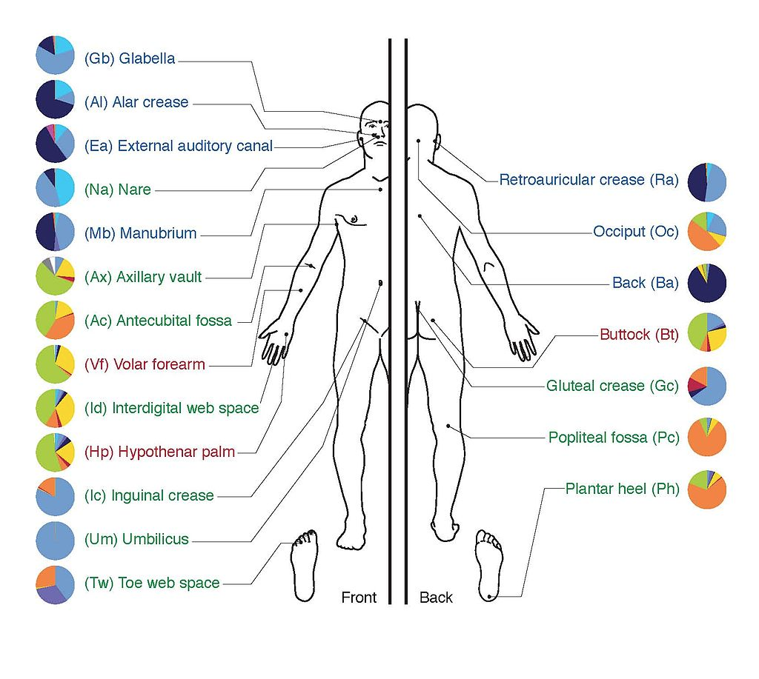
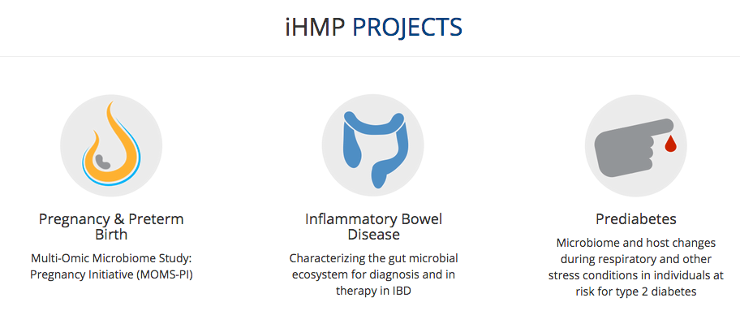
INTEGRATED HUMAN MICROBIOME PROJECT (HMP2)
Original project (HMP1)
  Catalog healthy microbiomes
Second common fund project (HMP2)
  Generate host + microbe data
  Diabetes: Snyder and Weinstock

Slide 12
Gut Microbiome and Diabetes
Gut microbiome affects metabolism and energy homeostasis (Cani et al., Diabetes 2007; Cani et al., Diabetes 2008; Samuel et al., PNAS 2008; Cani et al., Gut 2009; Vijay-Kumar et al., Science 2010)
Diabetics and Healthy Subjects have distinct microbiomes (Qin et al., Nature 2012)
Type 2 Diabetes and insulin resistance associated with stress and infection (Backhed et al., PNAS 2007; Maslowski et al., Nature 2009; Vijay-Kumar et al., Science 2010; Chen et al., Cell, 2012)
Focus on Pre-Diabetics:
Longitudinal profiling of microbiota & host over 3 years
Observe what might push them into full diabetes
Notes:
#3: viral infection – one of the early slides will show that viral infection can spike blood glucose level

Slide 13
RSV correlated to Diabetes
HbA1c (%) 6.4 6.7 4.9 5.4 5.3 4.7
(Day Number) (329) (369) (476) (532) (546) (602)
HRV
RSV
LIFESTYLE CHANGE
Chen et al., Cell 2012
Notes:
One of our subjects. Also happens to be one of the PIs on the project. Great deal more described in the Cell paper.

Slide 14
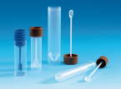


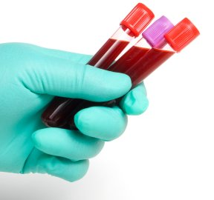
Sample Collection
Assays
Metagenome
Metatranscriptome
Proteomic Profile
Stool samples
Metagenome
Metatranscriptome
Microbial
Host
Nasal Swabs
Metabolite Profile
Urine samples
  Whole genome sequencing
  Transcriptome
  Proteome
  Cytokines
  Autoantibodyome
  Metabolite Profile
Blood samples

Slide 15
Number of Assays: a lot of data
Cohort | Cohort Size | # Samples/Subject | Total Samples
Over-Feeding | 25 | 4 | 100
Viral Infection | 20 | 7 | 140
Immunization | 20 | 7 | 140
Dietary Supplement | 20 | 19 | 380
Other Sub-studies | 40 | 10 | 400
1,160 samples total
‘omics | Microbes | Host |  | # Data Points
(m)WGS | ✓ | ✓ |  | 2320
Transcriptome | ✓ | ✓ |  | 2320
16S community profile | ✓ |  |  | 1160
Proteome | ✓ | ✓ |  | 2320
Metabolome | ✓ | ✓ |  | 2320
Cytokines |  | ✓ |  | 1160
Autoantibodyome |  | ✓ |  | 1160
x 1,160
samples
= 12,760 data points
Notes:
When we look at microbial taxa, genes, metabolites, we are looking at A LOT of different things, so this number is really very conservative.

Slide 16
Different sub-studies
~70
Subjects
Other dietary studies
Other
sub-studies
Healthy vs. viral infection
Over-feeding study
Immunization

Slide 17
Over-Feeding Cohort
Longitudinal ‘omic profiling response to over-feeding in humans

Slide 18

Over-feeding Study Timeline
Maintain peak weight
Weight gain
Weight loss
Maintain
30
days
7
days
60
days
T1
baseline
T2
peak
T3
post
T4
followup
Baseline
Weight loss of 1.5-3 kg
Weight Loss
Weight gain of 1.5-3 kg
Weight Gain
Collect blood and microbiome
Day 0
Collect blood and microbiome
Collect blood and microbiome
Follow-Ups
Every 90 days thereafter
Collect blood and microbiome
Notes:
Longitudinal ‘omic profiing response to over-feeding in humans

Slide 19
Over-feeding Study Weight Change
Change in Body Weight (kg)
Baseline
Peak
Weight Loss
Follow-Up
Participants gained an average of 3.4 kg over 30 days.
Notes:
----- Meeting Notes (5/20/15 16:00) -----
check initial weight
level of activity

Slide 20

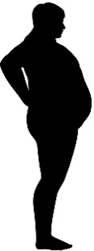
Over-feeding induced transcriptional changes in pre-diabetes
Gene Set Enrichment Analysis
Olfactory Signaling
Inflammatory Response to LPS
TNF-alpha Targets
NRG1 Signaling
Platelet-specific genes
STAT5A Targets
FGFR Ligand Binding and Activation
Weight gain
Weight loss
Platelet-specific genes
STAT5A Targets
FGFR Ligand Binding and Activation
Maturity Onset Diabetes of the Young
Olfactory Signaling
Inflammatory Response to LPS
Voltage-Gated Potassium Channels

Slide 21
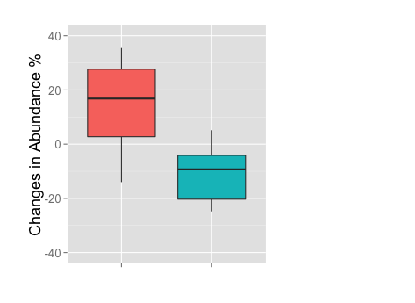
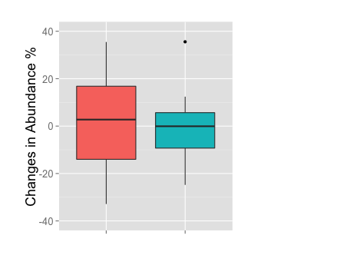
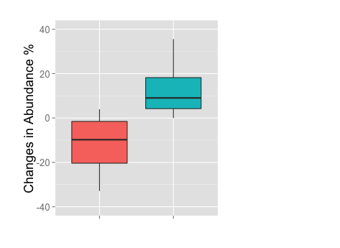
Stratifying by IR and IS shows different responses to weight loss
Full Cohort
IS
Phylum Bacteroidetes Firmicutes
IR
Phylum Bacteroidetes Firmicutes
Phylum Bacteroidetes Firmicutes

Slide 22
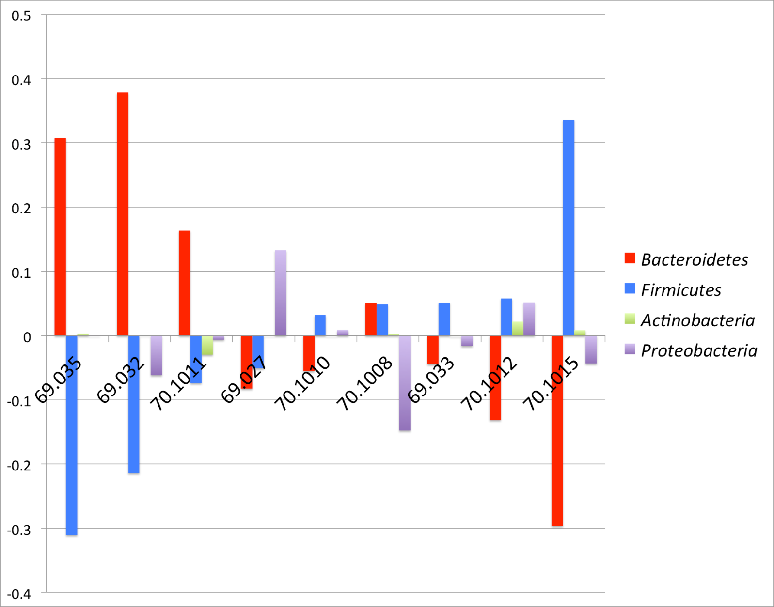
Changes in Phyla from Peak to Weight Loss
IS
IR
% Change in Relative Abundance
Subjects
Notes:
Sorting by change in Firmicutes recapitulates the metadata for insulin resistance

Slide 23
WHY I LIKE THIS PROJECT
Opportunity for matching microbiome to host metabolomics / cytokines / proteome
  Will have RNA-Seq and mWGS of microbiome samples
Few samples, lots of noise, need to leverage longitudinal samples

Slide 24
OUTLINE
General overview of microbiome workflow
Data analysis projects
  Integrated Human Microbiome Project (HMP2)
  JAX mouse study
  The effect of Pneumococcal vaccination on the infant nasopharyngeal microbiome
Data production projects
  JAX building sampling

Slide 25
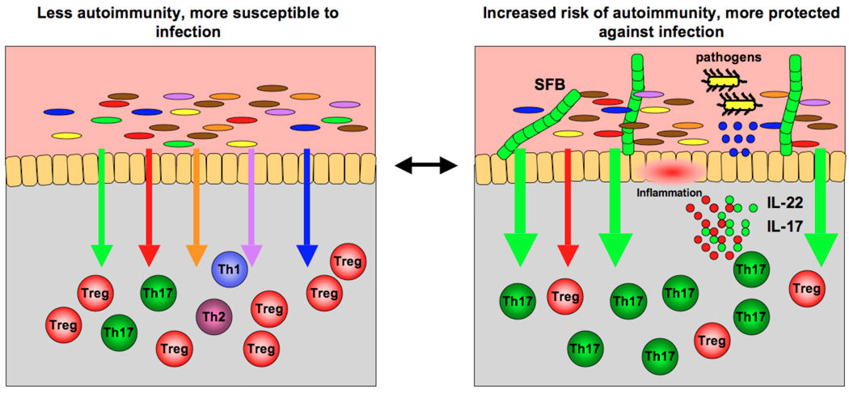
JAX MOUSE MICROBIOME PROJECT
Genetically identical JAX vs Taconic mice respond differently in Irritable Bowel Disorder modeling (Ivanov et al, Cell 2009)
  Differences in regulation of effector T-cell populations
  Linked to the presence of Segmented Filamentous Bacteria
Do any JAX mice have SFB? How different are their microbiomes? Should microbiome data be sent with genotype information?
gut
Lamina
propria
From Ivanov et al. Mucosal immunology (2010)
Notes:
The composition of intestinal microbiota participates in the regulation of immune homeostasis. (Left panel) Signals from different components of the microbiota (different color arrows) regulate different branches of mucosal T cell response in the lamina propria (corresponding color immune cells). (Right panel) Changes in the composition of commensal bacteria, for example, introduction of segmented filamentous bacteria (SFB), shift the immune homeostasis in a different direction, in this case, increase in the signals mediating induction of Th17 cells (green arrows). This changes the immunological fitness of the individual. In the case of SFB, the increased production of Th17 cell effector cytokines, for example, IL-17 and IL-22, and the consecutive increase in anti-microbial peptide production from epithelial cells (blue circles) augments the ability of the host to fight off intestinal infections. At the same time, this increase in proinflammatory cytokines may render the host more susceptible to chronic autoimmune inflammation. In this way, differences in the repertoire of commensal bacteria between the individuals of the same species may account for differences in the nature and robustness of their response in the face of similar environmental challenges.

Slide 26
SAMPLE OVERVIEW
Sequencing stool microbiomes of production facility mice
  Outsourced to MR DNA http://mrdnalab.com/
    142 samples
    454 sequencing V4-V6
  Subset of samples sent to JAX-GM
    36 samples
    Illumina sequencing V1-V3
  To what extent can these data be integrated?

Slide 27
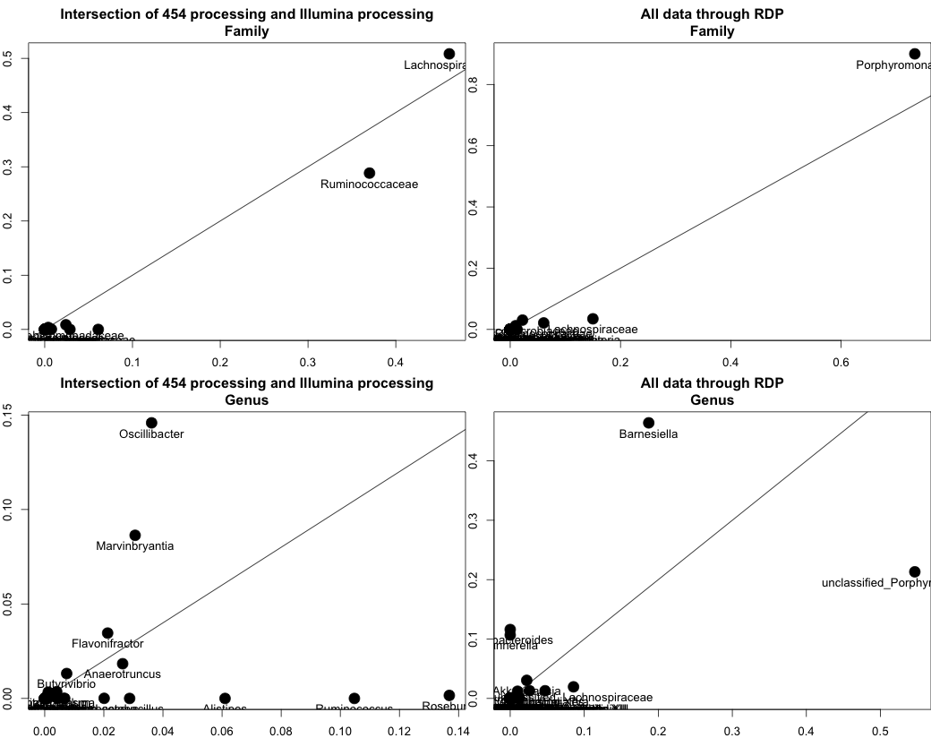
COMPARING 454 AND ILLUMINA RESULTS:
One sample (1.14.778) Relative abundances of Families and Genera
Rel abundance by 454
Rel abundance by Illumina

Slide 28
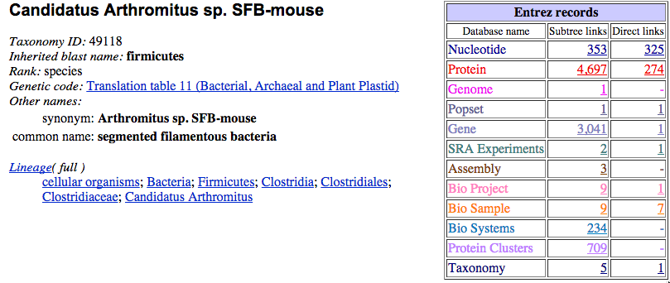
CUSTOM DATABASE OF MOUSE CANDIDATUS ARTHROMITUS SEQUENCES
Searched OTUs against a database of NCBI Candidatus Arthromitus mouse sequences
-evalue 0.0000000001
-perc_identity 97
-qcovs 100
Only match is from Illumina data (OTU_299), perfect match to:
Candidatus Arthromitus sp. SFB-mouse-NL, complete genome
GenBank: CP008713.1
No SFB was observed in the 454 data.
Notes:
----- Meeting Notes (5/7/15 16:38) -----
grab the RDP sequence for SFB and then BLAST
Dan Lipman's paper SFB
search SFB's against NCBI
what sequences were used for PCR of SFB?
how many 16S genes does SFB have?

Slide 29
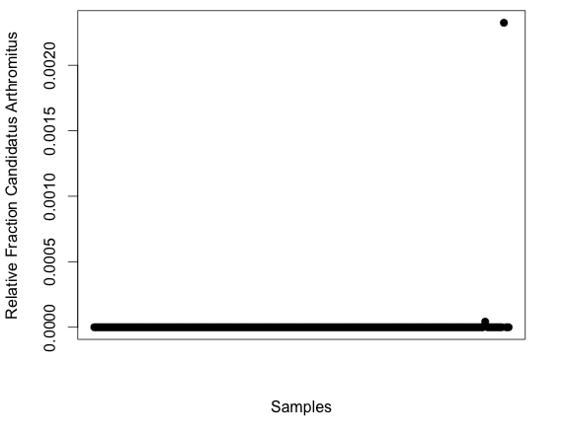
CANDIDATUS ARTHROMITUS IS OBSERVED IN LOW ABUNDANCE IN TWO SAMPLES
VFP_277
6_1210

Slide 30


Mouse room / strain relationship and potential questions
MP14
MP15
MP13
MP23
BALB/cJ
BALV/cJ
A/J
A/J
CBA/J
BALB/cJ
A/J
CBA/J
C57BL/6J
A/J
A/J
CBA/J
AX9
CBA/J
AX1
AX28
AX4
BALB/cJ
C57BL/6J
C57BL/6J
C57BL/6J
BALB/cJ
CBA/J
C57BL/6J
AX27
AX30
NOD.Cg
NOD.Cg
NOD.Cg
NOD.Cg
NOD.Cg
1210
1230
MGL277
AMP
VFPWT3
CByB6F1
AMP
VFP_277
VFPWT3
CByB6F1
CByB6F1
CByB6F1
AMP
VFP_277

Slide 31
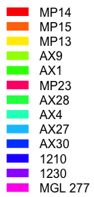
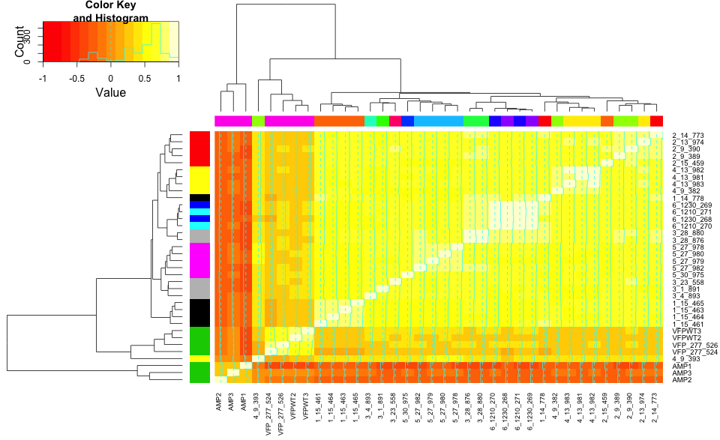
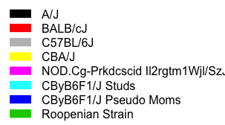
Spearman correlation shows more similarity of bacterial communities by genotype than room
Notes:
InputLocation= "~/Box Sync/Projects/mpm1/dataProcessing/"
FileName = "otu_table_fraction.csv"
ForInput = paste(InputLocation, FileName, sep="")
OTUTable=read.csv(file=ForInput, header=TRUE, sep = ",", quote = "\"", dec = ".", stringsAsFactors=FALSE)
rownames(OTUTable) <- OTUTable$X
OTUTable$X <- NULL
OTUTable$X.1 = NULL
colnames(OTUTable) = c("1_14_778", "1_15_461", "1_15_463", "1_15_464", "1_15_465", "2_13_974", "2_14_773", "2_15_459", "2_9_389", "2_9_390", "3_1_891", "3_23_558", "3_28_876", "3_28_880", "3_4_893", "4_13_981", "4_13_982", "4_13_983", "4_9_382", "4_9_393", "5_27_978", "5_27_979", "5_27_980", "5_27_982", "5_30_975", "6_1210_270", "6_1210_271", "6_1230_268", "6_1230_269", "AMP1", "AMP2", "AMP3", "VFP_277_524", "VFP_277_526", "VFPWT2", "VFPWT3")
# tOTUTable <- as.data.frame(t(OTUTable))
# tOTUTable$Sample <- rownames(tOTUTable)
# tOTUTable$Sample <- gsub("Joe1.1.Aging.Qia.ube", "", tOTUTable$Sample)
# tOTUTable$Sample <- gsub("^\\.", "", tOTUTable$Sample)
# tOTUTable$Sample <- gsub(".ST", "", tOTUTable$Sample)
# tOTUTable$Sample <- gsub("min.*_L001", "min", tOTUTable$Sample)
# rownames(tOTUTable) <- tOTUTable$Sample
# tOTUTable$Sample <- NULL
#ObsList <- grep('*.5.min.*', tOTUTable$Sample, ignore.case = FALSE, perl = FALSE, value = FALSE,
# fixed = FALSE, useBytes = FALSE, invert = FALSE)
#tOTUTableSub <- tOTUTable[ObsList,]
#tOTUTableSub$Sample <- NULL
# OTUTableFinal <- as.data.frame(t(tOTUTable))
# var 1 is the strain information
var1 <- c(1, 1, 1, 1, 1, 2, 2, 2, 2, 2, 3, 3, 3, 3, 3, 4, 4, 4, 4, 4, 5, 5, 5, 5, 5, 6, 6, 7, 7, 8, 8, 8, 8, 8, 8, 8)
var1 <- replace(var1, which(var1 == 1), "black")
var1 <- replace(var1, which(var1 == 2), "red")
var1 <- replace(var1, which(var1 == 3), "grey")
var1 <- replace(var1, which(var1 == 4), "yellow")
var1 <- replace(var1, which(var1 == 5), "magenta")
var1 <- replace(var1, which(var1 == 6), "cyan")
var1 <- replace(var1, which(var1 == 7), "blue")
var1 <- replace(var1, which(var1 == 8), "green3")
# var 2 is the room information
var2 <- c(1, 2, 2, 2, 2, 3, 1, 2, 4, 4, 5, 6, 7, 7, 8, 3, 3, 3, 4, 4, 9, 9, 9, 9, 10, 11, 11, 12, 12, 13, 13, 13, 13, 13, 13, 13)
var2 <- replace(var2, which(var2 == 1), "#FF0000FF")
var2 <- replace(var2, which(var2 == 2), "#FF7600FF")
var2 <- replace(var2, which(var2 == 3), "#FFEB00FF")
var2 <- replace(var2, which(var2 == 4), "#9DFF00FF")
var2 <- replace(var2, which(var2 == 5), "#27FF00FF")
var2 <- replace(var2, which(var2 == 6), "#FF0076FF")
var2 <- replace(var2, which(var2 == 7), "#00FF4EFF")
var2 <- replace(var2, which(var2 == 8), "#00FFC4FF")
var2 <- replace(var2, which(var2 == 9), "#00C4FFFF")
var2 <- replace(var2, which(var2 == 10), "#004EFFFF")
var2 <- replace(var2, which(var2 == 11), "#2700FFFF")
var2 <- replace(var2, which(var2 == 12), "#9D00FFFF")
var2 <- replace(var2, which(var2 == 13), "#FF00EBFF")
#Creates a correlation variable (r=matrix of correlations, n=number of observations, p=asymptotic p-values)
CorrTable <- rcorr(as.matrix(OTUTable), type="spearman")
CorrTable.r <- CorrTable$r
CorrTable.p <- CorrTable$P
# dev.off()
heatmap.2(CorrTable.r, margin= c(6,6), dendrogram = c("both"), cexRow = 0.9,
RowSideColors = var1, ColSideColors = var2)
par(lend = 1) # square line ends for the color legend
legend("topleft", # location of the legend on the heatmap plot
legend = c("A/J", "BALB/cJ", "C57BL/6J", "CBA/J", "NOD.Cg-Prkdcscid Il2rgtm1Wjl/SzJ", "CByB6F1/J Studs", "CByB6F1/J Pseudo Moms", "Roopenian Strain"), # category labels
col = c("black", "red", "grey", "yellow", "magenta", "cyan", "blue", "green3"), # color key
lty= 1, # line style
lwd = 15 # line width
)
legend("topright",
legend = c("MP14", "MP15", "MP13", "AX9", "AX1", "MP23", "AX28", "AX4", "AX27", "AX30", "1210", "1230", "MGL 277"),
col = c("#FF0000FF", "#FF7600FF", "#FFEB00FF", "#9DFF00FF", "#27FF00FF", "#FF0076FF", "#00FF4EFF", "#00FFC4FF", "#00C4FFFF", "#004EFFFF", "#2700FFFF", "#9D00FFFF", "#FF00EBFF"),
lty= 1, # line style
lwd = 15 # line width
)
----- Meeting Notes (3/25/15 16:51) -----
break down by mixed vs indiv
----- Meeting Notes (5/20/15 16:00) -----
pca analysis for sure

Slide 32
WHY I LIKE THIS PROJECT
Going to proceed with Illumina sequencing of the mouse colony
  LOTS of mice and replicates for well defined orgs
Controlled diet, environment
  Look for changes due to genetics
    Presence / absence of taxa
    Amount of variability
Spatial / colonization component

Slide 33
OUTLINE
General overview of microbiome workflow
Data analysis projects
  Integrated Human Microbiome Project (HMP2)
  JAX mouse study
  The effect of Pneumococcal vaccination on the infant nasopharyngeal microbiome
Data production projects
  JAX building sampling

Slide 34
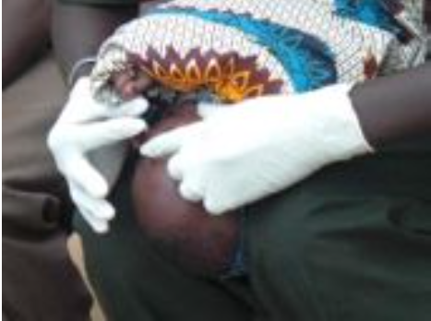
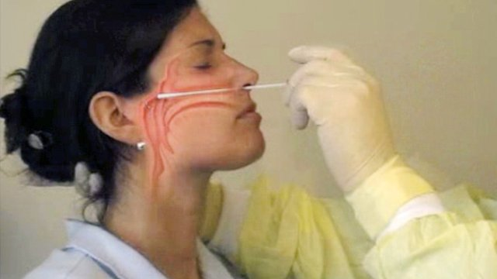
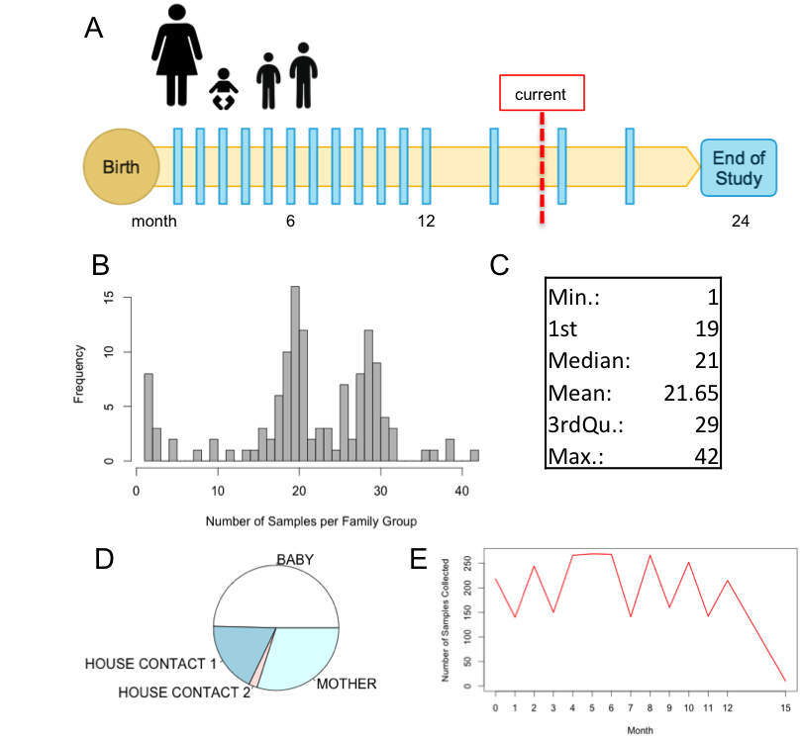
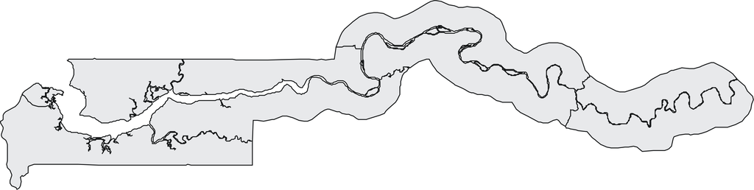
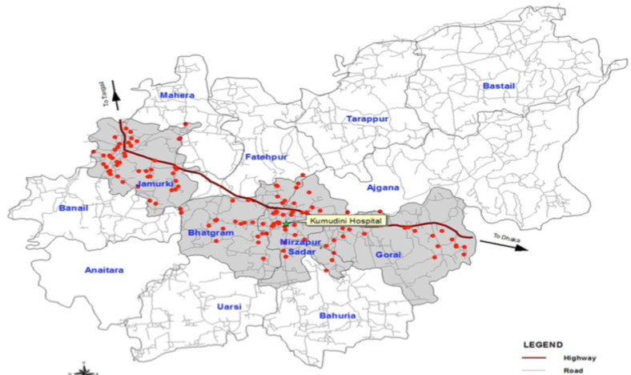
The Effect of Pneumococcal Conjugate Vaccines on the Pediatric Nasopharyngeal Microbiome
Colonization of the nasopharynx by pathogens including Streptococcus pneumoniae can lead to diseases such as pneumonia and meningitis that are a leading cause of vaccine-preventable infant deaths in the developing world
colonization efficiency affected by the existing microbial ecosystem
the identification of high-risk phenotypes
aid in the development of region-specific vaccines
to understand the consequences of vaccination with different valences
A
A
A
B
B
B

Slide 35
SUMMARY OF SAMPLE COLLECTION

Slide 36
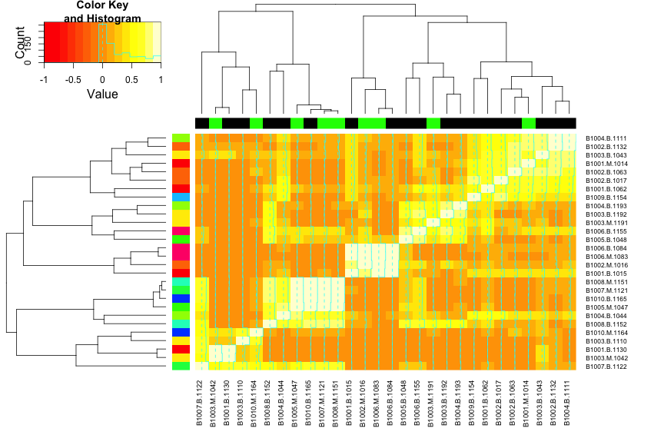

Baby and mother NPS are not consistently similar

Slide 37
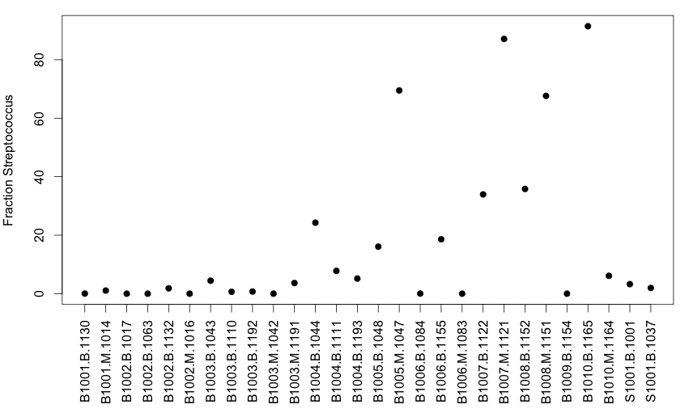
AMOUNT OF STREP PNEUMO

Slide 38
WHY I LIKE THIS PROJECT
Strain-level information is important
Clear hypothesis for perturbation effect

Slide 39
OUTLINE
General overview of microbiome workflow
Data analysis projects
  Integrated Human Microbiome Project (HMP2)
  JAX mouse study
  The effect of Pneumococcal vaccination on the infant nasopharyngeal microbiome
Data production projects
  JAX building sampling

Slide 40
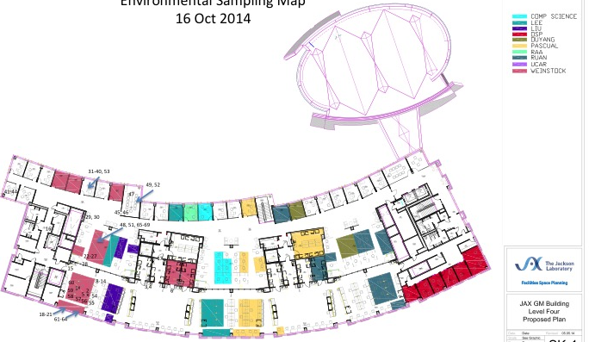
JAX BUILDING SAMPLING
20 weeks
(~ 160 samples/wk, ~3 hrs collecting time/ wk , 3 indiv = 7.5 person days of work)

Slide 41
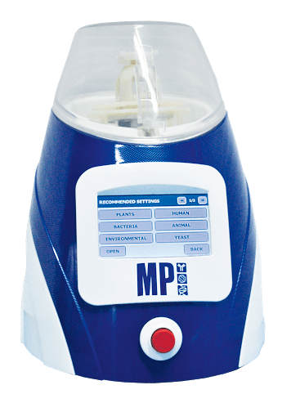
CURRENT PHASE OF PROTOCOL DEVELOPMENT
EXPERIMENT 4: Comparing two kits, matrix types
SAMPLES
Dusty Shelf
Clean-ish Bench
x3
+ 1 PC, NC
PROCESSING
FastPrep
Matrix Y
(as previous)
FastPrep
Matrix E
FastPrep
Matrix A
Extract N Amp
MpBio Fast DNA
MoBio Soil
PCR
PCR
PCR

Slide 42
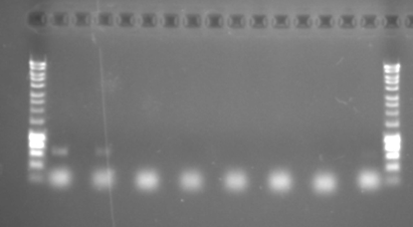
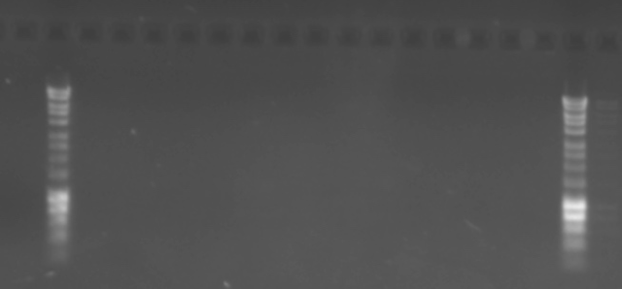
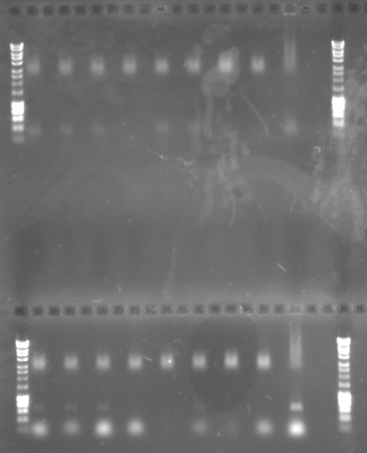
EXAMPLE OF RESULTS FROM PREVIOUS EXPERIMENTS
PCR amplification of 16S and ITS after kits
ITS
Bead beating 5 min
20 min
1
2
3
NC
1
2
3
NC
No bands
16S
ITS
16S
ITS
No spin
with spin
No spin
with spin
bp
1
2
3
NC
1
2
3
NC
dust
NTC
1
2
3
NC
1
2
3
NC
dust
NTC
16S
ITS
3000
600

Slide 43
CONCLUSIONS
Integrative Human Microbiome Project: Diabetes
  Potential signals from preliminary samples
    Human transcriptome experiments suggest response to microbes
    Stool samples suggest different effects in insulin sensitive / resistant individuals
  Effect of viruses?
JAX Mouse Microbiome
  More depth and quality from Illumina
    Depth necessary for low abundance org detection
  Beginning to generate lots of data
    Thorough phenotype analysis
    Known genotype / diet / location
Nasopharyngeal microbiome and vaccination
  Fully enrolled, samples being collected
    Sequencing will be started Sept 2015
JAX building sampling
  Should have final protocol in a few weeks
    Next will be pilot runs with real samples

