Slide 1
Cell types in the mouse cortex and hippocampus revealed by single-cell RNA-seq
Shuang Liu
Jclub
2015-05-19

Slide 2
Cell types in the mouse cortex and hippocampus revealed by single-cell RNA-seq
Amit Zeisel,^{1*} Ana B. Muñoz Manchado,^{1*} Simone Codeluppi,¹ Peter Lönnerberg,¹ Gioele La Manno,¹ Anna Juréus,¹ Sueli Marques,¹ Hermany Munguba,¹ Liqun He,² Christer Betsholtz,^{2,3} Charlotte Rolny,⁴ Gonçalo Castelo-Branco,¹ Jens Hjerling-Leffler,^{1†} Sten Linnarsson^{1†}
1Division of Molecular Neurobiology, Department of Medical Biochemistry and Biophysics, Karolinska Institutet, S-171 77 Stockholm, Sweden. 2Department of Immunology, Genetics and Pathology, Rudbeck Laboratory, Uppsala University, Dag Hammarskjölds väg 20, S-751 85 Uppsala, Sweden. 3Division of Vascular Biology, Department of Medical Biochemistry and Biophysics, Karolinska Institutet, S-171 77 Stockholm, Sweden. 4Department of Oncology-Pathology, Karolinska Institutet, S-171 76 Stockholm, Sweden.

Slide 3
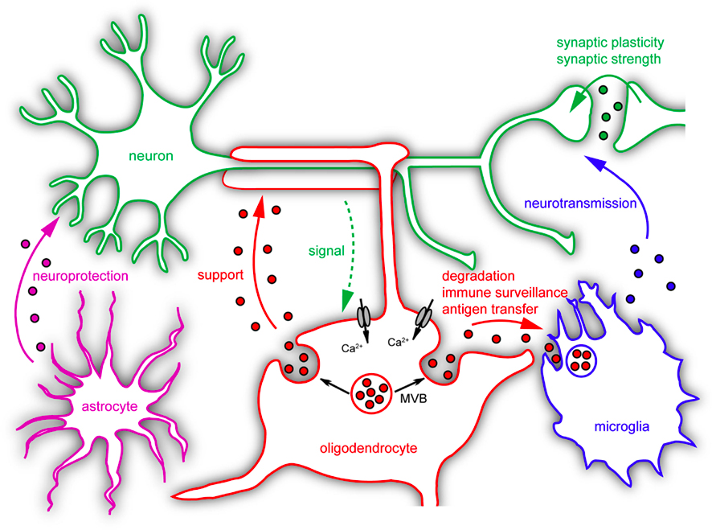
Background
The mammalian cerebral cortex supports cognitive functions
The brain is built from a large number of specialized cell types including neurons, glia, and vasculature.
Cells in the nervous system have historically been classified using location, morphology, target specificity and electrophysio-logical characteristics, often combined with molecular markers.

Slide 4
Motivation
No enough information on definitive cell type identification
Single-cell RNA-seq has been used to classify cells in spleen, lung epithelium and embryonic brain
The adult nervous system has greater complexity and more cell types, presenting a challenge both to sample preparation methods and computational analysis

Slide 5
Workflow
Quantitative single-cell RNA-seq to perform a molecular census of the primary somatosensory cortex (S1) and the hippocampal CA1 region
Used BackSPIN biclustering https://github.com/linnarsson-lab/BackSPIN to discover molecularly distinct classes of cells

Slide 6
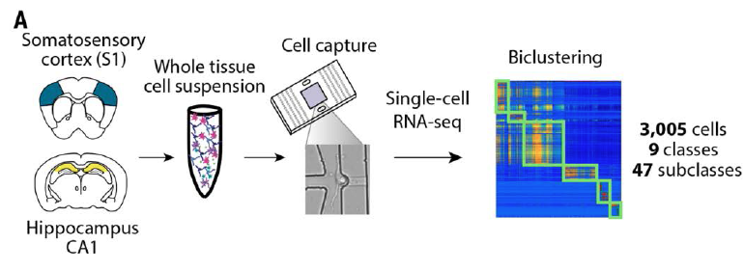
Fig. 1. Molecular census of somatosensory S1 cortex and hippocampus CA1 by unbiased sampling and single-cell RNA-seq.
(A) Workflow for obtaining and analyzing single-cell RNA-seq from juvenile mouse cortical cells, from dissection to single-cell RNA-seq and biclustering.
Notes:
Mice were deeply anesthetized
Quantitative single-cell RNA-seq to perform a molecular census of the primary somatosensory cortex (S1) and the hippocampal CA1 region
Used BackSPIN biclustering to discover molecularly distinct classes of cells

Slide 7
Results 1
Revealed nine major classes of cells:
S1 pyramidal neurons
CA1 pyramidal neurons
in-terneurons
oligodendrocytes
astrocytes
microglia
vascular endothelial cells
mural cells
ependymal cells
Identified the most specific markers for each class

Slide 8
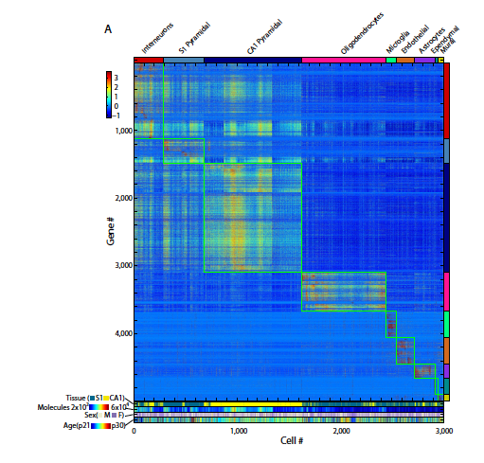

Slide 9
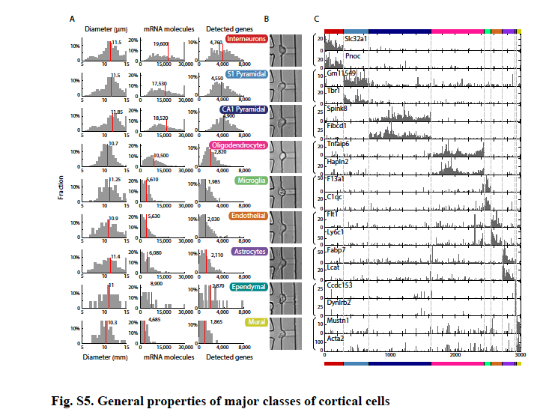
Notes:
(A) Histograms of cell diameter, total number of molecules and number of detected
genes for each one of the nine classes. (B) Representative image of cell from each
class as they appear during capture on the C1 chip. (C) Examples of class-specific
genes, two per class. Barplots show raw detected molecule counts over all cells
(ordered as in Fig. S3) without any normalization.
S1 pyramidal cells were marked by Tbr1, a transcription factor required for the final differentiation of cortical projection neurons;

Slide 10
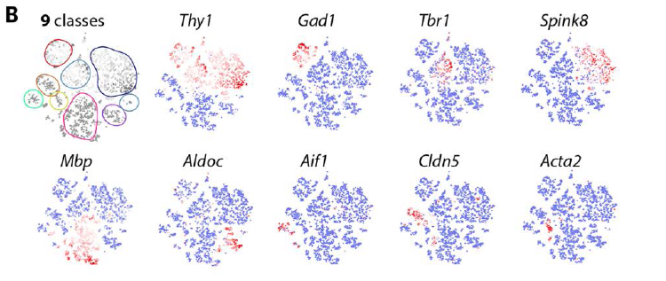
Fig 1. (B) Visualization of nine major classes of cells using t-Distributed Stochastic Neighbor Embedding (tSNE). Each dot is a single cell, and cells are laid out to show similarities. Colored contours correspond to the nine clusters in (A) and fig. S3. Expression of known markers is shown using the same layout (blue, no expression; white, 1% quantile; red, 99% quantile).

Slide 11
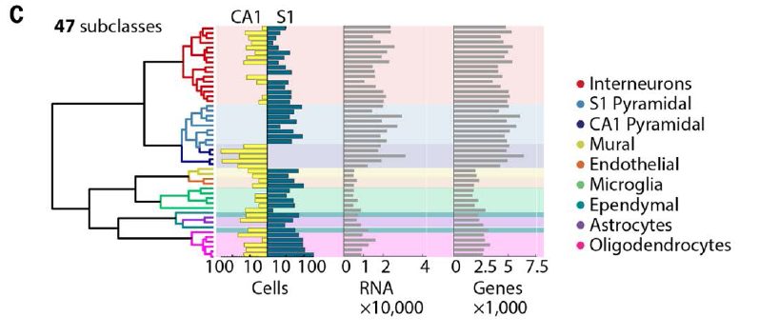
Results 2
Neurons contained more RNA than glia and vascu-lar cells, and a larger number of detectable genes
(C) Hierarchical clustering analysis on 47 subclasses. Barplots show number of captured cells in CA1 and S1, number of detected polyA+ RNA molecules per cell, and total number of genes detected per cell.

Slide 12
Results 3
Identified seven subclasses of S1 pyramidal cells (Fig. 2A), which were largely layer-specific.
Two types of CA1 glutamatergic cells (fig. S8), plus cells derived from the adjacent CA2 (as defined by Pcp4) and subiculum

Slide 13
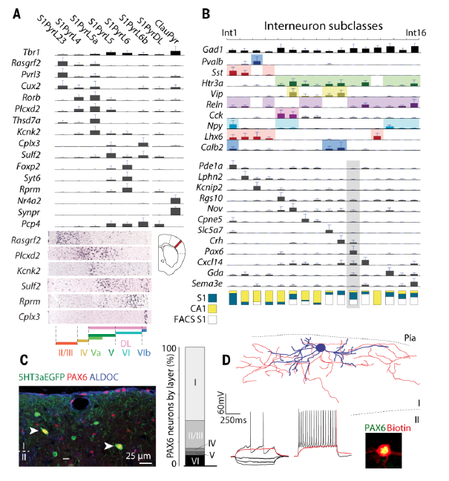
Fig. 2. Neuron subclasses in the somatosensory cortex.

Slide 14
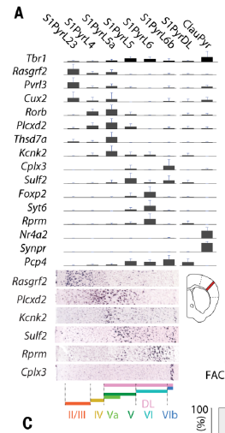
(A) Subclasses of pyramidal neurons in the somatosensory cortex (S1) identified by BackSPIN clustering. Barplots show mean expression of selected known and novel markers (error bars show standard deviations). Layer-specific expression shown by in situ hybridization (Allen Brain Atlas). S1PyrL23, layer II-III; S1PyrL4, layer IV; S1PyrL5a, layer Va; S1PyrL5, layer V; S1PyrL6, layer VI; S1PyrL6b, layer VIb; S1PyrDL, deep layers; ClauPyr, claustrum.

Slide 15
Result 4
16 subclasses of interneurons
CA1 and S1 regions both contained interneurons of al-most every subclass (Fig. 2B) showing that interneurons residing in functionally distinct cortical structures are tran-scriptionally closely related.

Slide 16
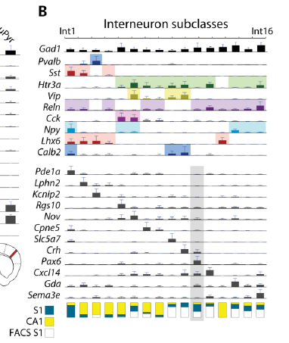
(B) Identification of interneuron subclasses. Barplots show selected known and novel markers. Fraction of S1/CA1 cells is depicted at bottom: blue, S1; yellow, CA1; white, flow sorted Htr3a+ cells from S1.

Slide 17
Result 5
In superficial layers of S1 they identified an Htr3a and Pax6-expressing interneuron subclass, confirmed by immunohistochemistry

Slide 18
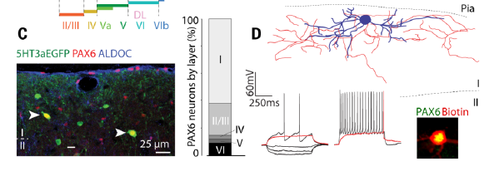
(C) Immunohistochemistry demonstrating the existence and localization of novel PAX6+/5HT3aEGFP+ interneurons, Int11. Barplots show the layer distribution of these neurons. (D) Intrinsic electrophysiology and morphology of PAX6+ interneurons in S1 layer I, identified by post hoc staining.
Notes:
In whole-cell current clamp recordings of layer 1 neurons, subsequently stained for PAX6, these cells exhibited intrinsic electrophysiological and morphological characteristics of late-spiking neurogliaform cell

Slide 19
Result 6
Astrocytes formed two subclasses, distinguished by differential expression of Gfap (type 1) and Mfge8 (type 2).
Type 1 astro-cytes were derived from layer I,
Type 2 astro-cytes were more uniformly distributed in the cortex, were smaller and less ramified.

Slide 20
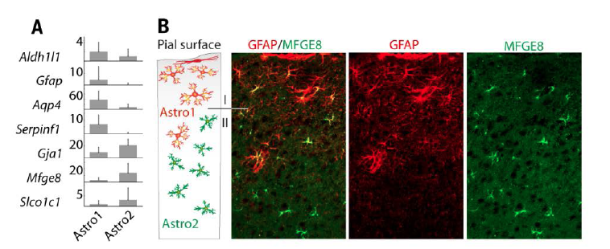
Fig. 3. Characterization of glial subclasses. Caption(A) Two types of astrocytes (Astro1 and Astro2) identified by common and distinct markers. (B) Immunohistochemistry for GFAP (red, Astro1) and MFGE8 (green, Astro2).
Notes:
Immunostaining showed that type 1 astro-cytes were derived from layer I, particularly from the glia limitans, a thin layer made up mostly of astrocytes that is arranged against the pia (Fig. 3B). In contrast, type 2 astro-cytes were more uniformly distributed in the cortex,

Slide 21
Results 7
Identified two types of immune cells: microglia (the tissue-resident macrophages of the brain) and perivascular macrophages
microglia (AIF1+/LYVE1-/MRC1-) had a classical, ramified morphology and were lo-cated throughout the cortex.
In contrast, perivascular macrophages (AIF+/LYVE1+/MRC1+) were locat-ed only along vessels and showed an ameboid morphology.
Notes:
Both expressed brain macrophage markers Aif1 and Cx3cr1, while perivascular macrophages were distinguished by expression of Mrc1 and Lyve1, characteristic of pro-angiogenic perivascular type 2 macrophages

Slide 22
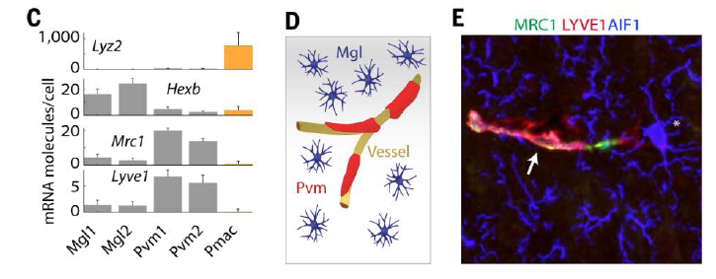
(C) Genes showing expression restricted to microglia (Mgl), perivascular macrophages (Pvm) and peritoneal macrophages (Pmac). Error bars show standard deviations. (D) Cartoon illustrating the morphology and localization of microglia and perivascular macrophages. (E) Immunostaining for AIF1 (previously known as Iba-1, blue) marking microglia, and for MRC1 (green) and LYVE1 (red) marking perivascular macrophages. Asterisk, a microglia cell. Arrow, a perivascular macrophage aligned to a vessel (not stained).
Notes:
Both expressed brain macrophage markers Aif1 and Cx3cr1, while perivascular macrophages were distinguished by expression of Mrc1 and Lyve1, characteristic of pro-angiogenic perivascular type 2 macrophages

Slide 23
Results 8
Six subpopulations of oligodendrocytes were identified:
immature (Oligo4)
pre-myelinating (Oligo2)
myelinat-ing (Oligo5)
terminally differentiated post-myelination (Oligo6) oligodendrocytes
Oligo3 may represent a distinct cellular state specific for this somatosensory cor-tex tissue
The subclass Oligo1 may represent a postmitotic cellular state, associated with the first steps of oligodendrocyte differentiation
May represent sequential steps in the process of maturation from an OPC to a terminally differentiated oligodendrocyte
Notes:
likely representing stages of matura-tion

Slide 24
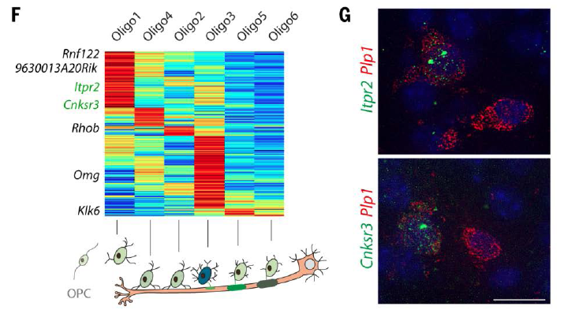
(F) Heatmap showing progressive changes in gene expression along oligodendrocyte differentiation, illustrated below. (G) Single-molecule RNA FISH for Itpr2 and Cnksr3 mark a strict subset of oligodendrocytes (as identified by Plp1).
Notes:
Oligo1 cells expressed a distinct set of genes, includ-ing Itpr2, Prom1, Gpr17, Tcf7l2, 9630013A20Rik, Idh1, Cnksr3, and Rnf122. Single-molecule RNA FISH confirmed that Itpr2 and Cnksr3 were expressed in strict subsets of cells expressing Plp1, a pan-oligodendrocyte marker (4.5% and 7.5% respectively) (Fig. 3G).
a distinct postmitotic oligodendrocyte subclass marked by Itpr2

Slide 25
Results 9
They found many transcription factors with highly restricted expression patterns

Slide 26
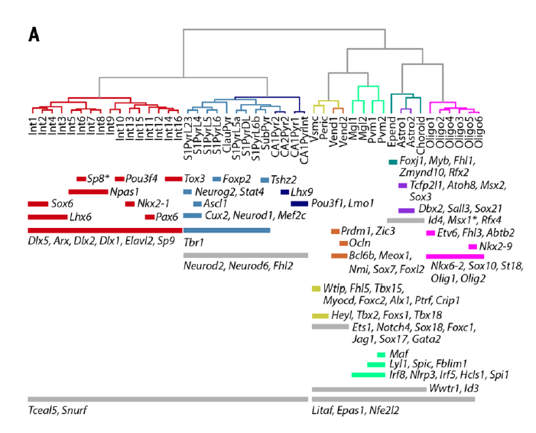
Fig. 4. Expression of regulatory genes across 47 subclasses. Caption(A) Transcription factors showing restricted expression across cell types. Asterisks denote genes with additional expression in distinct subclasses: Sp8 in Int11, Msx1 in vascular cells and microglia.
Notes:
For example, inter-neurons expressed key interneuron regulators Dlx1, Dlx2, Dlx5, and Arx, and pyramidal layer II/III neurons expressed Neurog2, which can directly reprogram human ES cells to excitatory neurons of layer II/III phenotype with near 100% efficiency (21). Lyl1 and Spic were specific to perivascular macrophages; Spic is essential for the maintenance of red pulp macrophages (22), suggesting it may play a similar role in brain perivascular macrophages

Slide 27
Results 10
Expanding this analysis to all genes, we found extensive functional specialization between cellular subclasses.
Ependymal cells ex-pressed the largest set of subclass-restricted genes
Notes:
(multiciliated cells lining the ventricles)

Slide 28
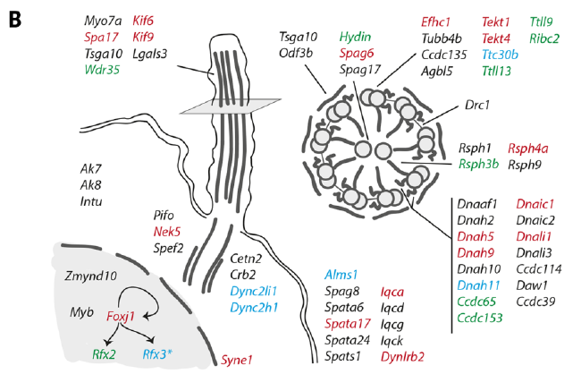
(B) Genes specific to ependymal cells. Transcription factors Foxj1, Rfx2 and Rfx3 (with asterisk to indicate its wider expression), and their known targets are shown in red, green and blue, respectively. Arrows indicate known direct interactions between transcription factors. Only genes with known ciliary function are included.
Notes:
including transcription factors Foxj1, Myb, and Rfx2, the master regulators of motile ciliogenesis (23) (24), and Zmynd10, which causes ciliopathy when mutated in humans (25).
Transcription factors are proteins involved in the process of converting, or transcribing, DNA into RNA. Transcription factors include a wide number of proteins, excluding RNA polymerase, that initiate and regulate thetranscription of genes

Slide 29
summary
Reveal the diversity of brain cell types and transcriptomes
47 molecularly distinct subclasses, comprising all known major cell types in the cortex
identified numerous marker genes, which allowed alignment with known cell types, morphology, and location.
found a layer I interneuron expressing Pax6 and a distinct postmitotic oligodendrocyte subclass marked by Itpr2
Transcription factors formed a complex, layered regulatory code cross the full set of cell types, suggesting a plausible mechanism for the maintenance of adult differentiated cell types

Slide 30
Future work
whole-brain and even whole-organism cell type discovery and characterization
Notes:
More broadly, these results showcase the power of explorative single-cell RNA-seq, and point the way toward future

Slide 31
In the brain, pericytes help sustain the blood–brain barrieras well as several other homeostatic and hemostatic functions of the brain.
The nodes of Ranvier also known as myelin sheath gaps, are the gaps (approximately 1 micrometer in length) formed between the myelin sheaths generated by different cells.
The glial cells surround neurons and provide support for and insulation between them. Glial cells are the most abundant cell types in the central nervous system. Types of glial cells include oligodendrocytes, astrocytes, ependymal cells, Schwann cells, microglia, and satellitecells.

