Slide 1
AlleleDB Figure Pack
Notes:
Allelic != allele-specific

Slide 2
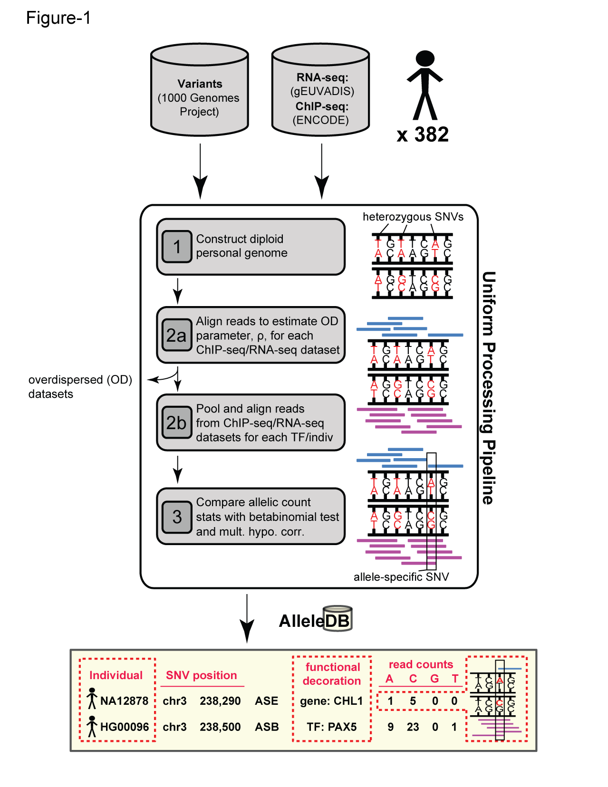
Figure 1. Workflow for uniform processing of data from 382 individuals and construction of AlleleDB.

Slide 3
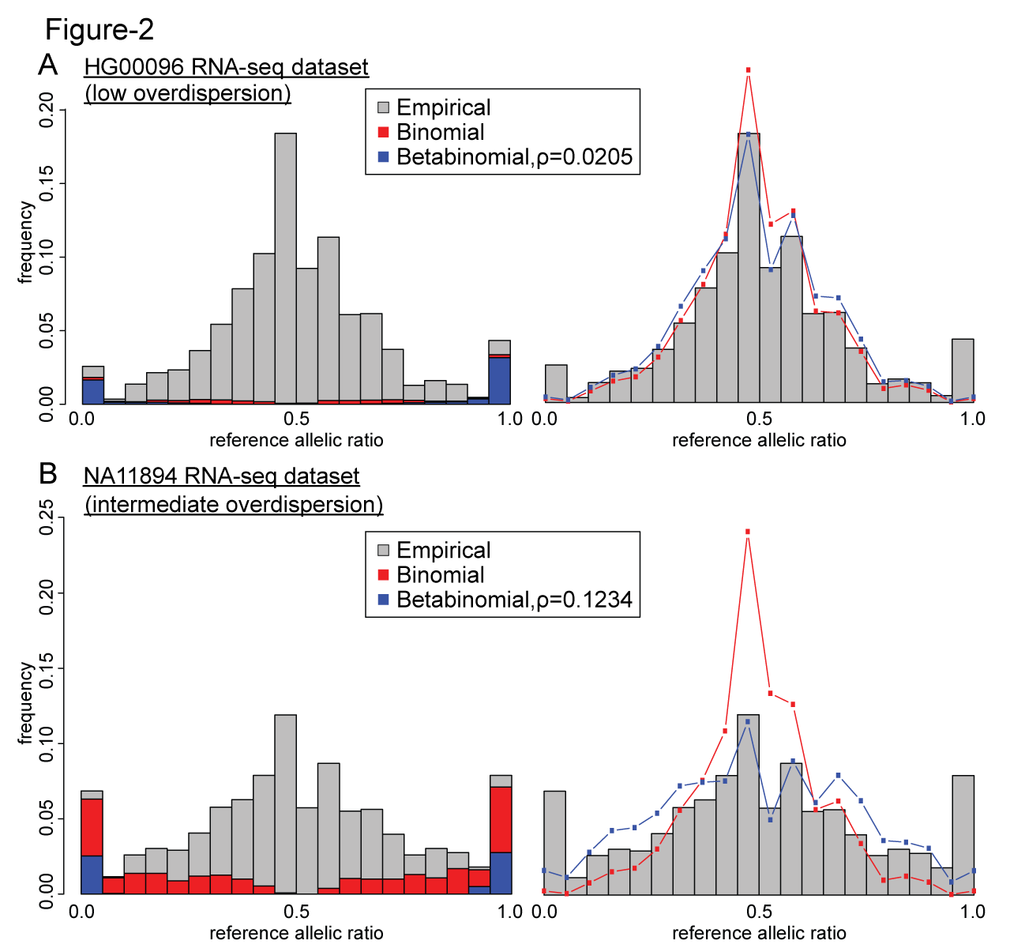
Figure 2. Comparing the effects of the binomial and beta-binomial tests in datasets with low and intermediate level of overdispersion.

Slide 4
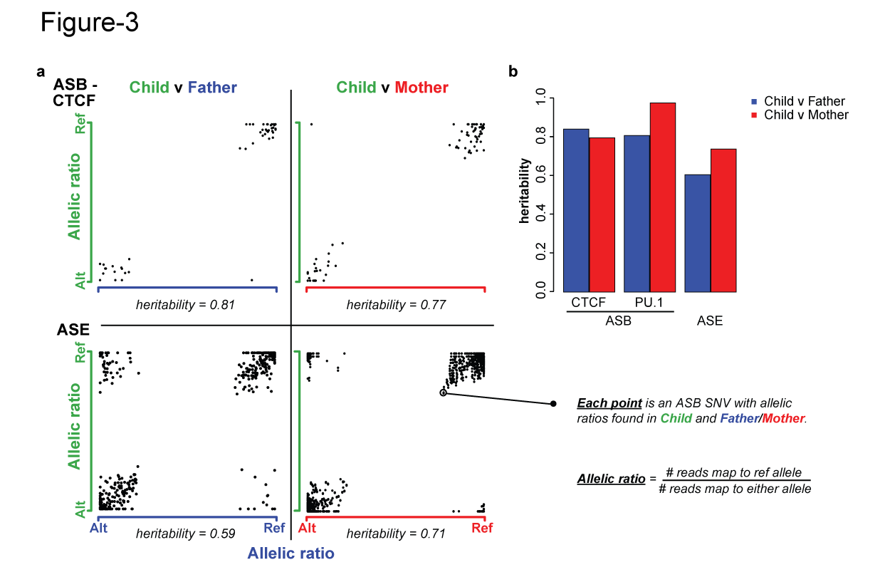
Figure 3. Inheritance of allele-specific behavior.

Slide 5
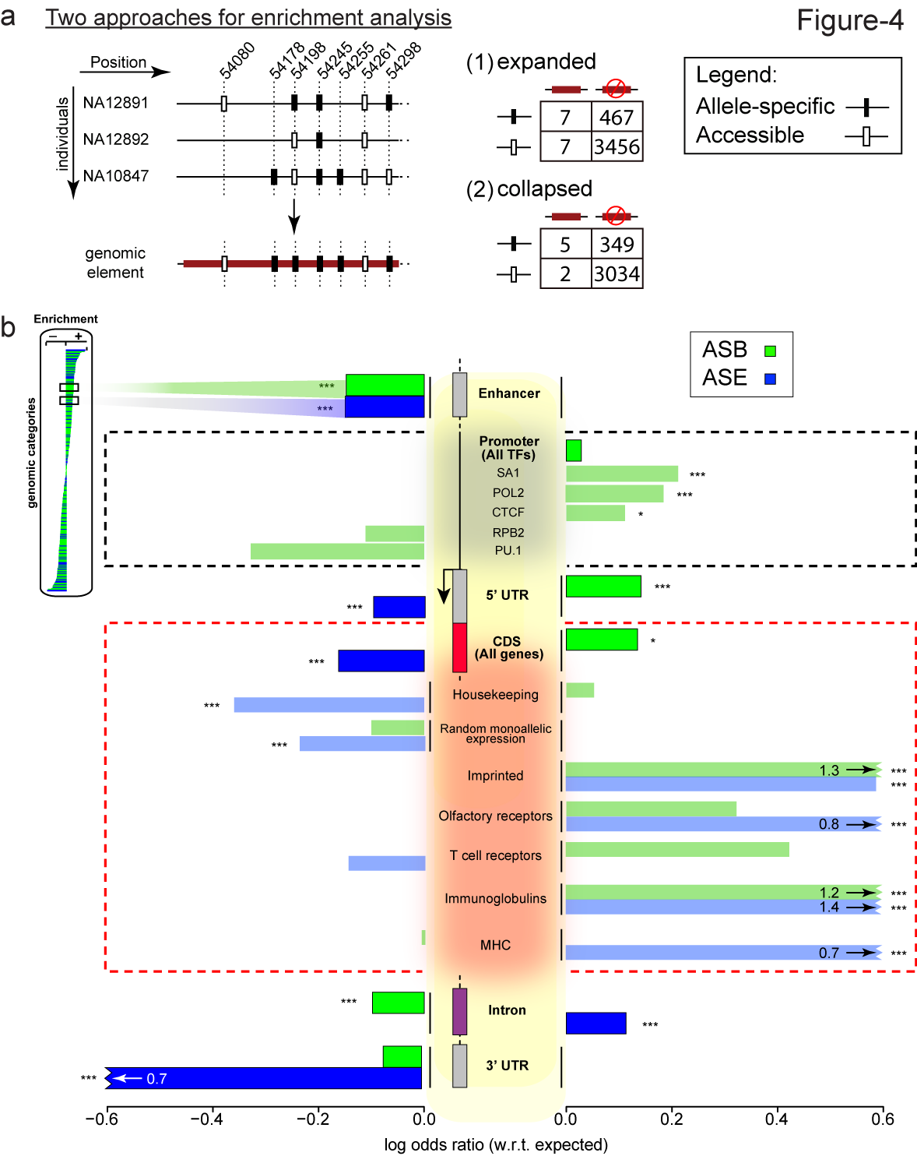
Figure 4. (a) 2 approaches to enrichment analysis (b) Some genomic regions are more inclined to allele-specific regulation. (expanded)
Notes:
Bonferonni corrected p

Slide 6
Figure 4. (a) 2 approaches to enrichment analysis (b) Some genomic regions are more inclined to allele-specific regulation. (expanded)
Notes:
Bonferonni corrected p

Slide 7
CHD5; enriched>depleted
 | ‘Collapsed’ |  |  | ‘Expanded’
 |  | ASE | nonASE |  | ASE | nonASE
CHD | 10.95 (p=0.03) | 12 | 6 | 0.52 (p=0) | 36 | 774
By MAF |  | 2r 10c | 4r 2c
By accessibility |  | 11(1,2,3) 1 (20) | 5 (1,2,5) 1 (41)

Slide 8
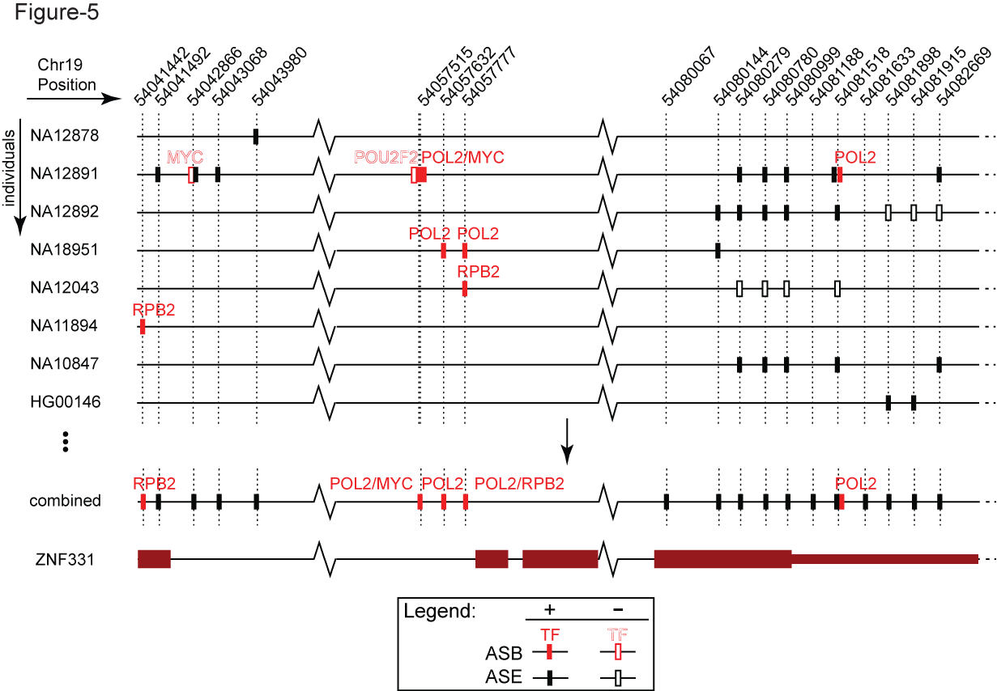
Figure 5. Visualization ASB and ASE in ZNF331 (chr19, position 54,041,333-54,083,523) in AlleleDB
Notes:
(54,041,333-54,083,523)

Slide 9
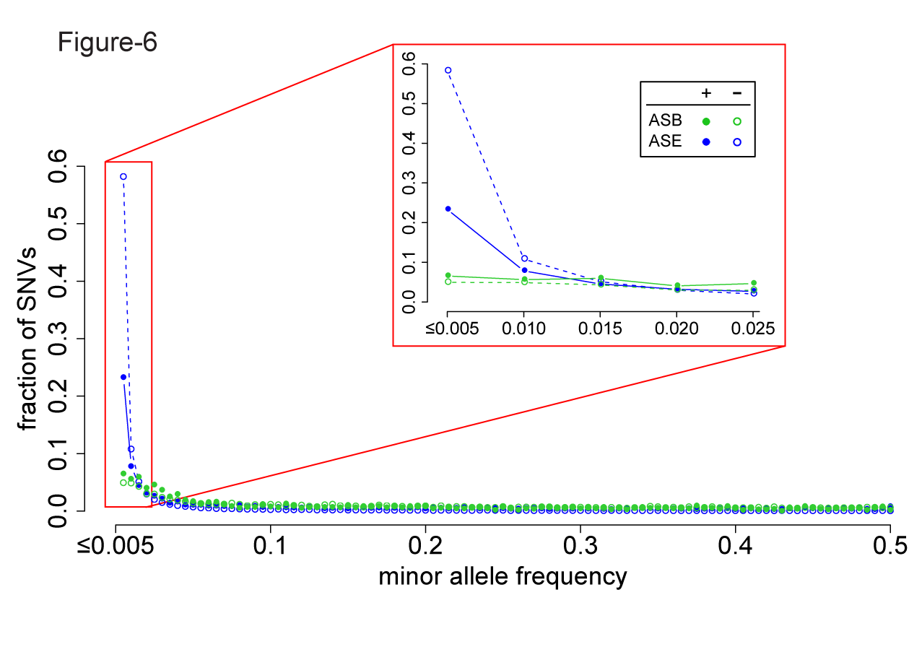
Figure 6. A considerable fraction of AS variants are rare but do not form the majority. Lesser proportion of ASE SNVs than non-ASE SNVs are rare, suggesting less selective constraints in ASE SNVs.

Slide 10
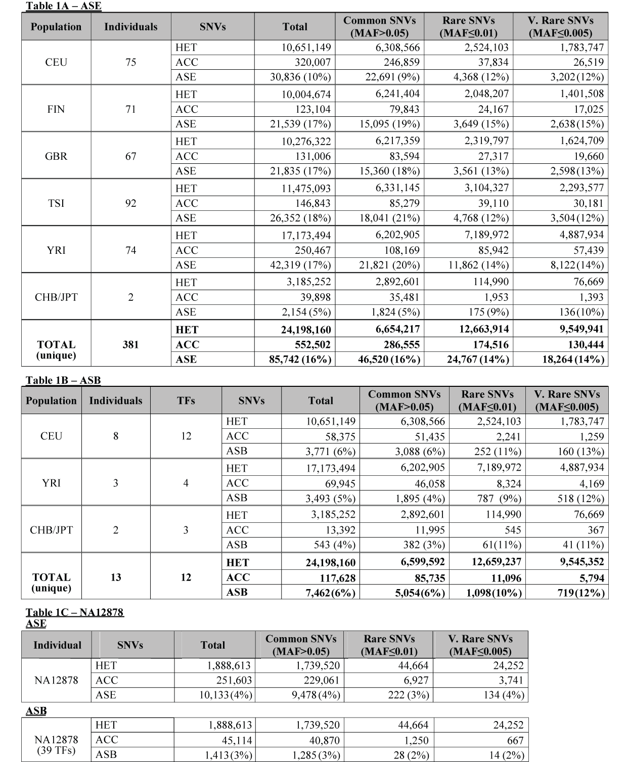
Table 1.

Slide 11
Supplementary Figure 1
Figure 5. Some genomic regions are more susceptible to allele-specific regulation (collapsed/unique SNVs).

Slide 12
Supplementary Table 1 Inconsistencies in the original eight studies
Notes:
Add a row that says AlleleDB where everything is the same
Dup reads (RNA-seq/ChIP-seq)

Slide 13
Supplementary Table 2 Flagging of individual datasets

Slide 14
Supplementary Table 3 Allelic inheritance
Notes:
# sNVs

Slide 15
Supplementary File 1 708 unique non-coding categories, gene elements, enhancers
ASB, ASE and AS, with Bonferroni-corrected p values

Slide 16
Supplementary File 2 19,257 genes and MAE categories
 | AS.OR | AS.p.bon | AS | nonAS | ASB.OR | ASB.pbon | ASB | nonASB | ASE.OR | ASE.pbon | ASE | nonASE
FHIT | 0.13884 | 6.30E-07 | 6 | 262 | 0.00 | 1.00E+00 | 0 | 23 | 0.14 | 4.74E-07 | 6 | 242
SNURF | 186.1098 | 4.62E-45 | 61 | 2 | 0.00 | 1.00E+00 | 0 | 1 | 167.96 | 9.04E-43 | 61 | 2
ASB, ASE and AS, with Bonferroni-corrected p values

Slide 17
Supplementary File 3 ASB SNVs of 44 TFs in promoters
ASB, ASE and AS, with Bonferroni-corrected p values

Slide 18
Supplementary File 4 ASB SNVs in TF motifs

Slide 19
Supplementary File 5 R Pseudocode for bisection method to estimate overdispersion parameter

Slide 20
Supplementary File 6 More confident set

Slide 21
Abstract
112 words
Allele-specific behavior can provide insight into the functional effect of the variants in particular regions of a personal genome. However, since many of these allelic variants are rare, aggregation across multiple individuals is necessary to identify broadly applicable “allelic regions” and their association with variants in a particular personal genome of interest. To this end, we comprehensively annotate allele-specific binding and expression in 382 individuals by uniformly processing 1,263 ChIP-seq and RNA-seq datasets, developing approaches to reduce the heterogeneity between the datasets, many of which are highly over-dispersed. Then we identify genomic regions and coherent groups of allele-specific variants enriched in allelic activity, creating a resource, AlleleDB (alleledb.gersteinlab.org) to make these available.
94 words
Allele-specific behavior provides insight into the functional effect of the variants in personal genomes. However, since many of these allelic variants are rare, aggregation across multiple individuals is necessary to identify broadly applicable “allelic regions” and their association with variants in a particular personal genome. Thus, we comprehensively annotate allele-specific binding and expression in 382 individuals by uniformly processing 1263 ChIPseq and RNAseq datasets, developing approaches to reduce the heterogeneity between the datasets. Then we identify genomic regions and coherent groups of allele-specific variants enriched in allelic activity, distributing them via a resource (alleledb.gersteinlab.org).
100 words
Allele-specific behavior provides insight into the functional effect of the variants in personal genomes. However, since many of these allelic variants are rare, aggregation across multiple individuals is necessary to identify broadly applicable “allelic regions” and their association with variants in a particular personal genome. Thus, we comprehensively annotate allele-specific binding and expression in 382 individuals by uniformly processing 1263 ChIPseq and RNAseq datasets, developing approaches to reduce the heterogeneity between the datasets, many of which are over-dispersed. Then we identify genomic regions and coherent groups of allele-specific variants enriched in allelic activity, distributing them via an online resource (alleledb.gersteinlab.org).

Slide 22
Overdispersion versus size of dataset (indiv)
Notes:
1261
1141

Slide 23
Overdispersion versus size of dataset (indiv)
Notes:
1261
1141
NA18486 (circle)

Slide 24
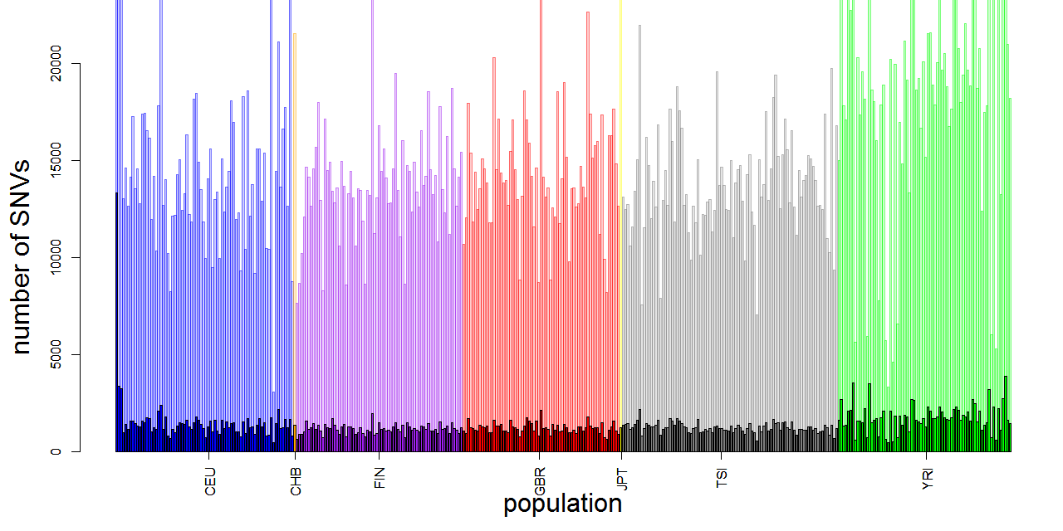
RNA-seq: accSNVs (transparent) with intHets

Slide 25
ChIP-seq -byTFs

Slide 26
ChIP-seq – by pop

Slide 27
numIntHets VS size of datasets
Notes:
Nontrio spearman remains the same; pearson changes

